Slide 1
Lessons Learned: Family and Provider Satisfaction with Medical Day Treatment
Cassandra LeFebre
Jennifer Lindwall, PhD
University of Colorado
Children’s Hospital Colorado
2017 Summer Research Program for Undergraduate Students at the PMHI
August 14, 2017
Denver, CO

Slide 2
Childhood Chronic Illness
Chronic illness can significantly impact a child’s
Academic development
Psychosocial functioning
Notes:
Education is something we value as a society. We hope that all children are able to attend school because it is an important part of their development. However, chronic illness during childhood can cause children to miss a lot of school or not be able to attend school at all. This can negatively impact their academic development and psychosocial functioning

Slide 3
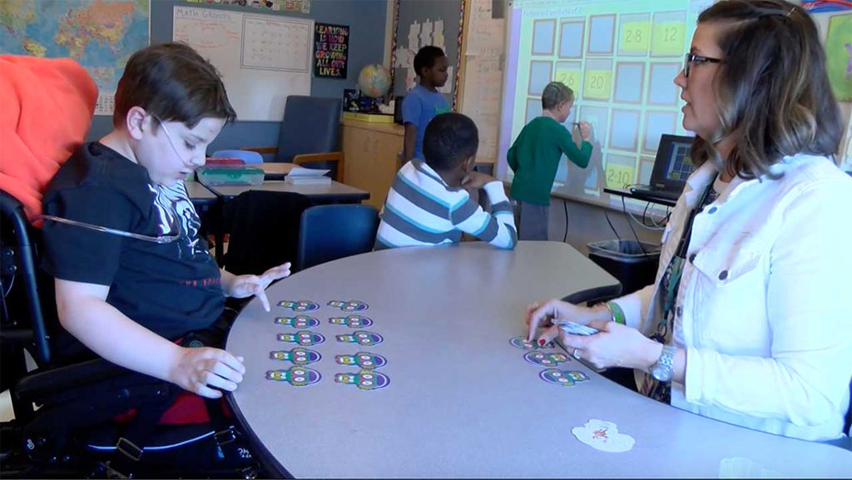
A Day at MDT
Medical Day Treatment (MDT): a unique hospital school that provides medical, educational, and psycho-social support to children (ages 7-21) with chronic medical diagnosis
Collaboration between CHCO and Aurora Public Schools
Notes:
MDT is a hospital school where children affected by conditions such as diabetes, cancer, epilepsy, blood disorders, and organ transplants come every day to learn.
MDT provides these children with the medical and psychological support they need so they can continue their education despite their illness
They also teach them about their disease and help them learn to manage it
I had the opportunity to spend a lot of time at MDT this summer and my mentor Dr. Lindwall is the director

Slide 4
Project Goals
Evaluate family and provider experiences with MDT
Identify strengths and areas for improvement

Slide 5
Gathering Data from the Families
Family Satisfaction Survey
Likert type scale with 8 questions (0=extremely dissatisfied to 4=extremely satisfied)
2 open-ended questions
Completed at mid-year and at discharge
126 caregivers of current patients responded to the survey (2013 – 2017)
Open-ended Family Satisfaction Survey Questions
1. Please share any suggestions you have for MDT to improve in the future
2. Please share any other general feedback you have for the MDT program

Slide 6
Gathering Data from Providers
Provider Satisfaction Survey
Likert-type scale with 4 questions (0=highly dissatisfied to 100=highly satisfied)
3 open-ended questions
Completed in REDCap, sent via email
37 frequently referring providers, surveys completed in 2016
Open-ended Provider Satisfaction Survey Questions
1. Suggestions for improving the referral process
2. Ways my patients have benefitted from MDT
3. Other feedback

Slide 7
Data Analysis: Mixed Methods
Quantitative data: computed means and standard deviations
Qualitative data:
Used guiding principles of the Consensual Qualitative Research-Modified (CQR-M) framework
Identified categories and subcategories
Frequencies for each category and subcategory were computed
Notes:
For the likert responses we computed the means and SD for each question, For the open-ended questions we used the CQR-M method. We reviewed all the responses as a team and developed initial categories. Then we coded each response into the category it best fit into. Each response could belong to more than one category. Then we found the frequencies for each category and sub category

Slide 8
Family Feedback About MDT
Likert Scale Question | Mean ± SD
1. Overall satisfaction with MDT: | 3.7 ± 0.6
2. Satisfaction with nursing and medical care: | 3.8 ± 0.5
3. Satisfaction with teachers and educational support: | 3.7 ± 0.6
4. Satisfaction with mental health services: | 3.7 ± 0.6
5. Child’s overall functioning since attending MDT: | 3.5 ± 0.7
6. Child’s health and physical functioning since attending MDT: | 3.4 ± 0.8
7. Child’s academic/educational functioning since attending MDT: | 3.4 ± 0.7
8. Child’s emotional and social functioning since attending MDT: | 3.4 ± 0.8

Slide 9
Major Family Categories
Open-ended Family Satisfaction Survey Questions
1. Please share any suggestions you have for MDT to improve in the future
2. Please share any other general feedback you have for the MDT program
General Gratitude 41%
Suggested Changes 30%
Family Categories
Perceived Benefits to Child/Family 48%
Program Strengths 5%

Slide 10
Benefits 48%
Gratitude 41%
Suggested Changes 30%
Program Strengths 5%
Psychosocial 39%
Overall Support 27%
Educational 18%
Medical 16%
“We are so thankful for MDT and all it has meant for our child’s quality of life”
Other 50%
Communication 28%
Transportation 13%
Education 9%
Communication 60%
Collaboration 40%
“The collaboration [between] all the aspects of care a special needs child needs was so helpful in making our child’s life well rounded without things falling through the cracks. MDT got him back on track so he can lead a full life…”
Notes:
Psychosocial: caregivers noticed things such as their children learning better coping skills, having greater self esteem, were making friends, and seemed happier
Overall support for children & parents, also identified medical and educational benefits of the program
Other: more family events, more variety in food choices, more interactive activities for older children, more anxiety support
Quote is a good example because it captures multiple themes and describes MDT’s mission through the words of a parent

Slide 11
Provider Feedback About MDT
Slider Scale Questions | Mean ± SD
1. Satisfaction with referral process | 84.1 ± 23
2. Satisfaction with collaboration and communication between MDT and your team | 84.3 ± 22.9
3. Satisfaction with overall care patients received | 89.4 ± 19.2
4.Likelihood of referring a patient within the next year | 85.7 ± 19.2

Slide 12
Major Provider Categories
Open-ended Provider Satisfaction Survey Questions
1. Suggestions for improving the referral process
2. Ways my patients have benefitted from MDT
3. Other feedback
Barriers to the Referral Process 27%
Benefits of the Program 90%
Positive Feedback 25%
Provider Categories

Slide 13
Benefits 90%
Barriers 27%
Positive Feedback 25%
Medical 37%
Educational 33%
Psychosocial 30%
Admission Criteria 23%
Program Related Factors 77%
“I love referring to MDT because I know it is a great program that will provide comprehensive and quality care”
Notes:
For Benefits providers mentioned things such as increased adherence, better consistency of care, increased academic engagement, better school attendance, and more normalization. These nicely fit into Medical, Educational, and Psychosocial categories.

Slide 14
Lessons Learned
Majority of responses were positive
Family survey suggested improving:
Communication
Education
Transportation
Provider surveys: offered more specific feedback about barriers to the referral process
Notes:
Overall the feedback was positive which was encouraging for the program to receive, however, nothing is perfect and some areas that MDT can look to improve in the future is in communication, education, and transportation. They can also work on changing some of the more specific things Providers mentioned

Slide 15
Limitations
Responses were voluntary
Surveys were anonymous
Provider surveys were not given immediately after referral
Future Directions
Administer provider survey shortly after patient is admitted
Ask more specific questions about family satisfaction and child functioning
Include a patient satisfaction survey

Slide 16
Feedback is informing change
MDT staff attend medical team meetings with CHCO
Referral process has improved
Monthly Family treatment meetings established
Overall, MDT will utilize the feedback to identify additional strategies for improving the program and strengthening patient care
Notes:
Overall, MDT will continue to use this feedback to improve the program so that it can be the best that it can be. All the way from the referral process to discharge.

Slide 17
Acknowledgements
Dr. Dominique Martinez (CCTSI),
Dr. Douglas Novins and Dr. Jennifer Hagman (PMHI)
for their generosity in allocating funds to support the program
Dr. Jennifer Lindwall for her mentorship and support
Merlin, Emmaly, and Marisa for sharing their knowledge and their support throughout the program
2017 Summer Research Program for Undergraduate Students at the Pediatric Mental Health Institute

Slide 18
Jennifer Lindwall, Phd Cassandra LeFebre
Jennifer.Lindwall@childrenscolorado.org Cassandra.lefebre@ucdenver.edu

