Slide 1
Comparison of Functional Behavior Assessment Methodologies to the Functional Analysis of Problem Behavior
Andrea L. Boorse¹ and Patrick W. Romani^{1,2}
1 Pediatric Mental Health Institute, Children’s Hospital Colorado; 2 School of Medicine, University of Colorado (Anschutz Medical Campus)
Notes:
Hello all, my name is Andrea Boorse and this summer I worked with Dr. Patrick Romani on the neuropsychiatric special care unit looking at a Comparison of Functional Behavior Assessment Methodologies to the Functional Analysis of Problem Behavior

Slide 2
Functional behavior assessment
Functional Behavior Assessment
Indirect Assessment
Direct Assessment
ABC Interview
Questionnaires (QABF and FAST)
ABC Narrative
Functional Analysis
Notes:
The typical course of assessment for children on the unit takes place in four phases to comprise the entire functional behavior assessment.
A Functional Behavior Assessment is a government mandated procedure to evaluate the function of problem behavior, or the reason why problem behaviors occur.

Slide 3
Functional behavior assessment
Functional Behavior Assessment
Indirect Assessment
Direct Assessment
ABC Interview
Questionnaires (QABF and FAST)
ABC Narrative
Functional Analysis
Notes:
First, we conducted indirect assessments in the form of an ABC Interview and multiple questionnaires

Slide 4
ABC Interview
Antecedent-Behavior-Consequence (ABC) Interview (O’Neill et al. 1997)
Functional Context | Example Questions | Responses
Escape | How does your child behave when asked to take a shower? What about complete homework?
Tangible | How does your child act when told, “No” they cannot have a specific toy or snack?
Attention | How does your child act when you are on the phone or playing with their sibling?
Notes:
During this presentation I am going to highlight one particular patient’s course of assessment to explain the methods for the current study.
During the ABC Interview we typically ask questions that correspond to the three main functional contexts (escape, tangible, and attention)
Example:

Slide 5
ABC Interview
Antecedent-Behavior-Consequence (ABC) Interview (O’Neill et al. 1997)
Functional Context | Example Questions | Responses
Escape | How does your child behave when asked to take a shower? What about complete homework? | “He ignores me and then may throw toys. He doesn’t do homework.”
Tangible | How does your child act when told, “No” they cannot have a specific toy or snack? | “He flips out. I get hit and bit until I finally let him keep playing the iPad.”
Attention | How does your child act when you are on the phone or playing with their sibling? | “He usually plays alone well. Finds the iPad and that keeps him busy.”
Notes:
Here are the data for this particular patient.
As you can see, it seems that this kiddo exhibits problem behavior within the escape context as well as the tangible context.
In the escape context the patient's care giver responded that the child exhibited problem behavior when asked to preform a task (homework) and when unable to access an item (iPad).
It didn't’t seem like parent attention was a reinforcer of problem behavior, based on the ABC Interview, as the care giver claimed the child was able to play by themselves.

Slide 6
Interpretation
FBA Method | Results
ABC Interview | Escape and Tangible
Notes:
Based on these data we hypothesized that the child acts out to escape demands and gain access to preferred activities/toys.

Slide 7
Functional behavior assessment
Functional Behavior Assessment
Indirect Assessment
Direct Assessment
ABC Interview
Questionnaires (QABF and FAST)
ABC Narrative
Functional Analysis
Notes:
After the ABC Interview is conducted the behavior analyst delivers the behavioral questionnaires to the parent/caregiver to complete.
The two questionnaires used were the Questions About Behavioral Function and Functional Analysis Screening Tool.
These questionnaires ask parents whether their child exhibits problem behavior to escape demand, gain access to an item/activity, or to gain attention.
For example this is one question asked on the QABF:
“How often does your child engage in problem behavior to escape work or learning situations?” (Scale of 0=Never to 3=Often)

Slide 8
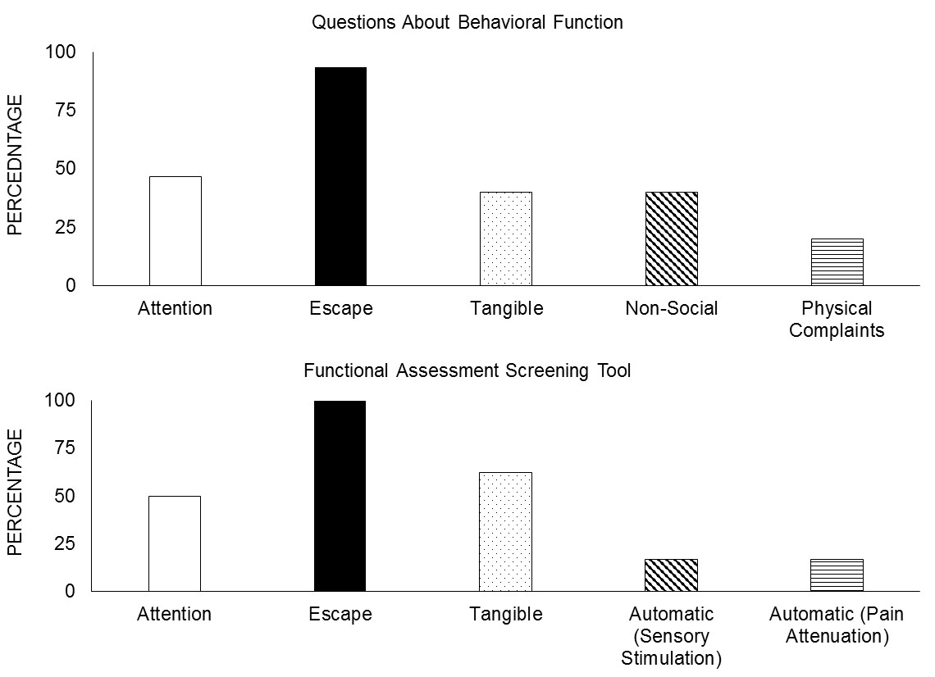
QABF & FAST
Notes:
Based on these two questionnaires, the escape context was identified as the most likely reinforcer of problem behavior.

Slide 9
Interpretation
FBA Method | Results
ABC Interview | Escape and Tangible
Questions About Behavioral Function | Escape
Functional Assessment Screening Tool | Escape
Notes:
The data from both the QABF and the FAST produced the hypothesis that escape from demands was the primary reinforcer for problem behavior.

Slide 10
Functional behavior assessment
Functional Behavior Assessment
Indirect Assessment
Direct Assessment
ABC Interview
Questionnaires (QABF and FAST)
ABC Narrative
Functional Analysis
Notes:
Following indirect assessments, we transitioned to implementing direct assessment methods.
An ABC Narrative is the first of these assessments.
Behavior analysis or direct care staff observed the child and wrote down descriptive information about the antecedent and consequence to problem behavior. (A B C)

Slide 11
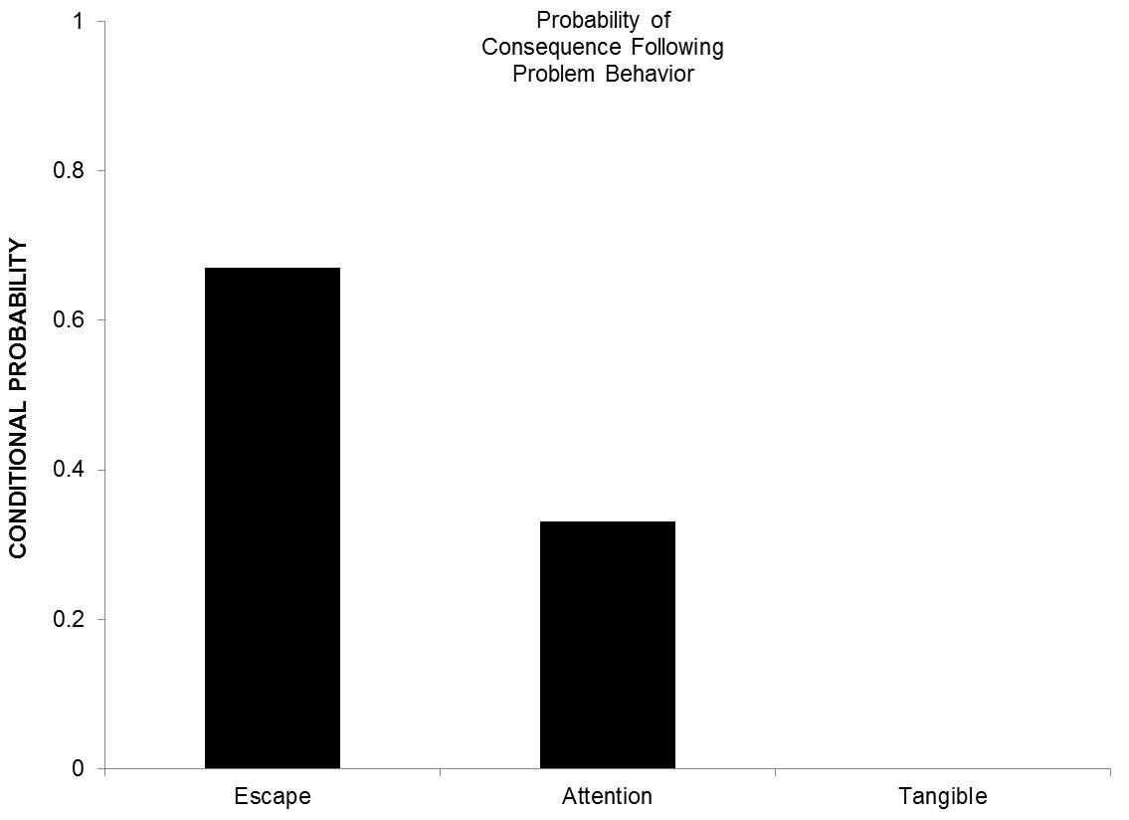
ABC Narrative
0.65=65%
0.35=35%
Notes:
Based on this patient’s ABC Narrative data it appears that about 65% of the time problem behavior occurrence was followed by some sort of escape from the demand. For example a child might refuse to do their work and then was directed out of the room for a break. About 35% of the time attention followed problem behavior. For example in the cafeteria during snack the child started cussing and the direct care staff attended to him by redirecting the child in an attempt to try and get him to talk about something else.

Slide 12
Interpretation
FBA Method | Results
ABC Interview | Escape and Tangible
Questions About Behavioral Function | Escape
Functional Assessment Screening Tool | Escape
ABC Narrative | Escape and Attention
Notes:
Based on these data we can hypothesize that Escape and Attention are reinforcers of problem behavior for this child.

Slide 13
Functional behavior assessment
Functional Behavior Assessment
Indirect Assessment
Direct Assessment
ABC Interview
Questionnaires (QABF and FAST)
ABC Narrative
Functional Analysis
Notes:
All of these data culminate in a functional analysis of problem behavior, which research has shown is the gold standard for determining function of problem behavior.

Slide 14
Functional analysis of problem behavior (Iwata et al., 1982/1994)
Notes:
START: 1:39:25
END: 1:39:47

Slide 15
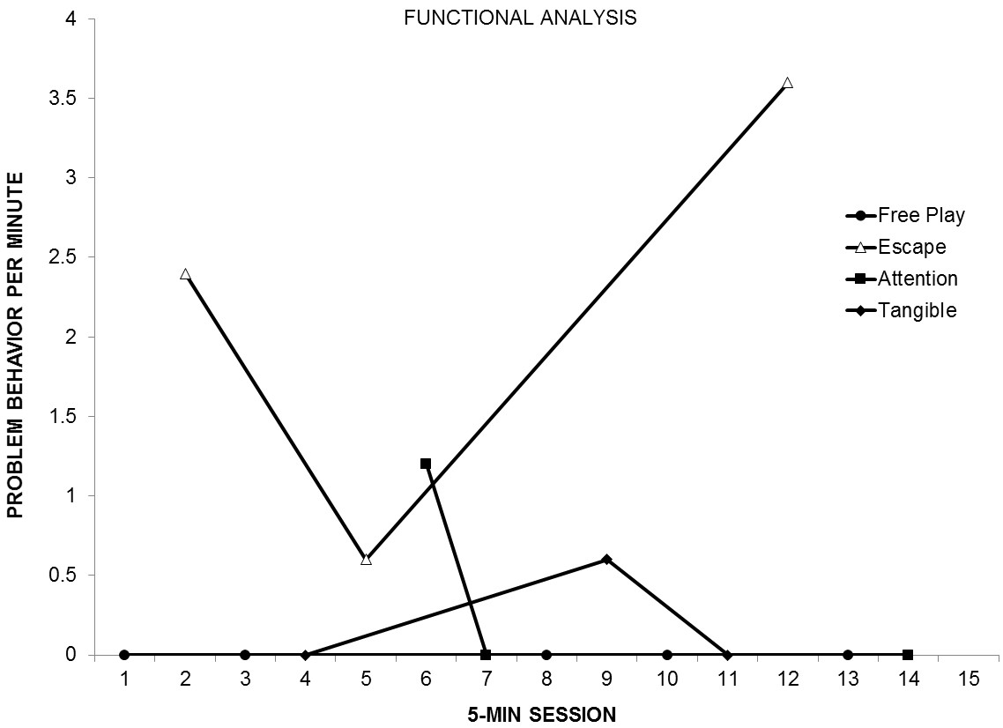
Notes:
These are the data from this patient’s Functional Analysis, which shows that problem behavior occurred most frequently during the escape condition.
Behavior:
Cussing and throwing furniture

Slide 16
Interpretation
FBA Method | Results
ABC Interview | Escape and Tangible
Questions About Behavioral Function | Escape
Functional Assessment Screening Tool | Escape
ABC Narrative | Escape and Attention
Functional Analysis of Problem Behavior | Escape
Notes:
Based on these data the Functional Analysis shows that problem behavior is maintained by escape from demands.

Slide 17
Purpose: Study 1
What combination of FBA methods relates best to the FA?
Do FBA methods discriminate certain functions better than others?
Notes:
Our study aimed to answer two questions.
The purpose of our first study was to identify which combination of FBA methods related best to the FA.

Slide 18
Dependent variables
Agreement was defined as when the results of one or more assessments matched the function(s) of problem behavior identified in the FA.
Disagreement was defined as when the results of one or more assessments did not match the function(s) of problem behavior identified in the FA.
Notes:
We calculated percent correspondence with the FA by dividing agreements plus disagreements and multiplying by 100.

Slide 19
Interpretation
FBA Method | Results | Percentage Correspondence
ABC Interview | Escape and Tangible | 50%
Questions About Behavioral Function | Escape | 100%
Functional Assessment Screening Tool | Escape | 100%
ABC Narrative | Escape and Attention | 50%
Functional Analysis of Problem Behavior | Escape | ----
Notes:
Here is the percent correspondence of each of the 4 assessments to the Functional Analysis for this particular patient.
Go through each…

Slide 20
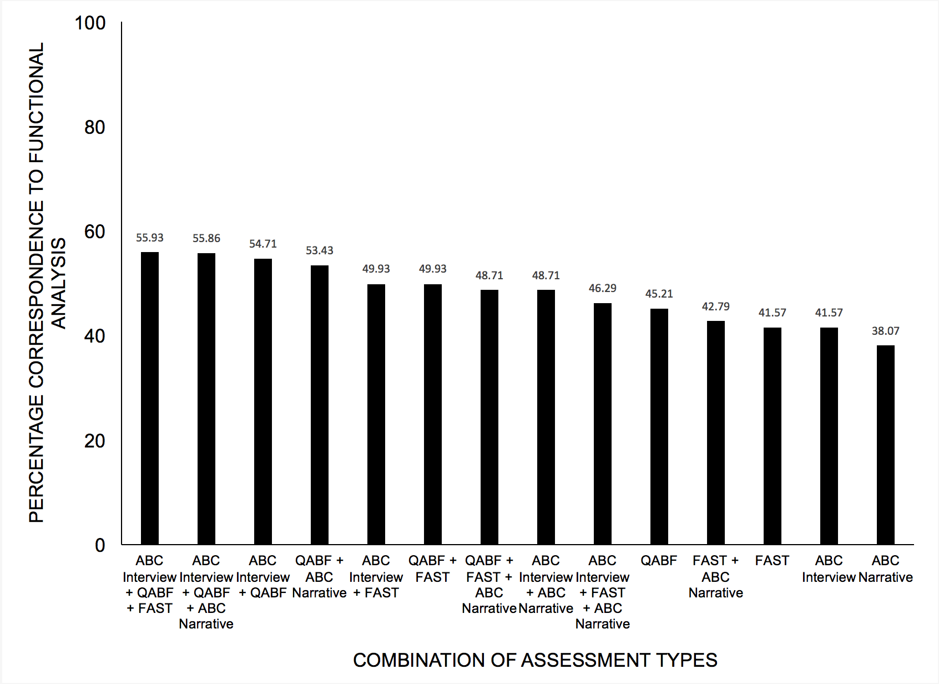
Notes:
Various combinations of FBA methods produced moderate correspondence with the FA.
Highest correspondence to the FA was demonstrated by:
ABC Interview plus both questionnaires (QABF+FAST)=55.93%
ABC Interview + QABF + ABC Narrative=55.86%

Slide 21
Notes:
Lowest correspondence to the FA was ABC Narrative alone=38.07%

Slide 22
Discussion: Study 1
With previous research showing use of direct FBA methods relates best to the FA (Alter et al., 2008), and this sample showing equal correspondence with the combination of indirect methods, the combination of the indirect and direct methods may be most useful for practitioners.
Notes:
These data suggest that a combination of both indirect and direct methods may be most helpful for practitioners.
BUT because the most accurate combination of FBA methods we found was only moderately related to the FA a Functional Analysis should still be done whenever possible.

Slide 23
Discussion Study 1
BCBAs are not routinely using functional analysis with 48.3% of BCaBAs stating they “Almost Never” use functional analysis in their practice. (Oliver et al., 2015)
Notes:
These results are important to know because, as shown by Oliver et al., across all levels of education the majority of Behavior Analysts do not use a functional analysis in practice due to the extensive training and resources required to implement an FA as well as environmental limitations.

Slide 24
Purpose: Study 2
What combination of FBA methods relates best to the FA?
Do FBA methods discriminate certain functions better than others?
Notes:
In an effort to continue refining the functional assessment process we looked at whether certain FBA methods discriminate specific functions better than others. Again the functions being escape, tangible, and attention.

Slide 25
Signal Detection Theory
Variables were defined as follows:
A hit was defined as an FBA method identifying the same function(s) as the FA.
A correct rejection occurred when an FBA method omitted a function that was not identified by FA.
A miss was when an FBA method did not identify a function that was identified by FA.
A false alarm was when an the FBA method identified a function that was not identified by FA.
Notes:
We modeled our SDT analysis off of a study done in 2010 by Lerman et al.
Signal Detection Theory is a way of finding false positives and false negatives in the data.
We calculated percentage hit, correct rejection, miss, and false alarm recorded by each FBA method across behavioral function by adding frequency of each outcome, dividing by 14, and multiplying by 100.

Slide 26
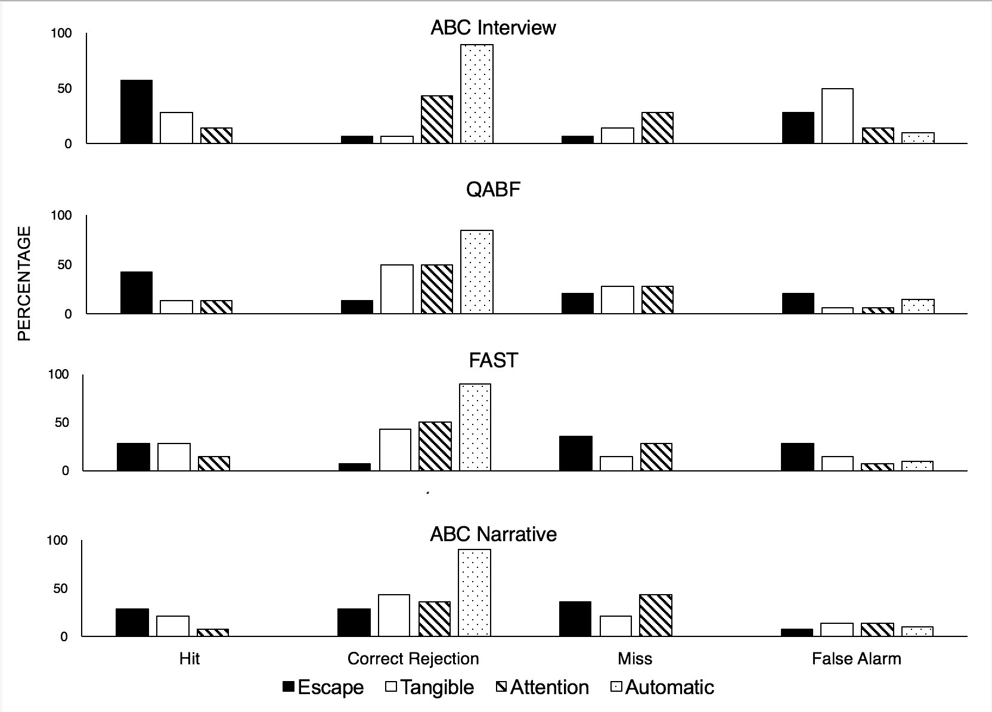
Notes:
Here are OUR data from the SDT Analysis which shows the percentage of hits, correct rejections, misses, and false alarms.

Slide 27
Notes:
The two general findings were the accuracy of the escape function across assessments

Slide 28
Notes:
and the high correct rejection rate of both tangible and attention contexts.
With equal levels of misses and false alarms occurred across behavioral functions.

Slide 29
Discussion: Study 2
Follow-up analysis of these data using signal detection theory showed escape as the reinforcer most likely to be identified via both indirect and direct FBA methods.
Tangible and attention functions were most likely to be correctly rejected.
Approximately equal levels of misses and false alarms occurred across behavioral functions.

Slide 30
General Discussion
In conclusion, these data showed that, within this sample of 14 children, the first and second best FBA combination was:
ABC Interview + QABF + FAST= 55.93% correspondence to the FA
ABC Interview + QABF + ABC Narrative= 55.86% correspondence to the FA
The escape function was most accurately identified throughout all FBA assessments.
Notes:
-Again, these two FBA combinations were most accurate to the FA but were still only moderately accurate at ~56% meaning that whenever possible an FA should be conducted.
-It could be the case that the escape context is particularly salient and pervasive within the lives of young children or those individuals with disabilities requiring prompts to complete daily activities, like shower or homework. Thus, making it easier to identify for parents.

Slide 31
Future Research and Limitations
Using these data, a logical second experiment would be to evaluate if treatment matched to the results of the most- and least-accurate FBA methods produces different treatment outcomes.
Future researchers should replicate these data across different levels of care (e.g., intensive outpatient, outpatient, school-based).
Notes:
-A second study needs to be done to show that the more accurate FBA method combination we identified leads to more effective treatment while the least effective FBA method leads to less effective treatment.
-We also think it would be interesting to do this study across different levels of care because of findings in the 2009 Matson study which showed that the QABF may be more accurate when evaluating high-rate problem behaviors. Various levels of care may be associated with lower rate problem behavior occurrence and thus may lead to less accurate FBA results.

Slide 32
Acknowledgements
Program Sponsors for their generosity in allocating funds for this program
Dr. Dominique Martinez (CCTSI Office of Diversity and Inclusion).
Dr. Douglas Novins and Dr. Jennifer Hagman (PMHI).
2017 Summer Research Program for Undergraduate Students
Dr. Merlin Ariefdjohan who ran this program and provided unending support and assistance.
Marisa Deguzman for helping me with my poster presentation and providing support to the entire cohort.
Emmaly Owens & Robert Evans for their support and help running this program
Mentor Extra-ordinaire!
Dr. Patrick Romani for mentoring me this summer and being my #1 support throughout this program.
Notes:
Thank you all and I hope you enjoyed my presentation!
And lastly, Dr. Romani for teaching me about all of this and spending countless hours helping me with my poster, my presentation, and letting me be a part of the team on the unit. I could not have done any of this without him or without you all!
THE ENTIRE NEUROSPYCHIATRIC SPECIAL CARE TEAM!!

