Slide 1
Mandated Reporting Policies for Perinatal Substance Use: A Systematic Review of the Literature
Keinada Andereas, BS
Sandra A. Appiah, BA; Christina Bodison, MD; Aviva K. OlsavSky, MD
The Psychiatry Undergraduate Research Program And Learning Experience (PURPLE)

Slide 2
“The first thing [the caseworker] said to me was, ‘So I noticed you were on methadone. You realize that's liquid heroin, correct?’”
(31-year-old Black/mixed race mother)
“It [methadone] allowed me to have a life. It allowed me to start to work on myself without having to have the daily waking up not well every day and starting my day off like that... It gave me the opportunity. That's what it does. It gives you the opportunity.”
(33-year-old White mother)
“Just because I'm on methadone and taking meds, it seemed like everything that happens is always because it's methadone fault… I was tired, so that must be—not the baby getting up every night, but it must be my methadone. Everything had to do with my meds. That’s how they viewed it.”
(35-year-old White mother)
Qualitative Quotes
- Schiff et al, 2022
Notes:
-Imagine a scenario: you are a pregnant individual in your early 20s, who originally started using opioids to cope with your anxiety and depression, and now you escalated to using fentanyl (synthetic opioid with a higher overdose risk)
You live in a low-income neighborhood with barriers to mental health resources/treatment
You start using methadone (doctor prescribed, a medication assisted treatment for opioid use disorder) because you want to keep you and the baby safe and healthy by avoiding a fatal overdose
AND you don’t want to modify your life to support ongoing use (i.e. – obtaining money to use, having difficulty with holding a job, use limiting your relationships with your extended family.
(depending on the state where you live) But now you’re at a higher risk of being reported to child protective services for your use of this life-saving treatment
Avoid seeking prenatal care by your doctor or healthcare provider = increases your exposure to the unintended consequences of mandated reporting for substance use
These are some quotes from a qualitative study which examined lived experiences of people in medication assisted treatment for opioid use disorder in the state of Massachusetts.

Slide 3
Mandated Reporting
Legally enforceable duty for those who have contact with vulnerable populations to report to authorities when mistreatment or abuse of those populations is suspected or confirmed
Identifying and Reporting Child Abuse and Maltreatment/Neglect
First enacted in the U.S between 1963-1967
Some laws include any substance use as reportable neglect
Mathews, B. et al (2008). Child maltreatment.
Notes:
-It’s important to reflect on these lived experiences throughout this presentation
-approach the data with a lens of empathy and kindness
Mandated Reporting = legally enforceable duty for healthcare providers and other trusted people who work with kids to report abuse/neglect (KEEP KIDS SAFE)
ANY substance use; not use disorder.. USE

Slide 4
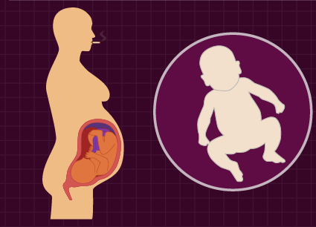
BACKGROUND
Women in reproductive years at highest risk for developing a substance use disorder
Early interventions to protect infants
Inequities in mandated reporting
Race, ethnicity, SES
Mandated Reporting is a significant tool in hospitals
~5 and 10% of pregnant people use alcohol or other substances (NIDA/NIAAA)
Policies vary by state
In 2017, greater than one-third of children entering foster care due to parental substance use
Forray 2016; Nguemeni Tiako MJ, et al 2022; Meinhofer 2017
Notes:
Mandated reporting is an area with a high risk of unintended conseuqences
When I report you, are you actually seeking care or do you actually feel alienated from treatment/ care
What is actually happening in response to mandated reporting? Is it effective? How can we improve it?

Slide 5
OBJECTIVE
To perform a systematic review of U.S. mandated reporting literature for perinatal substance use
In utero exposure
Perinatal and infant health
Mandated Reporting
Inequities
Policies vary
Notes:
“Ecosystem”
-Factors that orbit around mandated reporting
-we don’t know how they are related to one another but we do know there is a relationship
-So we performed a review to see how thy related and where some of the gaps existed
Prenatal care is critical during earlier stages of pregnancy
Barriers to prenatal care include lack of accessibility, stigma, structural barriers (i.e racism, discrimination based on SES, immigration status)
Substance use is comorbid with other psychiatric disorders (ex. Depression, anxiety, etc → to cope)
Less mental health treatment = higher risk
Long history of removing children from minoritized communities from their families, CPS context (ex. Native American population) → misunderstanding of supervision of child
Criminalization of substances; we don’t treat SUD like mental health issues

Slide 6
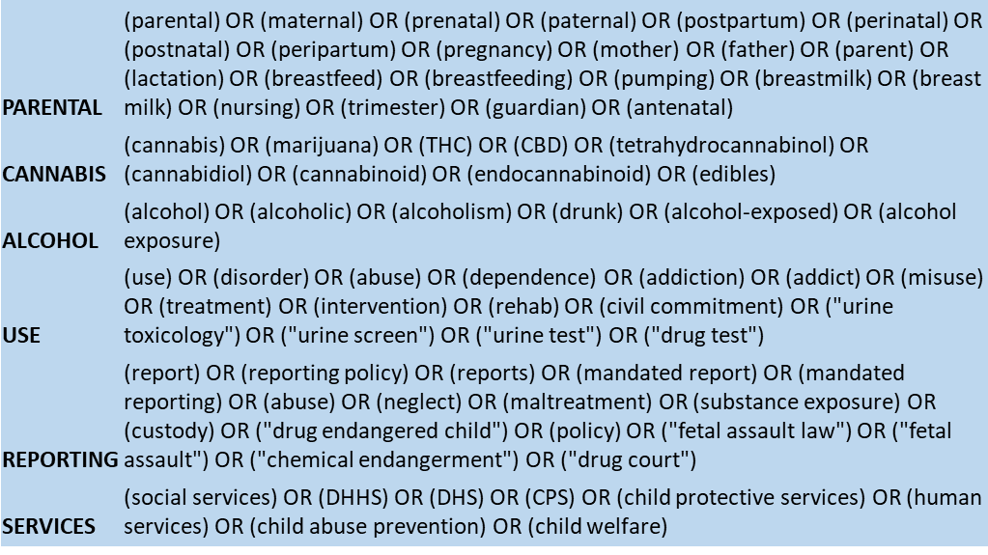
METHODS – Search Terms
Databases: PubMed, CINAHL, PsycINFO, Cochrane
Search Strategy: [PARENTAL + {(CANNABIS OR ALCOHOL) + USE}] + REPORTING
Notes:
Search terms were iteratively developed in a collaborative manner by multiple team members in order to maximize the sensitivity of our search terms. And to make sure we are capturing all of the articles. We also are in the process of examining review papers to be certain our search does not omit publications which would be helpful for understanding mandated reporting policies.

Slide 7
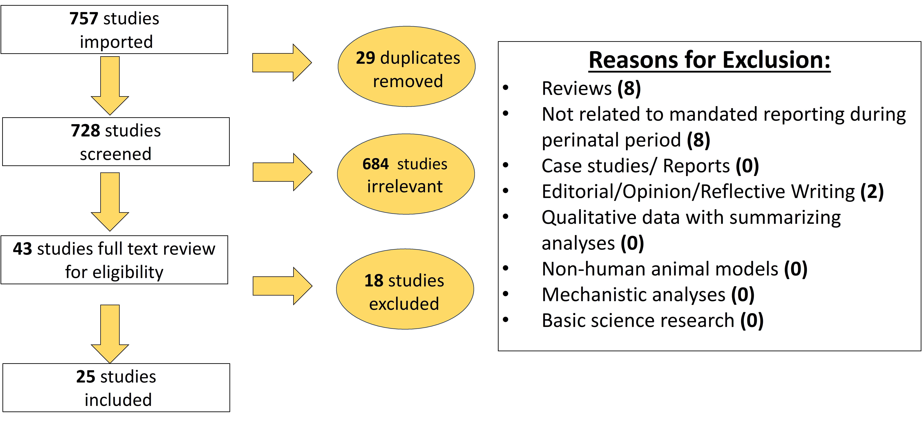
METHODS – PRISMA Flow Diagram
Notes:
PRISMA = Preferred Reporting Items for Systematic Reviews and Meta-analyses – akin to CONSORT diagram in clinical trials which shows flow of potential participants through study. This methodology allows for transparency in why articles are/are not included and make a reproducible study.
We screened 757 studies
Ended up with 25 included studies

Slide 8
RESULTS (Preliminary)
Policies of mandated reporting vary by state
In some states, any use of substance is automatically interpreted as neglect
Treatment engagement not addressed
Racial/ethnic/SES disparities in screening and reporting
Most frequently detected: cannabis, cigarettes, and cocaine
Cannabis vs. alcohol treated differently when reporting
Notes:
-Still in the process of making it comprehensive; reviewing state by state policies
-Important themes from each study that was included and reviewed
-Cannabis is treated differently from alcohol likely due to prior criminalization of cannabis use
Ex: cannabis use will screen as a positive result but simply alcohol use will not be considered positive unless it’s a chronic alcohol use disorder (both are not good perinatally; but there are disparities that exist between the two).

Slide 9
RESULTS (Preliminary)
Notes:
Here we can see the results by (a) type of study and (b) by year.
What I’d like you to notice about the pie chart here is that the majority of studies are not longitudinal. Let’s think about this together—what are the benefits of a longitudinal study which follows people across time compared to a cross-sectional study, which examines the experiences/characteristics of people at one time-point
[PAUSE – you’re looking for a volunteer to say—you can track outcomes over time or potentially think about “causality” or actual impact of reporting]. It is only through longitudinal studies that we will be able to ascertain the true impact of reporting.
Does reporting actually improve outcomes? Are perinatal people more likely to access care for problematic substance use? What are the outcomes of children across time?
Now, as we look at the number of studies by year, you can see that although this issue impacts perinatal people, partners, and offspring significantly, this issue has not been well-studied. Referring to a prior slide, over 1/3 of kids entering in foster care are due to parental substance use (this is something tht really needs to be studied)

Slide 10
CONCLUSIONS
Not all substance use is necessarily neglect – nuanced and evidence-based approaches will likely increase access to care
Insufficient access to high-quality substance use disorder treatment following reporting
Prior criminalization of substance use perpetuates stigma and makes pregnant and postpartum people less likely to engage with care
Promote earlier substance use screening during pregnancy (first trimester) to prevent increased substance use
There is a need to integrate our evidence into screening, referral, and treatment processes
Motivational interviewing
Abstinence only approach vs. harm reduction model
Notes:
-Need to integrate evidence into screening
Reporting to CPS could be done in a more or less therapeutic way (ex. Motivational interviewing)
Using harm reduction model over abstinence only approach (ex. Clean needles)

Slide 11
FUTURE DIRECTIONS
Prospective longitudinal studies
Clinical trials of perinatal MI and harm reduction
Studies on reporting inequities
Advocacy for access to care and decreasing stigma
Culturally, sex-, and gender-specific care
Culture of safety in obstetric and pediatric clinics
Notes:
Overall = Culture of safety in obstetric and pediatric clinics
We want people to feel safe = clear recommendations and guidelines from physicians/clinicians regarding the impact of substance use (esp MJ) during pregnancy
Earlier interventions/education about impacts of substance use in pregnancy, starting as early as adolescence.
Further training/education for CPS workers regarding substance use and state policies (with the goal of reducing stigma and hopefully to avoid comments like - methadone being “liquid heroin”)

Slide 12
Research Team, THANK YOU!
Aviva K. Olsavsky, MD
Sandra A. Appiah, BA
Christina Bodison, MD
SIMBA (Stress in Moms and Babies) Lab
PURPLE Mentors and colleagues

Slide 13
QUESTIONS?
Notes:
Thank you for listening! Any Questions?

Slide 14
REFERENCES
Forray A. Substance use during pregnancy. F1000Res. 2016 May 13;5:F1000 Faculty Rev-887. doi: 10.12688/f1000research.7645.1. PMID: 27239283; PMCID: PMC4870985.
Mathews, B., & Kenny, M. C. (2008). Mandatory Reporting Legislation in the United States, Canada, and Australia: A Cross-Jurisdictional Review of Key Features, Differences, and Issues. Child Maltreatment, 13(1), 50–63. https://doi.org/10.1177/1077559507310613
Meinhofer A, Anglero-Diaz Y. Trends in Foster Care Entry Among Children Removed From Their Homes Because of Parental Drug Use, 2000 to 2017. JAMA Pediatr. 2019;173:881-883.
Nguemeni Tiako, M. J., & Sweeney, L. (2022). The government’s involvement in prenatal drug testing may be toxic. Maternal and child health journal, 26(4), 761-763.
Schiff, D. M., Work, E. C., Muftu, S., Partridge, S., MacMillan, K. D. L., Gray, J. R., ... & Bernstein, J. (2022). “You have to take this medication, but then you get punished for taking it:” lack of agency, choice, and fear of medications to treat opioid use disorder across the perinatal period. Journal of substance abuse treatment, 139, 108765

