Slide 1
Associations between anxiety and adherence barriers among pediatric solid organ pre-transplant patients
Amy Linares-Francois
August 12^{th,} 2019

Slide 2
Adherence
Adherence to medication is one of the most crucial aspects of the post-transplant medical care.
Studies have shown that the average rate of adherence is around 70% for post-transplant young adult patients (Eaton, 2014).
Excellent medication adherence requires taking the correct dose of medication, at the correct time of day, every day, for as long as the condition is being treated (Foster, 2014).
Poor adherence to medications is one of the most important barriers to long term graft survival (Foster, 2014).
Notes:
As many as 25–70% of pediatric transplant patients are non-adherent at some point
Not only are there higher nonadherence rates for this age group, but higher organ rejection rates only second to those over the age of 65.
Poor adherence is a major risk for graft failure which can have quality of life implications and even be fatal.
Studies have shows that the quality of life is significantly poorer for patients treated with dialysis than for those with a functioning transplant

Slide 3
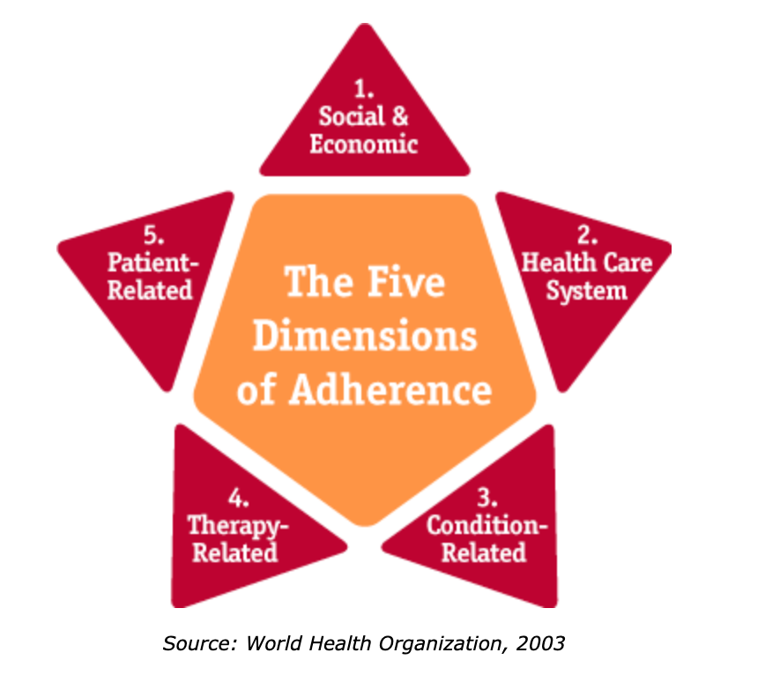
Barriers
Notes:
Barriers have been shown to be the most powerful predictor of adherence, so here's what barriers could look like
Social & economic: Limited English language proficiency, not having insurance, cost of medication
Health care system: Patient provider relationship, long wait times
Condition related: Depression, chronic conditions, depression
Therapy related: Side effects of medication, or how often you have to take it
Patient related: physical factors like cognitive impairment, behavior factors like knowledge about the disease

Slide 4
Anxiety
Research suggests that children who have had solid organ transplant are at higher risk for poor psychosocial functioning relative to both healthy peers or those with other medical conditions (Wu, 2010).
However, little is known about how anxiety impacts adherence
Little research on pre-transplant adherence and anxiety rates
No studies using the child SCARED.
Notes:
I’m sure all of you have experienced anxiety at some point – taking a toll, taking a toll of adherence
Although a clear relationship between psychosocial factors and post-transplant outcomes has been established, no studies with rates of anxiety among pediatric solid organ transplant patients has been identified.
No research could be identified using SCARED to measure anxiety.

Slide 5
Study’s Purpose
To examine patient self-report of anxiety symptoms and self-report adherence barriers during the pre-transplant evaluation process for solid organ transplant pediatric candidates.
Notes:
Aim to understand whether anxiety symptoms and barriers to adherence have a relationship
Aim to understand if anxiety is a barrier to adherence
Create a study measuring anxiety with SCARED

Slide 6
Hypothesis
One study’s findings showed higher anxiety were not related to poorer adherence, conclusions were that maybe children who worry are more likely to be planful in their general habits, including medication-taking behaviors (Wu, 2010).
Notes:
According to a study by Wu in 2010….
Assessed by electronic monitoring, among 55 children and adolescents who received liver or kidney transplantation.
Higher levels of anxiety were associated with higher and more stable patterns of medication adherence.
Anxiety may be an important factor to consider when assessing and intervening with posttransplantati medication adherence.
Future research- individual and family behaviors associated with anxiety that may influence adherence.

Slide 7
Hypothesis
One study’s findings showed higher anxiety were not related to poorer adherence, conclusions were that maybe children who worry are more likely to be planful in their general habits, including medication-taking behaviors (Wu, 2010).
We hypothesized we would also find that those who report higher anxiety would report less barriers.
Notes:
According to a study by Wu in 2010….
Assessed by electronic monitoring, among 55 children and adolescents who received liver or kidney transplantation.
Higher levels of anxiety were associated with higher and more stable patterns of medication adherence.
Anxiety may be an important factor to consider when assessing and intervening with posttransplantat medication adherence.

Slide 8
Methods
Database
Electronic medical records review of EPIC database
Assessments
Child SCARED –Anxiety self-report screener for children
Child AMBS – Adherence self-report screener for children
Participants
N=49
Mean age=14.2
Data collected over 6 years (2014-2019).

Slide 9
Methods
Database
Electronic medical records review of EPIC database
Assessments
Child SCARED –Anxiety self-report screener for children
Child AMBS – Adherence self-report screener for children
Participants
N=49
Mean age=14.2
Data collected over 6 years (2014-2019).

Slide 10
Methods
Database
Electronic medical records review of EPIC database
Assessments
Child SCARED –Anxiety self-report screener for children
Child AMBS – Adherence self-report screener for children
Participants
N=49
Mean age=14.2
Data collected over 6 years (2014-2019).

Slide 11
Screeners for Anxiety and Adherence
Self-report assessments collected by transplant psychologists at the pre-transplant evaluation
Screen for Child Anxiety Related Disorders (SCARED)
41 question, 3-point Likert scale child self-report questionnaire on overall anxiety and sub-types of anxiety
Adolescent Medication Barriers Scale (AMBS)
17 question, 5-point Likert scale child self-report questionnaire on perception of barriers to medication adherence
Notes:
SCARED has questions like “I get nervous being at home alone”
Questions like “my medication is hard to swallow” “my medication tastes bad”

Slide 12
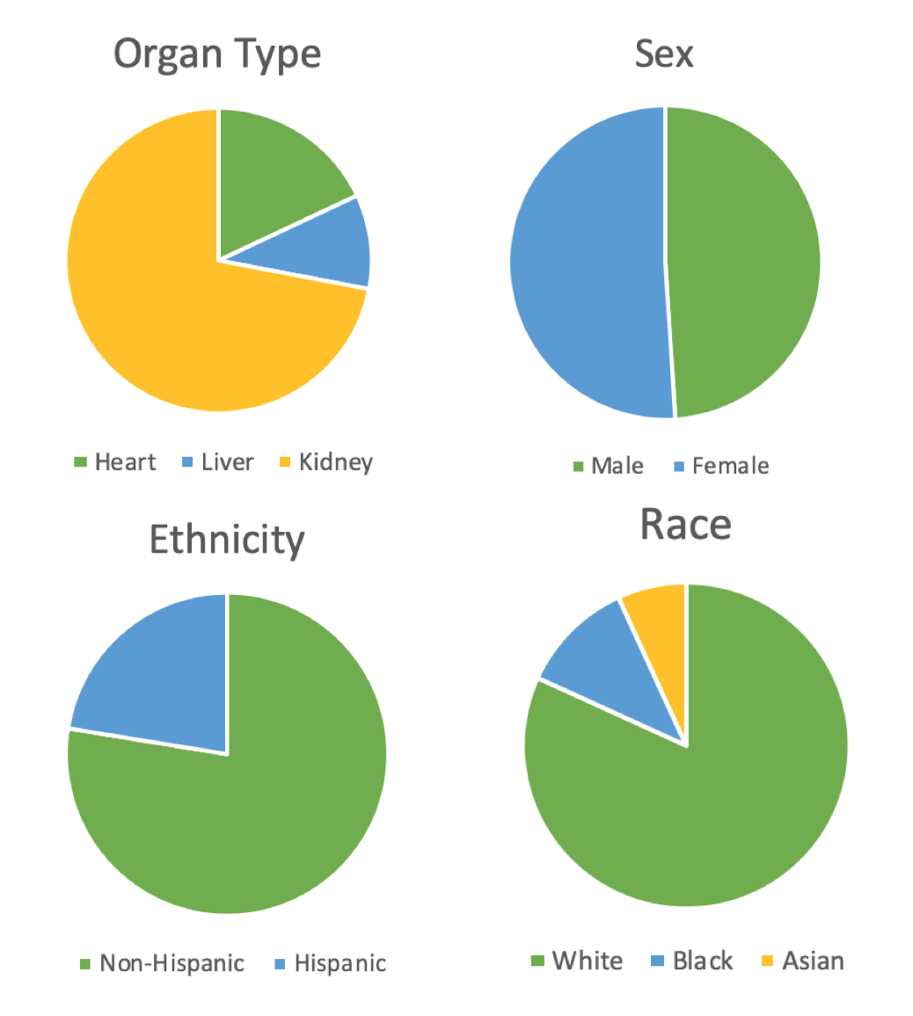
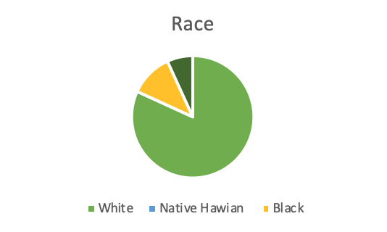
Demographics
Notes:
Majority were white kidney transplant candidates

Slide 13
Results
Normality testing (Kurtosis, Shapiro-Wilks) was conducted and results showed the data was normally distributed.
A Pearson product-moment correlation coefficient was computed to assess the relationship between patient self-report anxiety symptoms and patient self-reported barriers to adherence.
There was a positive moderate correlation between the two variables,
r = .572, n = 49, p = .000.

Slide 14
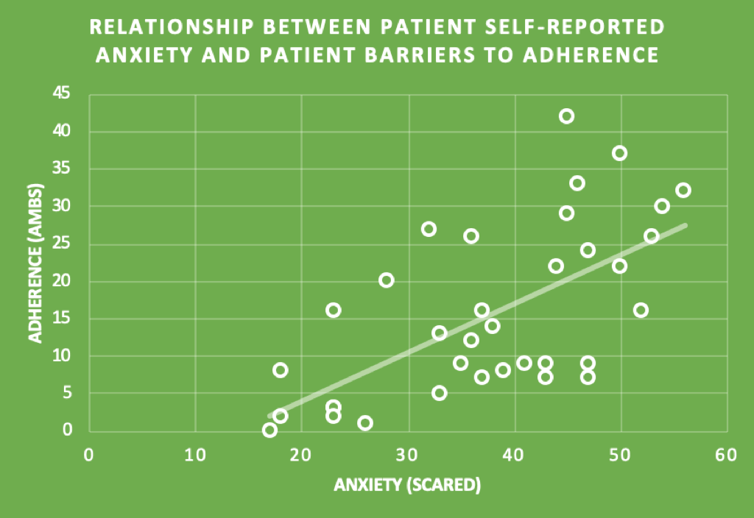
Results
Notes:
WE WE’RE WRONG
R = .572 There was a moderate, positive correlation between the two variables,
Significant correlation between higher reported anxiety symptoms and more barriers to adherence
Anxiety could be a mental health barrier to medication adherence because of the demands and stress coming from being adherent post-transplant.

Slide 15
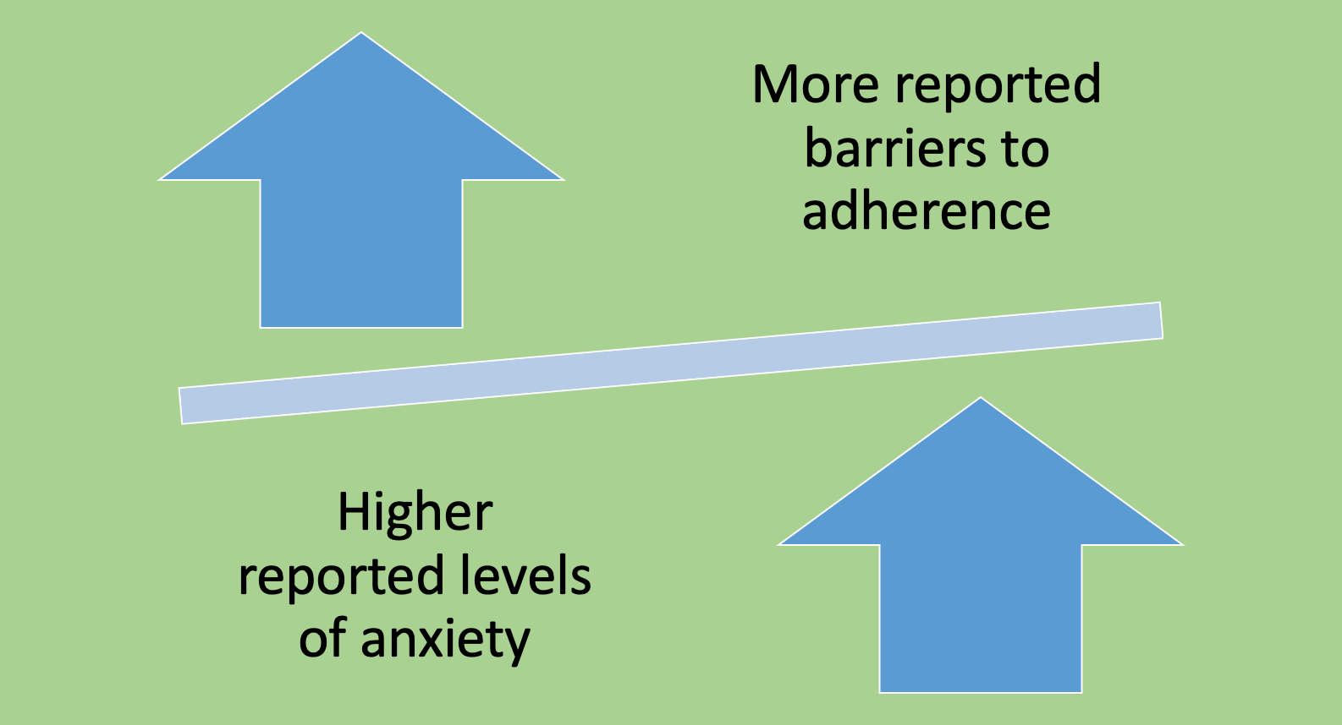
Discussion
Notes:
Contrary to our hypothesis, higher anxiety levels had a relationship with more reported barrier to adherence.
There are many reasons why this might be: Symptoms of anxiety may exacerbate barriers to medication adherence and cause impaired capacity to attend to medical tasks
Symptoms of anxiety could lead to forgetting medication, reduced energy levels, sleep interference, and a diminished capacity to attend to medical tasks.

Slide 16
Future implications
Larger multisite study on the relationship between anxiety symptoms and adherence pre-transplant.
Notes:
More diverse – organs and race
Larger participant pool

Slide 17
Future implications
Larger multisite study on the relationship between anxiety symptoms and adherence pre-transplant.
Future research should consider the potential individual and family behaviors associated with anxiety that may influence adherence.
Notes:
Focused research on what parts of anxiety are causing adherence barriers

Slide 18
Future implications
Larger multisite study on the relationship between anxiety symptoms and adherence pre-transplant.
Future research should consider the potential individual and family behaviors associated with anxiety that may influence adherence.
The need for psychologists on a transplant team
Notes:
The psychological evaluation is critical in assisting the transplant team with identifying risk factors (such as anxiety) in patients that could lead to poor outcomes- Although a team of pre-transplant psychologists are at Children’s Hospital, this is not the standard. This study can highlight the need for a psychologist on the transplant team.

Slide 19
Future implications
Larger multisite study on the relationship between anxiety symptoms and adherence pre-transplant.
Future research should consider the potential individual and family behaviors associated with anxiety that may influence adherence.
The need for psychologists on a transplant team
Interventions for those reporting higher levels of anxiety pre-transplant.
Notes:
To prepare for NOT ONLY the surgery but the lifelong struggle of adherence to medication, going to your doctor visits, getting your labs done, adhering to certain diet.
What interventions look like at Children’s Hospital – Why they are important
The family is ultimately responsible for the child’s adherence to the post-transplant treatment regimen, a more family systems approach could be used in therapy

Slide 20
Acknowledgements
Thank you to
Dr. Merlin Ariefdjohan, Ms. Emmaly Perks, Dr. Douglas Novins, and Dr. Dominic Martinez
with the PURPLE program.
A very special thank you to
Dr. Elizabeth Steinberg
and
Dr. Amie Lofton!

Slide 21
References
Behrens, B., Swetlitz, C., Pine, D. S., & Pagliaccio, D. (2019). The screen for child anxiety related emotional disorders (SCARED): Informant
discrepancy, measurement invariance, and test–retest reliability. Child Psychiatry and Human Development, 50(3), 473-482. doi:http://dx.doi.org.aurarialibrary.idm.oclc.org/10.1007/s10578-018-0854-0
Lefkowitz, Debra S., et al. “Best Practices in the Pediatric Pretransplant Psychosocial Evaluation.” Pediatric Transplantation, vol. 18, no. 4, 2014, pp.327–335., doi:10.1111/petr.12260.
Eaton, Cyd K., et al. “Clinical Cutoffs for Adherence Barriers in Solid Organ Transplant Recipients: How Many Is Too Many?” Journal of Pediatric Psychology, vol. 40, no. 4, 2014, pp. 431– 441., doi:10.1093/jpepsy/jsu102.
Engle, D. (2001). Psychosocial aspects of the organ transplant experience: What has been established and what we need for the future. Journal of Clinical Psychology, 57(4), 521-549. doi:http://dx.doi.org.aurarialibrary.idm.oclc.org/10.1002/jclp.1027
Fung, Ernest, and Richard J. Shaw. “Pediatric Transplant Rating Instrument - A Scale for the Pretransplant Psychiatric Evaluation of Pediatric Organ Transplant Recipients.” Pediatric Transplantation, vol. 12, no. 1, 2008, pp. 57–66., doi:10.1111/j.1399-3046.2007.00785.x.
Foster, Bethany J, and Ahna L.H Pai. “Adherence in Adolescent and Young Adult Kidney Transplant Recipients.” The Open Urology & Nephrology, 2014, pp. 133–143. DOI:10.2174/1874303X014070100133
Kelly, S. L., Morris, N., Mee, L., Brosig, C., & Self, M. M. (2016). The role of pediatric psychologists in solid organ transplant candidacy decisions: Ethical considerations. Clinical Practice in Pediatric Psychology, 4(4), 417-422. doi:http://dx.doi.org.aurarialibrary.idm.oclc.org/10.1037/cpp0000155
King, M. L. M., Mee, L. L., Gutiérrez-Colina, A. M., Eaton, C. K., Lee, J. L., & Blount, R. L. (2014). Emotional functioning, barriers, and medication adherence in pediatric transplant recipients. Journal of Pediatric Psychology, 39 (3), 283-293. doi:http://dx.doi.org.aurarialibrary.idm.oclc.org/10.1093/jpepsy/jst074
Kuntz, Kristin, et al. “Psychosocial Challenges in Solid Organ Transplantation.” J Clin Psychol Med Settings, vol. 22, 2015, pp. 122–135., doi:DOI 10.1007/s10880-015-9435-6.
Shaw, R. J., & Taussig, H. N. (1999). Pediatric psychiatric pretransplant evaluation.Clinical Child Psychology and Psychiatry, 4(3), 353-365. doi:http://dx.doi.org.aurarialibrary.idm.oclc.org/10.1177/1359104599004003006
Workman, J. K., Myrick, C. W., Meyers, R. L., Bratton, S. L., & Nakagawa, T. A. (2013). Pediatric organ donation and transplantation. Pediatrics, 131(6), e1723-e1730. doi:http://dx.doi.org.aurarialibrary.idm.oclc.org/10.1542/peds.2012-3992
Wu, C., Erickson, S. R., Piette, J. D., & Balkrishnan, R. (2012). The association of race, comorbid anxiety, and antidepressant adherence among medicaid enrollees with major depressive disorder. Research in Social & Administrative Pharmacy, 8(3), 193-205. doi:http://dx.doi.org.aurarialibrary.idm.oclc.org/10.1016/j.sapharm.2011.04.002
Wu, Y. P., Aylward, B. S., & Steele, R. G. (2010). Associations between internalizing symptoms and trajectories of medication adherence among
pediatric renal and liver transplant recipients. Journal of Pediatric Psychology,35(9), 1016-1027. doi:http://dx.doi.org.aurarialibrary.idm.oclc.org/10.1093/jpepsy/jsq014

Slide 22
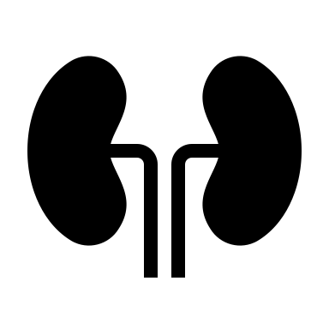
Questions?

