Slide 1
Express yourself:
Demographic differences among physical and emotional manifestations of depression
and associated interventions
in pediatric primary care
The Psychiatry Undergraduate Research Program and Learning Experience (PURPLE)
Haley Almeida
Dr. Kenny & Dr. Talmi

Slide 2
Disclosures
This presentation is supported by the Health Resources & Services Administration (HRSA) of the U.S. Department of Health & Human Services (HHS). The contents are those of the author and do not necessarily represent the official views of, nor an endorsement, by HRSA, HHS, or the U.S. Government. For more information, please visit www.HRSA.gov.

Slide 3
Introduction/Background
Depression impacts one in eight adolescents every year, making it the most common mental health disorder (Federal Interagency Forum on Child and Family Statistics, 2017).
Only 15-30% of adolescents receive needed mental health care (Kataoka et al., 2002; Martini et al., 2012).
Lack of unmet treatment needs is even more common for ethnic minority youth, youth living in poverty, and youth who are uninsured or publicly insured (Hodgkinson et al., 2017; Kataoka et al., 2002).
High levels of untreated mental health symptoms among ethnic minority youth may be due to lack of access to care or underdiagnosis due to differences in depressive symptoms among various ethnic minority groups (Hodgkinson et al., 2017; Kataoka et al., 2002; Bailey, et al., 2019; Anderson, 2010).

Slide 4
Introduction/Background
A previous study has shown integrated care intervention in primary care as ideal to address adolescent depression as it showed significantly more improvement in depressive symptoms than typical primary care (Richardson et al., 2014).
Adolescent depression is common in primary care as a previous study found 13% of adolescents had an elevated depression screener (Kenny et al., 2021).
The Patient Health Questionnaire for Adolescents (PHQ-9A) can be used as a validated depression screening tool in pediatric primary care settings (Siu, 2016; Johnson et al., 2002).
Improved understanding of how demographic groups respond to items on the PHQ-9A in a primary care setting is important to better recognize and intervene for various presentations of depression.

Slide 5
Objective #1
Analyze demographic differences in how adolescents report emotional (item 1: feeling down) versus physical (item 5: feeling tired) symptoms of depression on the PHQ-9A in a pediatric primary care setting.

Slide 6
Objective #2
Determine the most common primary care physician (PCP) and behavioral health clinician (BHC) interventions when emotional or physical symptoms are endorsed.

Slide 7
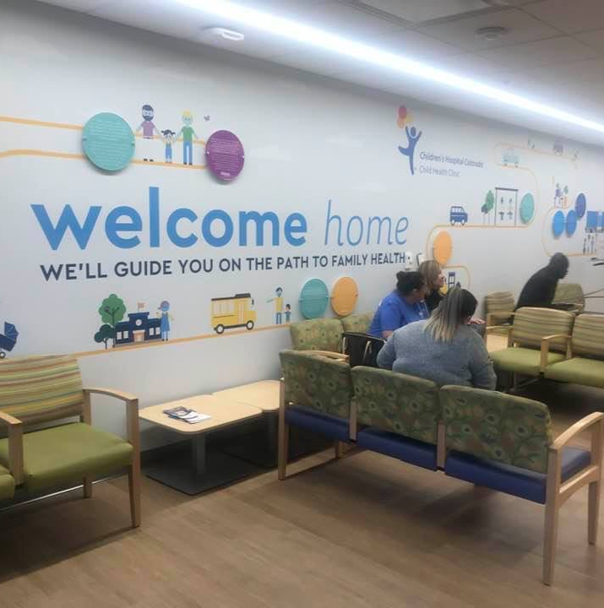
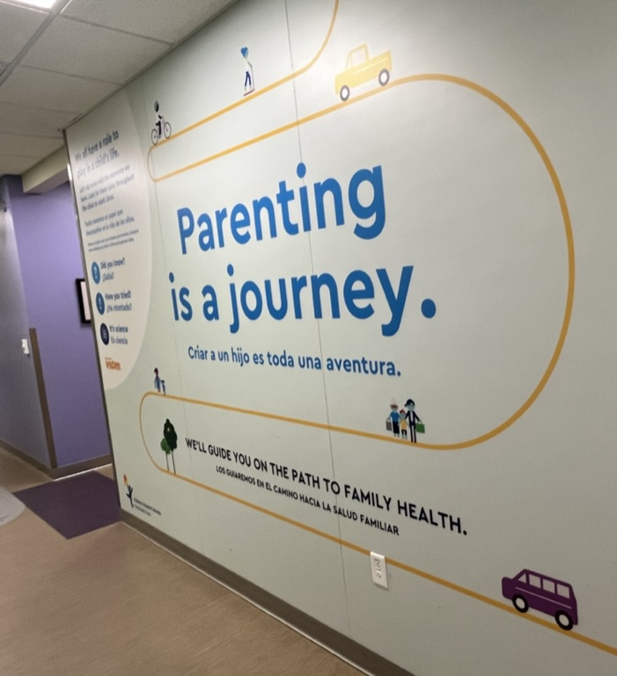
Methods: Setting
The Child Health Clinic (CHC)
Notes:
Here I will talk about CHC being a pediatric primary clinic and the population it serves – introduce CLIMB and the PHQ9A
low-income, diverse population
~80-90% publicly insured
One-third monolingual Spanish-speaking
Integrated model of care – Project CLIMB is an integrated behavioral health program that provides service for ages 0-18; includes psychologists, child and adolescent psychiatrists, developmental pediatricians, master’s level clinicians, child psychiatry fellows, psychology postdoctoral fellows, and psychology interns
“behavioral health visits occur in the context of primary care”

Slide 8
Methods PHQ-9A
Notes:
PHQ-9A is used to identify elevated depressive symptoms in adolescents
Modified from the original PHQ-9 to be appropriate for adolescents
Elevated score = 10+ and/or a positive item 9 score regardless of overall score
Clinic providers responsible for giving the PHQ-9A during visits
Given to all adolescents 11-18 yo, except for those with ASD or an intellectual disability (excluded due to questionable validity of PHQ-9A)

Slide 9
Methods: Data Analysis
Chi-Square tests
Conventional content analyses (Hsieh & Shannon, 2005) was used to code primary care physician (PCP) and behavioral health consult (BHC) interventions for elevated PHQ-9As.
Qualitative codes were transformed into quantitative results.
Notes:
All EMR encounter notes were coded for 277 adolescents with an elevated PHQ-9A using ATLAS.ti software (version 8). This process involved developing a code book with definitions and key words/phrases that exemplified the codes for PCP and CLIMB interventions, recommendations, or topics discussed in response to the elevated PHQ-9A. An iterative process of refining and further developing the codes with a multidisciplinary, research team at weekly meetings was used. The final code book included 40 codes, 17 specific to PCPs, and 23 specific to BHCs. To achieve reliability, 46 notes were randomly selected. A team of 3 coders (one main and two
independent coders) coded all 46 notes. Each independent coder was compared with the main coder, resulting in an average agreement of 83% for the 46 notes.
For the 17% disagreement, the coding team met to discuss the responses and come to consensus on a code that was used in the final analysis.

Slide 10
CLIMB Intervention Definitions
CODE | CODE DEFINITION
CLIMB: Discuss Trauma | Current or history of "scary event" "abuse", "death," resource needs (e.g., homelessness), provider mentioned
CLIMB: Caregiver Involvement | Helping parents/caregiver understand level of depressive symptoms, discussing plan to improve depressive symptoms, or encouraging parents and child to talk more about child's mood/depressive symptoms
CLIMB: Safety Plan | Created a plan specifically addressing safety or if symptoms get worse (e.g., locking up sharps/medications/guns at home)
CLIMB: Risk Assessment | Conducted risk assessment (related to suicidal ideation, self-harm, or other safety concern).
CLIMB: Follow-up in Clinic | Family should return for a follow-up visit to see CLIMB to monitor mood
CLIMB: Refer to Outside Mental Health | Referred to therapy outside of CHC to help with mood

Slide 11
PCP Intervention Definitions
CODE | CODE DEFINITION
PCP: Discuss Medications | Psychopharmacology/medication discussed, talk about introducing or benefits of medication, but not prescribed
PCP: Refer to CLIMB | PCP referred patient to CLIMB
PCP: Counsel without CLIMB | Counseled family on depression score without consulting CLIMB, only when CLIMB did not see family (provider note ok) and provider wrote more than PHQ template.
PCP: Refer to Outside Mental Health | Referred to or are already attending outside/community mental health services without any mention of CLIMB
PCP: No Action | No apparent action taken and no mention of CLIMB - only when PHQ elevated (10+ or elevated #9).
PCP: Risk Assessment without CLIMB | Conducted risk assessment (related to suicidal ideation or other safety concern) without CLIMB, determining that they are safe

Slide 12
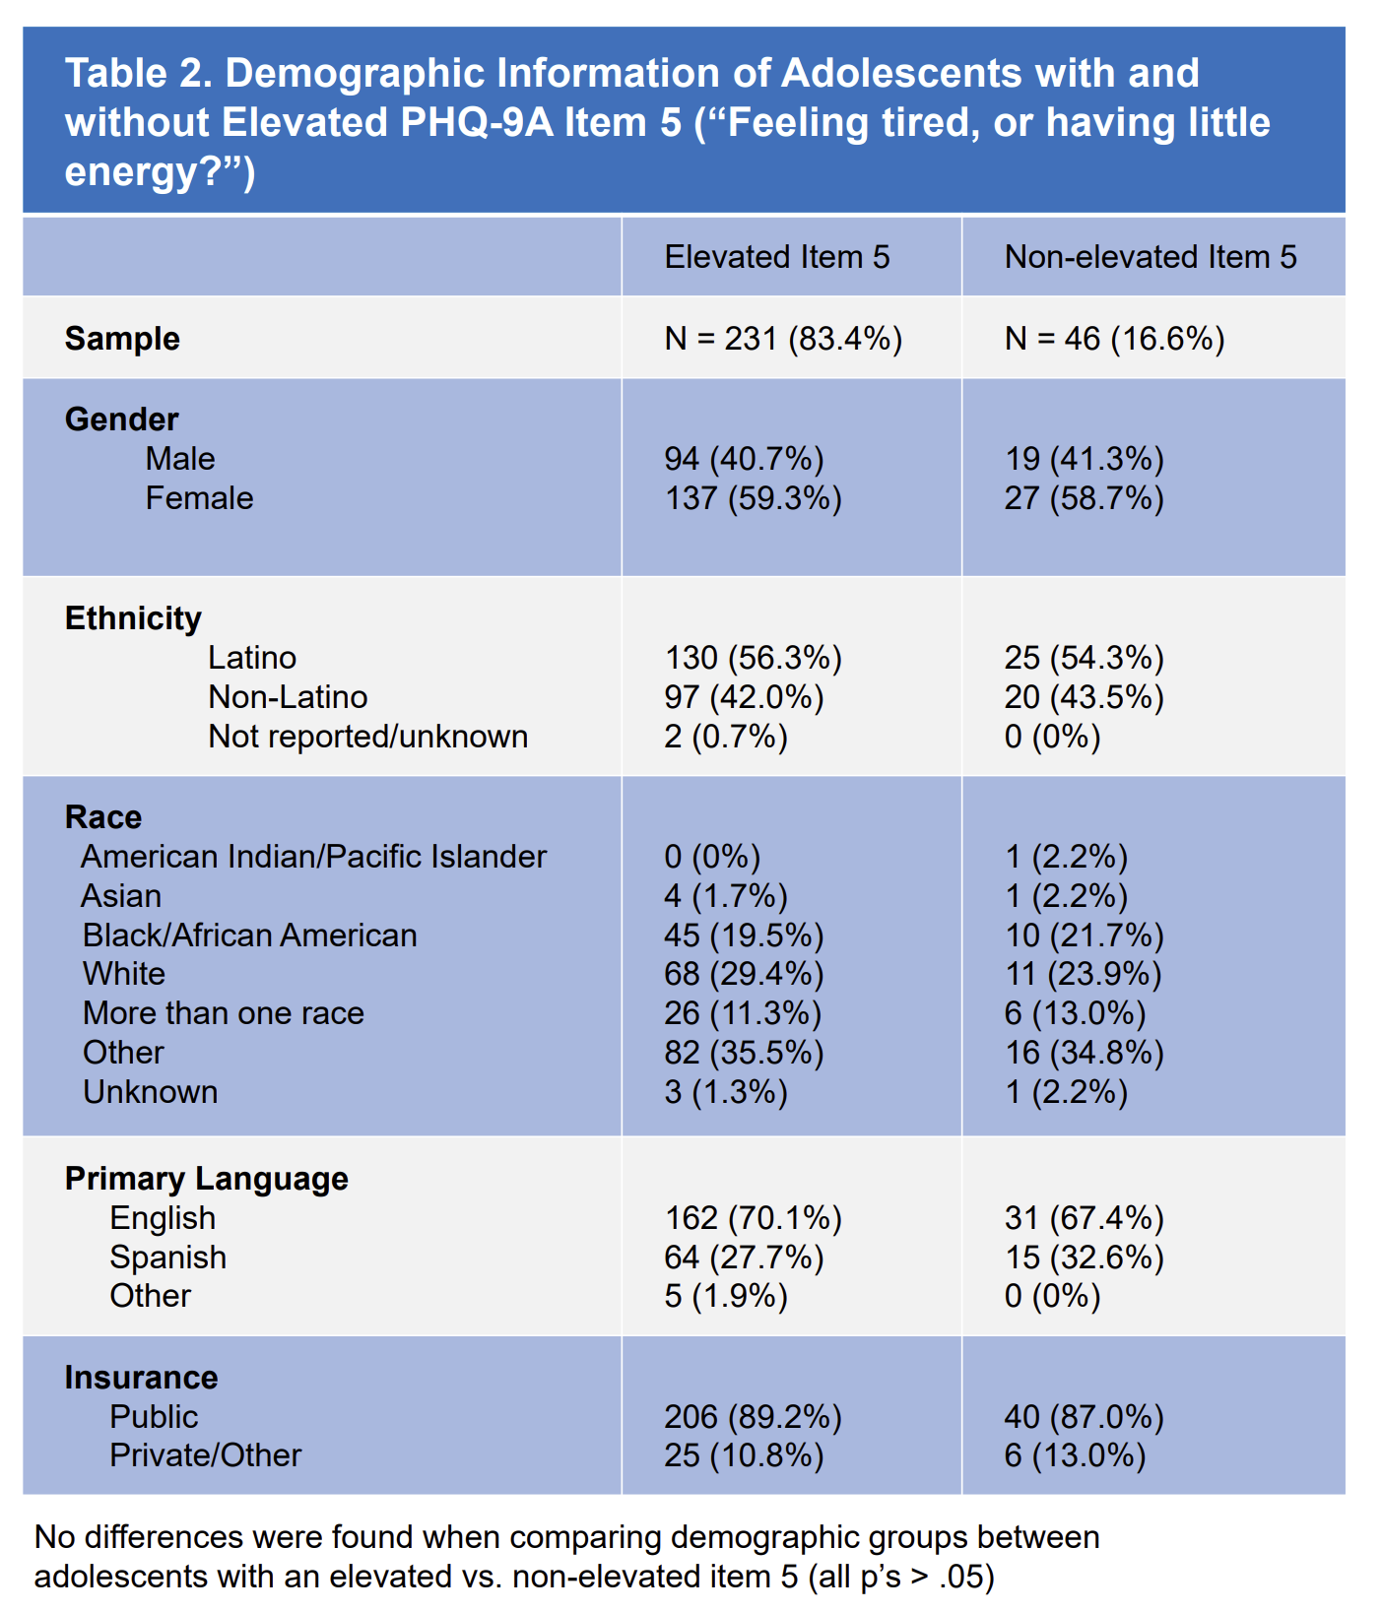
Results: Item 5 (feeling tired)
no significant differences found when comparing demographic groups between adolescents with an elevated vs. non-elevated item 5 (all p’s > 0.05)
Notes:
- Will discuss the data we looked at for this presentation was from the 277 adolescents with elevated scores

Slide 13
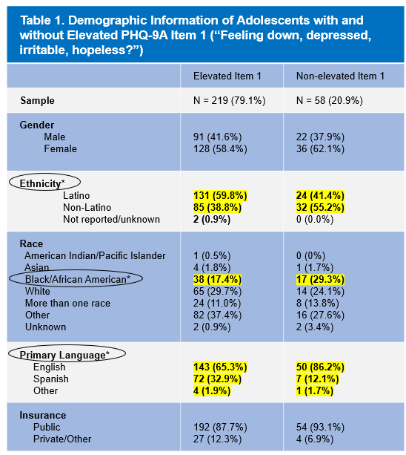
Results: Item 1 (feeling down)
Latino adolescents
Primarily Spanish-speaking adolescents
Increased/decreased endorsement of item 1
Black/African American Adolescents

Slide 14
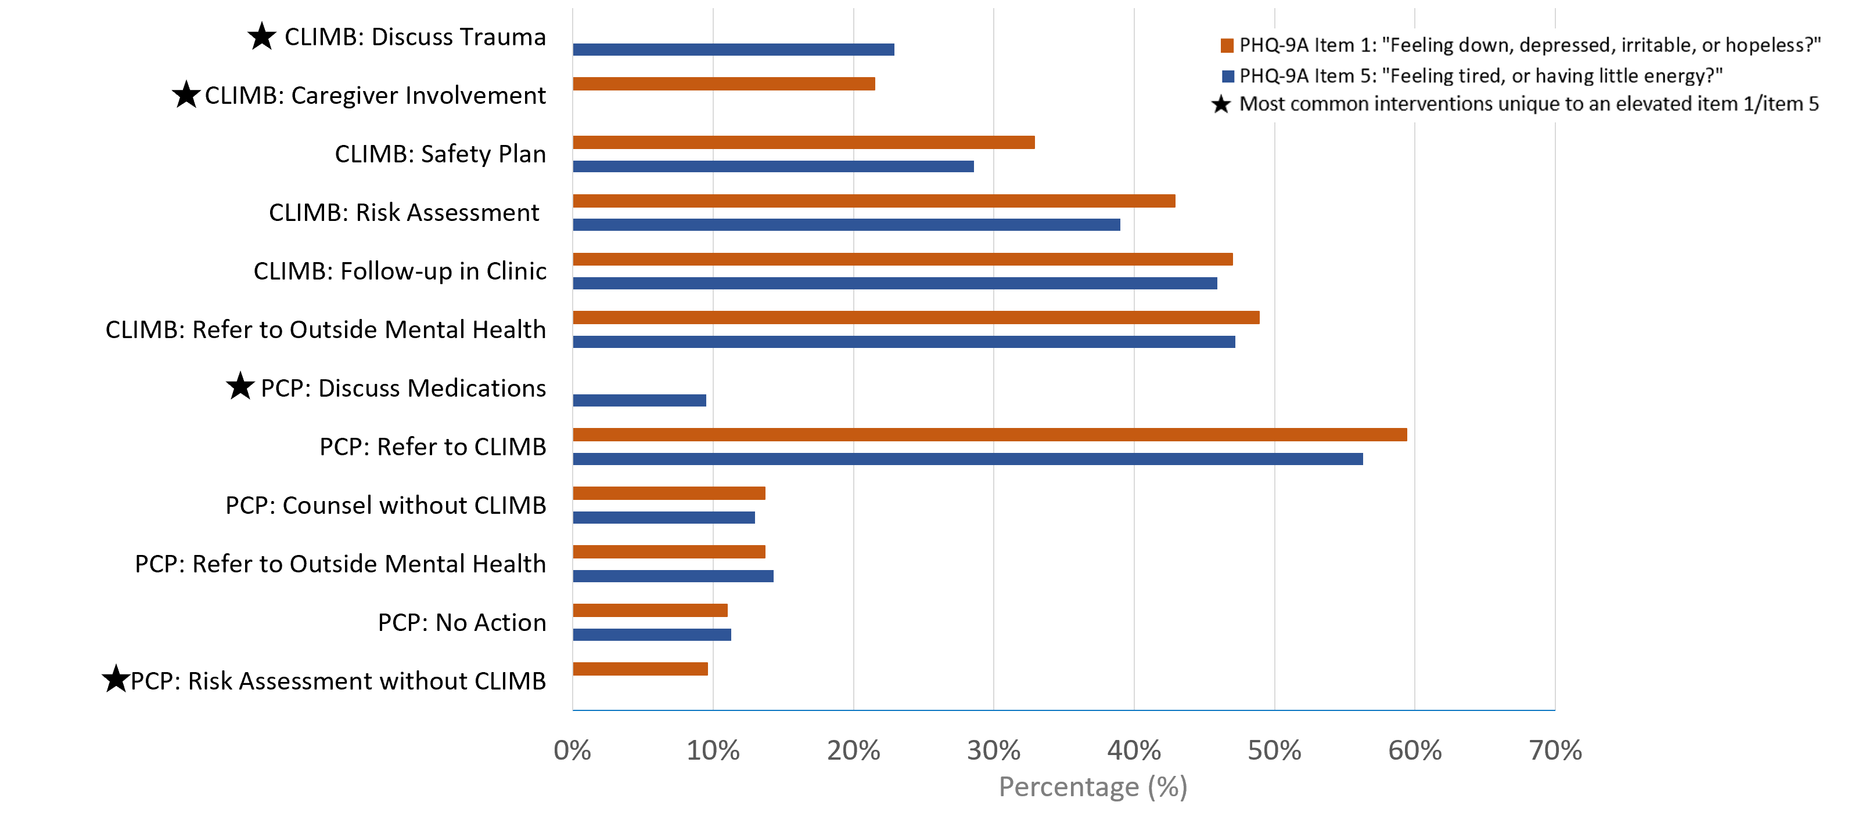
Results: Interventions
Figure 1. Most frequent primary care and behavioral health provider interventions and recommendations in response to reported emotional (item 1: feeling down) and physical (item 5: feeling tired) depressive symptoms

Slide 15
Discussion: Latino & Primarily Spanish-Speaking Youth
WHY MIGHT THESE DEMOGRAPHIC GROUPS ENDORSE EMOTIONAL SYMPTOMS OF DEPRESSION (ITEM 1: FEELING DOWN) MORE THAN NON-LATINO AND PRIMARILY ENGLISH-SPEAKING YOUTH?
Acculturation or differences in how mental health and mental health interventions are viewed between successive generations.
Heterogenous sample of youth (Wassertheil-Smoller et al., 2014).
Medical homes may provide comfort and improve access to care.

Slide 16
Discussion: Black/African American Youth
WHY MIGHT THIS DEMOGRAPHIC GROUP ENDORSE EMOTIONAL SYMPTOMS OF DEPRESSION (ITEM 1: FEELING DOWN) LESS THAN OTHER RACIAL GROUPS?
Maintenance of an overall positive attitude and hope (Assari & Lankarani, 2016).
Endorsing physical symptoms more than emotional symptoms of depression due to stigma (National Alliance on Mental Illness, 2023).

Slide 17
Limitations
(1) Our understanding of recommendations/interventions is entirely based on and limited by what was documented in the electronic medical record; we are unable to capture both in visit and out of visit factors that are not documented.
(2) Data are entirely based on adolescents’ willingness and desire/ability to be forthcoming when completing the self-report PHQ-9A.
(3) Manually inputted data may contain some human error; reviewing raw screening data may ensure accuracy.
Notes:
OUR UNDERSTANDING OF RECS/INTERVENTIONS IS ENTIRELY BASED ON AND LIMITED BY WHAT WAS DOCUMENTED IN EMR; WE ARE UNABLE TO CAPTURE BOTH IN VISIT AND OUT OF VISIT FACTORS THAT ARE NOT DOCUMENTED

Slide 18
Implications/Future Directions
Investigate depression symptom presentation among adolescents from different countries of origin, particularly different subgroups of Latinos.
Future studies might investigate how interventions correlate with PHQ-9A scores at subsequent visits.
Different groups of individuals present depression with different symptoms (e.g., feeling down, feeling tired). Therefore, PCPs and BHCs should be aware and employ equitable and effective interventions (e.g., discuss trauma, discuss medications, etc.).

Slide 19
References
Federal Interagency Forum on Child and Family Statistics. America’s Children: Key National Indicators of Well-Being, 2017. Washington, DC: U.S. Government Printing Office.
Kataoka, S. H., Zhang, L., & Wells, K. B. (2002). Unmet need for mental health care among U.S. children: variation by ethnicity and insurance status. The American Journal of Psychiatry, 159(9), 1548-1555. doi:
10.1176/appi.ajp.159.9.1548.
Martini, R., Hilt, R., Marx, L., Chenven, M., Naylor, M., Sarvet, B., & Ptakowski, K. K. (2012). Best Principles for Integration of Child Psychiatry into the Pediatric Health Home. American Academy of Child & Adolescent
Psychiatry.
Hodgkinson, S., Godoy, L, Beers, L. S., & Lewin, A. (2017). Improving Mental Health Access for Low-Income Children and Families in the Primary Care Setting. Pediatrics, 139(1). doi: 10.1542/peds.2015-1175.
Bailey, R. K., Mokonogho, J., & Kumar, A. (2019). Racial and ethnic differences in depression: current perspectives. Neuropsychiatric Disease and Treatment. doi: 10.2147/NDT.S128584.
Anderson, E. R. & Mayes, L. C. (2010). Race/ethnicity and internalizing disorders in youth: A review. Clinical Psychology Review, 30(3), 338-348. https://doi.org/10.1016/j.cpr.2009.12.008.
Richardson, L. P., Ludman, E., McCauley, E., Lindenbaum, J., Larison, C., Zhou, C., Clarke, G., Brent, D., & Katon, W. (2014). Collaborative care for adolescents with depression in primary care: a randomized clinical
trial. JAMA, 312(8), 809-816. doi: 10.1001/jama.2014.9259.
Kenny, J., Costello, L., Kelsay, K., Bunik, M., Xiong, S., Chiaravalloti, L., Millar, A., & Talmi, A. (2021). All Hands on Deck: Addressing Adolescent Depression in Pediatric Primary Care. Journal of Pediatric Psychology,
46(8), 903-911. doi: 10.1093/jpepsy/jsab033.
Siu, A. L. (2016). Screening for Depression in Adults US Preventive Services Task Force Recommendation Statement, JAMA, 315(4), 380-387. doi:10.1001/jama.2015.18392.
Johnson, J. G., Harris, E. S., Spitzer, R. L., & Williams, J. B. W. (2002). The patient health questionnaire for adolescents: validation of an instrument for the assessment of mental disorders among adolescent primary
care patients. J Adolesc Health, 30(3), 196-204. doi: 10.1016/s1054-139x(01)00333-0.
Hsieh, H.F. & Shannon, S. E. (2005). Three Approaches to Qualitative Content Analysis. Qual Health Res. 15(9), 1277-1288. doi: 10.1177/1049732305276687.
Wassertheil-Smoller, W., Arredondo, E. M., Cai, J., Castaneda, S. F., Choca, J. P., Gallo, L. C., Jung, M., LaVange, L. M., Lee-Rey, E. T., Mosley, T., Jr., Penedo, F. J., Santistaban, D. A., & Zee, P. C. (2014).
Depression, anxiety, antidepressant use, and cardiovascular disease among Hispanic men and women of different national backgrounds: results from the Hispanic Community Health Study/Study of Latinos. Ann Epidemiol, 24(11), 822-830. doi: 10.1016/j.annepidem.2014.09.003
Assari, S., & Lankarani, M. M. (2016). Association between stressful life events and depression; intersection of race and gender. Journal of Racial and Ethnic Health Disparities, 3(2), 349–356.
National Alliance on Mental Illness (2023). Black/African American. https://www.nami.org/Your-Journey/Identity-and-Cultural-Dimensions/Black-African
American#:~:text=Black%20people%20may%20also%20be,pains%20when%20talking%20about%20depression

Slide 20
Acknowledgements
This research was approved by the Colorado Multiple Institution Review Board and generously funded with State and philanthropic dollars. The authors are grateful to the families, staff, and providers in the Child Health Clinic and the CLIMB team for ongoing contributions and support.
Dr. K. Ron-Li Liaw, Chair of PMHI
Dr. Neill Epperson, Chair of Department of Psychiatry
Dr. Dominic Martinez, Dir. Office of Inclusion and Outreach, CCTSI
Dr. Jessica Kenny & Dr. Ayelet Talmi
Emmaly Perks, Director PURPLE Program
Yunliang (Lily) Luo, Director PURPLE Program
University of Colorado School of Medicine, Departments of Psychiatry and Pediatrics
Children’s Hospital Colorado, Pediatric Mental Health Institute
CLIMB Team and families involved in this study

