Slide 1
Racial/Ethnic Identification as a Predictor of Treatment Effectiveness and Acceptability in a Partial Hospitalization Program
August 10, 2021
Alazar Gebremichael, BA, Sarah Kennedy, PhD
Notes:
Hello, my name is Alazar Gebremichael (I use he/him pronounce) and I will be presenting on my research on emotional disorders within children and adolescents of varying ethnic backgrounds. My mentor on this research is Dr. Sarah Kennedy and the title of my Research Project is…

Slide 2
Disparities in mental health
Treatment satisfaction vs. treatment effectiveness
Fewer well established psychosocial interventions for ethnic minority groups.
“Four psychosocial interventions now meet the highest standard of evidence (i.e., well-established) for H/L and AfA minority youth”
Notes:
I am an aspiring clinical psychologist who is interested in closing the disparities within mental health regarding patients of ethnic backgrounds.
This summer, I have worked with Dr. Sarah Kennedy on her research in the Partial hospitalization program at children's hospital. After being allowed an opportunity to do my own research, I brought up the idea that we should look at the PHP's psychosocial intervention and identify if there were any ethnic identity predictors of treatment outcome. After doing some literary research, we found that treatment satisfaction has been relatively understudied among ethnic minority groups receiving psychosocial mental health treatment compared to treatment effectiveness. We also found that there are few well established psychotherapy interventions for ethnic minority groups as compared to interventions for white patients.

Slide 3
Adaptation
Adaptations of psychotherapy interventions positively impact effectiveness for ethnic minority groups.
“Clinicians should preferentially use evidence-based psychosocial interventions…. with individuals that represent the ethnic minority.”
Social and cultural pressures
Little guidance available on how to adapt existing evidence-based intervention for ethnic minority groups.
Notes:
We found that adaptations may be necessary for psychosocial interventions to have the same level of effectiveness for ethnic minority groups as they do for white patients. We stipulated that among other reasons, social and cultural pressures had significant impact on psychosocial interventions surrounding ethnic minority groups. Adaptation of the interventions could mitigate for this discrepancy but there is currently minimal guidance on how to adapt existing evidence-based intervention for ethnic minority groups.

Slide 4
Objective
Hypothesis
To determine if there is a difference in treatment satisfaction between POC and WP for youth receiving a transdiagnostic treatment for emotional disorders in a Partial Hospitalization Program (PHP)
Satisfaction with treatment will be significantly higher in WP as compared to POC
POC= Patient of Color
WP= White Patient
Notes:
So in this study, we had three objectives. The first objective was to determine if there was a difference in satisfaction between individuals of color and white individuals for youth receiving transdiagnostic treatment for emotional disorders in a Partial Hospitalization Program. We hypothesized that Satisfaction with treatment would be higher in white identifying patients as compared to patients of color due to things we read in the literature.

Slide 5
Objective
Hypothesis
To examine whether POC versus WP differ significantly in post-treatment anxiety and depression scores, controlling for pre-treatment scores
POC and WP will not differ in post-treatment anxiety and depression
POC= Patient of Color
WP= White Patient
Notes:
Secondly, we wanted to examine whether youth of color versus white youth significantly differed in post treatment anxiety and depression between individuals of color and white individuals for youth receiving transdiagnostic in the Partial Hospitalization Program. We hypothesized that youth of color will not differ in post-treatment anxiety and depression due to the confidence we had in the program’s adaptation.

Slide 6
Objective
Hypothesis
To examine whether POC versus WP differ significantly in post-treatment emotional reactivity scores, controlling for pre-treatment scores
POC and WP will not differ in post treatment emotional reactivity scores
POC= Patient of Color
WP= White Patient
Notes:
Lastly, we wanted to examine whether youth of color versus white youth significantly differed in post treatment emotional reactivity scores between individuals of color and white individuals for youth receiving transdiagnostic in the Partial Hospitalization Program. We hypothesized that youth of color will not differ in post-treatment emotional reactivity scores due to the confidence we had in the program.

Slide 7
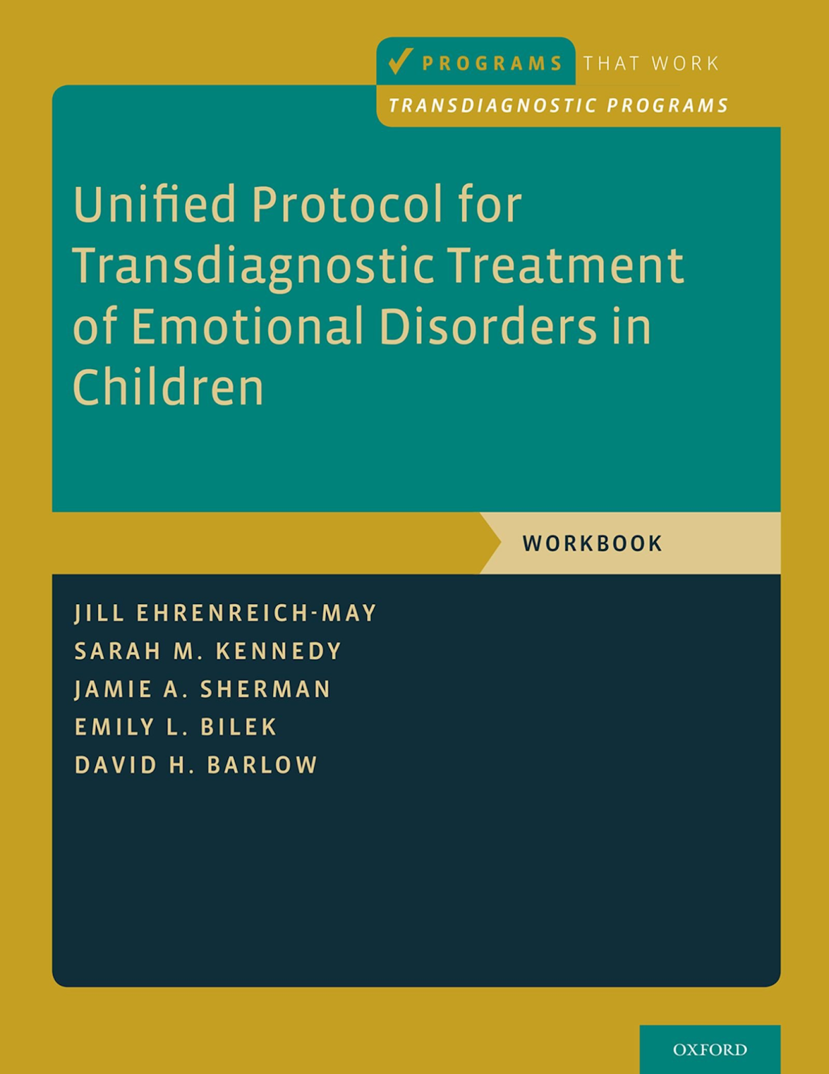
Methods – Program
Unified Protocol
Transdiagnostic Treatment of Emotional Disorders.
Children and Adolescents in PHP.
Supporting Evidence for Adult UP, UP-A, and UP-C
Notes:
Now, before I discuss the actual research conducted, let me provide some background on the program that the participants are receiving treatment in. My mentor, Dr. Sarah Kennedy has been working on administering and implementing a program that she co created which helps children and adolescents suffering from emotional disorders. The program is based on the treatment manuel called The Unified Protocols for Transdiagnostic Treatment of Emotional Disorders in Children and Adolescents. This intervention is designed to treat multiple emotional disorders by presenting evidence-based intervention strategies that uses more broad language in the context of emotions. This protocol is used on Partially Hospitalized Patients at Children’s Hospital who are in need of psycotherpay.

Slide 8
Methods - Demographics
69 patients (ages 7 to 17) and their caregivers enrolled in the CHCO PHP participated (40.57% POC, 59.43% WP)
Figure 1.
Identity | n (%)
Caucasian/White | 52 (80)
Asian/Pacific Islander | 3 (4.6)
Black/African-American | 5 (7.7)
Native American | 3 (4.6)
Something else | 3 (4.6)
Prefer not to say | 1 (1.5)
Human | 1 (1.5)
Jewish | 1 (1.5)
Multi-Ethnic | 1 (1.5)
Hispanic/Latinx | 12 (18.5)
Figure 2.
Table 1. Demographic data for consented patients enrolled in the CHCO PHP.
Notes:
In this study, we enrolled 69 consenting patients (ages 7-17) and their respected caregivers who participated in the Children's Hospital PHP program. We classified patients as person of color (40.57%) or white individuals (59.43%) based on the way they reported their racial and ethnic identification which is illustrated in table 1. We also collected more data regarding the patient's identity which is illustrated in Figure 1 and 2.

Slide 9
Methods - Measures
The Emotion Dysregulation Inventory—Reactivity Short Form: 7-item, caregiver-report measure of emotional reactivity
Client Satisfaction Questionnaire 8 (CSQ-8): An 8-item self and parent report measure of satisfaction with treatment.
The PROMIS® Pediatric and Pediatric proxy Anxiety 8a and depression 6a: 6 and 8 item self and parent report measures of anxiety and depression, respectively.
Notes:
These are the measures that we used to measure acceptability, depression, anxiety, and emotional reactivity. (Number 1) The client satisfaction questionnaire 8 was used to measure acceptability of treatment. (Number 2 and 3) were both used to measure effectiveness of treatment. Both youth and parents filled out anxiety and depression measures and only parents reported on emotional reactivity. 2 and 3 were taken pre and post treatment. 1 was taken only post treatment.

Slide 10
Methods - Analysis
Independent Samples T-Test
Multiple linear regression
Treatment Satisfaction
Treatment Effectiveness
Anxiety
Depression
Emotional Reactivity
Notes:
Utilizing SPSS, we conducted multiple regression analysis to examine differences in depression, anxiety, and emotional reactivity from pre to post treatment. We then conducted some t-tests to examine differences in satisfaction from pre to post treatment.

Slide 11
Results
Table 2.
Overall changes in anxiety, depression, and emotional reactivity from pre-treatment to post-treatment
 | Pre-treatment | Post-treatment | Sig. (2 tailed) | Effect Size (Cohen's d)
Parent PROMIS Anxiety | 64.1358 | 56.3547 | < 0.001 | 0.992
Parent PROMIS Depression | 65.3189 | 58.3604 | < 0.001 | 0.848
Emotion Reactivity | 16.6731 | 12.2308 | < 0.001 | 0.698
Youth PROMIS Anxiety | 59.1719 | 52.8895 | < 0.001 | 0.612
Youth PROMIS Depression | 62.5421 | 55.5561 | < 0.001 | 0.727
Notes:
The first thing we looked at is just to see if the entire sample improved on our outcome measures. The good news is that the entire sample improved on all our outcome measures from pre to post treatment and the effect size was in the medium to large range. That is what Table 2 is illustrating.

Slide 12
Objective
Conclusion
To determine if there is a difference in treatment satisfaction between POC and WP for youth receiving a transdiagnostic treatment for emotional disorders in a Partial Hospitalization Program (PHP)
Ethnic minority participants did not significantly differ in post-treatment satisfaction from participants identifying as white, based on both parent and self report.
Parent report (t = -.28, p = .81)
Youth report (t = -.70, p = .49)
POC= Patient of Color
WP= White Patient
Notes:
We then considered ethnic minority status as a predictor. When we looked at post treatment satisfaction, we found that ethnic minority youth and white youth did not differ when it came to post treatment satisfaction from youth or parent report. (Show the T-test results)

Slide 13
Objective
Conclusion
Ethnic minority status predicted higher parent reported anxiety and depression scores at post-treatment (i.e. worse outcomes).
Ethnic minority status did not predict higher youth reported anxiety and depression scores at post-treatment (i.e. worse outcomes).
To examine whether POC versus WP significantly in post-treatment anxiety and depression scores, controlling for pre-treatment scores
POC= Patient of Color
WP= White Patient
Notes:
However, when we ran a regression analysis, we did find differences between ethnic minority youth and white youth when it came to two outcomes in particular.
When it came to Parent reported anxiety, identifying as an ethnic minority did predict higher parent reported anxiety symptoms at post treatment (controlling for baseline scores). It also predicted higher parent reported depression symptoms at post treatment (controlling for baseline scores). There weren't any differences when it came to youth reported symptoms.

Slide 14
Results
Table 3.
Ethnic minority status as a predictor of post-treatment outcomes
 | 𝜷 | Sig.
Parent PROMIS Anxiety | 0.223 | 0.02
Parent PROMIS Depression | 0.231 | 0.023
Emotion Reactivity | 0.186 | 0.123
Youth PROMIS Anxiety | 0.06 | 0.609
Youth PROMIS Depression | 0.134 | 0.25

Slide 15
Objective
Conclusion
To examine whether POC versus WP differ significantly in post-treatment emotional reactivity scores, controlling for pre-treatment scores
Ethnic minority status did not predict higher parent reported emotional reactivity scores at post-treatment.
POC= Patient of Color
WP= White Patient
Notes:
There also weren’t any differences when it came to emotional reactivity.

Slide 16
Results
Table 3.
Ethnic minority status as a predictor of post-treatment outcomes
 | 𝜷 | Sig.
Parent PROMIS Anxiety | 0.223 | 0.02
Parent PROMIS Depression | 0.231 | 0.023
Emotion Reactivity | 0.186 | 0.123
Youth PROMIS Anxiety | 0.06 | 0.609
Youth PROMIS Depression | 0.134 | 0.25

Slide 17
Implications
There is at least some evidence that the intervention in PHP is not as effective for patients who come from an ethnic minority background.
This psychotherapy intervention (like other psychotherapy interventions) may need to be adapted for individuals from an ethnic minority background in order to be as effective.
Notes:
After reviewing these results, it became clear that there is at least some evidence that this PHP intervention is not as effective for patients who come from an ethnic minority background. Considering this, this Psychosocial intervention (like other interventions) may need to be adapted for individuals from an ethnic minority background. Another implication of this study is that these measures may not be as sensitive to change for patients of ethnic backgrounds as it for white patients. Maybe we aren't assessing the outcomes that are important to minority parents. Maybe the parents of ethnic minority’s were not paying attention to whether the child is lonely or suffering, but they were paying attention to emotional reactivity. They could care more about these things. There may have been a misunderstanding signs of anxiety of depression as behavioral reactivity. It could also be that parents of ethnic ethnic background do not feel the program is taking cultural differences in the program into consideration. It is generally unclear and there would have to be more research done to get a definitive answer.

Slide 18
Limitations
Small sample size resulted in the categorization of patients in a binary, which may collapse cultural/ethnic differences that may have an impact on outcome.
In the future, we plan to conduct analyses in a larger sample size in order to examine differences in outcome for specific ethnic sub-groups.
Notes:
A limitation of this study was that we had a small sample size which resulted in categorizing patients in a binary manner which may have collapsed cultural and ethnic differences that may have had an impact on treatment outcome. In the future, we would conduct analysis in a much larger sample size so we can examine differences in outcome for specific ethnic sub-groups.

Slide 19
Acknowledgements
Thank you to Ms. Emmaly Perks, Ms. Yunliang Luo, and Dr. Merlin Ariefdjohan for giving me the opportunity to do meaningful work in research during the PURPLE Program.
Special thank you to Dr. Sarah Kennedy for mentoring me through this project and teaching me valuable skills in my aspiring field.

Slide 20
References
Bogner, Hillary, et al. “Patient Ethnicity and Perceptions of Families and Friends Regarding Depression Treatment.” Taylor & Francis, 29 Sept. 2009, www.tandfonline.com/doi/abs/10.1080/13557850802023125.
Givens, Jane L., et al. “Stigma and the Acceptability of Depression Treatments Among African Americans and Whites.” Journal of General Internal Medicine, vol. 22, no. 9, 2007, pp. 1292–1297., doi:10.1007/s11606-007- 0276-3.
Lagomasino, Isabel T., et al. “Racial-Ethnic Composition of Provider Practices and Disparities in Treatment of Depression and ANXIETY, 2003–2007.” Psychiatric Services, 14 Jan. 2015, ps.psychiatryonline.org/doi/full/10.1176/ps.62.9.pss6209_1019.
Lydecker, Janet, et al. “Examining Race as a Predictor and Moderator of Treatment Outcomes for Binge-Eating Disorder: Analysis of Aggregated Randomized Controlled Trials.” Journal of Consulting and Clinical Psychology, U.S. National Library of Medicine, 22 Apr. 2019, pubmed.ncbi.nlm.nih.gov/31008634/.
Pina, Armando A., et al. “Evidence-Based Psychosocial Interventions for Ethnic Minority Youth: The 10-Year Update.” Journal of Clinical Child & Adolescent Psychology, vol. 48, no. 2, 2019, pp. 179–202., doi:10.1080/15374416.2019.1567350.
Schraufnagel, Trevor J, et al. “Treating Minority Patients with Depression and Anxiety: What Does the Evidence Tell Us?” General Hospital Psychiatry, U.S. National Library of Medicine, 2006, pubmed.ncbi.nlm.nih.gov/16377362/.

