Slide 1
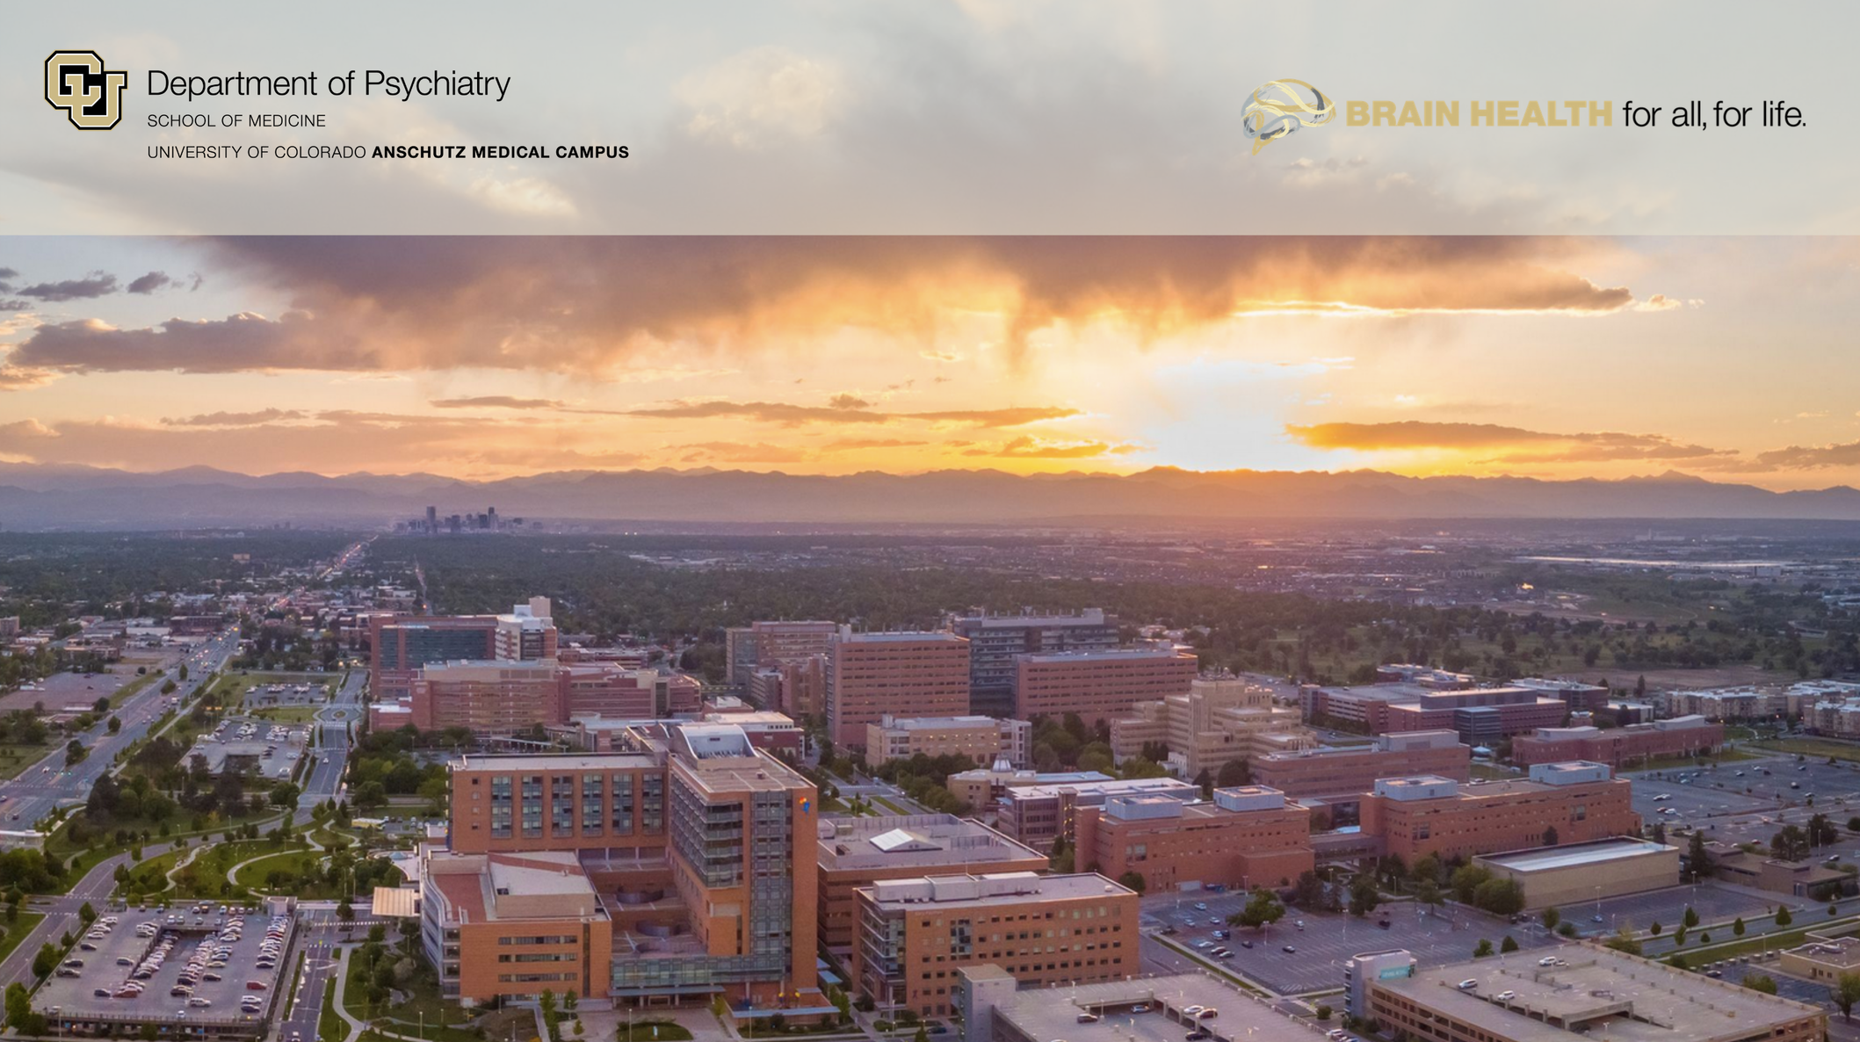
Research in the Translational Addiction Imaging Lab
Office of Psychological Science and Practice
16 March 2026
Joseph P. Schacht, Ph.D.
Department of Psychiatry
University of Colorado School of Medicine joseph.schacht@cuanschutz.edu

Slide 2
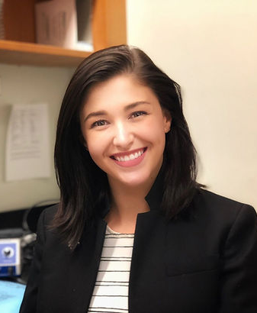
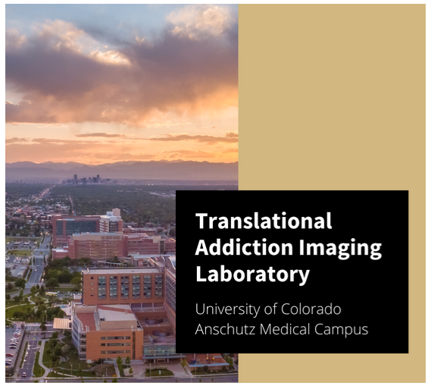
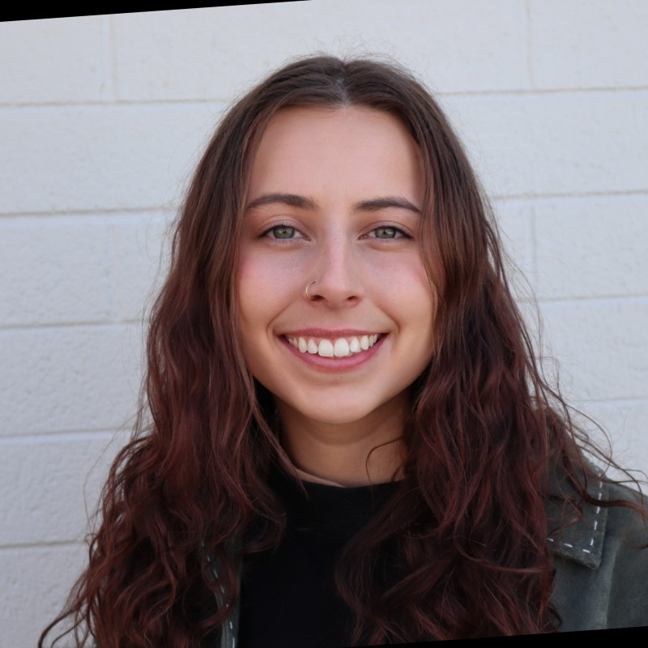
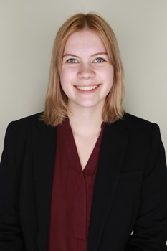
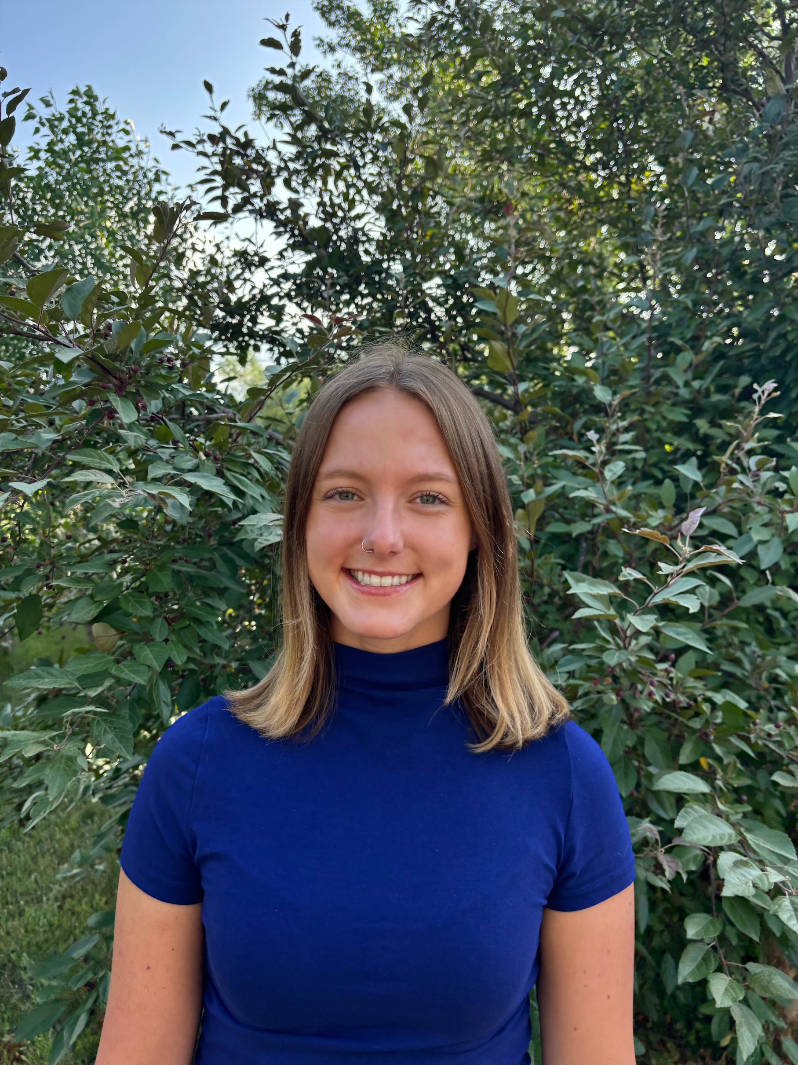
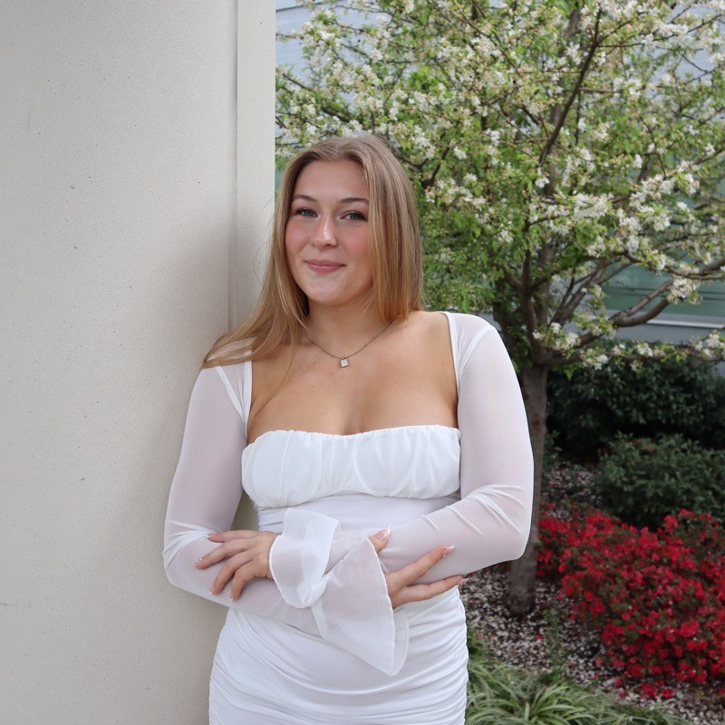
Lab members
Joseph Sakai, M.D.
Associate Professor
Kristen Raymond, B.A.
Senior Clinical Research Manager
Morgan Zipperly, M.D., Ph.D.
R25 Research Resident
Robert Shelton, M.S.
Lab Technician
Madeline Peloff, M.P.H..
Senior Research Coordinator
Emma Shaffer, B.A.
Research Coordinator
Jaedyn Birchmier, B.S.
Research Coordinator
Olivia Hornung, B.S.
Research Coordinator

Slide 3
Mission
Our purpose is to develop new treatments for alcohol and substance use disorders.
We use behavioral genetics, functional neuroimaging, and experimental pharmacology to test novel medications in a research laboratory setting.
Our goal is to create a future in which safe and effective treatments for these disorders are easily available and widely used.

Slide 4
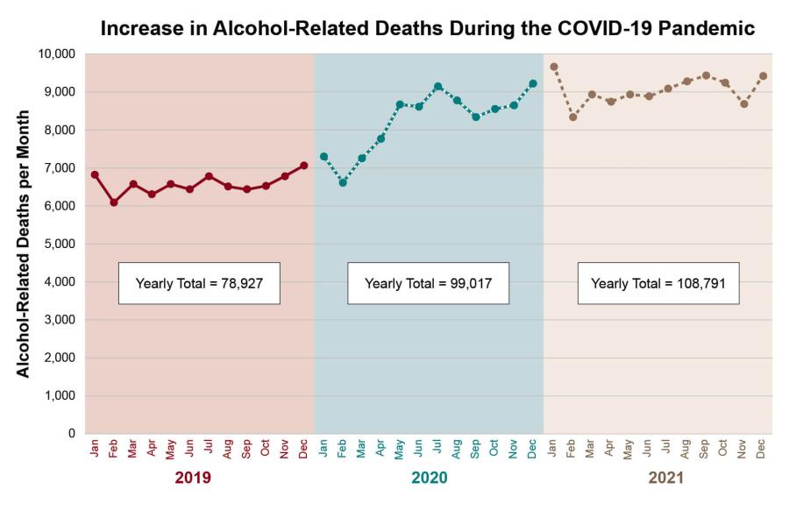
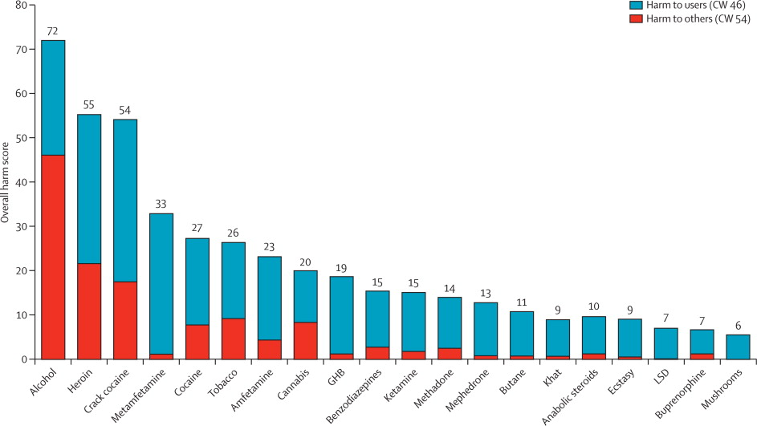
Alcohol Use Disorder (AUD)
“Alcoholism is a disorder of great destructive power” (Vaillant, 2012)
  3rd leading cause of preventable death
  10% of all deaths among working-age adults
  5% of cancer diagnoses attributable to alcohol consumption
  Harm to society exceeds heroin, crack cocaine, and methamphetamine (Nutt et al., 2010)
Notes:
Male Harvard sophomores 1939-1944
Alcoholism was the main cause of divorce between the Grant Study men and their wives.
Together with associated cigarette smoking, was the single greatest contributor to their early morbidity and death.

Slide 5
AUD treatment landscape: Why medications?
8% with a current AUD diagnosis seek treatment (Grant et al., 2015)
In 2017, 84% of alcohol treatment programs offered only group therapy or 12-step program referral (Abraham et al., 2020)
  Historical reluctance to view AUD/SUD as brain-based diseases
CBT, relapse prevention are modestly effective
  But adherence to empirically-supported methods varies between programs
  Psychotherapy often not covered by insurance, inaccessible in many areas
12-step programs are modestly effective
  But abstinence-based, explicitly spiritual; many patients don’t want to be abstinent
  Duration of treatment necessary for therapeutic effect is unclear
  Typically, lifelong participation is encouraged

Slide 6
Study paradigms
Human lab studies: non-treatment-seekers
  Short-term (1-4 weeks) medication dosing
  Alcohol subjective response
  Alcohol self-administration (bar lab), cannabis self-administration (mobile pharmacology lab)
  Functional neuroimaging (fMRI)
Clinical trials: treatment-seekers
  Longer-term (8-16 weeks) medication dosing
  Alcohol, nicotine biomarkers for use
Mechanism of action: test potential mechanisms (e.g., craving, response inhibition) in controlled setting
Precision medicine: genotyping and dense phenotyping to identify subgroups with potential for greater efficacy

Slide 7
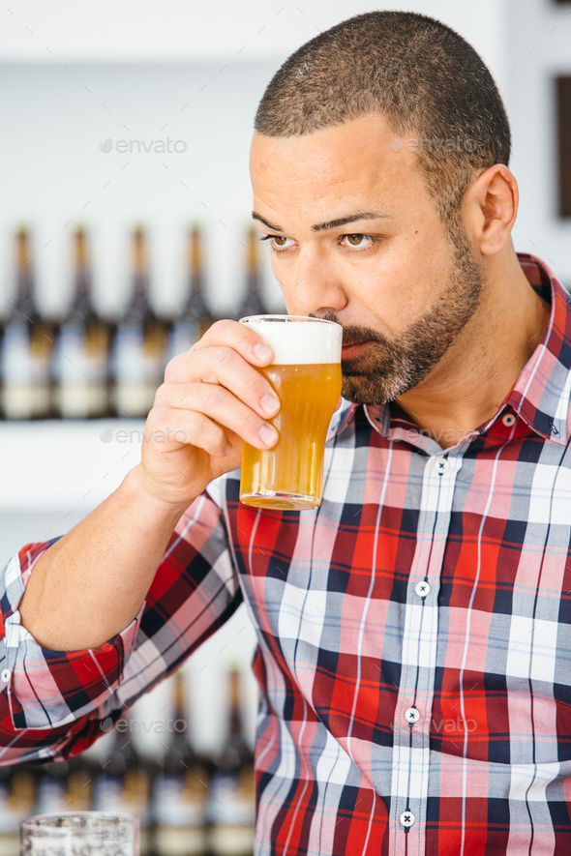
Lab-based alcohol cue reactivity paradigm
Present water or preferred alcoholic beverage in original packaging, pour into appropriate glass in front of participant
Participant repeatedly brings glass to his/her face and smells, but does not drink
Participant rates urge to drink on 20-point visual analog scale
  Baseline urge >= 5 for study inclusion

Slide 8
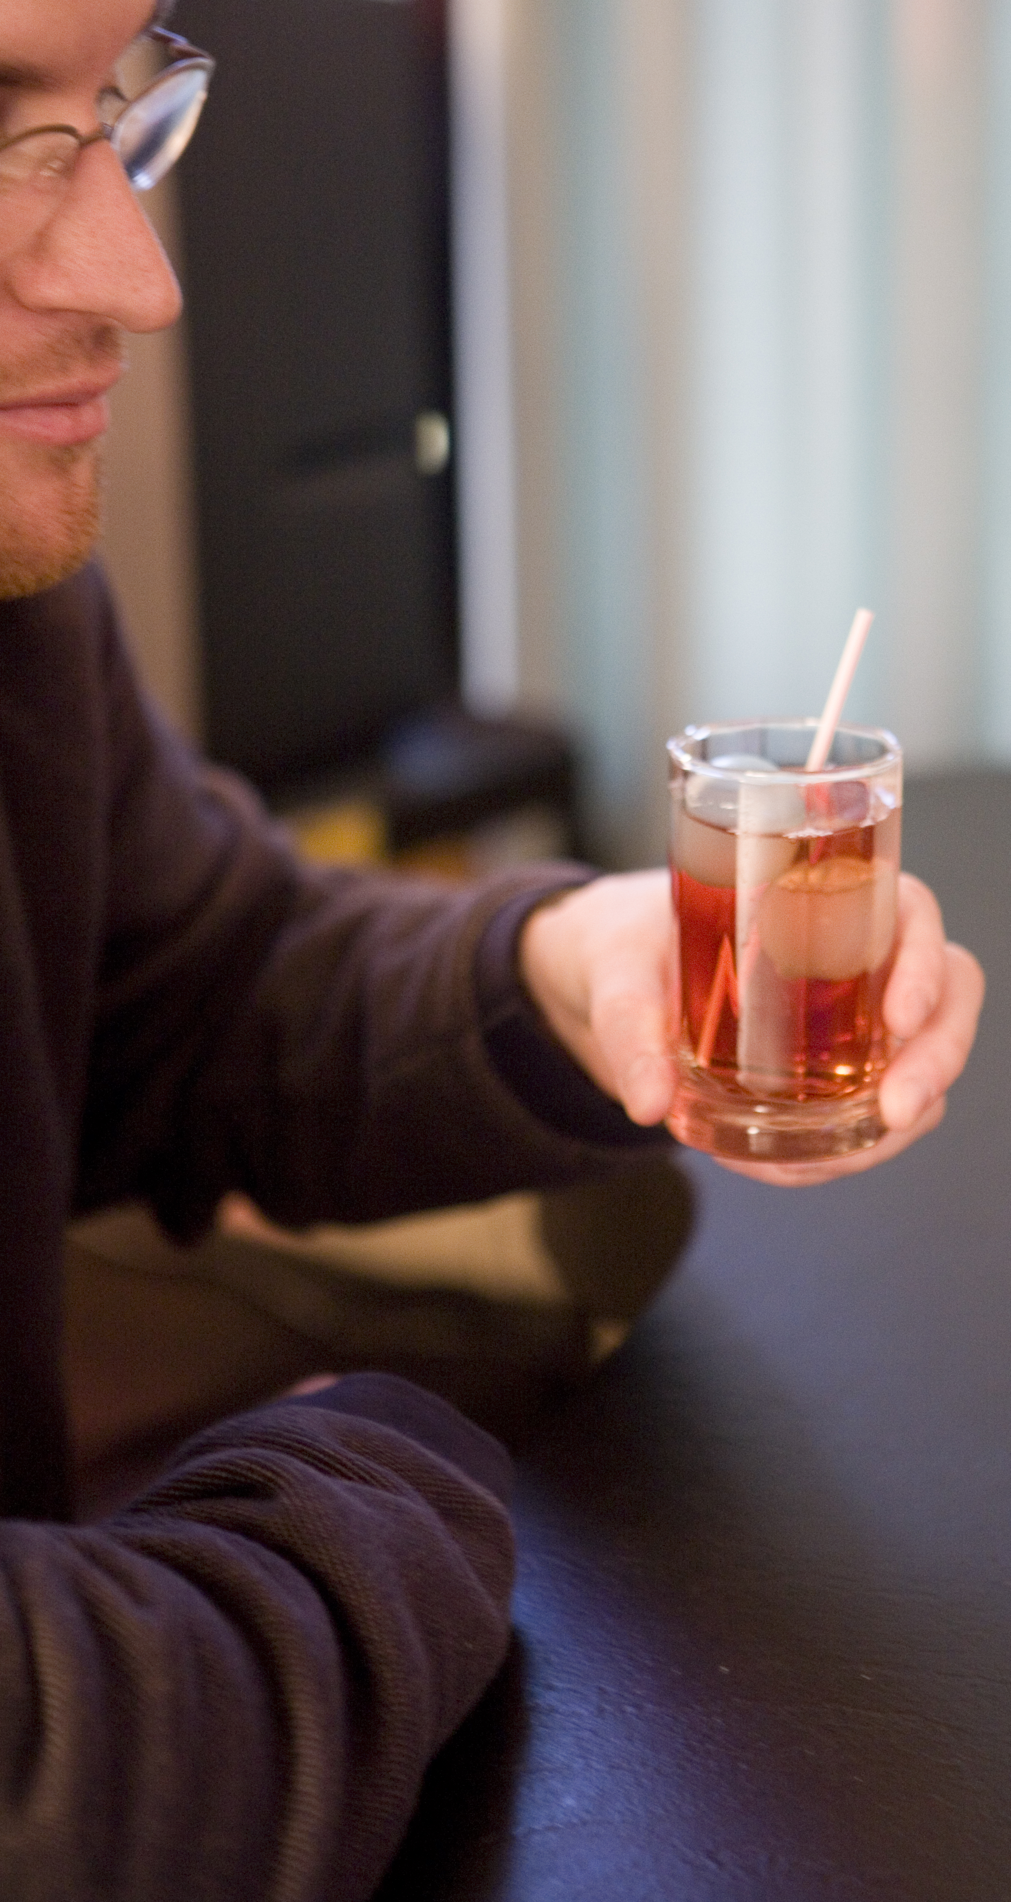
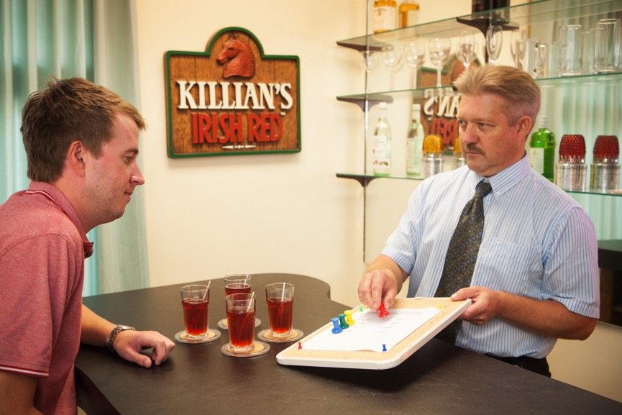
Alcohol self-administration paradigm
Initial (priming) drink calculated to produce BrAC of 0.03%
  Subjective response (craving, stimulation, sedation) measured for 30 minutes
Participants subsequently given opportunity to consume up to 8 additional drinks, each with 0.015% BrAC target
  Cost: $2 per drink (taken from compensation)
  Max total BrAC ~= 0.12%

Slide 9
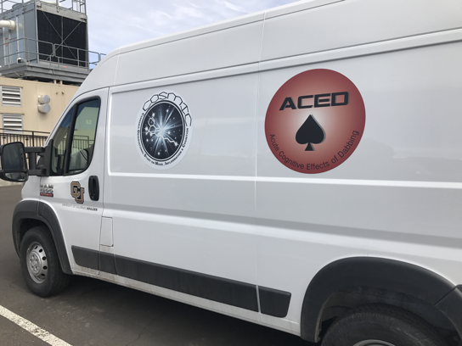
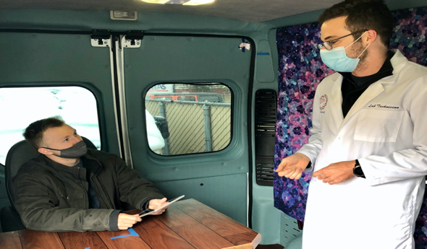
Cannabis self-administration paradigm
Mobile pharmacology lab
Van parks in front of participant’s home
Participant uses cannabis at home ad libitum
  Blood draw immediately before and after use to quantify THC and other cannabinoids
  Subjective response, neurocognitive testing while participant is acutely intoxicated

Slide 10
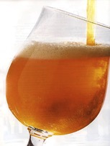
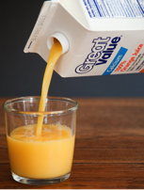

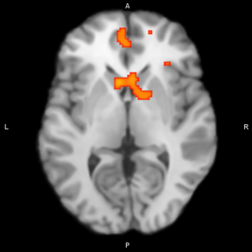
fMRI alcohol cue reactivity paradigm
12-minute passive viewing task
  24-s blocks of alcohol, neutral (non-alcoholic) beverage, blurred control images, and fixation (6 blocks of each)
  Sip of alcohol (10 mL) immediately before task begins
Compare BOLD signal during alcohol vs. neutral beverage images (ALC > BEV)
Consistently shown to elicit activation of ventral striatum, other reward-related brain areas
  Reliable within participants over time
+
Schacht et al., 2011, NeuroImage; Schacht et al., 2013, Addict Biol

Slide 11
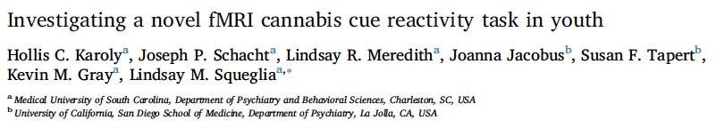
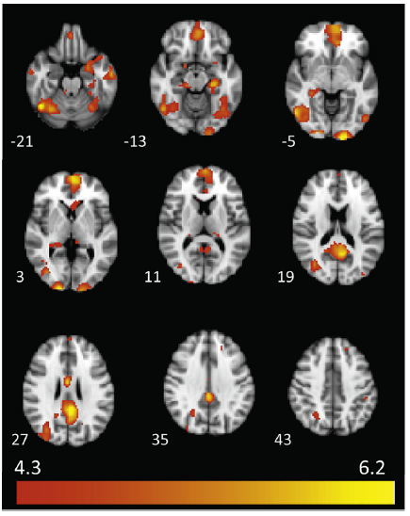
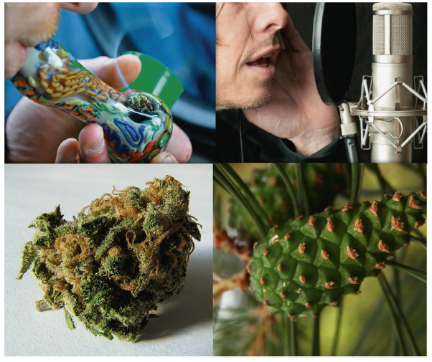
Karoly, Schacht et al., 2019, Addict Behav

Slide 12
Current and recent studies
75N94025F00002: Alcohol cue human laboratory study testing apremilast
P50 DA056408: Cannabidiol and cannabis concentrate users: A randomized, placebo-controlled study
R21 AA031146: An exploratory randomized controlled trial of the effects of oral semaglutide on alcohol craving and consumption
U01 DA064384: Multi-site randomized trial of a GLP-1/GIP receptor agonist for smoking cessation

Slide 13
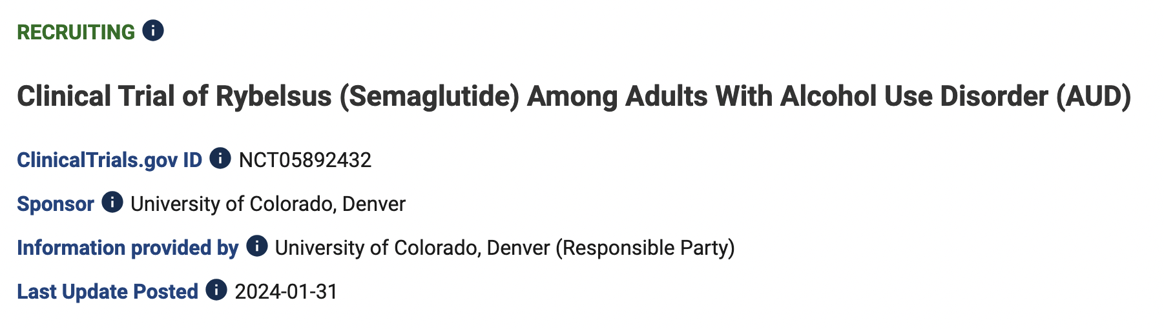
Colorado AUD semaglutide trial
Inclusion Criteria
Current DSM-5 AUD (at least moderate severity)
Wants to stop or cut down on drinking
≥ 28 (male)/21 (female) standard drinks per week in month prior to screening
≥ 1 heavy drinking day (≥ 5/4 drinks for males/females) in week prior to randomization
BMI ≥ 25 kg/m²

Slide 14
d = 0.69
Schacht et al., under review

Slide 15
Contact/patient referrals
(303) 724-2424
alcoholstudy@ucdenver.edu
cannabis.study@cuanschutz.edu
quitsmoking@cuanschutz.edu

