Slide 1
OPSP – 2025 Well-Being Survey Results for DOP Psychologists
Liz Chamberlain, PhD
DOP Faculty Wellness Officer
Emily Muther, PhD
PMHI Wellness Leader
March 16, 2026
Notes:
1

Slide 2



DOP Response Rates by Role & Respondents Across Sites
Psychiatry
Notes:
THANK YOU for participating!
Administered October-November 2025 across SOM
Inclusion criteria: >50% FTE CU SOM Faculty Instructor and above as of July 1, 2025
Did not include affiliate sites (e.g., VA, Denver Health)
GME Residents and Fellows (did not include Psychology Fellows)
Survey collected and analyzed by independent consulting firm, Sullivan Luallin Group
uses Healthcare Professional Wellbeing Academic Consortium as benchmark...
National benchmark is compared to other similar institutions—I can share the other institutions

Slide 3
The Big Picture – How Are Psychologists Doing?
Met national benchmarks for Burnout, Professional Fulfillment, stable since 2024 survey
Meaningful improvement in collegiality (listed as "Peer Support")
Wellness infrastructure in place
Faring better than other CU SOM faculty in Meaningfulness in Work, Efficiency of Clinical Practice, EHR Hassles

Slide 4
Well-being Outcomes

Slide 5
How Are Scores Calculated? Compared to What?
Scoring Key
Standard Deviation to Benchmark Standard
A difference of at least 0.2 standard deviations is a reasonable threshold to determine a meaningful difference. With this definition of a meaningful difference, the following color coding is used to indicate a difference that is favorable (green) or unfavorable (red). A difference less than 0.2 standard deviations (for each population) is too small to be meaningful, and is neutral (yellow).
Cut‐Points
A cut‐point of 7.5 for "high" Professional Fulfillment and of 3.325 for "high" Burnout are based on published research. The percentage of respondents in your group or organization whose score was at or beyond the cut‐point is displayed alongside your "mean score" results. The mean score and percentage of respondents in the PWAC benchmark who are at or beyond the cut‐point are displayed as points of comparison.
The Fuel Gauge
Mean scores for Professional Fulfillment and Burnout are presented as a color‐coded fuel gauge graphic

Slide 6
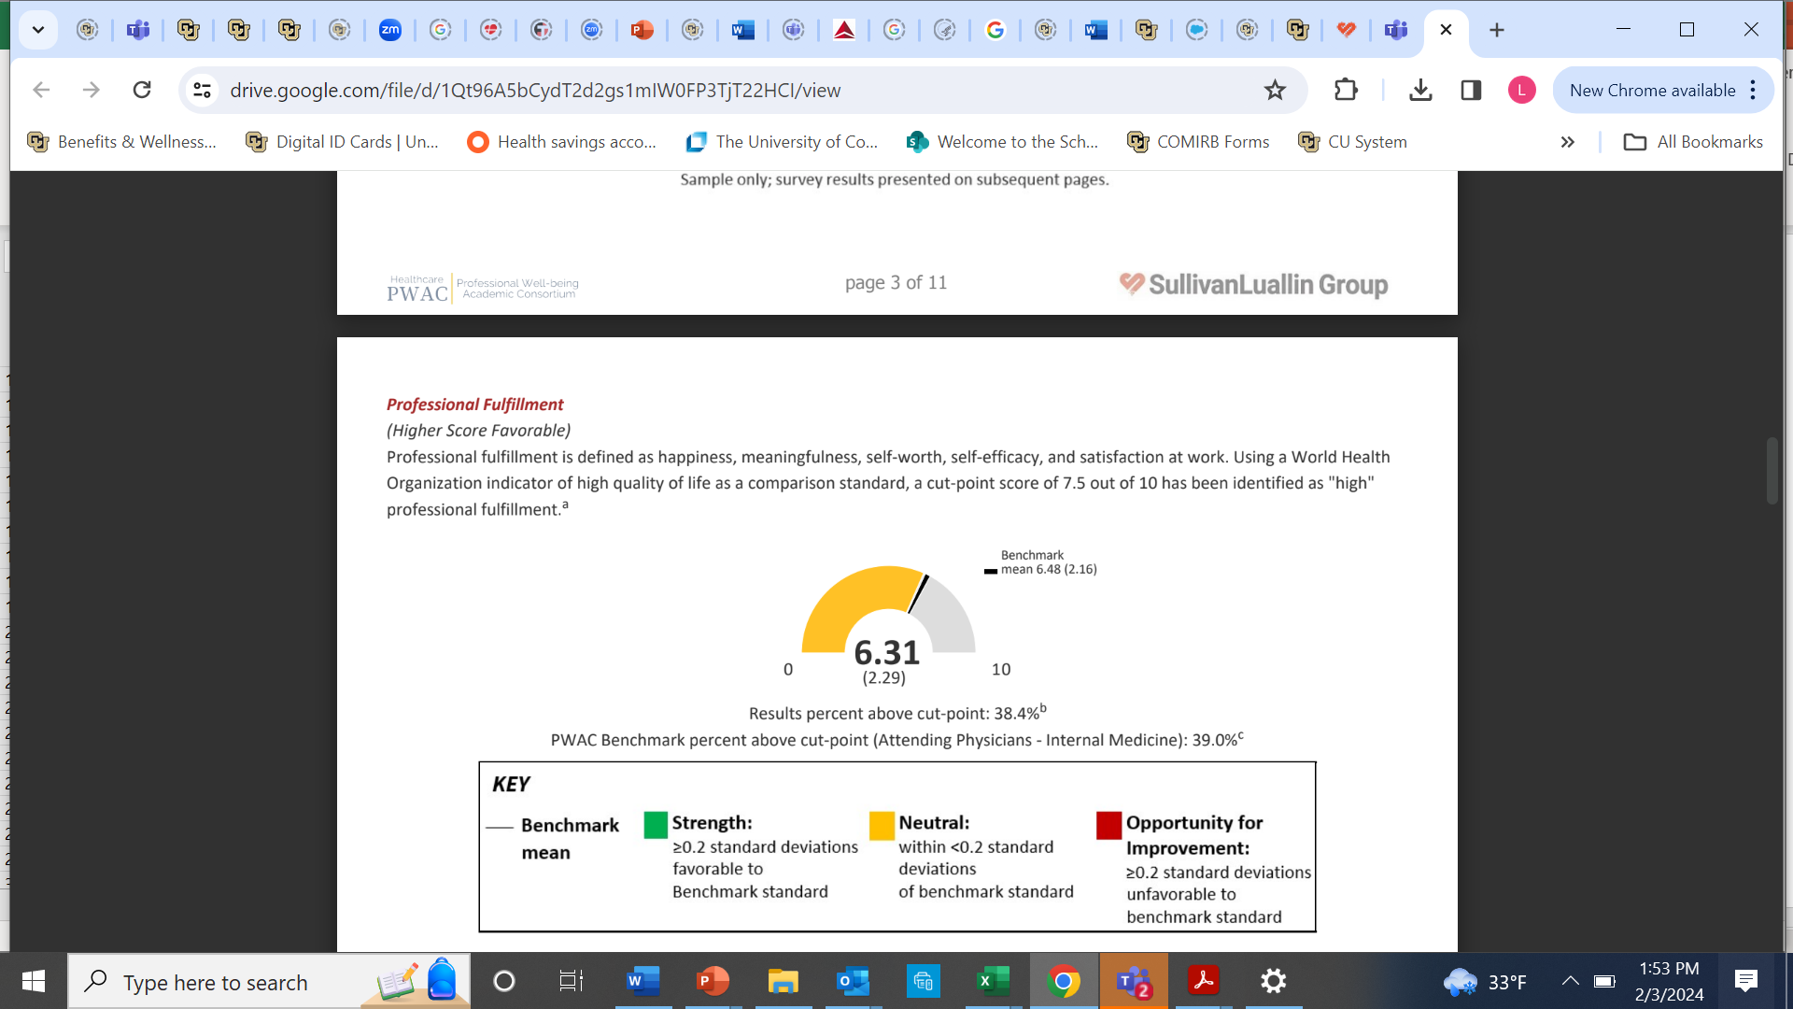

Slide 7
PWAC Gauges for Psychologists – Report with Graphics

Slide 8
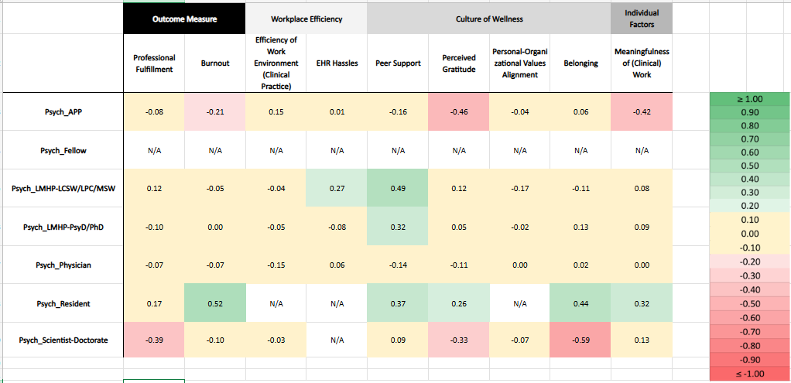
What’s Improved in DOP Since 2024

Slide 9
Well-being Drivers
Work Design• Culture • Individual Development & Support
Notes:
9

Slide 10
Culture of Wellness: Preferred Recognition from Leaders (different from collegial belonging*)
(1 = most valuable)
 | Physicians | APPs | Scientists-Doctorate | Residents | Fellows | LMHP-PsyD/PhD | LMHP-LCSW/LPC/MSW
One-on-one verbal praise | 1 | 1 | 2 | 1 | 1 | 1 | 1
Public recognition | 5 | 5 |  | 6 | 6 | 5 | 5
Written acknowledgment | 2 | 3 | 4 | 3 | 2 | 4 | 4
Group celebration | 6 | 6 | 6 | 5 | 5 | 6 | 6
Nomination for awards/honors | 4 | 4 | 3 | 4 |  | 3 | 3
Support for professional development | 3 | 2 | 1 | 2 | 4 | 2 | 2
Psychiatry
Most valued across roles: verbal praise & professional development
*Least valued: group celebration & public recognition
Notes:
There are missing values for scientists-doctorate and fellows due to low number of responders
✔ Most valued across roles: verbal praise & professional development
✔ Least valued: group celebration
10

Slide 11
Qualitative Data
Open Text Questions
Given the current challenges in funding and resources across academic medicine, what would most help you feel supported and committed to your role at CU SOM over the next 3 years?
What is one thing that is going well in your department, division, section, or at your primary site of practice that should be continued moving forward?
Thinking specifically about factors the CU School of Medicine or your department can influence, what one change would have the biggest positive impact on your well-being at work within the next 6 months?
Psychiatry
Notes:
Given the current challenges in funding and resources across academic medicine, what would most help you feel supported and committed to your role at CU SOM over the next 3 years?
What is one thing that is going well in your department, division, section, or at your primary site of practice that should be continued moving forward?
Thinking specifically about factors the CU School of Medicine or your department can influence, what one change would have the biggest positive impact on your well-being at work within the next 6 months?
What else would you like to share that is affecting your professional well-being that we haven’t asked about?
11

Slide 12
Psychologists' Responses
We are the most loquacious in the DOP!
sychiatry • Open-Ended Survey Responses • 202
~70 Responses Analyzed (Child Division = 44; Adult Division = 28)
24 Themes Identified
Psychiatry
Notes:
Given the current challenges in funding and resources across academic medicine, what would most help you feel supported and committed to your role at CU SOM over the next 3 years?
What is one thing that is going well in your department, division, section, or at your primary site of practice that should be continued moving forward?
Thinking specifically about factors the CU School of Medicine or your department can influence, what one change would have the biggest positive impact on your well-being at work within the next 6 months?
What else would you like to share that is affecting your professional well-being that we haven’t asked about?
12

Slide 13
Key Findings at a Glance – Thematic Analysis
Theme | Child Division | Adult Division
1. Compensation & Financial Equity | Very high frequency; cost of living, delayed merit raises, and integrated psychologist pay equity are central concerns. | Very high frequency; anti-moonlighting policy is a distinct and intensely felt frustration alongside cost-of-living concerns.
2. Administrative & Documentation Burden | High frequency; EPIC access inequity, billing support for integrated roles, room scheduling burden, space. | High frequency; EHR template design (checkbox overload), office space scarcity, inadequate admin support.
3. Leadership, Transparency & Communication | High frequency; deep frustration with department-level leadership; warm praise for division-level supervisors. | High frequency; appreciation for recent transparency improvements; concern about national-level policy impacts.
4. Autonomy, Scope & Work Flexibility | Moderate-high frequency; hybrid work equity, private practice restrictions, scheduling control. | High frequency; remote work described as essential; private practice restriction described as insulting and illogical.
5. Professional Development & Career Growth | Moderate frequency; protected time for scholarship, promotion clarity, mentorship support. | Moderate frequency; conference fund flexibility, career coaching, compensation for unpaid contributions.
6. Workload, Staffing & Sustainability | High frequency; group-first model burden, coverage gaps, work-life spillover. | High frequency; RVU model stress, PTO coverage gaps, job security anxiety.
Notes:
Given the current challenges in funding and resources across academic medicine, what would most help you feel supported and committed to your role at CU SOM over the next 3 years?
What is one thing that is going well in your department, division, section, or at your primary site of practice that should be continued moving forward?
Thinking specifically about factors the CU School of Medicine or your department can influence, what one change would have the biggest positive impact on your well-being at work within the next 6 months?
What else would you like to share that is affecting your professional well-being that we haven’t asked about?
13

Slide 14
More Specifics – Any Requests (by Question or Theme)?

Slide 15
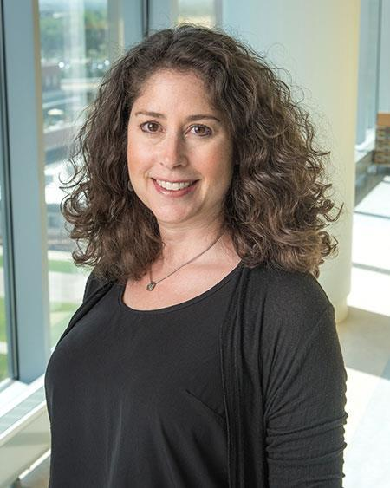
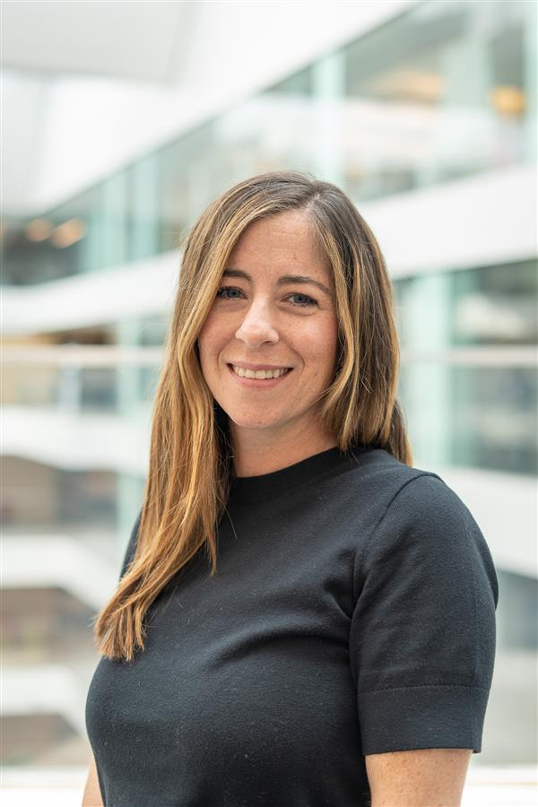
Next Steps
Present Survey Results to DOP
Data sharing with divisions/team and listening sessions (Liz/Emily), action steps identified
Begin implementation of action plan using established quality and process improvement methods
April
June
March 2026
April-May
July
Psychiatry
Analyze open-ended responses for themes
Develop action plan and present to CU Thrive and DOP
elizabeth.chamberlain@cuanschutz.edu
emily.muther@childrenscolorado.org
Notes:
15

Slide 16
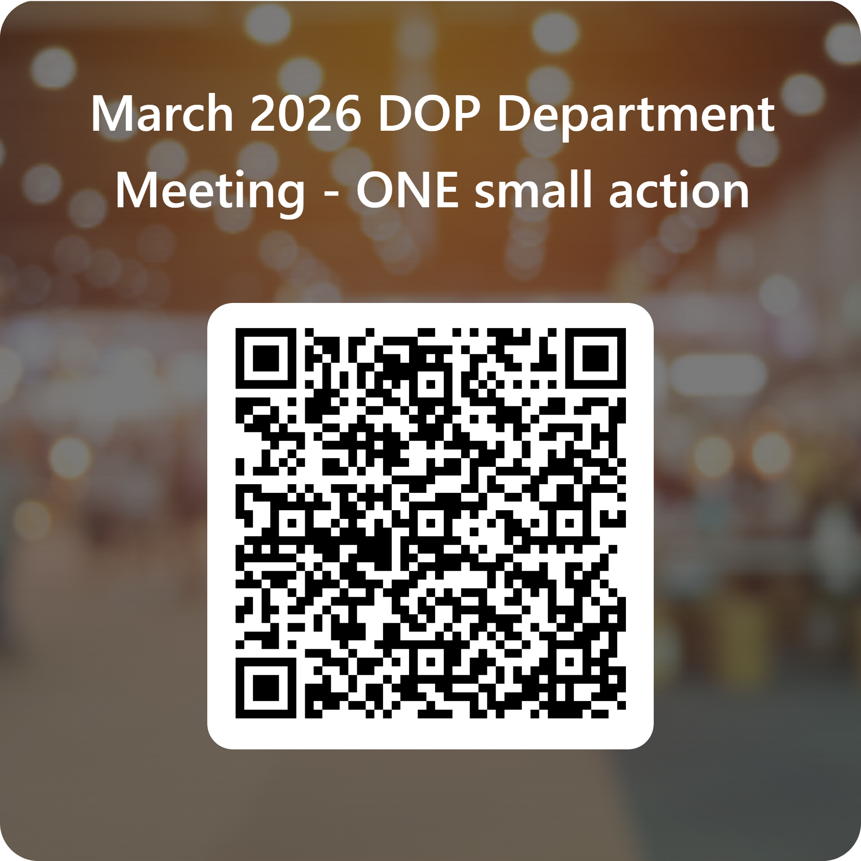
Breakout Groups
Questions, thoughts, reactions?
Based on this data, what is one small action you would implement for Psychologists?
  Think of a manageable, small project
  Examples:
    Scheduling 1x/month team lunch
    Schedule Abridge or other EPIC learning session quarterly in team meeting
    Create an accomplishment box for teams to fill and leaders to select, provide 1:1 verbal praise
    Creating a team agreement with wellness/mh/admin day rotation schedule
    Create space rotation schedule?
Psychiatry
Notes:
16

