Slide 1
Office of Psychological Science and Practice
All Psychologists Meeting: Mar 16, 2026

Slide 2
WELCOME!
Agenda
Welcome new faculty
Announcements
Joe Schacht: Cannabis Project Presentation
Liz Chamberlain: Psychology Wellness survey results

Slide 3
Welcome New Psychology Faculty!
Anika Guha, PhD (9/1/2025)
  Research Associate, APT
Lisa Horowitz, PhD (9/1/2025)
  Visiting Professor, CAMH
Marie Rodrigues, PhD (11/1/2025)
  Instructor, Adult
Megan Weishaar, PhD (11/1/2025)
  Assistant Professor, Adult
Kara Belfer, PhD (12/1/2025)
  Instructor
Emma Lecarie, PhD (12/1/2025)
  Assistant Professor, CAMH
Amy Patinella, PsyD (12/1/2025)
  Instructor, CAMH
Shannon Savell, PhD (12/1/2025)
  Assistant Professor, CAMH
Lauren Stone, PhD (12/1/2025)
  Instructor
Jaspreet Shahi, PsyD (12/1/2025)
  Instructor, CAMH
Leonora "Nori" Ryland, PsyD (12/1/2025)
  Instructor

Slide 4
Welcome New Psychology Faculty!
Natalie Finn, PhD (1/1/2026)
  Instructor, CAMH
Danielle Swales, PhD (2/1/2026)
  Assistant Professor, CAMH
Tess Simpson, PhD (2/17/2026)
  Associate Professor, CAMH

Slide 5

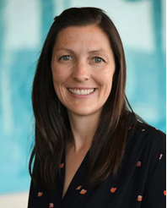
Kudos and Announcements
https://www.uchealth.org/today/care-trial-reducing-fear-improving-mental-health-outcomes-high-risk-pregnancy/

Slide 6
Conger Lecture

Slide 7
U.S. News & World Report’s Best Hospitals Expert Opinion Survey
What: USNWR voting of top children’s hospitals
Who: Psychologists (and physicians) with clinical child/adolescent specialty focus
When: Now through March 27th
Where: Doximity account
Why: Grow our visibility, expand donor interest, recruit top talent, drive improvements in clinical care

Slide 8
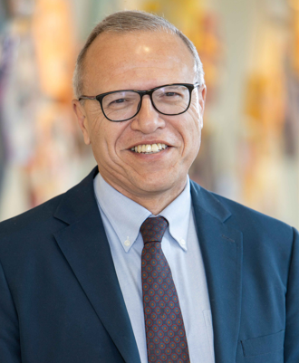
SAVE THE DATE
Zimet Lectureship
Bruno J. Anthony, PhD
June 9, 2026
June 10, 2026

Slide 9
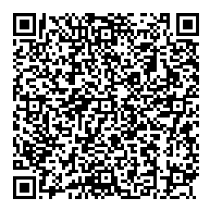
We want your feedback!
Scan the QR code to access a survey re: the OPSP All Psychologists meeting
OPSP Intranet Page
https://olucdenver.sharepoint.com/sites/Psychiatry/SitePages/OPSP.aspx
OPSP website
https://medschool.cuanschutz.edu/psychiatry/offices/office-of-psychological-science-and-practice-main

Slide 14
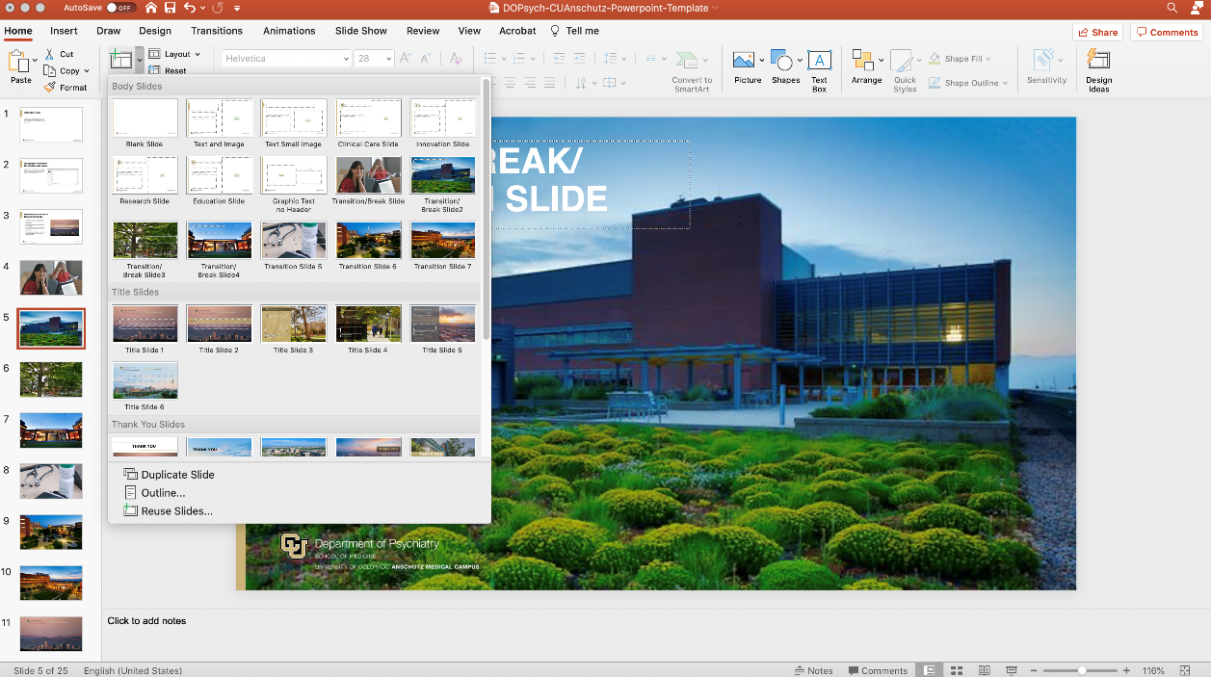
Adding New Slides to Your Presentation:
Navigate to the drop-down arrow next to the New Slide button on the Home ribbon. Then select from the assortment of title, body, and ends slides.

Slide 21
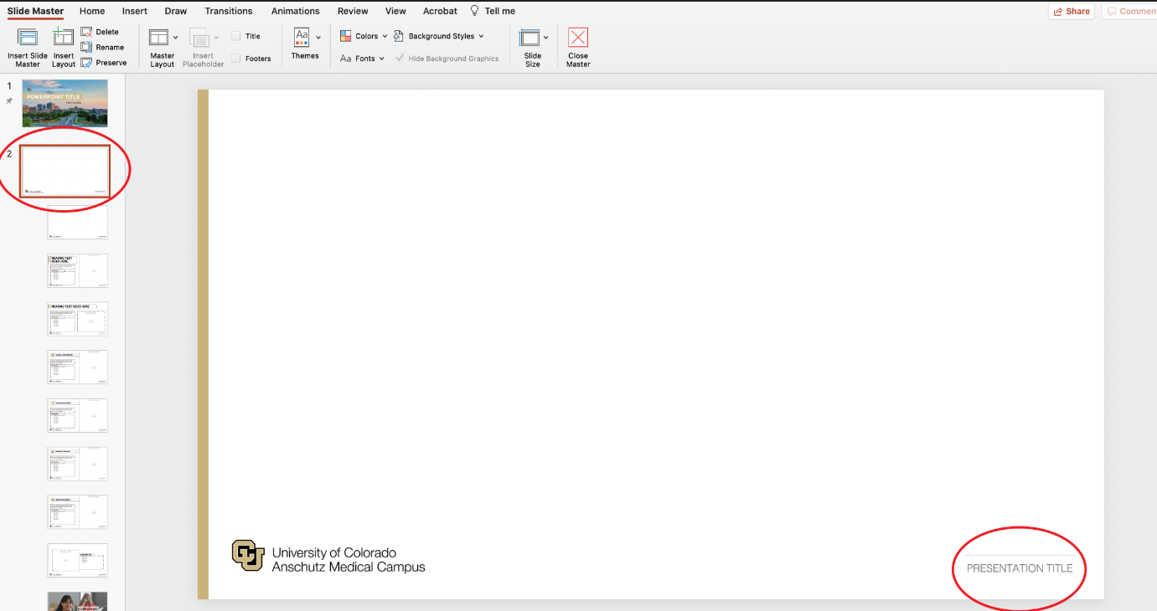
Changing the presentation title in bottom right corner:
Navigate to the master slide (View > Master). Select the parent master and click on the title to edit. It should then change on all slides when you exit out of the master.

Slide 25

Presentation Guidelines for Branding and Design:
At minimum always include a title slide, thank you slide, and end slide with your presentation.
For the title slide, keep the presentation title in all caps.
The End slide must go last to reinforce our brand’s logo and the ”Brain health for all, for life” motto.
Please keep all text boxes on all slides in the original positions for alignment and design purposes.

Slide 26
ICONS TO USE
Notes:
TIP: Once you have copy and pasted the icons you like onto your presentation slides, you may delete this page out of your presentation.

