Slide 1
What can systems thinking and methods teach us about community health?
The case of COVID-19
Dave Zelinka, PhD, EIT
Mortenson Center for Global Engineering

Slide 2
a bit about me
education
BS environmental and ecological engineering (Purdue University)
MS environmental and sustainability engineering (CU Denver)
MS global engineering (CU Boulder)
PhD civil systems engineering (CU Boulder)
research and work
Sustainable Development Goals (SDGs) & the nexus approach
complex systems focusing in system dynamics
applied complexity science
bridging disciplines through systems thinking
sustainable development, conflict, corruption, & transboundary issues
life-cycle analysis & anthropogenic metabolism
qualitative system dynamics and grounded theory
data science & deep learning (new)
renewable energy and climate change

Slide 3
contents
one | THE EVOLUTION OF SCIENTIFIC PHILOSOPHY
two | SYSTEMS THINKING
three | COMPLEX SYSTEMS SCIENCE
four | SYSTEM DYNAMICS OF COVID-19

Slide 4
| one |
THE EVOLUTION OF SCIENTIFIC PHILOSOPHY

Slide 5
the three eras of thought and scientific philosophy
science is guided by the prevailing worldview held by scientists of the time
Eurocentric, but generally global
1.0 natural philosophy
organic, natural, & spiritual worldview
before 1500 in Middle Ages
Aristotle, Thomas Aquinas, the Church
1.5 paradigm shift
1500-1700 | the Renaissance and the Scientific Revolution
Leonardo da Vinci, Nicolaus Copernicus, Johannes Kepler, Galileo Galilei, & Isaac Newton
2.0 mechanistic reductionism
universe viewed as a machine that is reduced to manageable parts
1500-present-future | Modern Era
Rene Descartes ruined it for all of us
2.5 paradigm addition
1900-present-future
emergence of wicked problems
3.0 systems thinking
emphasis on the whole & interconnections among parts
varied perspectives and disciplines
1950-present-future | Contemporary Era

Slide 6
Greek philosophy
order of the universe was that of a living organism not a machine
PLACE IN THE UNIVERSE
subordination of the individual to the needs of the community
all parts had a purpose that contributed to the harmonious functioning of the whole
world viewed as an ordered & harmonious structure (kosmos) with concentric circles containing various aspects of our universe with Earth at its center (heliocentrism)
kosmos also means a system of thought
science does not exist only philosophy & thinking
THE IDEA OF THE SOUL
early Greek philosophers thought that the soul was the source of movement and life (quality > quantity)
individual soul was thought to make up the force (not that Force) of the universe
life was characterized by interdependence of material and spiritual concerns
RELATIONSHIP WITH NATURE
people lived in small, cohesive communities and were close to nature
humans are part of nature, not separate from it

Slide 7
medieval European pre-science
Aristotle (4th century BC)
first philosopher to systematically write about the main branches of learning
synthesized and organized scientific knowledge
foundation of Western science
The Church
the spiritual and organic worldview naturally lent (pun intended) it to religious authority
Christian medieval philosophy derived from Christian theology not Aristotle’s work
Greek philosophy was largely forgotten in Western Europe
unlike Arabic academics who translated and examined Greek philosophical texts (e.g., algebra)
practice of combining philosophy (broadly defined) with theology became known as scholasticism
Thomas Aquinas (1225-1274)
taught that there was no conflict between faith and reason: the Bible and book of nature were both written by God
leading figure merging Christian teachings with Aristotle's Greek philosophy
fun fact: the Big Bang Theory was theorized by a theologian

Slide 8
pre-science in the Renaissance
Greek philosophy and classical texts were rediscovered paving the way for the emergence of rationality and modern scientific thought
Leonardo da Vinci (1452-1519)
developed a new empirical approach about the systematic observation of nature, reasoning, and mathematics; main characteristics of the scientific method
different than the quantitative, mechanistic approach of modern science
qualitative approach focusing on the visual, artistic, and natural
his work was lost during the time of modern science was formed, so no effect
saw nature as a mentor and model for science & engineering not a way to dominate it
rediscovering da Vinci’s approach: biophilia, sustainability, ecology, etc.

Slide 9
Scientific Revolution
other qualitative properties were merely subjective and not useful for because they could not be measured or quantified
“Galileo’s program offers us a dead world: Out go sight, sound, taste, touch, and smell, and along with them have since gone esthetic and ethical sensibility, values, quality, soul, consciousness, spirit. Experience as such is cast out of the realm of scientific discourse, Hardly anything has changed our world more during the past four hundred years than Galileo's audacious program. We had to destroy the world in theory before we could destroy it in practice.”
psychiatrist, R.D. Laing
Nicolaus Copernicus (1473-1543)
heliocentrism (On the Revolution of Celestial Spheres)
started to separate religion from science
and therefore, natural view of the cosmos
Johannes Kepler (1571-1630)
empirical laws of planetary motion
mechanistic, mathematical, & quantitative
Galileo Galilei (1564-1642)
like da Vinci, combined scientific experimentation with mathematics
goal was to describe nature quantitatively

Slide 10
Scientific Revolution: mechanistic reductionism
Francis Bacon (1596-1650)
formalized Galileo’s approach
focused on scientific experimentation, empiricism, & inductive reasoning
induction required studying the specific parts of nature; broad generalizations from specific observations
father of the Scientific Method
his writings shifted the worldview to the mechanistic universe
humankind should control & dominate nature

Slide 11
Scientific Revolution: mechanistic reductionism
Rene Descartes (1596-1650)
the anathema of systems thinkers
universe was a machine with no soul
caused detachment from nature
how did that affect the environment
universe inherently mathematical: language of nature is mathematics
science is synonymous with math
mathematics guided his philosophy

Slide 12
Scientific Revolution: mechanistic reductionism
Descartes created the analytical method: break up problems into manageable pieces and arrange them in a logical order
A Discourse on the Method of Correctly Conducting One’s Reason and Seeking Truth in the Sciences
scientific work but a philosophy classic - scientific approach to thinking
also, “I think therefore I am” and Cartesian coordinates (my third favorite coordinate system behind complex and polar)
“overemphasis on the Cartesian method has led to fragmentation that is characteristic of both our general thinking and our academic disciplines, and to the widespread attitude of reductionism in science - the belief that all aspects of complex phenomena can be understood by reducing them to their smallest constituent parts (Capra & Luisi, 2016).”

Slide 13
Scientific Revolution: mechanistic reductionism
Isaac Newton (1642-1727)
Descartes only outlined the concept
Newton finalized it
developed a grand synthesis of the works of the previous scientific philosophers
mathematical formulation of the mechanistic model of the universe
Mathematical Principles of Natural Philosophy
his work in calculus, optics, and the laws of motion and gravity made huge strides while quarantining himself to escape the Bubonic Plague of 1665/6 - Annus Mirabilis, or the “Year of Wonders’
etymology of science
skei from Proto-Indo-European: to cut, split
scire from Latin: to know; to separate one thing from another, to distinguish (probably)
also, “experiential knowledge” & “collective human knowledge”
used to be called philosophy in 16/17 cent.
definition gets more familiar after

Slide 14
| two |
SYSTEMS THINKING

Slide 15
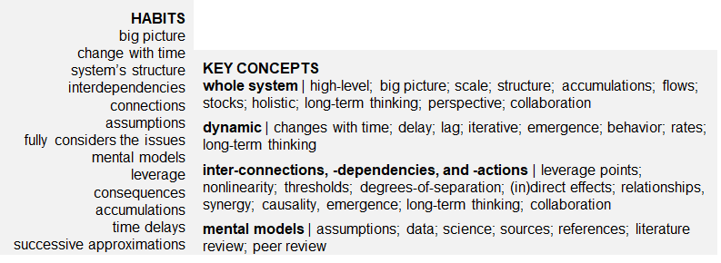
habits of system thinkers (Waters Foundation)

Slide 16
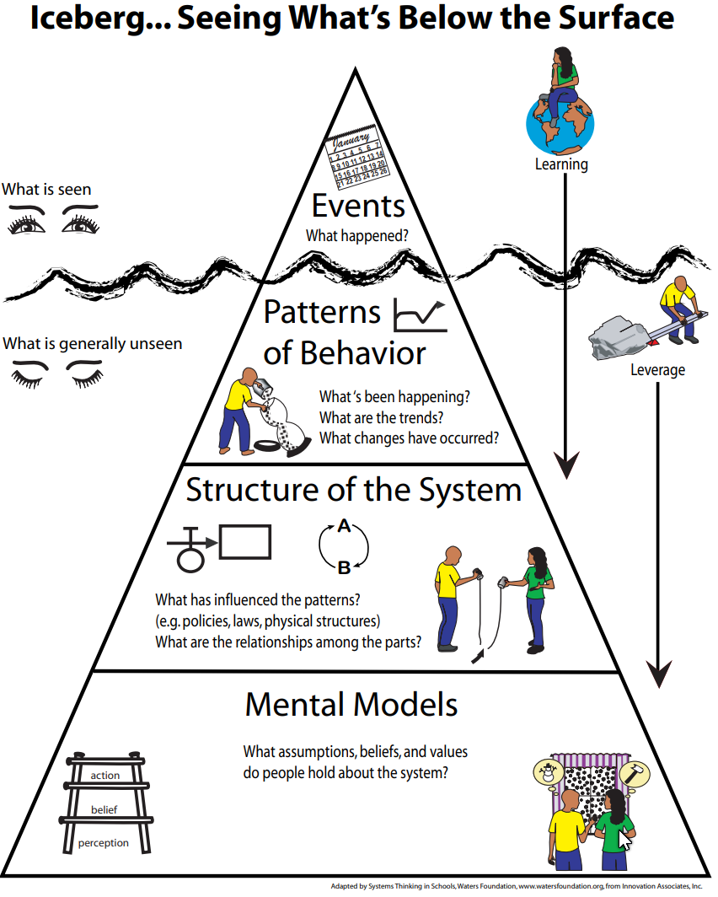
iceberg model
events are discrete events and markers in time
patterns are changes in variables and related events over time
a system’s structure are the rules that dictate how the system operates; usually implied determined by patterns
mental models are a person’s assumptions, attitudes, behavior, values, and so on that influence how they interact with a system (their rules)
even deeper are the prevailing social norms, culture, and shared history that influences how mental models form of a group

Slide 17
system archetypes
common & recurring patterns of behavior
SHIFTING THE BURDEN: addresses the symptoms but not the underlying cause; instant gratification reduces the short-term pressure; problematic especially because of election cycles to make their constituency happy
ESCALATION: two parties view (or are) threats to each other; they grow increasingly competitive with one another; arms races, sports teams rivalry, conflict, Apple vs Google
TRAGEDY OF THE COMMONS: when a resource (usually without a substitute) is used its quality and quantity decreases; its costs increases making it more profitable, but causes its depletion; occurs when the markets fail to manage common goods in the interest of the community

Slide 18
system archetypes
SUCCESS TO THE SUCCESSFUL: the rich get richer, and the poor get poorer; human population; under resource scarcity, one sector becomes the focus of resources, while others suffer; inequality is an outcome; developed versus developing countries
GROWTH AND UNDERINVESTMENT: spurts of growth are followed by periods of little or no growth; a tech startup
LIMITS TO GROWTH: populations under a carrying capacity; S-shaped growth; related to the CHANGE-OF-STATE archetype
LIMITS TO SUCCESS: law of diminishing returns; productivity of a systems decreases as the output or overall complexity increases

Slide 19
system archetypes
FIXES THAT FAIL: hastily making a solution that doesn’t address the root problem; short-sightedness; lack important information to understand the problem
ACCIDENTAL ADVERSARIES: a mutually beneficial partnership stops being so because of an insignificant event sustained over time; one party will take action that undermines the other creating tension over time; two roommates that don’t address seemingly small issues
DRIFTING/CONFLICTING GOALS: discrepancy between perceived state and the actual state due to mis- or dis-information; past information is used to make future projections; goals must be changed to meet the current state of the system; delays occur in changing goals; think lag time for making policies; climate change

Slide 20
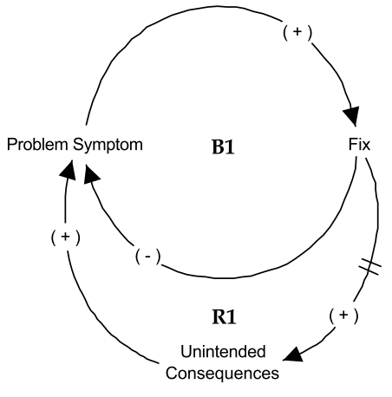
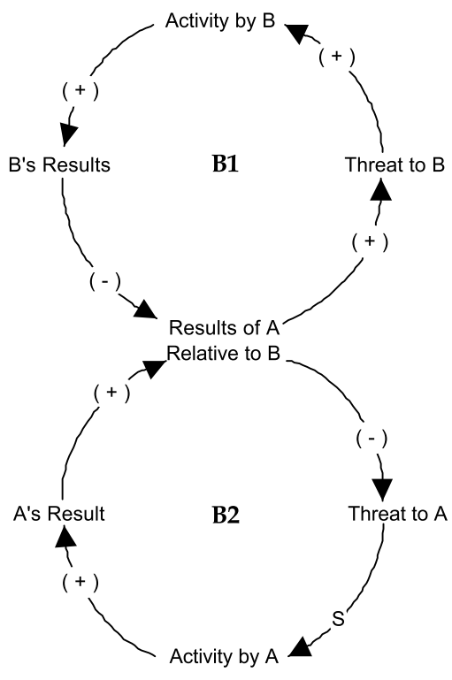
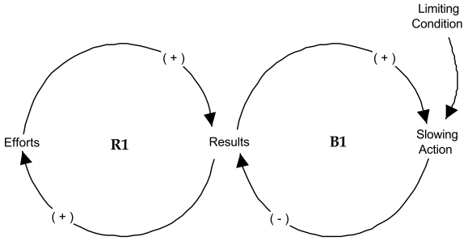
causal-loop diagram
success to successful (left) fixes that fail (right)
limits to growth (bottom)

Slide 21
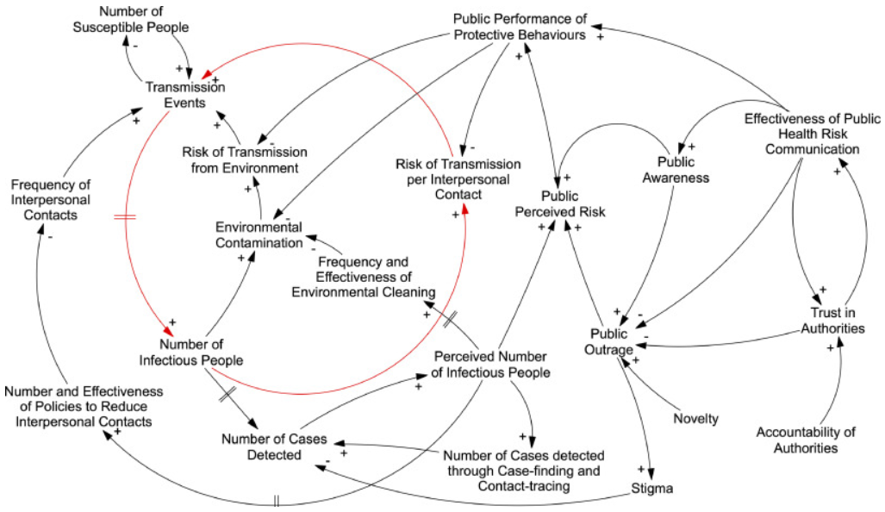
causal-loop diagram
Bradley, D. T., Mansouri, M. A., Kee, F., & Garcia, L. M. T. (2020). A systems approach to preventing and responding to COVID-19. EClinicalMedicine, 21:100325

Slide 22
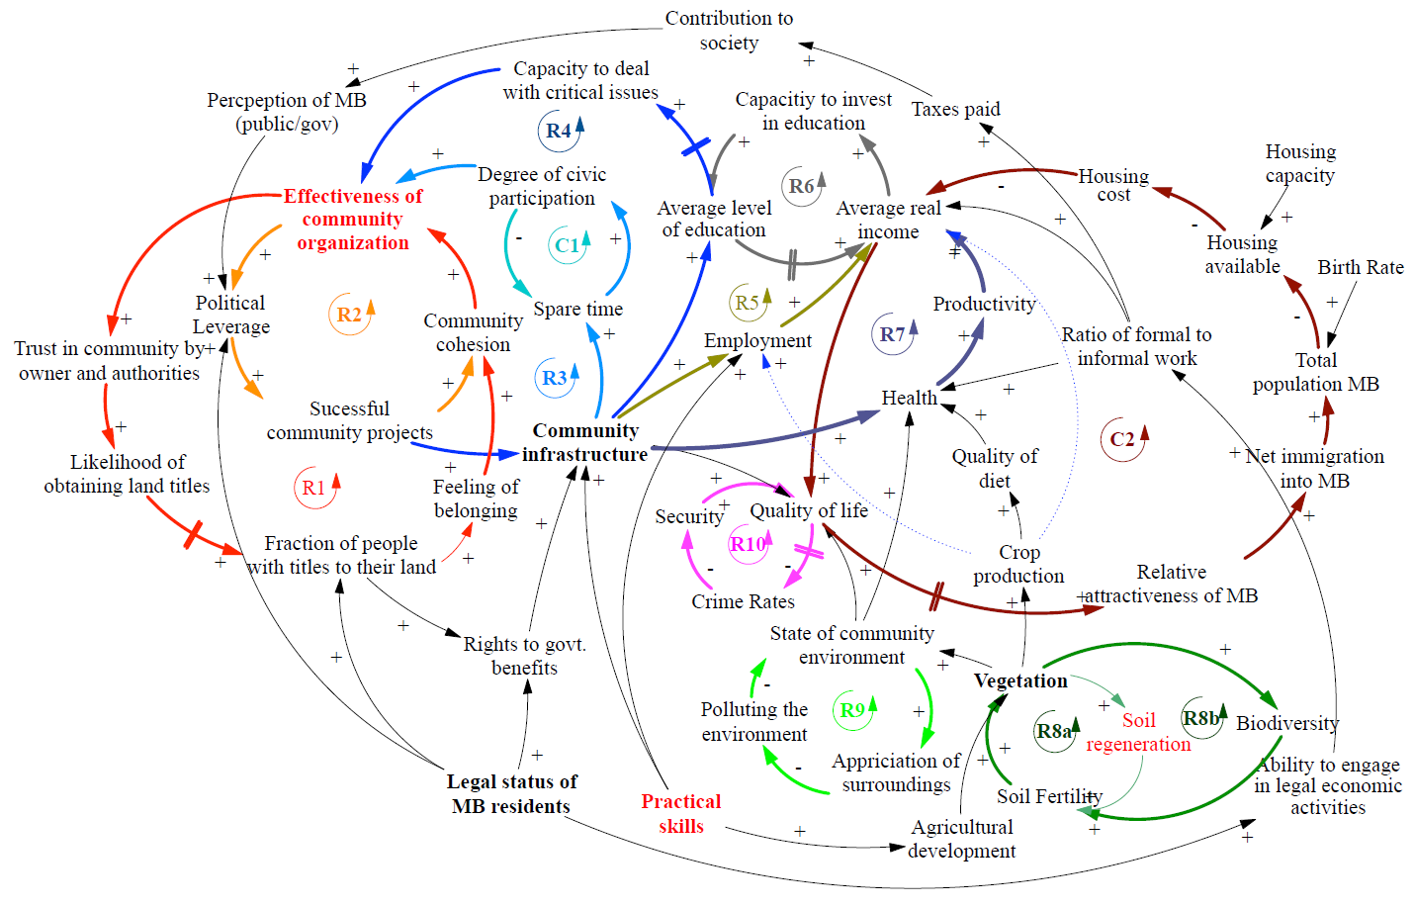
causal-loop diagram
https://www.colorado.edu/center/mortenson/sites/default/files/attached-files/gsf_mb_master_5.pdf

Slide 23
| three |
COMPLEX SYSTEMS SCIENCE

Slide 24
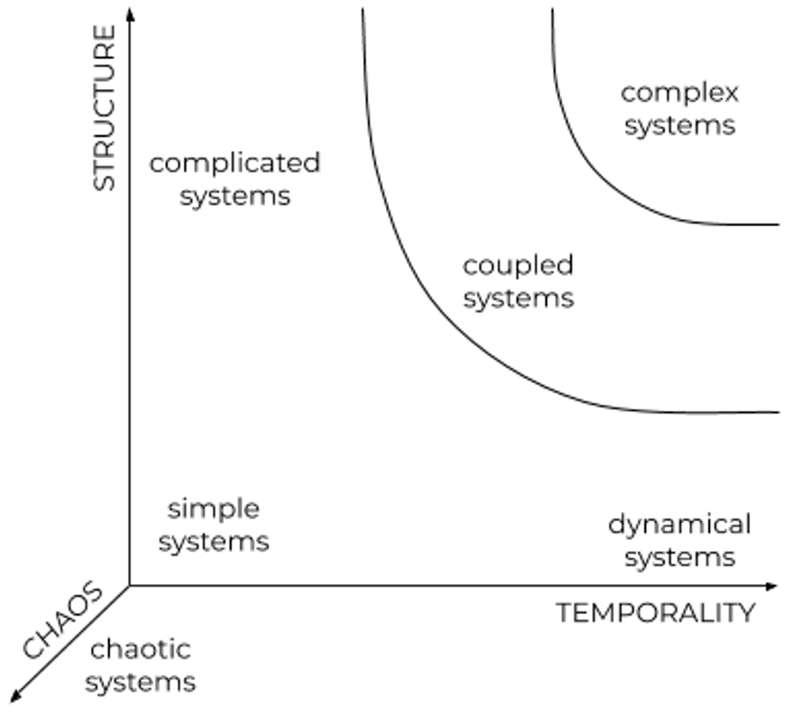
dimensionality of systems
structure
as elements increase the interconnections increase much faster
hierarchy (horizontal and vertical)
spatial scale (levels)
temporality
time becomes an increasingly influential
temporal-scale (short-, medium-, & long-term)
chaos
general randomness and unpredictability
deterministic
stochastic

Slide 25
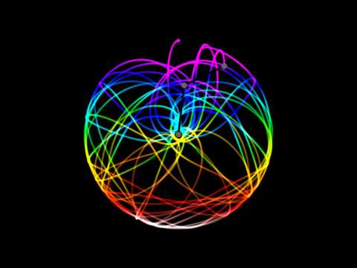
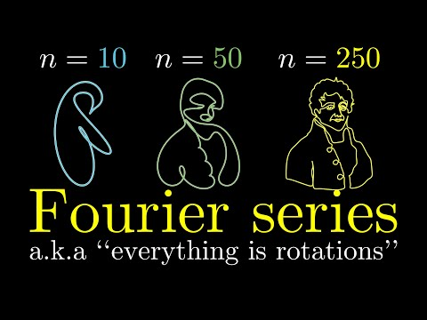
deterministic chaos
when an equation generates random and aperiodic behavior, e.g., the logistics equation
chaos from order order from chaos

Slide 26
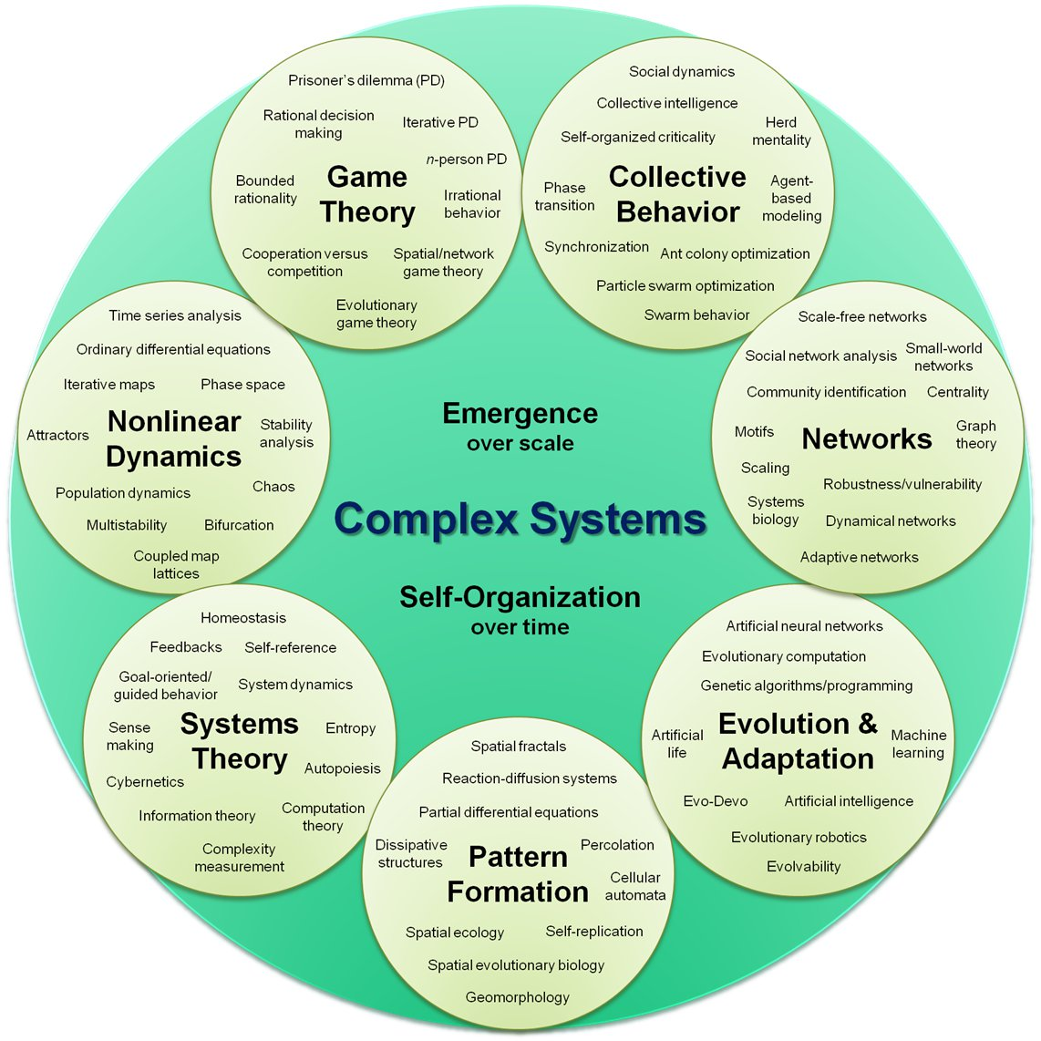

Slide 27
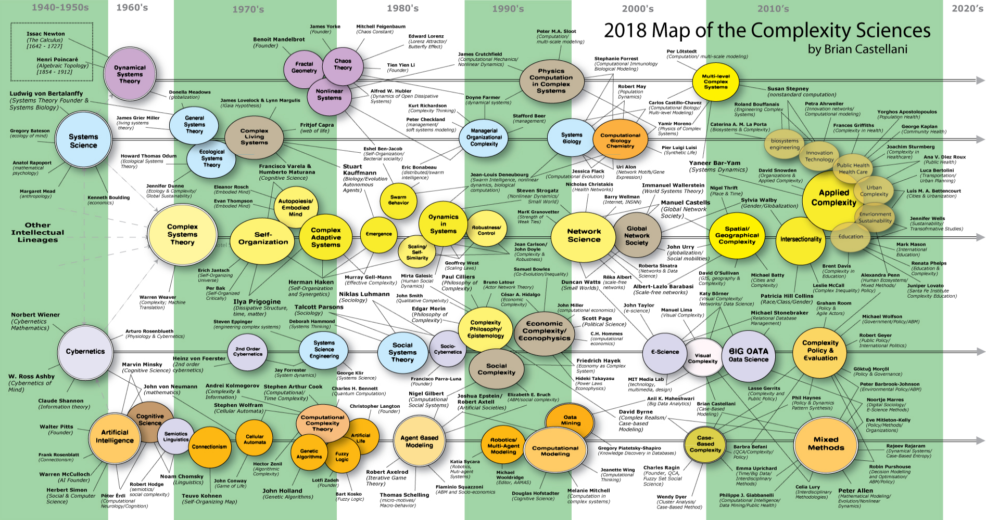
https://www.art-sciencefactory.com/complexity-map_feb09.html

Slide 28
| four |
SYSTEM DYNAMICS & COVID-19:
METACONCEPT OF DIFFUSION

Slide 29
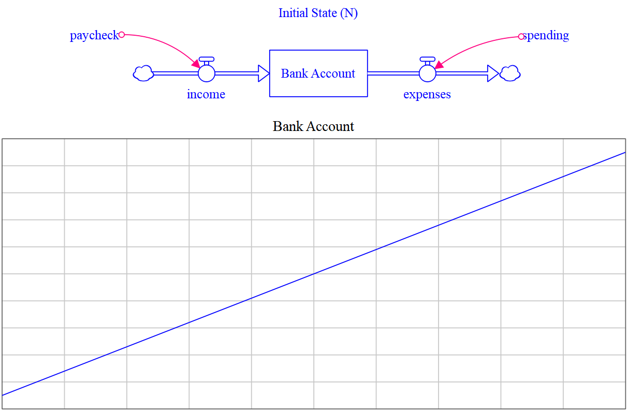
linear system

Slide 30
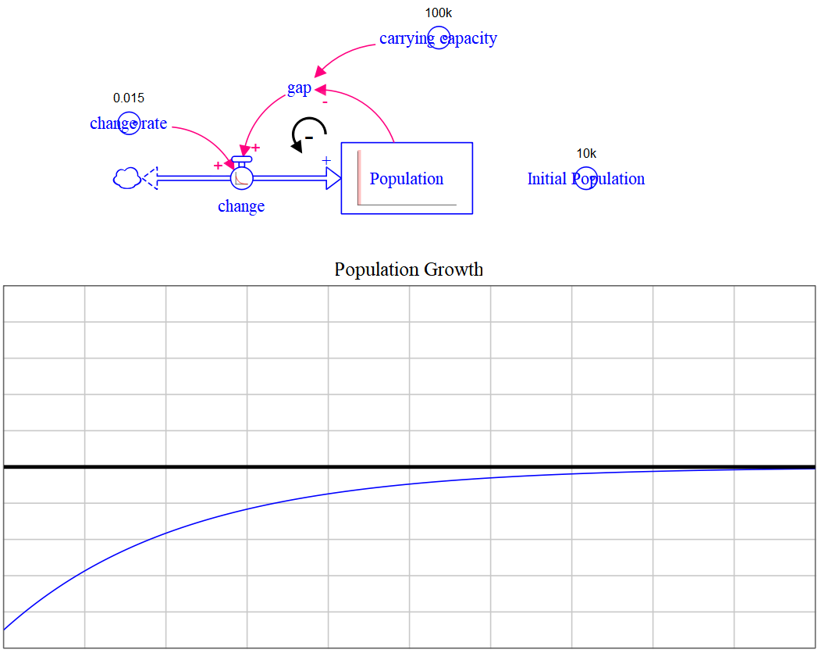
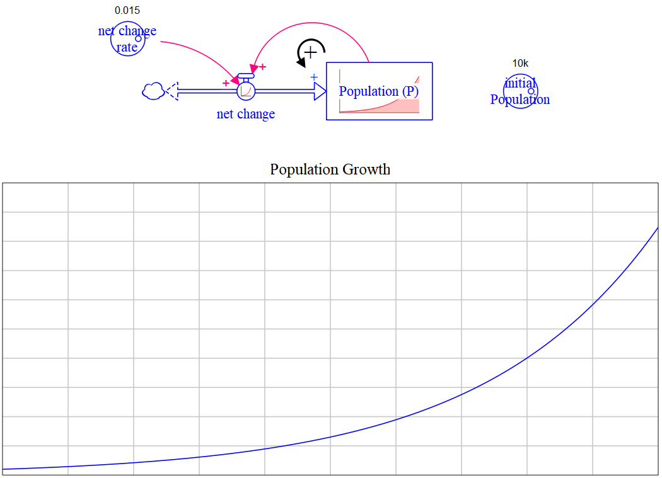
reinforcing feedback
exponential growth/decay
balancing feedback
goal-seeking

Slide 31
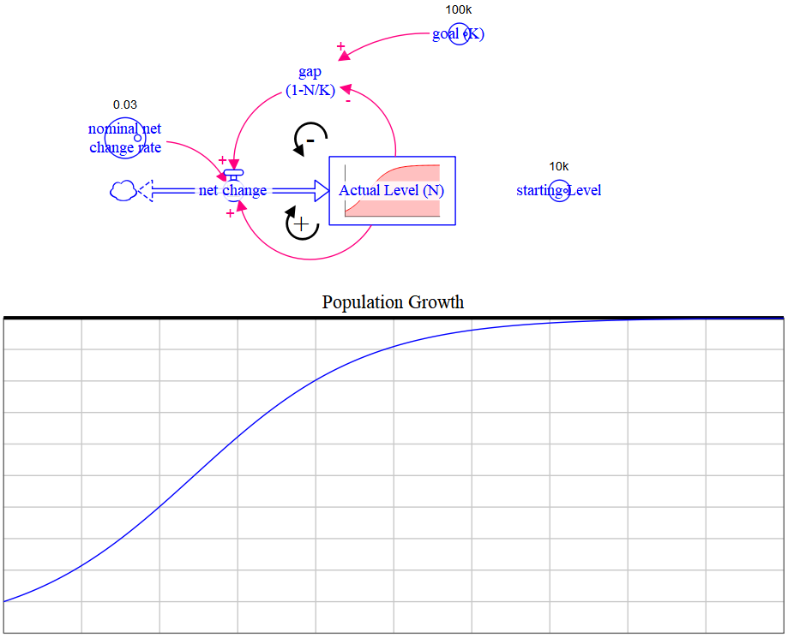

Slide 32
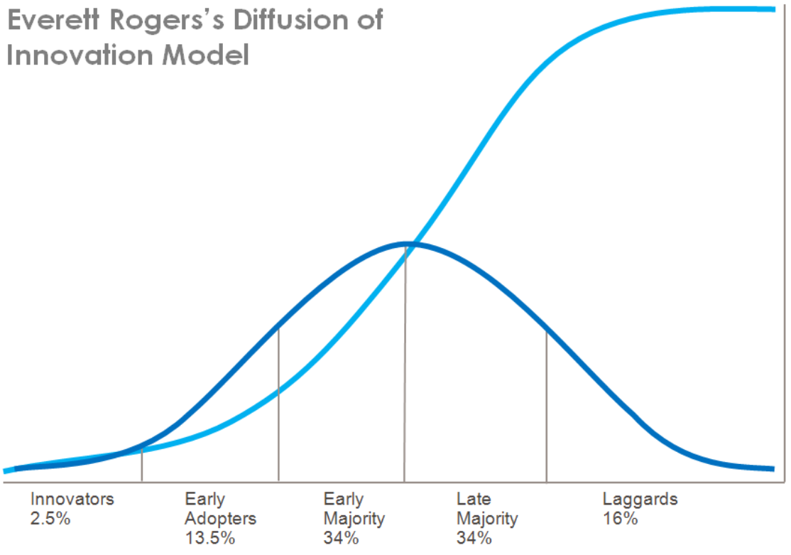
diffusion: adoption of new technologies and ideas
Bass Diffusion Model

Slide 33
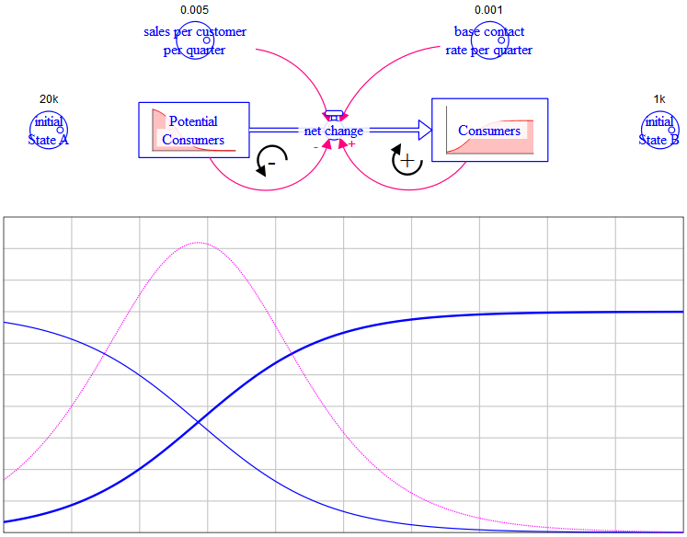
Bass diffusion model

Slide 34
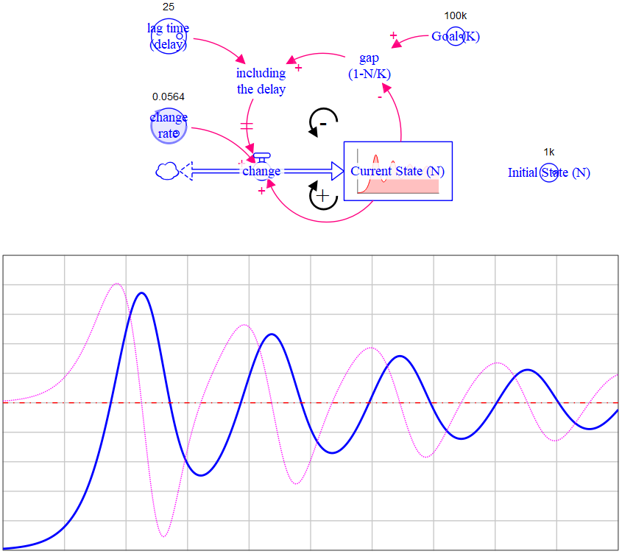
oscillations

Slide 35
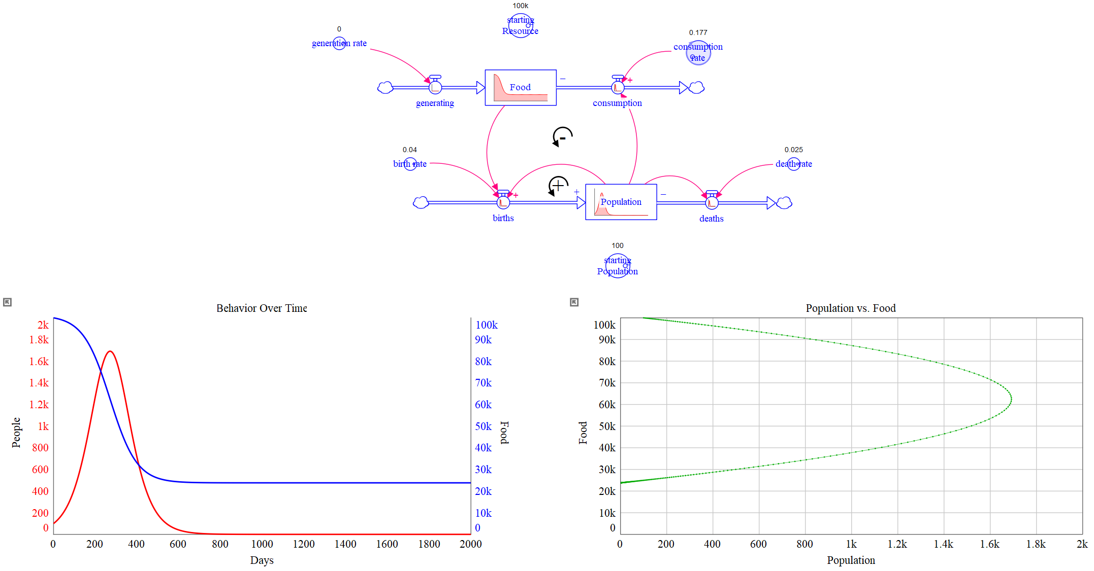
limits to growth archetype

Slide 36
population dynamics

Slide 37
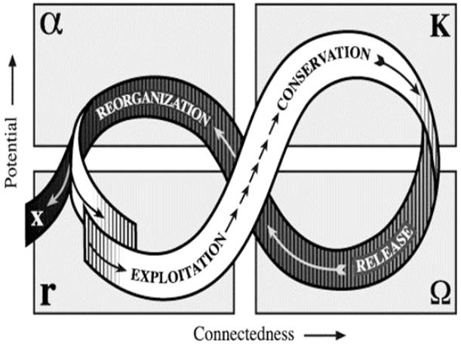
complex adaptive system
ecological dynamics (succession theory) perspective but general for all CAS
first phase (foreloop): slow, incremental growth and accumulation
growth or exploitation (r)
conservation (K)
second phase (backloop): rapid reorganization and eventual renewal
collapse or release (omega)
reorganization (alpha)
business & economic cycles, war and post-war reconstruction, viral outbreaks, among many other examples
https://www.resalliance.org/adaptive-cycle

Slide 38
live coronavirus tracker

Slide 39
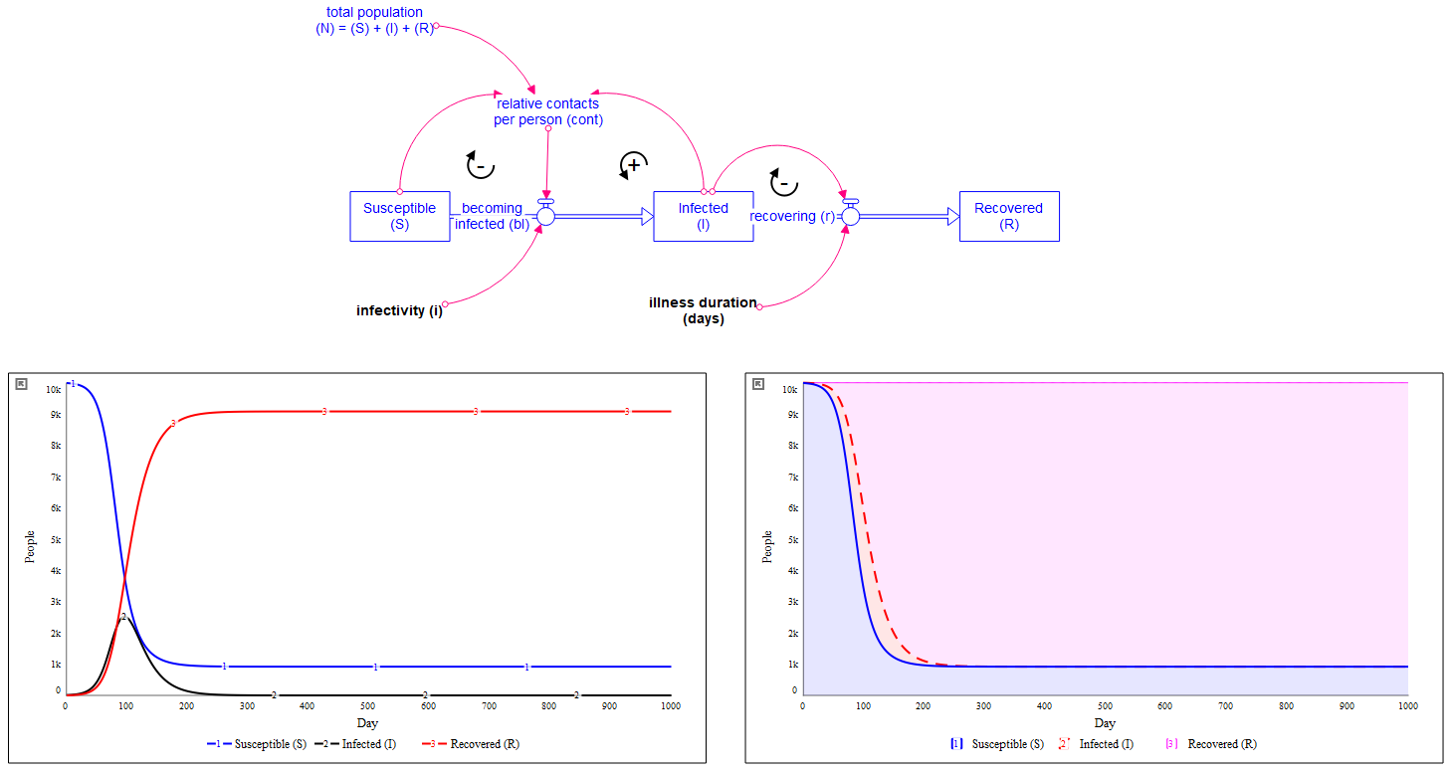
viruses as complex adaptive systems, SIR model

Slide 40
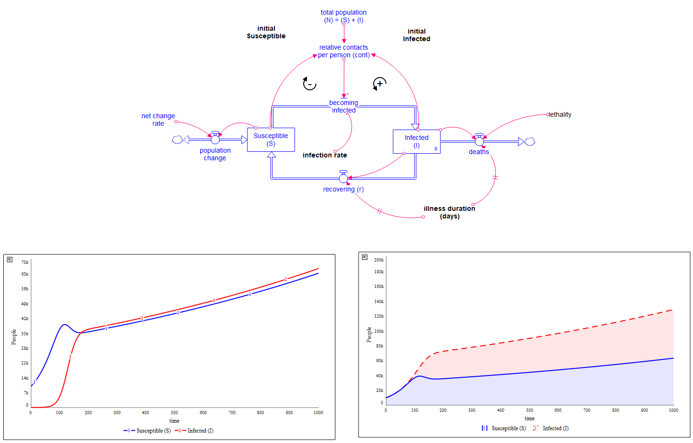
viruses as complex adaptive systems, Influenza

Slide 41
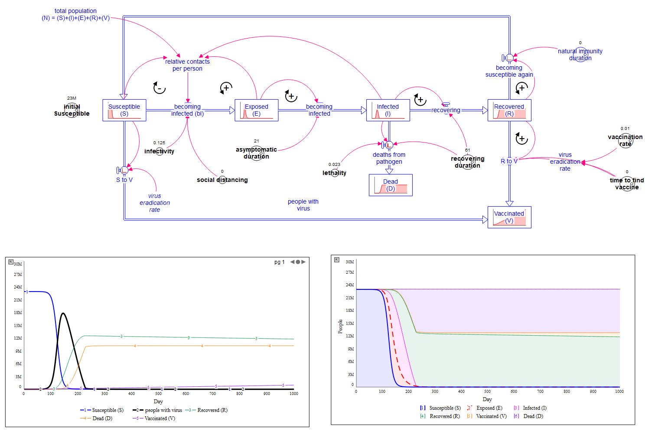
viruses as complex adaptive systems, COVID19

Slide 42
stuff, things, and links
System Dynamics Society (COVID-19 page)
Viruses as Complex Adaptive Systems (2019) by Richard Sole & Santiago F Elena
agent-based modeling approach to COVID-19 (video)
Thinking in Systems (2008) by Donella H Meadows
The Systems View of Life (2014) by Fritjof Capra & Pier Luigi Luisi
Business Dynamics (2000) by John Sterman
Managing Complexity in Social Systems (2019) by Christoph E Mandl

Slide 43
oh, there’s more
Braun, W. (2002). The System Archetypes
Sante Fe Institute
logistic equation, chaos, and fractals in the real-world (video)
Complexity: A Guided Tour (2009) by Melanie Mitchell
Chaos and Dynamical Systems (2019) by David P Feldman
Walker, B. & Salt, D. (2012). Resilience Practice: Building Capacity to Absorb Disturbance and Maintain Function. Island Press.
Sole, R. V. (2011). Phase Transitions. Princeton University Press.

Slide 44
questions

