Slide 1
Screening, Brief Intervention, and Referral to Treatment (SBIRT): What’s happening on the High Plains?
Linda Zittleman, msph
University of Colorado dept of family medicine
High plains research network co-director
Notes:
Co-Director for the HPRN. HPRN is based at the Univ of CO, DFM. It works with primary care practices and communities in rural eastern Colorado. I’m happy to talk with you today about what’s happening on the High Plains around SBIRT.

Slide 2
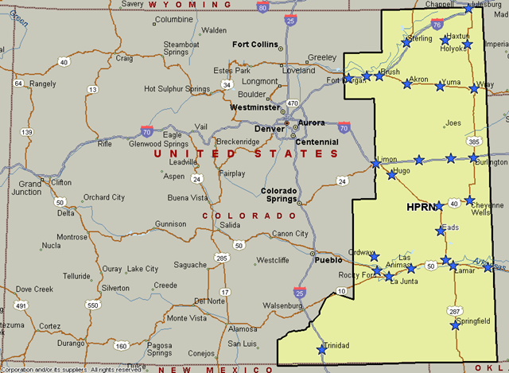
Established 1997
16 counties of eastern rural and frontier Colorado
54 primary care practices
16 hospitals
30,000 sq. miles
150,000 people
Colorado
Notes:
Thank you. I’m the co-Director for the High Plains Research Network, which is based in the Dept of Family Medicine at the University of Colorado. That’s where my office is, but most of the work we do takes places in the 16 counties of eastern Colorado.

Slide 3
What is SBIRT?
Screening: Using validated questions
Brief Intervention: Brief conversation to enhance motivation to change
Referral to Treatment: Assessment and services for the person with a more severe alcohol or drug use problem
Peer Assistance Services, Inc.
Notes:
Like hypertension or depression screening, SBIRT is a preventive service that provides the opportunity for earlier intervention to address a problem that otherwise may be missed.
Step one is to screen using validated questions to ask about alcohol, marijuana, nonmedical use of prescription medications and other drug use to identify an individual’s level of risk.
Step two is to engage in a brief motivational conversation with the patient about substance use, and together, identify ways to reduce their risk;
Step three only applies to those with a more serious problem. It involves arranging further assessment, treatment services and ongoing follow-up.
Based on prevalence of alcohol and drug use in the general population, we anticipate that the most commonly identified need will be for a brief intervention – the 25% of the population described in the alcohol use pyramid. Far fewer will need a referral for more intensive services. Over time, as screening and brief intervention becomes routine, it should result in fewer people presenting with a more serious problem.
Evidence for SBIRT
The United States Preventive Services Task Force and Partnership for Prevention have endorsed Screening and Brief Intervention as an efficacious method for screening adults for risky or hazardous substance use. The USPSTF currently lists screening and brief intervention with a “B” rating for adults and an “I” rating for adolescents.
“B” rating by the USPSTF means that with high certainty SBI has demonstrated that net benefit is moderate or there is moderate certainty that the net benefit is moderate or substantial.
“I” rating by the USPSTF means that there is insufficient evidence to assess the balance of benefits to harms for SBI for adolescents at this time.
In summary: The Task Force found that clinicians should screen all adults for unhealthy alcohol use and offer brief counseling to those who drink above recommended limits. It also found that more research is needed to make a recommendation for adolescents.
There are no current recommendations at this time by the USPSTF or Partnership for Prevention for the “RT” component of SBIRT due to lack of adequate research of referral to treatment as a tertiary prevention strategy. However, RT is considered a best practice as a component of the SBIRT model.
Other major organizations that recommend SBIRT include the Centers for Disease Control (CDC), Veterans Administration (VA), American College of Surgeons (ACS), American Academy of Family Physicians (AAFP), and American Academy of Pediatrics (AAP), and the Substance Abuse and Mental Health Services Administration (SAMHSA)

Slide 4
The Focus of SBIRT
4%
25%
71%
Severe Alcohol Use Disorder
Brief Intervention + Referral to Treatment
Alcohol Misuse
Brief Intervention + Monitoring and Support
Low Risk Use or Abstention
Positive Reinforcement + Continued Screening
Adapted from SAMHSA
Alcohol use in the U.S. general population
adults age ≥ 21 years
Peer Assistance Services, Inc.
Notes:
When clinics initiate routine screening for alcohol use they are often concerned that they will identify a large number of patients who have a serious alcohol use disorder.
This pyramid illustrates overall patterns of alcohol use in the general population of adults in the United States.
Overall, about 71% of adults are low risk – which means they abstain from alcohol or they stay within the lower risk limits for healthy adults who are not pregnant or under age 21.
Approximately 25% of adults report drinking that would be considered in the moderate risk level. They are at risk for future problems or may already be experiencing some health or social problems related to alcohol but they do not have a severe alcohol use disorder. For these individuals the primary intervention is a brief motivational conversation to encourage them to cut back or, in some cases, quit drinking altogether. From a public health perspective, this 25% of the population accounts for the majority of the harmful consequences of alcohol use including injuries and chronic diseases, family violence and other family problems, decreased productivity in the workplace, and more ED visits and higher medical costs.
The tip of the pyramid represents about 4% of the population that has a severe alcohol use disorder and will typically need further assessment and some level of ongoing services to help them change their alcohol use. ** Make sure to consult the DSM V so we do not over/under diagnose.
-----------------------------------
Source: Substance Abuse and Mental Health Services Administration. (2006) Results from the 2005 National Survey on Drug Use and Health: National findings Rockville (MD): Office of Applied Studies

Slide 5
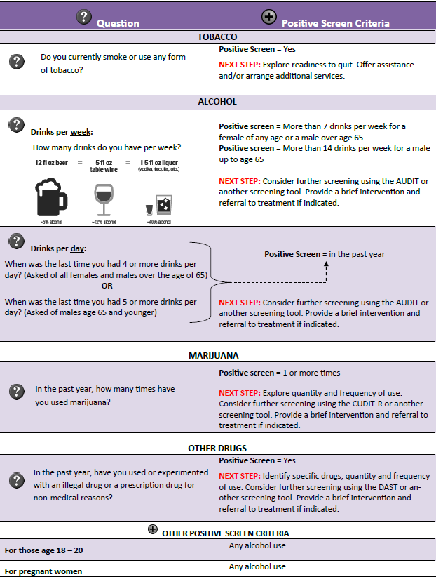
Screening:
Use validated questions exactly as worded
Self-administered preferred (paper or electronic forms the client fills out alone)
Two-step process
Brief screening
Further screening when brief screen positive
*Most efficient approach: brief screening = vital sign
“We ask everyone” sign
Peer Assistance Services, Inc.
Notes:
Key points on alcohol and drug use screening:
Use validated questions exactly as worded.
Questions can be self-administered by the patient or administered by a member of the health care team. Patients are often more comfortable with self-administered screening, they may report more accurately and it may be more time efficient.
A two-step screening process is often used starting with universal brief screening. This is followed by further screening only in the patients who have a positive brief screening result in order to further describe patterns of use and consequences of alcohol or drug use.
Key points for addressing stigma:
Routine, universal screening helps normalize conversations about alcohol and drug use.
When the health care team introduces the topic – the patient does not have to bring it up on their own. It sends a powerful message that alcohol and drug use is part of overall health. More than ten years of SBIRT work in Colorado demonstrated that patients overwhelmingly feel health professionals should address alcohol and drug use routinely.
Patients are more receptive to pursuing some sort of treatment or support for alcohol or drug use problems when their primary care team facilitates and coordinates the care.
Just as with other chronic conditions, motivation to change may need time – compassionate listening is key!
Continue to check in about the problem and assess readiness to change.

Slide 6
Brief Intervention: a conversation with a goal. Even one brief intervention can lead to change – especially for at-risk substance use. Multiple brief interventions are likely to be more effective and lead to change.
Brief Intervention:
Peer Assistance Services, Inc.
Notes:
A brief intervention is simply a short conversation between a health professional and patient to raise awareness about alcohol or other substance use health, and encourage change. The ideal outcome is when a person sets a goal to make a change now. The next best outcome is when a person agrees to keep the door open to consider that change may be a good idea in the future.
The brief intervention uses techniques of Motivational Interviewing to facilitate a constructive path through the challenges that get in the way of change.
Even one brief intervention can lead to change – especially for at-risk alcohol use. Multiple brief interventions are likely to be more effective and lead to change. Think of it like checking in about other health behaviors such as diet, medication adherence and physical activity as part of health promotion and chronic disease management.
1. The best outcome is to see the patient set goals and achieve change
2. The second best is agreeing to keep the door open for consideration of change in the future.

Slide 7
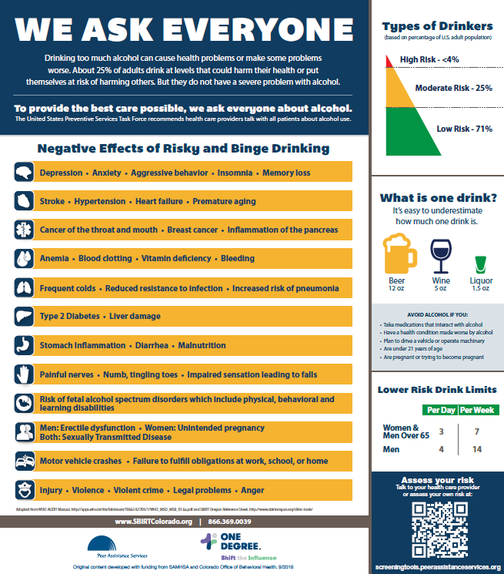
Treatment:
Only about 15% of people who meet criteria for a lifetime alcohol use disorder report receiving treatment
Fear of stigma is a common reason for not seeking treatment
Peer Assistance Services, Inc.
Notes:
In a nationally representative sample, only 14.6% of people meeting criteria for lifetime alcohol use disorders reported receiving any type of treatment. Factors related to stigma were common reasons people did not seek treatment (* Cohen et al, Drug and Alc Depend, 2007 and http://www.dpft.org/resources/NSDUHresults2007.pdf)
Other reasons people aged 12 or older who felt they needed but did not receive substance use treatment included:
They had no health coverage and could not afford the cost.
They were not ready to stop using alcohol or drugs.
They did not know where to go for treatment.
They felt they were able to handle the problem without treatment.
Key points for addressing stigma:
Routine, universal screening helps normalize conversations about alcohol and drug use.
When the health care team introduces the topic – the patient does not have to bring it up on their own. It sends a powerful message that alcohol and drug use is part of overall health. More than ten years of SBIRT work in Colorado demonstrated that patients overwhelmingly feel health professionals should address alcohol and drug use routinely.
Patients are more receptive to pursuing some sort of treatment or support for alcohol or drug use problems when their primary care team facilitates and coordinates the care.
Just as with other chronic conditions, motivation to change may need time – compassionate listening is key!
Continue to check in about the problem and assess readiness to change.
Photo Source: Connie Stock Photos

Slide 8
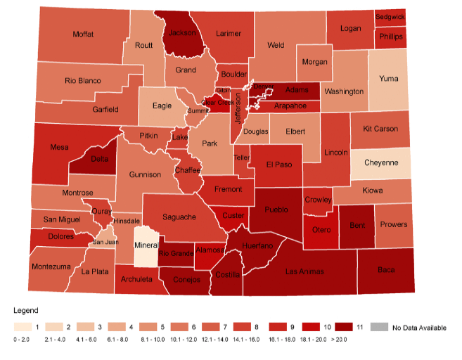
Why SBIRT now?
Partnership with Peer Assistance Services, Inc. and Signal Behavioral Health Network
PBRN infrastructure offers practices access to locally-based practice facilitators (NE, SE, and SLV regions)
Beneficial to IT MATTTRs practices working to deliver medication-assisted treatment (40 in region)
Great opportunity to support overall wellness in our rural communities
Colorado drug overdose death rates: 2014

Slide 9
Practice Participation
10 practices currently engaged
2 federally qualified health centers (6 practices)
2 hospital-based clinics
2 private practices
Recruiting 10 more practices over next three years

Slide 10
Screening
Starting Line:
Not screening
Screening but not using validated tool
Screening but not doing systematically in practice
Screening but not able to pull data from EHR
Successes:
Developing protocols, starting to screen
Switching from “Do you drink?” to using a validated tool (AUDIT, DAST-10)
Implementing protocols for screening: All patients or subgroup of patients? Every visit or wellness visits or other?
Finding a location in EHR to store and access data

Slide 11
Brief Intervention (BI)
Starting Line:
Successes:
No brief intervention occurring
Doing some BI somewhat regularly
Recognizing BI behavior (Hey, we are doing BIs!)
Learning motivational interviewing and other brief intervention techniques
Engaging behavioral health coaches, nursing staff, others in BI – not just clinicians

Slide 12
Referral to Treatment
Starting Line:
Successes:
Not screening, no referrals
Screening, no referral protocol
Referring everyone (skipping over BI)
Meeting with local behavioral health practices and/or substance use counselor to determine referral protocol
Actual referrals occurring!
Referrals made for those with most need for treatment

Slide 13
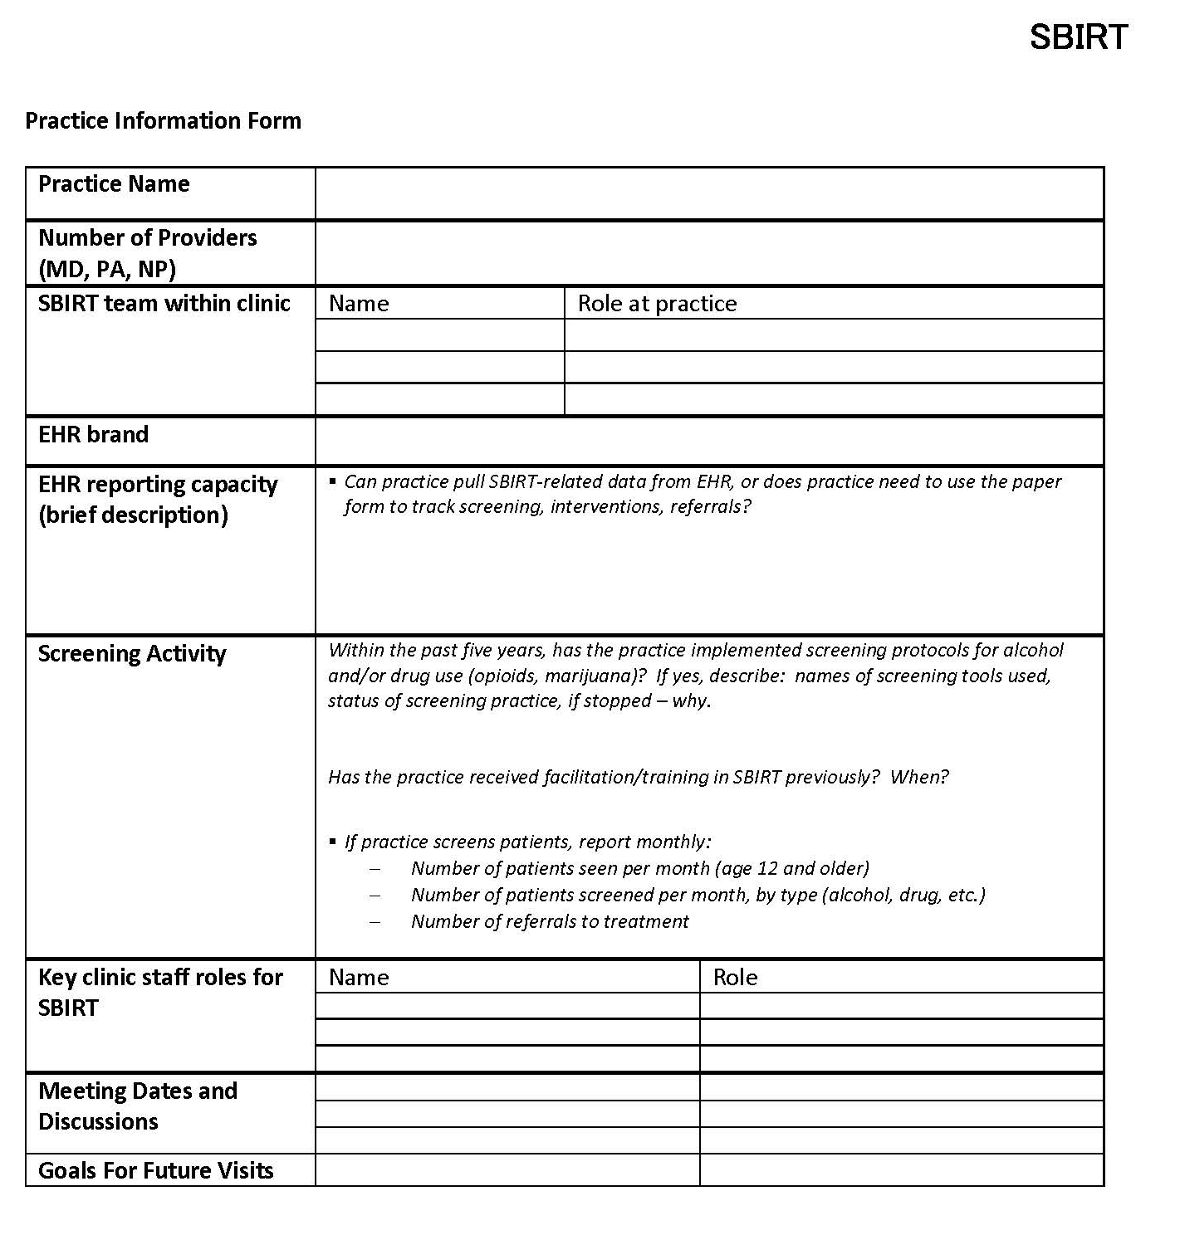
What’s Happening?
We are telling the story for each practice.
Demonstrate practice SBIRT behavior through monthly data reports.
“Every cup of tea” approach using the new Practice Information Form. (Recently adopted by Signal Behavioral Health for all SBIRT sites.)
Practices are having more of those potentially difficult conversations around topics very important to health…but so easy to avoid.
Aiming to work with 10 more practices!

Slide 14
Thank You!
Peer Assistance Services, Inc.
Signal Behavioral Health Network
HPRN and CaReNet Practices
Christin Sutter
Jen Ancona
Jay Brooke
Marlayna Martinez
Kristen Curcija
Email: linda.zittleman@cuanschutz.edu

