Slide 1
Levitt Lectureship
Where the Sidewalk Ends
and the Promise of Primary Care Begins
October 26, 2021
Prepared for the
Drs. Rebecca Etz and Kurt Stange

Slide 2
Innocence
Different ways of seeing and knowing
Graphic @amazon.com

Slide 3
The Punchline
Primary care grows well in the wild
Personal doctors are mission driven
Professionalism and generalism are foundational
This is good… and there is growth yet to come
Graphic @goodreads.com

Slide 4
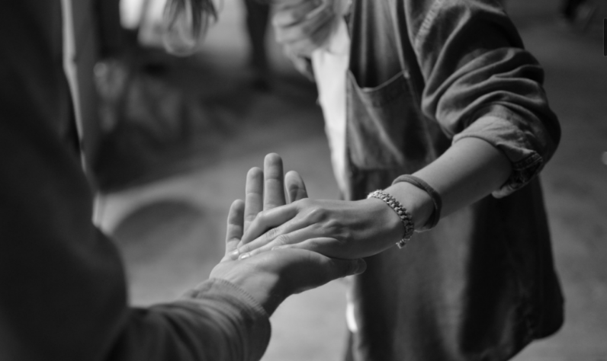
Unshakeable truths of primary care
Worthy of your trust
Safe to be vulnerable
Wholeness of your dignity
Patients come first
Societal investment in this basic good

Slide 5
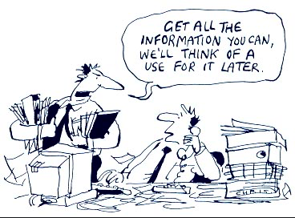
Timeframe: March 13, 2020 – present
~ 32,000 clinician surveys
~ 11,000 patient surveys
Funded by
AHRQ, Morris-Singer, Samueli
Typical Distributions (approx)
Sample size
~ 800, range 460-3131 (CO avg 40s)
50 states, (CA, CO, RI, NY, OR, WA, TX, VA, PA)
> 95% unique settings
Disciplines
70% family medicine
15% internal medicine
5% each pediatrics and geriatrics
Settings
20% rural, 15% CHCs, 5% each DPC/ofc/schools
40% each indept/system, 7% urgent/retail
Practice size
35% 1-3 clinicians, 35% 10+ clinicians
Graphic @devpolicy.org

Slide 6
What the survey told us: Practice strain like non-other
74%
40%
Notes:
Colorado n= avg # stress [WHAT NUMBER DO WE NEED HERE?]

Slide 7
What the survey told us: Shrinking capacity – practice member losses for many reasons
60%
10%
40%
25%
Notes:
Colorado= avg ? stress; [WHAT NUMBER DO WE NEED HERE?]

Slide 8
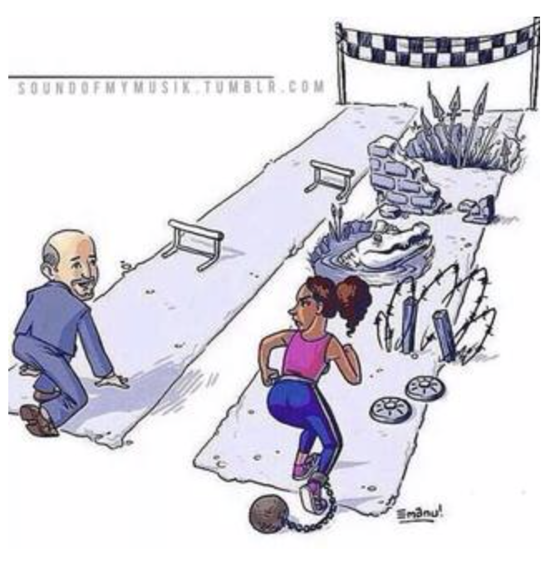
What the survey told us: FOR PATIENTS, inequities are growing …

Slide 9
What the survey told us: … and health is dropping.
Notes:
Patients come to primary care for everything, including when they don’t know where to go
Chronic conditions worse… series 31…now 56%... Eye and dental in the high 20s to low 30s
Limited access hospital and specialty care … low to mid 40s

Slide 10
Where the Wild Things Are
Graphic @goodreads.com

Slide 11
COVID patient volume
In Colorado
45% discovered great courage in their colleagues
And OR did more:
72% added TH for access/capacity
59% monitored COVID+ at home
51% added services to reduce system use
57% added help for social drivers of health

Slide 12
RELATIONSHIPS were key… “right care, right time, right place”
Clinicians said – it’s what I do
personalized, relational, integrated, equitable, compassionate
83%
Patients said – it’s the bedrock of my care
82% ... having someone I trust
76% … I can ask anything, medical or not
85% … helps me to make sense of things
79% … seeing them makes me feel better
Notes:
Help with vax hesitancy, diagnosis, misinformation, adherence to treatment

Slide 13
Telehealth grew helpful
70%
Video
Phone
Notes:
What TH was good for and not; shifted workflow; screen for TH literacy

Slide 14
From Here to Where? Gap analysis and investment in the future

Slide 15
Why was primary care so invisible?
99.8% respiratory illness
46% adult vaccinations
72% child vaccinations
Graphic @ wallpaperflare.com

Slide 16
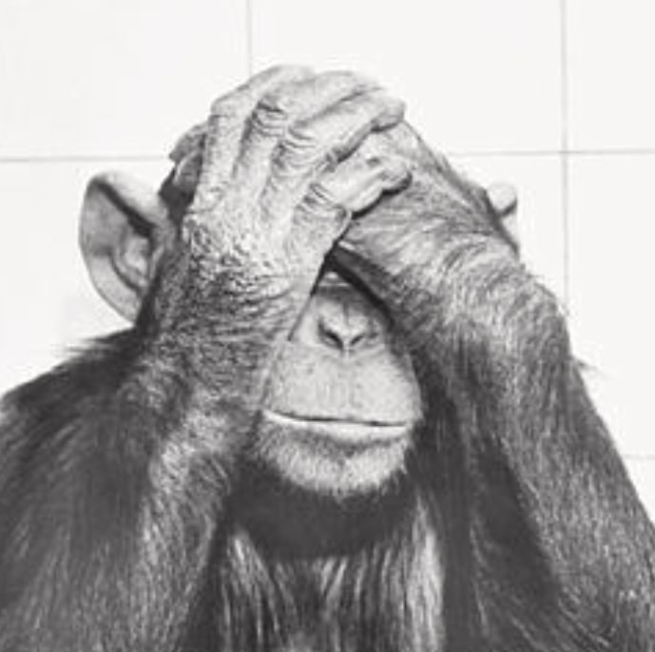
Policy makers were blind to us
Federal planning?
Relief funding?
… and the vaccines!
Graphic @ photos.com

Slide 17
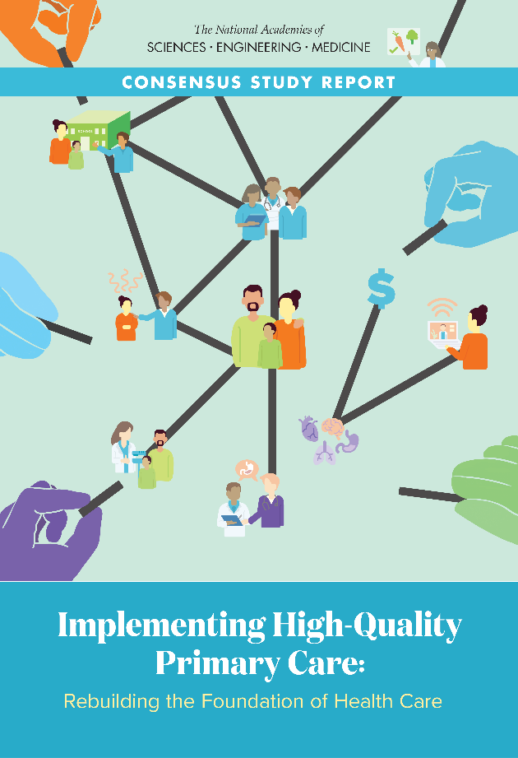
Implementing High-Quality Primary Care: Rebuilding the Foundation of Health Care
Payment – care for people, not services delivered
Access – every individual and family. Every.
Workforce – train where people live and work
Digital – to serve patients, families, teams
Accountability – ensure implementation
April 29, 2021
Nationalacademies.org/primarycare
primarycare@nas.edu

Slide 18
What do we do that makes a difference in the lives of people and communities?
And why is that so threatening?
The story of general practice and primary medical care transformation in the United States since 1981.
Miller WL. Commissioned paper for the NASEM Consensus Report: Implementing
high-quality primary care rebuilding the foundation of health care. 2021:1-60. https://www.nap.edu/resource/25983/The%20Story%20of%20General%20Practice%20and%20Primary%20Medical%20Transformation%20in%20the%20United%20States%20Since%201981.pdf
Graphic @goodreads.com

Slide 19
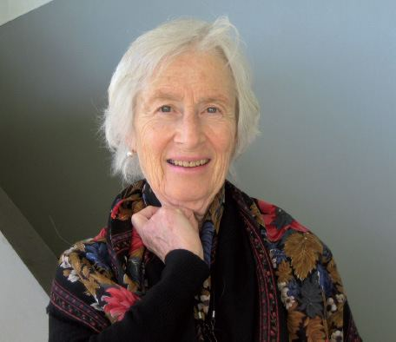
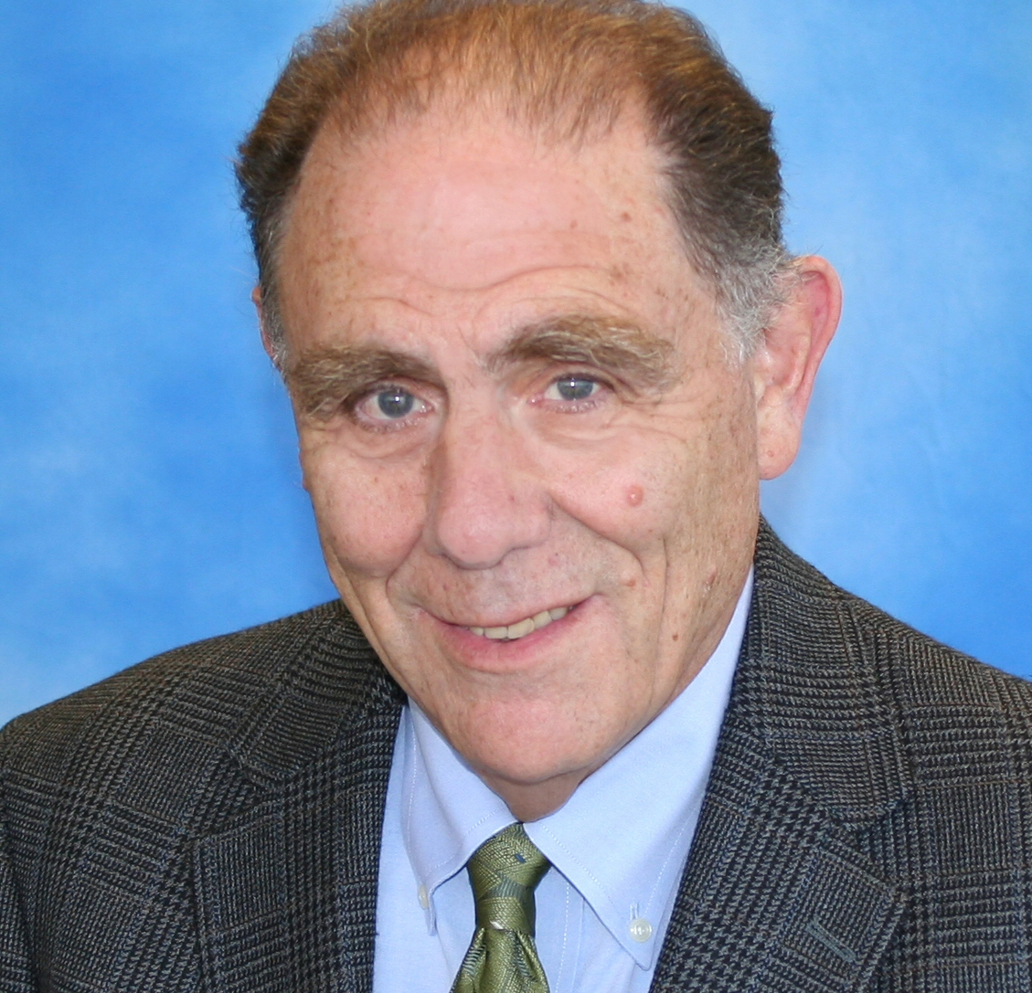
What’s behind
the 4 C’s
(first) Contact
Continuity
Comprehensiveness
Coordination
Bensken WP, Dong W, Gullett H, Etz RS, Stange KC. Changing reasons for visiting primary care over a 35-year period. J Am Board Fam Med. Mar-Apr 2021;34(2):442-448.

Slide 20
Sense of Safety
NAPCRG Forum Fostering a Sense of Safety:
Unpacking a Critical Generalist Strategy
Lynch JM, van Driel M, Meredith P, et al. The Craft of Generalism: skills and attitudes for whole person care. J Eval Clin Practice; 2021.
Lynch J. A Whole Person Approach to Wellbeing: Building a Sense of Safety. New York: Routledge; 2021.

Slide 21
What emerges from breadth?
Prioritizing – focusing on what matters most in the moment
Being known – as a person, family, community
Possibility of being a force for integration in a fragmented system and society
Gateway to the transcendent – unity of life

Slide 22
A Holarchy of Health Care
Healing & Transcendence
Prioritized
Integrated
Basic Care
Stange KC. A science of connectedness. Ann Fam Med. 2009;7(5):387-395.

Slide 23
Simple Rules for Primary Care
Recognize & make sense of problems/opportunities (through a life course perspective and being known as an individual and as a member of family and community)
Prioritize the most important problems/opportunities (for person & population at all life stages)
Personalize to generate healing, health, or connection
Etz RS, Miller WL, Stange KC. Three simple rules that explain the paradox of primary care. 2021; Fam Med. 2021;53(8):697-700.

Slide 24
Simple rules for specialty care
Identify & classify disease for management
Interpret through specialized knowledge
Manage a plan for disease care
Etz RS, Miller WL, Stange KC. Three simple rules that explain the paradox of primary care. 2021; Fam Med. 2021;53(8):697-700.

Slide 25
Ask what makes a difference

Slide 26
Person Centered Primary Care Measure
My practice makes it easy for me to get care
My practice is able to provide most of my care
My doctor considers all of the factors that affect my health
My practice coordinates the care I get from multiple places
My doctor or practice knows me as a person
My doctor and I have been through a lot together
My doctor or practice stands up for me
The care I get takes into account knowledge of my family
The care I get in this practice is informed by knowledge of my community
Over time, my practice helps me stay healthy
Over time, this practice helps me to meet my goals
Etz RS, Zyzanski SJ, Gonzalez MM, Reves SR, O’Neal JP, Stange KC. A New Comprehensive Measure of High-Value Aspects of Primary Care. The Annals of Family Medicine. 2019;17(3):221-230. www.annfammed.org/content/17/3/221
https://www.green-center.org/pcpcm

Slide 27
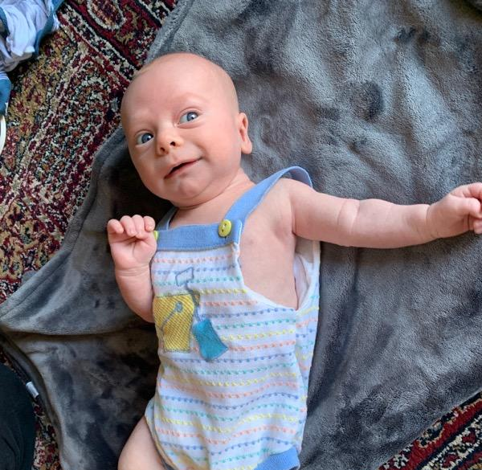
Sincere thanks to our funders
AHRQ
Morris-Singer Foundation
Samueli Foundation

Slide 28
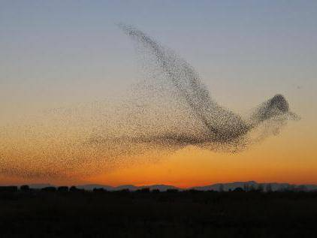
Notes:
This is the mesmerising moment a murmuration of starlings took the form of a giant bird while being targeted by a bird of prey.
Daniel Biber, 53, captured the breathtaking snap after observing thousands of birds and scouting locations over a four-day period.
Like clouds in the sky, the giant flocks often take on weird and wonderful - and sometimes graphic - moving forms and shapes.
And the birds made for a startling spectacle when they assembled over the Costa Brava in northeastern Spain in front of Mr Biber's eyes.
He managed to take a series of images which show the birds merging into the shape of a giant bird when they were targeted by a predator.
And the unique snap has since earned him the top prize in an international photography competition.
But Mr Biber said he only realised his luck once he reviewed the photographs on his computer.
He said: "I was taking pictures of the murmurations over several days.
"Only when I checked the pictures on the computer later, I realised what formation the starlings had created.
"I was so concentrated on taking pictures at the time that I hadn't realised that the starlings had created a giant bird in the sky.
"It took less than 10 seconds for the birds to create that formation.
"I realised that I had captured a unique snapshot, technically, sharp and in high quality."
Mr Biber lives in Hilzingen, Germany, and now runs a bicycle business following his career as an aerospace engineer.
He has been taking pictures since 1981 when he started off with his first reflex camera and has been taking digital snaps since 2008.
Mr Biber has visited the northeast of Spain for a number of years and knew about the fascinating display that starlings put on.
But he said it took him four days to capture the unique moment after he had to scout out locations and get the lighting right.

Slide 29
The Generalist Way
Being
Open, humble, connected
Knowing
iterates between whole & particulars
Perceiving
Scanning, prioritizing
Focusing on particulars while keeping the whole in view
Thinking & Doing
Contextualizing, connecting, integrating
Stange KC. The Generalist Approach. Ann Fam Med. 2009;7(3):198-203.
Gunn JM, Palmer VJ, Naccarella L, et al. The promise and pitfalls of generalism in achieving the Alma-Ata vision of health for all. Med J Aust. Jul 21 2008;189(2):110-2.

Slide 30
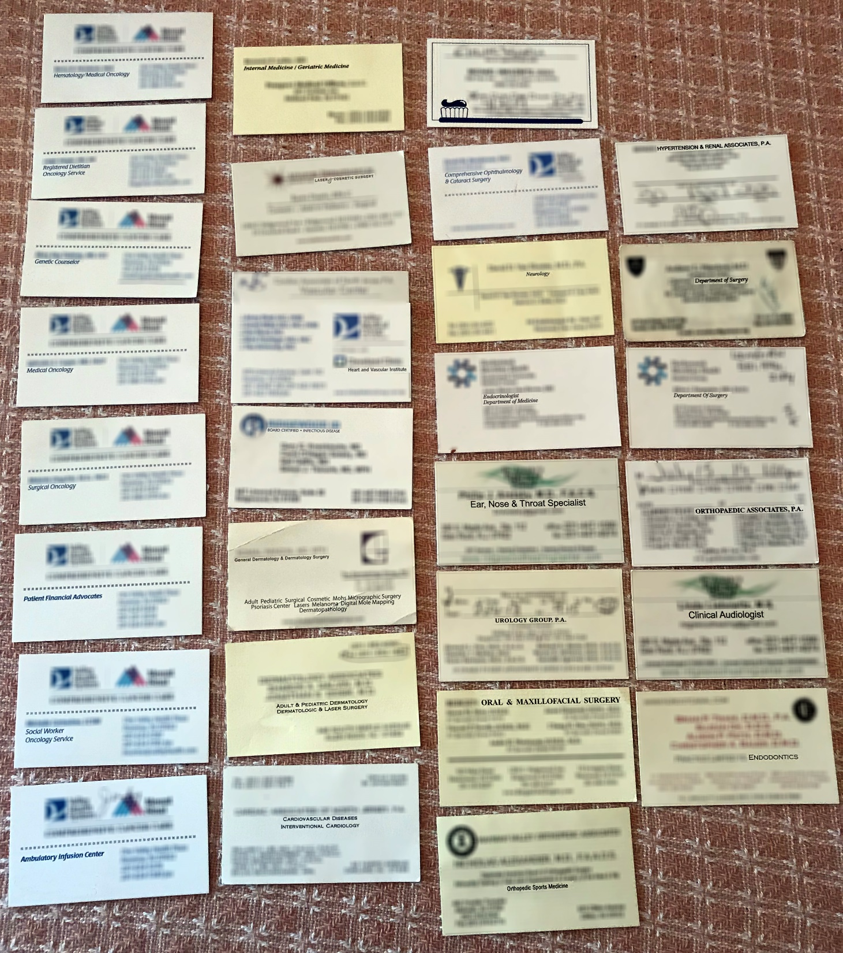

Slide 31
What’s next for primary care?
Balanced data driven decisions
Meaningful accountability
Digital tools, not services
Relational knowing
Notes:
This is our sidewalk but this is also where the wild things are, and the good news about primary care… we grow well in the wild.

