Slide 1

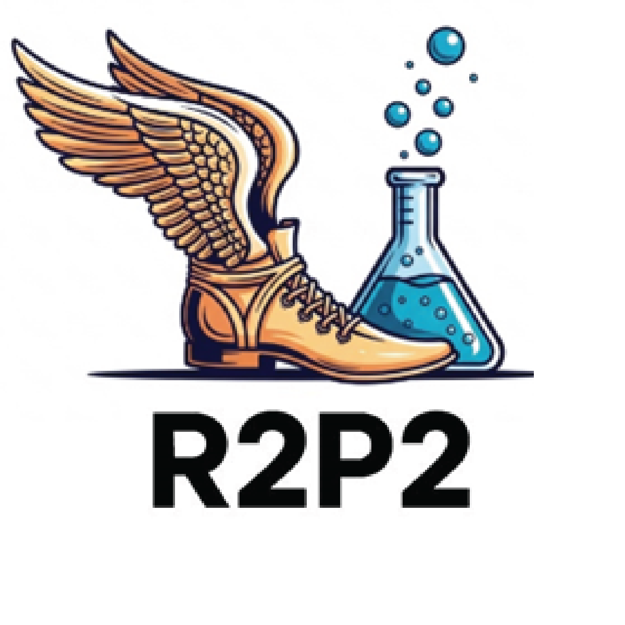
The Rapid, Rigorous, Patient-centered Program (R2P2):
Tools and Resources to make your research more pragmatic
Russ Glasgow and Bryan Ford
MPIs: Dan Matlock & Russ Glasgow
Program Managers: Kate Noonan and Bryan Ford
Key funding from the Anschutz Acceleration Initiative & support from ACCORDS

Slide 2

Overview
Roadmap
Background and Purpose
Examples of R2P2 Research
Resources from R2P2
Your Feedback, Questions, and Recommendations

Slide 3
Where We Are and Where We’re Going
Background and Purpose
17-year gap (or 15)
Basic vs. Translational Science Approaches
Traditional vs. Rapid & Rigorous Research
Pragmatic Research Methods
R2P2 was designed to stress-test these tensions – designing, testing, and disseminating patient-centered tools using rigorous methods at speed.
R2P2 offers TIP SHEETS and DETAILED GUIDANCE for a diverse audience to use, helping apply these rapid and rigorous methods

Slide 4
R2P2 Specific Aims
Aims
Design a host of R2P2 tools and resources to improve capacity to conduct rapid and rigorous research on patient-centered care.
Rapidly and rigorously Implement & Test interventions in multiple real-world settings and for many clinical issues (from primary prevention to palliative care) using pragmatic research and the tools and guides above.
Rapidly and rigorously Disseminate and Sustain project and delivery and outcomes.
Initial proof of ability to support and conduct rapid, rigorous pragmatic research- initially with 4 mid sized projects, ranging from primary prevention to end of life
Note- with generous support from and collaboration with ACCORDS Cores, staff, admin, and numerous investigators
Notes:
Note- I changed aim 1 it caught my attention!! ☺
OK, disseminate is another word to throw in the mix with generalizability, scalability etc. Disseminate implies something is generalizable, replicable and scalable. I think I am just going on on a little tangent with these notes about this bucket of words – I don’t think other people get hung up on the intended sentiment of them like I do.

Slide 5
Generalizability
Explanatory vs. Pragmatic Trials
Explanatory (Efficacy or Effectiveness) trial: Specialized experiment in a homogeneous setting(s) and population in controlled conditions Emphasizes internal validity | Pragmatic Clinical Trial (PCT): Real-world test in a real-world population Designs emphasize Generalizability: Participation or reach Adoption by diverse settings Ease of Implementation Maintenance or Sustainment
Pragmatic does not mean less rigorous!!!
NIH Health Care Systems Research Collaboratory. Rethinking Clinical Trials: A Living Textbook of Pragmatic Clinical Trials. https://rethinkingclinicaltrials.org/
Glasgow, R.E. (2013). What does it mean to be pragmatic? Health Educ Behav, June;40(3):257-65. https://doi.org/10.1177/1090198113486805

Slide 6
Generalizability
PCTs: Fewer Exclusions Allow for a Broader Subset of Settings, Staff, and Participants
Traditional RCTs
Pragmatic Trials (PCTs)
Eligible population
Eligible population
Exclusions, non-response, etc.
Exclusions, non-response, etc.
Efficacy, among a defined subset
Effectiveness, in a broad subset
Figure provided by Gloria Coronado, PhD

Slide 7
Continuum
The RCT-PCT Continuum
PCTs are not an abandonment of the scientific methods that have led to countless breakthroughs.
They don’t take away from or diminish the importance of traditional RCTs – we just need a balance.
No study is completely explanatory or pragmatic. RCTs and PCTs exist on a continuum.
Explanatory Trial
Can an intervention work under ideal conditions?
Pragmatic Trial
Does an intervention work under usual conditions?
Loudon, K., et al.(2015). The PRECIS-2 tool: designing trials. BMJ, 350 (May08 1) https://doi.org/10.1136/bmj.h2147

Slide 8
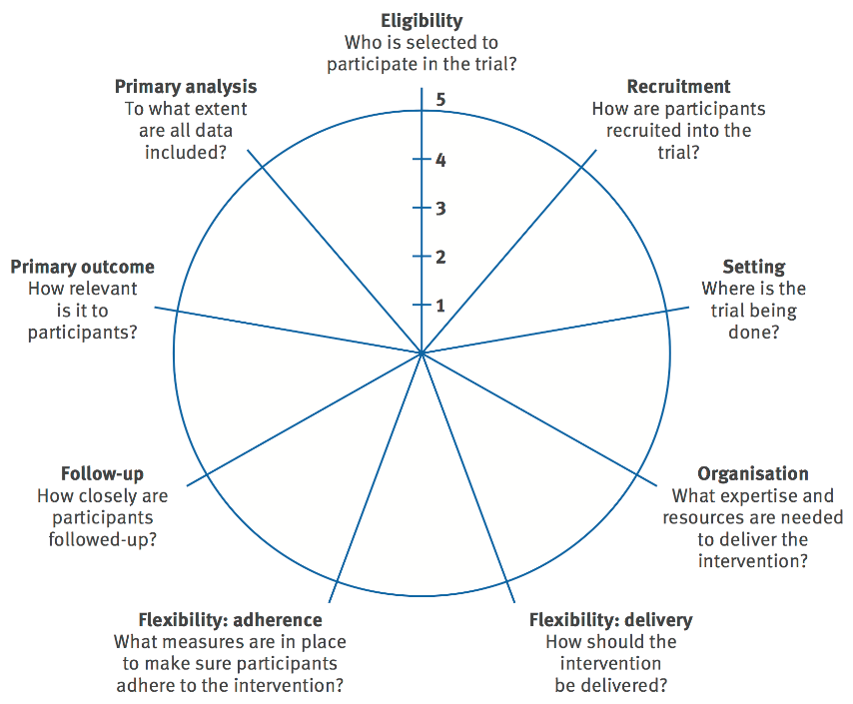
How pragmatic is your study on these 9 dimensions?
Not all or none- what dimensions are more and less pragmatic
PRECIS
Pragmatic Explanatory Continuum Indicator Summary
PRECIS- 2…and PRECIS- 2 PS updates
Norton WE, Loudon K, Chambers DA, Zwarenstein M. Designing provider-focused implementation trials: the PRECIS-2-PS Implementation Sci. 2021 Dec;16(1):1-1. doi.org/10.1186/s13012-020-01075-y

Slide 9
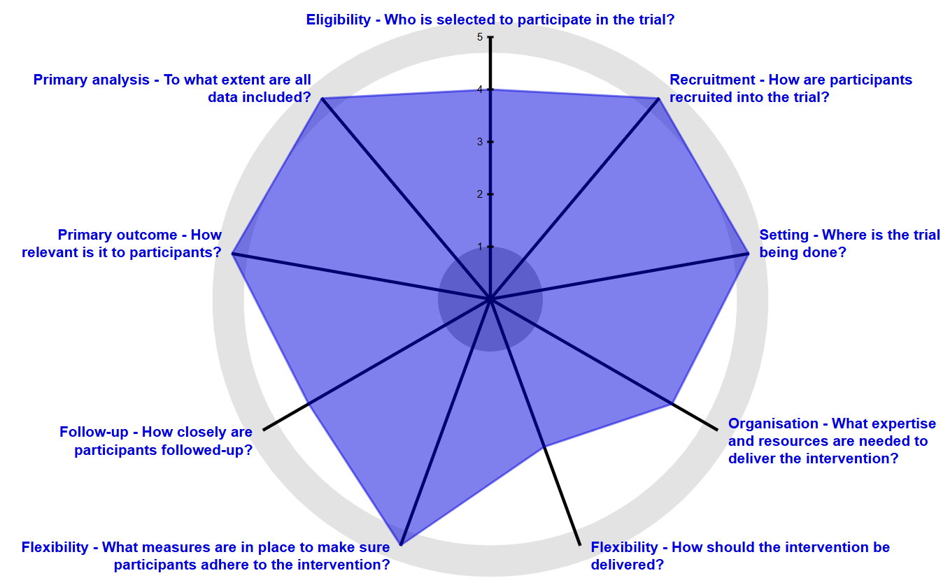
PRECIS
Example PRECIS-2 PS
Completed:
More Pragmatic

Slide 10
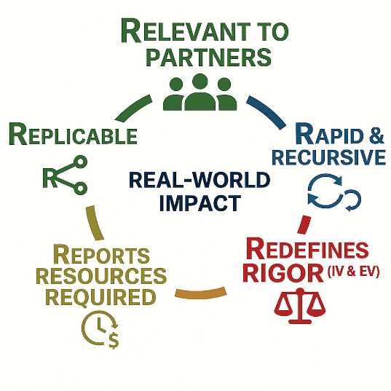
The 5 R's Model to Assess and Enhance Pragmatism, Implementation Science, and Likelihood of Translation
Assessment
Design for and Assess the Extent to which Research is:
Peek, C.J., et al. (2014). The 5 Rs: An emerging bold. Annals of Family Medicine, 12(5), 447-55. https://doi.org/10.1370/afm.1688
deGruy, F.V., et al. (2015). A plan for useful and timely family medicine and primary care research. Family Medicine, 47(8), 636-42.

Slide 11
Applying Pragmatic IS approaches early and often
Application
For more than late‑stage research:
Applying IS principles in early‑stage studies, not only T3–T4 research
Where things go wrong:
Using tools to anticipate, track, address, and transparently report implementation challenges and results (including bad ones)
Need for speed:
Moving more rapidly while maintaining rigor
Leppin A.L., et al. Situating Dissemination and implementation within and across...(2019) Jour Clin Transl Sci 4: 152-158. doi:10.1017/cts.2019.392

Slide 12
Feasibly Including Pragmatic IS Approaches in Pilot or Early-Stage Research
Application
How Can You…
Q: Assess context?
A: Include at least 2 settings; interviews or brief survey; process map
Q: Consider the range of adaptations needed/allowed?
A: Discuss Functions-Forms with your implementation partners
Q: Do intervention time and ‘back of envelope’ cost estimates?
A: Ask your implementation partners is this feasible for most settings?
Q: Assess feasibility and sustainment potential?
A: Ask is something like this possible to be implemented- and sustained?

Slide 13
The Need for Speed: Moving Rapidly and Iteratively
Iterative PRISM / RE-AIM
Expect early suboptimal performance:
Most interventions initially do not work as planned
Monitor what matters – repeatedly:
Track short‑term, multi‑dimensional impact (e.g., RE‑AIM outcomes) with attention to equity and population impact
Guide adaptations:
Adapt using theory, data, and partner priorities – fail fast and improve, not fail slowly
Record Adaptations:
Transparently report them!
Glasgow et al. RE-AIM Planning and Evaluation Framework: Adapting to New Science and Practice with a 20-Year Review. Front Public Health. 2019;7:64.
Maw, A.M., et al. Implementation Science Communications, 3(1). https://doi.org/10.1186/s43058-022-00334-x

Slide 14


Fidelity and Adaptations
Historical View
Mature View
Attention to BOTH program fidelity and adaptation during the complex process of program implementation is critical to successful, sustained implementation of evidence-based programs.

Slide 15
Tension 1: Basic vs. Applied Science
 | BASIC SCIENCE | APPLIED SCIENCE
Core Question | What is true, and why? | What works, for whom, under what conditions?
Focus | Theory testing, mechanistic inferences, contextual determinants, cognitive processing | Feasibility, replication costs, adaptations, scalability, equity
Example | Why do clinicians override decision support alerts? What cognitive or workflow factors drive that behavior? | Can we deploy a shared decision-making tool across 5 clinics within 6 months at sustainable cost?
Generalizability | Theoretical — findings inform models and frameworks | Practical — findings inform adoption, adaptation and sustainment decisions
Reviewer Expectations | Clean mechanistic inference | Immediate health system impact
The Argument: It is virtually impossible to do both well within a single study. Studies should make their focus explicit. Funders should recognize these as two distinct, equally valid categories; not a hierarchy.
Tension 2: Speed vs. Rigor
 | TRADITIONAL | RAPID + RIGOROUS
Timeline | 5-10 years from design to dissemination | Months to 1-2 years from design to dissemination
Perspective on Speed | Slow = credible & rigorous | Rapid + Rigorous = possible to be both & credible
Study Designs | RCTs, longitudinal cohorts | Roll-out designs (e.g., stepped wedge) rapid qualitative/ethnographic methods, adaptive trials
Data Sources | Purpose-driven data collection | Pragmatic measures, Big data, EHR, AI-assisted analysis
Example | Multi-site RCT testing a care coordination intervention over 5 years | Roll-out study across clinic waves (18 months) using EHR data as outcomes.
The Argument: Speed and rigor are not opposites. Rapid methods exist that preserve scientific integrity; the field has been too hesitant to use them for fear of appearing unscientific.

Slide 16
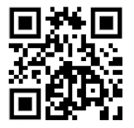
iPRISM Webtool- to rapidly assess and apply PRISM
Iterative PRISM / RE-AIM
Simplify implementation science - using PRISM
  For diverse researchers and implementation teams
  Support rapid learning health systems
Guide and prompt users to iteratively
  Assess context
  Align project with context
  Assess progress on key PRISM (RE-AIM) outcomes
  Develop feasible and impactful strategies/adaptations
  Create action plans
Try it out!!
IF YOU DO...for program name, please include ‘TEST’
prismtool.org
Trinkley K.E., et al. The iPRISM webtool. Impl Sci Comm (2023) 4:116 https://doi.org/10.1186/s43058-023-00494-4.
Maw, A. M, et al. Using Iterative RE-AIM to enhance hospitalist adoption. Impl Sci Comm, 3(1). https://doi.org/10.1186/s43058-022-00334-x

Slide 17
R2P2 Research
R2P2 Details
4 Original Use Case Projects (2024-2026)
Help develop, curate and test resources for rapid and rigorous pragmatic research
My Own Health Report (Primary Care)
  EHR-embedded risk assessment and goal setting intervention – testing two forms of structured follow-up support: text message and certified health-worker navigation
Carotid Stenosis Decision Aid (Specialty)
  Designing and testing a decision aid for carotid stenosis
Heart Transplant Decision Aid (Tertiary)
  Designing and testing a decision aid for heart transplantation
Dementia Roadmap (End-of-Life)
  A roadmap to help navigate the many important decisions by patient and caregivers after a dementia diagnosis.

Slide 18
R2P2 Research
R2P2 Details
2 New Use Case Projects
Use and test R2P2 resources for rapid and rigorous pragmatic research
R2Text Messaging (Peds)
  Develop, deliver and test family-centered text messages to parents and caregivers to support early and appropriate pediatric healthcare initiation
Vaccine Decision Aid & Training (Adult)
  Adapt and test a conversations guide and mini-training for frontline staff to help deliver evidence-based vaccine messages pre-visit

Slide 19
R2P2 Resources
R2P2 Details
8 Essential Components to Make Rigorous Pragmatic Research more Rapid
Define the Problem
Engagement
Costing
Co-Design
Implementation Strategies
Pragmatic Pilot Trial Design
Sustainment
Dissemination
Tip Sheets- areas covered on next page
Worksheets to Apply Guidance
Detailed Guidance
Curated Tools, Guidebooks, Links, and Articles
All housed within our program website
Notes:
BF start here

Slide 20
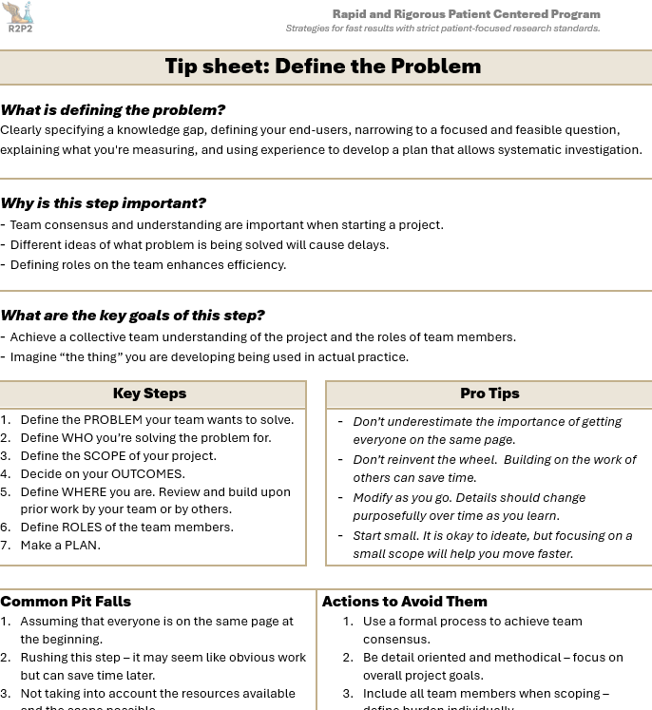
Tip Sheets
R2P2 Tip Sheets
Definitions
Goals of each component
Key Steps to accomplish the goals
Pro Tips
Common Pitfalls and Actions to Avoid Them

Slide 21
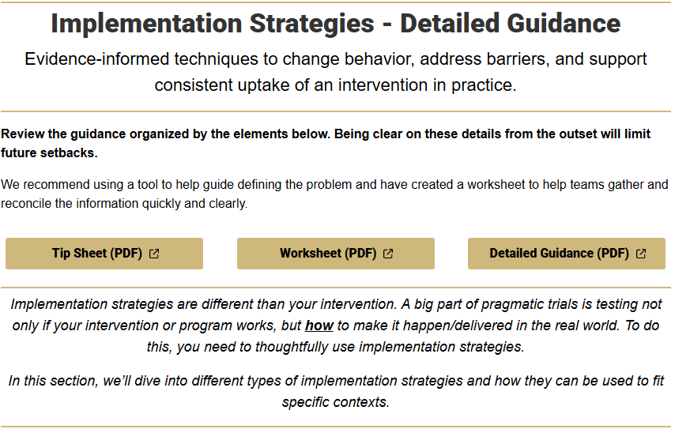
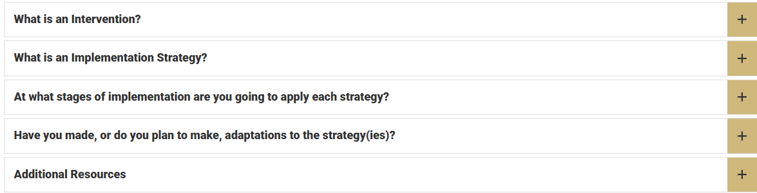
Detailed Guidance
R2P2 Detailed Guidance
Breaks down elements of each component
Provides actions to accomplish each component with rapidity
Links to key resources, tools, websites, and papers

Slide 22
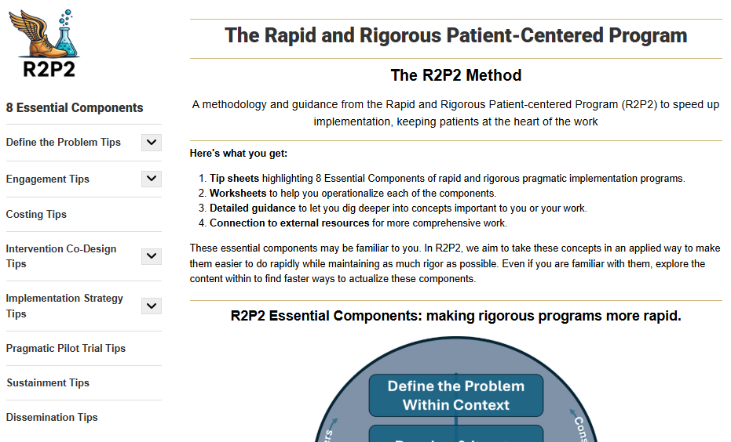

Resources Demo – R2P2 Website
R2P2 Website Demo
https://medschool.cuanschutz.edu/r2p2
Notes:
Live Demo here

Slide 23
Thank You!
Russell E. Glasgow, PhD
Research Professor Dept of Family Medicine
Director, Dissemination and Implementation Science Core
ACCORDS Center, University of Colorado Anschutz
russell.glasgow@cuanschutz.edu
Bryan Ford, MPH
Program Manager
Rapid and Rigorous Patient-centered Program
ACCORDS Center, University of Colorado Anschutz
bryan.ford@cuanschutz.edu
https://medschool.cuanschutz.edu/r2p2

