Slide 1
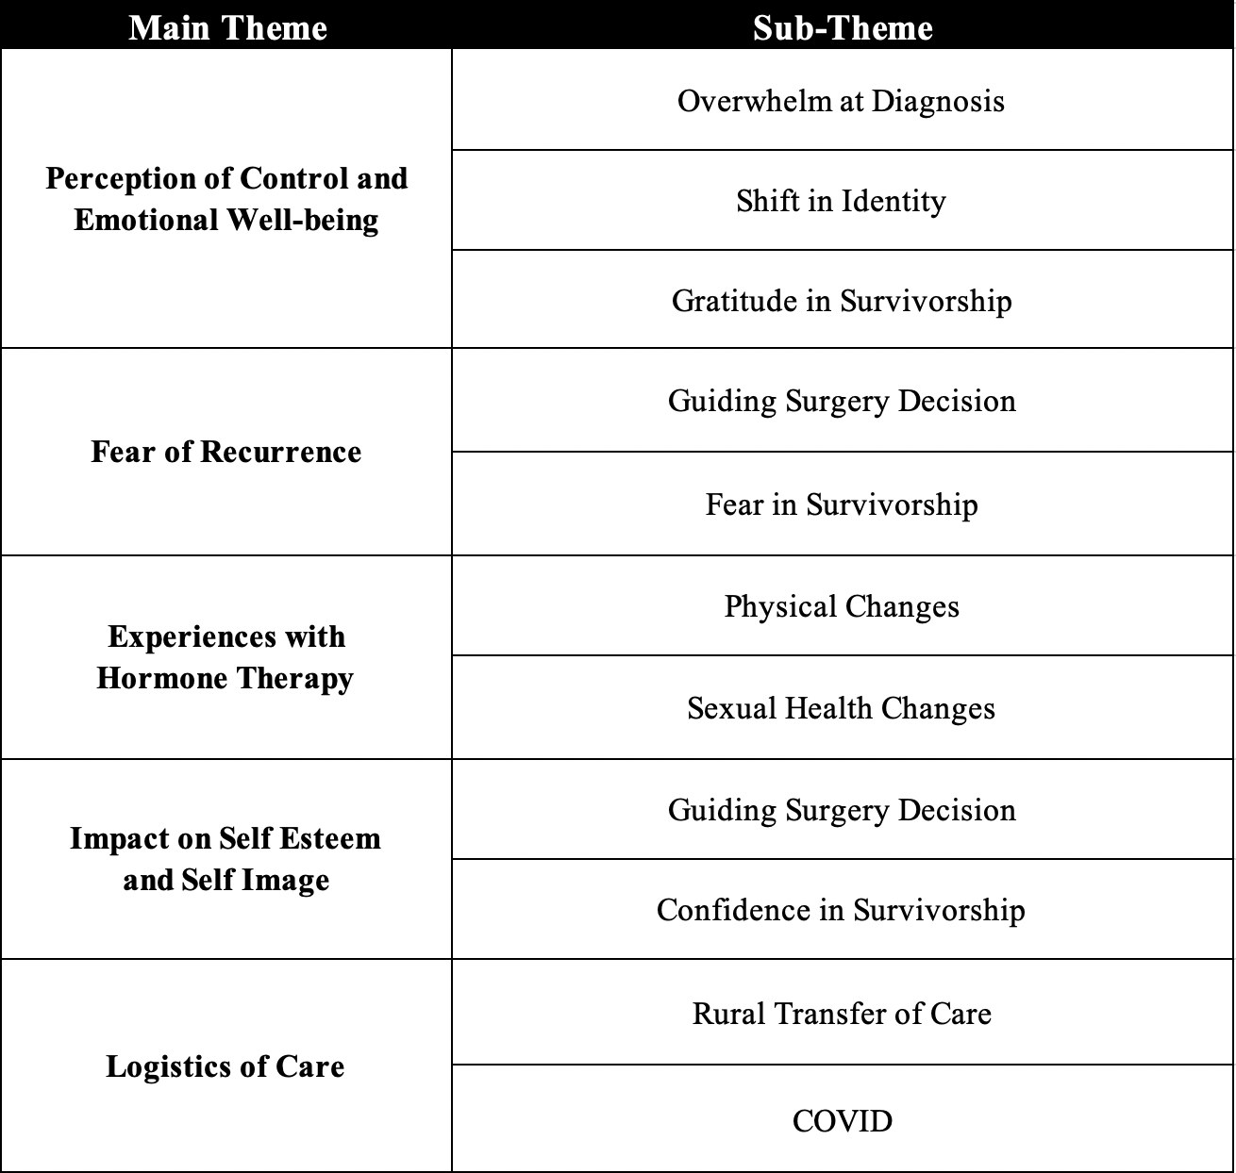
Journey Mapping: Evaluating Quality of Life Changes over Breast Cancer Treatment
Gabriella Annest Canty, BA, Monica Adams PhD, Madeline Higgins MD, Karen Hampanda PhD,
Sudheer Vemuru MD, Abigail Ludwigson BA, Clara Lee MD, Erin Baurle PhD, Dan Matlock MD,
Simon Kim MD PhD, Rebekah Davis BS MS, Sarah Tevis MD
Patients prioritize their
fears of recurrence and
cosmetic outcome in surgical decision making
Background
Common Themes
For early-stage breast cancer, patients have equivalent oncologic outcomes for mastectomy or lumpectomy (BCT)₁
Surgery choice may affect BREAST-Q₂ domains differently for each patient:
“I was ready to go ahead and do the mastectomy. I don't want to take any more chances, it's fine. And my surgeon pushed back a little and said a lumpectomy would be a good option too. But I couldn't lie awake at night with that choice.”
Psychosocial
well-being
Physical
well-being
Breast
satisfaction
Sexual
well-being
Methods
Breast cancer survivors participated in Zoom interviews
Survivors described changes in quality of life over time in BREAST-Q domains
Inductive thematic analysis of transcripts
“I was told if I did a lumpectomy, I would be really deformed because of the lack of tissue, so that made the most sense for me to do a mastectomy in the end”
Results
Conclusions and Implications
Table 1
N = 14 participants
Mean age 57 years (41-76)
Fear of recurrence and cosmetic outcomes are major themes for patients in surgical decision making (Figure 1)
Common themes identified on qualitative analysis: reduced sense of control, fear of recurrence, physical challenges with hormone therapy, evolution in confidence, and logistics of care affecting quality of life (Table 1)
The impact of breast cancer care extends past medical or surgical “cure”
Patients report fear of recurrence and cosmetic outcome as major drivers in surgery decision
Understanding key patient values allows them to be prioritized in surgical decision making
Figure 1
Figure 1
References
Kummerow, K.L., et al., Nationwide trends in mastectomy for early-stage breast cancer. JAMA Surg, 2015. 150(1): p. 9-16.
Pusic AL, Klassen AF, Scott AM, Klok JA, Cordeiro PG, Cano SJ. Development of a new patient-reported outcome measure for breast surgery: the BREAST-Q. Plast Reconstr Surg. 2009;124(2):345-353. doi:10.1097/PRS.0b013e3181aee807

