Slide 1
Department of Medicine Morbidity, Mortality, and Systems Improvement Conference
**TITLE***
Name
Division
Arun Kannappan, MD
Pulmonary & Critical Care Medicine
Tyler Anstett, DO
Hospital Medicine

Slide 2
Agenda
12:00-12:05 Introduction
Follow-Up from Prior M&Ms
12:05-12:20 Case Presentation
12:20-12:50 Case Analysis and Discussion
12:50-1:00 Solution Generation
Notes:
Change PRN – can add in teaching points if wanted

Slide 3
M&M Mission
To establish a safe venue to identify areas for improvement in patient care, while promoting professionalism, integrity, and transparency.
Notes:
Just culture refers to a values-supportive model of shared accountability. It's a culture that holds organizations accountable for the systems they design and for how they respond to staff behaviors fairly and justly

Slide 4
This meeting is privileged and confidential; subject to peer and medical review protections at UCH and the State of Colorado
“The records, reports, and other information (discussed in this meeting) shall not be subject to subpoena or discoverable or admissible as evidence in any civil or administrative proceeding. No person who participates in the reporting, collection, evaluation, or use of such quality management information with regard to a specific circumstance shall testify thereon in any civil or administrative”
2017 Colorado Revised Statutes, Title 25, section 25-3-109

Slide 5
M&M Follow Up Slide
Notes:
Slide to be given by MMSC/DOM reps

Slide 6
Case Summary
ONE-LINER of PRESENTATION

Slide 7
PAST MEDICAL HISTORY
MEDICATIONS
SOCIAL HISTORY
PAST SURGIAL HISTORY
FAMILY HISTORY
Notes:
Patient history

Slide 8
Admission
UCH Hospital Course
CODE Status
Notes:
Optional – sometimes nice to summarize the parts of care you are going to focus on – especially if complex

Slide 9
12:30 PM
Admitted to GI therapeutics for retrograde balloon enteroscopy. Unable to intubate distal ileum where large AVM previously noted. Fresh blood in colon, no source
Admitted to ACE service for medical management during ongoing GI treatment. Physically located in Cardiac Pre/Post Unit (CPPU). DNR order placed by admitting resident.
Exam: RRR, holosystolic murmur loudest @ L axila; mild wheezing, no rales; JVP difficult to assess due to habitus; 2+ BLE edema; weight 236 lbs (dry weight 231 lbs)
Labs: HGB 7.3, PLT 131, Na 137, K 3.3, AG 17, BUN 95, Cr 2.4,
Changed furosemide to 60 IV BID; held home metolazone.
Tagged RBC scan: No evidence of GIB during imaging
~3:30 PM
Admission
5:45 PM
Notes:
carvedilol started

Slide 10
HD 1
Clear liquid diet and GoLytely prep for GI procedure #2. Furosemide at 60 IV BID, home metolazone held.
Exam: Unable to assess JVD due to body habitus; mild wheezes; UOP 1050 cc + 1 unmeasured void; no weight
Labs: HGB stable at 7.3, PLT 131, Na 133, K 4.3, AG 14, BUN 108, Cr 3.1
Continued GoLytely prep; no clinical change; furosemide increased to 80/60 IV, home metolazone held.
Exam: Unable to assess JVD due to body habitus; mild wheezes, rales documented
Labs: HGB 7.7, PLT 130, Na 129, K 4.2, AG 16, BUN 107, Cr 3.3
UCH
Hospital Course
HD 2

Slide 11
HD 3
Successful treatment of AVM in ileum; clear liquid diet post-procedure; furosemide 60/80 IV, home metolazone held. Transferred from CPPU to ACE.
Exam: “Slightly volume up, ” unable to assess JVD due to body habitus; no rales reported; weight x2 246 lbs; I&O inaccurate.
AM labs: HGB 8.3, PLT 154, Na 131, K 3.6, AG 16, BUN 100, Cr 3.3
PM labs: Na 130, K 4.2, AG 18, BUN 113, Cr 3.6
Concern for worsening volume overload; pt denies dyspnea; furosemide increased to 100/120 IV; restarted metolazone 5; plan for Renal consult in AM if Cr worsening. RN notifies team of low UOP and urinary retention, bladder scan 368 cc.
Exam: Unable to assess JVD due to body habitus; mild wheezes; UOP 1050 cc + 1 unmeasured void; no weight; UOP 965 cc
AM labs: HGB 8.0, PLT 128, Na 133, K 4.0, AG 10, BUN 112, Cr 3.9
PM labs: Na 131, K 3.9, AG 14, BUN 119, Cr 4.2
UCH
Hospital Course
HD 4

Slide 12
 | HGB | PLT | Na | K | AG | BUN | Cr
HD0 | 7.3 | 131 | 137 | 3.3 | 17 | 95 | 2.4
HD1 | 7.3 | 131 | 133 | 4.3 | 14 | 108 | 3.1
HD2 | 7.7 | 130 | 129 | 4.2 | 16 | 107 | 3.3
HD3 | 8.3 | 154 | 131 130 | 3.6 4.2 | 16 18 | 100 113 | 3.3 3.6
HD4 | 8.0 | 128 | 133 131 | 4.0 3.9 | 10 14 | 112 119 | 3.9 4.2
HD5 | 7.4 | 127 | 130 131 | 3.6 3.5 | 13 14 | 122 123 | 4.2 4.3
UCH
Hospital Course

Slide 13
e.g. Unit
ACE
e.g. Creat
Cr 3.6
BUN 100
Cr 4.2
BUN 112
Cr 4.3
BUN 122
HD 0
HD 1
HD 2
HD 3
HD 4
HD 6
Notes:
Timeline of events with other information PRN

Slide 14
HD 0
Initially FULL Code with GI, then DNR order placed by ACE admitting resident; documented in H&P.
12:17 PM: Anesthesiologist orders Suspend DNR/Reinstate DNR orders
14:22 PM: CRNA orders Suspend DNR/Reinstate DNR orders
14:26 PM: CRNA cancels primary team’s DNR order from 3/26
15:25 CRNA cancels anesthesiologist’s reinstate DNR order, but not their suspend DNR order
15:26 PM: Anesthesiologist cancels Suspend DNR/Reinstate DNR order placed by CRNA but does not cancel their own Suspend DNR order
Suspend DNR order remains as code status in the chart overnight
13:17 PM: ACE resident cancels anesthesiologist’s Suspend DNR order and re-orders DNR; documented in progress note
HD 3
CODE STATUS
HD 4
Notes:
14:26 CRNA Reinstate DNR, discontinued by A
14:26 Suspend DNR discontinued by A
12:17 Reinstate DNR order (canceled by CRNA)
12:17 Suspend DNR ordered by A, discontinued next day by res

Slide 15
CODE STATUS

Slide 16
4:35 AM
RN looks for DNR bracelet, does not see one, starts CPR
CODE Team MD member noted DNR order in the chart shortly before second pulse check.
Immediately re-checked for DNR bracelet, did not find one
Asked primary RN for code status, RN was uncertain
Reviewed chart; found code status had been changed multiple times since admission; did not see code status documentation from HD 4; no documentation of discussion surrounding code change
Checked paper chart; no MOST or DNR paperwork available
Contacted cross-cover, verified DNAR
Compressions stopped, pt declared dead, family notified
4:38 AM
to
4:46 AM
CODE STATUS
4:46 AM

Slide 17
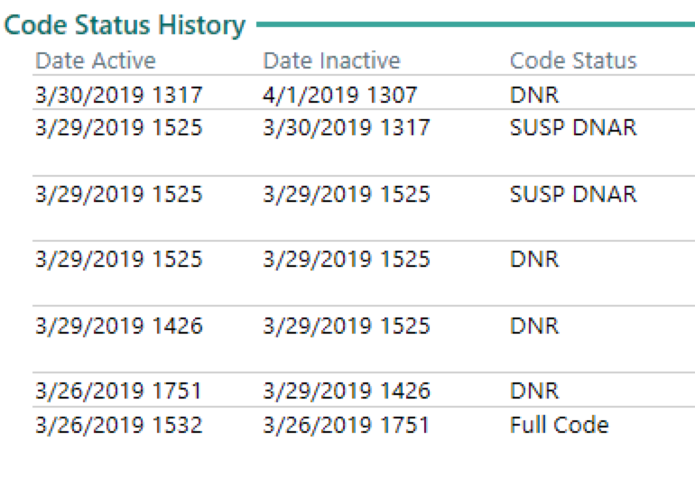
CODE STATUS

Slide 18
Notes:
OPTIONAL – sometimes nice to provide a logistical summary of a certain policy or procedure

Slide 19
If you have a chat question/comment you want to keep anonymous – please send to: _______________
PROBLEM
ANALYSIS
SOLUTION
Notes:
NOTE – animation
NOTE: this is an opportunity to identify the Zoom logo as a queue for audience participation and to give instructions for how to participate

Slide 20
ADVERSE EVENT
(not preventable)
MEDICAL ERROR
(near-miss)
Notes:
Adverse event (IHI): Unintended physical injury resulting from or contributed to by medical care (including the absence of indicated medical treatment), that requires additional monitoring, treatment, or hospitalization, or that results in death
Medical error: an act of commission (doing something wrong) or omission (failing to do the right thing) leading to an undesirable outcome or significant potential for such an outcome."

Slide 21
Preventable
ADVERSE EVENT
(not preventable)
MEDICAL ERROR
(near-miss)
Notes:
Adverse event (IHI): Unintended physical injury resulting from or contributed to by medical care (including the absence of indicated medical treatment), that requires additional monitoring, treatment, or hospitalization, or that results in death
Medical error: an act of commission (doing something wrong) or omission (failing to do the right thing) leading to an undesirable outcome or significant potential for such an outcome."
NOTE: animation

Slide 22
If you have a chat question/comment you want to keep anonymous – please send to: _______________
MEDICAL ERROR
What error(s) occurred?
Notes:
Type in specific error from this case

Slide 23
If you have a chat question/comment you want to keep anonymous – please send to: _______________
ADVERSE EVENT
What was the Adverse Event?
Notes:
Type in specific adverse event(s) you are going to focus on.

Slide 24
PROBLEM
ANALYSIS
SOLUTION

Slide 25
Cognitive Factors
TYPE IN ADVERSE EVENT
Systems Factors

Slide 26
What Cognitive Factors Contributed?
If you have a chat question/comment you want to keep anonymous – please send to: _______________
Medical Knowledge
Clinical Judgement
Clinical Decisions
Cognitive Biases
TYPE IN ADVERSE EVENT
Anchoring: rely too heavily on one piece of information
Availability: overestimating events with greater ‘availability’ in memory
Confirmation: search for information that confirms preconceptions
Framing effect: drawing different conclusions based on how information is framed

Slide 27
What Systems Factors Contributed?
If you have a chat question/comment you want to keep anonymous – please send to: _______________
TYPE IN ADVERSE EVENT
Communication
People
(Pt & Providers)
Machines, Technology
Processes

Slide 28
***Learning Points***
AMA J Ethics. 2015;17(3):229-235. doi: 10.1001/journalofethics.2015.17.3.nlit1-1503

Slide 29
***Learning Points***
AMA J Ethics. 2015;17(3):229-235. doi: 10.1001/journalofethics.2015.17.3.nlit1-1503

Slide 30
***Learning Points***
AMA J Ethics. 2015;17(3):229-235. doi: 10.1001/journalofethics.2015.17.3.nlit1-1503

Slide 31
PROBLEM
ANALYSIS
SOLUTION

Slide 32
If you have a chat question/comment you want to keep anonymous – please send to: _______________
Quick Wins!
Major Projects
HIGH IMPACT
LOW EFFORT
HIGH EFFORT
Fill in Jobs
LOW IMPACT
Thankless Tasks
Notes:
Manage DO IT (crisis) → focus SCHEDULE IT (goals) → avoid DELEGATE (interruptions) → Limit DON’T DO IT (Distractions)

Slide 33
THANK YOU !

