Slide 1
Diagnostic Cross-check
Katie Raffel, MD

Slide 2

Vong

Slide 3
There are many patients with a story like Vong.
More than one every day in our hospital.

Slide 4
ADEPT Cross-Site Study
14 academic hospitals
Two-provider structured diagnostic error case reviews
2500 cases reviewed-- patients experiencing Rapid Response, ICU escalation or death

Slide 5
Our Team

Slide 6
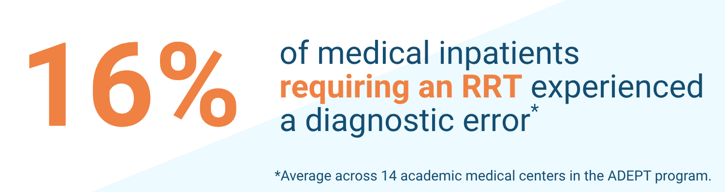
This means that among our 3000 patients who experienced an RRT, nearly 500 a year may have had an earlier diagnostic opportunity
y
These are 40 patients/month, 9 patients/week
At least one person today

Slide 7
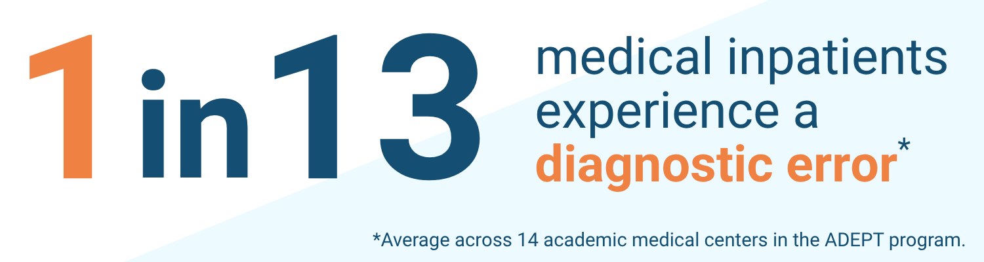
What if we think about all medical inpatients, including those with and without care escalation?
Notes:
This is combining data from our UPSIDE/ADEPT studies as well as Winters study (ICU) and Dalal/Gunderson studies (general medicine acute care patients).

Slide 8
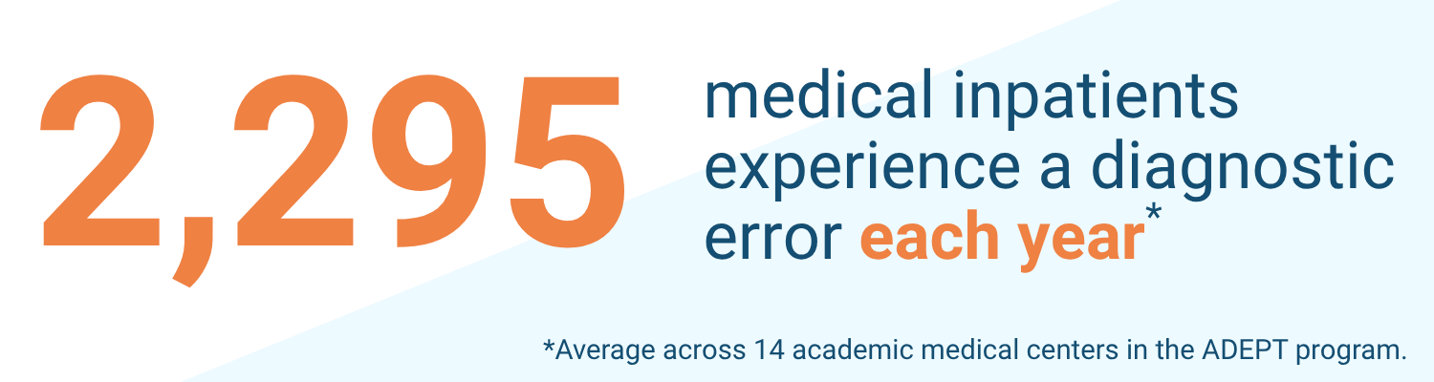

Slide 9
Majority have some contribution from an error in provider clinical assessment or decision-making.
Almost all cases have multifactorial cause with relevant cognitive load, systems and patient factors.
RRT events are particularly high stress, high cog load, evolve quickly and often are mngt focused.

Slide 10
How can we support diagnosis during RRT?
Evidence that more than one clinician is associated with increased likelihood of an accurate diagnosis than a solo clinician
Unstructured peer consultation is a common practice, both in ethnographic observation and in self-reported survey
Peer consultation is valued but structural barriers exist to its use
Two-physician cross-check in ED has reduced medical error

Slide 11
Collaboration in medicine
Studies that multiple provider pooled differential > individual
Diagnostic error among medicine patients who go to ICU or die
  Direct care was associated with a higher risk of any DE compared with teaching teams
  APP services had a lower risk of harmful DEs compared with direct care
Existing structures: Complex care Board, External Second Opinions, Internal Second Opinion (visual specialties)
Notes:
Second bullet is from UPSIDE subanalysis

Slide 12
Ethnographic Observations of Diagnosis
What are the daily habits and work patterns of diagnosticians? How does this differ with a focus on effective diagnostic experiences?
What diagnostic adaptations do clinicians make as they move through their day?
How is diagnosis influenced by patient factors, clinician factors, and the practice environment?
Notes:
6 sites, 120 patient obs/96hrs, 12 interviews.
4 themes: collateral is critical, recognizing uncertainty is key, peer consultation is invaluable, clinical environmental constraints must be navigated.

Slide 13
Ethnographic Observation Theme: Informal Peer Consultation
“What I've noticed is when you don't have a team, especially…when you're on your own, sometimes you don't have somebody to bounce off ideas from…If you have a question, there's nobody to bounce on diagnosis from. I didn't know many people, and I didn't know who to approach, initially, in my job, but now I think it's getting a little better. Even if I don't have a team member, I just approach one of my hospitalist friends. I just ask them."
“We don't know what we don't know. Who helps us when we don't know what we don't know? When I don't know what's going on, I'm involving consultants, right? I want other minds. I want other people helping me think through this process. Who is giving me that second opinion? Is it a peer that I'm talking to in the room? Is it someone that I know who has some degree of a deeper knowledge around this? Whether it's another hospitalist, who I think might know, versus is it a consultant or a subspecialist?”
Notes:
One of four themes.

Slide 14
Peer second opinion practice and culture survey (mock data)
85% of you most of the time or always consult a peer when you are experiencing diagnostic uncertainty
65% of you believe that this practice improves diagnostic accuracy somewhat or to a great extent
BUT also---
70% of you report barriers such as fear of bothering a colleague or vulnerability as inhibiting you somewhat or to a great extent
60% of you feel somewhat or very uncomfortable disagreeing with a colleague's diagnosis

Slide 15
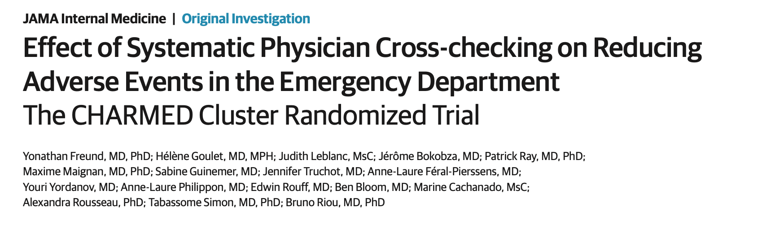
Notes:
Design: Cluster randomized crossover trial
Random sample of 14 adult patients (age 18 years) per day during two 10-dayperiod in 6 EDs (n = 1680 patients)
Intervention: Systematic cross-checking between emergencyphysicians, 3 times a day
Brief presentation of one physician’s case to another
Second physician’s feedback to the first
Outcome: Medical error in the ED
Identified using a 2-level error detection surveillance system, blinded to thestrategy allocation
54 adverse events (6.4%) in the cross-check group versus 90adverse events (10.7%) in the standard care group
RRR: 40%; ARR: 4.3%
Number needed to treat: 24 Patients
But we’re not in the ED!
Rapid decision making with incomplete information
Management by a sole clinician

Slide 16
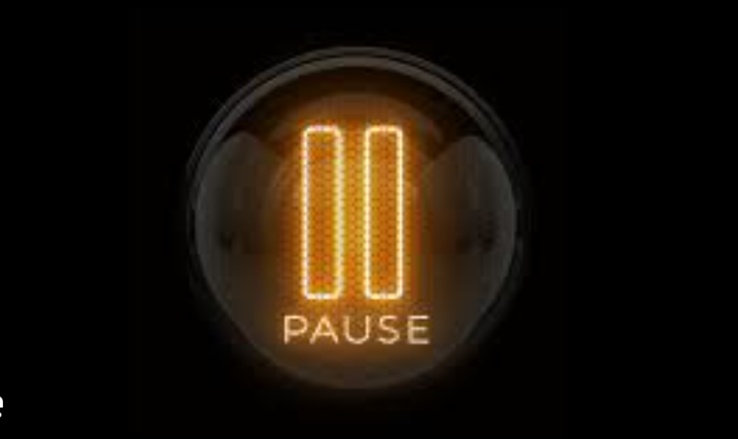
What could have gone differently for Somchai?
Diagnostic Cross-check—the PAUSE

Slide 17

What could have gone differently for Somchai?
Diagnostic Cross-check—the PROMPTING

Slide 18
Diagnostic Cross-check
RRT event
Structured contact between diagnostic guide and clinician
Closed-loop reassessment of diagnosis

Slide 19
Diagnostic Cross-check
When: Within 6hrs of day-time Rapid Response event
What: Verbal structured peer-peer diagnostic huddle
How: Diagnostic peer resource (cross-checker) will reach out to primary clinician via Securechat to find connection time
Who:
  Hospital Medicine Service lines: HMS 1- 15
  Diagnostic peer resource from ADEPT team

Slide 20

OCTOBER 6th
LAUNCH

Slide 21
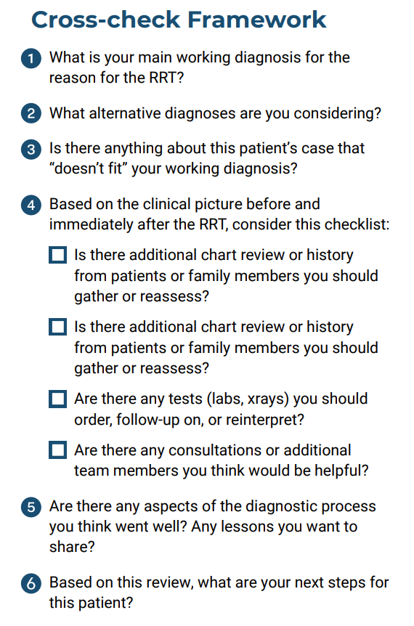
Your peer diagnostic resource will use a diagnostic huddle structure in conversation.

Slide 22
Tracking and Learning: Primary Clinician Survey
When: Within several days of offered diagnostic cross-check
What:
  <10 questions
    Satisfaction, willingness to do another DXC in the future
    Change to diagnostic care plan for this patient and for future patients
    Most valuable part of the process
How: Electronic REDCap survey via text or email

Slide 23
Our Goals
The Diagnostic Cross-check is here to make an existing valued practice easier and safer with the goal to improve diagnostic accuracy for our patients who experience RRT.

Slide 24
Our Vision
We can build culture and programs around diagnostic reflection that can improve patient safety, leveraging concepts of collective intelligence.
We believe this will make us among the most collaborative hospital medicine diagnosticians in the country.

Slide 25
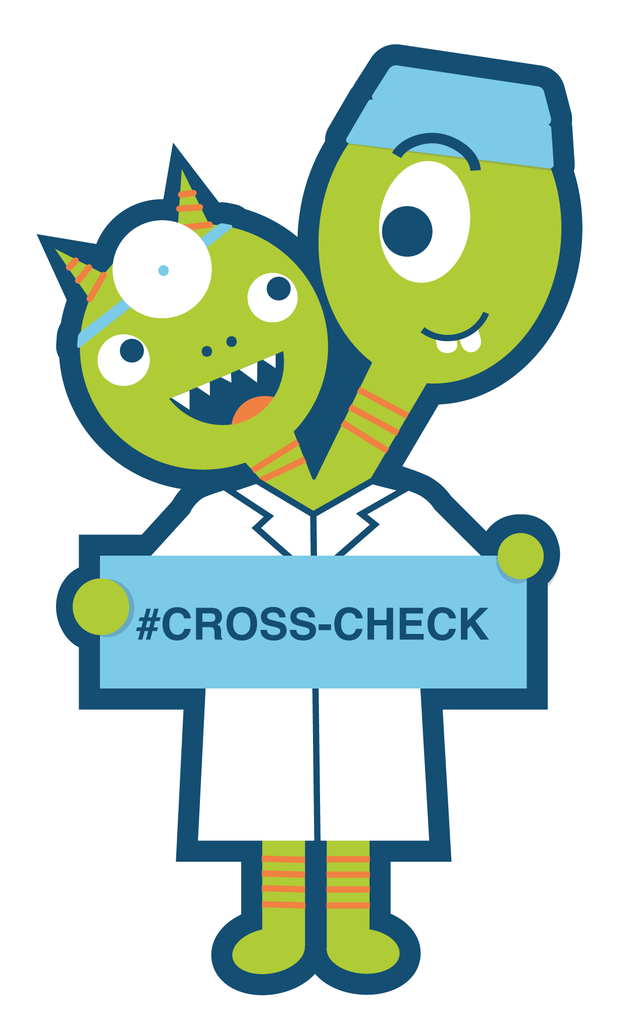
We believe more heads are better than one. So please give us your thoughts and feedback on this new intervention.
[QR CODE]

Slide 26
Supplemental for Reference/Incorporation

Slide 27
References
Freund Y, Goulet H, Bokobza J, et al. Factors associated with adverse events resulting from medical errors in the emergency department: two work better than one. J Emerg Med. 2013;45(2):157-162. doi:10.1016/j.jemermed.2012.11.061
Freund Y, Goulet H, Leblanc J, et al. Effect of Systematic Physician Cross-checking on Reducing Adverse Events in the Emergency Department: The CHARMED Cluster Randomized Trial. JAMA Intern Med. 2018;178(6):812-819. doi:10.1001/jamainternmed.2018.0607
Kämmer JE, Hautz WE, Herzog SM, Kunina-Habenicht O, Kurvers R. The potential of collective intelligence in emergency medicine: pooling medical students' independent decisions improves diagnostic performance. Med Decis Making. 2017;37(6):715-724. doi:10.1177/0272989x17696998
Hautz WE, Kämmer JE, Schauber SK, Spies CD, Gaissmaier W. Diagnostic performance by medical students working individually or in teams. JAMA. 2015;313(3):303-4. doi:10.1001/jama.2014.15770
Barnett ML, Boddupalli D, Nundy S, Bates DW. Comparative accuracy of diagnosis by collective intelligence of multiple physicians vs individual physicians. JAMA Netw Open. 2019;2(3):e190096. doi:10.1001/jamanetworkopen.2019.0096
Blanchard MD, Herzog SM, Kämmer JE, Zöller N, Kostopoulou O, Kurvers R. Collective intelligence increases diagnostic accuracy in a general practice setting. Med Decis Making. 2024;44(4):451-462. doi:10.1177/0272989x241241001

Slide 28
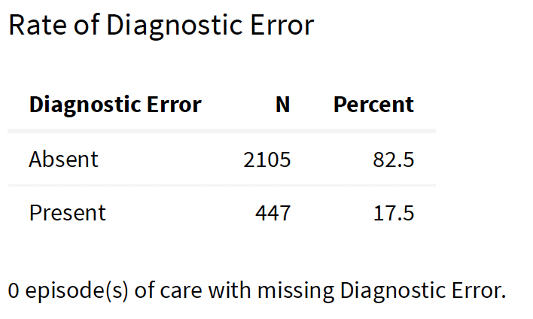
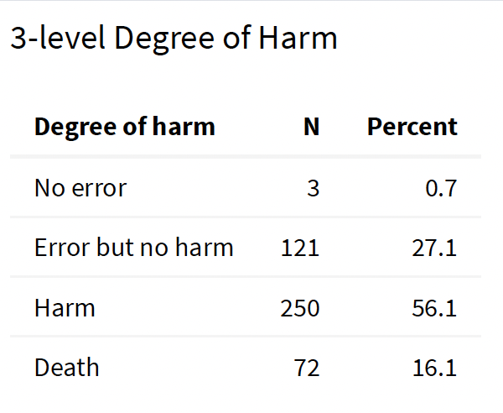
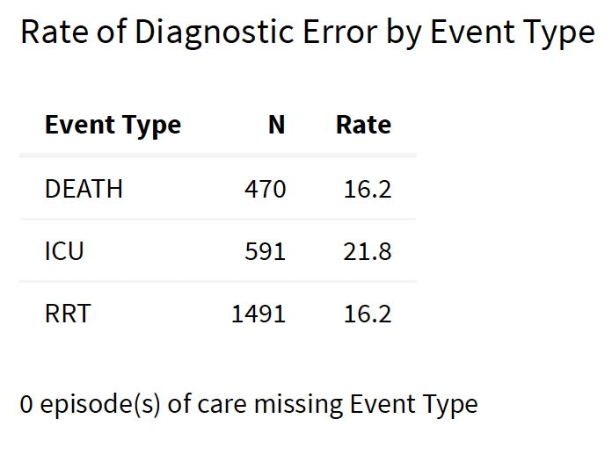
Our data

Slide 29
Data from Vizient:
Average ADEPT Hospital
 | Patients | Mean LOS | Mean ICU LOS | Total Cost
All admits | 29,100 | 7.16 | 4.97 | $ 28,112
ICU admits | 5780 | 12.25 | 4.97 | $ 62,656
ICU transfers | 1180 | 19.4 | 5.51 | $ 86,340
Deaths | 885 | 12.35 | 7.79 | $ 66,980
ICU transfer + death | 166 | 20.29 | 8.01 | $ 100,328
RRTs (estimated) | 3,000 | 11 | 5.7 | $ 50,000

Slide 30
Why we are here
2295 patients suffered a diagnostic error, 8% of total admits.
91 patients died from the diagnostic error.
33 patients transferred to the ICU due to their diagnostic error.
  Others had a prolonged LOS due to DE even without ICU transfer (temporary harm).
228 patients with an RRT had a prolonged LOS or required treatment due to a diagnostic error.
1205 patients had a DE that increased their cost of care.

Slide 31
Collective intelligence models in medicine
Complex care Board
  Tumor board
  Surgical/procedural case conferences
  Clinical case conundrums
External Second Opinions
Internal Second Opinion
Notes:
We have a strong history of collective intelligence in medicine—of leaning in multispecialty or multidisciplinary expertise.

Slide 32
Collective intelligence in medicine diagnosis
Multiple physician pooled differential > individual
  Barnett et al
    Digital diagnostic platform (HumanDx)
    Independent differential diagnoses of multiple MD's combined to a weighted list outperformed individual differential
      Present with groups as small as 2
      Increased accuracy up to groups of 9
  Blanchard et al
    GP with diagnosing real world cases
    Aggregated independent diagnoses outperformed individual
Notes:
Barnett et al. (2019, JAMA Netw Open)
Design: Compared the accuracy of multiple physicians’ independent answerscombined vs. individual physicians using a digital diagnostic platform.
Findings: The collective diagnosis was more accurate than most individualphysicians.
Takeaway: Aggregating physician input can improve real-world diagnosticaccuracy across specialties and experience levels.
Blanchard et al. (2024, Med Decis Making)
Design: Studied general practitioners diagnosing real-world cases; looked atcollective judgment aggregation.
Findings: Aggregated GP decisions outperformed individual ones, especiallyin complex or ambiguous cases.
Takeaway: Collective intelligence can be leveraged in frontline settings likeprimary care, not just in experimental settings.

Slide 33
UPSIDE: Teams versus individuals and DE
Question: Are direct attending care, resident teaching teams, or advanced practice provider (APP) services are associated with differences in DE rates?
Design: Retrospective observational study using average treatment effect and inverse probability of treatment weighting to estimate marginal rate ratios (mRRs) for DEs across care team models
Setting: Twenty-nine hospitals (UPSIDE!); 1,544 general medicine patients who transferred to the ICU or died in hospital
Primary outcomes were any DE and harmful DE
Notes:
A total of 1,544 patients were included in the study. Of these, 969 (63%) received care on teaching services, 442 (29%) on direct care services, and 133 (9%) on APP services. Patient demographics, including sex, age, race, ethnicity, timing of diagnostic error, and Elixhauser comorbidity score, were generally similar across care team models. However, there were significant differences in admission source, insurance payor, and reason for inclusion in the original study (Table 1).
There were significant differences in the unadjusted risk of diagnostic errors across care team models. All percentages were weighted by the inverse of the number of reviewed cases relative to the total eligible cases for review, which varied by site. Teaching teams had a weighted error rate of 19.9% (n=203), direct care teams had an error rate of 26.5% (n=100), and APP services had an error rate of 33.4% (n=36). Among these errors, 80% (n=169) on teaching services were harmful, 86.9% (n=82) on direct care services were harmful, and 62.8% (n=26) on APP services were harmful (Table 2).

Slide 34
UPSIDE: Teams versus individuals and DE
Of 1,544 patients: 63% were cared for by teaching teams; 29% by direct care; 9% by APP services
Any Diagnostic Error
  Direct care was associated with a higher risk of any DE compared with teaching teams
Harmful Diagnostic Error
  APP services had a lower risk of harmful DEs compared with direct care
Notes:
A total of 1,544 patients were included in the study. Of these, 969 (63%) received care on teaching services, 442 (29%) on direct care services, and 133 (9%) on APP services. Patient demographics, including sex, age, race, ethnicity, timing of diagnostic error, and Elixhauser comorbidity score, were generally similar across care team models. However, there were significant differences in admission source, insurance payor, and reason for inclusion in the original study (Table 1).
There were significant differences in the unadjusted risk of diagnostic errors across care team models. All percentages were weighted by the inverse of the number of reviewed cases relative to the total eligible cases for review, which varied by site. Teaching teams had a weighted error rate of 19.9% (n=203), direct care teams had an error rate of 26.5% (n=100), and APP services had an error rate of 33.4% (n=36). Among these errors, 80% (n=169) on teaching services were harmful, 86.9% (n=82) on direct care services were harmful, and 62.8% (n=26) on APP services were harmful (Table 2).

Slide 35
Comparison | Marginal Rate Ratio (95% confidence interval) | P-value
Risk of Any Diagnostic Error
Direct Care (n= 100 DE) vs Teaching Service (n= 203 DE) | 1.40 (1.06, 1.73) | 0.005
APP Service (n= 36 DE) vs Teaching Service (n= 203 DE) | 1.27 (0.95, 1.60) | 0.053
APP Service (n= 36 DE) vs Direct Care (n= 100 DE) | 0.91 (0.75, 1.07) | 0.30
Risk of Harmful Diagnostic Error
Direct Care (n= 82 harmful DE) vs Teaching Service (n= 169 harmful DE) | 1.10 (0.98-1.23) | 0.09
APP Service (n= 26 harmful DE) vs Teaching Service (n= 169 harmful DE) | 0.80 (0.58, 1.03) | 0.08
APP Service (n= 26 harmful DE) vs Direct Care (n= 82 harmful DE) | 0.73 (0.50, 0.96) | 0.03

Slide 36
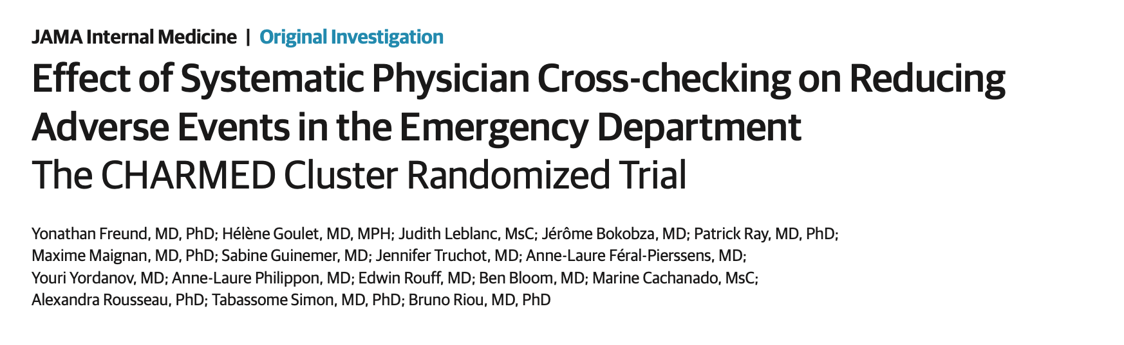

Slide 37
Physician cross-checking to reduce medical error
Design: Cluster randomized crossover trial
  Random sample of 14 adult patients (age 18 years) per day during two 10-day period in 6 EDs (n = 1680 patients)
Intervention: Systematic cross-checking between emergency physicians, 3 times a day
  Brief presentation of one physician’s case to another
  Second physician’s feedback to the first
Outcome: Medical error in the ED
  Identified using a 2-level error detection surveillance system, blinded to the strategy allocation

Slide 38
Physician cross-checking in ED to reduce medical error
54 adverse events (6.4%) in the cross-check group versus 90 adverse events (10.7%) in the standard care group
  RRR: 40%; ARR: 4.3%
  Number needed to treat: 24 Patients
But we’re not in the ED!
  Rapid decision making with incomplete information
  Management by a sole clinician

Slide 39
ADEPT Qualitative Case Review
Angela Keniston, PhD, MSPH

Slide 40
Agenda
What we did
What we learned
What is next

Slide 41
Design
Thematic analysis using a mixed inductive-deductive
Observations & interviews
Clinicians involved in patient care
Triangulation to enhance validity & deepen understanding of diagnostic practices

Slide 42
Data collection
Conducted observations during clinical shifts using a standardized data collection form
Semi-structured interviews and focus groups with clinicians conducted post-shift, recorded and transcribed

Slide 43
Data analysis
Rapid qualitative analysis with templated summaries and matrix analysis for early findings
Full thematic coding using both a priori and emergent codes
Triangulation between interview and observational data to identify and refine themes
Member-checking and reflexivity practices used to enhance trustworthiness and credibility

Slide 44
Questions
What are the daily habits and work patterns of diagnosticians? How does this differ with a focus on effective diagnostic experiences?
What diagnostic adaptations do clinicians make as they move through their day?
How is diagnosis influenced by patient factors, clinician factors, and the practice environment?

Slide 45
Preliminary findings
6 sites
12 observation sessions
~96 hours of observation
~ 120 patients observed
12 interviews
~30 minutes for each interview

Slide 46
Diagnostic work is nonlinear and iterative.
“When you have been doing this work for a while, need to pause and ask: Is this right? Does it fit? Am I missing something? Anything that doesn’t add up? What is the threshold for double-checking thought process?” (session 2)
Notes:
Diagnosis is seen not as a discrete event but as an evolving process influenced by data, time, conversations, and clinical evolution. Clinicians universally begin with electronic health record (EHR) reviews. This helps form a preliminary picture, although many emphasize avoiding anchoring bias by reassessing after patient contact. However, some clinicians placed greater weight on the value of seeing patients right away, whereas other clinicians placed greater weight on doing a thorough chart review before seeing patients. Most follow a structured morning routine (e.g., vital signs, labs, note review), then flexibly adapt the depth and pace of their diagnostic process based on time and patient complexity. Many clinicians revisit data for "slow thinking" once immediate tasks are handled, doing “deep thinking” and “deep dives” in the afternoons, evenings, or even at home, especially when interruptions during the day inhibit cognitive focus. Writing notes often serve dual purposes: as communication and as an evolving diagnostic checklist or thought tool. Clinicians often revisit and revise the differential as new information arrives or if the plan is not yielding expected outcomes.

Slide 47
Collateral is critical.
“I try to go to the patient’s side and have them replay to me—restate to me why they’re here or why they came to the hospital and share what their concerns are mostly. That allows for in a way a re-vetting of what they’ve shared with the provider earlier. Also sometimes there’s—they recall something that they may have not shared earlier. That gives them that opportunity to do so. That’s a part of my process of trying to have them repaint their picture and what their main concerns continue to be.” (session 11)
Notes:
Some teams very deliberately include nurses in rounding, Others would include nurses if they happened to be present. Very few patients had family present during rounds and a non-insignificant number of patients did not or could not fully participate in the conversation, mostly just answered questions directed at them. Communication challenges with patients are quite common (requiring an interpreter, using a virtual interpreter, altered mental status, lack of engagement, challenges with therapeutic rapport, disenfranchised patients). However, patient, family, and, to a lesser extent, nursing collateral are considered deeply important to the diagnostic process. Often conversation with patients and physical exam provided vital data that broadened the differential and changed the care plan.

Slide 48
Acknowledging and expressing uncertainty is a part of the diagnostic journey.
“Saying out loud, "I don't know. I'm not sure." Saying that to the patient. Saying that to our team when we're talking about, that unless you can bring up new piece of data or evidence that will make me more certain, I will continue to express my uncertainty. I have to go back and read something, and then that'll make me more confident” (session 3)
Notes:
Normalized among clinicians, who often emphasize the value of “sitting with” not knowing, acknowledging and expressing uncertainty is a necessary part of the process. However, this can be uncomfortable to acknowledge especially for learners.

Slide 49
Clinicians value both formal and informal peer consultation.
“I think what I've noticed is when you don't have a team, especially…when you're on your own, sometimes you don't have somebody to bounce off ideas from…If you have a question, there's nobody to bounce on diagnosis from. I didn't know many people, and I didn't know who to approach, initially, in my job, but now I think it's getting a little better. Even if I don't have a team member, I just approach one of my hospitalist friends. I just ask them" (session 6)
“We don't know what we don't know. Who helps us when we don't know what we don't know? I think this is some of what we were talking about this morning, right? When I don't know what's going on, I'm involving consultants, right? I want other minds. I want other people helping me think through this process. Who is giving me that second opinion? Is it a peer that I'm talking to in the room? Is it someone that I know who has some degree of a deeper knowledge around this? Whether it's another hospitalist, who I think might know, versus is it a consultant or a subspecialist?” (session 10)
Notes:
When working solo, hospitalists adapt by reaching out to colleagues for second opinions or diagnostic input. On teaching teams, residents often contribute fresh perspectives. Many value consultants as sources of insight but cite lack of direct communication as a barrier.

Slide 50
Clinical environment constraints hinder the diagnostic process.
“Honestly, it's time, right? Sometimes, I just don't have time to think about this. I can think. In our current, busy work culture, especially in the increase of focus on throughput and efficiency, we outsource thinking. In some ways, I'm just here to do the checkboxes and move things forward. I don't like thinking about it in that sense, but that is globally what my role is, right? It's like, "Lemme figure as much out as we can to get you moving forward and figure out who can help to continue to address things moving forward." Sometimes, it's just at night, after my kids go to bed, that I'm like, "Okay, lemme spend 10 minutes actually thinking about this—look into this." (session 10)
“We have traditionally taught about diagnosis as this purely cognitive process and it's really influenced by absolutely everything else. Probably more than what's just going on in our brain…the census, the testing availability, how long a test is gonna take, whether we can get an in-person interpreter, whether we can have a conversation. (session 12)
Notes:
Limited time, high patient loads, frequent interruptions, and systemic pressure for throughput lead to diagnostic shortcuts, missed nuances, and deferral of deep analysis.

Slide 51
Next steps
Formal rapid qualitative analysis
Full thematic coding
Dissemination!

Slide 52

Questions?

Slide 53
Peer second opinion practice and culture survey
Frequency of peer second opinion in diagnosis
  Types of diagnostic questions
Beliefs on value add to patient safety
Comfort seeking/providing peer second opinions
Barriers to seeking/providing peer second opinion

Slide 54
Peer second opinion practice and culture survey (mock data)
85% of you most of the time or always consult a peer when you are experiencing diagnostic uncertainty
65% of you believe that this practice improves diagnostic accuracy somewhat or to a great extent
BUT also---
70% of you report barriers such as fear of bothering a colleague or vulnerability as inhibiting you somewhat or to a great extent
60% of you feel somewhat or very uncomfortable disagreeing with a colleague's diagnosis

Slide 55
So why the Diagnostic Cross-check?
Evidence that more than one clinician is more likely to arrive at an accurate diagnosis than a solo clinician
Unstructured peer consultation is a common practice, both in ethnographic observation and in self-reported survey
Peer consultation is valued but structural barriers exist to its use
There is precedent for cross-check reducing medical error in a parallel setting (ED)

Slide 56
So why the Diagnostic Cross-check?
The Diagnostic Cross-check is here to make an existing valued practice easier and safer and to improve diagnostic accuracy for our patients.

