Slide 1
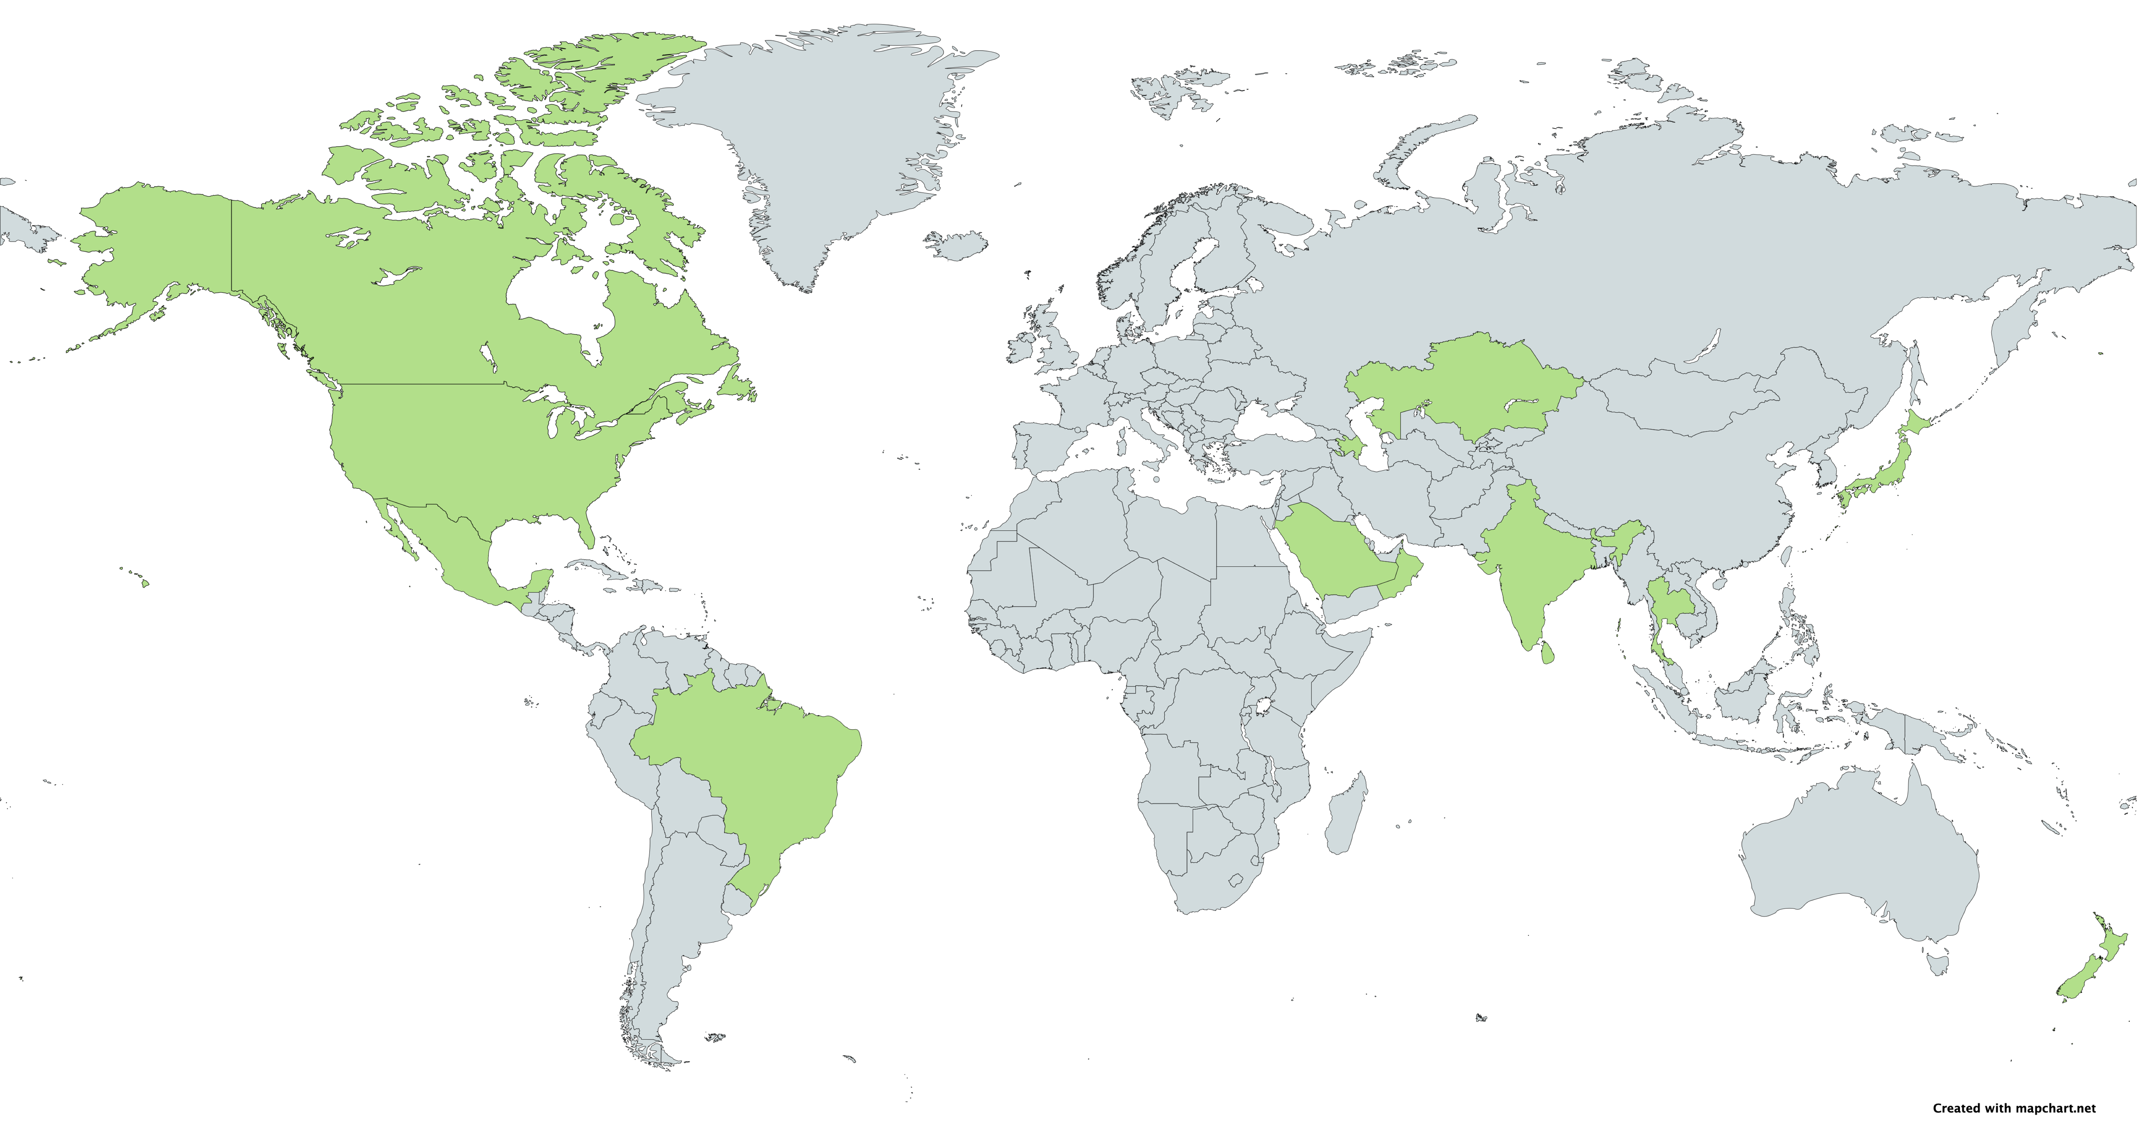
Mortality Associated with Delayed Vascular Surgery During the COVID-19 Pandemic Disproportionately Affects Female Patients
Ethan Moore BA¹, Max V. Wohlauer, MD¹, Mahmood Kabeil, MD¹, Riley Gillette, BS¹, Nicolas J. Mouawad, MD², Jason Chuen, MD³, Joseph Mills MD⁴, Judith Lin MD⁵, London Guidry Lyons, MD⁶, Issam Koleilat, MD⁷, Leigh Ann O’Banion⁸, MD, and Robert F. Cuff, MD⁹
University of Colorado Anschutz Medical Campus¹, McLaren Health System², Austin Health³, Baylor College of Medicine⁴, Michigan State University⁵, Louisiana State University Program⁶, RWJ/Barnabas Health⁷, University of California San Francisco (UCSF) Fresno⁸, Spectrum Health⁹
Results
Background
Conclusions
On March 13th, 2020, the University of Colorado Hospital postponed all elective surgeries. Since the COVID-19 pandemic is the first pandemic to arise since vascular surgery became a distinct specialty, guidelines for triaging vascular surgeries were primarily based on physician experiences rather than objective data. The goal of this study was to determine the impact that surgery postponement had on patient mortality.
Total Patients
(n=1,050)
Patients Who Died Waiting for Surgery
(n=29)
Widespread delays and cancellations, while possibly necessary due to COVID-19 pandemic-related factors, could represent a significant number of additional deaths.
The data suggests that females may be at unique risk of delay-related mortality.
Further research could identify patients at a higher risk of mortality and could allow better decision making in times of healthcare resource rationing during global crises.
Male
Male
587 (56%)
13 (45%)
Countries with VASCC patients in the study
Female
Female
461 (44%)
16 (55%)
Methods
2.8% of Patients Died Waiting for Surgery
The Vascular Surgery COVID-19 Collaborative (VASCC) was founded in March 2020 by Max Wohlauer, MD and Robert Cuff, MD to assess the affect of delayed surgeries on vascular surgery patients. VASCC is an international REDCap registry housed at the University of Colorado where outcomes of patients with delayed vascular surgeries during the COVID-19 pandemic are recorded. Patient conditions consisted of five categories: aortic, carotid, peripheral artery disease (PAD), end-stage renal disease (ESRD), and venous. An interim data analysis of patients from 14 countries who died before their postponed surgeries was performed.
Cause of Death | Number of Patients
Unknown | 12
COVID-19 | 10
Sepsis | 2
Aneurysm rupture | 1
Aorta Rupture | 1
Congestive heart failure | 1
Myocardial infarction | 1
Respiratory failure | 1
Total | 29
Disclosures
No financial disclosures.

