Slide 1
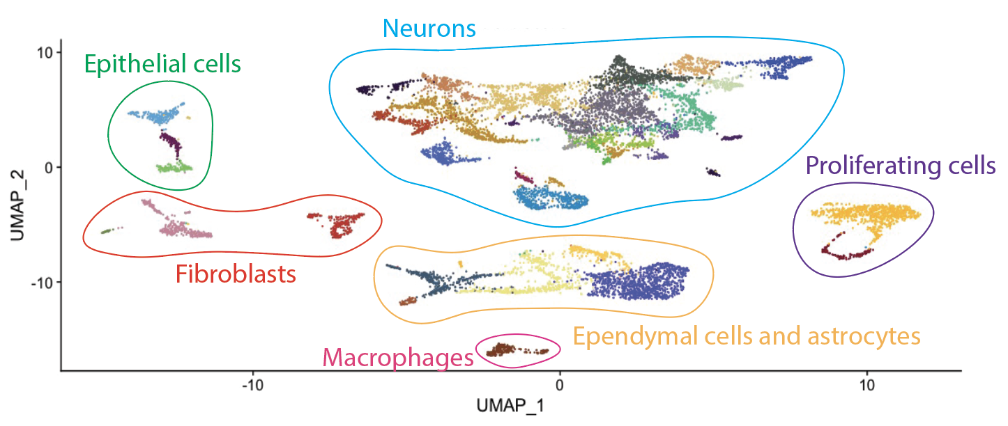
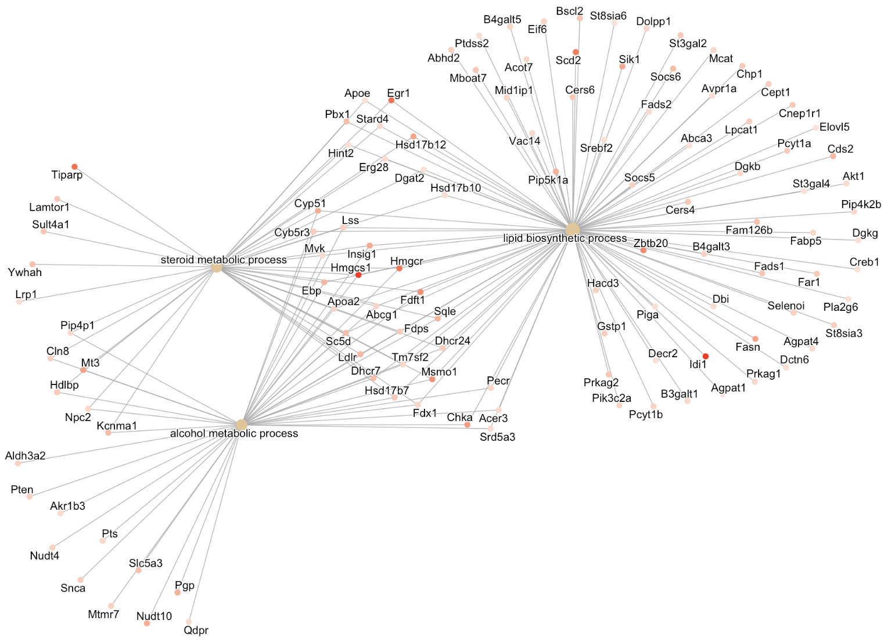
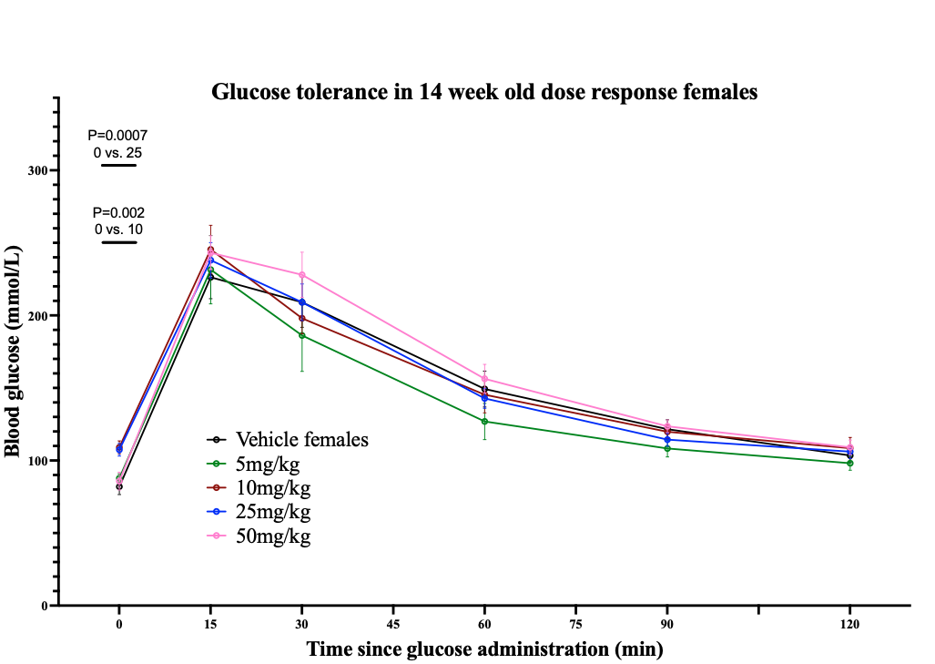
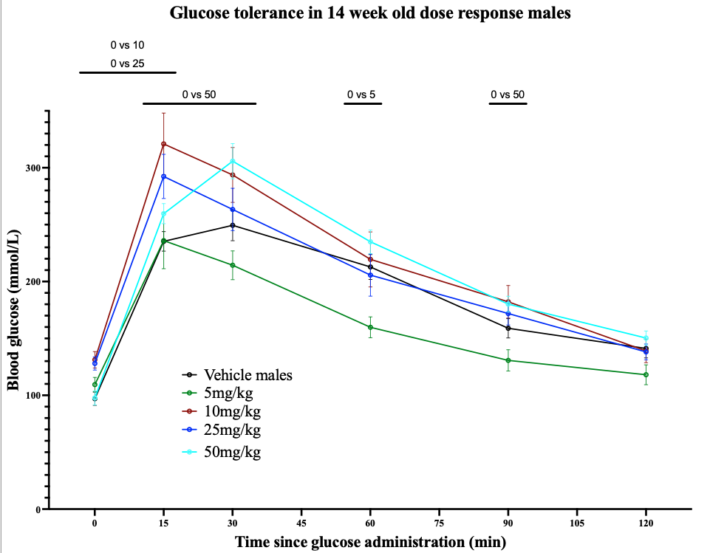
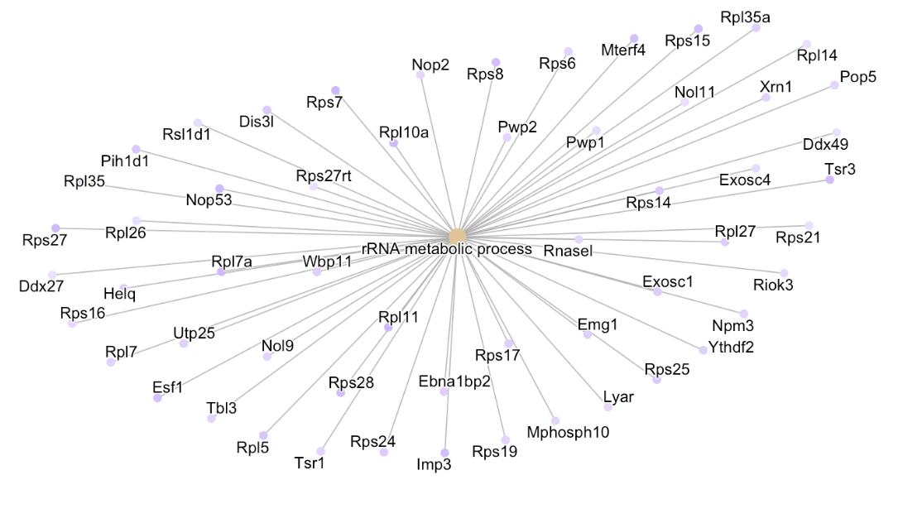
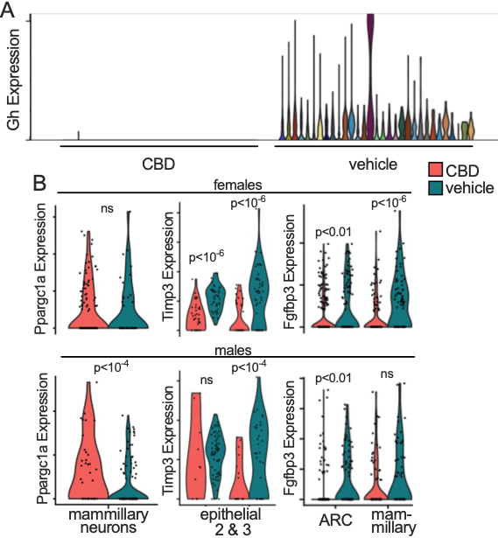
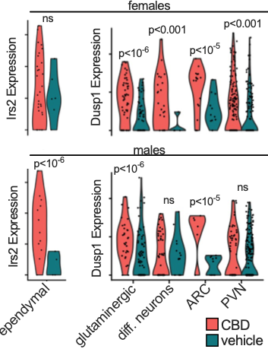
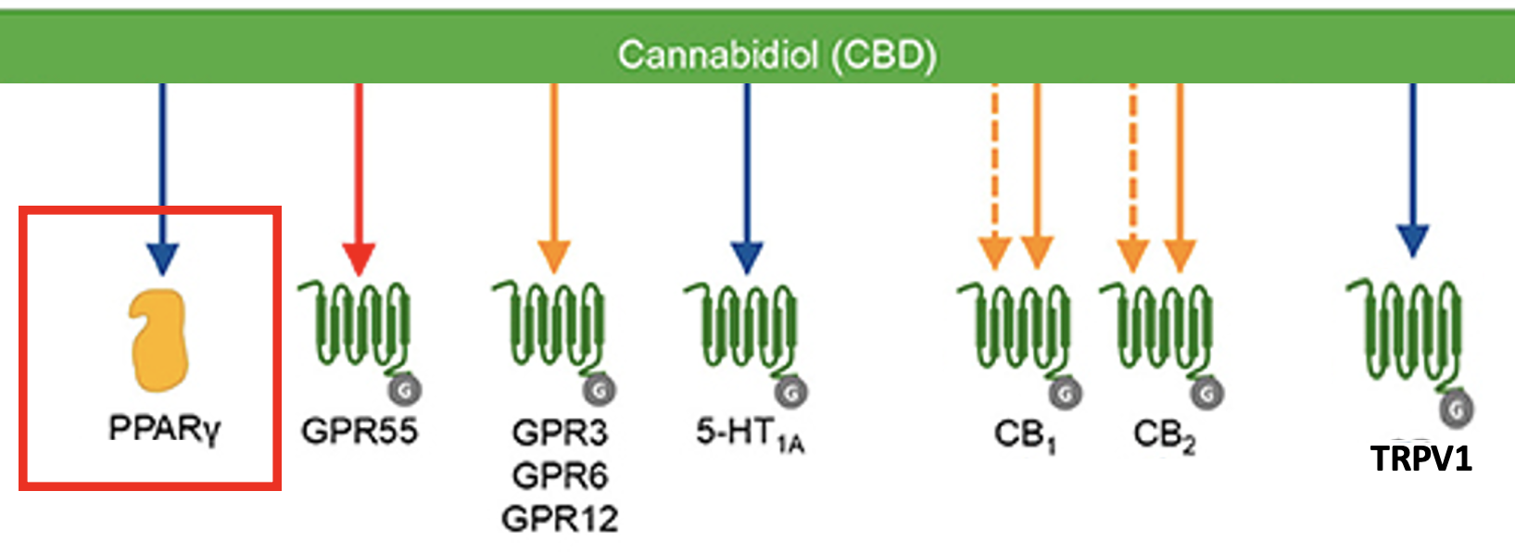
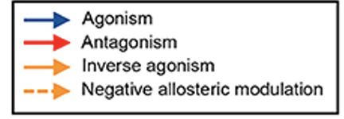
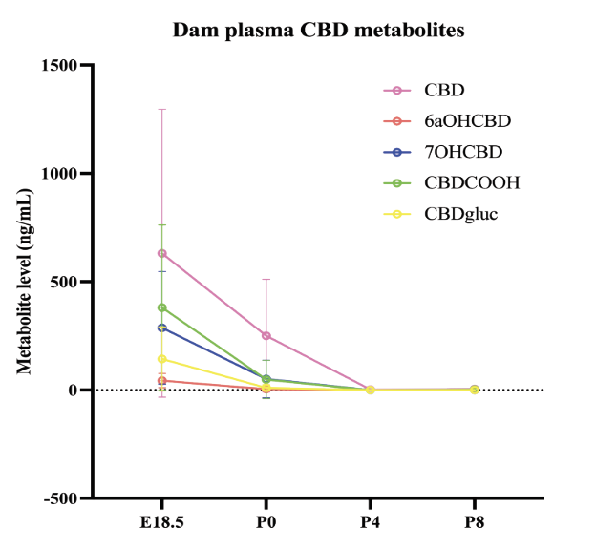
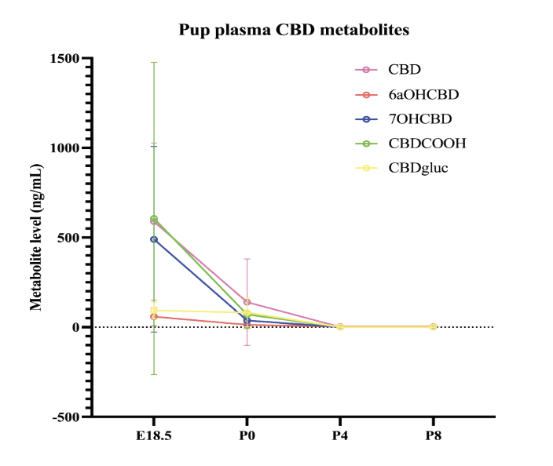
Gestational Cannabidiol (CBD) Consumption Impacts Offspring Hypothalamus Development and Metabolism in a Sex-Specific Manner
Lillian Folts, Karli Swenson, Becky O’Rourke, Emily Bates. Department of Pediatrics, University of Colorado | Anschutz Medical Campus
Goal: Determine how gestational CBD consumption effects offspring metabolism
CBD Exposure Alters Gene Expression in 1.5-day-old Hypothalamus
Fetal CBD exposure induces glucose intolerance and insulin resistance in a dose and sex-dependent manner
Postnatal day 1.5 hypothalamus dissection of two CBD exposed female offspring, two vehicle exposed female offspring, two CBD exposed male offspring and two vehicle exposed male offspring. Single cell RNA sequencing, 5,000 cells per sample, 100,000 reads per cell.
A
B
Consumption During Pregnancy is Increasing
Neurons 5 - ARC
Consumption Rates_{1,2,3,4}:
Pregnant people: 7% self reported
Consumption increased 62% 2002 - 2014
Highest consumption <25 years old
Biological samples show verbal underreporting, cord blood ~22% positive
Consumption reason_{5,6}:
Nausea and/or vomiting (77.8%, 77%)
Stress/anxiety (81.5%, 75%)
Pain (55.1%, 83%)
Insomnia (74%)
Appetite (70%)
Above: UMAP plots of cell type based on gene expression. Right: GO term analysis (gene enrichment analysis) identifies biological processes altered between vehicle exposure and CBD exposure. GO terms of interest include insulin signaling, glucose/carbohydrate metabolism and transport, lipid metabolism/biosynthesis, and nutrient sensing etc.
C
D
Clinical Studies of Marijuana Exposure Show Harm
Clinical studies are:
Retrospective
Self-reported
Dosing is unclear
Nonspecific to marijuana components
Confounded with nicotine and/or alcohol
Clinical studies show_{7,8}:
Decrease in birth weight
Increase in preterm labor
Increase in small for gestational age
Increase in NICU admissions
Higher circulating blood glucose by 5 years of age₉
A. Glucose tolerance test for dose response CBD and Vehicle exposed females (Vehicle N=21, 5 mg/kg CBD = 11, 10 mg/kg CBD = 11, 25 mg/kg CBD = 20, 50 mg/kg = 23) and B. males at 14 weeks (Vehicle N=31, 5 mg/kg CBD = 10, 10 mg/kg CBD = 13, 25 mg/kg = 18, 50 mg/kg CBD = 35). C. Insulin tolerance test for CBD and Vehicle exposed females (Vehicle N = 7, 5 mg/kg CBD = 11, 10 mg/kg CBD = 10, 25 mg/kg CBD = 5, 50 mg/kg CBD = 5) and D. males (Vehicle N = 14, 5 mg/kg CBD = 13, 10 mg/kg CBD = 5, 25 mg/kg CBD = 4, 50 mg/kg CBD = 9) at 14 weeks.
CBD activates receptors in the developing brain₉
PPARg receptor activation in-utero impacts offspring metabolism
PPARg:
Expressed in:
Hypothalamus
Liver
Pancreas
Adipose tissue
Is critical for implantation, intrauterine growth restriction, preterm birth and gestational diabetes₁₀
Is activated by maternal high fat diet and maternal obesity which cause increased incidence of offspring obesity and diabetes
Fetal exposure to PPAR agonist rosiglitazone reduces expression of several components of the insulin signaling pathway and glucose transporters in fetal sheep cardiac muscle
Fetal CBD exposure alters gene expression regulating proliferation of hypothalamic neural progenitor populations. P-values based on Wilcoxon rank sum test. PVN, paraventricular nucleus, ARC, arcuate nucleus.
Conclusions and Implications
Fetal CBD exposure induces male glucose intolerance and female insulin resistance
Fetal CBD exposure:
Changes metabolic gene transcription and cell populations in the newborn hypothalamus of male and female offspring
In adult female offspring:
Does not alter in glucose tolerance
Induces insulin resistance in a dose-dependent manner
In adult male offspring:
Alters glucose tolerance in a dose-dependent manner
Induces insulin resistance in a dose-dependent manner
Children exposed to CBD during development could be predisposed to diabetes or other metabolic disorders, warranting further research
A.
B.
Expressed in the developing brain (including the hypothalamus)
Methods
C.
D.
Blinding: I was blinded to which group was CBD exposed and which was vehicle until experiments were complete.
Future work
At the bench:
Understand how fetal CBD exposure could sensitize offspring to postnatal high fat diet
Analysis of CBD transfer through breastmilk
Determine molecular mechanisms driving metabolic phenotypes
In the clinic:
Educate clinicians, dispensaries, and the lay public about the potential risks of CBD consumption during pregnancy
CBD metabolite validation
Via blood plasma liquid chromatography tandem mass spectrometry of litters from embryonic day 18.5 to postnatal day 8
E.
F.
Funding: Institute of Cannabis Research, Colorado Clinical and Translational Science TL1 TR002533, Diabetes Research Center, University of Colorado Anschutz Medical Campus
IACUC approval: 139
References: 1. Ko et al 2020. 2. Jutras-Aswad, D. et al. 2019., 3. Crume et al. 2018. 4. Metz et al. 2019. 5. Dickson et al. 2018. 6. Marist Poll April 2017. 7. Hayatbakhsh, M. et al., 2012. 8. Chia-Shan Wu, et al. 2011. 9. Moore, et al 2022. 10. Hutson et al. 2019.
A. Glucose tolerance test for CBD and Vehicle exposed females (CBD N=23, Vehicle N=21), and B. males at 14 weeks (CBD N=35, Vehicle N=30). C. Insulin tolerance test for CBD and Vehicle exposed females (CBD N=9, Vehicle N=11) and D. males (CBD N=16, Vehicle N=14) at 14 weeks. E. Insulin tolerance test for CBD and Vehicle exposed females (CBD N=11, Vehicle N=9) and F. males (CBD N=13, Vehicle N=9) at 22 weeks.

