Slide 1
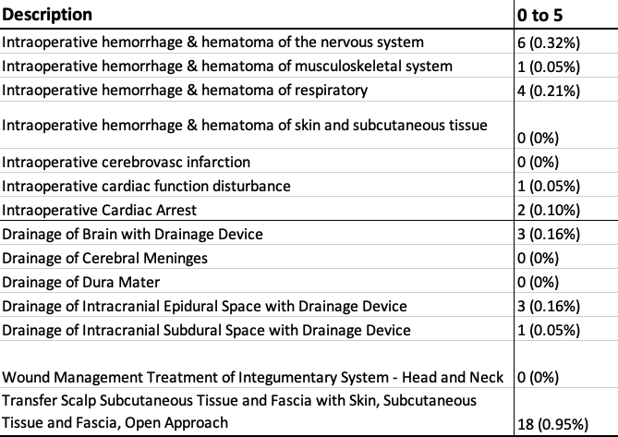
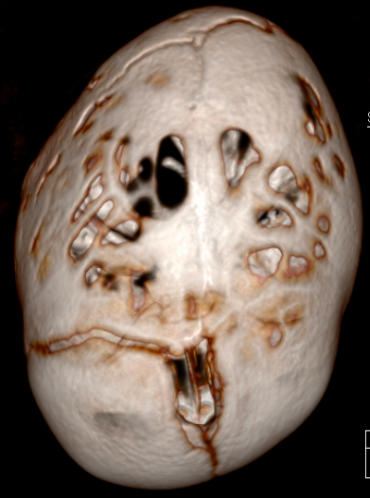
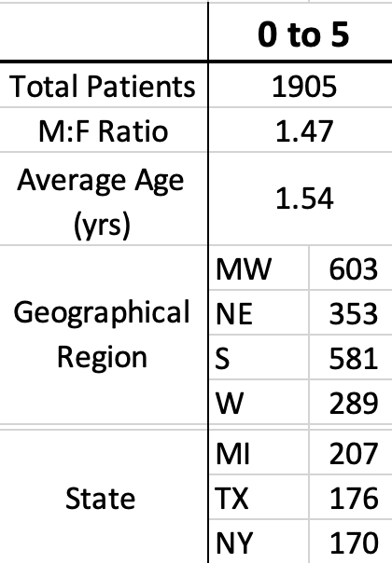
National CPT and ICD Surgical Outcomes After Pediatric Front-orbital Advancement Surgery
Anna D. Lee, BS¹; Elliot Le, MBA, MD¹; Jason Yu, DMD MD¹; Christodoulos Kaoutzanis, MD¹; David Khechoyan, MD¹
¹ Division of Plastic and Reconstructive Surgery, University of Colorado School of Medicine, 13001 E 17th Pl, Aurora, CO 80045
Background
Results
Conclusion
Frontoorbital advancements (FOA) for craniosynostosis is the gold-standard of treatment to prevent future neurological deficits from restricted calvaria growth
Due to many centers operating in isolation, FOA complications and reoperation rates have limited studies completed on a national level
This retrospective analysis aims to use a multicenter billing database with more recent data to identify the current demographics of patients undergoing FOA, evaluate the short-term and long-term reoperation rates, and identify intra- and post-operative complication rates
a
b
FOA surgical repair was found to be a safe procedure with a 1.1% re-operation rate 365 days after surgery, and an overall return to surgery rate of 7.15% 365 days after surgery.
Surgeons must continue to stay vigilant when treating pediatric craniosynostosis patients to maintain low complication rates and better inform future families of unintentional FOA procedure outcomes
c
Implications
Figure 1. Example of (a) scaphocephaly and plagiocephaly in a 3D reconstruction model of the calvarium. Cartoon models of (b) intact sutures and (c) the model’s craniosynostoses.
We effectively address the need to quantify in a multicenter analysis the complications and need for reoperations after FOA
This abstract influences the performance of clinicians to remain vigilant in decreasing surgical complications and provides a resource for families to reference when concerned about FOA complications
Table 2. Intra-operative complications based on ICD-9 and ICD-10 codes
Methods
Consecutive patients needing forehead advancement between 2010 and 2020 were identified from a PearldiverTM, a national deidentified aggregate database
Patients were eligible for inclusion if they underwent operative treatment of a FOA and were billed with CPT-21175 between the ages 0 and 5 years old.
Intra and post-operative complications were queried using CPT, ICD-9, and ICD-10 codes.
Post-operative complications were identified 0, 30, 90, 180, and 365 days after surgery and identified based on need for reoperation
Disclosures
Figure 2. Post-operative complications identified for patients aged 0-5 years old, based on CPT and ICD codes. Percentage at end of each bar represents total percent of patients who were coded with the complication at the end of 365 days.
None
Table 1. Demographics of FOA in patients aged 0 to 5 years old

