Slide 1
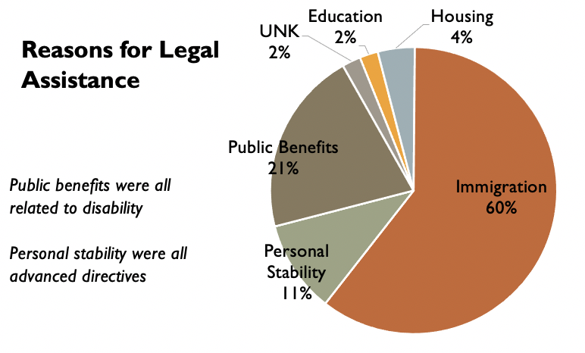
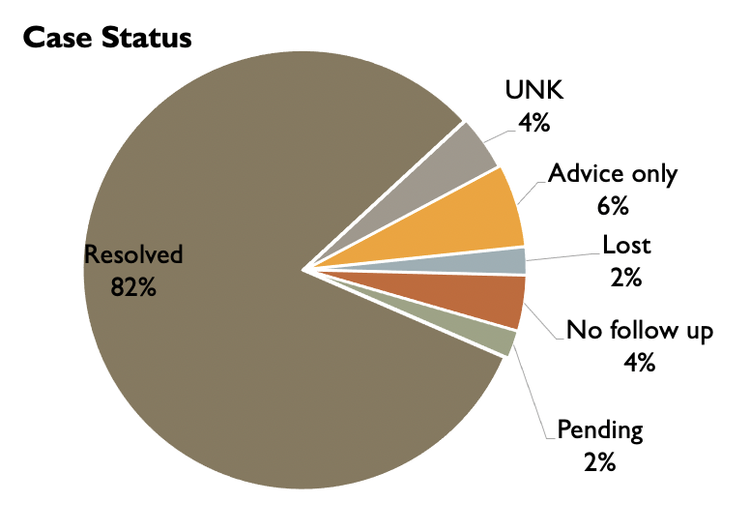
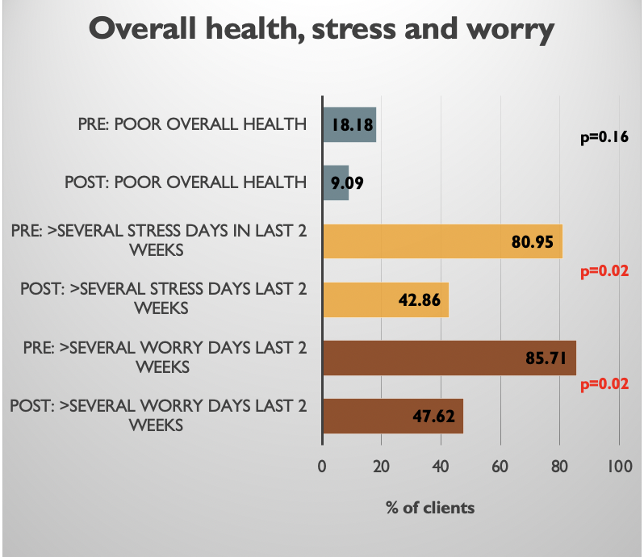
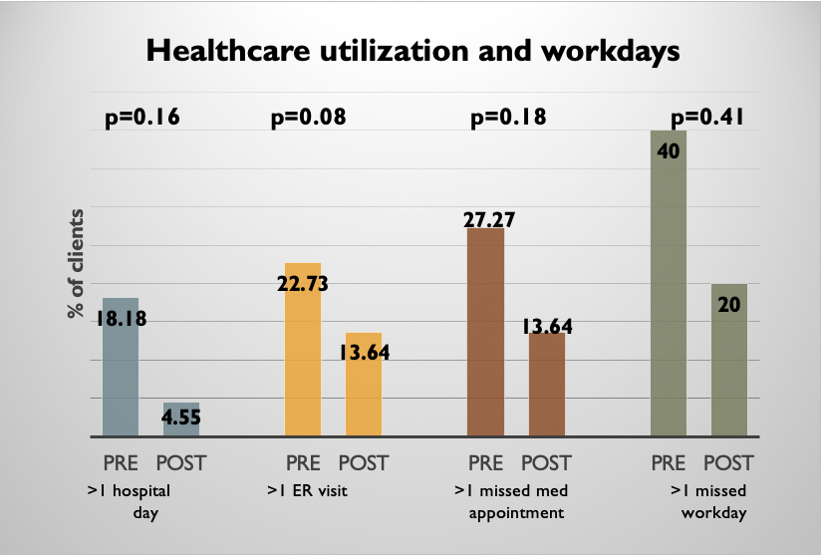
Evaluation of Medical Legal Partnership Colorado
Gabriela Santos, MPH, MPA
Background
Results
Discussion
Medical-legal partnerships (MLPs) were created in 1993 to support collaboration between healthcare providers and legal professionals to address social determinants of health tied to laws, policies, and enforcement.
Services provided are determined by I-HELP, which encompasses Income and benefits, Housing and utilities, Education and employment, Legal status, and Personal and family stability. ^{1,2}
Prior research has seen positive changes including improved resources and health. Clients have received increased public benefits including housing, insurance, and nutritional. Physical and mental health has also been seen to improve. ^{1,2} An example is lawyers supporting asthmatics with triggers within the home. They can work to have landlords remove the hazards or change housing. ³
The Medical-legal Partnership Colorado (MLP-CO) began in 2014 at the Salud Family Health Center in Commerce City, Colorado. From 2015 to 2020, approximately 200 cases were closed, with 185 open cases in November 2020. During 2020, MLP-CO expanded services to patients in various Salud clinics in the Denver Metro Area and opened an office within one clinic in Aurora. In prior MLP-CO study, 76% of clients who visited the emergency room less often and missed fewer medical appointments after the legal intervention. Additionally, 71% of clients reported their physical health improved and, 76% reported their mental health improved since their first meeting with the lawyer. ⁴
MLP-CO sought to assess the program's impact at Salud Family Health Centers on legal case resolution, satisfaction with legal care, health outcomes, and healthcare utilization among clients.
The primary reason for legal assistance was immigration (60%), followed by public benefits (21%). All public benefit cases were for disability benefits. From the total random sample, MLP-CO also resolved 82% of cases by the start of this study.
Survey response rate was 59%
Demographics
Median age - 54 years old 54% Female 75% < $30,000 per year
12.5% uninsured 54% SNAP 21% SSI/SSD
68%. Spanish in the home 58% less than high school education
Legal Services
62% met with lawyer 3-6 times. 90% lawyer always or usually listened
86% lawyer always or usually explained clearly
86% lawyer always or usually spent enough time
86% rated lawyer 4 or 5 (0-5 with 5 being the best lawyer possible)
75% immigration clients said the lawyer was helpful and situation was improved
Health outcomes – comparison from baseline to follow-up
Decreased days of poor physical health (p=0.03) and mental health (0.006), and days with no activity (p-0.39) at follow up
Poor overall health reduced at follow up (p=0.16)
Less days of stress (p=0.02) or uncontrolled worry (p=0.02)
Healthcare Utilization –
Decline in all categories. Measured as more than 1 day in the category
- Days in the hospital. - Emergency room visit. - Missed medical appointments. - Missed workdays
Demographic data demonstrated that many of the clients served by MLP-CO came from underserved populations at higher risk for unmet legal issues. Those who were served by MLP-CO had a substantial likelihood of receiving the support they need based on the number of closures and the reports of improved situations. Not only was the service meeting the legal needs, but clients had positive experiences with their lawyers.
Statistically significant evidence showed reduced days of poor mental and physical health after the legal intervention. Addressing unmet legal needs can help to improve an individual's health and can be an upstream solution. Though not statistically significant, many of the other areas measured showed a decline from baseline to follow-up. This same trend occurred with healthcare utilization. Additional studies can help strengthen these findings.
Limitations
Small sample size
Phone calls
  Answering 800 number from translator
  Political calls happening at the same time
Using translation service means that questions may vary slightly
  “Usually” -> Usualmente or Generalmente
  “Fair” -> Pobre or Regular were common switches
Methods
References
At intake, clinic staff gave the baseline survey upon intake. The questions for physical and mental health originated from the Short Form-36 (SF-36) questionnaire. For the follow-up survey, the same SF-36 questions were used along with questions about legal services and legal satisfaction. Researchers called each client at least three times, leaving voicemails, to complete the follow-up survey.
A tele-interpreter provided support for clients with limited English proficiency. If clients provided more information than the question asked, notes were kept at the top of the survey to add qualitative information. Additional case data were provided by MLP-CO records.
Data analysis included descriptive statistics of the population served, cases solved, and satisfaction with legal care received. Univariate comparisons between baseline and follow-up variables were completed for health outcomes and healthcare utilization. Paired Wilcoxon signed-rank nonparametric tests were used for numerical variables, while researchers performed McNemar’s paired tests for categorical variables.
1. Tobin-Tyler, E., & Teitelbaum, J. B. (2019). Medical-Legal Partnership: A Powerful Tool for Public Health and Health Justice. Public Health Rep, 134(2), 201-205. doi:10.1177/0033354918824328
2. Zuckerman, B., Sandel, M., Lawton, E., & Morton, S. (2008). Medical-legal partnerships: transforming health care. Lancet, 372(9650), 1615-1617. doi:10.1016/s0140-6736(08)61670-0
3. O’Sullivan, M.M., et al., Environmental Improvements Brought by the Legal Interventions in the Homes of Poorly Controlled Inner-city Adult Asthmatic Patients: A Proof-of-Concept Study. Journal of Asthma, 2012. 49(9): p. 911-917.
4. The Partnerships. 2020 [cited 2020]; Available from: https://medical-legalpartnership.org/partnerships/

