Slide 1
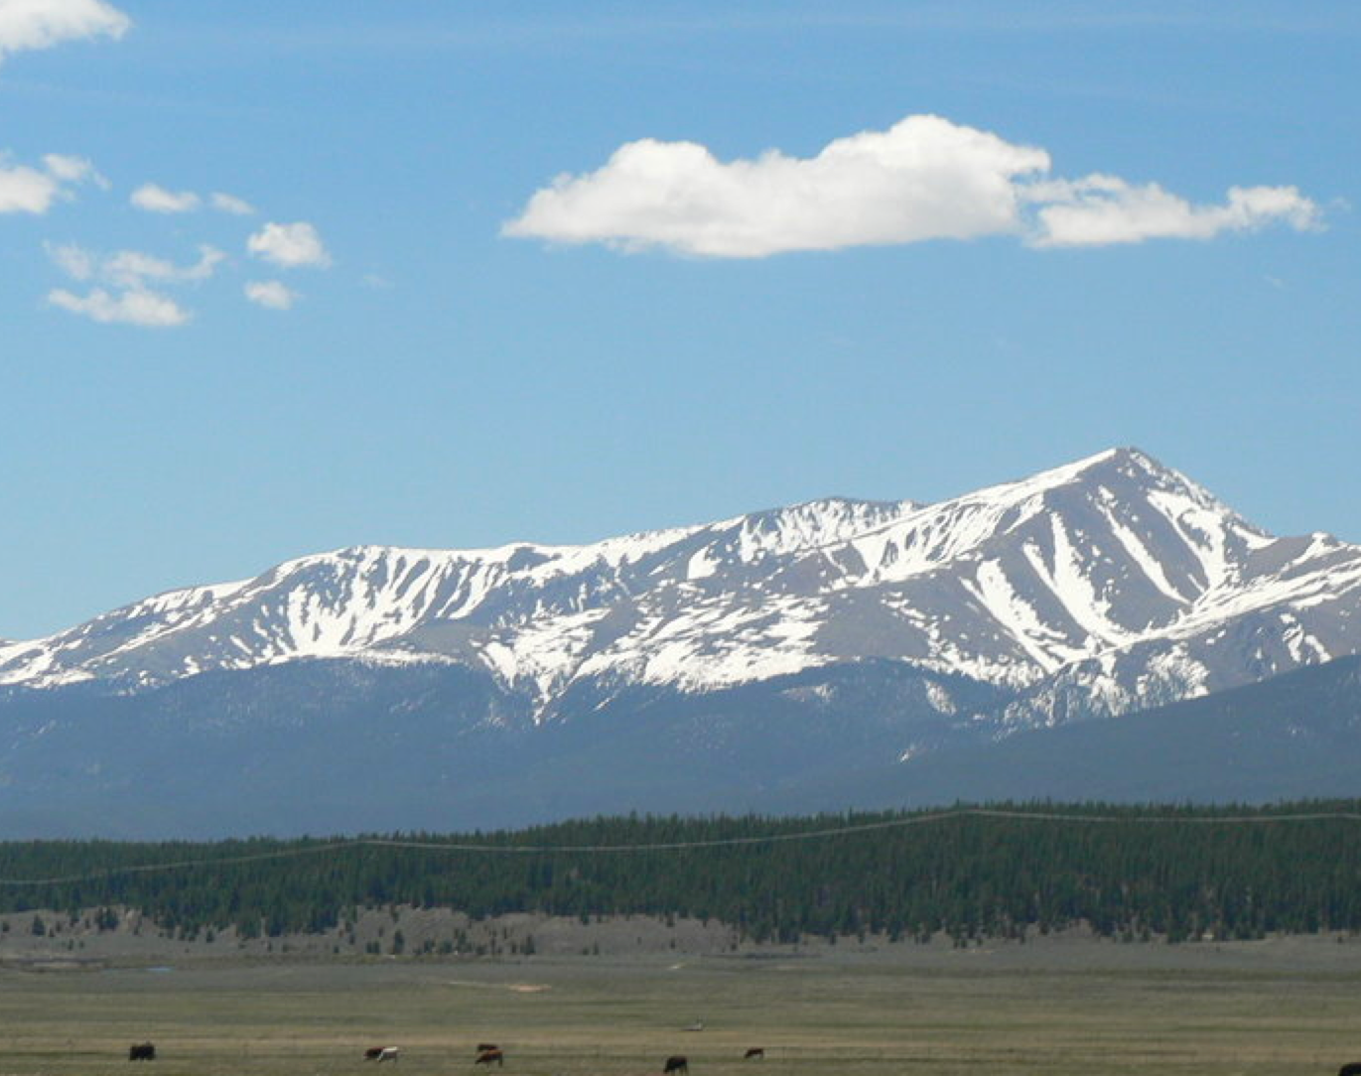
Alpine – Summit Introduction
April 2026
Anna Neumeier, MD- Assistant Dean Post-Clerkship (Alpine-Summit) Curriculum
Chad Stickrath, MD- Associate Dean for Post-Clerkship (Alpine-Summit) Curriculum

Slide 2
Agenda
Welcome & Goals
Timeline Overview
Advanced Science Courses
Acting Internships & Electives
Trails
Integrated Science Selectives
Critical Care Rotation Requirement
Basecamps

Slide 3
Alpine Mission & Goals
Through a highly tailored curriculum guided by an individual learning plan developed in conjunction with their coach, students will: deepen their knowledge and skills as well-rounded physicians-in-training, choose and prepare for their residency and enhance their ability to positively transform the health of their future community beyond their direct clinical practice.
Add
Depth & Breadth to your Education
Select
A specialty, apply for residency, interview, and match!
Strengthen
Skills needed for your chosen career
Fill
Gaps in your education and ensure that you are competent in all core areas before graduation
Explore
Areas of medicine that interest you
Skills needed to lead transformation

Slide 4
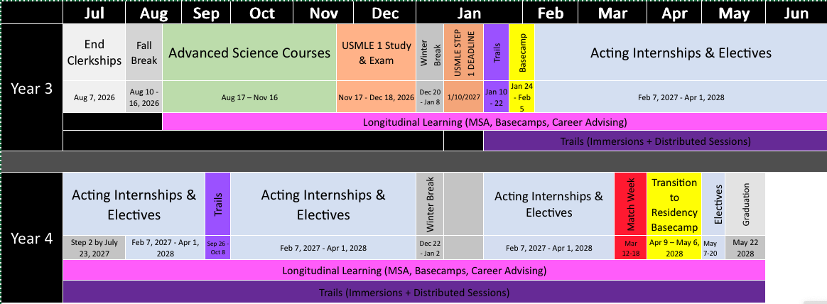
Alpine – Summit Timeline
AI/Elective Orient Lottery & Specialty Advising
More AI/Elective Success Details
Detailed Post-Clerkship & ASC Orientation

Slide 5
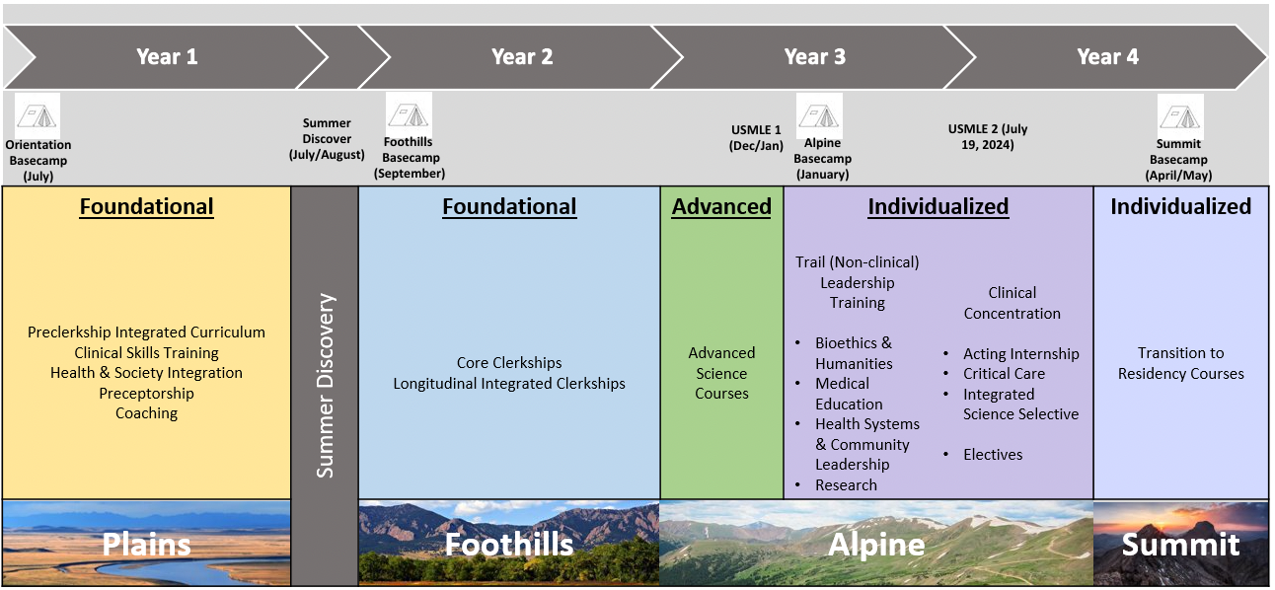
Alpine – Summit Requirements
Already on Calendar:
ASCs – 13+ weeks
Trail – 4 weeks
Alpine Basecamp – 2 weeks
Transition to Residency Basecamp – 4 weeks
Student schedules in Fall Lottery
ICU Requirement – 2-week Alpine Critical Care (IDPT 8096) or a 4-week ICU course
Integrated Science Selective – 4 weeks
Required Acting Internship – 4 weeks
Additional Courses – 28 weeks
Finish MSA, Complete Other Trail Requirements, Take Step 1 & Step 2 by Deadlines
Leaves 18+ unstructured weeks for: Step 2, Interviews, Vacation, Weddings, Additional Courses
Notes:
93 weeks: 66 required here + 4 weeks Step 1 = 23 weeks left over (5 holiday/break weeks + 18 unstructured)

Slide 6
Scheduling Concepts
Lottery for 2027
Step 1 Deadline: Jan 10, 2027
Step 2 Deadline July 23rd, 2027
If need score to determine competitiveness for residency -> consider earlier time
If need early AI/Elective timeframe for additional career exploration, can take later/closer to deadline
Talk to your specialty advisor
Schedule Individualized Curriculum each fall for following calendar year with Lottery
You have lots of flexibility and unscheduled time in Alpine-Summit!
Schedule absences for voluntary situations outside of required curricular elements (in Red)
Lottery for 2028

Slide 7
Attendance / Absences
Advanced Science Courses
Rest of Alpine-Summit
Excused absences – 2 Days
Voluntary Requests must be submitted via form 60 days in advance
Involuntary Requests- illnesses, emergencies- notify as soon as able via form
Conference – 48 hours per AY (in courses > 2 weeks)
4-wk Course – Up to 2 Excused
2-wk Course – Up to 1 Excused
Total per AY – 5 Excused (after ASCs in Year 3)
Request via Alpine Summit Absence form
Professionalism form for non-adherence
Exceptions:
Extenuating Circumstances (e.g.- can only get an away rotation during a Trail immersion week- will excuse up to 5 days with make-up work submission)
Flexibility around interviews
Notes:
As we introduce our phase, we will introduce the attendance policy.
To begin with the rationale, Medicine is a profession of accountability- patients, teams, and systems rely on our presence. These policies are not meant to be punitive but rather operationalize professionalism early in training.
Being present demonstrates respect for our patients, our peers, our faculty and our staff. We also anticipate that at times, you may need to miss.
Therefore, all absences require notification. If you have an advanced absence, that is voluntary, you must request via our form 60 days ahead of time to ensure it is approved and you will be permitted up to 2 days…..
If you have an unanticipated/ involuntary absence (illness, emergency), then notify us as soon as possible.
Depending on the course and what you miss, you may be required to make-up work. If you miss more than alotted absences, you will be required to make-up time.
If you do not follow notification processes, we will have a meeting to review professionalism standards.

Slide 8
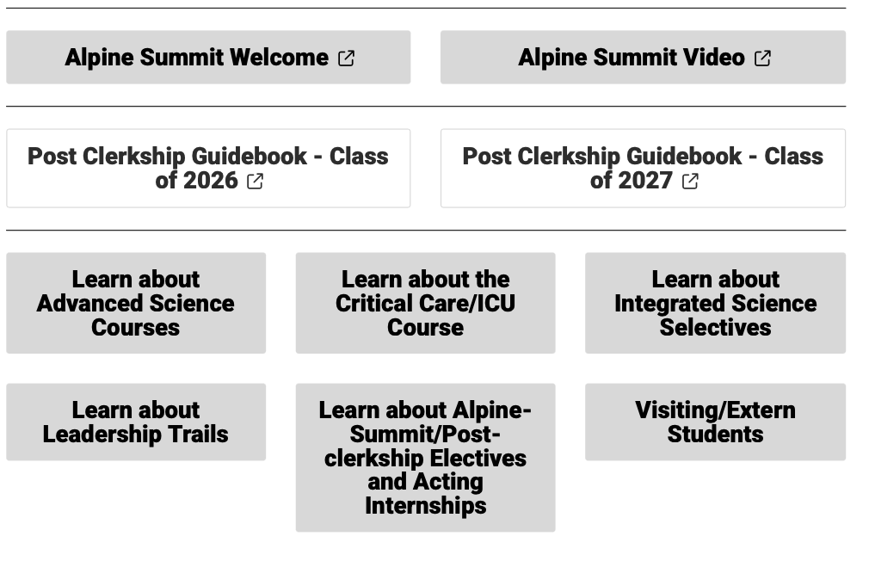
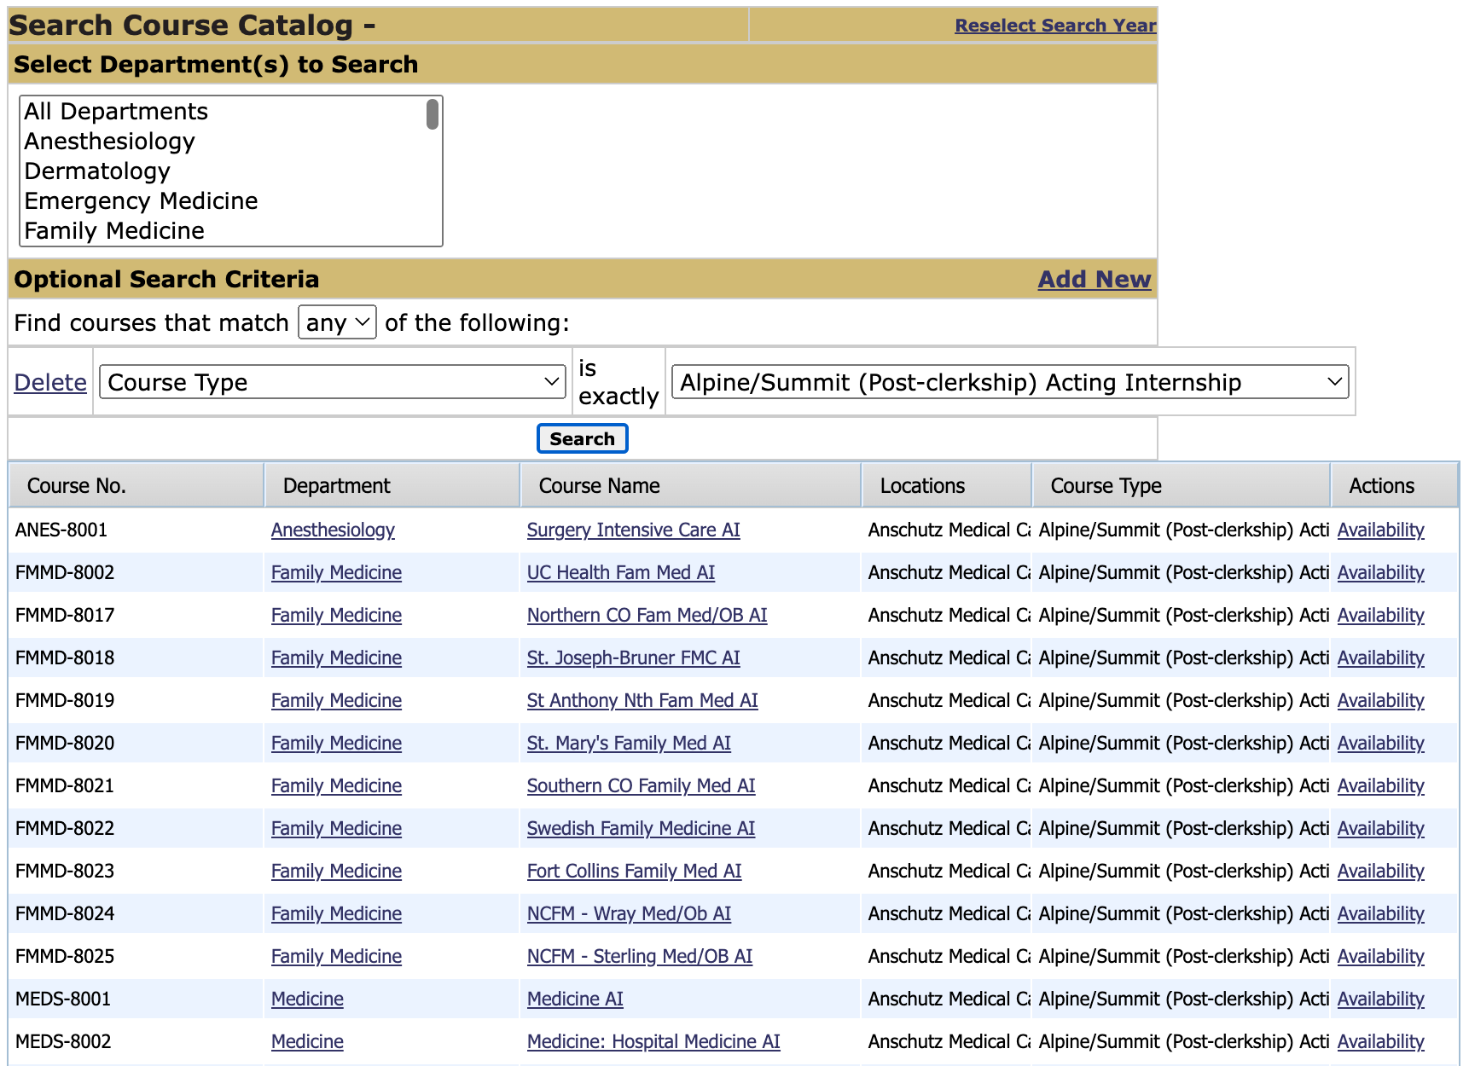
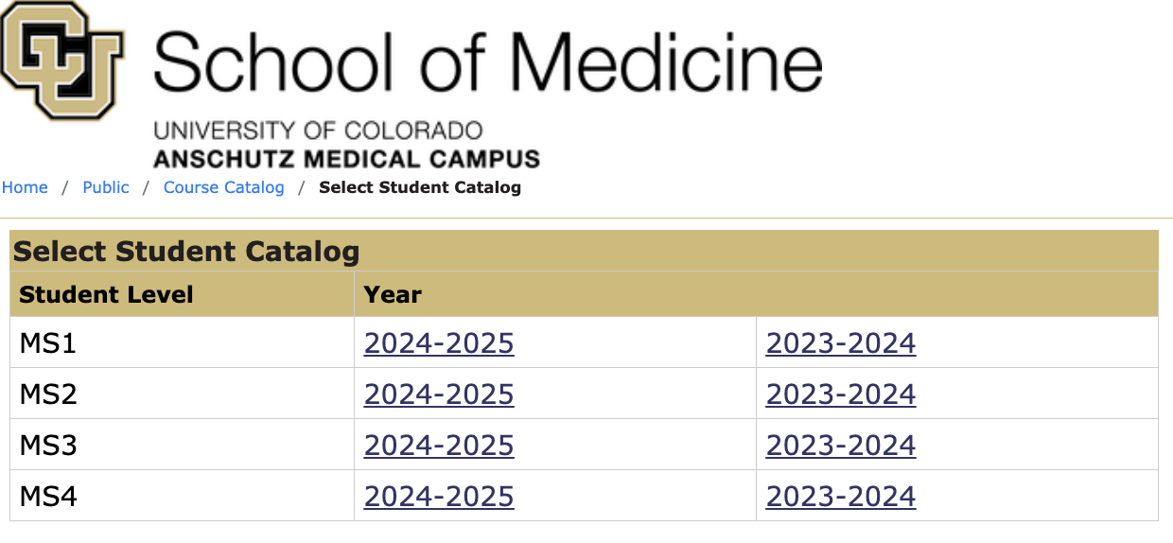
Policies & Procedures & Phase IV Guidebook & Oasis
Alpine Summit Website and Guidebook: https://medschool.cuanschutz.edu/education/current-students/curriculum/trek-curriculum/alpine-summit-post-clerkship-phase
Oasis: https://ucdenver.oasisscheduling.com/public/courses/select_student_level.html

Slide 9

Advanced Science Courses

Slide 10

Advanced Integrated Science Courses
The Advanced Sciences courses will weave together advanced clinical topics and basic science, to promote critical thinking, develop clinical reasoning skills and foster the habits of mind of a curiosity-driven physician
Goals & Values
Utilize advanced science concepts in advancing the care for patients
Engage in authentic advanced clinical experiences
Explain advanced Health System Science concepts in the context of advanced clinical patients
Other values of the Advanced Science Courses:
Overlap with Step 1 learning and preparation

Slide 11
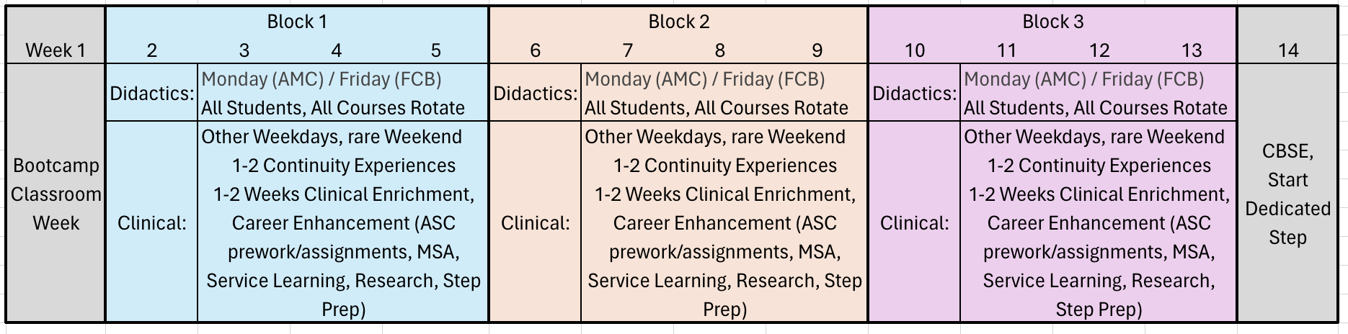
ASCs Integrated²
13 weeks*, 3 Courses
Cardiovascular Connections
Advanced Immunology & Immunotherapy
Advanced Neurosciences
Week 1 = Classroom Bootcamp Week
Week 14 = CBSE on Monday, Start dedicated Step study
Monday = Didactic Sessions, All Students, All Courses Rotate
Notes:
Integrated within a course and across courses

Slide 12

Advanced Science Course Directors
Cardiovascular Connections:
AMC: Alexis Tumolo, MD; Joe Burke, MD; Rory Bricker, MD
FCB: Adam Chicco, PhD; Shivanshu Madan, MD; Robert Rayson, MD
Advanced Immunology:
AMC: Lindsey Davis, MD; Suzanne Ngo, MD; KD Nowicki, MD; Steven Mudroch MD
FCB: Marta Rowh, MD, PhD; Erin Willits, MD
Advanced Neurosciences:
AMC: Aaron Carlson, MD; Hannah Gilbert, MD
FCB: Tod Clapp, PhD, Barbara Hager, MD

Slide 13
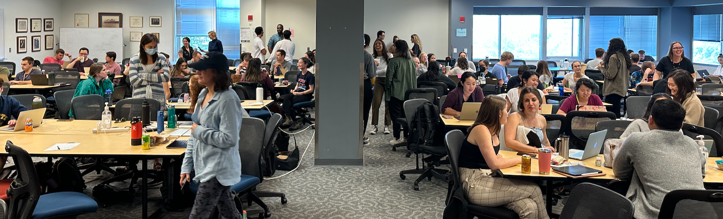
Didactics Big Picture
One Didactic Day per Week (Monday)
Up to 4 hours of prework
TBL, other approaches
Required attendance

Slide 14
Advanced Clinical Learning Big Picture
Clinically, students spend whole month in one course
2 weeks continuity/immersion
1-2 days off per week
1-2 weeks same experience
EG: Inpatient Oncology Consults
2 weeks enrichment
6-8 half-days over 2 weeks of ASC enrichment
Enrichment examples: Transplant conference, Allergy Testing, BAR Lab
CPE
Extended Learning Time: Step correlations, Research, Compass Guide/Specialty Advising, ASC pre-work/oral presentation prep
Preferences for continuity/immersion
Schedule released 1 month ahead

Slide 15
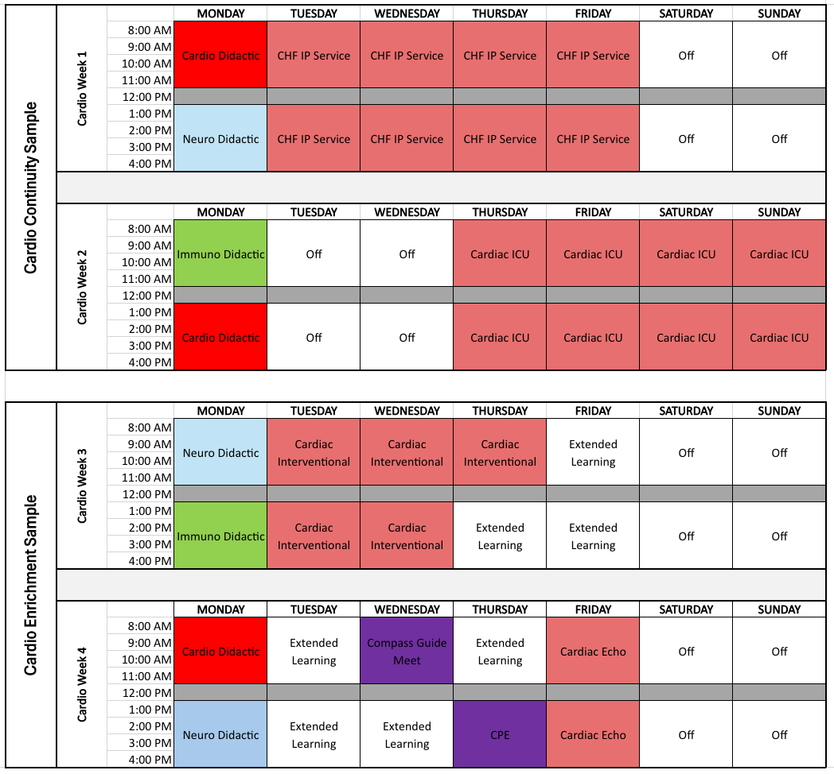
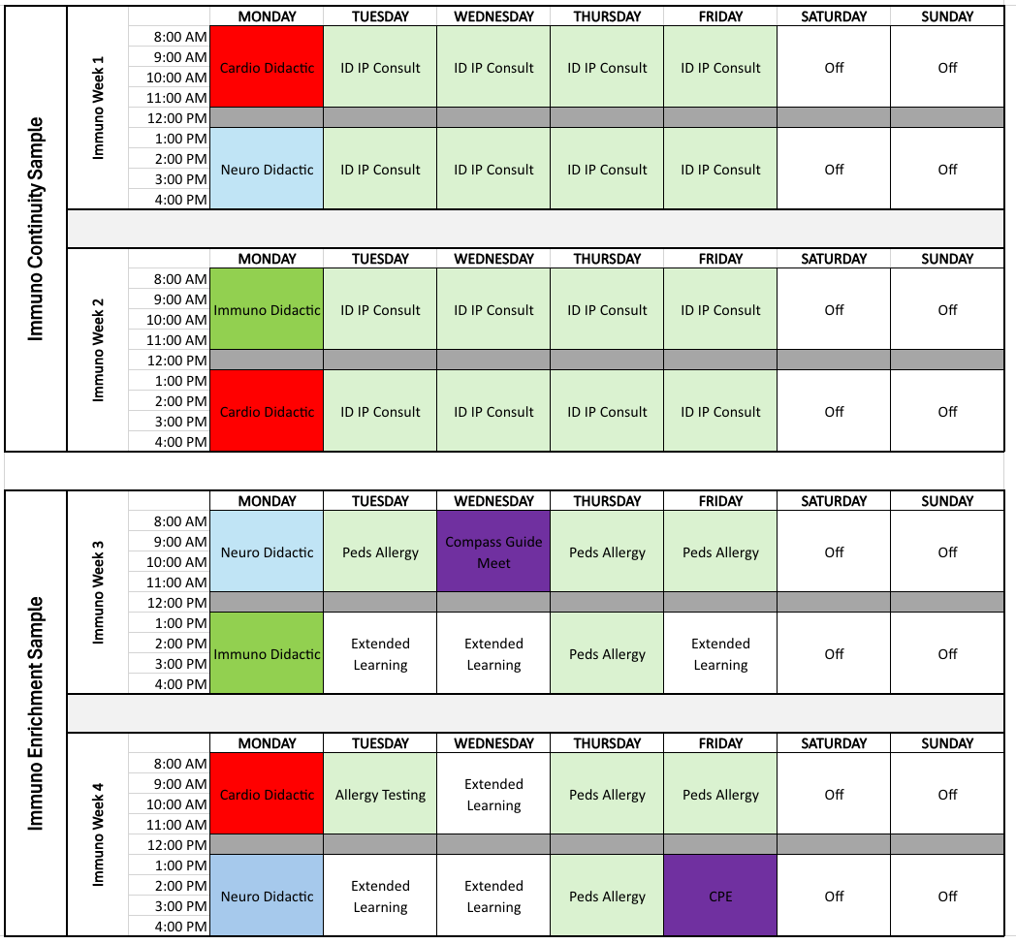
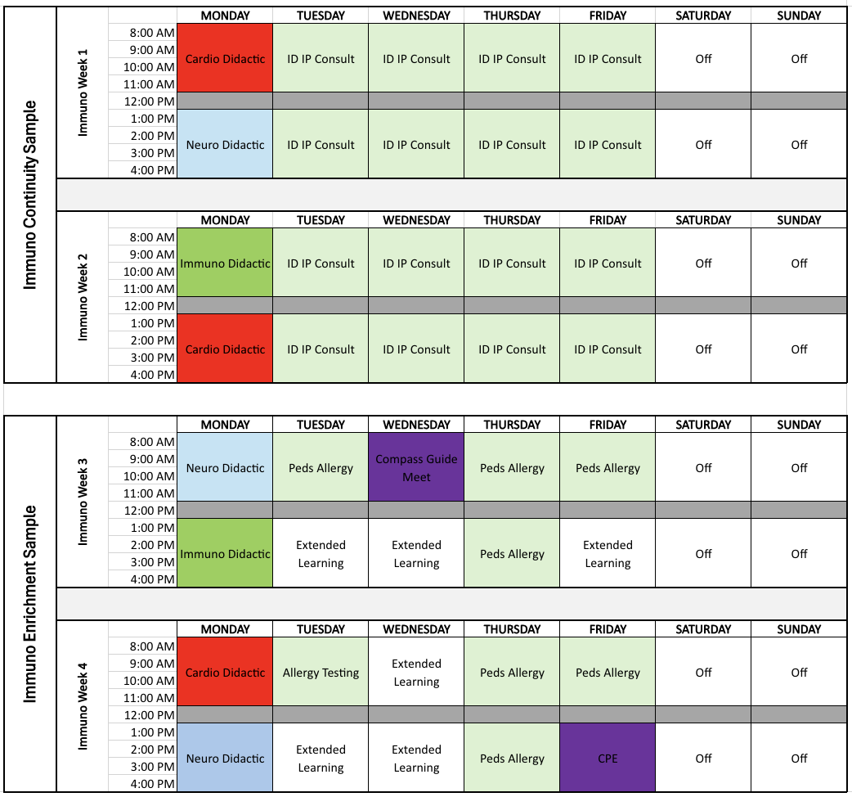
(Main Campus) Sample Student Schedules

Slide 16
ASC Assessments
Pass / Fail
Medical Knowledge
Mid-Term & Final
Follow Plains Standard Setting & Retake Approach
Clinical Skills
Must pass CPE
Brief Clinical Eval for Continuity/Immersion experiences
Attendance at ASC clinical experiences
Curiosity
Oral Case Based Presentation
Professionalism
Small group professionalism form for selected didactics
Contain items from each course, non-cumulative

Slide 17
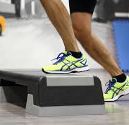
Step Considerations
ASC is not a step prep course, but material does overlap with Step 1 & 2.
More deliberate Step Overlap Indication
Week 14 -> Transition to Step
Bootcamp Week -> Dr. Seymour intro to Step prep considerations
Extended Learning can be used for Step
Week 14 ->
Monday is CBSE
Rest of week: meet with Compass Guide individually, start Step Prep
Step 1:
5 weeks between ASCs and Winter Break
(2 weeks Winter Break)
ADDED: 1 week between Winter Break and Trails

Slide 18
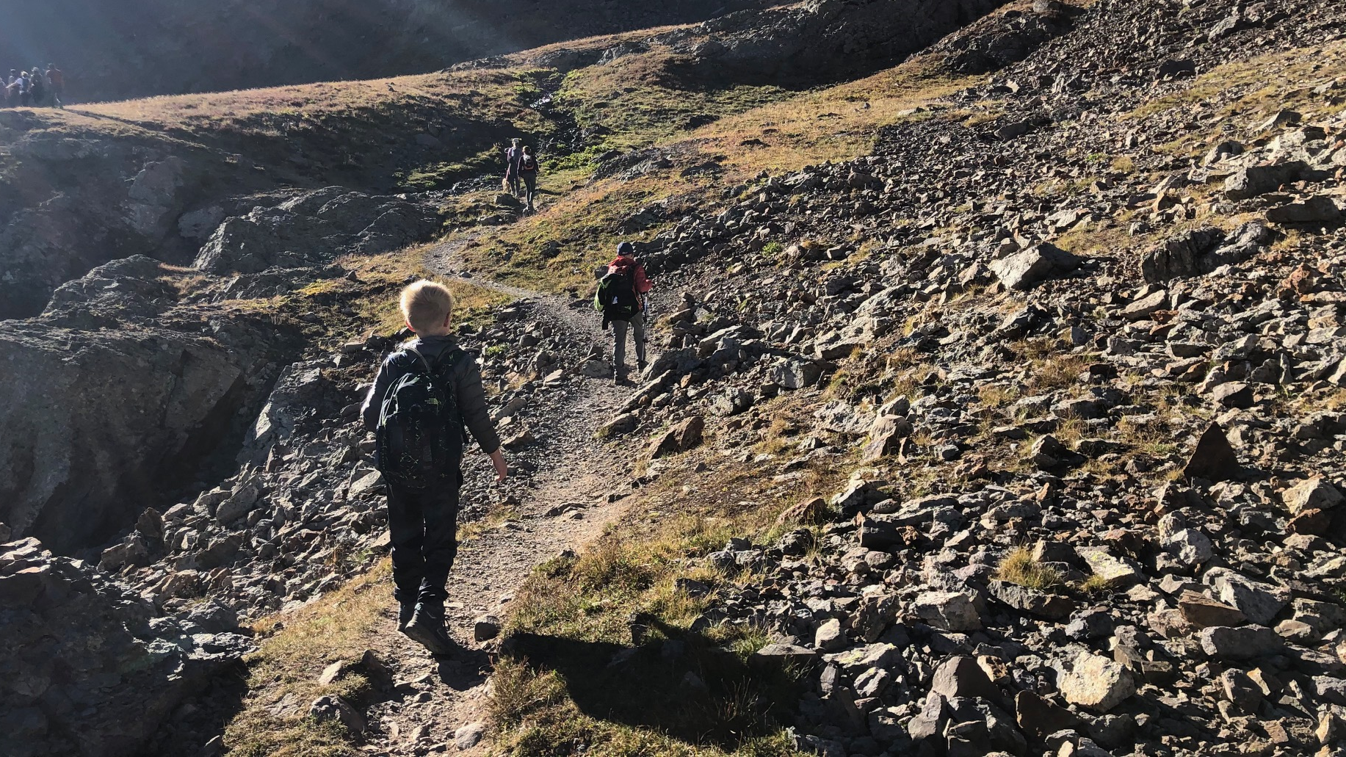
The Trails (non-clinical) Leadership Development

Slide 19
What Does a Trail Look Like?
Trails List
Bioethics & Humanities
Medical Education
Health Systems & Community Leadership (AMC & FCB)
Research
One Health (FCB)
Structure
2 weeks during Jan MS3
2 weeks during Sep-Oct MS4
Distributed Learning & Cohort Activities across Alpine-Summit
Common Trail Requirements
Combo asynchronous and scheduled activities

Slide 20
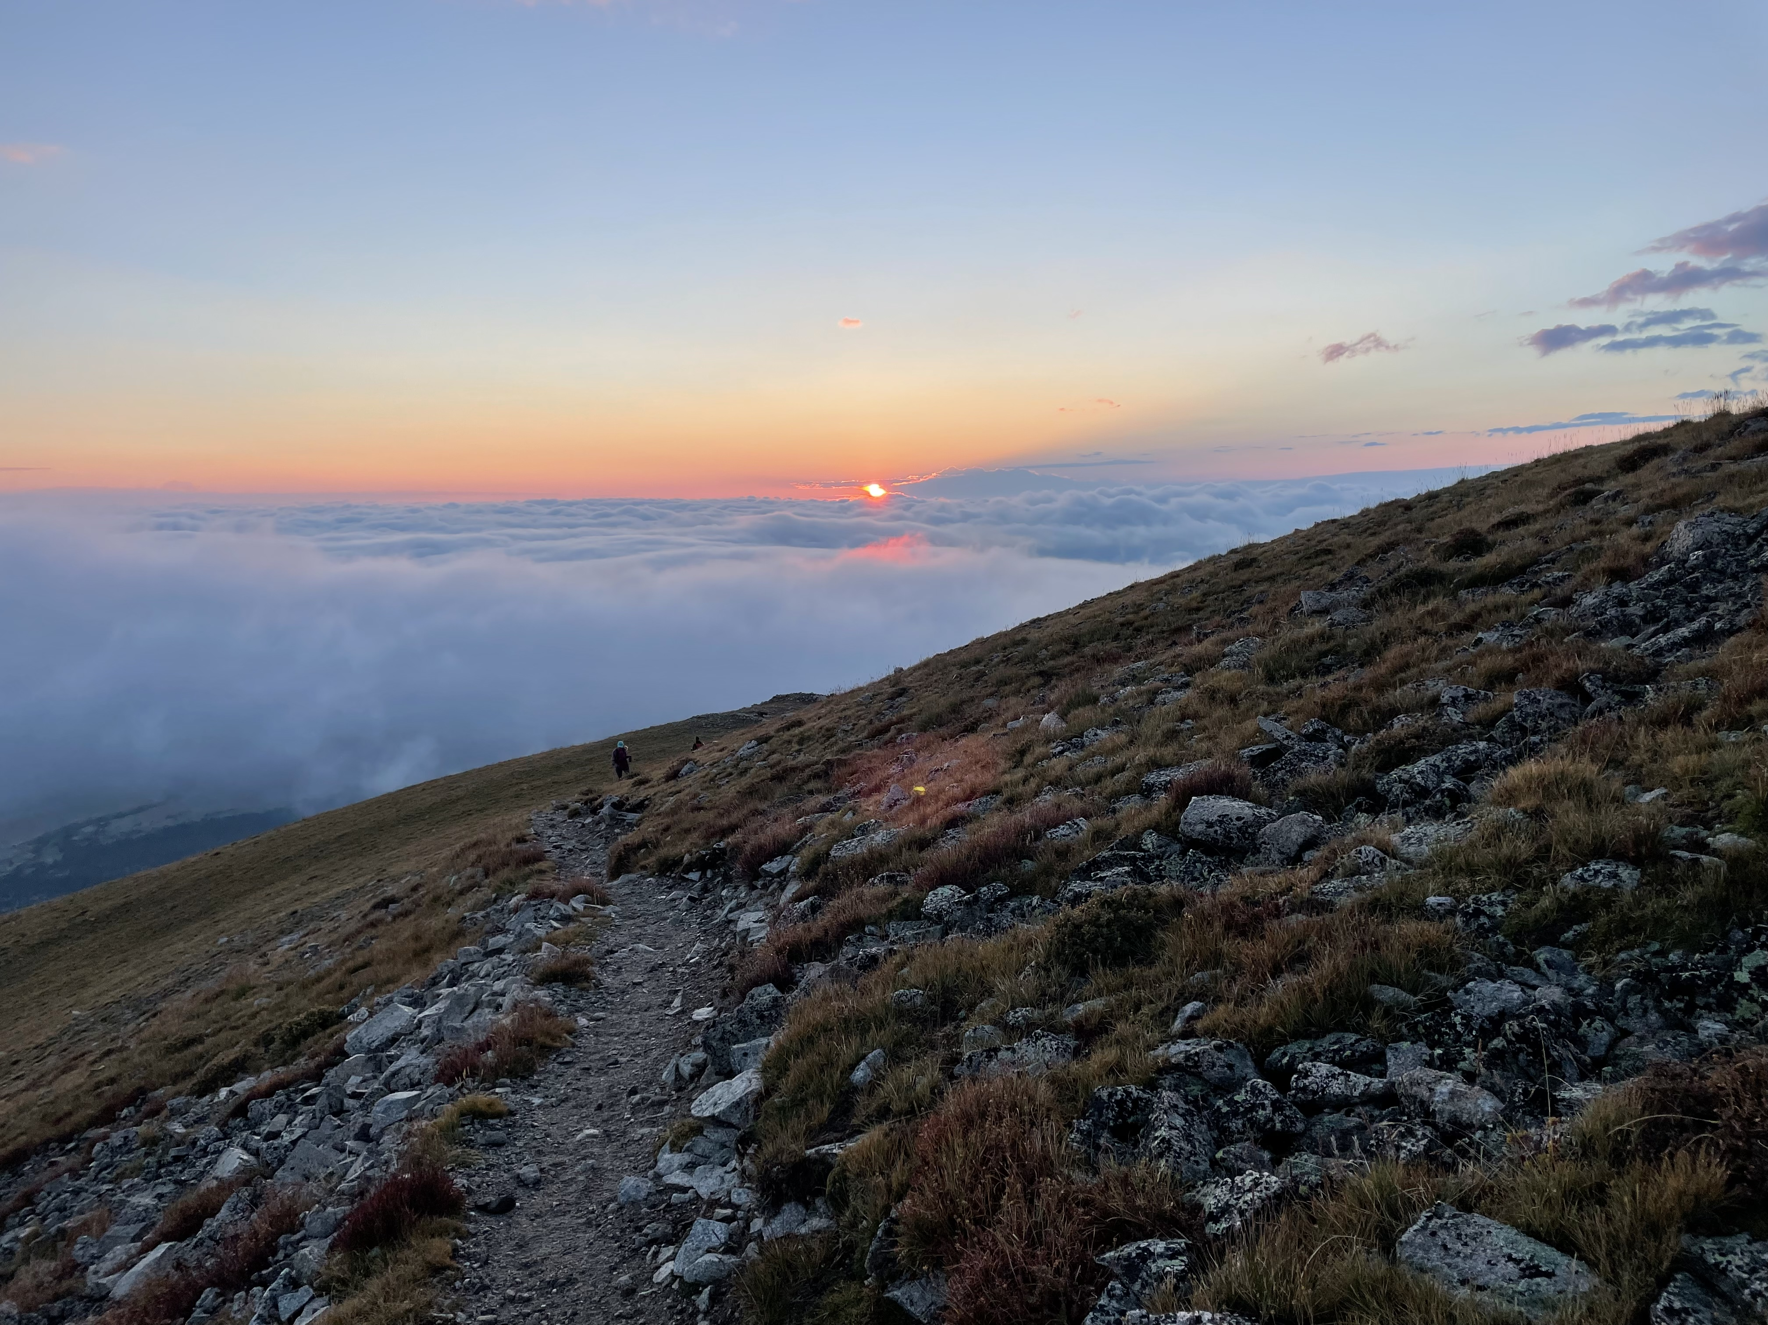
Trail Directors
Trail | Directors
Bioethics & Humanities | Daniel Goldberg & Brian Jackson
Health Systems & Community Leadership *FCB version | Ed Havranek & Jay MacGregor & *Rebecca Bade at FCB
Medical Education | Danielle Miller & Nicolle Dyess
Research | Tim Bernard & Meredith Tennis
One Health* FCB Based | Anuja Riles & Nikita Habermehl

Slide 21

Integrated Science Selectives
Integrated Science Selectives are 4-week courses for Post-clerkship/Advanced Medical Students that integrate biomedical and clinical science learning in various didactic and clinical settings to help students learn about cutting-edge science in a given field, provide a way of thinking about how to advance the edge of the evidence and advanced clinical care, and engage students in self-directed learning.
Examples include Nutrition & Culinary Medicine, Advanced Concepts in Public Health, Climate Change and Environmental Health, Integrated MSK Care, The Frontier of AI & Medicine, Translational Medicine, Global Health, Cancer Biology, coming soon... Advanced Precision Dissection

Slide 22
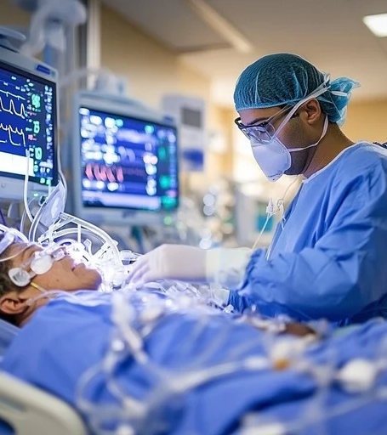
Critical Care Graduation Requirement
Preparation for Residency Training and to better understand patient experiences
Two ways to meet requirement
Alpine Critical Care Rotation (IDPT 8096)
4-week ICU rotation
Many 4-week ICU rotations are acting internships, but not all

Slide 23
Critical Care Rotation Options
4-week ICU Acting Internship
ANES 8001 (STICU) | MEDS 8034 (MICU-St. Joe’s) | MEDS 8037 (MICU- UCH, DH) | PEDS 8015 (NICU) | PEDS 8027 (PICU) | SURG 8008 (CT Surgery/ ICU) | SURG 8021 (DH SICU)
4- week ICU rotation (not an Acting Internships)
SURG 8010 (Burn CC) | SURG 8052 (SICU in Colorado Springs)
2-week Alpine Critical Care (IDPT 8096) Rotation Site Options
MICU- UCH | MICU-DH | PICU- Children’s | NICU- UCH | NICU- FC | CT-ICU- UCH | Neuro ICU- UCH

Slide 24
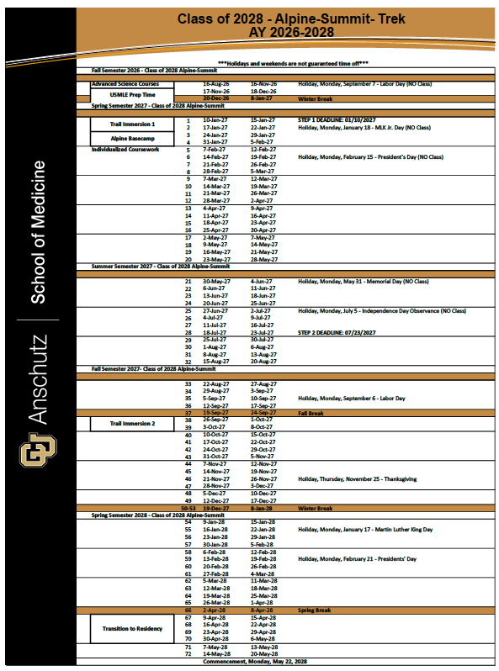
AI & Electives
Required core AI (4 weeks)
Integrated Science Selective (4 wks)
Critical Care* (2 wks)
Electives, Aways, Research Courses, Non-clinical Courses (28 wks)

Slide 25
Transition to Residency Basecamp
On-call challenges (vitals, labs, nurse calls, transfusions, potpourri)
Evidence-based medicine
Radiology
Delivering Serious News
Opioid and Pain management
Foundational Code skills
ACLS rhythm interpretation
Resuscitation Simulations
Anatomy
Ultrasound
Patient Safety/ Root Cause Analysis
Content- relevant to Internship
Content Expert
Clinical Specialty
IM
Surgery
Anesthesiology
EM
Pediatrics
Family Medicine
OBGYN
Radiology
Ultrasound
Anatomy
Palliative Care
Psychiatry/Addiction Medicine
Transfusion Medicine
COPIC
Critical Care Nursing
Respiratory Therapy
Small groups hands-on skill sessions
https://www.ttreducators.com/program-descriptions/univ-of-colorado
Notes:
2 days during March 2020

Slide 26
Next Steps
We will email you an ASC rotation preference form on 4/17 → due EOD 4/26
We will email you the link to excused absence/personal days request form
Focus on your core clerkship experience!
Detailed orientation on first day: August 17, 2026
Email our team with questions:
SOM.Alpine-Summit@cuanschutz.edu

Slide 27
Thanks!
Anna Neumeier, MD- Assistant Dean for Medical Education, Post-Clerkship
Chad Stickrath, MD- Associate Dean for Medical Education, Post-Clerkship
Jessica Ackels – AMC Curriculum Program Manager
Maggie Howard – Pre & Post-clerkship Curriculum Manager
Alpine Summit Team
Sabrynne Buchholz (ASCs, Selectives)
Nomi Poprish (ASCs, Critical Care)
Sasha Robeson (ASCs)
Tracy Johnson (Critical Care)
Megan Rhyne (Trails, Basecamps)
Maritza Casillas (AIs, Electives, Selectives)
Jodie Wang (Electives, Selectives)
Mary McGinnis (MSA)
Fort Collins Alpine Summit Team
Kelley Yseth, Fort Collins Regional Campus Manager
Jessica Duncan (ASC)
Kelli Harris (Electives)
Michelle Prado –Ferrin (Trails, Basecamps, Selectives)
Basecamp Team, ASC Team, Trails Team, Critical Care Team
CSB, FCB Teams
Post-Clerkship Course Directors, Coordinators, Faculty
Office of Student Life, Office Assessment & Evaluation
More info
Alpine-Summit Guidebook
Slides to be posted
During orientation on day 1 ASCs
Email with Questions: SOM.Alpine-Summit@cuanschutz.edu

