Slide 1
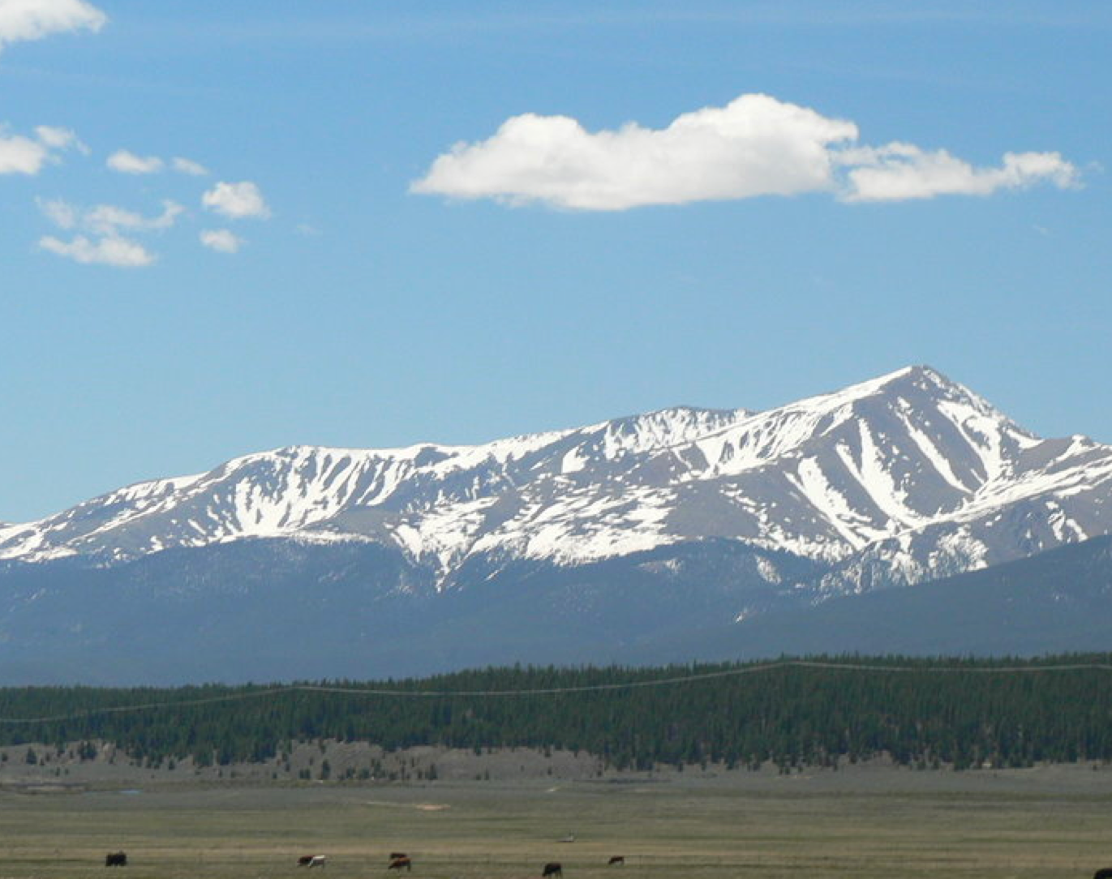
Alpine – Summit Introduction
April 2025
Chad Stickrath, MD
Associate Dean for Post-Clerkship (Alpine-Summit) Curriculum

Slide 2
Agenda
Welcome & Goals
Timeline Overview
Advanced Science Courses
Acting Internships & Electives
Trails
Integrated Science Selectives

Slide 3
Alpine Mission & Goals
Through a highly tailored curriculum guided by an individual learning plan developed in conjunction with their coach, students will: deepen their knowledge and skills as well-rounded physicians-in-training, choose and prepare for their residency and enhance their ability to positively transform the health of their future community beyond their direct clinical practice.
Add
Depth & Breadth to your Education
Select
A specialty, apply for residency, interview, and match!
Strengthen
Skills needed for your chosen career
Fill
Gaps in your education and ensure that you are competent in all core areas before graduation
Explore
Areas of medicine that interest you
Skills needed to lead transformation

Slide 4
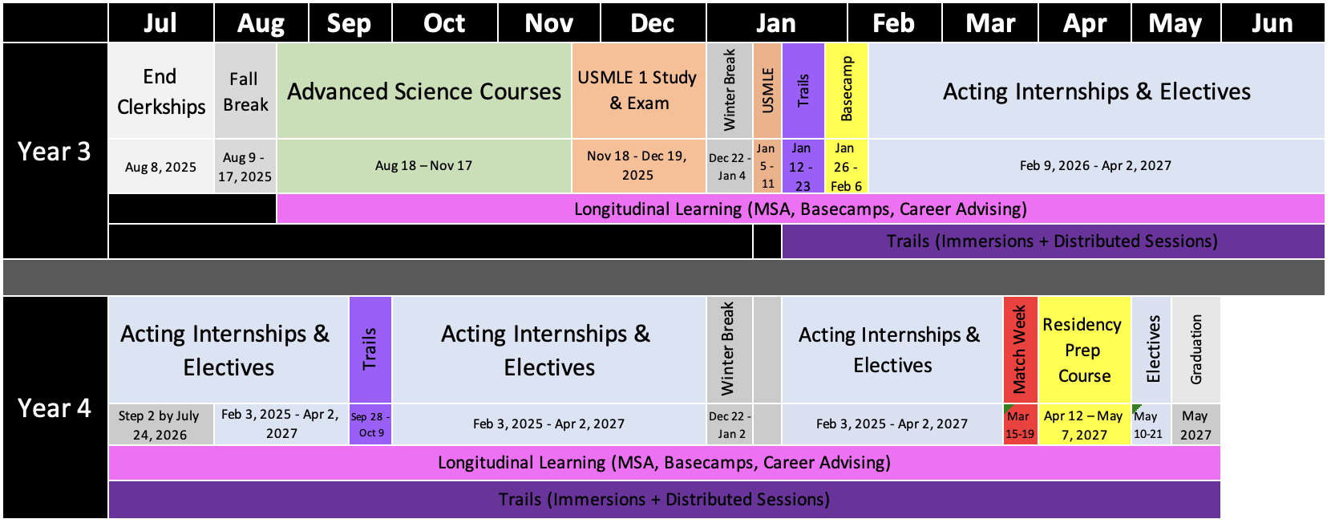
Alpine – Summit Timeline
AI/Elective Orient Lottery & Specialty Advising
More AI/Elective Success Details
Detailed Post-Clerkship & ASC Orientation

Slide 5
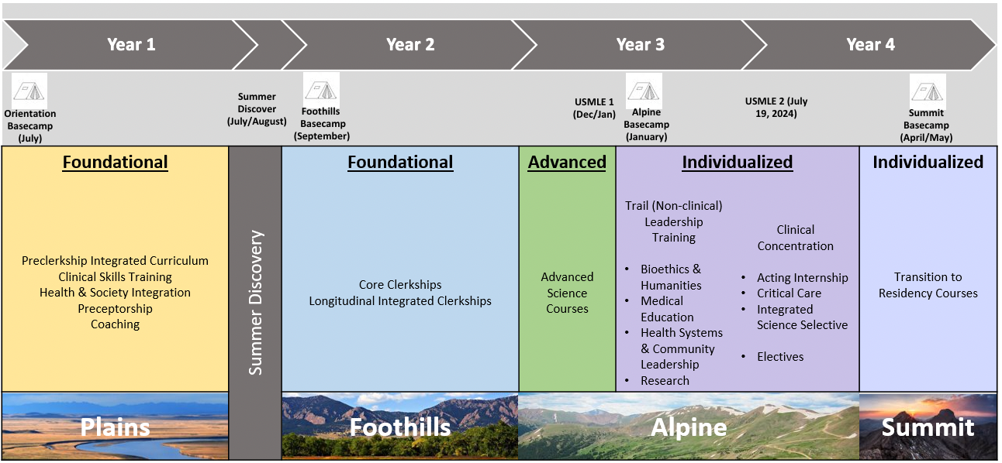
Alpine – Summit Requirements
Already on Calendar:
ASCs – 13+ weeks
Trail – 4 weeks
Pre-Alpine Basecamp – 2 weeks
Transition to Residency Basecamp – 4 weeks
Student schedules in Fall Lottery
2-week Critical Care Course or standard 4-week ICU course
Integrated Science Selective – 4 weeks
Required Acting Internship – 4 weeks
Additional Courses – 28 weeks
Finish MSA, Complete Other Trail Requirements, Take Step 1 & Step 2 by Deadlines
Leaves 18+ unstructured weeks for: Step 2, Interviews, Vacation, Weddings, Additional Courses
Notes:
93 weeks: 66 required here + 4 weeks Step 1 = 23 weeks left over (5 holiday/break weeks + 18 unstructured)

Slide 6
Scheduling Concepts
Lottery for 2026
Step 1 Deadline: Jan 11, 2026
Step 2 Deadline July 24th, 2026
If need score to determine competitiveness for residency -> consider earlier time
If need early AI/Elective timeframe for additional career exploration, can take later/closer to deadline
Talk to your specialty advisor
Schedule Individualized Curriculum each fall for following calendar year with Lottery
You have lots of flexibility and unscheduled time in Alpine-Summit!
Schedule absences for voluntary situations outside of required curricular elements (in Red)
Lottery for 2027

Slide 7
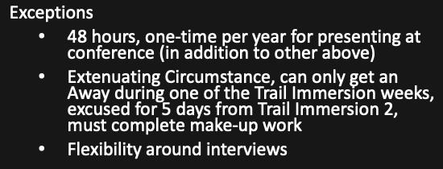
Attendance / Absences (No Carry Over from Foothills)
Advanced Science Courses
Rest of Alpine-Summit
Personal Days – 2 Days
Requested via form 60 days in advance
Conference – 48 hours per AY (in courses > 2 weeks)
4-wk Course – Up to 2 Excused
2-wk Course – Up to 1 Excused
Total per AY – 5 Excused (after ASCs in Year 3)
Request via form
Professionalism form for non-adherence

Slide 8
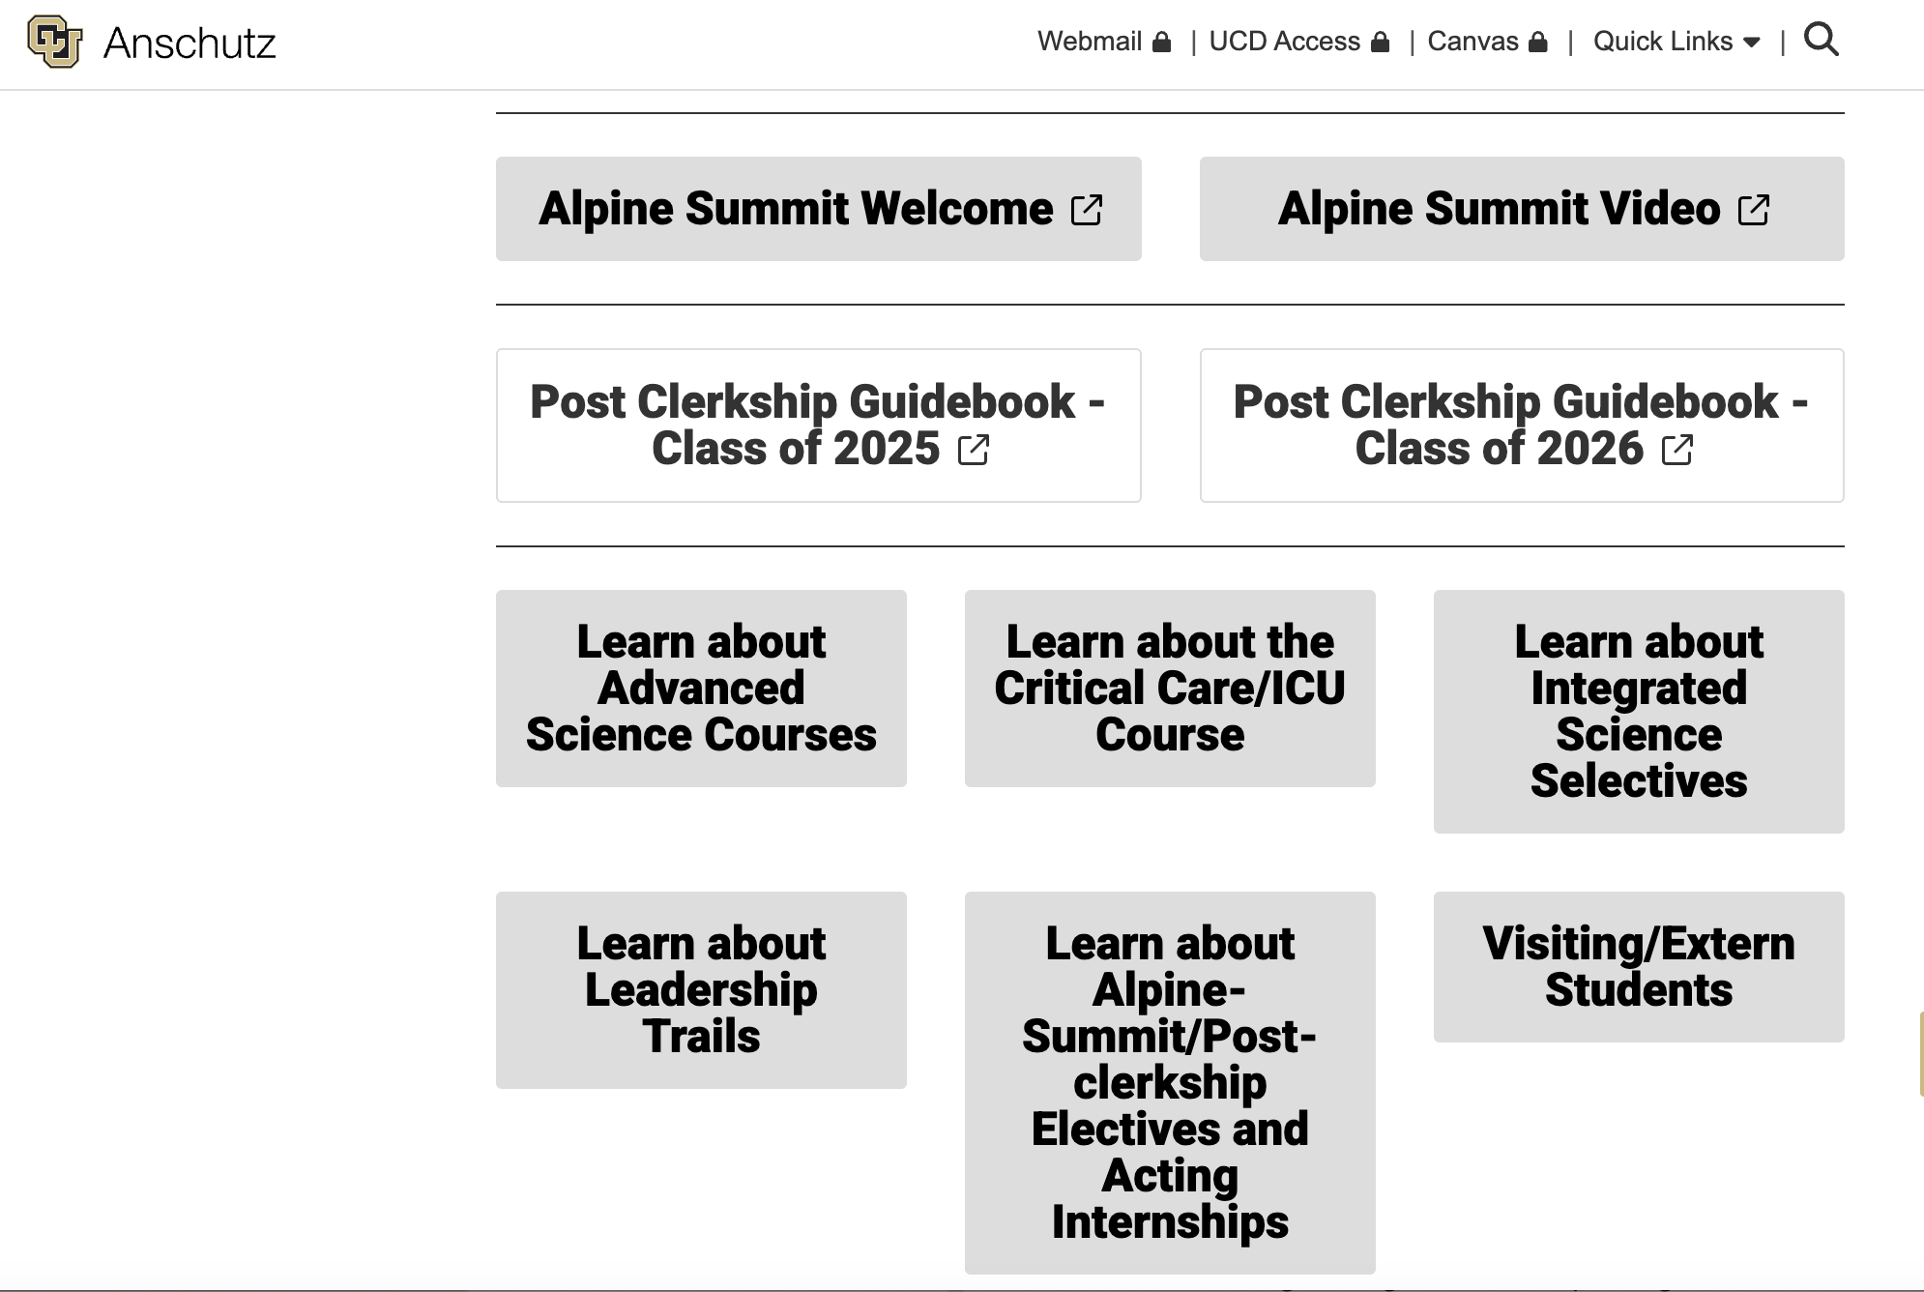
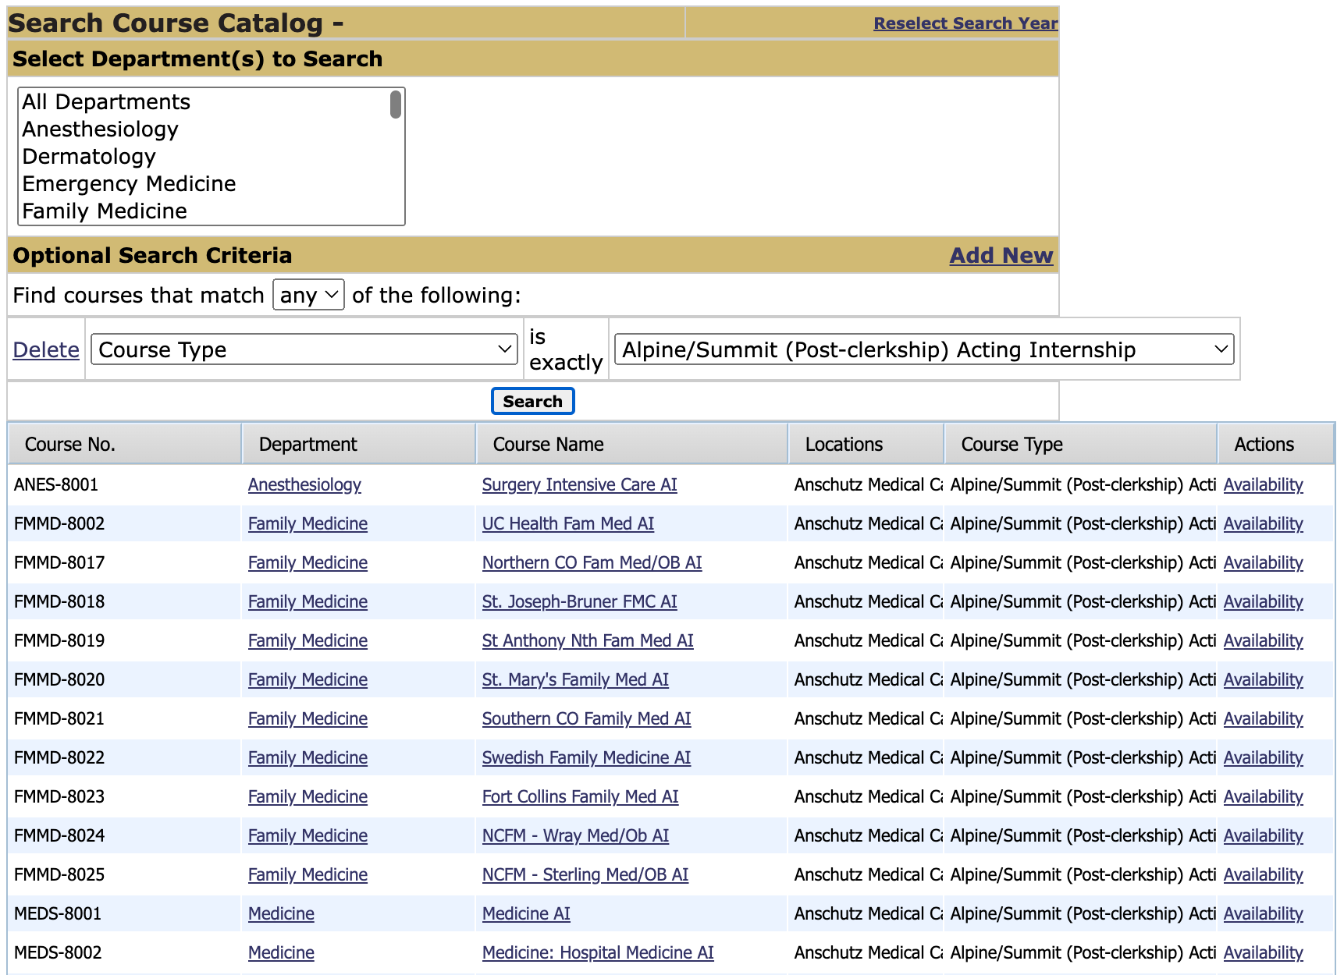
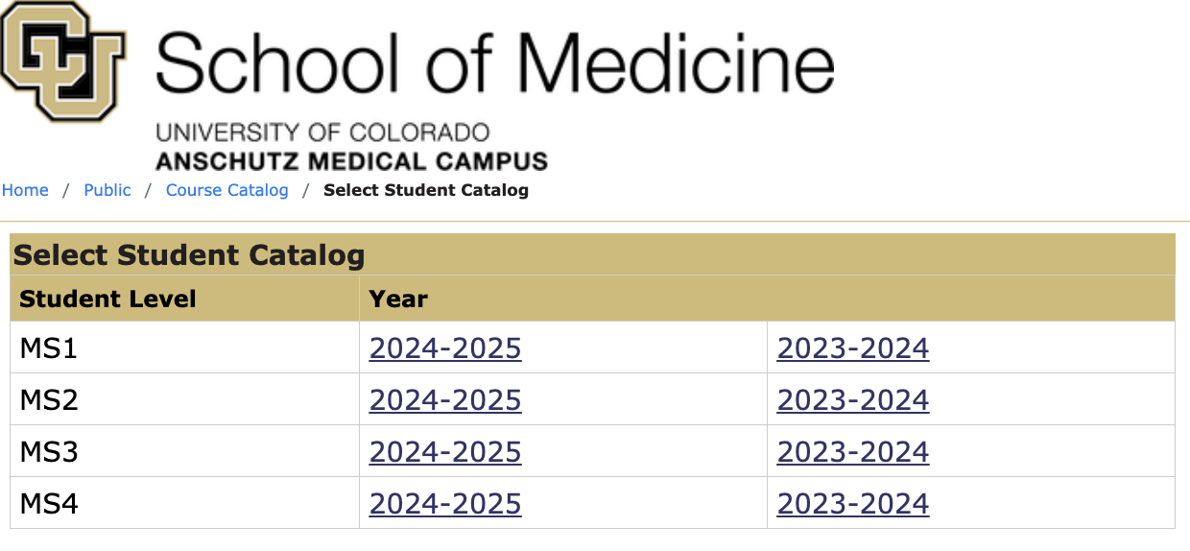
Policies & Procedures & Phase IV Guidebook & Oasis
Guidebook: https://medschool.cuanschutz.edu/education/current-students/curriculum/trek-curriculum/alpine-summit-post-clerkship-phase
Oasis: https://ucdenver.oasisscheduling.com/public/courses/select_student_level.html.

Slide 9

Advanced Science Courses

Slide 10

Advanced Integrated Science Courses
The Advanced Sciences courses will weave together advanced clinical topics and basic science, in order to promote critical thinking, develop clinical reasoning skills and foster the habits of mind of a curiosity-driven physician
Goals & Values
Utilize advanced science concepts in advancing the care for patients
Engage in authentic advanced clinical experiences
Explain advanced Health System Science concepts in the context of advanced clinical patients
Other values of the Advanced Science Courses:
Overlap with Step 1 learning and preparation

Slide 11
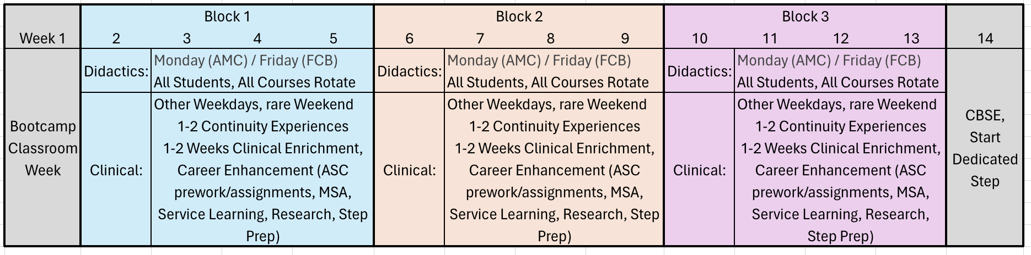
ASCs Integrated²
13 weeks*, 3 Courses
Cardiovascular Connections
Advanced Immunology & Immunotherapy
Advanced Neurosciences
Week 1 = Classroom Bootcamp Week
Week 14 = CBSE on Monday, Step planning, Start dedicated
Monday (AMC) / Monday (FCB) = Didactic Sessions, All Students, All Courses Rotate
Notes:
Integrated within a course and across courses

Slide 12

Advanced Science Course Directors
Cardiovascular Connections:
AMC: Alexis Tumolo, MD; Joe Burke, MD; Rory Bricker, MD
FCB: Adam Chicco, PhD; Shivanshu Madan, MD
Advanced Immunology:
AMC: Lindsey Davis, MD; Suzanne Ngo, MD; KD Nowicki, MD; Elena Hsieh, MD
FCB: Marta Rowh, MD, PhD; Erin Willits, MD
Advanced Neurosciences:
AMC: Aaron Carlson, MD; Hannah Gilbert, MD; Maureen Stabio, PhD;
FCB: Tod Clapp, PhD, Barbara Hager, MD

Slide 13
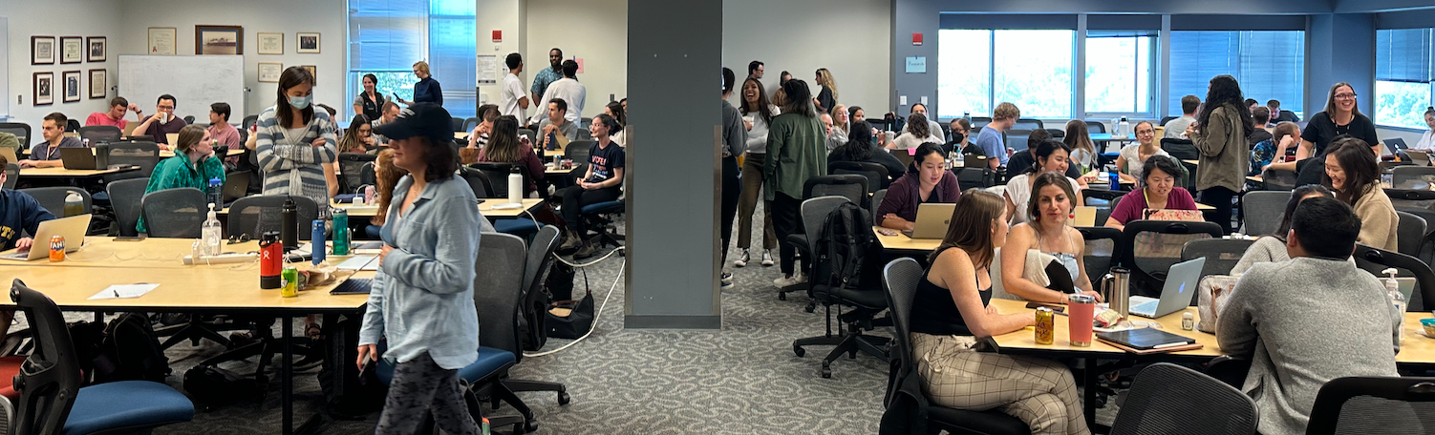
Didactics Big Picture
One Didactic Day per Week (Monday)
Up to 4 hours of prework
TBL, other approaches
Identify Step overlap
Required attendance

Slide 14
Advanced Clinical Learning Big Picture
Clinically, students spend whole month in one course
2 weeks continuity/immersion
1-2 days off per week
1-2 weeks same experience
EG: Inpatient Oncology Consults
2 weeks enrichment
6-8 half-days over 2 weeks of ASC enrichment
Enrichment examples: Transplant conference, Allergy Testing, BAR Lab
CPE
Extended Learning Time: Step correlations, Research, Compass Guide/Specialty Advising, ASC pre-work/oral presentation prep
Preferences for continuity/immersion
Schedule released 1 month ahead

Slide 15
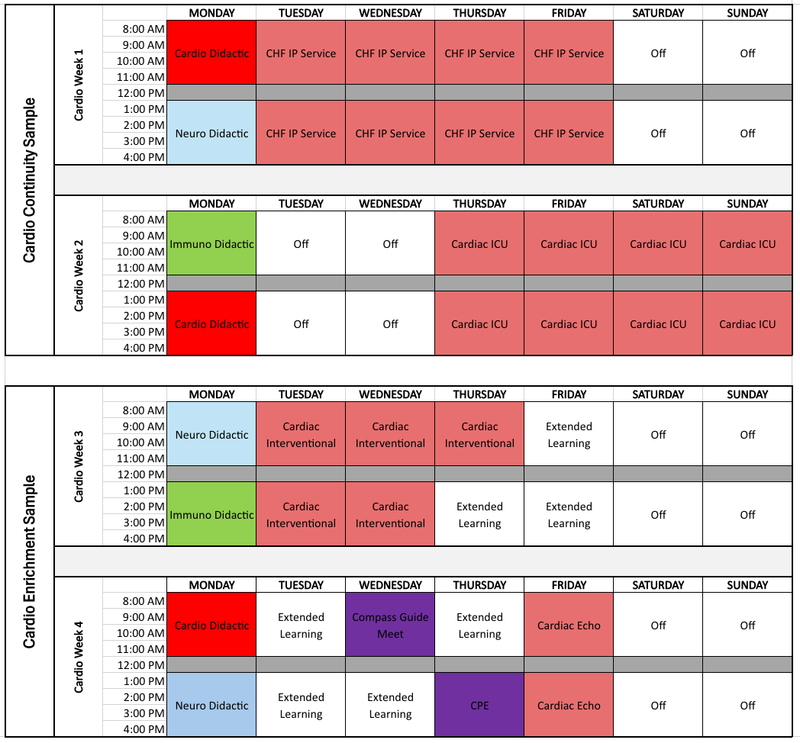
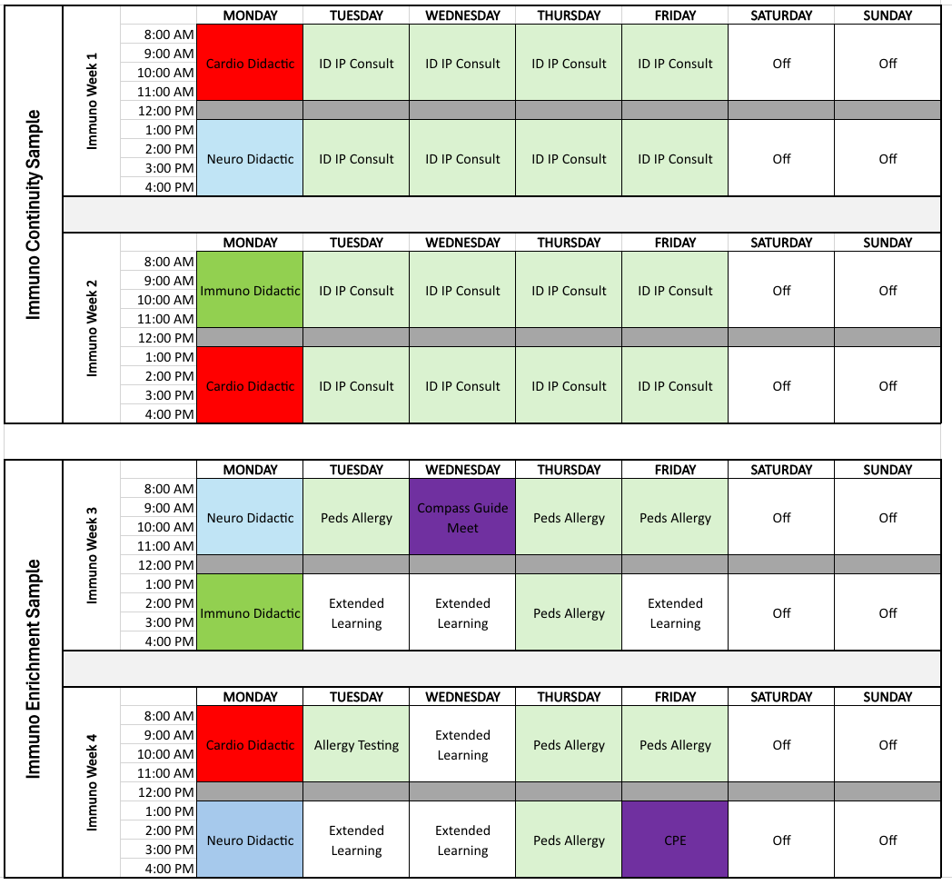
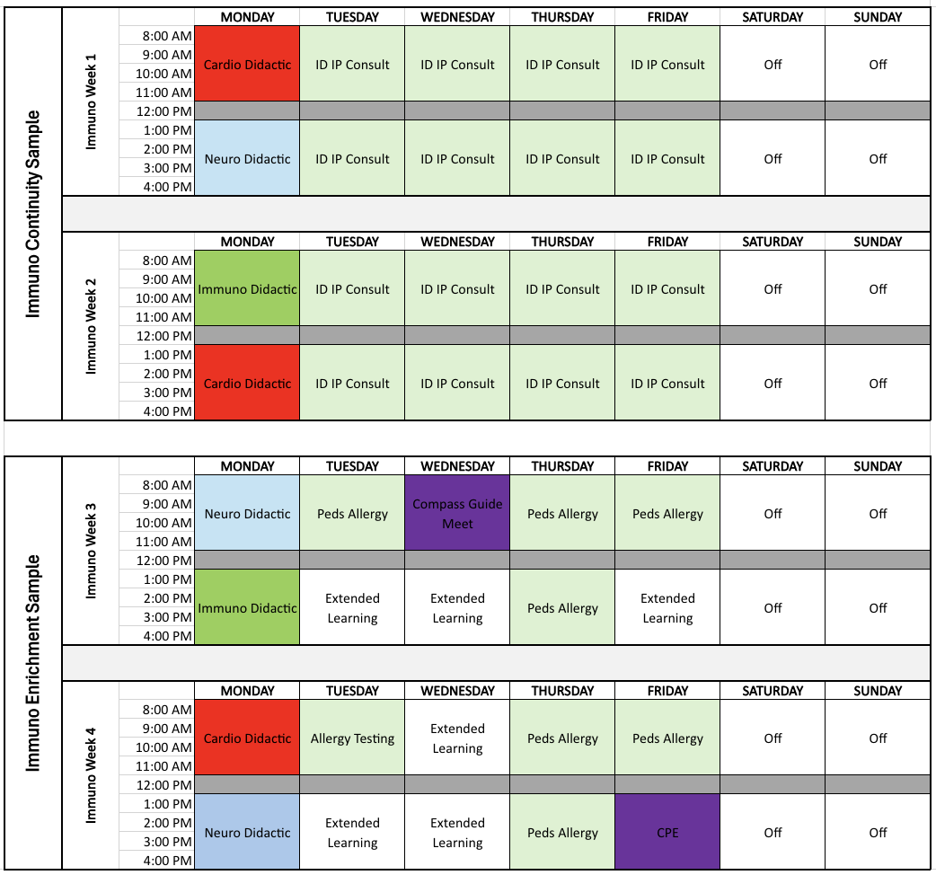
(Main Campus) Sample Student Schedules

Slide 16
ASC Assessments
Pass / Fail
Medical Knowledge
Mid-Term & Final
Follow Plains Standard Setting & Retake Approach
Clinical Skills
Must pass CPE
Brief Clinical Eval for Continuity/Immersion experiences
Attendance at ASC clinical experiences
Curiosity
Oral Case Based Presentation
Professionalism
Small group professionalism form for selected didactics
Contain items from each course, non-cumulative

Slide 17
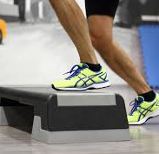
Step Considerations
ASC is not a step prep course, but material does overlap with Step 1 & 2.
More deliberate Step Overlap Indication
Week 14 -> Transition to Step
Bootcamp Week -> Dr. Seymour intro to Step prep considerations
Extended Learning can be used for Step
Week 14 ->
Monday is CBSE
Rest of week: meet with Compass Guide individually, start Step Prep
Step 1:
5 weeks between ASCs and Winter Break
(2 weeks Winter Break)
ADDED: 1 week between Winter Break and Trails

Slide 18
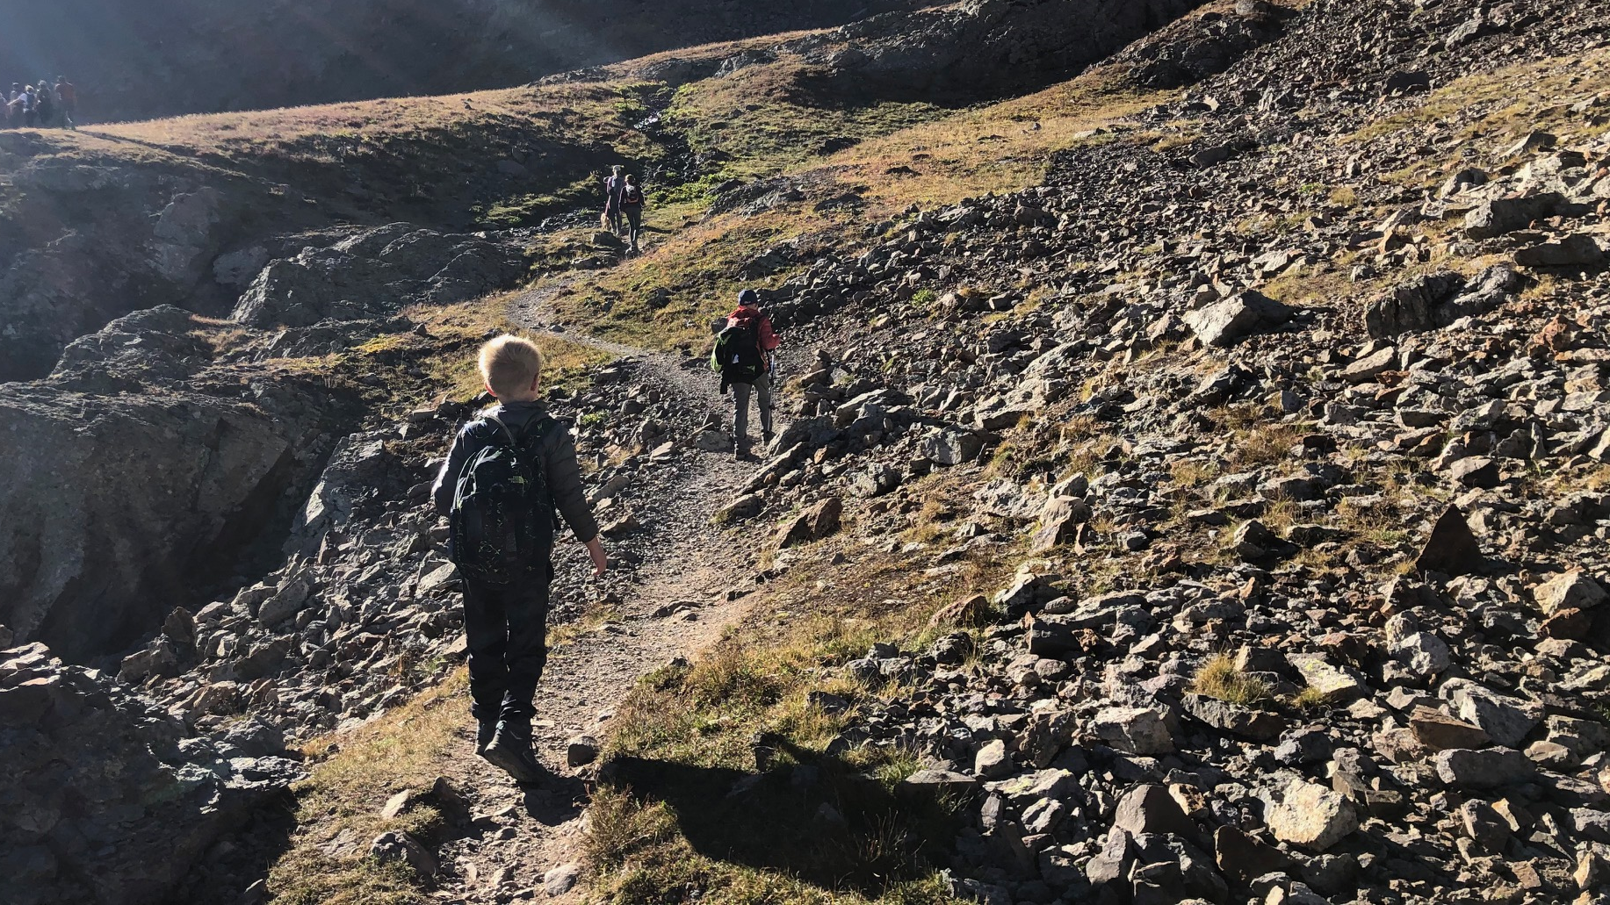
The Trails (non-clinical) Leadership Development

Slide 19
What Does a Trail Look Like?
Trails List
Bioethics & Humanities
Medical Education
Health Systems & Community Leadership (AMC & FCB)
Research
One Health (FCB)
Structure
2 weeks during Jan MS3
2 weeks during Sep-Oct MS4
Distributed Learning & Cohort Activities across Alpine-Summit
Common Trail Requirements
Combo asynchronous and scheduled activities

Slide 20
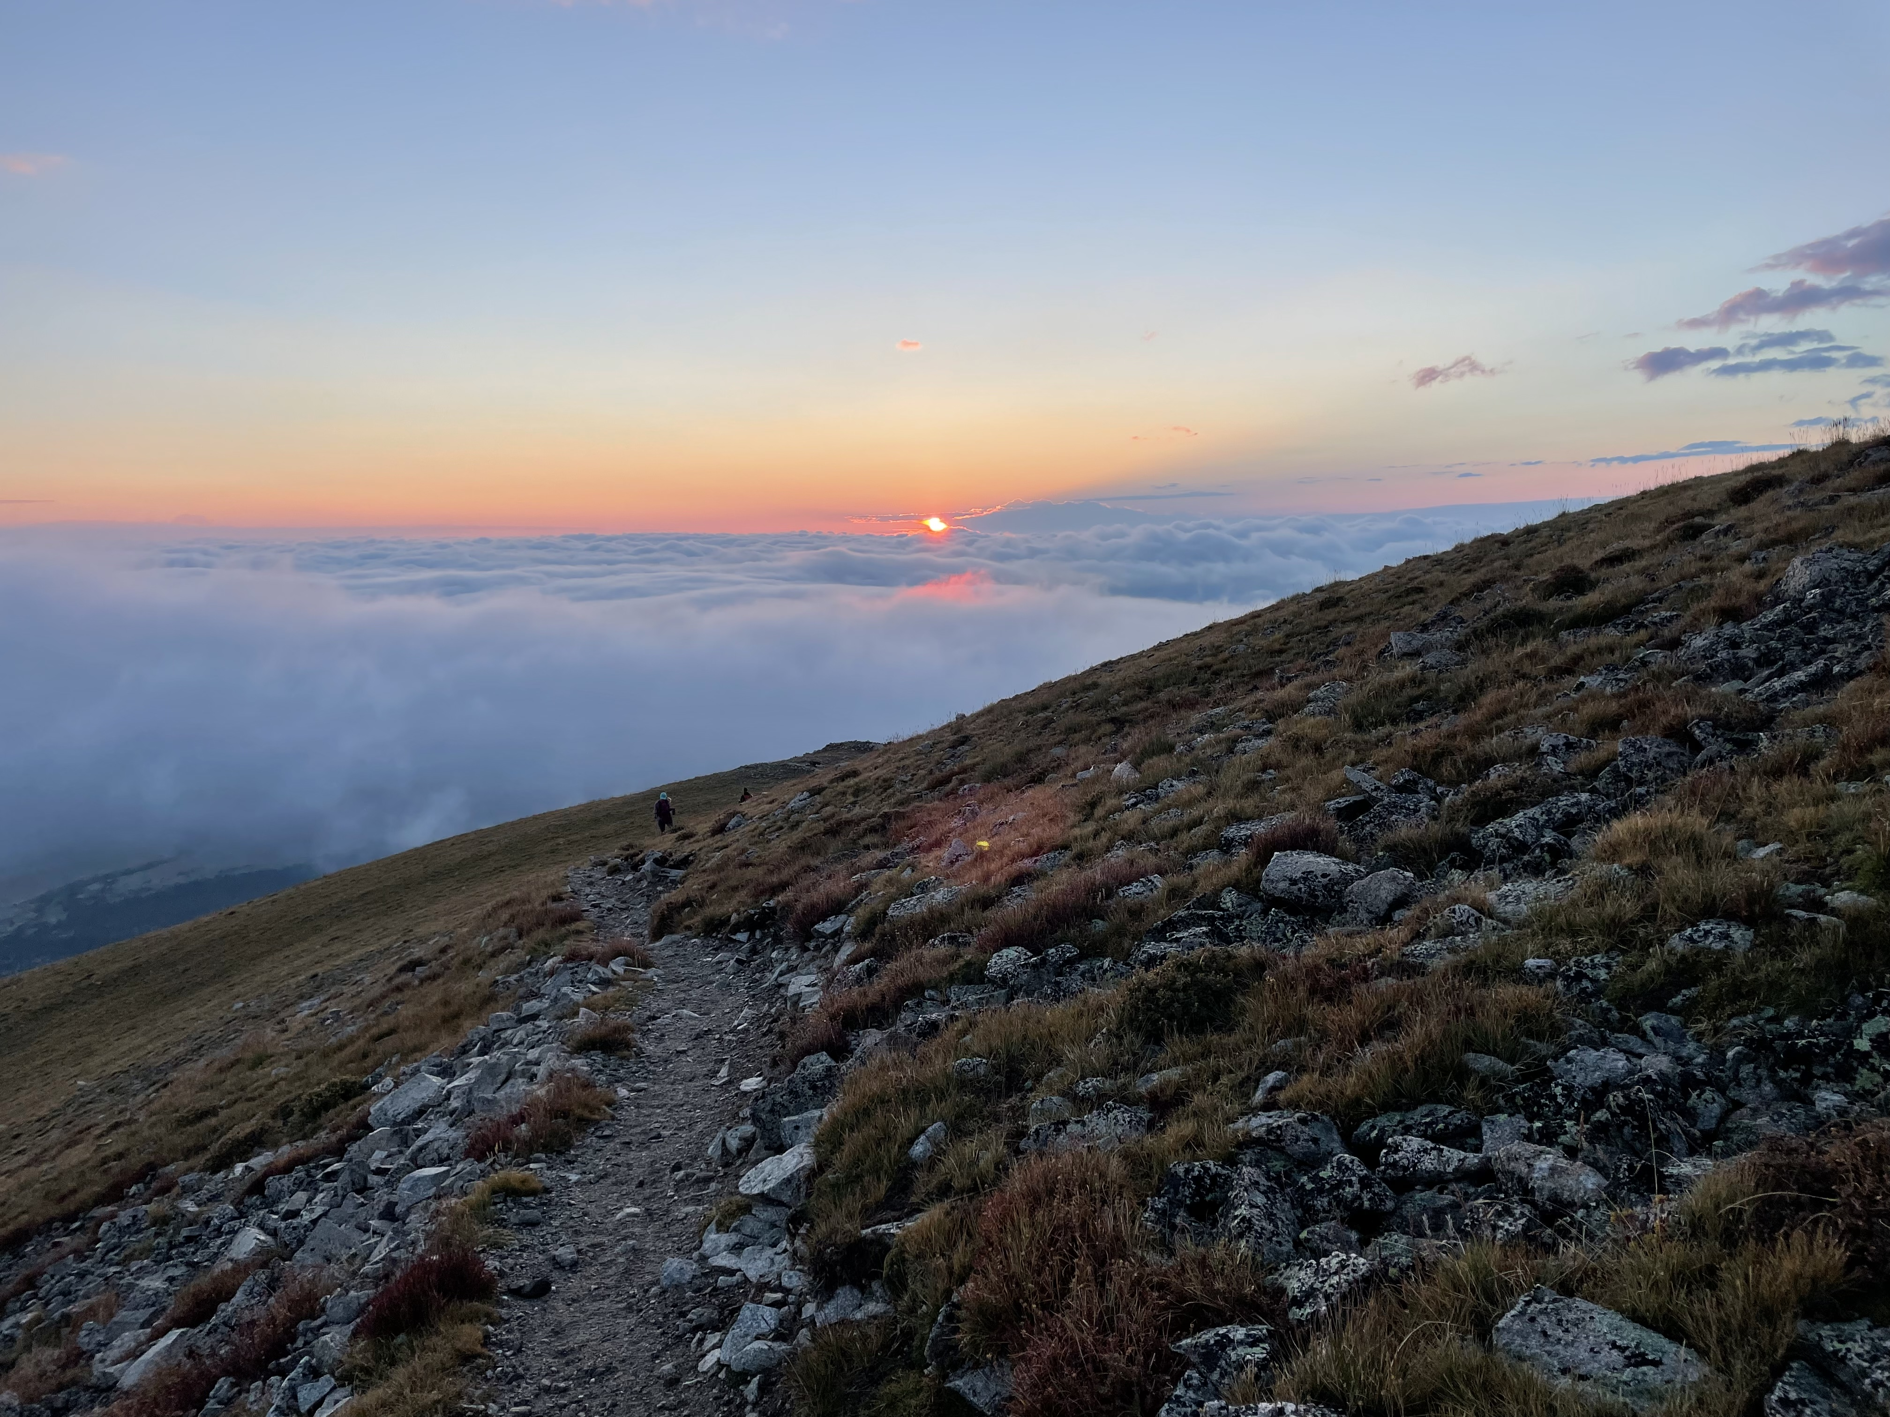
Trail Directors
Trail | Directors
Bioethics & Humanities | Daniel Goldberg & Brian Jackson
Health Systems & Community Leadership *FCB version | Ed Havranek & Jay MacGregor (*Rebecca Bade at FCB)
Medical Education | Danielle Miller & Nicolle Dyess
Research | Tim Bernard & Meredith Tennis
One Health* FCB Based | Anuja Riles & Nikita Habermehl

Slide 21

Integrated Science Selectives
Integrated Science Selectives are 4-week courses for Post-clerkship/Advanced Medical Students that integrate biomedical and clinical science learning in various didactic and clinical settings to help students learn about cutting-edge science in a given field, provide a way of thinking about how to advance the edge of the evidence and advanced clinical care, and engage students in self-directed learning.
Examples include Nutrition & Culinary Medicine, Advanced Concepts in Public Health, Climate Change and Environmental Health, Integrated MSK Care, The Frontier of AI & Medicine, Translational Medicine, Global Health, Cancer Biology

Slide 22
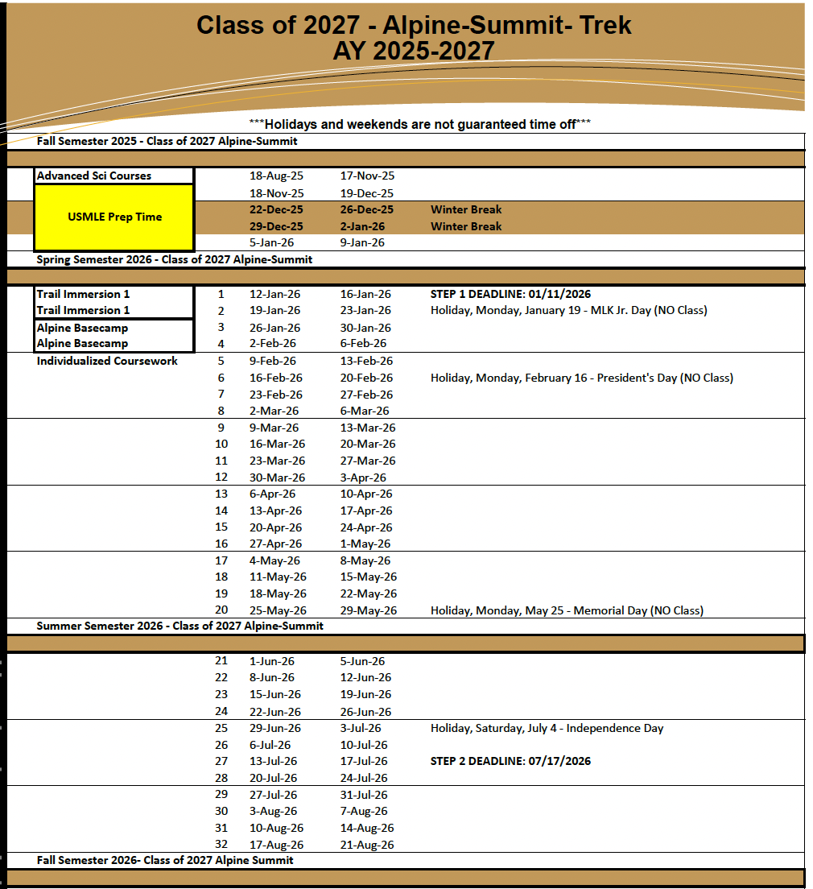
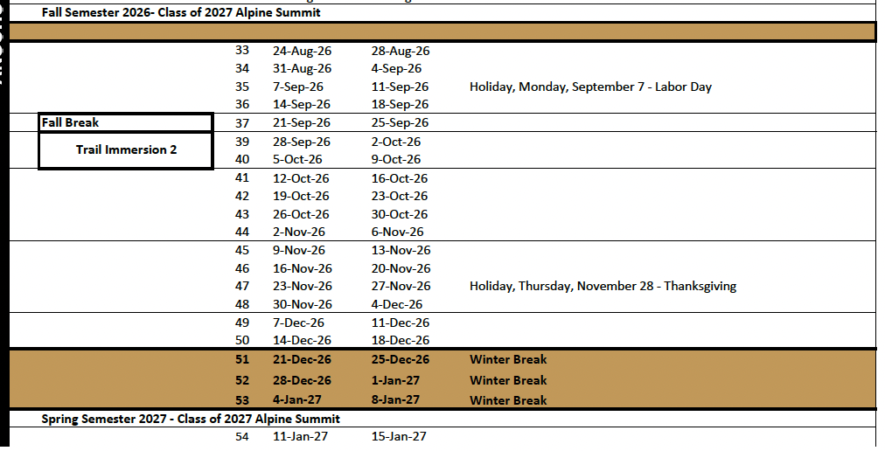
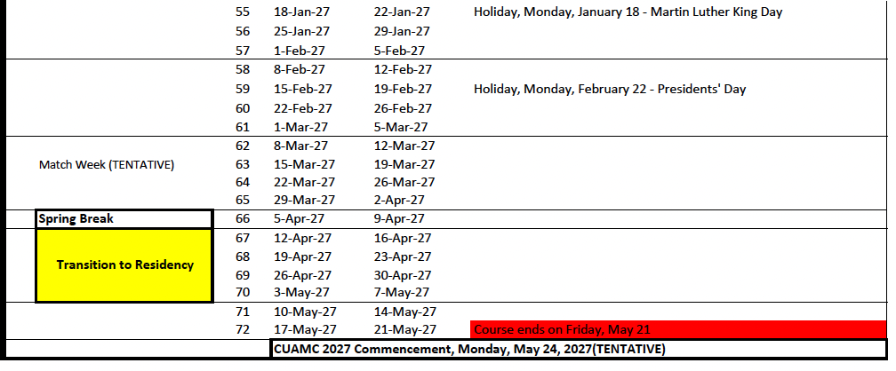
AI & Electives
Required core AI (4 weeks)
Integrated Science Selective (4 wks)
Critical Care* (2 wks)
Electives, Aways, Research Courses, Non-clinical Courses (28 wks)

Slide 23
Transition to Residency Basecamp
Evidence-based medicine (guideline review)
Radiology
Delivering Serious News
Opioid and Pain management
CPR skills (compressions and BVM)
ACLS rhythm interpretation
Resuscitation Simulation
Anatomy
Ultrasound
Patient Safety/ Root Cause Analysis
Content- relevant to Internship
Content Expert
Clinical Specialty
IM (3-5 cohorts)
Surgery (2 Cohorts)
Anesthesiology
EM
Pediatrics
Family Medicine
OBGYN
Radiology
Ultrasound
Anatomy
Palliative Care
Psychiatry/Addiction Medicine
Transfusion Medicine
COPIC
Critical Care Nursing
Respiratory Therapy
Small groups hands-on skill sessions
https://www.ttreducators.com/program-descriptions/univ-of-colorado
Notes:
2 days during March 2020

Slide 24
Next Steps
We will email you preference form in 2-3 weeks
We will email you link to excused absence/personal days request form
Focus on your core clerkship experience!
Detailed orientation on first day: August 18, 2025
Email our team with questions:
SOM.Alpine-Summit@cuanschutz.edu

Slide 25
Thanks!
Chad Stickrath, MD
Associate Dean for Medical Education, Post-Clerkship
Jessica Ackels
Pre & Post-clerkship Curriculum Manager
Alpine Summit Team
Sabrynne Buchholz (ASCs, Selectives)
Nomi Poprish (ASCs, Critical Care)
Megan Rhyne (Trails, Basecamps)
Maritza Casillas (AIs, Electives, Selectives)
Jodie Wang (Electives, Selectives)
Mary McGinnis (MSA)
Fort Collins Alpine Summit Team
Kelley Yseth, Fort Collins Regional Campus Manager
Jessica Duncan (ASC)
Kelli Harris (Electives)
Michelle Prado –Ferrin (Trails, Basecamps, Selectives)
Basecamp Team, ASC Team, Trails Team, Critical Care Team
CSB, FCB Teams
Post-Clerkship Course Directors, Coordinators, Faculty
Office of Student Life, Office Assessment & Evaluation
More info
Alpine-Summit Guidebook
Slides to be posted
During orientation on day 1 ASCs
Email with Questions: SOM.Alpine-Summit@cuanschutz.edu
Notes:
Challenges: logistics, congruence in ASCs, scaling the pilots, authentic clinical experiences

