Slide 1
Abby Leibowitz & David Sabio
Notes:
Sabio

Slide 2
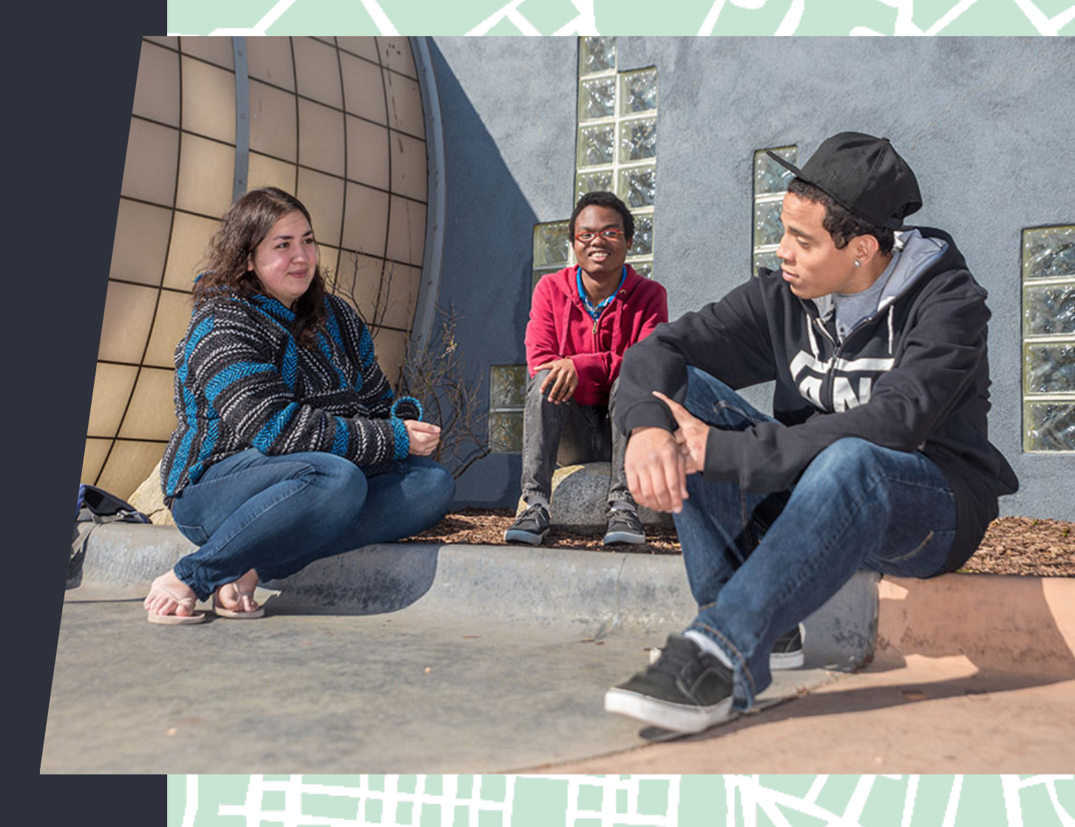
Notes:
Sabio “read the mission!!!”
Mission of The Place

Slide 3
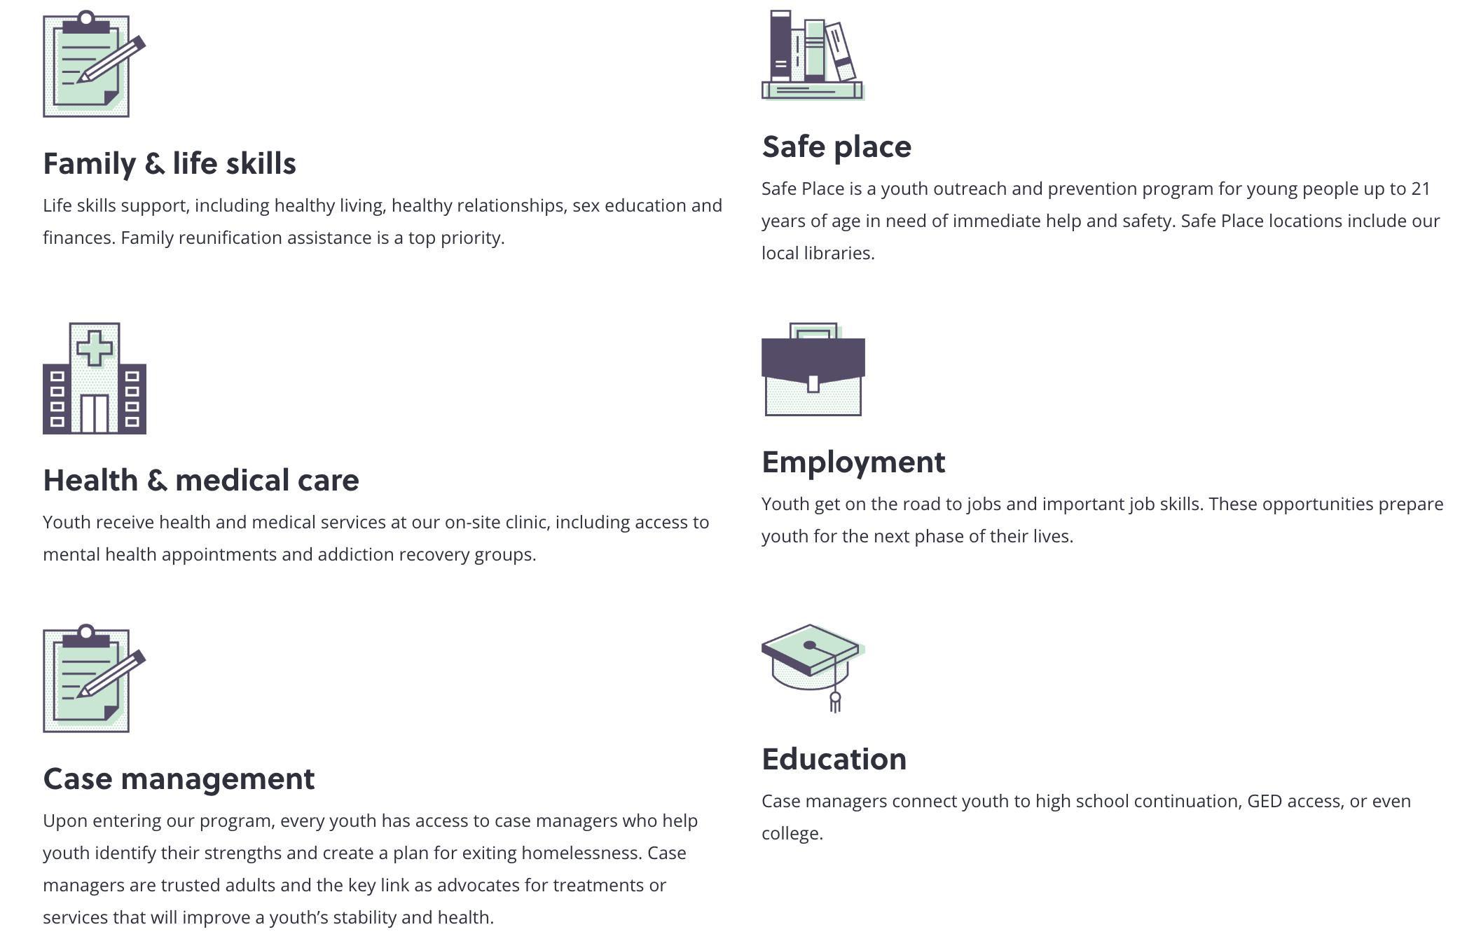
Notes:
Sabio
How do they accomplish their mission?
Urban Peak is the only youth shelter in Colorado Springs, and they provide wrap-around services with the goal of helping youth to exit homelessness. They are an incredibly robust organization, and services include shelter, housing, case management, life skills, education, employment. https://www.urbanpeak.org/colorado-springs/about-us/about-urban-peak/about-urban-peak-colorado-springs/

Slide 4
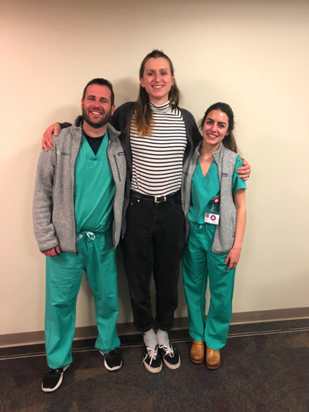
First Steps
June: Transition meeting with last year’s CUSOM students
July: Meet volunteer coordinator to learn about The Place’s mission & programs
August: Meet with outreach staff to learn about outreach work
Notes:
We started off last June by meeting with last year’s CU students to talk about their project.
They had cooked breakfast for youth at the shelter to build relationships with the youth and then they did some Q&A dinner sessions with the youth about STD’s, drug use, and more.
We then met with Juniper, the volunteer coordinator to learn about the range of services offered by the Place and we were particularly struck by the unique work of the outreach team.

Slide 5
Outreach Team
Three staff members who walk around the local community and connect with homeless youth
Staff provide immediate assistance with items such as socks and water, and foster trusting relationships to facilitate future engagement with The Place
Notes:
Often times, Outreach Team is meeting youth in “pre-contemplative” stage of change - people who are not ready to come into the shelter and access more in-depth services.
However, Outreach Team also checks-in on youth - often making sure they get reminded about doctors or legal appointments, letting them know that someone at the shelter is trying to contact them

Slide 6
Shared Goals
Improve health of youth experiencing homelessness in Colorado Springs
Strengthen the existing relationship between The Place and CUSOM
Increase outreach team’s capacity to address medical needs of their clients
Notes:
That had been built by last year’s students
We didn’t know exactly what that would look like, and we wanted to give ourselves room to

Slide 7
How we get there:
Sept - Nov: Shadow outreach team, meeting youth in streets & community (4x)
Ongoing: Elicit the perspectives from staff regarding opportunities for growth
Nov: Meet with outreach staff to collaboratively determine priorities
Jan - March: Pilot Project

Slide 8
Assets
Opportunities
Outreach team is the face of the organization to youth they serve
Dedicated staff and impressive retention
Empowering outreach team incredible way to impact youth
Staff must feel comfortable talking to youth about an enormous range of issues
Notes:
Staff obviously talk to youth about housing issues, but they also talk through legal issues, they talk to youth about mental health, relationships with parents and significant others. They also see a number of medical issues on a daily basis. Youth will ask for medical supplies to help treat wounds, for instance.
This was the best way we could fit in - to help build staff’s working understanding and knowledge of the medical issues they see
Met with outreach team in Nov and talked through all of our different ideas for how we could do this - revamping first aid kits, accompanying youth to medical appointments so they would have someone else to advocate for them. What we settled on was lunch lectures to build the working knowledge of staff members so they are better able to serve their own clients.

Slide 9
Lunch & Learn
Notes:
Insert slide from lunch lecture

Slide 10
Outcomes
Nine staff attended first Lunch & Learn on infectious diseases
Learning about Hep A is good for my work.
Helpful to know how things are passed and what to do with clients when they come with issues
Really helpful, down to earth, in normal language info! Thanks!

Slide 11
Outcomes
Next Lunch & Learn on cold injuries and wound care scheduled for 3/17
When to go to doctor and when you know antibiotic is needed
Self wound care and when to refer youth to go to urgent care or emergency room, because they are frequently hesitant to go
How to care for small wounds

Slide 12
Sustainability Plan
Meet with next cohort of students in summer 2020
Encourage early engagement with the outreach team
Provide list of possible future projects for this collaboration
Investment in staff

Slide 13
Leadership Lessons
Notes:
As medical providers, wanting to be the one who directly cares for people and solves problems is part of our identity. Sometimes that is not what’s needed. In general, it’s very generous tendency but recognizing where you are most valuable to the people you serve and respecting that (even if it’s not the role you expected) is an even better approach

Slide 14
Thank you Shannon, Adrienne, Allison, and Vic!

