Slide 1

Mitchell High School:
Healthcare Exploration
PEAK Project
March 6, 2020
Sanju Garimella, Colton Leavitt, Megan Kunkel

Slide 2
Community Partner
Mitchell High School:
Underserved/under-represented students
Title 1 school
Biomedical Science education program
Mitchell High School HOSA program
Health Occupations Students of America
Compete in state/national competitions

Slide 3
Community Partner: Demographics

Slide 4
AssetS and NeedS
 | ASSETS | NEEDS
CSB Students | Students with a passion for medical education and mentorship Large resource network Dedicated white space time Innovations Award $2000 | Well-established community Stakeholder investment in CSB and PEAK Enthusiasm from students!
Mitchell High School | Structured biomedical courses Invested faculty liaisons Case-based learning curriculum Passionate students | Immersive healthcare experiences and mentorship Community connections

Slide 5
Shared Goals
Inspire
Inspire students to pursue healthcare-related training and careers through mentorship and experiential learning
Cultivate
Cultivate an avenue for professional development
Sustain
Develop a sustainable community partnership plan

Slide 6
The project: Monthly Events

Slide 7
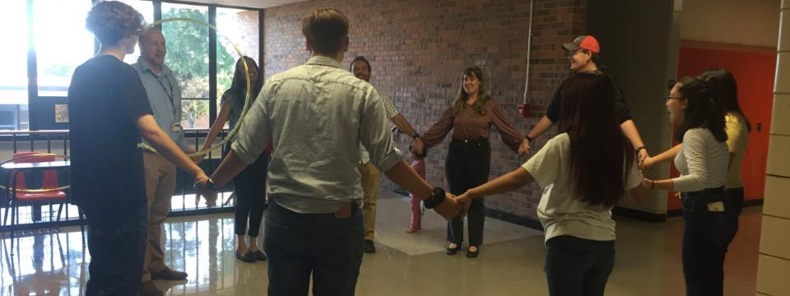
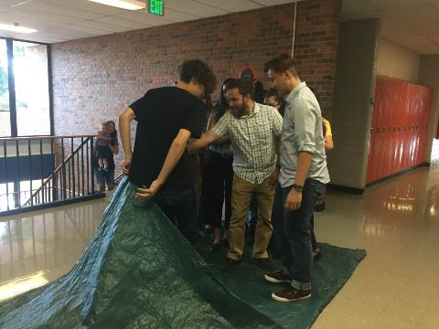
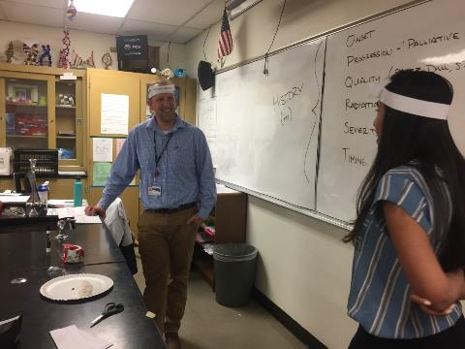
September
Meet and Greet, Team Building,
Diagnosis Headband Game

Slide 8
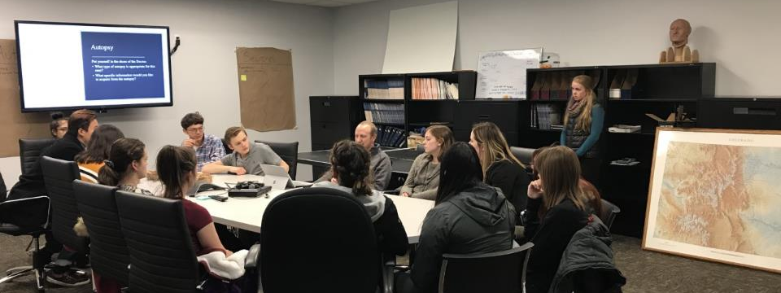
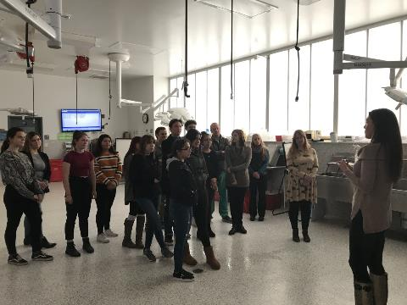
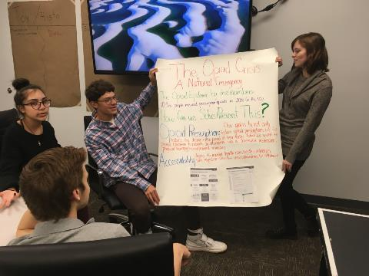
  October:
  Coroner’s Office &
  Public Health Interventions

Slide 9
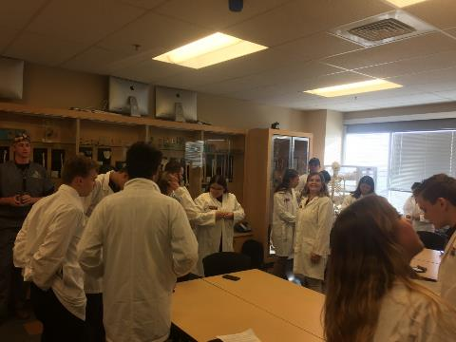
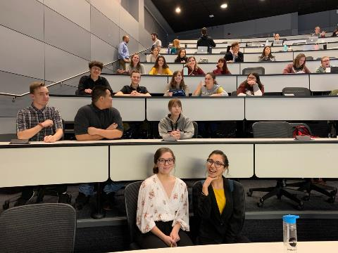
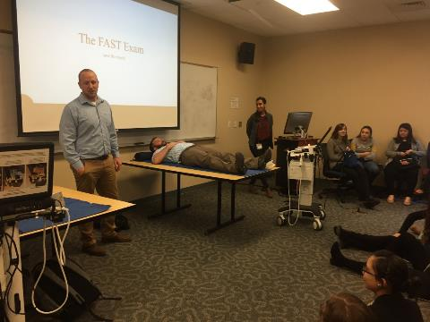
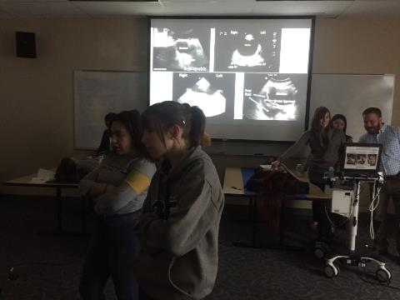
  November:
  Day in Life of Med School – Anschutz Medical Campus
  (Cadaver Lab, Ultrasound, MS1 Lecture, PBL)

Slide 10
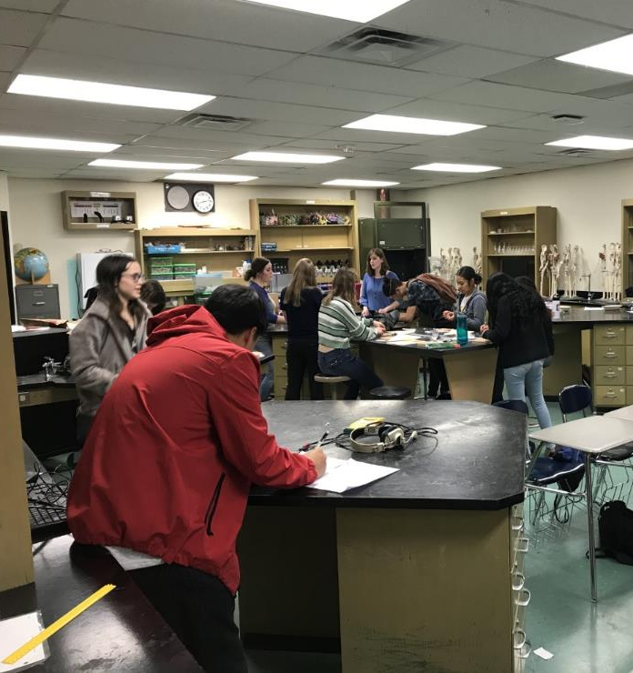
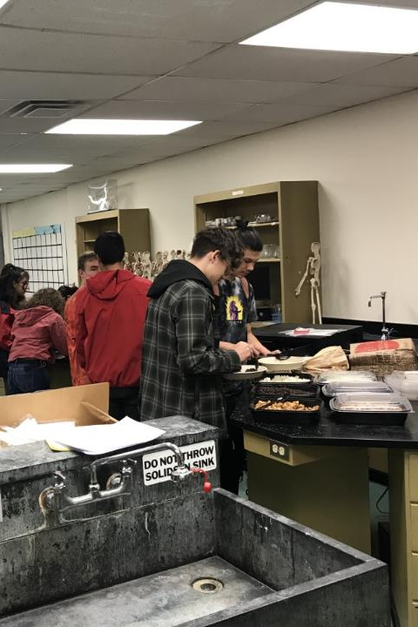
  January:
  Physical Exam and Suturing Skills

Slide 11
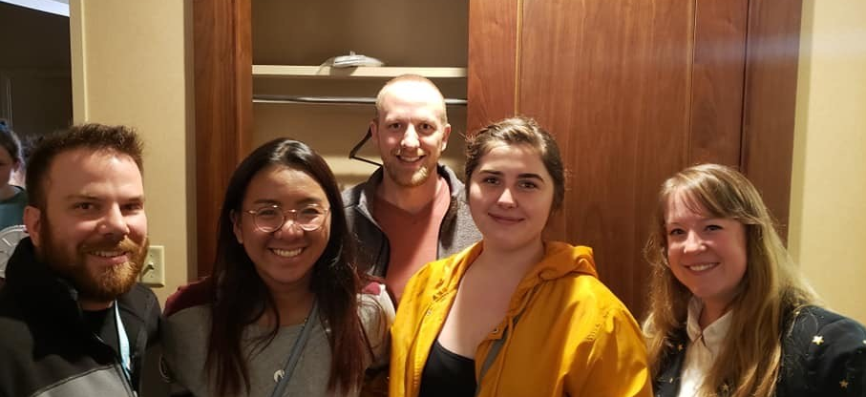
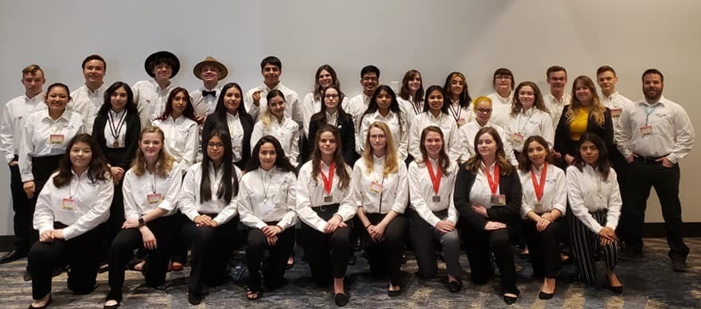
  February:
  Dinner at HOSA competition

Slide 12

  March 18th @ 4PM
  Communication and Patient interviews
  April:
  Final Banquet and team hand-off

Slide 13
Outcomes

Slide 14
Healthcare career interests

Slide 15
Community Partner: Barriers

Slide 16
Interests in Healthcare

Slide 17
Family influence on healthcare
27% (6 students) have at least one family member working in healthcare
  Dentistry
  Optometry
  Nurse
  Prosthesis

Slide 18




Shared Goals
Inspire
Inspire students to pursue healthcare-related training and careers through mentorship and experiential learning
Cultivate
Cultivate an avenue for professional development
Sustain
Develop a sustainable community partnership plan

Slide 19
Leadership Lessons
Assess the community’s needs earlier in the year- perhaps even in April
Plan early, incorporate contingency plans, and be flexible (in case of blizzards!)
Partner with community experts to utilize their strengths to balance our weaknesses
Communicate needs, maintain a consistent open line of communication
Collaborate with community members with shared interests and goals

Slide 20
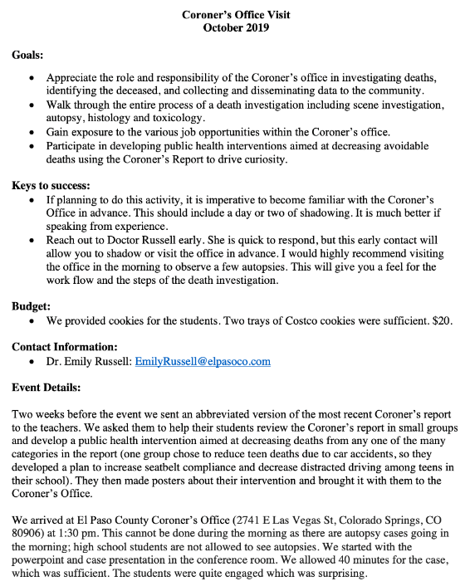
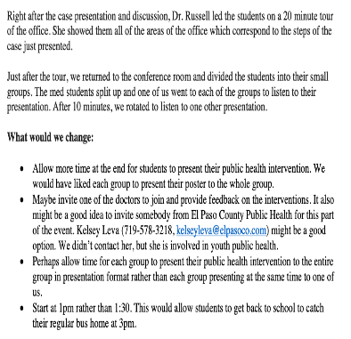

Sustainability
Secure future sources of funding
Partnership with AHEC
Event summary and recommendations

Slide 21
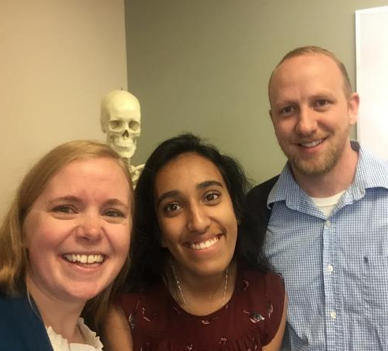
Thank you!
Julia Walden & Ryan Cowles
D11:
Duane Lee Roberson
Mitchell High School Students
AMC:
Dr. Regina Richards
Dr. Maurice Scott and PBL facilitators
Dr. John Kendall
Dr. Matt Taylor and Dr. Michael Yeager
Erica Hymen
MSC Innovations Committee
Colorado Springs:
Dr. Heather Cassidy
Dr. Tiffany Willard
Dr. Emily Russell
All the restaurants and bars in CS for every loud planning meeting!

Slide 22
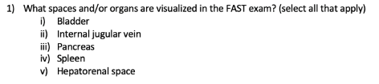
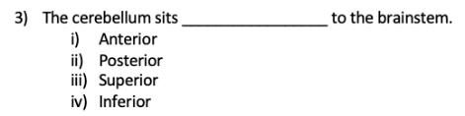
Long-term learning

Slide 23
Outcomes: Career Interests

