Slide 1
PEAK Project
Casey Dolen

Slide 2
Community Partners / Stakeholders
El Paso County Department of Health
Security Fire Department
UCH Memorial Hospital
Colorado Springs Children’s Hospital
El Paso County Department of Health and Human Services

Slide 3
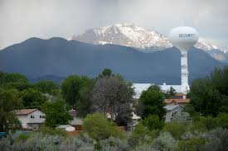
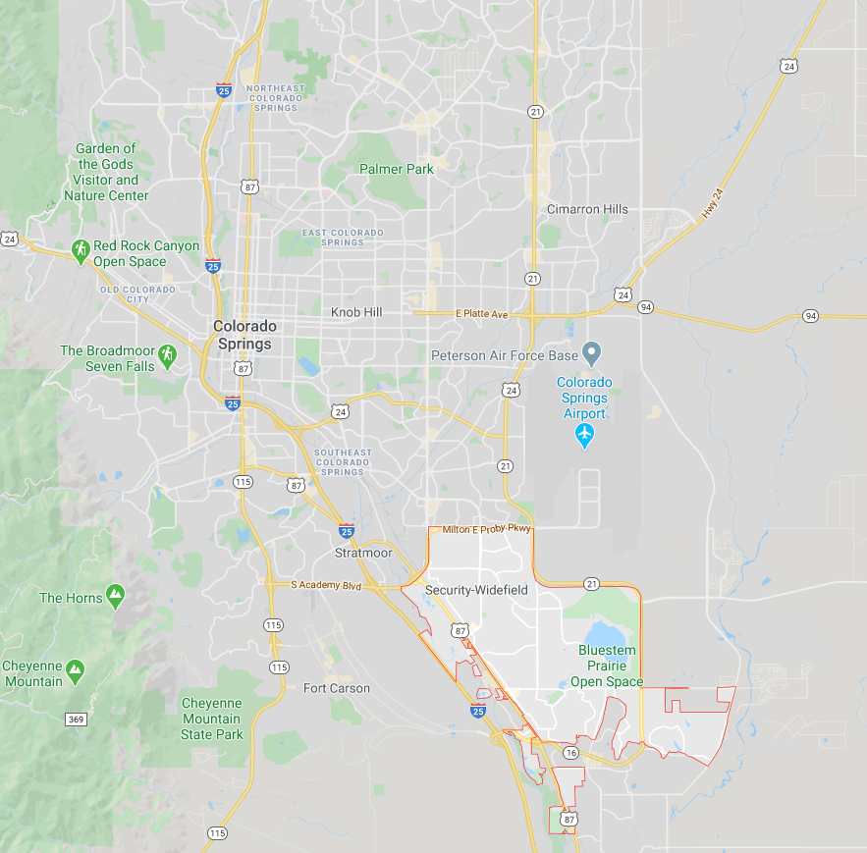
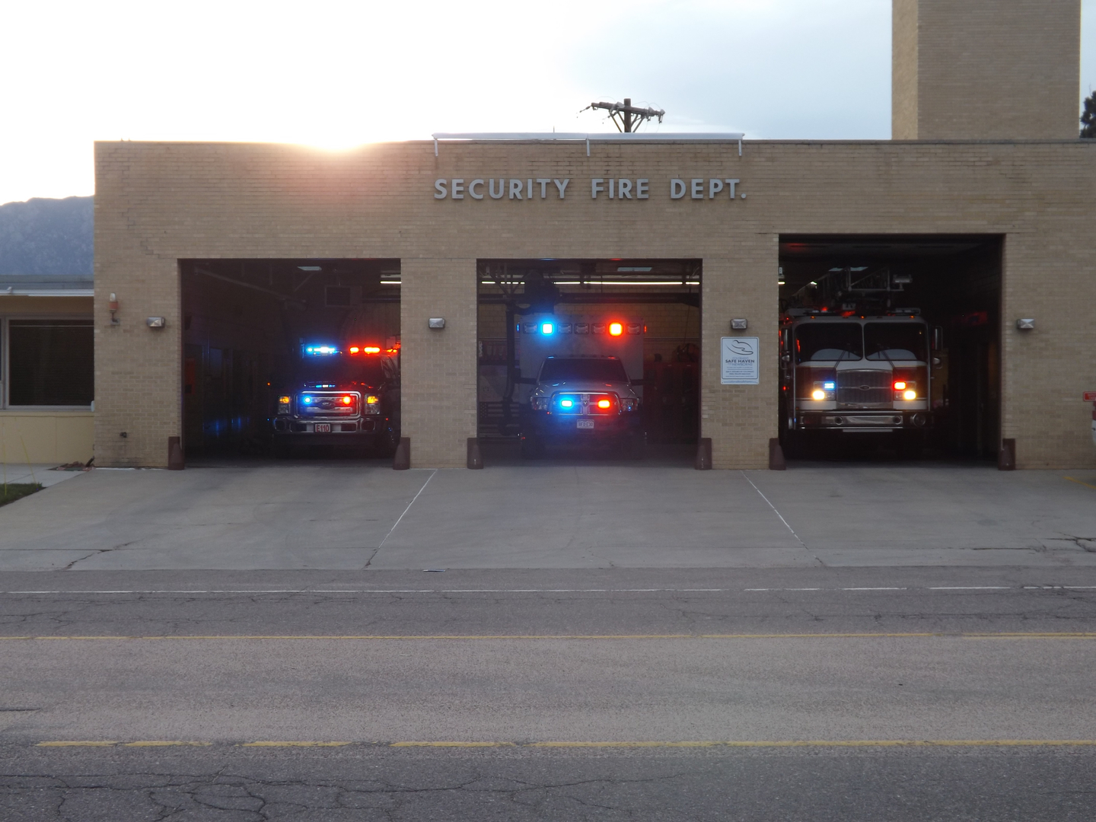
Assets and Needs
Security, CO
Population ~35,000
Families ~8,000, 50% with children <18
More diverse than Colorado Springs
Median household income $48,911 ($54,228)
Widefield School District 3
Security Fire/EMS
64-year-old department
~5,400 calls per year (~80% medical)
Fire and EMS service
Volunteers and paid members

Slide 4
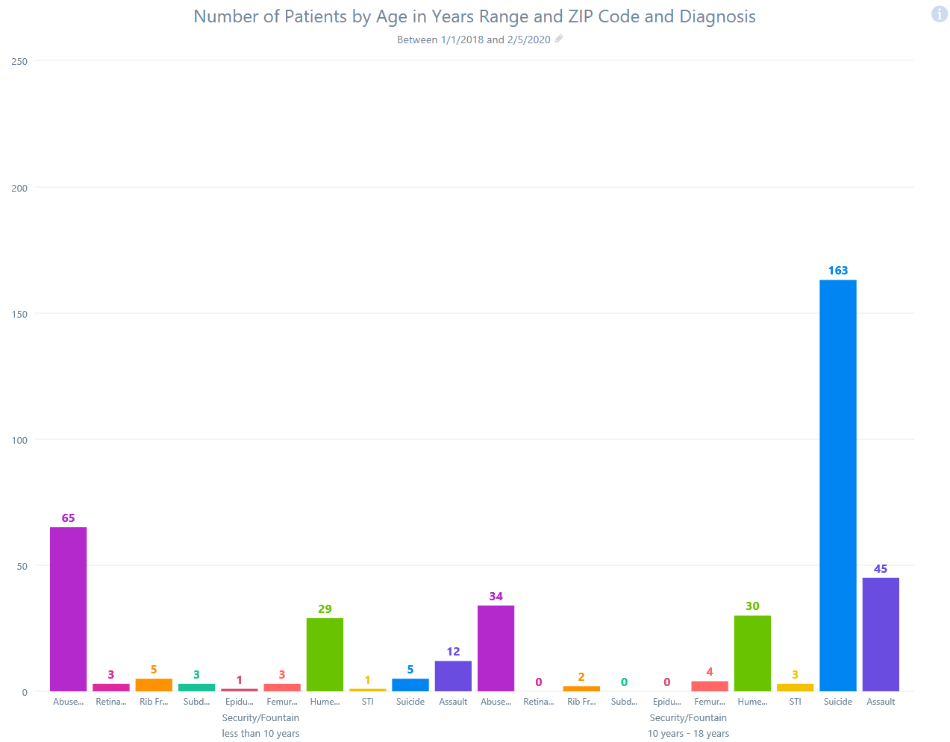

Slide 5
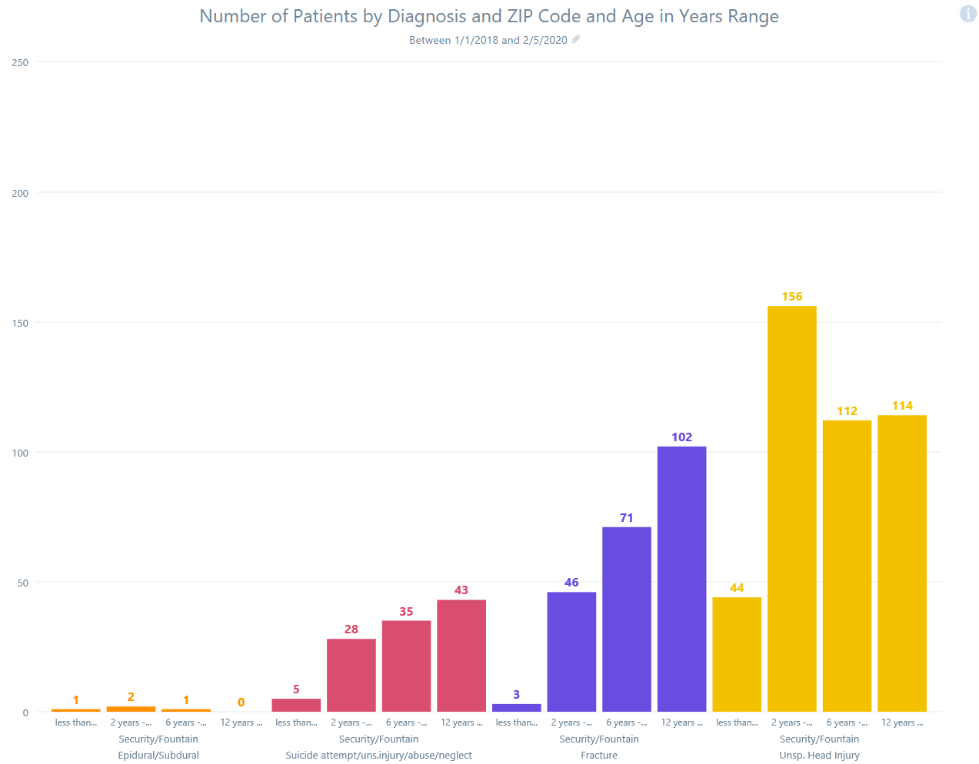

Slide 6
Shared Goals
County Government
Enforcing law
Elections
Prevention
ED
Community
Hospitals
Families and children
Child
Welfare
Providing medical care
Funding
Regulations
EMS
Public Relations
Medical Direction
Responding to emergencies
Security Fire/EMS

Slide 7
Project
Obtain Data
Goal
Reduce the incidence of undiscovered child abuse in Security, CO using current EMS data
Process
Use EMS data to identify children at risk
Review selected cases
Intervene on selected cases
Medical Direction
Statutory requirement for EMS agency to have physician oversight
QA/QI required duty
Mandatory reporters
Review
Intervention

Slide 8
Outcomes
Obtain Data
Challenges
Fragmented records
System design (QA/QI)
Funding
Fragmented systems
Police
Fire
EMS
Fire EMS
Private EMS
Hospitals
County agencies
Physicians
Ethics
Limitations of data
Review
Intervention

Slide 9
Ethical Considerations
Higher county poverty concentration is associated with increased rates of child abuse fatalities.¹
Is there bias in child abuse reporting? Would this project contribute?
Black children are almost twice as likely as white children to be reported as victims of child abuse, although the estimated incidence of abuse is similar.²
Diverse communities are more likely to interact with mandatory reporters
More likely to interact with police and EMS
Community agencies (DHS, schools, welfare services, foster agencies)
Determining abuse from injuries is subjective
¹ Drake, B., Jolley, J., Lanier, P., Fluke, J., Barth, R., & Jonson-Reid, M. Racial bias in child protection? A comparison of competing explanations using national data. Pediatrics, 127(3), 471-478.
² Farrell, C., Fleegler, E., Monuteaux, M., Wilson, C., Christian, C., & Lee, L. Community Poverty and Child Abuse Fatalities in the United States. Pediatrics, 139(5), Pediatrics, 2017, Vol.139(5).

Slide 10
Leadership Lessons
Working outside comfort zone is tough
How does my project contribute to disparity or equity in the community?
Change is difficult for large and small organizations
Middle managers drive change
Organizations love data

Slide 11
Sustainability
Intervention first
Education, encourage reporting
Bring stakeholders together
Probably would not happen without continued external support

