Slide 1
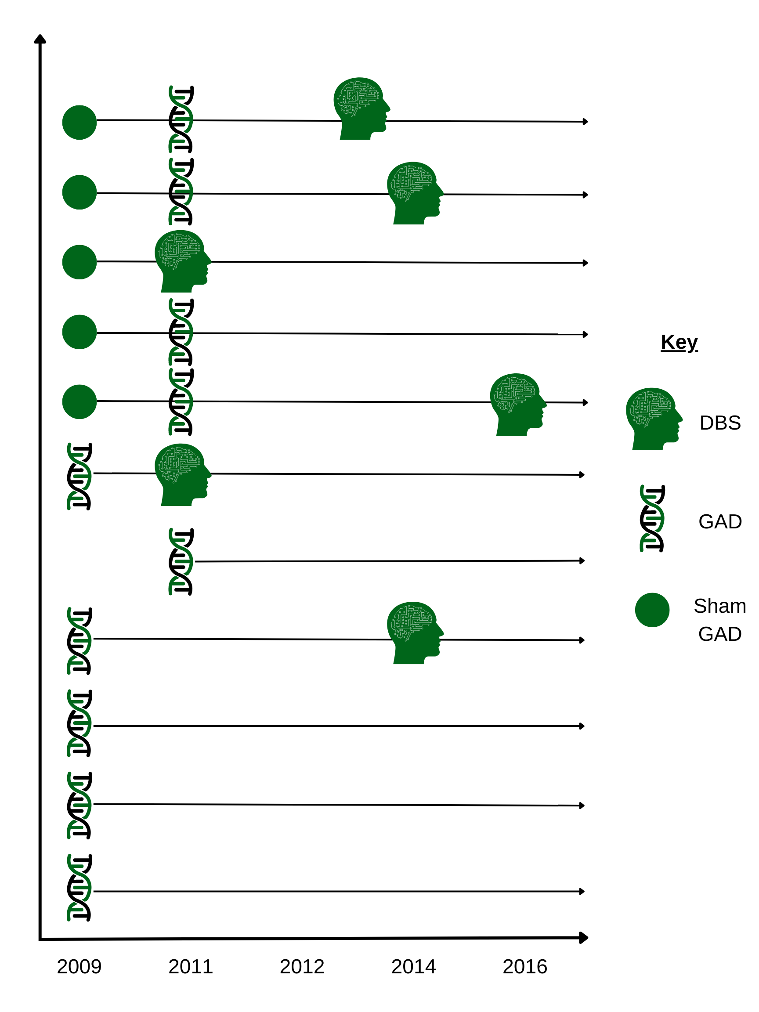
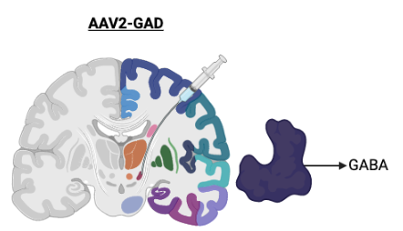
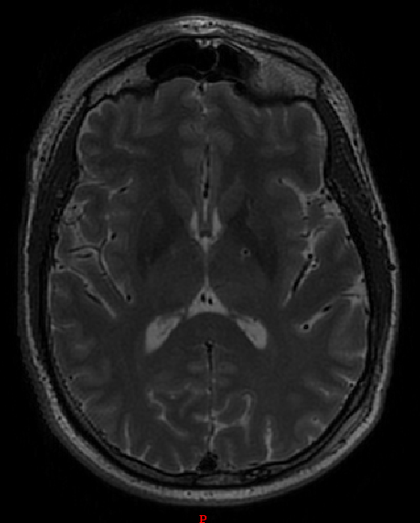
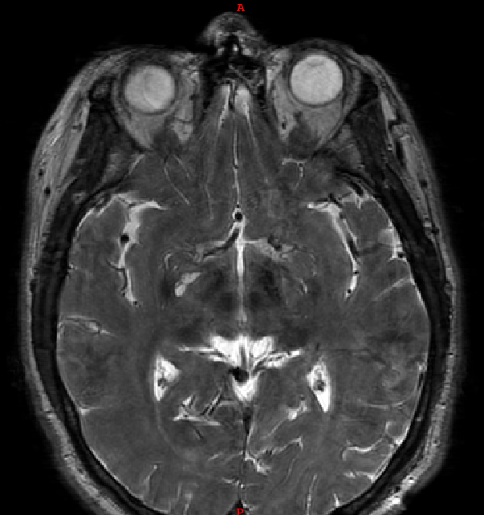
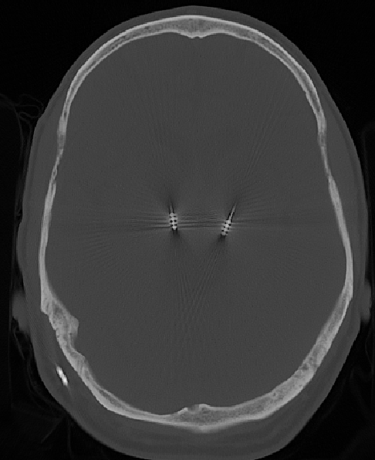
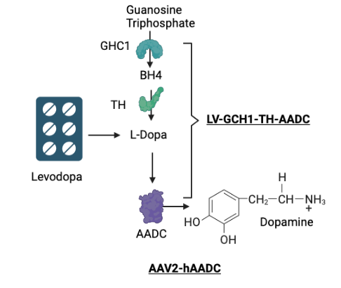
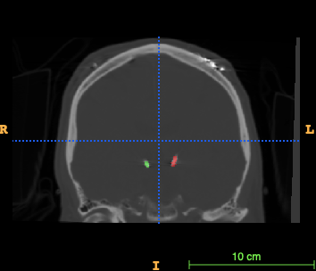
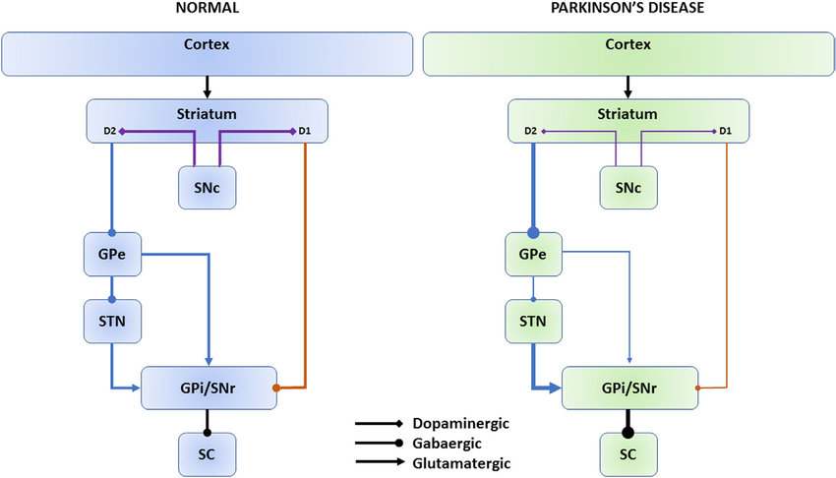
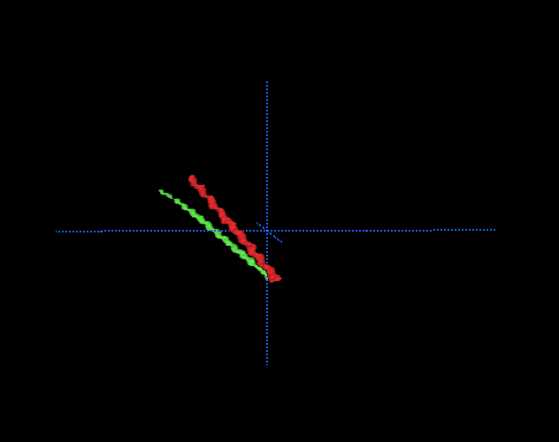
GAD Gene Therapy and Subsequent Deep Brain Stimulation for Parkinson’s Disease
Yaswanth Chintaluru BS¹, John A Thompson PhD^{1,2}, Pamela David Gerecht PhD², Drew S Kern MD MS^{1,2}, Steven Ojemann MD^{1,2}
1. University of Colorado School of Medicine 2. University of Colorado School of Medicine Department of Neurology & Neurosurgery
Background
Methods
Results
Deep Brain Stimulation
No conclusive evidence that DBS is neuroprotective
Fails to fully address some major chronic concerns such as cognitive and nonmotor symptoms (Castrioto et al., 2011)
Does not stop progression of disease
Gene Therpay
Gene therapy may bridge this missing piece
Multiple targets have been studied
hAADC (adenovirus): Striatum
GCH1-TH-AADC (lentivirus): Striatum
GAD gene therapy (adenovirus): STN
Produces an enzyme that converts glutamate into gamma-aminobutyric acid (GABA)
GAD-glutamic acid decarboxylase hypothesis
STN hyperactivity in PD creates toxic levels of glutamate
GAD catalyzed synthesis of GABA decreases hyperactivity of the STN and consequentially, overproduction of glutamate
GAD therapy targets the neurodegenerative property of PD
UPDRS ON results suggest improved motor symptoms with GAD+DBS compared to GAD
Significantly lower mean UPDRS ON scores at Post GAD+DBS at 6 (p=.041) and 12-months (p=.036) compared to Post GAD 12 month.
Pre-treatment
Post-GAD Cannula
Post DBS
LEDD results suggests clinical improvement with GAD+DBS compared to pre and post GAD
Results yielded significantly lower mean LEDD scores between Pre-GAD and Post GAD+DBS (p=.027).
Pre-GAD vs. Post GAD+DBS at 3-month (p=.041)
Pre-GAD vs. 12-month time points (p=.018)
Significantly lower LEDD scores Post GAD vs. Post GAD+DBS at the 12-months (p=.006).
Figure 3. Imaging at different treatment timepoints
11 patients were enrolled in 2009-2011 and had variable timelines
GAD=5
Placebo=6
Placebo decision (unblinding)
GAD=4
DBS=1
Final follow up decision
DBS=5 (out of 10 GAD)
UPDRS motor scores and calculated LEDD scores after both GAD and DBS surgeries
Baseline
3 months
6 months
12 months
Figure 4. Study Timeline
Figure 1. Gene Therapy Approaches
Investigated if viral delivery endpoint contributed to outcomes for DBS and GAD
Baseline MRI and overlayed intra GAD CT imaging and post DBS electrode placement CT
Created a 3D rendering of both GAD and DBS placement matched to baseline MRI
Calculated Euclidean distances between DBS and GAD endpoints
Conclusions
DBS is highly effective at treating clinical symptoms
Mixed evidence of neuroprotection
GAD gene therapy aims to address the pathophysiology of PD
Positive outcomes suggest compatibility of the treatments
Results inform us that combined treatment could address underlying pathophysiology, while continuing to treat clinical manifestations
GABA
Methods
Figure 2. GAD effects through GABA on Parkinson’s Pathway
Results
Figure 5. Example DBS lead segmentation
Multi –site study including CU
16 patients received bilateral GAD-STN treatment, 21 received sham surgery
Data showed improved motor scores at 6 months follow up
Patients received either sham surgery or GAD treatment
Placebo arm patients were offered GAD treatment at final follow up
All study patients with long term follow up that failed to respond were offered STN-DBS
Model Fit Measures
Model |  |  | R |  | R²
1 |  |  | 0.724 |  | 0.525
Euclidean Distance positively correlated with change in LEDD scores at 3 months post DBS+GAD
May explain variation in GAD outcomes
5 patients did not receive subsequent DBS
Model Coefficients - Change from baseline to DBS + GAD 3 months
Predictor |  |  | Estimate |  | SE |  | t |  | p
Average Euclidean Distance |  |  | 23.6 |  | -15.9 |  | 1.49 |  | 0.276
References
Bove F, Mulas D, Cavallieri F, Castrioto A, Chabardès S, Meoni S, Schmitt E, Bichon A, Di Stasio E, Kistner A, Pélissier P, Chevrier E, Seigneuret E, Krack P, Fraix V, Moro E. Long-term Outcomes (15 Years) After Subthalamic Nucleus Deep Brain Stimulation in Patients With Parkinson Disease. Neurology. 2021 Jun 2:10.1212/WNL.0000000000012246. doi: 10.1212/WNL.0000000000012246. Epub ahead of print. PMID: 34078713.
Davidson, C., Paor, A., Cagnan, H., & Lowery, M. (n.d.). Analysis of oscillatory neural activity in series network models of parkinson's disease during deep brain stimulation. Retrieved March 01, 2021, from https://www.embs.org/tbme/articles/b9-analysis-of-oscillatory-neural-activity-in-series-network-models-of-parkinsons-disease-during-deep-brain-stimulation/
Hamid, N. A. (2005). Targeting the subthalamic nucleus for deep brain stimulation: Technical approach and fusion of pre- and postoperative mr images to define accuracy of lead placement. Journal of Neurology, Neurosurgery & Psychiatry, 76(3), 409-414. doi:10.1136/jnnp.2003.032029
LeWitt, P. A., Rezai, A. R., Leehey, M. A., Ojemann, S. G., Flaherty, A. W., Eskandar, E. N., . . . Feigin, A. (2011). AAV2-GAD gene therapy for Advanced parkinson's disease: A Double-blind, sham-surgery Controlled, randomised trial. The Lancet Neurology, 10(4), 309-319. doi:10.1016/s1474-4422(11)70039-4
Luo, J. (2002). Subthalamic GAD gene therapy in a Parkinson's disease rat model. Science, 298(5592), 425-429. doi:10.1126/science.1074549
Pretegiani, E., & Optican, L. M. (2017). Eye movements in parkinson’s disease and inherited parkinsonian syndromes. Frontiers in Neurology, 8. doi:10.3389/fneur.2017.00592

