Slide 1
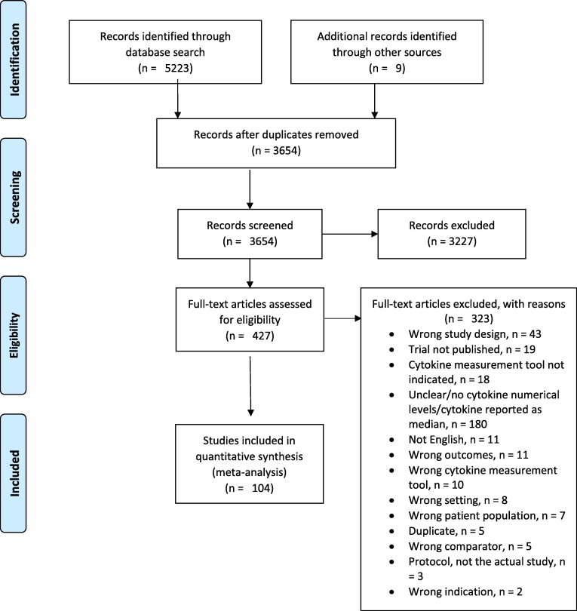
Cytokine levels in Sepsis, TNF-α Association with Mortality but not Sepsis Severity or Infection Source: a Systematic Review
and Meta-analysis
Amal A. Gharamti, Omar Samara, Anthony Monzon, Lilian Vargas Barahona, Sias Scherger, Kristen DeSanto, Daniel B. Chastain, Stefan Sillau, Jose G. Montoya, Carlos Franco-Paredes, Andrés F. Henao-Martínez, Leland Shapiro
Introduction
Results
Discussion
Sepsis is a global health problem associated with significant morbidity and mortality.
It is postulated that elevated cytokines levels play a significant role in the pathogenesis of sepsis. However, anti-cytokine therapies in sepsis have overwhelmingly failed in clinical trials.
Tumor Necrosis Factor (TNF)α, interleukin-1 (IL-1)β, and interferon (IFN)γ are considered pivotal mediators of the "cytokine storm" in sepsis.
It is crucial to quantify cytokine levels in sepsis, which will help characterize its role in sepsis pathogenesis.
To our knowledge, this is the first systematic review and meta-analysis characterizing the levels of key cytokines in the circulation in patients with sepsis and assessing the association between these levels and outcomes related to sepsis.
The pooled mean TNF level in sepsis was 58.4 pg/ml.
In animal sepsis models, lethal or sublethal doses of TNF were needed to reproduce the hemodynamic changes characteristic of sepsis patients. Therefore, it is less likely that the amount of TNF in sepsis patients, reported in our meta- analysis, accounts for the hemodynamic alterations of sepsis.
Several randomized placebo-controlled clinical trials failed to show any mortality benefit for anti-TNF-α therapy in patients with sepsis.
Failure of anti-TNF-α therapy could be attributed to two factors. First, underdosing of anti-TNF-α therapy is possible in the setting of elevated TNF levels, which is unlikely given the mean TNF level obtained in sepsis patients in the present study. Second, elevated TNF could serve as a prognostic marker, whereby elevations represent worse prognosis and severe disease and not necessarily direct harmful effects. This is a more plausible explanation for the failure of TNF-blocking agents.
Objectives
This systematic review aims to characterize key cytokine levels in the circulation in patients with sepsis and assess the association between these levels with sepsis clinical outcomes.
Methods
Table 1: Cytokine levels in patients with sepsis
Search Strategy and Selection Criteria
Studies of any design that reported relevant cytokine levels in patient cohorts were included. We excluded case reports.
Cytokine | Number of studies | Pooled estimate (pg/ml) | 95% Confidence Interval | I2 (%) | Heterogeneity p-value
TNF-α | 69 | 58.4 | 39.8-85.8 | 99.9% | <0.001
IL-1-β | 24 | 21.8 | 12.6-37.8 | 99.9% | <0.001
IFN-γ | 5 | 63.3 | 19.4-206.6 | 99.7% | <0.001
IL-1-RA | 6 | 24052.6 | 2359-245487.2 | 100% | <0.001
Limitations
There was significant heterogeneity in the number of observational studies obtained, owing to different study designs, measurement techniques, timing of cytokine level measurement, and the baseline characteristics of the patients included.
A possible publication bias exists due to the restriction of the included studies to the English language and the exclusion of unpublished studies.
Finally, the small sample size of the included studies reduces the power of the included studies.
We included studies that defined sepsis according to the diagnostic criteria proposed by the American College of Chest Physicians and the Society of Critical Care Medicine in 1992 as the presence of systemic inflammatory response syndrome and infection.
A systematic search in Medline (via Ovid), Embase (via Elsevier), Cochrane Library (via Wiley, including Cochrane Central Register of Controlled Trials), and Web of Science Core Collection (via Clarivate Analytics, including Science Citation Index Expanded and Social Sciences Citation Index) databases was conducted on 5/1/2020.
Data Analysis and Quality Assessment
The primary outcome was the 28-day mortality.
Secondary outcomes included the SOFA score, need for supplemental oxygen or mechanical ventilation, need for renal replacement therapy (RRT), and the emergence of secondary or supervening infections.
The protocol can be accessed by scanning the QR code.
Prospero Registration Number: CRD42020179800
Table 2. Metaregression outcome for TNF-α levels
Variables | Coefficient | 95%CI | P-value
Age | -0.06 | -0.11;-0.01 | 0.026
Technique | 0.28 | -1.05;1.61 | 0.681
Preexisting CV Disease | 0.05 | -1.79;1.88 | 0.96
Percent females | 0.15 | 0.09;0.20 | 0.0001
Fungal sepsis | -0.93 | -2.23;0.36 | 0.158
Mortality at 28 days | 0.13 | 0.06;0.20 | 0.001
References
Fleischmann C, Scherag A, Adhikari NK, Hartog CS, Tsaganos T, Schlattmann P, et al. assessment of global incidence and mortality of hospital-treated sepsis. Current estimates and limitations. American journal of respiratory and critical care medicine. 2016;193(3):259-72.
Singer M, Deutschman CS, Seymour CW, Shankar-Hari M, Annane D, Bauer M, et al. The third international consensus definitions for sepsis and septic shock (Sepsis-3). Jama. 2016;315(8):801-10.
Abraham E, Anzueto A, Gutierrez G, Tessler S, San Pedro G, Wunderink R, et al. Double-blind randomized controlled trial of monoclonal antibody to human tumour necrosis factor in treatment of septic shock. The Lancet. 1998;351(9107):929-33.
Corresponding author: Andrés F. Henao-Martínez, MD, University of Colorado Denver 12700 E. 19th Avenue, Mail Stop B168. Aurora, CO 80045, USA

