Slide 1
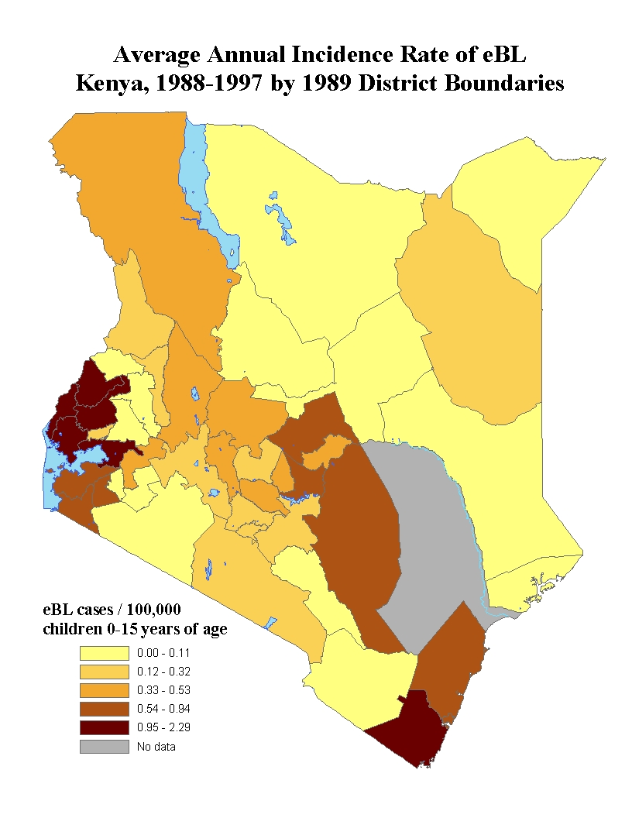
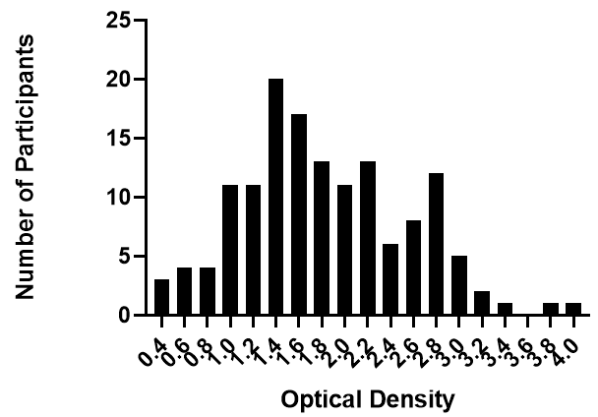
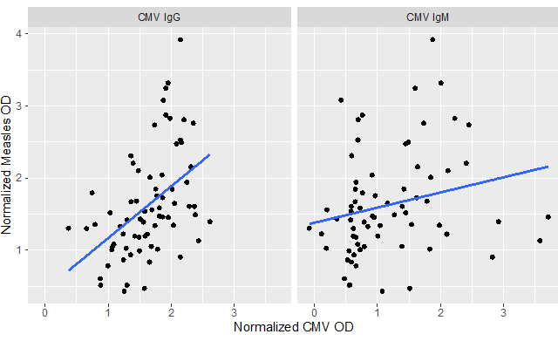
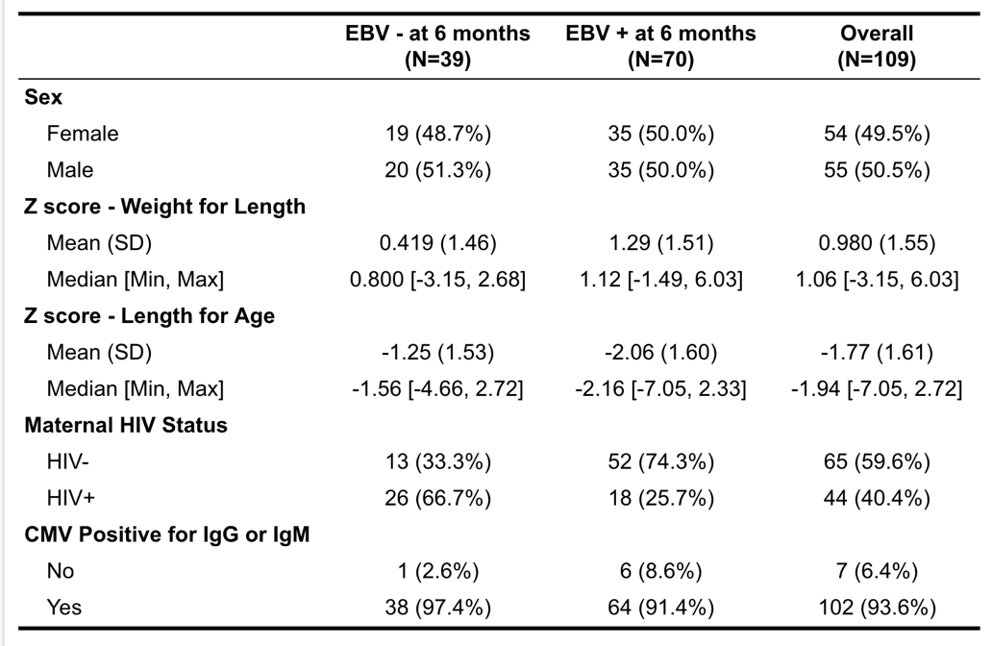
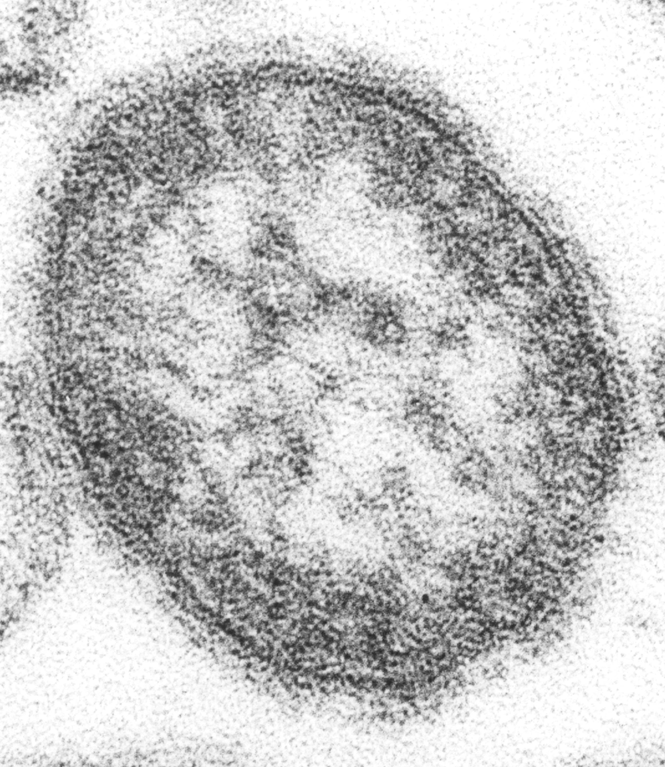

Early EBV Infection in Kenyan Infants by 6-Months and Response to Measles Vaccination
Derek S. Mason, MPH,¹ Conner Jackson, MS,¹ Siobhan Flaherty, MS,¹ Emmily Koech, MSc,² Gabriela S. Reyes, PhD,¹ Mahdi Maktabi, BS,¹ Arlene Dent, PhD, MD,³ Sidney Ogolla, MSc, PhD,² and Rosemary Rochford, PhD¹
¹Department of Immunology and Microbiology, University of Colorado, Aurora, USA; ²Kenya Medical Research Institute, Kisumu, Kenya; ³Case Western Reserve University, Cleveland, OH, USA
Nandi
district
Kisumu district
BACKGROUND
Optical Density Distribution
Measles OD Value by CMV OD Value Among EBV+ Children
Measles is a preventable disease through vaccination, but still presents a large burden of disease throughout the world. In 2019, there were more than 207,000 worldwide due to measles. Measles vaccination in Sub-Saharan Africa appears to be less effective (Bull World Health Organ, 1966). In a study based in the Gambia (Whittle et al., 2010, PLoS One), Epstein-Barr virus (EBV) infection measured at 9 months of age prior to measles vaccination resulted in diminished anti-measles antibody levels. Previous work by our group on an infant cohort in Western Kenya revealed a young age of initial EBV infection of 7-8 months, with ~30% of infants infected with EBV prior to 6 months of age (Piriou et al., 2012, JID).
OBJECTIVE
The aim of this study was to determine the response to measles vaccine following routine 9-month vaccination in infants who had been previously infected with EBV by 6-months of age.
METHODS
The mean optical density was 1.83 (SD ± 0.72; 95% CI 1.71-1.94), with a minimum optical density of 0.42 and maximum optical density of 3.92.
There is a significant positive correlation between CMV OD and measles OD. For IgG, the non-parametric correlation coefficient is strong with a rho of 0.529 (p-value <0.001) compared to IgM with a rho of 0.317 (p-value = 0.008).
The Chulaimbo Antenatal Postnatal (CHAP) study based in Chulaimbo County, Kenya, followed infants born to HIV-negative mothers from delivery through 2 years of age. Plasma samples were collected from 154 children in Kenya at several timepoints prior to 6 months and at 9 and 12 months of age. These infants received the measles vaccine at 9 months of age in line with WHO standards. Infants were defined as infected with EBV if any sample at 6 months or earlier had detectable EBV DNA as assessed by Q-PCR. An indirect ELISA was performed at 12-months of age to assess for anti-measles IgG. Infants whose EBV PCR data, CMV status, and measles vaccination data were collected and verified were included in the final analysis, resulting in 109 infants.
Difference in OD Based on EBV Status at 6 Months and CMV Status at 12 Months
IMPLICATIONS AND NEXT STEPS
RESULTS
Children who were infected by EBV by age 6 months had a statistically significant reduction in normalized OD values (p-value = 0.030; 95% CI = -0.665 to -0.034). Interestingly, infants infected with both EBV and CMV had greater normalized OD values (p-value < 0.001; 95% CI = 0.403 to 1.528). This aligns with previous work done by Whittle and colleagues (2010, PLoS One). As EBV is a B-cell tropic virus, there may be disruption in humoral immunity from early infection leading to decreased vaccine efficacy. CMV infection, conversely, provides a protective effect, perhaps by activating T-cell response. More work will need to be done to understand the biological mechanism affecting response to vaccination. From a public health perspective, we believe that this represents a possible opportunity for acquiring measles. The correlate of protection for measles antibody measured by OD is >0.1 (Huiss et al., 1997, Clin Exp Immunol). While none of our samples had ODs <0.1, there is evidence of anti-measles IgG declining over time in children infected with EBV (Lasaviciute et al., 2017, Front Immunol). A future study to look at how these children’s ODs trend over time.
Table 1: Demographics and Characteristics of Enrolled Children
Normalized measles OD values by EBV and CMV status. From left to right: 39 children were EBV- by 6 months, while 70 were EBV+ by 6 months; 7 children were CMV- at 12 months, and 102 were CMV+ at 12 months. Adjusting for sex, z-scores for wasting, stunting, and maternal HIV status, children who were EBV+ by 6 months had significantly lower normalized OD values (p-value = 0.030); conversely, children who were CMV+ at 12 months had significantly greater normalized OD values (p-value < 0.001).
ACKNOWLEDGEMENTS
We acknowledge the Chulaimbo Sub-District Hospital and Mosoriot Sub-District Hospital for allowing us to use their facilities to perform this study. We also thank our clinical officers, medical officers, and data entry and field staff who were involved in the project. We are particularly grateful to the mothers and children for their participation in this study. This work was supported by the National Cancer Institute at the National Institutes of Health (CA102667 to R. R., AI098511 to A.D.) as well as a grant from Alex’s Lemonade Stand (to R. R.)
We additionally express gratitude to Pamela Strauch and Mary McCarthy for their assistance in this project.

