Slide 1
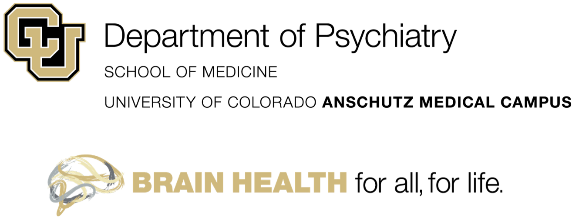
Anti-Stigma Panel: A peer-led mental health initiative Claire Koljack, BA; Mackenzie Garcia, MD; Rachel Davis, MD
Background & Objectives
Results
Discussion & Next Steps
Health professional students (medical, dental, nursing, graduate, pharmacy) are at higher risk of mental health problems than the general population.¹
One study found that 11% of medical students reported suicidal ideation within a year.²
Despite the apparent need for mental health resources, less than 30% of medical students report that they would seek professional help for a serious emotional problem.³
Negative self-stigma has shown to negatively impact individuals’ intention to seek help for mental illness.⁴
We developed a brief, peer-led, inter-professional, and cost-effective method for reducing self-stigma among health professional students on the Anschutz Medical Campus.
The presented format lends to a small program adjunct to current psychiatry or behavioral health curricula.
Issues of reproducibility may occur if implementing a mandatory program.
It is possible that a less self-selecting sample could experience a greater effect from the panel than we did.
Significantly Different Survey Responses Measured Pre/Post Panel:
If a fellow student/staff/faculty/resident/family member/friend experienced a mental health problem, I would know what resources are available and how they could access them.
Medication can be an effective treatment for people with mental health problems.
Psychotherapy can be an effective treatment for people with mental health problems.
I would be worried about seeking care for a mental health issue in case it might affect my ability to practice or obtain my license.
We recommend that our developed measure be used in replications because it specifically targets the experiences of health professional students.
We created a toolkit for panel replication. The toolkit can be found on the Department of Psychiatry’s webpage:
https://medschool.cuanschutz.edu/psychiatry/programs/student-resident-mental-health
Objectives
*
*
*
This 1.5-hour long panel where three health profession students spoke to 30 of their peers about their experiences with mental illness aimed to:
Improve health professional students’ knowledge of where to access resources should they need mental health assistance
Improve participants’ attitudes and intended behaviors regarding mental health self-stigma
*
References
Rotenstein LS; Ramos MA; Torre M; Segal JB; Peluso MJ; Guille C, et al. Prevalence of depression, depressive symptoms, and suicidal ideation among medical students: a systematic review and meta-analysis. JAMA. 2016;316(21):2214-36.
Dyrbye LN; Thomas MR; Massie FS; Power DV; Eacker A; Harper W, et al. Burnout and suicidal ideation among US medical students. Annals of internal medicine. 2008;149(5):334-41.
Dyrbye LN; Eacker A; Durning SJ; Brazeau C; Moutier C; Massie FS, et al. The impact of stigma and personal experiences on the help-seeking behaviors of medical students with burnout. Academic Medicine. 2015;90(7):961-9.
Corrigan PW; Watson AC. The paradox of self‐stigma and mental illness. Clinical Psychology: Science and Practice. 2002;9(1):35-53.

