Slide 1
Assessing medical students at CUSOM
Tai Lockspeiser, MD, MHPE
Assistant Dean of Assessment, Evaluation, and Outcomes

Slide 2
What is the overall goal of clinical assessment?
To provide the student and the school with helpful information on the student’s growth towards becoming an independent physician capable of providing safe and effective patient care.
Notes:
Key things to note in this goal is that assessment is for both the student and the school and there is no mention of grading. Although we use assessment data to grade our assessors do not need to worry about grading, you just need to worry about providing information. In addition, our frame of reference is creating independent physicians who provide safe and effective care which means that we are interested in how much support the student needs to complete the tasks of a physician.

Slide 3
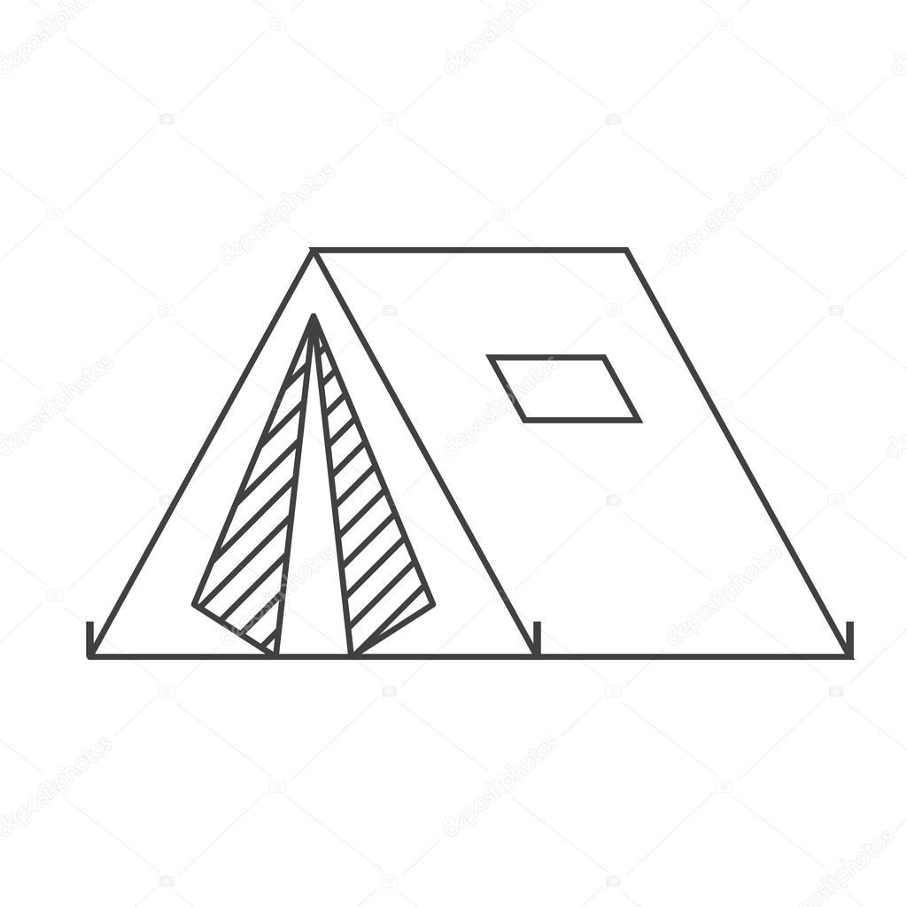
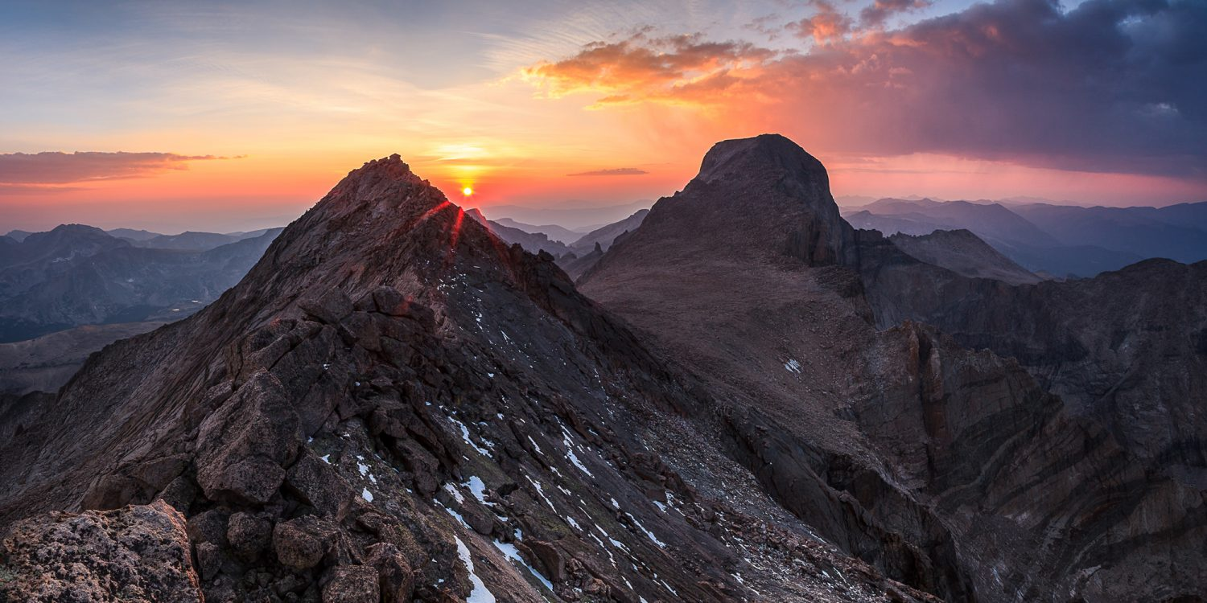
CUSOM Trek Curriculum
Year 1
Year 2
Year 3
Year 4
Orientation Base Camp (July)
Summer Discover (July/August)
Foothills Base Camp (September)
Alpine Base Camp (January)
Summit Base Camp (April/May)
USMLE 1 (Dec/Jan)
USMLE 2 (October)
Foundational | Summer Discovery | Foundational | Advanced | Individualized |  | Individualized
Preclerkship Integrated Curriculum Clinical Skills Training Health & Society Integration Preceptorship Coaching |  | Core Clerkships Longitudinal Integrated Clerkships | Advanced Integrated Science Courses | Trail (Non-clinical) Leadership Training Bioethics & Humanities Medical Education Health Systems & Community Leadership Research | Clinical Concentration Acting Internship Acute Care Individualized Integrated Science Selective Electives | Transition to Residency Courses
Plains |  | Foothills | Alpine |  |  | Summit
Notes:
Given the changes to the CUSOM curriculum what are the clinical expectations for students?
Students complete their core clinical rotations in longitudinal integrated clerkships during their second year (Foothills).
At the end of the Foothills, students should be able to take care of patients with common concerns somewhat independently but not completely independently – i.e. with some input.
Students have their 3rd and 4th year to complete electives and acting internships (Alpine).
At the end of the Alpine, the expectations relate to what an intern needs to do on their first day of residency. As such, students are expected to take care of patients with common concerns on their own and those with more complex concerns with some input.

Slide 4
Assessment Forms
All assessment is done in Oasis
Be on the look out for emails from Oasis with direct links to the forms – no need to remember your login!
All forms have two types of questions:
Ratings
Comment boxes

Slide 5
What are the tasks that you will assess?
Gather a history from a patient.
Perform a physical exam.
Develop a differential diagnosis.
Provide written documentation of a clinical encounter.
Provide an oral presentation of a clinical encounter.
Develop a management plan (including selecting/interpreting tests and preventative care).
Basic Technical skills
Urgent/ Emergent care
Organization/Prioritization
Evidence-Based Medicine
Professionalism
Compassion
Situational Awareness
Advocacy
Interprofessional Collaboration
Self-directed learning/Agency
Notes:
Not all of these are required on each form

Slide 6
For a patient with a common concern, if you were to supervise this student again how would you assign the task to the student to assure safe and effective patient care?
Let the student watch me do it
Do it with the student together
Let the student do it on their own and then repeat all findings or provide substantial input/revisions
Let the student do it on their own and then repeat some findings or provide minimal input/revisions
Notes:
Safe and effective patient care is at the core of all that we do and we are working to create independent clinicians. Trust depends on more than just knowledge and skill

Slide 7
Common misconceptions about ratings
Selecting that a student is very independent in the task does NOT mean they do not need teaching/ feedback.
Billing rules do not apply!
The amount of supervision a student needs is different depending on the context/complexity of the patient.
Asking for help and knowing your limits is part of being an independent clinician and not always a marker of a need for increased supervision.
Notes:
Entrustment and feedback are based on the context (i.e., details about the patient)
Often students are more independent with simpler patients before more complex so that can be a next
What type of patient is the student able to independently care for?
Common diagnosis with typical presentation
Common diagnosis with atypical presentation
Uncommon diagnosis with typical/atypical presentations
Complex social situation
Undifferentiated patient
Urgent/emergent situation

Slide 8
Independence in clinical care is context dependent
Independence
Common presentations
Complex presentations
Time/Practice
Notes:
How would your rating change if the patient was medically/socially complex or undifferentiated?
The key difference between common and complex patients isn’t always just the diagnosis (i.e., a patient with a fever could be common or complex or a patient with leukemia could be common or complex).
The difference instead lies in the amount and complexity of clinical decision making that is needed for that patient at that visit.

Slide 9
Common vs Complex
Common
Single or a few uncomplicated concerns
Routine problem
Minimal intervention/orders/ follow-up needed
Follow up care of a stable chronic condition
Complex
Multiple problems that may interact and require extensive clinical decision-making
Extensive test/ referral/medication ordering
Undifferentiated patient with unclear diagnosis
Atypical presentations of common diagnoses
Patients who need urgent/emergent care
Decision-making heavily influenced by a complex social situation

Slide 10
Suggestions for high quality feedback and narrative comments
Describe what the student did in detail with specific examples
Avoid clichés – i.e. “he went above and beyond” – what does that mean?
Use verbs not adjectives
Describe what the learner can do to move to the next level
Don’t use comparative language
Include specific reference to the activities we expect students to perform
Notes:
Would I have written the same thing if the student was a different gender or race?
Am I describing personal attributes of the students or how well they fit in, or am I describing the actual skills and knowledge they demonstrated during our time together ?
For every adjective in my narrative did I include examples of what the student did that led me to include this adjective?
Did I actually see the student performing the activities that I am assessing them on or am I making inferences about their performance in one area from their performance in another area?

Slide 11
Mitigating bias
Pause to think about if your biases are influencing your perceptions of someone else
Would I have written the same thing if the student was a different gender or race?
Work to find common ground and similarities with all learners
Practice Perspective taking
Imagine being the student who reads the feedback you wrote.
Consider the difference between your intent and your impact.
Focus on behavioral observations
Am I describing personal attributes of the student or how well they fit in, or am I describing the actual skills and knowledge they demonstrated during our time together?
Notes:
Intent – personal – what your motivation for something was
In your control
Impact – the results of what you say/do, how are actions/words are perceived/interpreted
Partially determined by other people, not as personal
Sometimes intent can be good, and the impact can still be harmful

Slide 12
Be the eye-witness and not the judge!

Slide 13
Each assessment is another pixel to provide more detail
Notes:
With more assessments we can get a more detailed picture of each student and their strengths and weaknesses

Slide 14
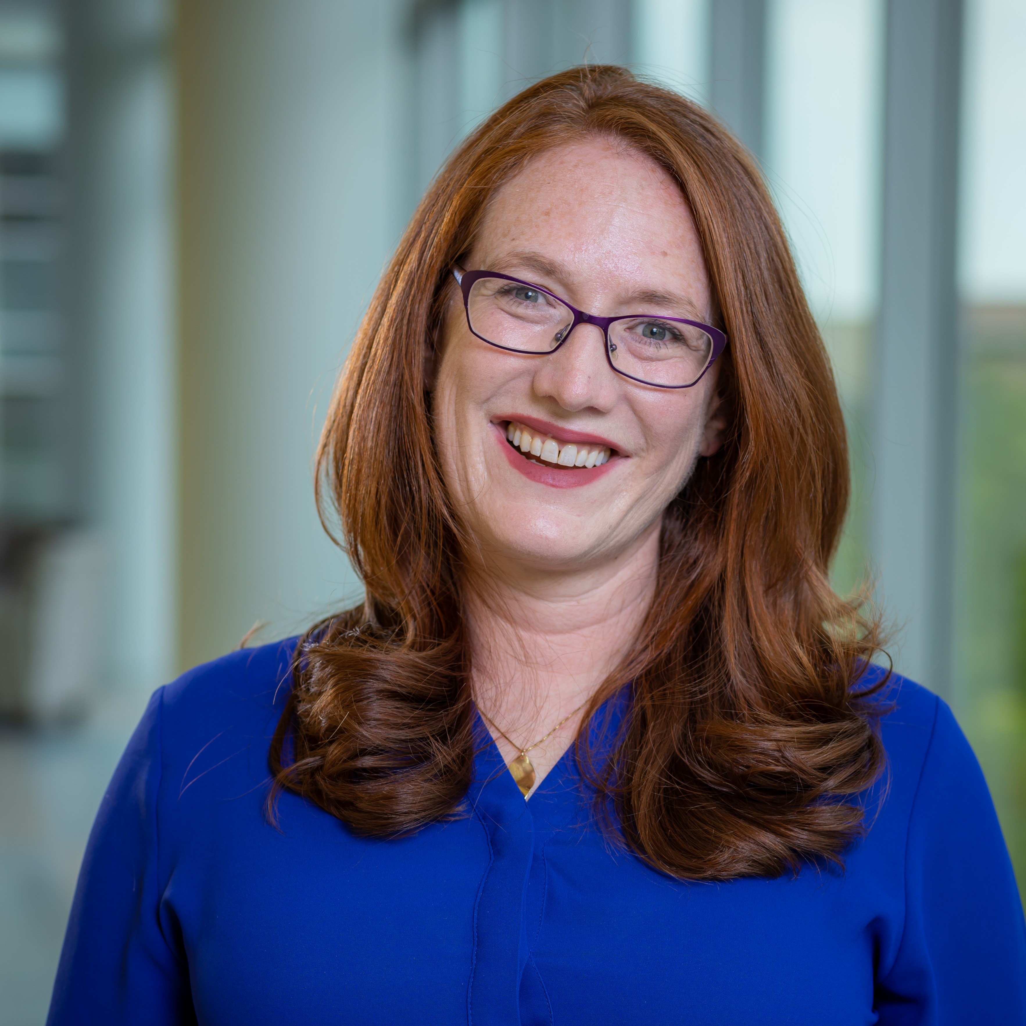
Always feel free to reach out with any questions!
Tai Lockspeiser, MD, MHPE
Assistant Dean of Assessment, Evaluation and Outcomes
Tai.Lockspeiser@cuanschutz.edu

