Slide 1



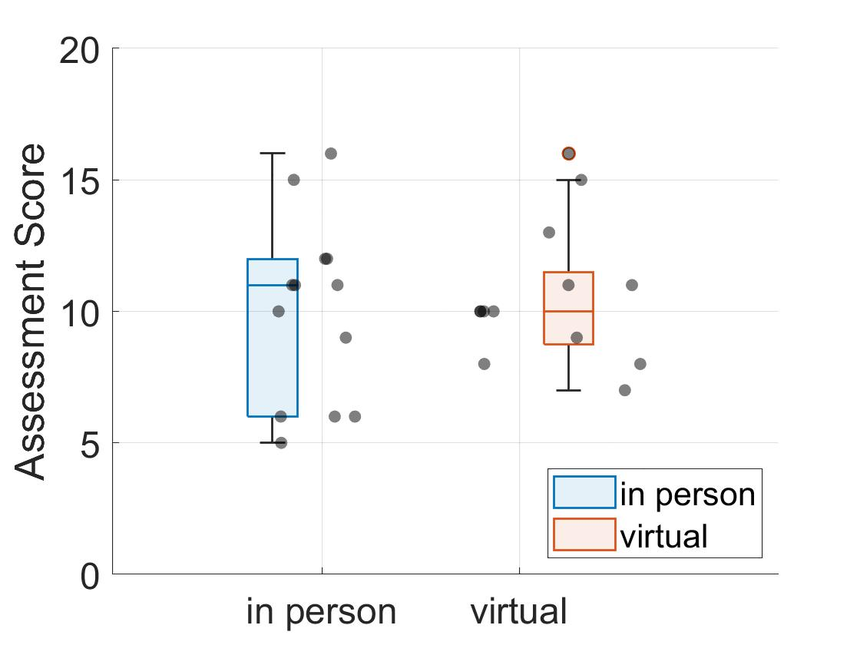
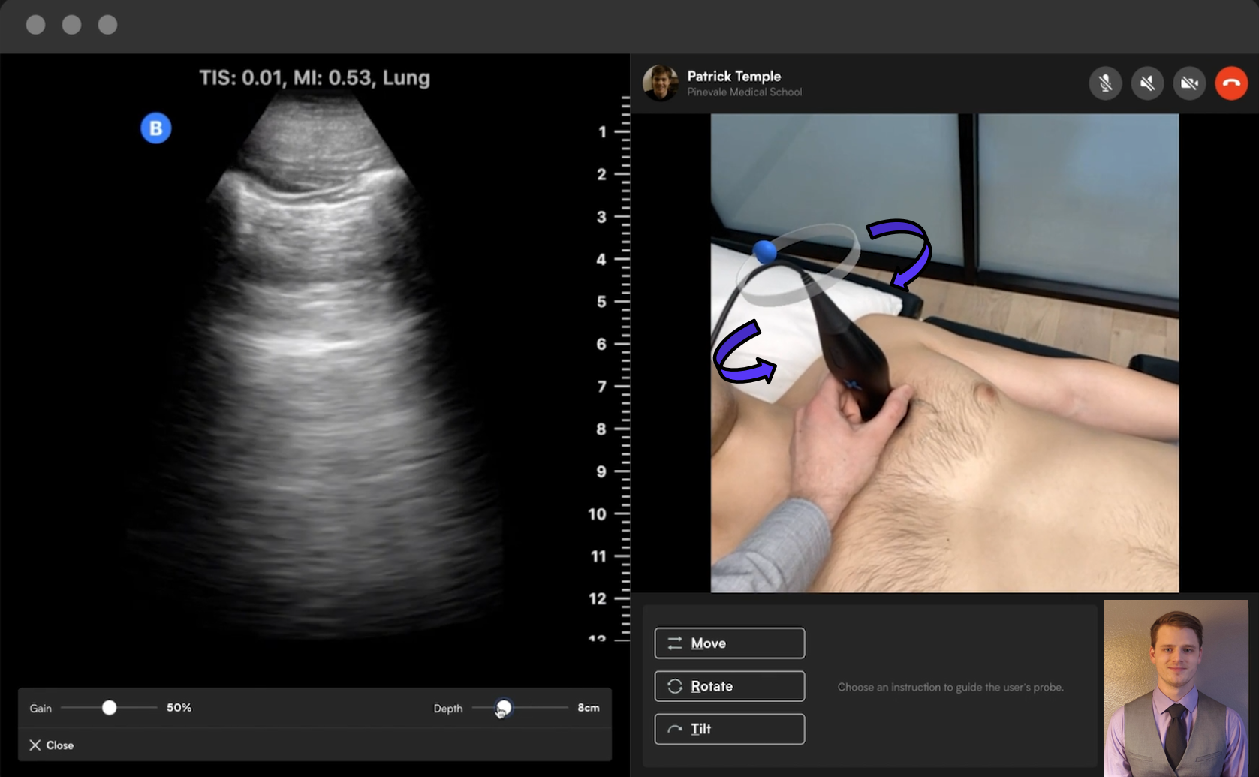
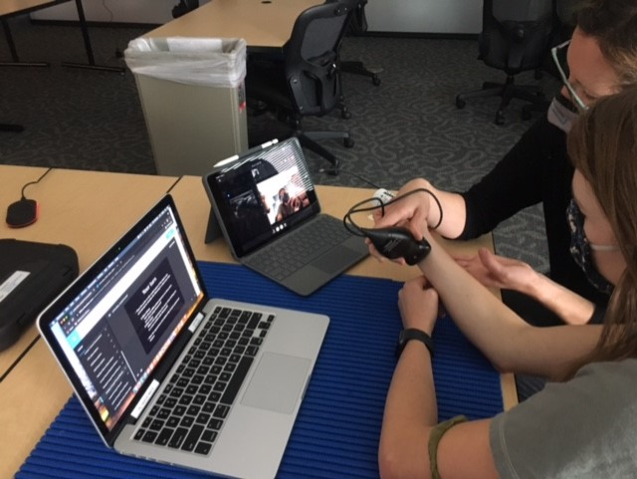

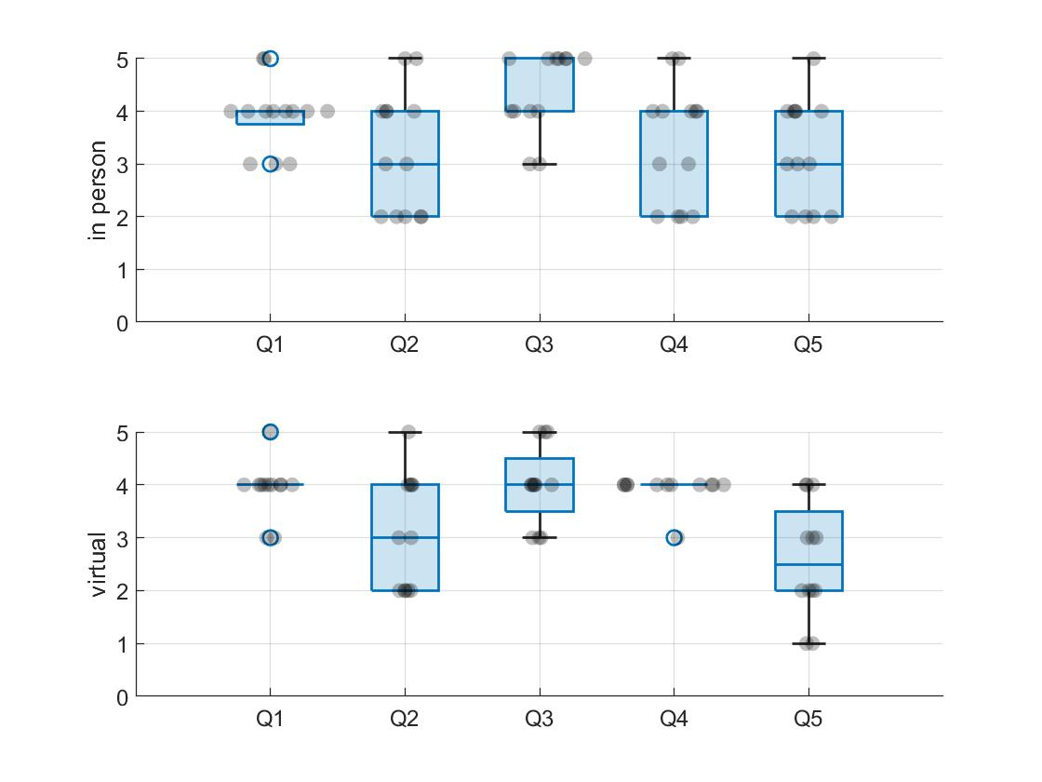
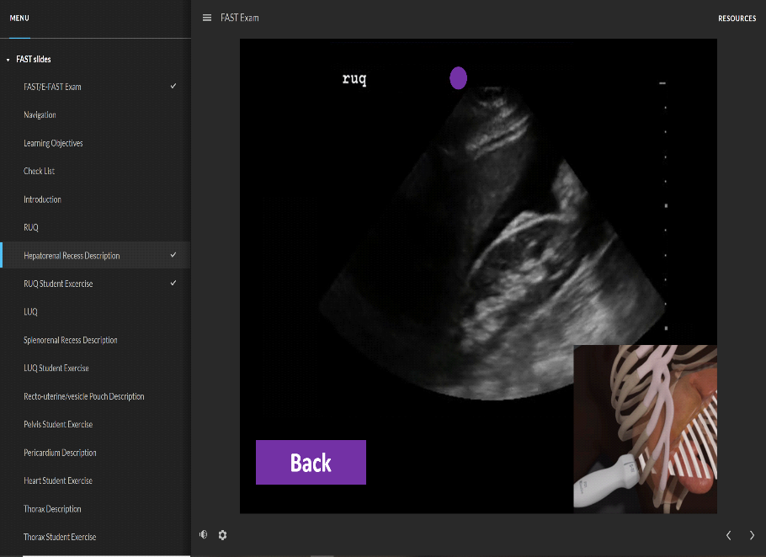
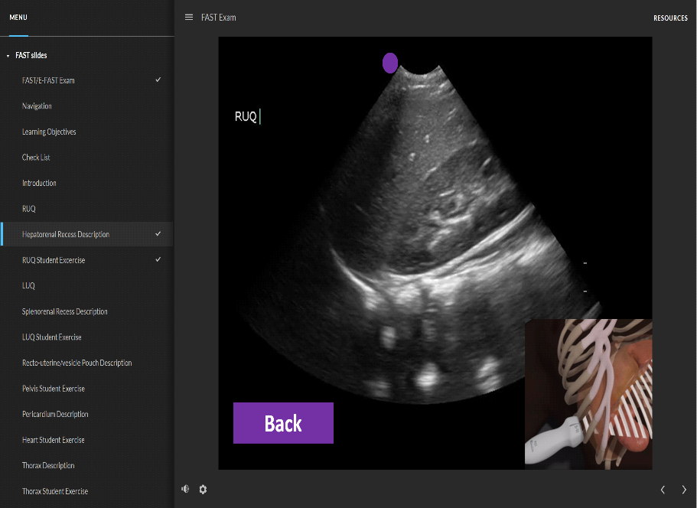
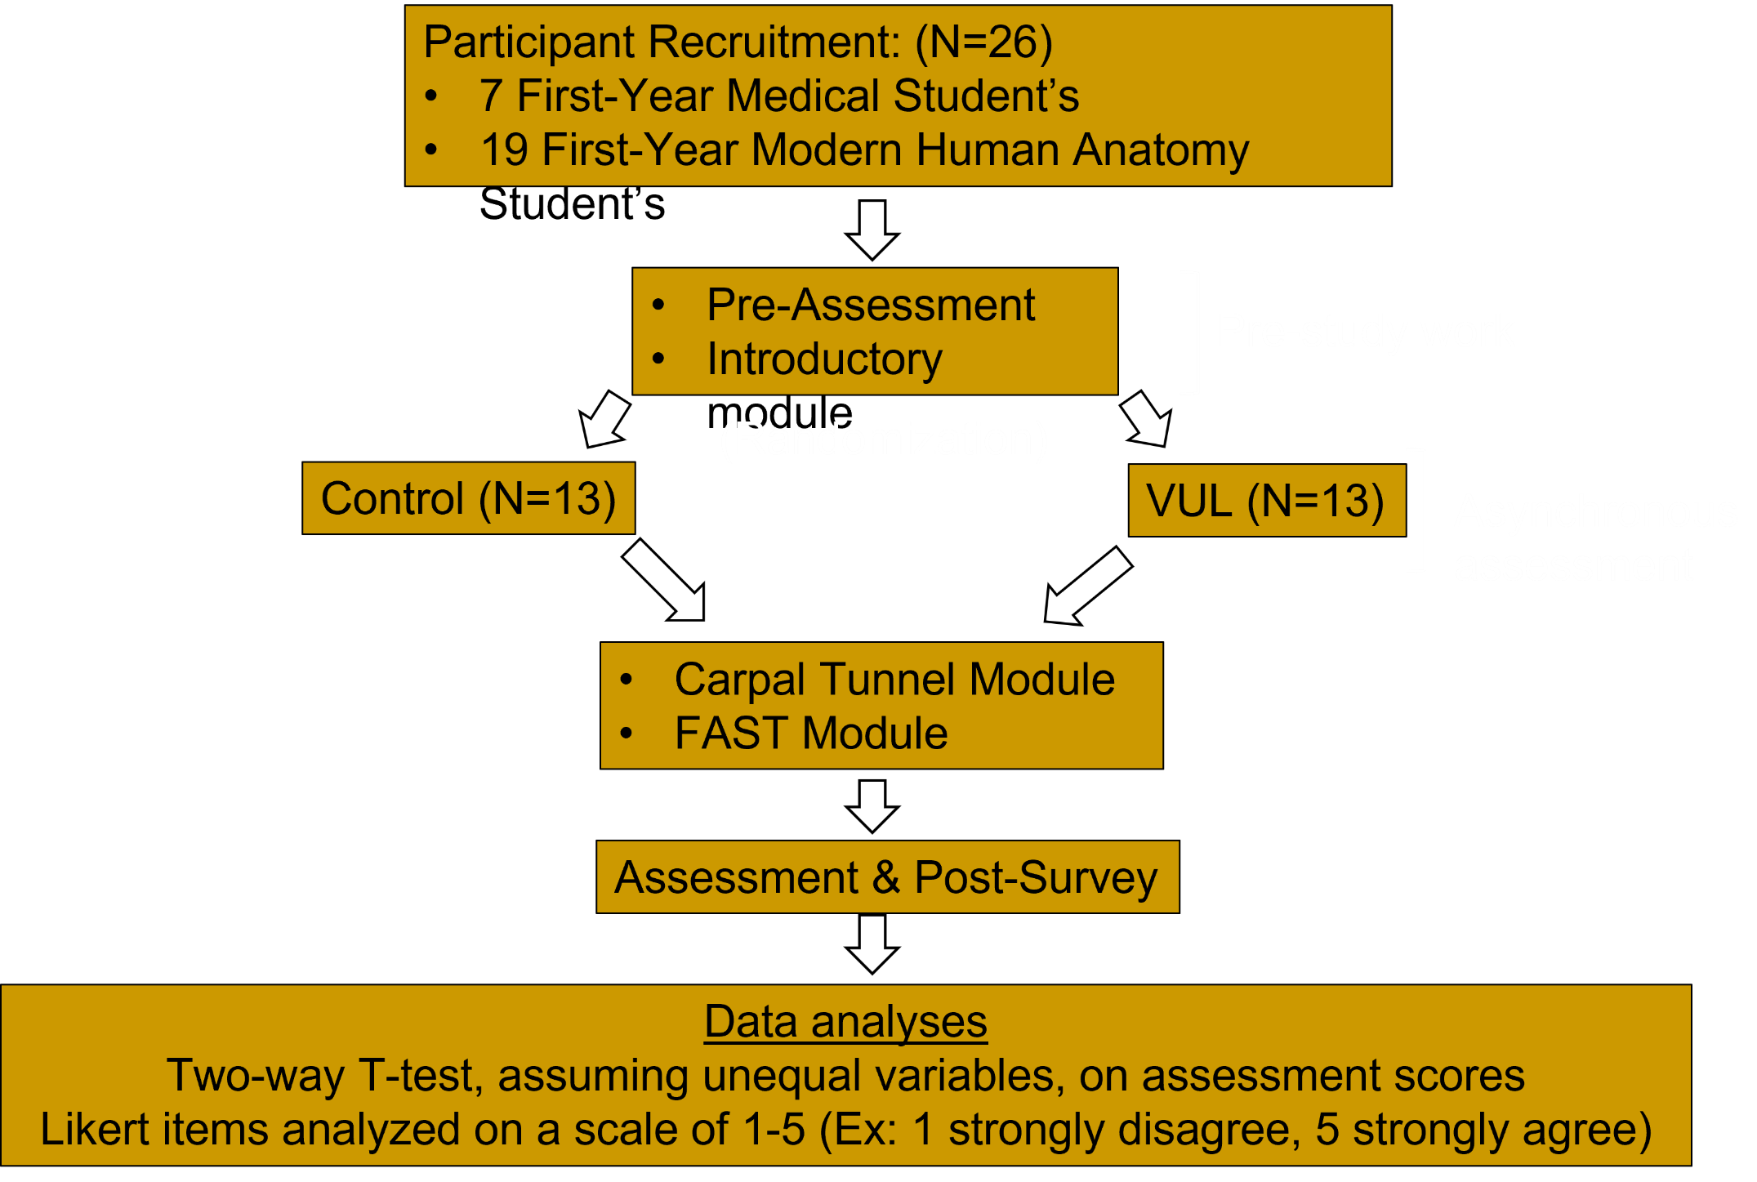
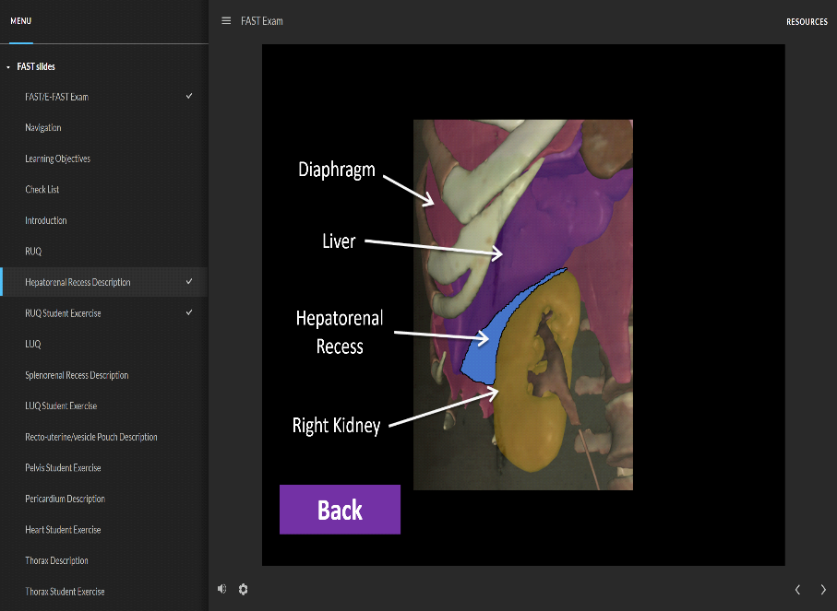
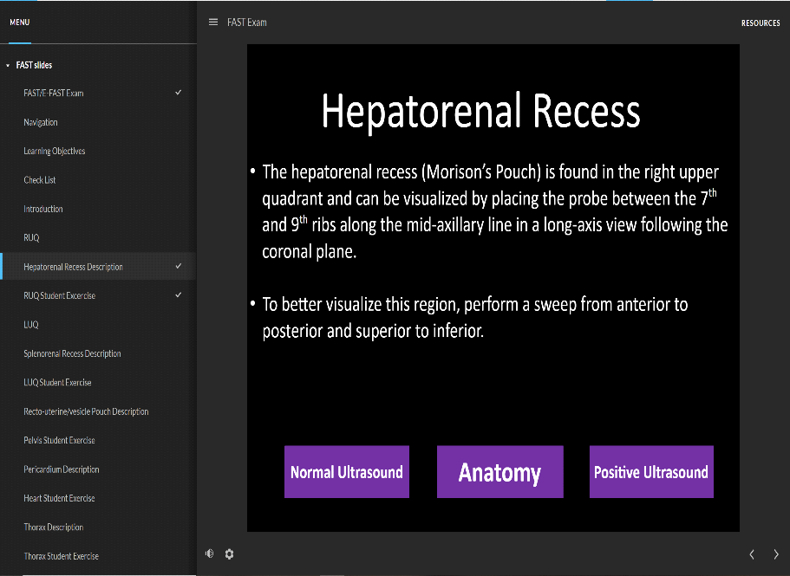
Tele-Ultrasound: Virtual Hands-on Medical Education for Novice Users Utilizing FAST & Carpal Tunnel Models, Pilot Study
Logan Scott BS¹; Juliana Wilson, MPH DO³; Danielle Royer, PhD^{1,2}; Chelsea Lohman-Bonfiglio, PhD^{1,2}
University of Colorado Anschutz Medical Campus; ¹Modern Human Anatomy Program, ²Department of Cell and Developmental Biology, ³Department of Emergency Medicine
COMIRB Exemption: #21-3964
Background & Rationale
Module Design
Results
Ultrasound (US): portable, real-time imaging, cheap, no radiation emission.
US is among one of the most utilized imaging modalities used to understand 3D anatomy in a 2D image⁷.
Recent integration of US as a supplemental teaching tool leads to greater level of anatomical understanding and enthusiasm when lead by trained instructors¹.
COVID-19 prompted modifications to traditional, hands-on anatomy education, pivoting to virtual, distanced learning that gives students the same levels of perceived confidence and understanding.
New US devices are being utilized to study the efficacy of remote teaching/learning of US^{3,5}.
Modules designed with: Articulate 360™, Visual Human Dissector™, Butterfly iQ™.
Self-directed modules: Introduction, Carpal Tunnel, FAST; (30 min. Each).
Integration of 3D renderings of anatomical structures, a description of what settings need to be used and where to find the region of interest, normal and positive US findings using mixed still images and videos.
Icon buttons for multidirectional navigation.
IP average= 10 ±3.49
VG average= 10.6 ±2.66
P=0.62
(A)
(B)
In-Study Assessment Score
Figure 1. (A) Screenshot of on-screen tele-guidance display, instructor view. Educator tools: provide direct feedback and probe manipulation instructions, on-screen indicators, augmented reality. (B) Picture of student set up; laptop displaying self guided instructional models, iPad & Butterfly iQ™ device used for ultrasound and tele-guidance (2-way video conferencing with trained staff, live-image relay, direct compatibility with devices with a Lightning Port™, ability to remotely change settings, provide visual instructional cues).
Figure 4. Quantitative report of assessment scores; 1st MS1 and MHA students (N=26). Exclusion of data for 1 participant was done do to experience level in US. (P=0.62)
Purpose
(A)
(B)
Figure 2. Screenshot of still US image demonstrating a short-axis view of the carpal tunnel (A) and a long-axis view of the hepatorenal recess (B), paired with associated probe placement. Structures appear with a color-coded region of interest and the structure name when learner hovers over them with a curser increasing interactive abilities.
Aim: To assess the educational value of virtual ultrasound learning (VUL) using Butterfly iQ, its impact on medical/anatomy students’ learning, their perceptions, and confidence.
Hypothesis: Integration of virtual education modules and guided virtual ultrasound sessions using the Butterfly iQ ultrasound device is as effective as in person sessions for novice ultrasound users.
Post-Study Survey Scores
Methods
Recruitment: Novice US users (>20h cumulative experience)
Population: 1st year Medical Students (MS1) & 1st year Modern Human Anatomy Graduate Students (MHA)
Pre-Study: Introductory Module, Pre-assessment survey, and random group assignment
In-Study: Carpal Tunnel & Focused Assessment of Sonography on Trauma (FAST) modules
Post-Study: Assessment & Post-Survey
Figure 5. Quantitative report of participant perception scores for Likert-Scale questions”
How easy was the Carpal Tunnel module to follow and learn from?(P=0.98).
How easy was the FAST exam module to follow and learn from? (P=0.75).
How useful was the Butterfly ultrasound device? (P=0.21).
I am confident in my ability to properly orient the probe and the onscreen image in order to identify the anatomy of the Carpal Tunnel. (P=0.12).
I am confident in my ability to perform the FAST examination and recognize what the normal anatomy should look like with ultrasound. (P=0.13).
Conclusions and Future Directions
No difference in perceived confidence or assessment scores between POCUS to Tele-US using the BiQ for novice learners.
Suggests equivalent competency levels when learning US virtually/in-person.
Findings supported by outside research^{3,5}
Additional research needs to be done to expand the sample size, gather qualitative data, and assess in-group variances such as time spent on Tele-US.
References & Acknowledgements
Figure 3. Screenshots of pages from FAST module depicting hepatorenal recess. Each region of interest demonstrated highlighted anatomy (Visual Human Dissector), normal US, pathological US, and a description page.
References available upon request.
The authors thank Mariafrancisca Zabalaga-Haberman, MSMHA and Ernesto Salcedo, PhD for assisting with data collection and analysis.

