Slide 1
Interviews
PreMD
Looking for previous PreMD Presentations?
https://medschool.cuanschutz.edu/deans-office/diversity-inclusion/about-us/pre-med-program

Slide 2
PreMD Entry Survey
Please complete our survey! You will be entered into a raffle for an MCAT practice exam or an AAMC MCAT section bank!

Slide 3
Overview

Slide 4
The Application Cycle
MCAT
Interviews
Primary App
Secondary Apps
Judgement Tests

Slide 5
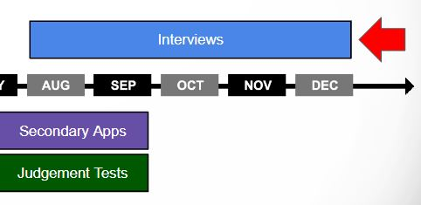
Timeline
Interviews: September – January
Secondaries: July - August

Slide 6
What is the point of an interview?
Observe how you interact with interviewers and other students
Judge your ability to problem solve
To get to know you personally
Discuss in further detail your activities and interests
Assess your ability to act professionally
See how you may interact with patients

Slide 7
Logistics
What do I need for virtual interviews?
Computer, Reliable wifi
Simple Background/Good Lighting/Private Space
How do I sign up for interviews?
Receive an email with an invite for an interview and instructions to schedule your interview
Schedule your interview on the same application portal you used for secondaries
How long are they?
Typically a few hours
What do I wear?
Suit
Who will I talk to?
Faculty members, deans, current students, community members

Slide 8
Types of Interviews

Slide 9
Traditional Interviews
Typically 1-on-1 with a faculty member
Question-answer format lasting anywhere from 15 minutes to an hour (usually around 30 mins)
Prepare for commonly used questions
Often end up feeling like a normal conversation where someone is trying to get to know you better
Be prepared to ask your interviewer questions at the end
Make sure questions are thoughtful and demonstrate genuine interest in the school (not things easily answered if you did your research)

Slide 10
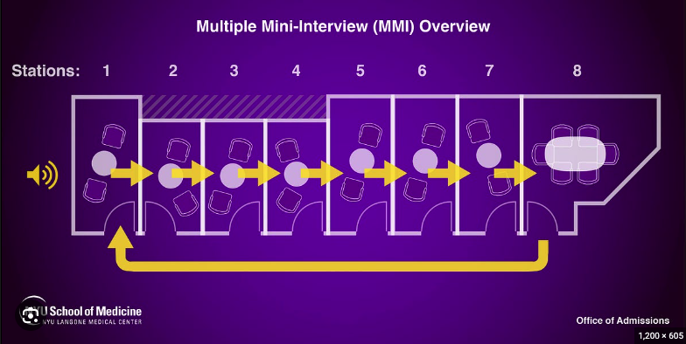
Multiple Mini Interviews
Many schools have adopted this style
Mixes components of traditional interviews with situational judgement/ethical discussion/communication skills evaluation
General structure:
Multiple stations of varying numbers (6-12)
Different interviewer at each station
Set amount of time at each station
Questions can be in a folder outside the door or asked upon entry

Slide 11
Multiple Mini Interviews
Different types of MMI stations
Traditional
Questions to get to know you better
Tell me about yourself
Why our school
Tell me about your greatest failure/challenge
Ethical
Prompt that provokes some kind of ethical dilemma (similar to CASPer)
They want to see what your stance is but more importantly want to hear why you believe what you believe
Important to take a stance, but also to acknowledge the other side and why you can understand that perspective as well
Example: The community has a growing opinion that HPV vaccination at a young age promotes promiscuous behavior in adolescents. How would you approach a mom refusing the vaccination for her kid due to these reasons?

Slide 12
Multiple Mini Interviews
Different types of MMI stations
Situational/Acting
Interviewer(s) are acting out a scenario and you are to address the situation as you would in a real life scenario
Testing for communication skills
Example: An elderly patient had a fall recently and their family wants to put them into a nursing home. They do not want this. Go talk to the patient.
Important to elucidate the patient’s perspective and understand why they don’t want this while also discussing safety and helping them to understand their family’s perspective

Slide 13
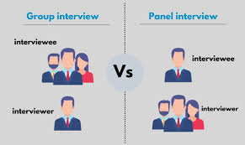
Group Interviews
Format:
One to several interviewers with multiple applicants
Questions distributed evenly between the applicants
Questions can be repeated for each individual or
new questions asked to each
General Approach:
Do not dominate the conversation
Be mindful of the time you’re taking to respond and how that impacts your co-applicant
Listen to what your co-applicants are responding to their questions and piggy-back off of what they’ve said
Shows that you’re engaged and working with your fellow applicant(s)

Slide 14
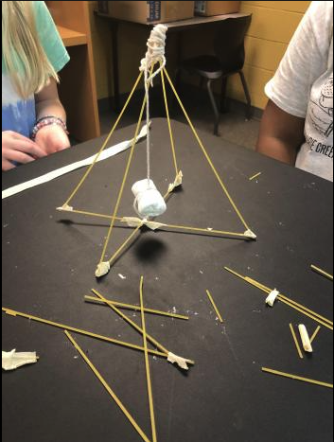
Group Exercises
Some interviews have integrated group/team exercises as part of their interview
Evaluating your communication skills and ability to work in a team
Always involve some arbitrary task that they ask you to complete with a team of your co-applicants
Can be done in direct “competition” with another team of your co-applicants
General Approach:
Whatever the task is, whatever the competition is, know that it doesn’t matter
The winning group won’t be accepted just because they won
Work together and communicate clearly to complete the task
Be easy-going, encourage your teammates, and present ideas in a collaborative manner
Absolutely, do not dominate your group or discard any ideas by your teammates

Slide 15
How do I prepare?

Slide 16
What should I know about the school?
Why are you interested in this school?
Location
Curriculum specifics
Specific people at the school
What is the curriculum like (preclinical and clinical)?
Were there changes to the curriculum recently?
What clinical sites do you rotate at?
What does the school mission statement say? Are there common themes to the words they use? (leadership, diversity, advocacy, etc)
If you are given the names of your interviewers, look them up beforehand and know what they do/are interested in and have questions prepared for them

Slide 17
What should I know about myself?
Know everything that is on your application in detail (including the activities that you may have spent the least amount of time participating in)
What do you want the interviewers to know about you by the end of the day?
What are your strengths?
What are your weaknesses?
Why do you want to go into medicine?
Why will you make a great doctor, colleague, advocate?
What do you like outside of medicine?
What experiences greatly influenced who you are today?

Slide 18
Common Interview Questions
Tell me about yourself.
Why medicine? Why do you want to be a physician?
Why do you want to go to our school?
How have your past experiences brought you/prepared you for medical school?
What is your greatest strength? Weakness?
Where do you see yourself in 5/10/15 years?
What would you change about healthcare in the United States?
How do you deal with stress? Tell me about a specific time you handled a stressful situation/conflict.
Tell me about a time you did not get along with a group. How did you handle it? What would you do differently?
Have you completed any research projects? Are you interested in research?
Why should we choose you?

Slide 19
How do I practice?
Practice as much as possible with as many people as possible
Teachers, advisors, friends, mentors
Have talking points, but don’t make a script
Practice common questions and know your stories
Record yourself answering questions and watch it back

Slide 20
What questions should I have prepared for my interviewers?
Why did you decide to come/work at this school?
What makes your school stand out?
Can you tell me more about the diversity and culture of this school?
What is your favorite thing about this school?
What makes this community special?
How is this school involved in the local community?
What changes has your medical school made to its curriculum, and why?

Slide 21
After the Interview
Outcomes
You can be accepted, waitlisted, or rejected
You will typically hear in 4-8 weeks
If waitlisted, you will have to wait until the end of the cycle to officially know whether you are accepted or rejected
What do I do while I wait?
Send a thank you email or letter
Send an application update/letter of interest/letter of intent

Slide 22
How do I have a good interview?

Slide 23
Do’s and Don’ts
Do
Be respectful to everyone you meet
Practice, practice, practice
Be honest and genuine
Ask good questions
Be professional (clothes, setting, interactions)
Follow-up after your interview with a thank you
Don’t
Be late or disrespectful
Be dishonest
Let one question throw off your whole interview
Only repeat information already in your application
Be vague (know details, sell yourself, show don’t tell)

Slide 24
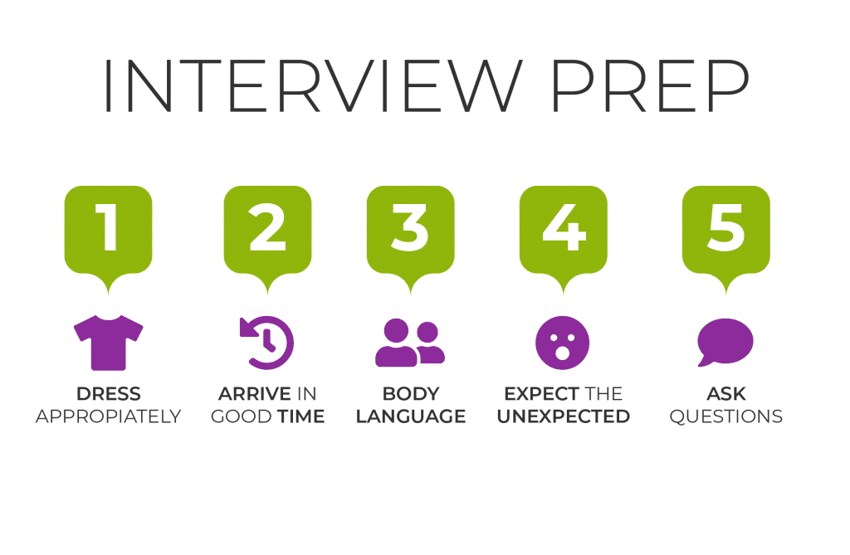
Keys to the Interview

Slide 25
Tips for Zoom
Check your Zoom connection in advance
Ensure your background is professional
Limit background noise
Ensure there is a strong connection with no lag
Have a backup location with another Wi-Fi network if feasible
Keep your camera on
Check the lighting of your location beforehand
Don’t forget about time zones!

Slide 26
Interview Anecdotes

Slide 27
Characteristics of a Medical Student

Slide 28
PreMD Exit Survey
Please complete our survey! You will be entered into a raffle for an an MCAT practice exam or an AAMC MCAT section bank!

Slide 29
Thank you! Questions?

