Slide 1
Secondary Applications
PreMD
Looking for previous PreMD Presentations?
https://medschool.cuanschutz.edu/deans-office/diversity-inclusion/about-us/pre-med-program

Slide 2
PreMD Entry Survey
Please complete our survey! You will be entered into a raffle for an AAMC question pack! This includes all 6 question banks for all the subjects with a total of 720 questions!

Slide 3
Overview

Slide 4
The Application Cycle
MCAT
Interviews
Primary App
Secondary Apps
Judgement Tests

Slide 5
What is a Secondary?
A set of essays that you write for a specific school
That school’s way of getting to know you better before a potential interview
Each school chooses which prompts they want to ask you and you answer them in essay format
Some prompts are commonly asked so many students will pre-write them
Other prompts are more unique to specific schools
Schools can also change which prompts they ask from year-to-year, BUT they typically stay the same
Primary
Secondary/Situational Judgement Tests
Interviews

Slide 6
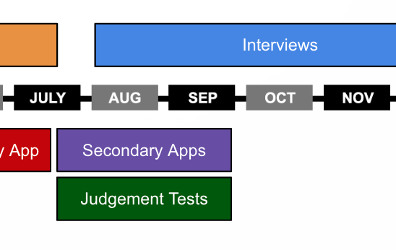
Timeline
They are sent to you after your primary application is cleared by the school
Secondary apps can be sent back immediately after your primary is approved or some primary apps will go through a more thorough review process and may take a few weeks to get to you
Start writing them in July and continue writing them through the end of September
Pre-write the common prompts to help with writing burden

Slide 7
Cost of Applying
Step | Description
Primary Application | $170 for first school, $43 for each additional school
Secondary Application | Varies from $50-$150
Interview Travel | Varies widely
Total | Expect total costs to be in the $1,000’s
AAMC’s Fee Assistance Program
Help with MCAT prep materials, MCAT fee, AMCAS fee, Secondary Application fees
Ask Pre-med advisor for other avenues to save money

Slide 8
Approach to Secondaries

Slide 9
How can I find the prompts?
Prospective Doctor
Medical School Headquarters – Library of prompts for each school
BeMo Academic Counseling – Library of prompts for each school
Student Doctor Network – School specific forums
Some schools post their secondaries on their website

Slide 10
How do I finish them all on time?
Prewrite your responses ahead of time using prompts from past years or those posted on the school website
Be prepared to have to rework the same response into a few different versions due to word-count / character restrictions
Research the school’s medical school website and social media to better understand their values and why you would be a good fit
Keep a spreadsheet of secondary invites you’ve received, and mark once you have submitted them
A good goal for secondary responses is 2 weeks from receiving the invite
Try to complete secondaries on a rolling basis, you can prioritize which secondaries matter more to you

Slide 11
What do I write about?
Ensure you are answering the question they asked you
Elaborate on any experiences/activities that you didn't get a chance to share details about in your primary application
Answer what makes you unique as a candidate to their specific program
Show; don't tell. Best to follow the format: proof -> claim. Use your journal to inspire stories that exemplify traits you claim you have or wish to show.
E.g. I work at a group-home and recently two residents had a violent altercation. My duty as a care aid was to step in and prevent the situation from escalating further. I resolved the situation and no one was seriously hurt. Through these types of experiences I am well-equipped to handle high-pressure and stressful situations.
Be authentic to who you are
Try to think of examples or experiences that set you apart and show how you might possess unique qualities that would make you a better medical student than other people applying

Slide 12
Strategy to templating responses to common prompts
Pre-write about some of the memorable experiences you’ve had throughout college and gap years. Once secondary prompts are given by each school, tailor/edit those stories to fit the prompts.
See if you can find mission/vision statements from the school, or other displays of values on their website/media/etc and use these to guide your responses to show what makes you a good fit for that specific program. You could have a few sentences in each common prompt that can be swapped out to be more specific to each program.
Keep a document of all your secondary responses - you will be able to reuse many responses with slight modifications since many prompts from different programs will be very similar.
SUPER helpful Reddit post about how to pre-write your secondaries

Slide 13
Example Prompts (bolded are more common questions)
Most prompts are either 2000 characters or 200-250 words limit.
What else do you feel is important for us to know about you? Please use this space to highlight something not addressed in your application, including new experiences not in your AMCAS application.
If you are a recent graduate, please tell us what you have been doing since graduation. You may answer "Not applicable".
If you have taken a gap year(s), please explain what you have been, or will be, doing since graduating from your undergrad institution.
Is becoming a physician a second career for you? If so, what was your first career choice?
Indicate any special experiences, unusual factors or other information you feel would be helpful in evaluating you, including, but not limited to, education, employment, extracurricular activities, prevailing over adversity.
Explain why you decided to apply to _________ School of Medicine.
Write a short statement describing how you envision using your medical education to advance care for under-represented or marginalized populations.
Tell us about a challenging problem you faced and how you resolved it.
This is a culturally diverse and talented community. How would you enrich/enliven this community? The essay should discuss material that is not included in the rest of your application.

Slide 14
Why Our School - What to Write About
Probably the most common secondary prompt
Important to research the school and find specific programs, philosophies, curriculum specifics, clubs, etc. that you can relate to and use
Employ the show then tell approach
E.g. Before medical school I worked as a scribe in an endocrinology clinic and saw the impacts of diabetes on our population’s youth. As a medical student at CU I plan to get involved with research at CU’s Barbara Davis Center for Diabetes to…
Anything like this. Relate your experiences/values to something specific about a school or its mission to prove that you really want to go there.
This is a good prompt to create a template for and switch out XYZ elements for different schools

Slide 15
Diversity Prompt - What to Write About
Can be anything that makes you unique!
Cultural background
Academic background
Hobbies
Personality traits
Whatever it is, relate it back to how it’s going to help you excel in medical school, be a stellar physician, and how your perspective and experiences are going to contribute to your teams
How will your experiences help you become a unique medical student/future physician

Slide 16
Adversity - What to Write About
Write about any particularly important challenge you’ve faced or failure you’ve experienced
Discuss what you learned from this experience and how it’s shaped you into who you are today
Don’t focus on external factors being the cause of the adversity you faced
Extremely important to identify specific areas of growth and personal development that resulted from your challenges, own the challenge
Relate it to how it’s going to make you a better medical student, physician, person, teammate, etc.
If you have something monumental, use it. If not, that’s totally fine.
Again, the most important thing is that you show your growth as a person and future doctor

Slide 17
What Makes it Good?
Brevity and Clarity: Is concise and straightforward, and makes points quickly without embellishment
Personalization: Shares unique experiences, skills, and perspectives in alignment with program values
Relevance: Actually answers the specific questions!
Demonstrate Diversity & Humanism: Shares how your background, experiences, skills, and capabilities can contribute to the medical school community and ultimately, your patients
Attention to Detail: Ensures no spelling and grammatical errors
Honesty and Integrity: Is straightforward and truthful in responses. Doesn't try to exaggerate or fake anything.
Remember, the main goal of your application is to show who you are and why you are an ideal candidate for medical school.

Slide 18
Editing?
Write multiple drafts, similar to your personal statement
Find a trusted mentor or friend to help edit your responses
Read it out loud

Slide 19
Tips
Start early: allow enough time to complete all applications and ensure you submit them by the deadline
Plan your time: create a realistic timeline and schedule that allows you to work on your applications while also meeting your other school or work obligations
Be organized: keep track of deadlines and make sure you have met all the necessary character limits
Showcase personality: show what makes you unique, your motivation for becoming a physician, and your accomplishments
Use proper grammar and spelling: proofread everything multiple times and consider having someone else review your applications before submitting
Be honest: don't embellish your experiences or accomplishments to make yourself look better
Show your potential: highlight your unique strengths, such as problem-solving skills, leadership abilities, and teamwork
Be yourself: convey your authentic self and let your application reflect your passion for medicine and your desire to make a difference in people's lives, specifically as a physician

Slide 20
Do’s and Don’ts
Do
Have a trusted friend/mentor review your responses
Use this as an opportunity to determine which programs you truly want to continue to apply at / interview with (almost every program will give you a secondary, and each one costs $$$)
Demonstrate humanism! This is your space to show who you are and how you would excel in the art of medicine. Usually, reviewers will not see your metrics/grades when rating your secondary responses - you have often passed a certain cutoff at this point and are now showcasing who you are and how that sets you apart
Be prepared - prewrite responses, do your due diligence on programs, and respond promptly
Don’t
Mistakenly copy the wrong response into a question prompt or have grammatical errors!
Use the same exact response to similar prompts at different programs - OR use the same examples/experiences in multiple answers to the same school - you should be tailoring your responses
Write a different school’s name in another school’s essay
When asked about challenges, own them and don’t blame them on external factors
Lie or exaggerate about anything you did - you may be asked details about your responses during interviews - if you say you speak another language, they may conduct the interview in that language

Slide 21
Characteristics of a Medical Student

Slide 22
Situational Judgement Tests (CASPer, DUET, PREview)
CASPer
Situational judgment test (SJT)
Evaluates professionalism and non-cognitive skills
DUET
Value-alignment assessment
Compares your values to what a program offers
PREview
Professional readiness exam
Assess knowledge of effective and ineffective professional behaviors

Slide 23
CASPer (Altus Suite)
CASPer is an open-response, situational judgment test (SJT) that evaluates professionalism and non-cognitive skills, such as collaboration, problem solving, ethics, and empathy
Format of the exam:
CASPer includes 14 dilemmas or scenarios, followed by 2 questions, each with 5 minutes to respond. Think of CASPer as an automated set of multiple mini interviews.
9 video-based scenarios and 5 word-based scenarios
8 scenarios require typed responses; 2 are word-based and 6 are video-based
6 scenarios require video responses; 2 are word-based and 4 are video-based
Sample Scenario and questions:
Consider this statement: “From time to time, we deal with conflict in some form.”
Describe a time when you had to deal with conflict and how you coped with it.
How might you handle a similar situation differently should it arise again?
What would be your strategy if you were faced with a conflict that was extremely difficult to resolve?

Slide 24
CASPer Continued
Five minutes to respond isn’t a lot of time so it is worthwhile to prepare for commonly asked scenarios/questions
Take the full practice test available on the CASPer website ahead of your real test
In your responses - briefly describe your actions and most importantly, discuss why you would choose those actions
Example: You catch your classmate cheating on an exam.
What do you do?
I’d have an open, honest, and nonjudgmental discussion with my classmate and elicit their perspective for why they cheated. It would be important for me to have this discussion with them so I could learn about their motivations and better understand their situation. Following this, I’d discuss with them that they should go to the professor and be honest about what they’ve done and why they’ve done it. If they refused to turn themselves in, I’d tell them that I’d regrettably have to report it because their actions were unfair to the rest of the class.
This test is essentially evaluating the same characteristics that will be evaluated for in MMI’s, a format of interviews used by many medical schools (more on this at later sessions)

Slide 25
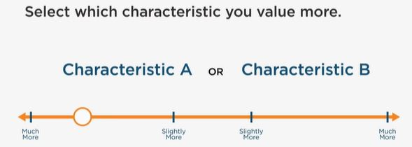
Duet (Altus Suite)
A value-alignment assessment comparing your values to what a program offers
For each group of characteristics, choose which is more important
Your answers are then compared to the programs you’ve applied to

Slide 26
AAMC PREview
The AAMC PREview™ professional readiness exam is designed to assess examinees’ understanding of effective pre-professional behavior across eight core competencies for entering medical students
The exam includes written scenario sets that present hypothetical dilemmas that you may encounter in medical school, which are linked to eight pre-professional competencies. They are set in educational, healthcare, or other real-life settings. The scenario sets are developed in collaboration with the medical school community.
There is a full-length practice exam provided by AAMC

Slide 27
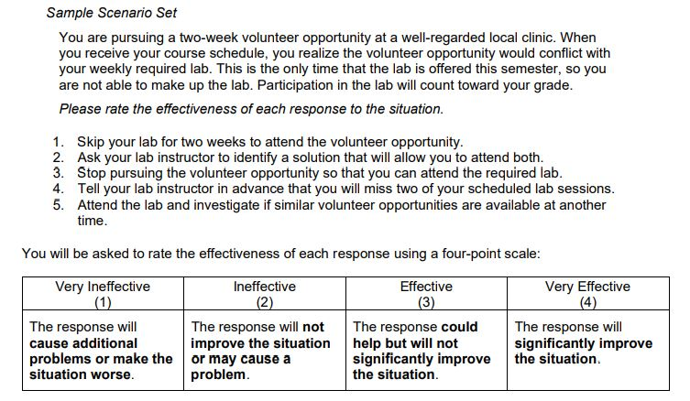
AAMC PREview

Slide 28
PreMD Exit Survey
Please complete our survey! You will be entered into a raffle for an AAMC question pack! This includes all 6 question banks for all the subjects with a total of 720 questions!

Slide 29
Thank you! Questions?

