Slide 1
Primary Application
PreMD
Looking for previous PreMD Presentations?
https://medschool.cuanschutz.edu/deans-office/diversity-inclusion/about-us/pre-med-program

Slide 2
PreMD Entry Survey
Please complete our survey! You will be entered into a raffle for a free 12-month sketchy MCAT subscription!

Slide 3
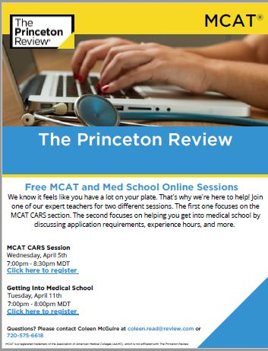
Upcoming Princeton Review Events
Link to CARS Session Registration: https://secure.princetonreview.com/event?PSOId=518530
Link to Medical School Session Registration: https://secure.princetonreview.com/event?PSOId=518531

Slide 4
Overview

Slide 5
The Application Cycle
Submit Primary App
Secondary Apps
&
Judgement Tests
MCAT
Interviews

Slide 6
Timeline
The current 2023-2024 application cycle dates are (starting school Fall 2024):
Tuesday, May 2: AMCAS application opens
Tuesday, May 30: AMCAS application submission begins
Friday, June 30: Initial transmission of application data to medical schools
Tuesday, August 1: Early Decision Program deadline

Slide 7
CUSOM Application Timeline
The CUSOM 2023-24 application cycle dates are:
Monday, May 29: Earliest filing date for primary application
Monday, July 10: Earliest filing date for CUSOM supplemental application
Sunday, October 15: CUSOM primary application deadline, offers of admission start to be offered on rolling basis
Thursday, November 30: CUSOM secondary application deadline

Slide 8
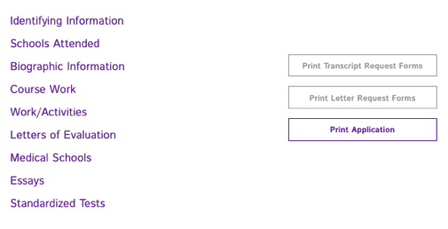
What is the Primary Application?
Background information
Coursework and official transcripts
MCAT score (previous session)
Letter of evaluation (previous session)
Personal statement
Work and Activities
Select which schools to send your application to (previous session)

Slide 9
Cost of Applying
Step | Description
Primary Application | $170 for first school, $43 for each additional school
Secondary Application | Varies from $50-$150
Interview Travel | Varies widely
Total | Expect total costs to be in the $1,000’s
AAMC’s Fee Assistance Program
Help with MCAT prep materials, MCAT fee, AMCAS fee, Secondary Application fees
Ask Pre-med advisor for other avenues to save money

Slide 10
What Do Each of These Sections Include?

Slide 11
Background Info
Section 1: Identifying Information
Name/birth/sex
ID numbers for schools (so they can link transcripts)
Section 2: Schools Attended
High School
Every Post-Secondary School where you were enrolled for one course (even if no credits given) – need transcripts from each of these schools!
Section 3: Biographic Information
Contact info
Ethnicity/race, languages spoken
Family information

Slide 12
Coursework and Official Transcripts
They will calculate your overall GPA AND “science” (BCPM) GPA
The BCPM GPA is comprised of Biology, Chemistry, Physics, and Mathematics courses. All other coursework will be calculated in the AO (All Other) GPA.
Official transcripts take a little while to get and to be processed by AAMC
AAMC says it will take 15 BUSINESS days to process electronic or 25 BUSINESS days to process mail.
Make sure to check the school’s course requirements and that you meet them
Remember it can also take up to 6-8 weeks to process your application once submitted

Slide 13
Personal Statement - What Is It?
“Use the space provided to explain why you want to go to medical school” (5,300 characters).
If you're applying to an MD-PhD program, you must complete two additional essays: the MD-PhD Essay and the Significant Research Experience Essay.
Proofread carefully! There is no “spell checker” in the AMCAS application, and no changes will be permitted to this section after you have submitted your application.
Type in Word/Google docs and copy them over -> formatting, sharing with others, saving for future use.
Formatting doesn’t go through -> you can space out your paragraphs but that’s it.
Tip: Read back on your “why doctor” journal for inspiration
Notes:
Why doctor journal is something we talked about in previous sessions! Writing down any thoughts you have about why you want to be a doctor or writing about your experiences when they happen (what you did, what you learned, how you felt)

Slide 14
Personal Statement - What Is It?
AAMC suggests considering these topics:
Why have you selected the field of medicine?
What motivates you to learn more about medicine?
What do you want medical schools to know about you that has not been disclosed in other sections of the application?
In addition, you may wish to include information such as:
Unique hardships, challenges, and obstacles that may have influenced your educational pursuits.
Comments on significant fluctuations in your academic record not explained elsewhere in your application.

Slide 15
Where do I start?
You may have multiple ideas of where to start!
A lot of people get stuck trying to think of a great intro - start in the middle!!!
Write out a couple different versions and see what fits best or gets you writing
Think about why you want to be a doctor and what experiences may have really impacted that decision
Think about an experience that may have solidified your choice to be a doctor
What things help you show and not tell
Check out the aspects of a medical student and see how you can incorporate those
Start early!
Start many months early because it will take you a long time to create a personal statement!

Slide 16
Personal Statement - What Makes It Good?
Answer the why and the how, not just the what
Don’t get stuck in the cycle of “I did all these things because I want to be a doctor, and now I want to be a doctor because I did all these things”
Leave no doubt that this is the career for you, especially in the conclusion:
Example: ended with “No other career could fulfill my desire for direct care, employ my love for human progress and technology, and satisfy my need to assist in the well-being of others realistically”
Don’t distract the reader or waste your words
Not so much what happened but how it changed you and your goals
Red flags: experiences where they practice medicine before getting the degree (like helping people give birth in other countries)

Slide 17
Personal Statement - What Makes It Good?
Answer the prompt in the first 5 sentences
Don’t overtly state “I want to help people”
Have a clear purpose
Don’t mention other professions
Answer the “why not another medical profession” without actually answering the question
Can use it to highlight other aspects of you that might not be covered in the activities section, scores, etc.
Don’t be afraid to be personal
If you are honest and upfront in your statement, that gives you the best chance of matching somewhere you will enjoy
Don’t send in something created by ChatGPT!

Slide 18
In Summary:
Be honest: your personal experience is unique, even if you don’t believe it
Don’t say you want to go into medicine “to help people”
Be specific: Why do you want to be a physician over other health professions

Slide 19
Personal Statement - Editing
Start early (months in advance)
Plan ahead for review
Identify people that will review
Friends can be good because they know who you are and can also be honest
Don’t let it impact your statement too much - you know your experiences and passion
Can take it to your writing center/premed advisors
Talk to current medical students if possible
Give people a timeline if they’re going to review
Can send people even bullet points/short paragraphs to review and ask them if they think that will make a good story
You can make different versions but you don’t have to
You can write over the world limit and then have people tell you what is more or less important to keep/what best aligns with your theme

Slide 20
AMCAS Application: Work/Activities
Up to 15 work/activities spots with 700 character limit
3 of these are listed as “most meaningful”
Included Details:
Dates, title, organization name
Time spent on work/activity
Responsibilities and accomplishments
Impact
Qualities you gained/demonstrated
Tip: Look back to your Activities Journal
Notes:
Activities - Don’t need to fill all 15!
Don’t put in things that aren’t actually meaningful because you lose credibility in your other activities
You can put in a hobby - it makes you unique and can be a great talking point
Other notes: work/experiences appear in chronological order, can only pick up to 4 activities in each category

Slide 21
AMCAS Application: Work/Activities
Categories:
Artistic Endeavors Community Service/Volunteer - Medical/Clinical Community Service/Volunteer - Not Medical/Clinical Conferences Attended Extracurricular Activities Hobbies Honors/Awards/Recognitions Intercollegiate Athletics Leadership - Not Listed Elsewhere | Military Service Other Paid Employment - Medical/Clinical Paid Employment - Not Medical/Clinical Physician Shadowing/Clinical Observation Presentations/Posters Publications Research/Lab Teaching/Tutoring/Teaching Assistant
Notes:
You can combine experiences
Especially for honors/awards/recognitions, shadowing, publications/presentations/posters
If you are separating out 4 different poster presentations into different activities and have nothing new to add - not the best use of space or showing your credibility

Slide 22
New for 2023: Anticipated Experiences
“Anticipated” experiences are activities that you have not yet started but plan to participate in; they will begin after you have submitted your application
An “Anticipated” activity could be:
An entirely new future experience
An upcoming, planned experience that is a continuation of a “Completed” experience
An “Anticipated” activity cannot have a date in the past – the start date must be the current month* or later and the latest end date must be August of the matriculating/following year (August 2023)

Slide 23
Example Experience Entry
Notes:
Example of what a normal sized entry looks like

Slide 24
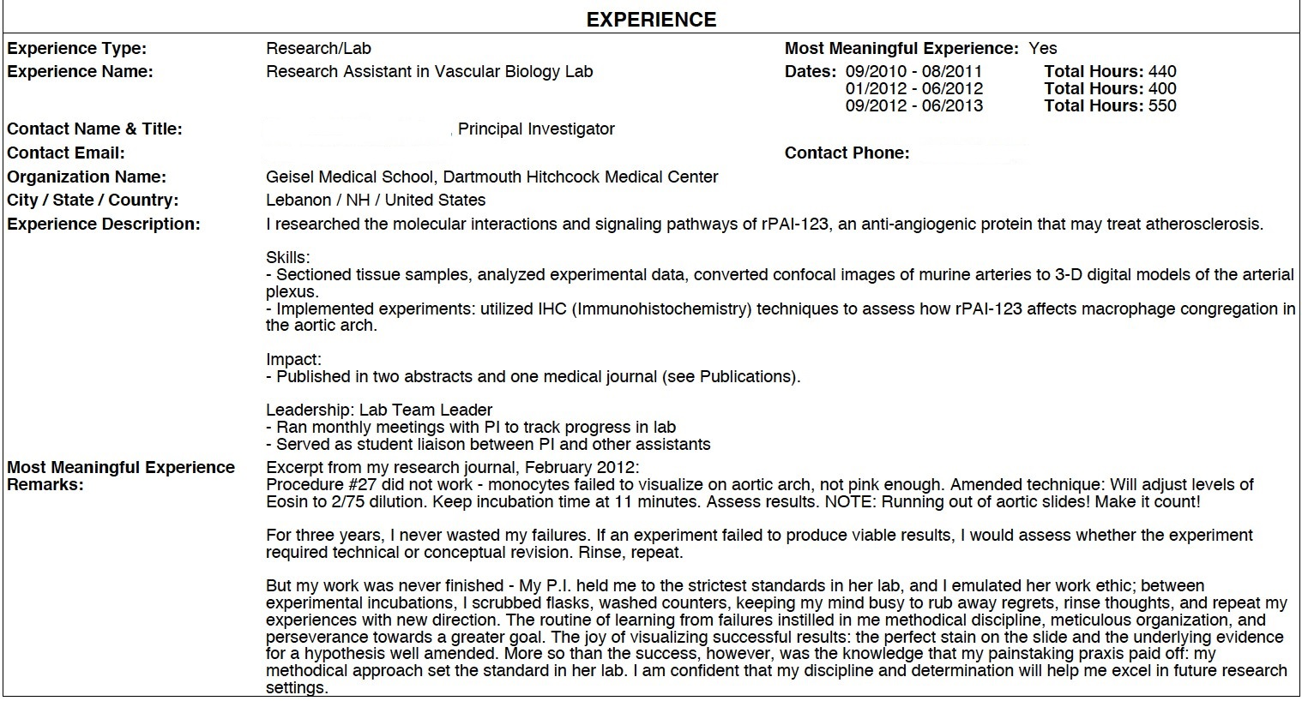
Example Experience Entry
Notes:
Example Most Meaningful - Included this mainly to see the layout - all the information that is necessary to collect for each experience and about how much information has to be entered for each

Slide 25
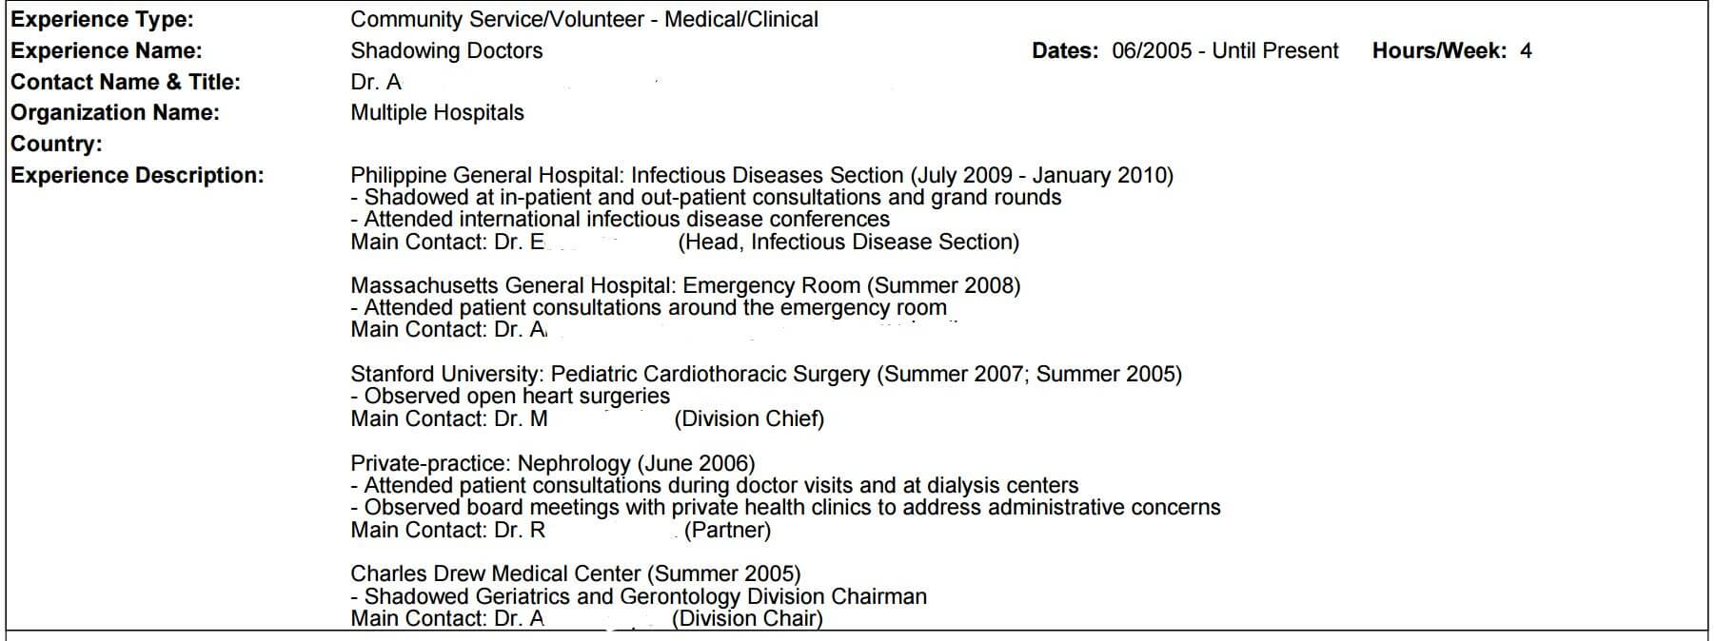
Example Experience Entry
Notes:
Example of how to list separate shadowing experiences in one entry - could also just list in one sentence all the departments you shadowed in and then expand on the one you have the most to say about for the rest of the entry.

Slide 26
Most Meaningful Experiences
Opportunity to write about 3 of your “most meaningful” experiences
More space to write - 1,325 character prompt
Often have letter writers from these experiences to further prove the impact of these activitities
What do you want to include in these responses?
Everything you write about from your other activities
How you grew from the experience
What makes it stand out from the other listed experiences
Often the activities where you have more to say, want to show more

Slide 27
Work and Activities - How to Prepare Beforehand
Do what you’re passionate about!
Ultimately you need to do what brings you joy and the readers/interviews will be looking to see how genuinely excited you are about your activities
Shadowing is probably the only must have activity
Follow your curiosity
It gives you a story to tell and will change you for the better
Do not add “fluff”
Do not stress about finding other things to do to make sure you have 15 activities
Do not write about activities you wouldn’t be excited to talk about in an interview
Do not participate and seek out opportunities to simply “check the box”
Interviewers will ask you about the experiences that you may not have as long of a description for – you need to be ready to talk about each and every one

Slide 28
Work and Activities - What Makes it Good?
Start early!
Write your experience as a story rather than a resume
Show rather than tell the impact/result, qualities demonstrated, what you learned, and how it changed you
Often good to describe a meaningful experience you had in that activity rather than what you did
You need to convince the reader that you gained something from each experience
Ex. for research you don’t have to spend the whole box describing your project
Certain activities to highlight
Activities that you engaged in for a long time are good for most meaningful experiences
Activities that aren’t likely to be in anyone else's application
You can include hobbies that are meaningful to you! (reading, fencing, etc)
Activities that demonstrate intentional pursuit
You don’t have to use all of the characters provided, it shows that you can clearly and concisely convey an idea

Slide 29
Characteristics of a Medical Student
Notes:
Good to think about how you can exemplify these competencies through your experiences and statements (Don’t forget that you still have secondary applications to continue to expand on your story!)

Slide 30
TMDSAS: Texas Medical Schools
Application opens May 1, submission opens May 15
Similar but different categories:
Personal essay: 5000 characters - this is shorter than AMCAS or AACOMAS
Has TWO additional essays. 2nd essay “optional”
Chronology of Activities - 300 characters for regular, 500 characters for “most meaningful”
5 yr old MCAT accepted
Match system: Schools and students match based on ranking in order of preference from both parties
Flat fee of $215 - Fee waiver unavailable
Notes:
Personal Essay Prompt: “asks you to explain your motivation to seek a career in medicine. You are asked to include the value of your experiences that prepare you to be a physician.”
Of the two additional essays - 1 is required, 2nd is optional but highly recommended
There is potentially a limit of 3 most meaningful experiences

Slide 31
AACOMAS: D.O. Schools
Application opened May 4, 2022 for 2023 cycle.
Look out for updated dates on the website
Similar but different categories:
Personal statement: 5300 characters
LORs: LOR will be submitted to every school; DO LOR highly recommended
Influences section: mention DOs or MDs that influenced commitment to medicine
Primary: $198 for first program + $50 for each additional - Fee waiver available
Secondary: Varies
Notes:
Each school has:
Varying deadlines
Each program has unique prerequisite classes, questions, essays which are all required within the AACOMAS application.
DO Personal Statement Prompt: “The colleges will see your personal statement exactly as you enter it in the box below. You are advised to check your spelling, syntax, and grammar before submitting your personal statement.”
Influences section: Who has influenced your decision to go to medical school -> MD, DO’s
Every application needs LOR submissions. Ex: If you are submitting both AMCAS and AACOMAS, you need to ask your LOR writer to submit to both applications.

Slide 32
Do I Need a Cohesive Application?
I does not necessarily need to be ‘cohesive’
Often stories evolve like this: I liked x, then tried y, learned z, and moved onto q
Show intent in the way you pursue things
I wanted to learn more about…
I wanted to get better at…
I wanted to gain experience in…
You might have a pattern of experiences that show you are passionate about leadership (or something else) and readers will be able to pick up on that – also okay if not!
It is good to show you are a well-rounded person

Slide 33
When do I apply?
Submit your AMCAS application as soon as the option becomes available! (May 30)
Applications do get reviewed in order so it is important to be early
You can apply without an MCAT score
Submit your application to just one school so it gets approved ASAP (it will take 6-8 weeks)
Consider this if you feel confident about your score, confident you will apply regardless of your score, etc.

Slide 34
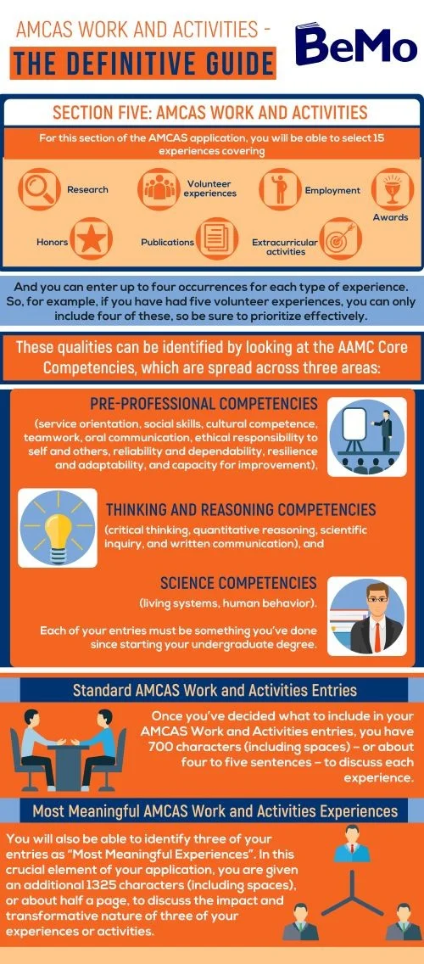

Slide 35
PreMD Exit Survey
Please complete our survey! You will be entered into a raffle for a free 12-month sketchy MCAT subscription!

Slide 36
Thank you! Questions?

Slide 37
Appendix

Slide 38
What is the Early Decision Program?
TLDR: You apply to one school by August 1st - you should be very competitive for that school - if you don’t get in you can apply to additional medical schools starting October 1st (this is very late in the cycle)
To apply through the Early Decision Program, applicants must follow these guidelines:
Apply to only one U.S. medical school by the stated deadline date (August 1 for schools that participate in AMCAS);
Not to apply through the Early Decision Program if they have already submitted an initial or secondary application (AMCAS or non-AMCAS) to a U.S. medical school for the current entering class.
Attend only this school if offered a place under the Early Decision Program to familiarize yourself and comply with the school-specific Early Decision Program policies and agreements of the program to which you were accepted, including any school-specific impacts if you decide to change programs types and apply to other medical schools.
If these guidelines are met, applicants will be notified of the school's admission decision by October 1.
Not all medical schools offer admission through the Early Decision Program. Since most participating schools only admit a small portion of their entering class through the program, only applicants with an excellent chance of admission to a particular school should apply under this program.

Slide 39
Resources
University of Utah PreMedical Website (https://advising.utah.edu/preprofessional/pre-medical/)
Activities Diagram: https://bemoacademicconsulting.com/blog/amcas-work-activities-definitive-guide
AAMC Core Competencies: https://www.aamc.org/services/admissions-lifecycle/competencies-entering-medical-students
AAMC Overview of the Application: https://students-residents.aamc.org/how-apply-medical-school-amcas/how-apply-medical-school-amcas
Early Decision Program: https://students-residents.aamc.org/applying-medical-school-amcas/early-decision-program

