Slide 1
Letters of Recommendation, School Requirements, Creating a School List
PreMD
Looking for previous PreMD Presentations?
https://medschool.cuanschutz.edu/deans-office/diversity-inclusion/about-us/pre-med-program

Slide 2
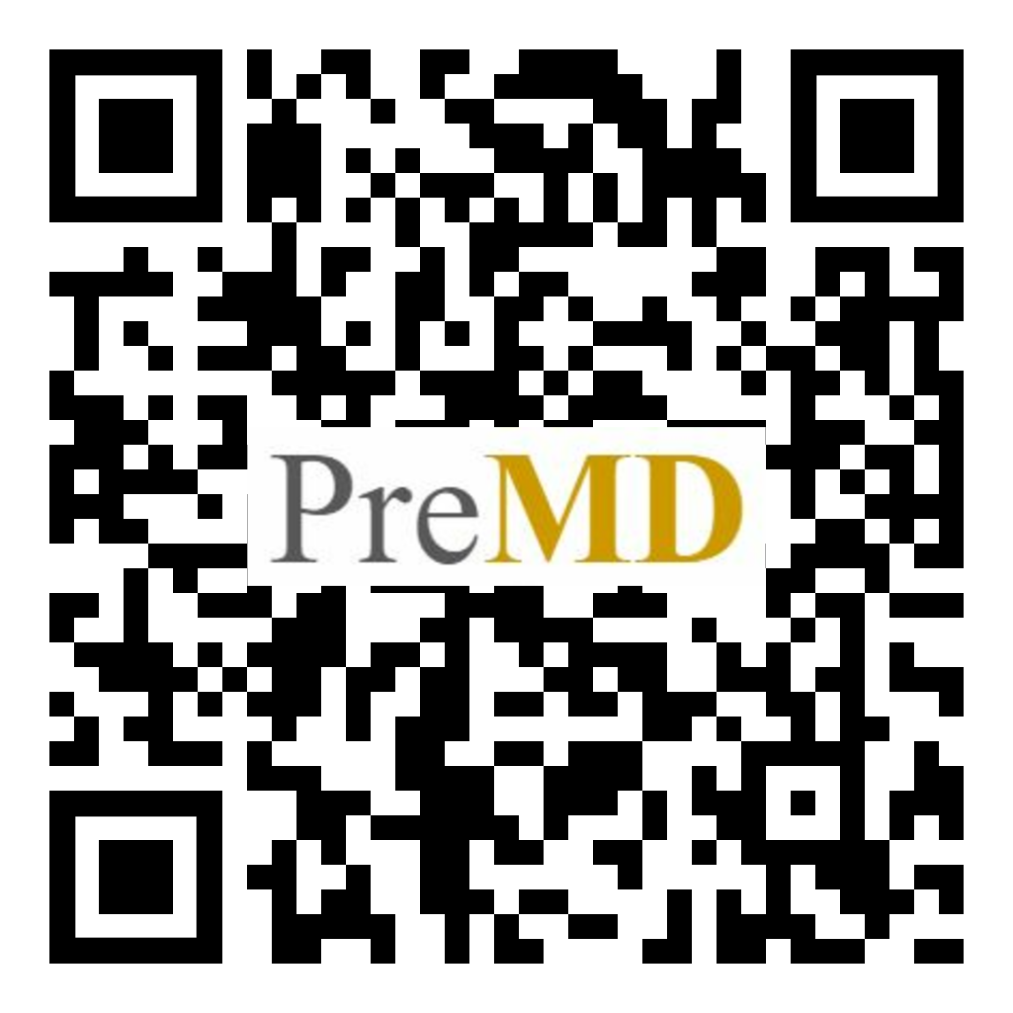
PreMD Entry Survey
Please complete our survey!

Slide 3
Looking for a Pre-Health Advisor?
Check your school’s advising website
Check out National Association of Advisors for the Health Professions
Get connected with an advisor:
https://www.naahp.org/public-resources/student-resources/find-an-advisor
See if your school has an NAAHP advisor:
https://www.naahp.org/public-resources/student-resources/find-an-advisor/locate-an-advisor-by-institution
Notes:
Pre-Health Advisor: recommended for students exploring a career in medicine; help you organize your required courses, tutoring/academic support if needed, help find experiences in the health field, and overall improve your application
1st link: help you find an advisor if you have no other access
2nd link: provides contact info for your schools advisor

Slide 4
Looking for shadowing opportunities during the pandemic?
Virtual Shadowing Program created by CU Faculty!
Watch over the shoulder of one of our physicians, nurse practitioners, or PAs as they go bedside in the ED to assess and diagnose a simulated patient. Each video is followed-up by a series of questions posed to the student and then a summary by the physician. A short quiz on the topic addressed finalizes each class.
14 hours of shadowing material
Apply for a Certificate of Completion from the University of Colorado School of Medicine for a $50 fee
If the fee is a barrier, just email them
https://www.coloradowm.org/courses/pre-med/virtual-shadowing-nano-course-emergency-medicine/

Slide 5
Letters of Recommendation

Slide 6
Letters of Recommendation (LORs)
WHO TO ASK?
Doctors, PIs, professors, extracurricular coordinators, job supervisors, religious leader
Range of individuals to highlight different aspects of you & your application
Important: If applying DO, AACOMAS will ask for a DO LOR
WHEN TO ASK?
The earlier the better
Give them a date you would need the letter by
They know when they need to work on it & can complete it in time
Can be stored on third party sites -- keep confidentiality (Interfolio)
HOW MANY SHOULD YOU GET?
Try to get 2-6+ letters
DO SOME RESEARCH
Does your school have committee letters
Medical school LOR requirements (science professors, humanities, volunteering, etc.)
Tips:
Talk to professors at the beginning of the course
Send letter writers your resume, personal statement, etc. and specific characteristics/qualities you would like them to attest to.

Slide 7
LOR - What should be in a LOR
Provide writers official Guidelines for Writing a Letter from the AAMC
Writers should provide stories/concrete examples of times you demonstrated Core Competencies for Entering Med Students
Ask different writers to speak to different competencies
Tips:
Provide a packet with Personal Statement draft, CV/updates, and other useful documents
Use thank you cards to nudge/remind writers when the deadline is soon
Ask your premed advisor to proof LORs if a writer is new to this process
Notes:
Core competencies -> maybe ask LOR writer to speak to specific ones in their letter
https://www.aamc.org/services/admissions-lifecycle/competencies-entering-medical-students
Tips
Give them materials - CV, how to write a medical school letter
Ask if advisors are willing to read letters for you if your letter writers may have never written a LOR for medical school before
What do I do if someone asks ME to write my own letter? (AMCAS confidentiality! Ask if they’d be willing to co-write with one of their grad students/TAs if you know one)
Thank you card as a nudge to remind your letter writer the deadline is coming soon
A broad scope can show you are a well rounded applicant - gives a complete view of your application
Can also show different aspects of your personality
Try to find a middle ground within the limit of LOR
Dont add too many if you’re not confident that they are all great - similarly, hopefully you didn’t ask people that you thought would write an “ok” one
The point of the LOR is to attest to who you are as a person -> dont need to repeat 4 from a basic science professor because they might not be saying anything different
Think about the actual content

Slide 8
Emailing a Letter Writer (previously agreed to write one)
Hi [Letter Writer]!
Thank you so much for writing a letter of recommendation in support of my application to medical school. I just took the MCAT yesterday, and I’ll get my scores back in about one month – things are getting very real, but I’m looking forward to having a little more breathing room and getting to enjoy some of my hobbies again! In the event that you might still find it helpful, I’ve attached a copy of my CV that includes awards, employment, volunteering experience and the like from both my undergraduate and postbaccalaureate experience. Other resources that might be helpful include the list of pre-medical competencies published by the AAMC that can be helpful when structuring a letter. These are traits and skills that many medical schools use when evaluating an application, so letters that speak to some of these competencies tend to be very helpful. Those competencies can be found here, and the main page for the AMCAS Letter Service is here, which may include answers to any other questions you have. Also attached is the letter request form that needs to accompany your letter, regardless of how it’s submitted. It contains my AAMC application ID, as well as the specific letter ID that will help match the correct letters to the correct application (and on my end, to make sure I get those letters sent to the correct school). While you might be familiar with the process already, there are three methods to upload a letter; all of my schools are using the AMCAS Letter Service, and their application works pretty seamlessly, so that might be the simplest route to go. You go to https://services.aamc.org/letterwriter.”
Thank you,
[Student]

Slide 9
Emailing a Letter Writer (has not agreed to write one)
Hi [Potential Letter Writer]!
I hope your time out east with your family has been super helpful (and restful)!
I’m gearing up to apply to medical schools this May/June, and since I’m considered a non-traditional student (I’ve been out of undergrad for some time now), some of my letters of recommendation can come from current and previous employers. If you feel that you might have the time and energy I was wondering if you would be willing and able to write a positive letter of recommendation in support of my application.
I’m still figuring out how the application process works, but I believe that once the applications open in May, I can simply send you a link where you can upload a letter. This letter then gets sent to the schools depending on the individual specifications for each program (how many employer letters they’d like, how many academic letters, volunteer letters, etc.).
If this isn’t going to be feasible for you right now, I completely understand, but I wanted to ask you since I really have valued my time at the Daily (as limited as it is now!) and because I have really enjoyed working for and with you in my time in Jackson! Please just let me know if this sounds like something you may or may not be able to take on.
Thank you,
[Student]
Notes:
Also offer up a time to meet for coffee, have a zoom/phone call to catch up if it has been awhile since you have interacted with this potential LOR

Slide 10
AAMC Core Competencies
Pre-Professional Competencies | Thinking and Reasoning Competencies | Science Competencies
Service Orientation | Critical Thinking | Living Systems
Social Skills | Quantitative Reasoning | Human Behavior
Cultural Competence | Scientific Inquiry
Teamwork | Written Communication
Oral Communication
Ethical Responsibility to Self and Others
Reliability and Dependability
Resilience and Adaptability
Capacity for Improvement

Slide 11
What does CUSOM say?
How many letters do you require?
3 to 5 letters
If a school offers a committee letter, do you want to see one?
Yes
If a student sends the maximum number of letters, do you read them all?
Yes
Do you prefer 3 vs 5 letters?
There is no need to have 5 letters, just make sure that every letter is strong and from someone who knows you really well
What makes a great letter of recommendation?
Have someone write it that knows you well and in a longitudinal fashion
What mistakes do students make?
A common mistake is getting letters from someone who doesn’t know you well. The letter might say “they were in my biology class and got an A”
Notes:
Good point here is longitudinal fashion - a LOR from a coordinator you completed 2 day of volunteer work for would not be an ideal option
For professors - I made sure to ask professors that I had more than 1 course with. I attended a small school so this might be more likely, but if you only have 1 class with that professor make sure you make a point to connect with them outside of class, do research with them, etc.

Slide 12
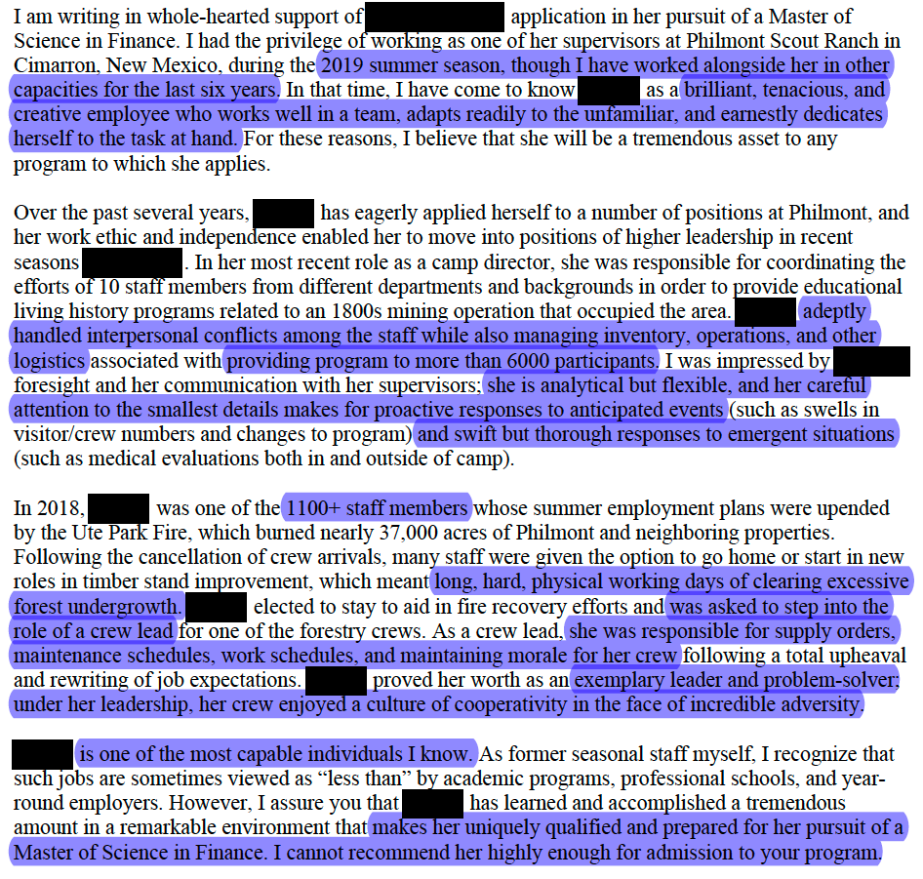
LOR Example
Notes:
How does this person know you? A letter from someone who has known you/your work over time will speak louder than the lecturing professor for the 8am, 400 person Chemistry lecture you (sometimes) attend
Can they say good things?
Specific examples
Descriptive (but not flowery) language
Punch lines - I have shown you that this person is competent at A, and remarkable at B. A punch line makes it blunt - they will not miss the point.
Offer to provide context - in the form of a CV, meeting for coffee, etc. In this case. Not everyone knows what Philmont is - if I’d left it in the top paragraph, it sounds like a summer camp. In reality, it’s the largest camping operation in the world and it serves ~22-24k people every summer, spread out across 220 square miles of high desert wilderness in northeastern New Mexico. Numbers - and sometimes extra details - speak volumes.
Ideally, choose someone who knows you but also what you’ve done (whether it’s in class, a job, volunteering role) and can explain WHY what you did and how you did it was so impressive.

Slide 13
Obstacles to Getting LORs
Knowing expectations for letters
Some professors will only provide them if you get an “A”
Some professors might request that you be more involved in their class -> being a TA
Asking for a letter long after a certain experience
Make sure you have a plan as to how to get the letter
Ask early
Losing contact with your letter writers
Provide letter writers with clear deadlines
Stay in continuous communication, it is okay to check in
Writers requesting to see your personal statement
Try to have a really rough draft of your statement prepped
Unsure of if the writer will write a good letter
Ask potential writers if they can write you a STRONG letter of recommendation
Potential writer says no
That’s okay! Not everyone you ask will feel like they can write a strong letter or have time to write a letter. It is better that they be honest than provide you with a weak LOR
Notes:
Potential Writes says “no” or doesn’t respond: I brainstormed and asked 6 people to write LORs, this gives you some wiggle room if 1-2 people say no or do not respond. Might be useful to brainstorm 7-8 people that could be potential LORs and then prioritize from there

Slide 14
School Requirements

Slide 15
Premed Course Requirements
Every med school has different requirements!
In general:
1 year biology WITH lab
1 year general chemistry WITH lab
1 year organic chemistry WITH lab
1 year physics WITH lab
1 year English/Humanities
1 year math
1 semester biochemistry
Can check MSAR to check specific school requirements or school websites will have them
Notes:
Try to think about humanities requirements that might not be so obvious
If schools want English at all, it’s usually a year. Some schools (OHSU and Emory in the EY2020 cycle) want more.
Consider AP credit/Community college credit
Work with your advisors to satisfy requirements, especially if you want to major in something other than science -> its easier to satisfy if you are science, but you dont have to be!
Consider how the classes you take might help you prepare for the MCAT (+ when you might take them related to your test)
Emphasize lab components!
There might be some wiggle room within these requirements -> Olivia used her Anthropology coursework toward a genetics course required by one school, Zoe used Mechanical Engineering for physics, Alex used Physiology for biology -> work with the school to pass requirements by the school
Think about saving your syllabus
Keep in contact with the admissions office -> schools will work with you
https://students-residents.aamc.org/medical-school-admission-requirements/required-premedical-coursework-and-competencies

Slide 16
TIPS: Course Requirements
Check early so you can plan ahead, don’t take extra classes if you don’t need to/want to
You don’t need to be a science major!
Being different from your peers and showing your specific interests can be a benefit, but only major in something else if you are truly interested in it
Can take more science classes outside your major if you are looking to increase your science GPA
Check if schools take AP credits
Consider timing your classes to help prepare for the MCAT
There is a potential to use “unusual” courses to satisfy requirements (e.g., Mechanical engineering lab for physics lab requirement; anthropology for genetics course)
Work with the medical school you are applying to
Save your syllabus/course description
Double check course requirements for each school in case there is something unique!
AAMC has a link to most school’s requirements here: https://students-residents.aamc.org/medical-school-admission-requirements/required-premedical-coursework-and-competencies

Slide 17
CUSOM Specific Course Requirements
Competitive applicants should demonstrate in-depth competency in each of the following areas of study, as reflected by their academic achievements and letters of recommendation
Biology
Chemistry/Biochemistry
Mathematics/Statistics and Physics
Social Sciences and Communication
Students are encouraged to consider additional coursework in biochemistry, computer sciences, genetics, humanities, and social sciences.
The CUSOM Course Requirements Page: https://medschool.cuanschutz.edu/education/md-admissions/requirements#ac-degree-and-coursework-1

Slide 18
Creating a School List

Slide 19
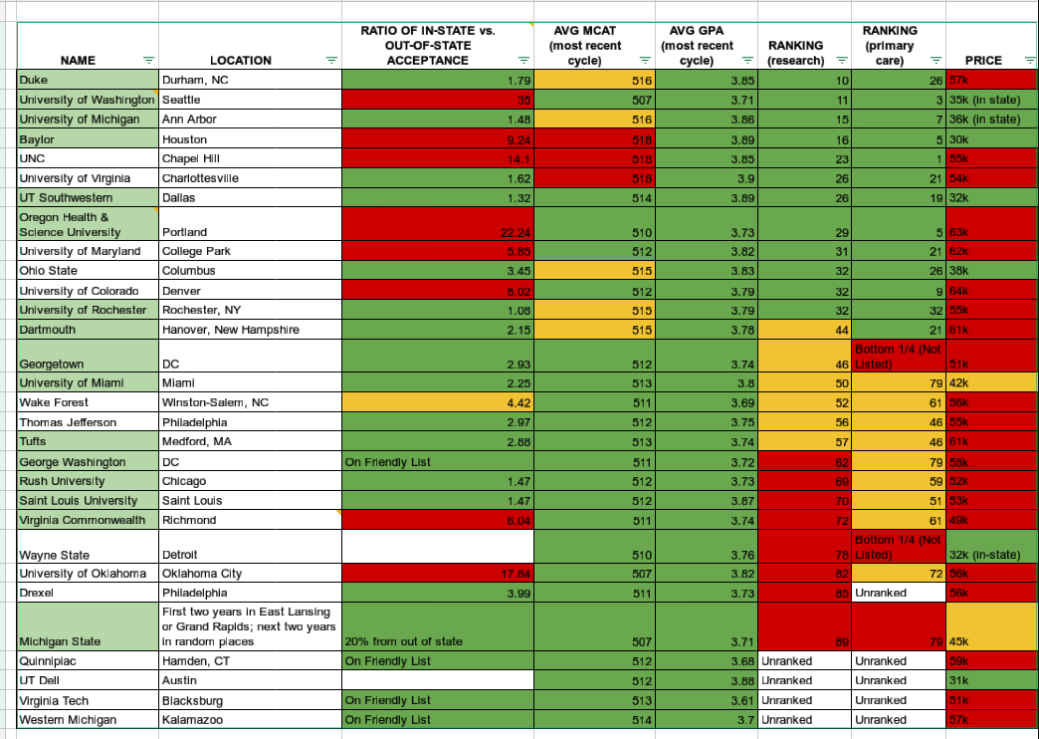
What to Consider When Picking Where to Apply
Location
Stats
GPA, MCAT
Requirements
Pre-requisite courses
Mission
Curriculum
2 year didactic or shortened didactics
CUSOM transitioned to 1 year
Clinical rotation
Traditional vs Longitudinal
Special programs
MD/PhD, MD/MPH, tracks (global, rural, research)
Tuition cost
Residency placement success rate
Learning environment, facilities
Out of state acceptance %
Any “ties” to the school
Public vs Private - Public may accept more in-state students
Make an argument of why you’ll fit the new community
US News Ranking
Many schools are dropping out of this ranking system
Notes:
Ranking
Out of state acceptance %
Think about what home ties mean
If you’re from there, if you have family there, etc
OOS interview % as well - they may only interview one or two folks from OOS. If the % looks good, double check it against the other numbers.
Application costs
MSAR lists “strong ties” for some schools, meaning you’ll have to justify a connection (historical, personal, etc) to that state. For most states, this needs to be GOOD - not just vacationing there every year, or having a relative who lives there. They want to hear why you’re more loyal to that state than wherever you currently call home.

Slide 20
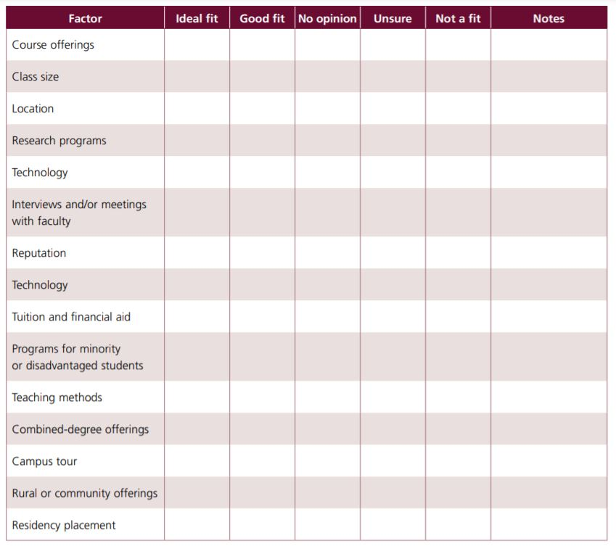
How the AAMC Organizes How to Choose a School
Notes:
https://students-residents.aamc.org/media/12716/download?attachment

Slide 21
What is the MSAR?
Compiles all up to date information that is relevant to applicants in one place for each school.
Matriculant demographics
Primary application information
Letter of recommendation information
Research information and opportunities
Combined degrees and special programs
Application deadlines
Enrollment data
Campus type
Mission statements
Where schools accept applicants from
The guide to buying and using MSAR: https://students-residents.aamc.org/medical-school-admission-requirements/buying-and-using-medical-school-admission-requirements-faq?topic=buying-access-to-the-msar-website
PRICE:
1 year = $28
2 year = $36
2 year subscription included with the AAMC Fee Assistance Program
Notes:
All information provided by MSAR can be found on each individual school’s website. However, MSAR is nice because it complies all information into one location as shown on the next slide.
You can even filter your school search by different search criteria

Slide 22
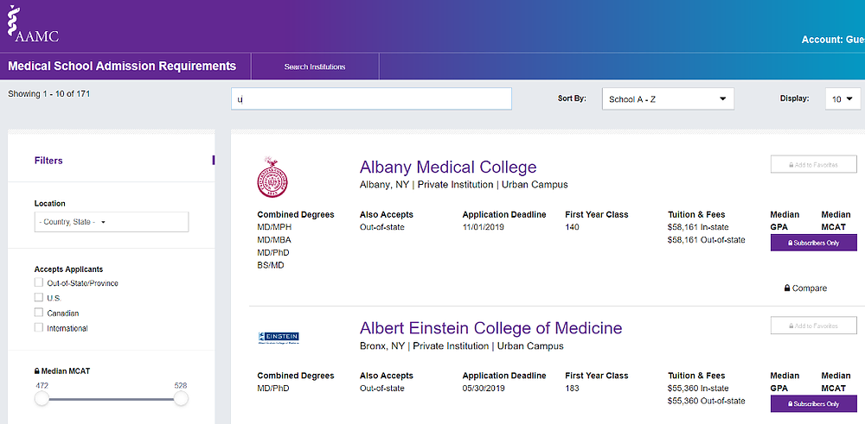
Example MSAR Page

Slide 23
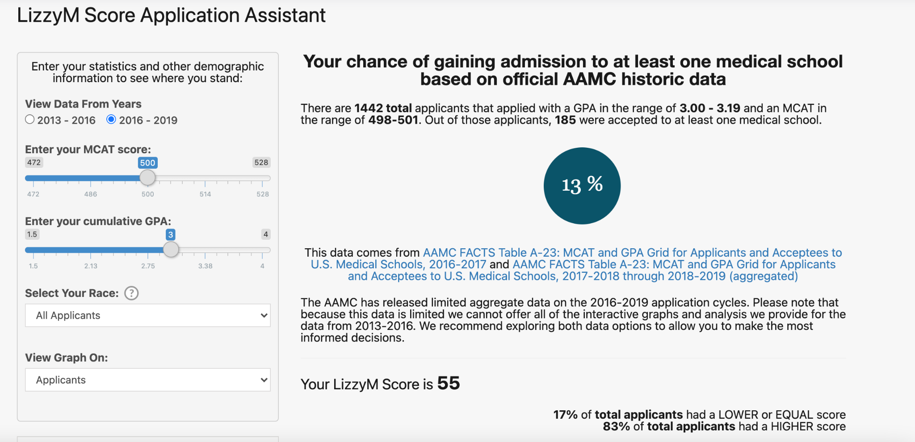
Other Ways to Build your Medical School List
LizzyM score - Student Doctor Network
Link to information on LizzyM scores:
https://themdjourney.com/lizzym-score-and-your-med-school-application-2021-review/#:~:text=Students%20with%20LizzyM%20scores%20of,schools%20and%20other%20medical%20schools
Notes:
Lizzy M score is where you enter your personal stats and you get a score - for example 55. With this score you look up your ideal medical schools on SDN and compare to see if your score is close to their Lizzy M score range.
Helps you determine if your overall application is a good match for that program
Can also adjust your school search to only find schools that are within 10% of your LizzyM score, for example.
Reddit link to LizzyM for schools
https://themdjourney.com/lizzym-score-and-your-med-school-application-2021-review/#:~:text=Students%20with%20LizzyM%20scores%20of,schools%20and%20other%20medical%20schools

Slide 24
How to Think About Out-of-State Friendly Schools
MSAR is very helpful
How many applicants are from out of state
How many of the interviews went to people from out of state
How many people were accepted from out of state
Some schools may be specified as out of state friendly
If you are out of state, do you have any connections to the state you are applying to
If you are in state, you may be asked to provide proof of residency during the application process with required documents

Slide 25
How many schools should I apply to?
Princeton Review reports the average number applied to is 15
If you apply to 10 schools, a common recommendation is:
Apply to 2 “reach schools”
Apply to 1-2 “safety schools”
The rest should be close to your level
How do you define a “reach” school?
Your stats are below the average (MCAT, GPA)
You are an out-of-state student
Consider your ability to complete all of the secondaries
Consider the cost of applications
AAMC Fee Assistance Program covers application to 20 schools
Do you want to go “all in” on getting in this cycle?
Do not apply to a school you would never consider going to

Slide 26
Tips
Certain schools have an agreement to be an “in state school” for “out of state applicants”
WWAMI
Utah
Talk to your pre-med advisor (or find one on NAAHP)
How to start your list
Common ways: Stats, OOS Friendly, Location
Make an excel sheet to organize your schools
Make sure to note pros and cons of each school
How do you think about “out of state friendly” schools: https://www.reddit.com/r/premed/comments/iz4rj4/what_percentage_of_a_student_body_is_considered/
How to make a school list: https://www.reddit.com/r/premed/wiki/schoollist
Disclaimer: Reddit threads are one person’s opinion, but may help you conceptualize
Notes:
MCAT/GPA get you in the door -> everything else gets you into the school
Dont apply to a school you would never consider going to!
If you get in and dont go -> BAD
How do you know your favorites
Feel on interview days
Looking at match stats to think about the future after medical school -> can find match lists online
How many schools to apply to
Secondaries
The best way to make the most of your money is to intend to finish each secondary
Depends on your preferences
Cost of application
Number you are interested in
Are you super committed to getting in this year
DO/MD applications as well
Think about how many secondaries you can complete
Have reasons you want to go to the specific school because they will ask

Slide 27
PreMD Exit Survey
Please complete our survey!

Slide 28
Thank you! Questions?

