Slide 1
MCAT
PreMD

Slide 2
PreMD Roadmap – Upcoming Sessions
Date | Session Topic
TBD | Letters of Recommendation / Building a School List / School Requirements
TBD | Personal Statement & Activities
TBD | Secondary Application / Altus (Casper, Snapshot, Duet)
TBD | Interviews
TBD | DO vs. MD vs. PhD vs. MD Dual-Degree
TBD | Reapplication/Non-Traditional Applicants
TBD | Finances

Slide 3
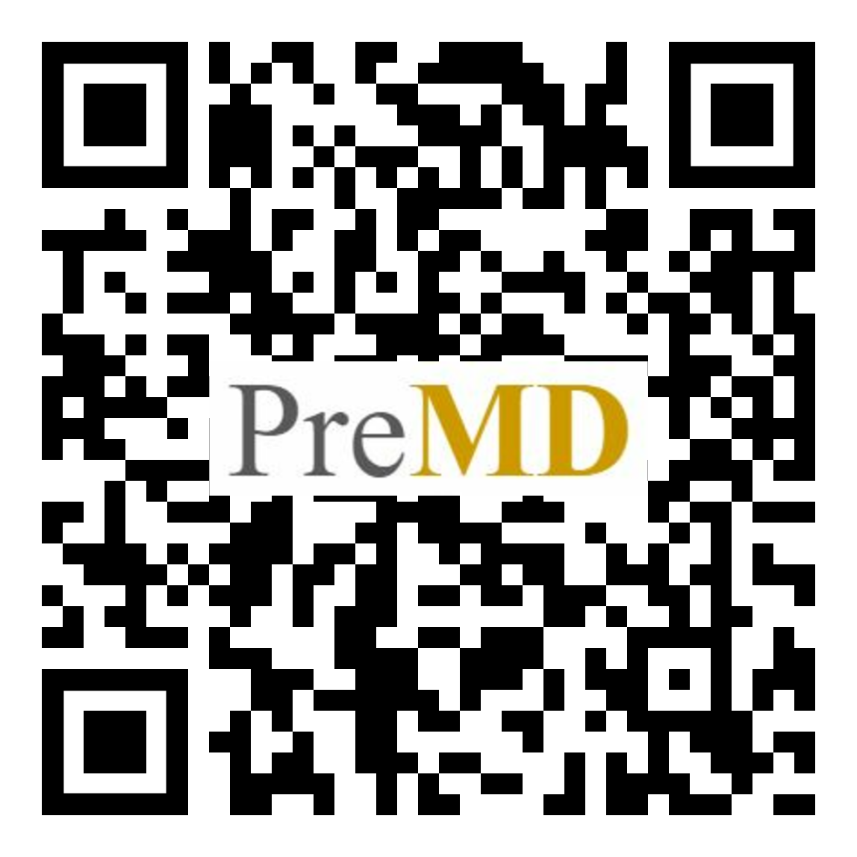
PreMD Entry Survey
Please complete our survey!

Slide 4
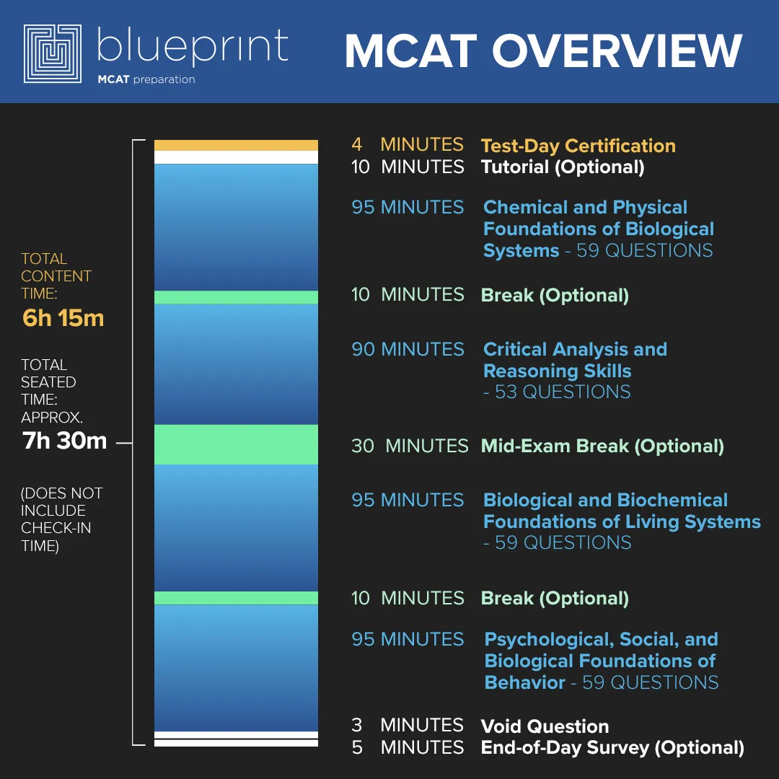
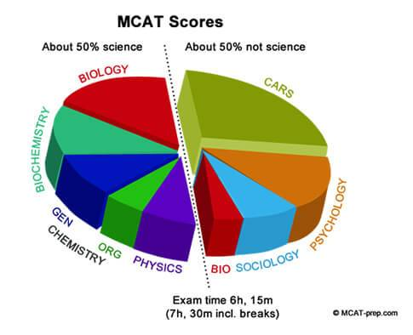
Overview of the MCAT
Notes:
This is a 6-7.5 hour test.
The content isn’t necessarily the hardest part; it’s also the stamina of working your brain for 6-7 hours.
The purpose of this test is to see if you can handle the rigorous pace of medical school, content wise.
4 Sections:
Chem/Physics - Gen. Chem, Biochemistry, Physics, Organic Chem, Biology
CARS - Critical Analysis and Reasoning Skills - Reading comprehension, humanities & social science passages.
Bio/Biochem - Biology, Biochemistry, Gen. Chem, Organic Chem.
Psych/Soc - Psychology, Sociology, Biology
Tips:
Every section matters - make sure to study them evenly, don’t overlook one because schools will look at the individual section scores too
Don’t be alarmed if certain topics do not show up on the actual MCAT. For example, there could be no Physics questions.

Slide 5
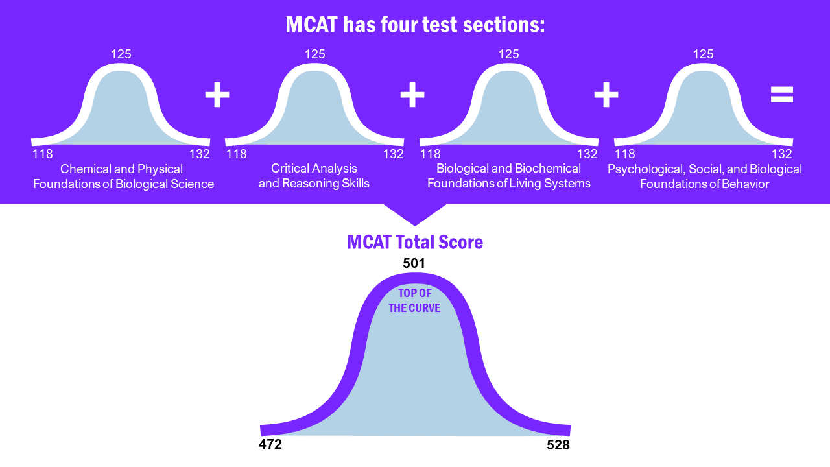
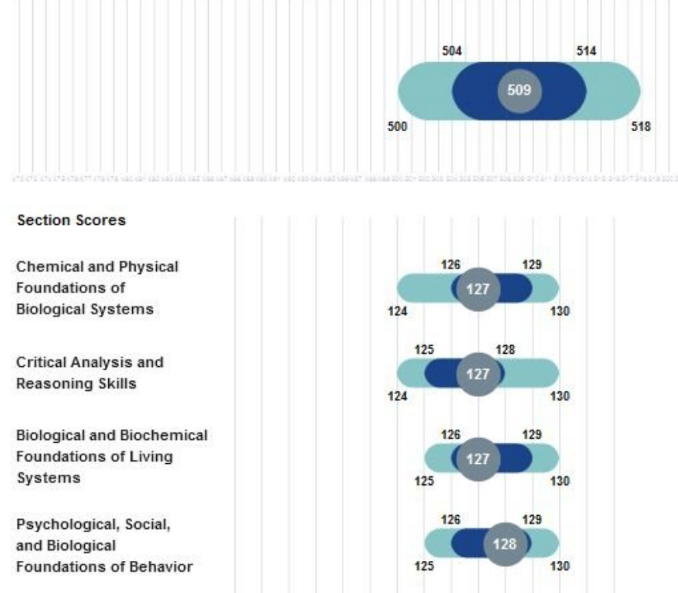
Overview of the MCAT
Each section is scored between 118-132. All four sections are added to get your total MCAT score between 472-528.
Tip: Look at the MSAR to set a goal and find the average accepted student scores for individual schools.
Notes:
Each section is weighted equally
MSAR - use as a tool to set a goal of what score you would like to get based on the schools you would hope to get into

Slide 6
Average Scores 2022-2023
 | Applicant | Matriculant
CPBS | 126.4 | 127.9
CARS | 125.8 | 127.0
BBLS | 126.8 | 128.2
PSBB | 127.5 | 128.9
Total MCAT | 506.5 | 511.9
 | Applicant | Matriculant
Science GPA | 3.52 | 3.68
Non-Science GPA | 3.76 | 3.84
Total GPA | 3.62 | 3.75

Slide 7
Timeline of Registration
Dates are offered from January to September
Cost is ~$330.
Note: there is a fee assistance program
Sign up months ahead of time. 10 days prior to exam day is the last day you can schedule an exam.
Ideally, take the MCAT early in the year
Don’t take it if you’re not ready
2023 MCAT EXAM SCHEDULE
Test Date | Score Release Date |  | Test Date | Score Release Date
Jan 13 | Feb 14 |  | Jun 16 | Jul 18
Jan 14 | Feb 14 |  | Jun 17 | Jul 18
Jan 19 | Feb 21 |  | Jun 23 | Jul 25
Jan 27 | Mar 3 |  | Jun 24 | Jul 25
Mar 11 | Apr 11 |  | Jun 29 | Jul 31
Mar 24 | Apr 25 |  | Jul 15 | Aug 15
Apr 14 | May 16 |  | Jul 28 | Aug 29
Apr 15 | May 16 |  | Aug 4 | Sep 6
Apr 28 | May 31 |  | Aug 19 | Sep 19
Apr 29 | May 31 |  | Aug 25 | Sep 26
May 12 | Jun 13 |  | Aug 26 | Sep 26
May 13 | Jun 13 |  | Aug 31 | Oct 3
May 18 | Jun 21 |  | Sep 1 | Oct 3
May 26 | Jun 27 |  | Sep 8 | Oct 13
Jun 3 | Jul 6 |  | Sep 9 | Oct 13
Notes:
Months ahead of time:
(Slots fill fast and then you may have to travel to another city).
Take the MCAT Early:
You want your scores back before you apply to know where you’re competitive at. Also, you never know if you will need to retake it (ie bad score, have to cancel last minute, or need to void score). It’s also nice to have it out of the way and to focus on your primary and secondary apps.
Don’t freak out if you have to take it later than you’d like - you can still apply
Pushing back test: Up until a certain date before your test you can pay money to postpone your exam date
Depending on period you’re taking it in, it can cost up to $150

Slide 8
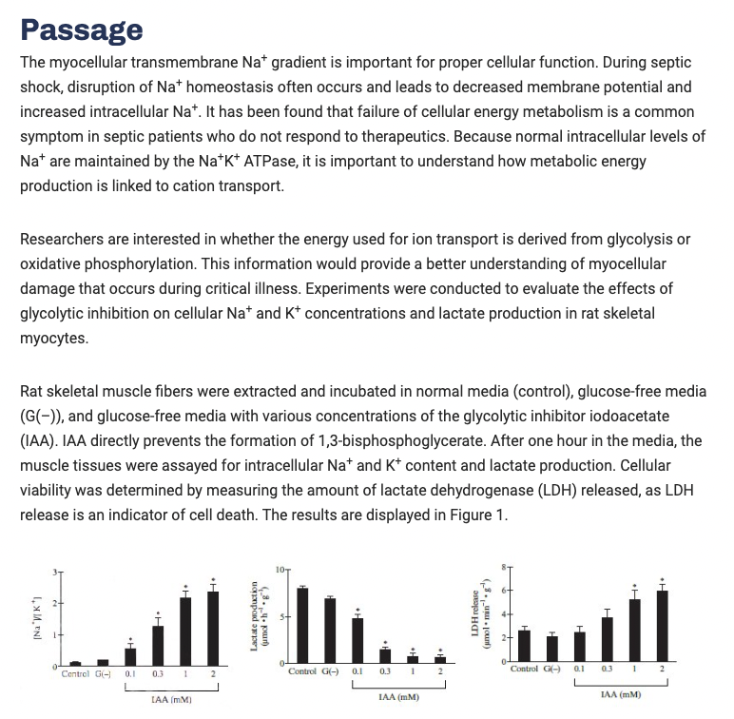
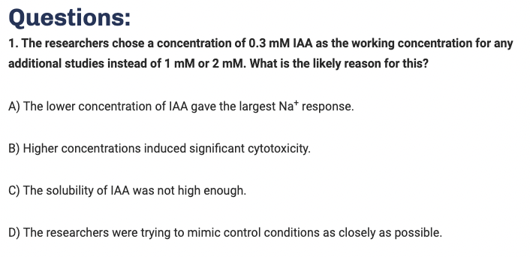
Question Example (Passage-Based)
AAMC, MCAT Sample Question Guide
Notes:
In each science section, there are 10 passages with 4-7 questions each.

Slide 9
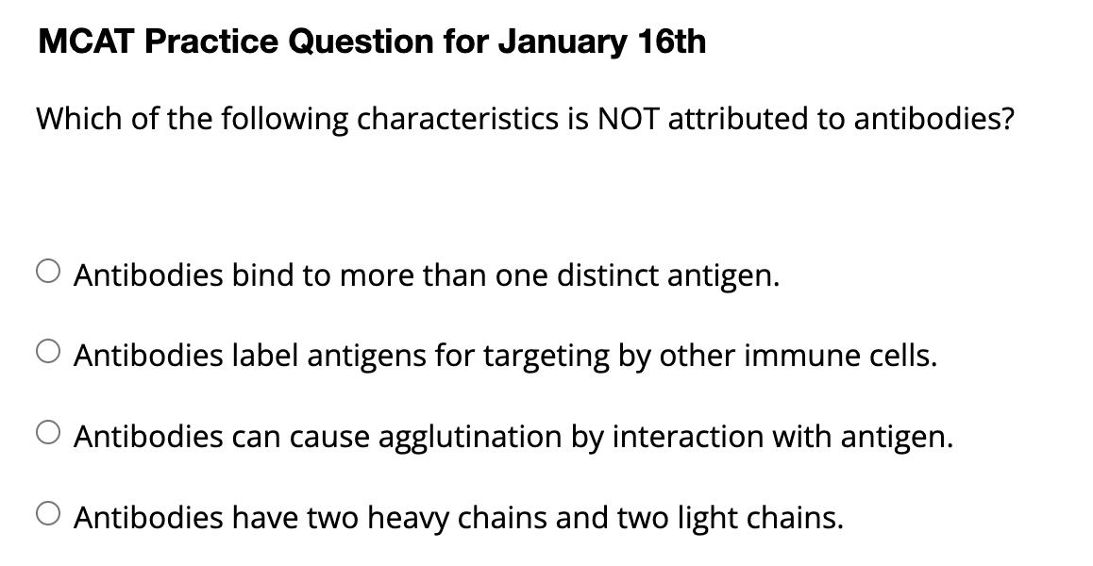
Question Example (Stand-Alone)
Kaplan, MCAT Question of the Day
Notes:
There are approx 15 stand alone questions in each of the science sections.

Slide 10
Study Approaches - No One Right Way
Practice exams/questions
Free exam through Kaplan, AAMC, Princeton Review
AAMC has qbanks/practice exams (starting at $35/exam)
Paid online courses
Kaplan (starting at $1,999), Princeton Review (starting at $1,999), Jack Westin (starting at $1,450)
Free online resources
Khan Academy, free apps with questions
Study books - often include multiple practice exams
Kaplan (starting at $270), Princeton Review (starting at $225)
Notes:
Find what works for you! Based on cost, study style, etc.
Practice Exams/Section Tests/Qbanks
Going to be the best way to gauge your score
Paid online courses:
Pros: lots of high-yield content, lots of support, very organized if you need structure. Access to a lot of practice exams/questions.
Cons: Quite expensive. Doesn’t fit everyone’s needs.
Khan Academy and Study Books
Both are great resources for content
Flaschards
A great way to incorporate spaced repetition
Base it off if flashcards work for you
Podcast
Good if you are driving, working, doing chores
Not a primary study source
Friends
Good support system, teach each other, review together
StudySchedule.org
TLDR MCAT
Leah4sciMCAT
MCAT retake calculator
MD Hero
Check into Reddit page and Discords - potential friends/support for studying

Slide 11
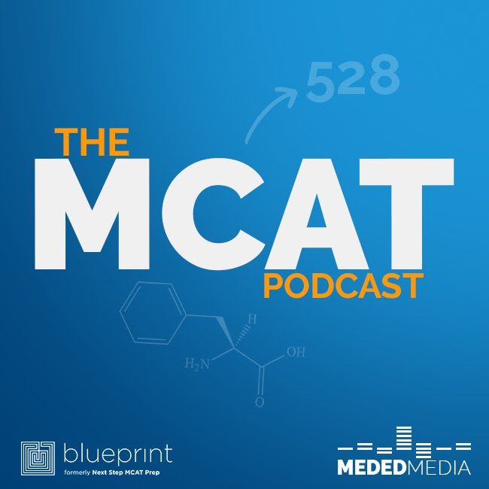
Study Approaches (Cont.)
Flashcards/Anki/Quizlet
Princeton Review has a free flashcard deck
Kaplan has a flashcard deck you can purchase on Amazon
Check MCAT Reddit/Google for pre-made decks
Spaced repetition is one of the best ways to learn and retain information
Podcasts
The MCAT Podcast + Others
Paid tutoring
Find a friend to study with
Notes:
Find what works for you! Based on cost, study style, etc
Practice Exams/Section Tests/Qbanks
Going to be the best way to gauge your score
Paid online courses:
Pros: lots of high-yield content, lots of support, very organized if you need structure. Access to a lot of practice exams/questions.
Cons: Quite expensive. Doesn’t fit everyone’s needs.
Khan Academy and Study Books
Both are great resources for content
Flaschards
A great way to incorporate spaced repetition
Base it off if flashcards work for you
Podcast
Good if you are driving, working, doing chores
Not a primary study source
Friends
Good support system, teach each other, review together
StudySchedule.org
TLDR MCAT
Leah4sciMCAT
MCAT retake calculator
MD Hero
Check into Reddit page and Discords - potential friends/support for studying

Slide 12
Pearls of Wisdom
Decide on a goal for your score
Take a practice test early to gauge where you’re at and what you need to focus on
Do full length practice exams in one sitting to prepare for the 8-hr marathon. Pretend like it’s test day and go through all the motions you would as if the test was the real thing
Waking up at the same, eating the same thing, do it on a Saturday, hold self to the time limit
The most important part is reviewing your practice exams: questions you got wrong AND got right

Slide 13
Pearls of Wisdom (Cont.)
Make a study plan and stick to it
Don’t burnout -- take time for self care
Drive to the test site beforehand
Know where to go, where to park, where you go in, how long it takes - do it at the same time on the same day of the week
MCAT score will remain valid for 2-4 years

Slide 14
Personal Anecdotes - How to Study

Slide 15
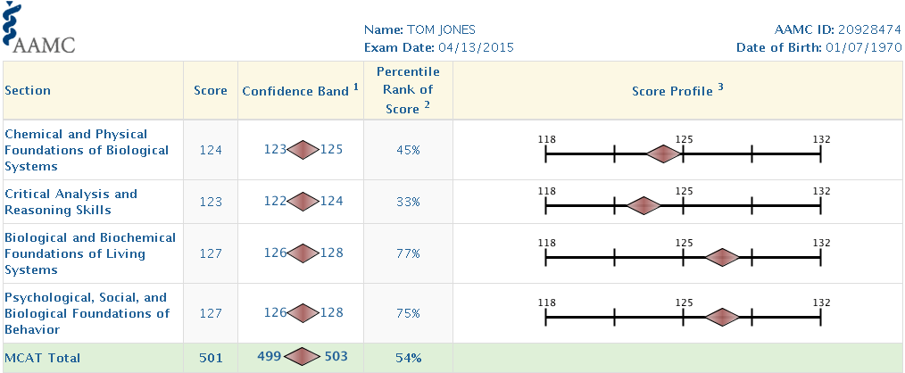
Timeline Post-MCAT - Results
Score timing:
Takes 30-35 days to get scores back
AMCAS will process your application without a score
However, your primary app likely won’t be reviewed without a score
Tip: If you’re waiting for your score, apply to 1 school to get verification. Verification can take up to 8 weeks during the busiest times.

Slide 16
Retaking the MCAT
Ask why? If your score is adequate, it could be risky
Consider the pros and cons of taking it again (do you have to wait another year to apply, do you have time to study again, will you do better, consider cost of taking it again, etc)
Weigh applying with a lower MCAT and risking not getting in vs. taking it again and risking doing worse
You are more than just your MCAT score.
Check your LizzyM score and think about holistic review!
Every school is different
A few schools do a super score (combine your best section scores). Check MSAR/School Website
It could show that you are serious about medical school
Don’t be scared if you have to retake it
Lots of conflicting information on how retakes impact you
Notes:
Evaluate the amount of time you have to give to a retake, evaluate the other aspects of your application, think about how this changes where you’re applying (which MD - consider DO programs)
You are more than just your MCAT score - whether MCAT is good or bad, you still have to have a well rounded application - also less important after you get an interview
MCAT retake calculator

Slide 17
Take-Home Points
In the end, your MCAT score isn’t the only thing that determines your acceptance.
There is no one right way of studying - make a schedule that works for you and stick to it!
Notes:
Don’t fear applying - think about holistic review
Consider the pros vs cons of having to take it again or taking another year without applying

Slide 18
MCAT Fee Assistance Program - AAMC
Can apply up to 5 times in lifetime but once per calendar year.
Benefits:
MCAT Official Prep products
MCAT registration fee from $330→ $135
MSAR subscription free
AAMC PREview registration free
Waiver for AMCAS fees for 1 application submission
Up to 20 medical schools
Secondary application fee also waived for some schools
What documents do I need?
You and your parents’ incomes (IRS Federal Income Tax Forms, or W-2 or 1099 forms)
If ≥ 26 of age, do not need parental financial information.
Consent and Certification Form
Financial Aid Award Letters and Cost of Attendance information
Other additional supporting documentations may be needed. Website listed in resources section.
Notes:
MCAT Official Prep products: can only receive once in a lifetime even if multiple awardee of the Fee Assistance Program.
MSAR= Medical School Admission Requirements

Slide 19
Resources
AAMC Fee Assistance Program: https://students-residents.aamc.org/fee-assistance-program/fee-assistance-program-fap
Free Kaplan Practice Exam: https://www.kaptest.com/mcat/free/mcat-free-practice-test
Kaplan book sets, online Qbank, and flash cards (less expensive than full course): https://www.kaptest.com/mcat/mcat-books and https://www.amazon.com/stores/page/1948048F-1466-4D53-A631-7BC814D0BA0E?ingress=3&visitId=a8afecbc-f022-4603-bcfe-191dff0545ed&linkCode=ll2&tag=kaptest-mcat-amazon-store-20&linkId=a91559c536a1638b97607c863b826773&language=en_US&ref_=as_li_ss_tl&_ga=2.199007215.1370487792.1634769909-304164658.1632788414&_gac=1.124985976.1634771872.CjwKCAjw_L6LBhBbEiwA4c46ut-18wBXAN2MT6qn0Ri4k3Q_VborAwZ0GiIXJbobWsRXZuK2WpRXhhoCzL4QAvD_BwE
Kaplan online site for full courses
AAMC Free Resources (Full exam, 16 questions, etc): https://students-residents.aamc.org/prepare-mcat-exam/free-planning-and-study-resources
Princeton Free Resources (Full exam, 550 flashcards, free webinars): https://www.princetonreview.com/medical/free-mcat-practice-test?gclid=CjwKCAjw_L6LBhBbEiwA4c46ulSsz_Uu7HSbTb1f9-subPZemG7BOcvmb3OA9zOVJSXgInszPTDVeRoCAd0QAvD_BwE&ExDT=2#!practice
Princeton Review Books: https://www.princetonreview.com/mcat-book
Princeton online site for full courses
Khan Academy: https://www.khanacademy.org/test-prep/mcat
Register for the MCAT: https://students-residents.aamc.org/register-mcat-exam/register-mcat-exam
MCAT FAQs: https://students-residents.aamc.org/mcat-faq/mcat-faqs
The MCAT Podcast
MSAR (1 yr subscription $28, 2 yr subscription $36): https://students-residents.aamc.org/medical-school-admission-requirements/medical-school-admission-requirements-applicants
The Medical School Directory (uses LizzyM Scores): https://themedicalschooldirectory.com/
LizzyM Calculator: https://www.studentdoctor.net/schools/lizzym-score
Student Doctor Network
Check local library/Barnes and Noble for books that publish information about schools
StudySchedule.org: https://www.studyschedule.org/
TLDR MCAT (Quick Overviews of MCAT Content + Mnemonics): https://tldrmcat.wordpress.com/content/chemistry/
Leah4sciMCAT (Helpful Content Videos): https://leah4sci.com/mcat/
MCAT retake calculator: https://jackwestin.com/mcat-retake-calculator
MD Hero (Quick Review Sheets of Content): http://mcat-review.org/

Slide 20
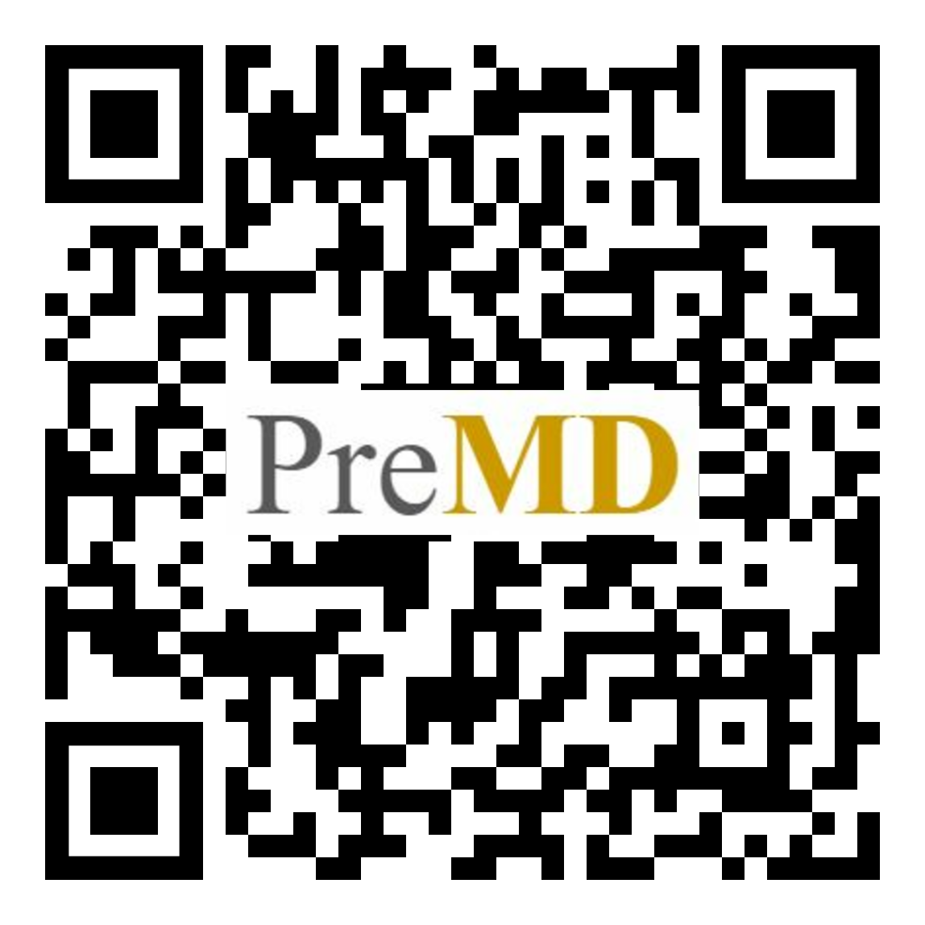
PreMD Exit Survey
Please complete our survey!

Slide 21
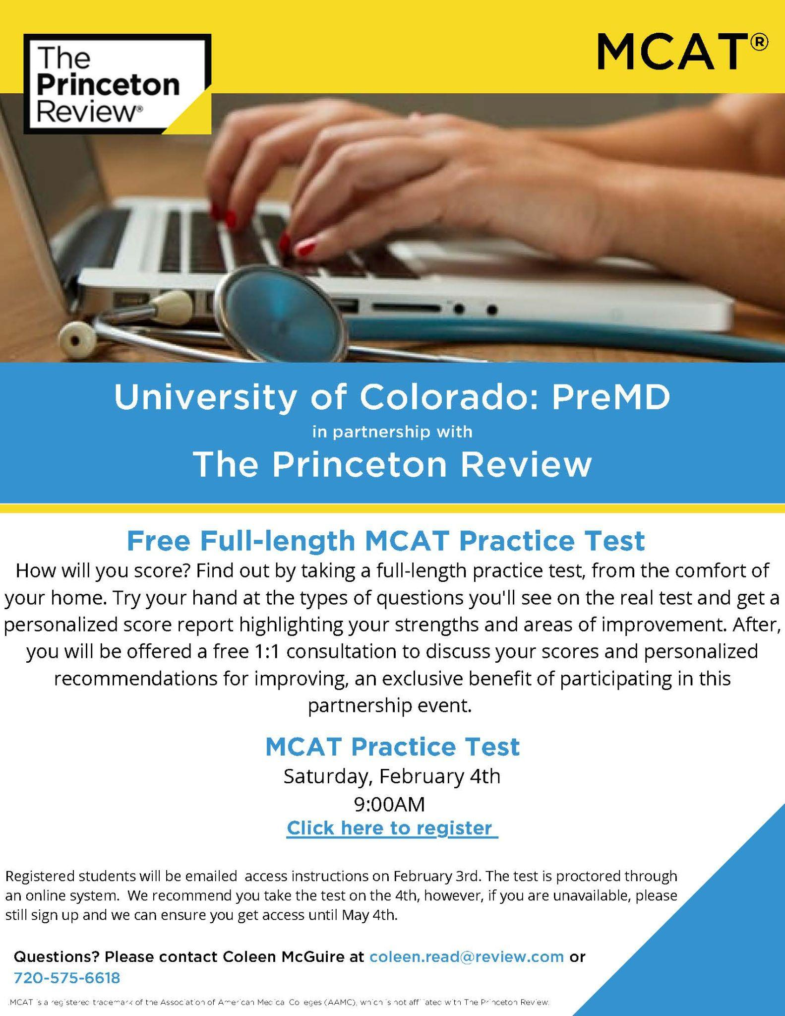
Practice MCAT - Princeton Review
We are excited to partner with the Princeton Review to offer a free MCAT practice exam! The test will be scheduled on February 4th (but you can take the test up to about 3 weeks after this date) and everyone who completes the test will be offered a one-on-one session to review their test results. Please RSVP at the link below.
https://forms.gle/F9xRqUQ9CTtHKGUz9

Slide 22
Thank you! Questions?

