Slide 1
Overview of the Application Process
PreMD

Slide 2
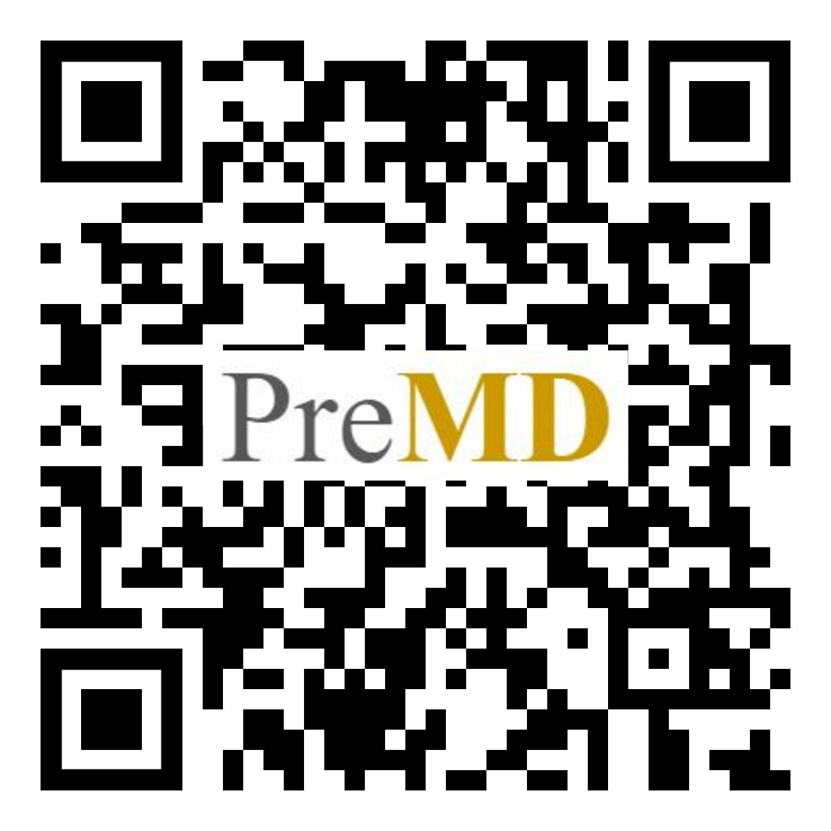
Pre-Session Survey and Raffle!
If you fill out the pre- and post-session survey you will be entered into a raffle for a scholarship for a free live online MCAT class from Kaplan. You must redeem the scholarship before 12/31/22 or the offer with expire.
https://forms.gle/G8By69r8ykaCrMYg9

Slide 3
PreMD Roadmap – Upcoming Sessions
Date | Session Topic
TBD | Letters of Recommendation / Building a School List / School Requirements
TBD | Personal Statement & Activities
TBD | Secondary Application / Altus (Casper, Snapshot, Duet)
TBD | Interviews
TBD | DO vs. MD vs. PhD vs. MD Dual-Degree
TBD | Reapplication/Non-Traditional Applicants
TBD | Finances

Slide 4
The Application Cycle
Submit Primary App
Secondary Apps
&
Judgement Tests
MCAT
Interviews

Slide 5
Pre-Primary Application

Slide 6
Pre-Primary Application: Years
Pre-primary application
Shadow, scribe, volunteer, do research, try being an EMT/CNA/direct care aid, make your own leadership opportunities
Document your activities
You will need to remember what happened.
Search for the story in an event and describe how you learned and grew from it.
2) Ask why do you want to be a doctor?
Tip: Have a journal

Slide 7
Pre-Primary Application: Months
MCAT:
Pick a date
Use study methods that have worked for you previously + practice tests
Letters of Recommendation:
Give letter writer enough time
Ask after finishing a class or activity & remind leading up to submitting application
Store on a third party site; ensures you have not seen letter before sending to AMCAS. (interfolio)
Personal Statement and Activities:
Identify people to review/edit
Limit number (grammar, content, MD perspective)
Start drafting

Slide 8
Pre-Primary Application: Personal Anecdote
Can take years off (gap years)!
Don’t be afraid to add your hobbies to the application, even if it may seem like a thing everyone does!
Do the things that bring you joy/add meaning to your life - not just what you think will look good on an application/re-application.

Slide 9
Primary Application

Slide 10
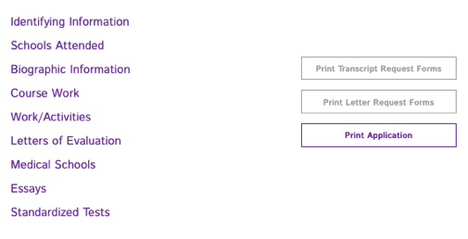
Primary Application Process
Write personal statement
Write activities/extracurriculars
Fill out AMCAS
AMCAS processing can take up to 8 weeks

Slide 11
Cost of Applying
Step | Description
Primary Application | $170 for first school, $43 for each additional school
Secondary Application | Varies from $50-$150
Interview Travel | Varies widely
Total | Expect total costs to be in the $1,000’s
AAMC’s Fee Assistance Program
Help with MCAT prep materials, MCAT fee, AMCAS fee, Secondary Application fees

Slide 12
AMCAS Application: Personal Statement
“Use the space provided to explain why you want to go to medical school” (5,300 characters)
Personal Statement = Personal
Don’t be afraid to be vulnerable
Dig deep, write several drafts, and put your best effort into selling your story
Leave no doubt that this is the career for you
Tip: Read back on your “why doctor” journal for inspiration

Slide 13
AMCAS Application: Work/Activities
Up to 15 work/activities spots with 700 character limit
3 of these are listed as “most meaningful” and have an additional 1,325 character prompt
Include:
Dates, title, organization name
Time spent on work/activity
Responsibilities and accomplishments
Impact
Qualities you gained/demonstrated
(Most meaningful): What you learned and how you grew from the experience
Update for 2023:
Now including “anticipated” experiences which are activities that you have not yet started but plan to participate in (https://students-residents.aamc.org/media/13376/download?attachment)
Tip: Look back to your Activities Journal

Slide 14
AMCAS Application: Work/Activities
Categories:
Artistic Endeavors Community Service/Volunteer - Medical/Clinical Community Service/Volunteer - Not Medical/Clinical Conferences Attended Extracurricular Activities Hobbies Honors/Awards/Recognitions Intercollegiate Athletics Leadership - Not Listed Elsewhere | Military Service Other Paid Employment - Medical/Clinical Paid Employment - Not Medical/Clinical Physician Shadowing/Clinical Observation Presentations/Posters Publications Research/Lab Teaching/Tutoring/Teaching Assistant

Slide 15
Primary Application Anecdote
Be honest: your personal experience is unique, even if you don’t believe it
Don’t say you want to go into medicine “to help people”
Be specific: Why do you want to be a physician over other health professions

Slide 16
MD/PhD
Typically takes 7-8 years to complete
Most people who complete an MD/PhD program are dedicating > 50% of their time to research
The MD/PhD application requires two additional essays
Why you are interested in MD-PhD training
Describe your significant research experiences
Timeline
AMCAS application opens: May preceding the year of expected entry
Applicants interviewed: October–March
Final decisions sent to applicants: December–March
Applicants revisit program(s) to decide where to matriculate: March–April
MD-PhD programs start: June–August
https://students-residents.aamc.org/applying-md/phd-programs/applying-md-phd-programs-0

Slide 17
AACOMAS: D.O. Schools
Application opened May 4, 2022. Most likely will open on the same day next cycle.
Similar but different categories:
Personal statement: 5300 characters
LORs: LOR will be submitted to every school; DO LOR highly recommended
Activities: 600 characters - No limit on amount
Influences section: mention DOs or MDs that influenced commitment to medicine
Primary: $198 for first program + $50 for each additional - Fee waiver available
Secondary: Varies. On average ~$100

Slide 18
TMDSAS: Texas Medical Schools
Application opens May 2, 2022 for 2023 Entry Year.
Similar but different categories:
Personal essay: 5000 characters - this is shorter than AMCAS or AACOMAS
Has TWO additional essays. 2nd essay “optional”
Chronology of Activities - 300 characters for regular, 500 characters for “most meaningful”
MCAT must have been taken no earlier than 2018 and no later than September, 2022 for 2023 Entry Year.
Match system: Schools and students match based on ranking in order of preference from both parties
Flat fee of $200 - Fee waiver unavailable

Slide 19
Post Primary Application

Slide 20
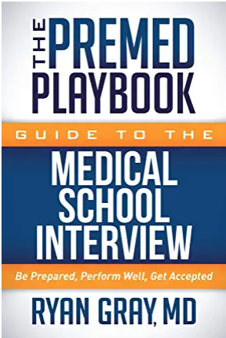
Post Primary Application
Start writing out common secondary questions
Many questions are repeated on different secondary applications
Check SDN page on that school’s application - typically has previous secondary questions or current secondary questions posted!
Casper, Snapshot, Duet, and AAMC Situational
Check which of your schools (if any) require these assessments
Schedule a time to take them
Interview Prep
Begin saving money for expenses
Draft your answers to common interview questions
Mock interviews with career center, educate yourself on interview practices
Great book on interviews - Amazon for $13

Slide 21
Use SDN to your Advantage
Google “school name + SDN” > search through posts for secondary prompts
Here is a screenshot of CUSOM’s SDN that has the secondary prompts as early as July 13th, 2020
Works for nearly every school!

Slide 22
Common Secondary Application Questions
If you can’t use SDN to your advantage for secondary prompts, start drafting responses to common questions
How do you contribute to diversity?
Gap year plans?
Why our school?
Challenge/adversity/failure you faced?
Describe your future medical career/how you plan to impact medicine.
Leadership examples?
Exposure to medicine/clinical experiences?
Most important non-academic/creative endeavor?
Situation in which you weren't in the majority/unfair situation/conflict?
Autobiography/describe your community.
Research interests (non-MSTP prompt)?
How has COVID-19 affected you/impacted how you see your future medical career?

Slide 23
Post Primary Anecdote
Ask for help - and accept that help!
Make sure to pre-write your secondary applications well before you start receiving any!
Make sure to have your supportive people around you during this time!

Slide 24
Helpful resources and what they’re used for + links
AMCAS (the application!): https://students-residents.aamc.org/applying-medical-school-amcas/applying-medical-school-amcas
MSAR (where to look at schools): https://students-residents.aamc.org/medical-school-admission-requirements/medical-school-admission-requirements-applicants
The Medical School Directory (where to look at schools - for free!): https://themedicalschooldirectory.com/
SDN (CAUTION -- use for secondary prompts but take everything else with a grain of salt): https://www.studentdoctor.net/
LizzyM Scores (chance of getting into medical school based on historical data): https://www.studentdoctor.net/schools/lizzym-score
Interfolio (where to store LoRs if taking several years/reapplication): https://www.interfolio.com/products/dossier/
AAMC’s Fee Assistance Program (help cover fees!): https://students-residents.aamc.org/fee-assistance-program/fee-assistance-program
AAMC Website (Helpful tips for the process, guidelines, etc): https://students-residents.aamc.org/preparing-medical-school/preparing-medical-school
Pre-Med Years Podcast by Ryan Gray

Slide 25
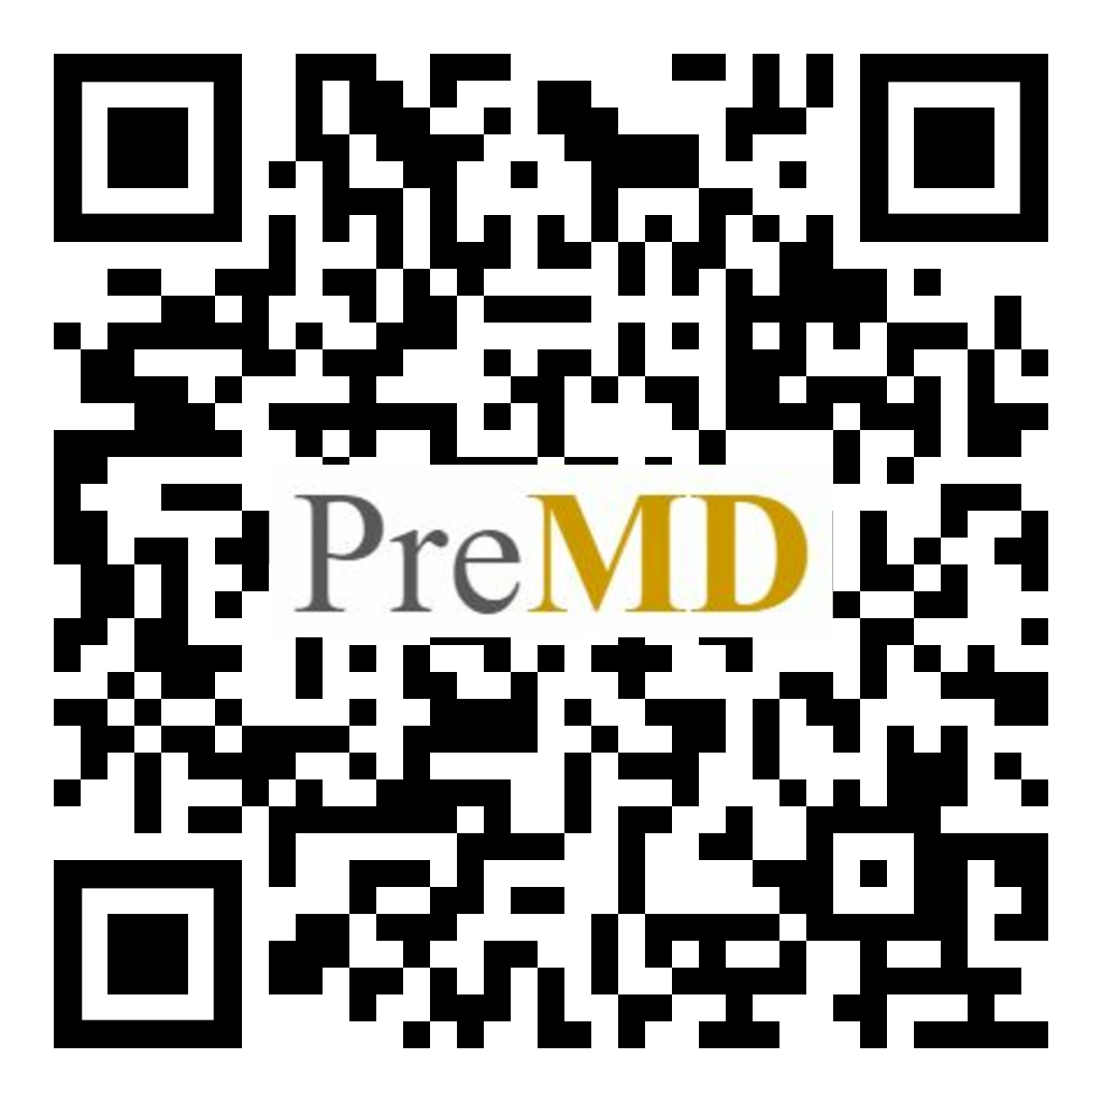
Post-Session Survey
If you fill out the pre- and post-session survey you will be entered into a raffle for a scholarship for a free live online MCAT class from Kaplan. You must redeem the scholarship before 12/31/22 or the offer with expire.
https://forms.gle/zUDZ6YGcDKq1bkGE7

Slide 26
Thank you! Questions?
Please fill out our survey!
If you are looking for PreMD recordings/powerpoints/information you can find it at: https://medschool.cuanschutz.edu/deans-office/diversity-inclusion/about-us/pre-med-program

