Slide 1
Overview of the Application Process
PreMD

Slide 2
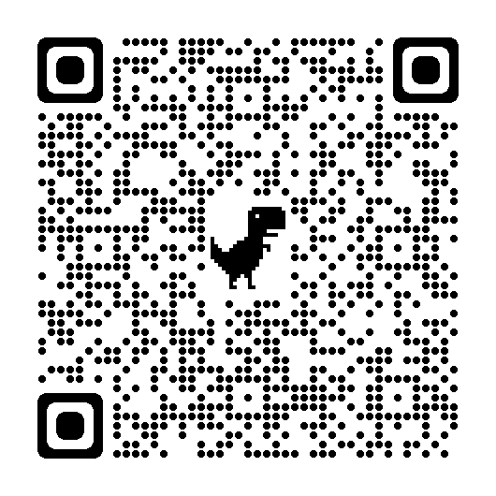
Please fill out our pre-seminar series survey!
Students who complete the initial and exit surveys will be entered in a raffle for free AMA swag and the chance to work with one of us to personally review your personal statement!

Slide 3
The Application Cycle
Submit Primary App
Secondary Apps
&
Judgement Tests
MCAT
Interviews

Slide 4
Pre-Primary Application

Slide 5
Pre-Primary Application: Years
Pre-primary application
Shadow, scribe, volunteer, do research, try being an EMT/CNA/direct care aid, make your own leadership opportunities
Document your activities
You will need to remember what happened.
Search for the story in an event and describe how you learned and grew from it.
2) Ask why do you want to be a doctor?
Tip: Have a journal

Slide 6
Pre-Primary Application: Months
MCAT:
Pick a date
Use study methods that have worked for you previously + practice tests
Letters of Recommendation:
Give letter writer enough time
Ask after finishing a class or activity & remind leading up to submitting application
Store on a third party site; ensures you have not seen letter before sending to school
Personal Statement and Activities:
Identify people to review/edit
Limit number (grammar, content, MD perspective)
Start drafting

Slide 7
Pre-Primary Application: Personal Anecdote
Can take years off (gap years)!
Don’t be afraid to add your hobbies to the application, even if it may seem like a thing everyone does!
Do the things that bring you joy/add meaning to your life - not just what you think will look good on an application/re-application.

Slide 8
Primary Application

Slide 9
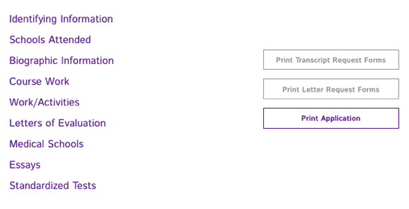
Primary Application Process
Write personal statement
Write activities/extracurriculars
Fill out AMCAS
AMCAS processing can take up to 8 weeks

Slide 10
Cost of Applying
Step | Description
Primary Application | $170 for first school, $42 for each additional school
Secondary Application | Varies from $50-$150
Interview Travel | Varies widely
Total | Expect total costs to be in the $1,000’s
AAMC’s Fee Assistance Program
Help with MCAT prep materials, MCAT fee, AMCAS fee, Secondary Application fees

Slide 11
AMCAS Application: Personal Statement
“Use the space provided to explain why you want to go to medical school” (5,300 characters)
Personal Statement = Personal
Don’t be afraid to be vulnerable
Dig deep, write several drafts, and put your blood, sweat, and tears into selling your story
Leave no doubt that this is the career for you
Tip: Read back on your “why doctor” journal for inspiration

Slide 12
AMCAS Application: Work/Activities
Up to 15 work/activities spots with 700 character limit
3 of these are listed as “most meaningful” and have an additional 1,325 character prompt
Include:
Dates, title, organization name
Time spent on work/activity
Responsibilities and accomplishments
Impact
Qualities you gained/demonstrated
(Most meaningful): What you learned and how you grew from the experience
Tip: Look back to your Activities Journal

Slide 13
AMCAS Application: Work/Activities
Categories:
Artistic Endeavors Community Service/Volunteer - Medical/Clinical Community Service/Volunteer - Not Medical/Clinical Conferences Attended Extracurricular Activites Hobbies Honors/Awards/Recognitions Intercollegiate Athletics Leadership - Not Listed Elsewhere | Military Service Other Paid Employment - Medical/Clinical Paid Employment - Not Medical/Clinical Physician Shadowing/Clinical Observation Presentations/Posters Publications Research/Lab Teaching/Tutoring/Teaching Assistant

Slide 14
Primary Application Anecdote
Be honest: your personal experience is unique, even if you don’t believe it
Don’t say you want to go into medicine “to help people”
Be specific: Why do you want to be a physician over other health professions

Slide 15
AACOMAS: D.O. Schools
Application opens May 4
Similar but different categories:
Personal statement: 5300 characters
LORs: LOR will be submitted to every school; DO LOR highly recommended
Activities: 600 characters - No limit on amount
Influences section: mention DOs or MDs that influenced commitment to medicine
Primary: $197 for first program + $48 for each additional - Fee waiver available
Secondary: Varies $65-150

Slide 16
TMDSAS: Texas Medical Schools
Application opens May 17
Similar but different categories:
Personal essay: 5000 characters - this is shorter than AMCAS or AACOMAS
Has TWO additional essays. 2nd essay “optional”
Chronology of Activities - 300 characters for regular, 500 characters for “most meaningful”
5 yr old MCAT accepted
Match system: Schools and students match based on ranking in order of preference from both parties
Flat fee of $200 - Fee waiver unavailable

Slide 17
Post Primary Application

Slide 18
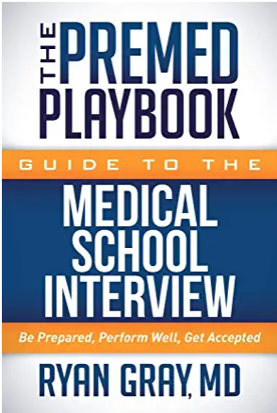
Post Primary Application
Start writing out common secondary questions
Many questions are repeated on different secondary applications
Check SDN page on that school’s application - typically has previous secondary questions or current secondary questions posted!
Casper, Snapshot, Duet, and AAMC Situational
Check which of your schools (if any) require these assessments
Schedule a time to take them
Interview Prep
Begin saving money for expenses
Draft your answers to common interview questions
Mock interviews with career center, educate yourself on interview practices
Great book on interviews - Amazon for $13

Slide 19
Use SDN to your Advantage
Google “school name + SDN” > search through posts for secondary prompts
Here is a screenshot of CUSOM’s SDN that has the secondary prompts as early as July 13th, 2020
Works for nearly every school!

Slide 20
Common Secondary Application Questions
If you can’t use SDN to your advantage for secondary prompts, start drafting responses to common questions
How do you contribute to diversity?
Gap year plans?
Why our school?
Challenge/adversity/failure you faced?
Describe your future medical career/how you plan to impact medicine.
Leadership examples?
Exposure to medicine/clinical experiences?
Most important non-academic/creative endeavor?
Situation in which you weren't in the majority/unfair situation/conflict?
Autobiography/describe your community.
Research interests (non-MSTP prompt)?
How has COVID-19 affected you/impacted how you see your future medical career?

Slide 21
Post Primary Anecdote
Ask for help - and accept that help!
Make sure to pre-write your secondary applications well before you start receiving any!
Make sure to have your supportive people around you during this time!
My latest decision was my first interview (Sep) and my first acceptance was my last interview (Feb).
Patience and hobbies throughout the process will go a long way and keep you sane.

Slide 22
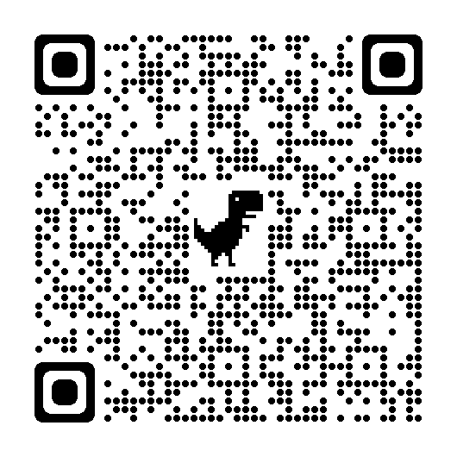
Pre-MD Exit Survey
Students who complete the initial and exit surveys will be entered in a raffle for free AMA swag and the chance to work with one of us to personally review your personal statement!
Exit survey - different from before!
Please remember to complete both surveys to be entered for the raffle!

Slide 23
Helpful resources and what they’re used for + links
AMCAS (the application!): https://students-residents.aamc.org/applying-medical-school-amcas/applying-medical-school-amcas
MSAR (where to look at schools): https://students-residents.aamc.org/medical-school-admission-requirements/medical-school-admission-requirements-applicants
The Medical School Directory (where to look at schools - for free!): https://themedicalschooldirectory.com/
SDN (CAUTION -- use for secondary prompts but take everything else with a grain of salt): https://www.studentdoctor.net/
LizzyM Scores (chance of getting into medical school based on historical data): https://www.studentdoctor.net/schools/lizzym-score
Interfolio (where to store LoRs if taking several years/reapplication): https://www.interfolio.com/products/dossier/
AMCAS Letter Service: https://students-residents.aamc.org/applying-medical-school-amcas/amcas-letter-service
AAMC’s Fee Assistance Program (help cover fees!): https://students-residents.aamc.org/fee-assistance-program/fee-assistance-program
AAMC Website (Helpful tips for the process, guidelines, etc): https://students-residents.aamc.org/preparing-medical-school/preparing-medical-school
Pre-Med Years Podcast by Ryan Gray

Slide 24
Thank you! Questions?

