Slide 1
Understand the APM2 workbook May 30th 2PM

Slide 2
Agenda
Introductions-presenters 5 min
Alternative payment concepts 5
The why behind the APM2 workbook (excel file) 8
Breakout session APM2 workbook 12 minutes
Share and explain 25 minutes

Slide 3
Introductions
Araceli Santistevan- HCPF APM 2 Analyst
Cordell Cossairt – HCPF
Pamela Ballou-Nelson Healthcare Consulting Inc

Slide 4
APM Framework
Notes:
The Health Care Payment Learning & Action Network (LAN) our grounding source for APM

Slide 5
PRINCIPLES concepts OF THE APM FRAMEWORK (Health Care Payment Learning Action Network (HCPLAN))
It is essential to empower patients to be partners in health care transformation.
Reforms to payment mechanisms will only be as successful as the capabilities of the delivery system and the innovations they support.
The goal for payment reform is to transition health care payments from FFS to APMs.
Payment models that do not take quality of care into account are not considered APMs in the APM Framework and thus are not counted as progress toward payment reform.
Value-based incentives should be considerable enough to motivate providers to invest in and adopt new approaches to care delivery without subjecting them to unmanageable financial and clinical risk.
When using more than one type of payment, APMs will be classified according to the dominant form of payment.
Centers of excellence, accountable care organizations, and patient-centered medical homes are examples, rather than Categories, in the APM Framework because they are delivery systems that can be applied to and supported by a variety of payment models.

Slide 6
WHY APM2? Understanding the APM2 workbook
Notes:
The Department developed a goal of shifting health care service reimbursement from volume-based payments to value-based payments, and the original APM program was the first step towards realizing this goal. APM 2 seeks to continue those efforts and expand their scope to realize the biggest impact possible from these value- based payment models. This furthers the core goals outlined in the ACC of improving health outcomes for Health First Colorado members, as well as saving money. As the ACC moves into the next phase, this new payment model will help maintain that forward momentum and continue the progress made with the existing value-based payment models.

Slide 7
APM2 Workbook How it is structured - Four sections
Summary Page
Summary Tab
Shared savings
Chronic Condition Threshold Tab
Supporting data
PMPM Data Tab
APM2 Code Set Tab
Notes:
Last Tab is the APM2 code set Tab

Slide 8
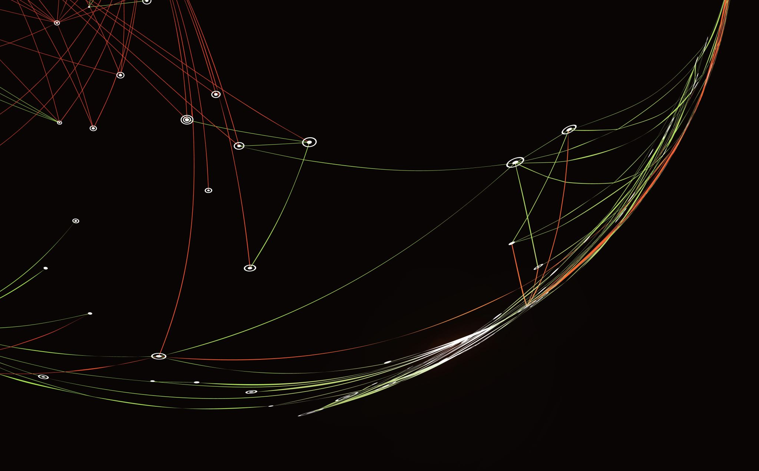
Breakout Rooms How would you explain APM2 workbook to a practice 15 minute
Notes:
Break out in Teams discuss your findings Come with one spokesperson to explain what you would say to a practice about this workbook and what does it tell them and why?

Slide 9
Review of breakout presentatons
One person from each group share
HCPF will respond
Notes:
One person from each group present summary tab data support tab shared saving chronic condition tab and the code set tab

Slide 10
Summary Tab 2024 workbook
Notes:
Araceli and Cordell presents slides 10- 19

Slide 11
Summary Tab

Slide 12
Supportive Data Tab - PMPM Data

Slide 13
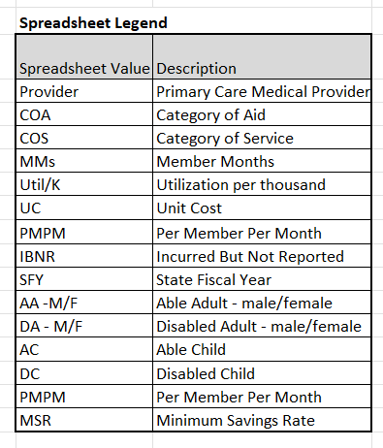
Supportive Data tab PMPM Data
Notes:
Who is included in the shared savings plan all members except those already exclude from prospective payment as in dual eligible , Geographic.

Slide 14
Supportive Data Tab PMPM Data

Slide 15
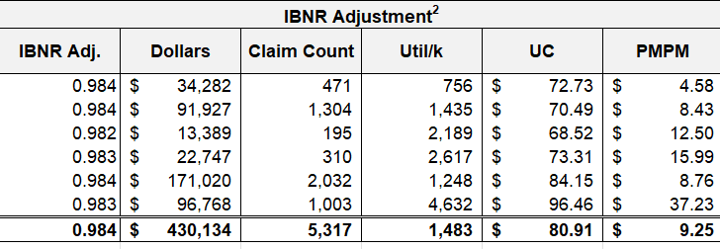
Supportive Data Tab PMPM

Slide 16
Supportive Data Tab PMPM

Slide 17
Supportive Data tab PMPM Data

Slide 18
Supportive Data tab PMPM Data

Slide 19
Supportive Data tab PMPM Data

Slide 20
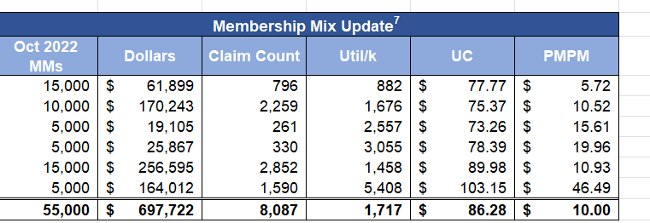
Supportive Data tab PMPM Data

Slide 21
Shared savings
Chronic Condition Threshold Tab Sample of conditions
Notes:
Who is included in the shared savings plan all members except those already exclude from prospective payment as in dual eligible , Geographic.

Slide 22
Shared savings
Chronic Condition Threshold Tab
Notes:
Who is included in the shared savings plan all members except those already exclude from prospective payment as in dual eligible , Geographic.

Slide 23
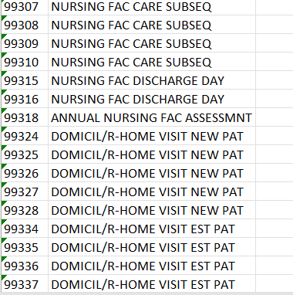
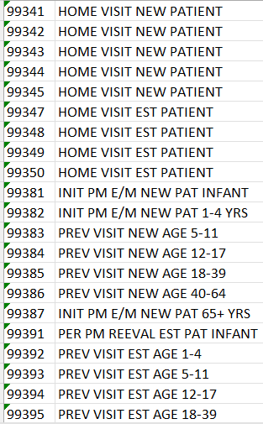
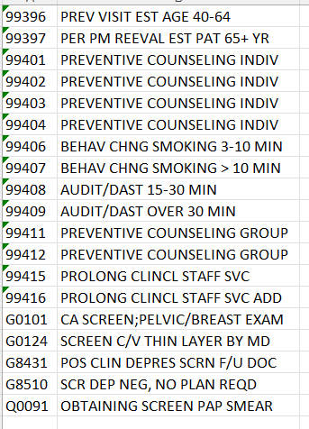
APM 2 Code Set Tab

Slide 24
Office hours with HCPF to discuss workbook
June 3rd

Slide 25
Next training session June 10th
APM2 calculator is APM2 the best APM for my practice

Slide 26
References
1. Physician-Focused Payment Model Technical Advisory Committee (PTAC) requested the development of a brief reference guide that summarizes some of the major types of payment methodologies that are typically used in Alternative Payment Models (APMs).1This analysis was prepared under contract #HHSP233201500048IHHSP23337014T between the Department of Health and Human Services’ Office of Health Policy of the Assistant Secretary for Planning and Evaluation (ASPE) and NORC at the University of Chicago. The opinions and views expressed in this analysis are those of the authors. They do not reflect the views of the Department of Health and Human Services, the contractor, or any other funding organizations. This analysis was completed on December 22, 2020.
2. PURPOSE The Health Care Payment Learning & Action Network (LAN) aims for: BETTER CARE MISSION SMARTER SPENDING HEALTHIER PEOPLE To accelerate the health care system’s transition to alternative payment models (APMs) by combining the innovation, power, and reach of the private and public sectors. OUR GOAL Adoption of Alternative Payment Model

Slide 27
Home work and class session
Every facilitator on the list is sent the workbook ahead of the meeting, sent by Wednesday May 22nd with these instructions.
Instructions:
Facilitators are encouraged to research ahead of the class session, from their own knowledge and from research on HCPF website what the HCPF APM2 workbook tells the pracice about their participation in APM2.
What does the summary page tells us what and how do they think the numbers are derived
Also, research what does the shared savings page means and how those numbers are derived.
What does the data support tab tell us how does it fit into the other tabs
How is the tab titled APM2 code set used?
At slide 8 they are broken onto teams for 10-12 minutes to discuss and agree as a team how they would explain one of thr three sections in the workbook to a pracice.
Come back to the whole group and share 10 minutes
HCPF team goes through slides 10-19 explaining the workbook conforming or correcting
The next session, APM2 calculator, wil reinforce this session.
Homework seek out practice with APM2 2024 workbook and review
Attend office hours which HCPF also needs to attend to answer your questions.

