Slide 1


Welcome RAE Practice Facilitators
Please put your name and the RAE you represent in the chat.
You can ask questions via the chat. We will monitor it as we go along. We will also pause for questions periodically. We are using AI Companion for notetaking.
These slides will be made available on the Practice Innovation Program website:
https://medschool.cuanschutz.edu/practice-innovation-program/current-initiatives/train-the-trainer/for-practice-facilitators
Notes:
Steph

Slide 2

AGENDA 5/21/2026
Overview of Upcoming Events and Opportunities
Debrief Managing Diabetes and Addressing Vaccine Hesitancy PCMP call
Prepping for June calls – Missed Opportunities for Billing and Coding for Integrated Behavioral Health
HCPF Survey re Data Tools – Month 4
Notes:
Steph

Slide 3
Upcoming PCMP Learning Community Calls
PCMP Learning Community Meetings
Second Thurs. of every month
12:00 PM-1:00 PM
NEXT meeting: 6/11/2026, 12:00-1:00
Topic: Missed Opportunities in Billing and Coding for Behavioral Health Integration
RAE PF Learning Community Meetings
Third Thurs. of every month
11:00 PM-12:00 PM
NEXT meeting: 6/18/2026, 11:00-12:00
Topic: PF Discussion on Missed Opportunities in Billing and Coding for Behavioral Health Integration
May PF Office Hours 5/28/2026
Notes:
We strongly encourage you to attend both as we will be using the PF calls to follow up on topics from the PCMP calls.

Slide 4
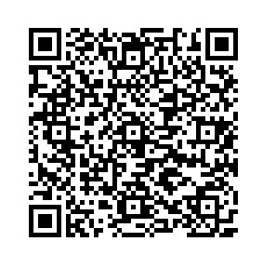
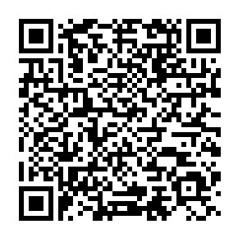
Opportunities for Individualized Support for PF, RAE teams, or PCMPs
Value Based Payment (VBP) Mentors
Mentors will work directly with practice to explore VBP topics, providing support in practice discussions and attending practice meetings as needed.
Subject Matter Experts
Consultation for clinical operations, billing, coding – Pam Ballou-Nelson
Pediatric specific coaching for Family Medicine and Pediatrics – Mindy Craig
Tactics to address ACC 3.0 Opportunities – HealthTeamWorks

Slide 5
Practice Facilitator Reflections from PCMP Diabetes Management and Addressing Vaccine Hesitancy Discussions

Slide 6
Prepping for June calls – Missed Opportunities for Billing and Coding for Integrated Behavioral Health

Slide 7
HCPF Quality Reports Monthly Survey

Slide 8
RAE PF Quality Reports Monthly Survey
Survey to help HCPF better understand how you, and the practices you support, use the ACC Phase III Primary Care Payment Program Reports that have been shared to date, which include Performance Reports for the Quality, Shared Savings, and Prospective Payment programs.
Your responses will guide improvements to future report design, usability, and practical application to better support program goals.

Slide 9
RAE PF Quality Reports Monthly Survey
Caveat: feedback on survey will not create an action item for HCPF
Use form linked below to request a data review of any of the HCPF reports:
https://app.smartsheet.com/b/form/95480a30dc194032ad17f22482f142ec

Slide 10

Survey will be shared with you following today's session to share with others in your organization.
The survey will be open for responses through 2/28/2026
This survey will be repeated monthly through June.
https://redcap.link/RAE_Monthly_Survey
Notes:
Update link to new survey

Slide 11
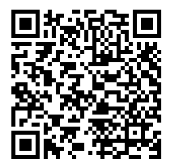
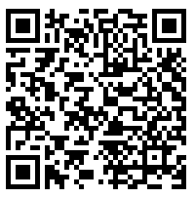
Scan to complete evaluation
https://practiceinnovationco.co1.qualtrics.com/jfe/form/SV_1FjolUm5P7y5SGG
Notes:
Update monthly

Slide 12

PIP Contacts
    Kyle Leggott, MD – Project Director
    Kyle.Leggott@cuanschutz.edu
    Allyson Gottsman, PCMP Learning Community Lead
    Allyson.Gottsman@cuanschutz.edu
Stephanie Kirchner, MSPH, RAE PF Learning Community Lead
    Stephanie.Kirchner@cuanschutz.edu
Lauren Quintana, MS - Project Manager
    Lauren.T.Quintana@cuanschutz.edu

Slide 13
THANK YOU!

