Slide 1
Non-Opioid Analgesic Medications
Rachael Rzasa Lynn, MD
26 May 2022

Slide 2
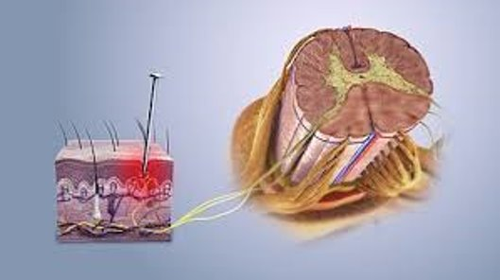
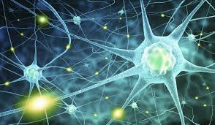
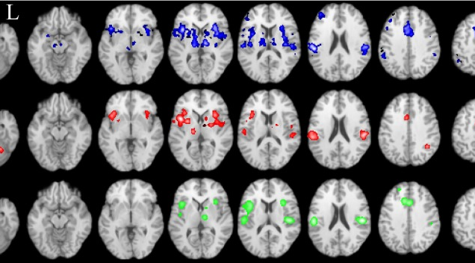
3 Types of Pain
Nociceptive Pain
Neuropathic Pain
Nociplastic Pain

Slide 3
Multimodal Pain Control
Defined as the continuous use of more than one method for controlling pain
Takes advantage of additive or synergistic effects by combining multiple agents with different mechanisms of action
Reduced side effects due to lower doses of drugs and differences in SE profiles
Kehlet H, Wilmore DW. Am J Surg. 200;183(6):630-41.
Hartrick CT, Am J Health Syst Pharm. 2004 Apr;61 Suppl 1:S4-10.

Slide 4
Pain Med Safety Precautions
Start low, go slow
Begin in the evening with lowest dose
Increase every 4-7 days if no side effects and ongoing pain
Stay at goal dose x4 weeks before declaring failure
If no improvement in function/pain relief after adequate trial, wean down by initial dose every 3 days

Slide 5
Common Non-Opioid Analgesics
Nonsteroidal anti-inflammatories (NSAID) and Cyclooxygenase-2 (COX2) Inhibitor
Anticonvulsants
Antidepressants
Skeletal Muscle Relaxants
Local Anesthetics
Capsaicin
Corticosteroids
N-methyl-D-aspartate (NMDA) receptor antagonists
Alpha-adrenergic agonists

Slide 6
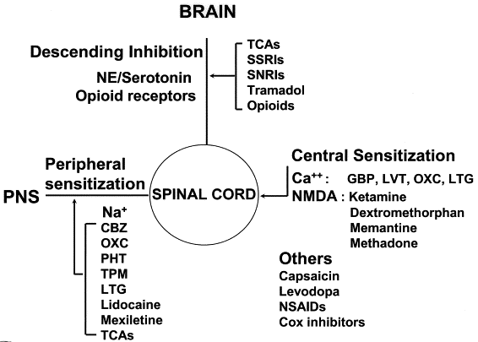
Mechanistic Stratification of Medications Used to Treat Neuropathic Pain
Fig. 4. Mechanistic stratification of antineuralgic agents. PNS = peripheral nervous system; CBZ = carbamazepine; OXC = oxcarbazepine; PHT = phenytoin; TPM = topiramate; LTG = lamotrigine; TCA = tricyclic antidepressant; NE = norepinephrine; SSRI = selective serotonin re-uptake inhibitor; SNRI = serotonin and norepinephrine re-uptake inhibitor; GBP = gabapentin; LVT = levetiracetam; NMDA = N-methyl-D-aspartate; NSAID = nonsteroidal anti-inflammatory drug.
Beydouna & Backonja M. J Pain Symptom Manage. 2003;25:S18-30

Slide 7
Non-Steroidal Anti-Inflammatory Drugs (NSAIDs)
Analgesic
Anti-inflammatory
Antipyretic
Drugs of choice for orthopedic-related pain
Opioid sparing

Slide 8
Non-Steroidal Anti-Inflammatory Drugs (NSAIDs)
Act both peripherally and centrally
  In peripheral, afferent pathway: block COX, preventing synthesis of prostaglandins
    Prevents sensitization of pain receptors after injury
  In central pathways:
    Block production of PGE2 in the spinal dorsal horn
    Activate medullary and cortical areas involved in descending inhibition
Gupta Curr Pain Headache Rep 2016

Slide 9
NSAIDS
COX1 and COX2
  ASPIRIN
  Naproxen (Naprosyn)
  Diflusinal (Dolobid)
  Ibuprofen
  Indomethacin
  Ketorolac (Toradol)
  Piroxicam (Feldene)
  Sulindac*
  Nabumetone*
  Diclofenac (Voltaren)
    Accumulates in synovial tissue
  Etodolac
  Meloxicam (Mobic)
    COX2>COX1 at lower dose
COX2
  Celebrex (Celecoxib)
Acetaminophen inhibits central PG synthesis, poor COX inhibition
*prodrug
Notes:
Specificity of COX 1 and 2 blockers is relative – No drug is 100% specific
Sulindac may cause more cholestasis than other NSAIDs
Prodrugs supposed to be gastroprotective
Diclofenac accumulates in synovial tissue
Acetaminophen: spinal cord and brain effects (TRPV1 and CB1); in inflammation there are other downstream changes including upregulation of these receptors

Slide 10
NSAIDs
Similar efficacy for nonselective NSAIDs and COX-2 inhibitors
  Formulation may matter: liquid ibuprofen faster and better analgesia than tablet
Lower NNT than APAP (3.0 v 3.9)
Gupta Curr Pain Headache Rep 2016. PAIN 107:86-90 (2004)

Slide 11
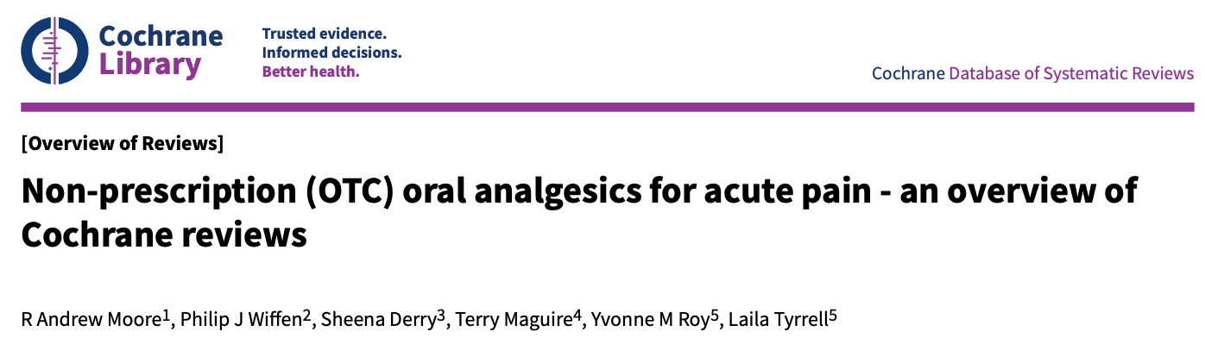
21 different OTC analgesic drugs, doses, formulations from 10 Cochrane Reviews
Postop pain model primarily 3rd molar extraction (industry model for everyday pain)
50% pain relief vs placebo
Lowest NNT values were combo of ibuprofen + paracetamol (NNT <2)
  Combinations of ibuprofen plus paracetamol worked in 7 out of 10 people
Analgesics with NNT values close to 2 included
  Fast-acting ibuprofen 200mg/400mg
  Ibuprofen 200mg + caffeine 100mg
  Diclofenac 50mg
Important finding: low doses of some medications in fast-acting formulations were best
Fewer side effects for people taking ibuprofen plus paracetamol than those taking placebo. The results for side effects may be different if the painkillers are taken for more than a few days.

Slide 12
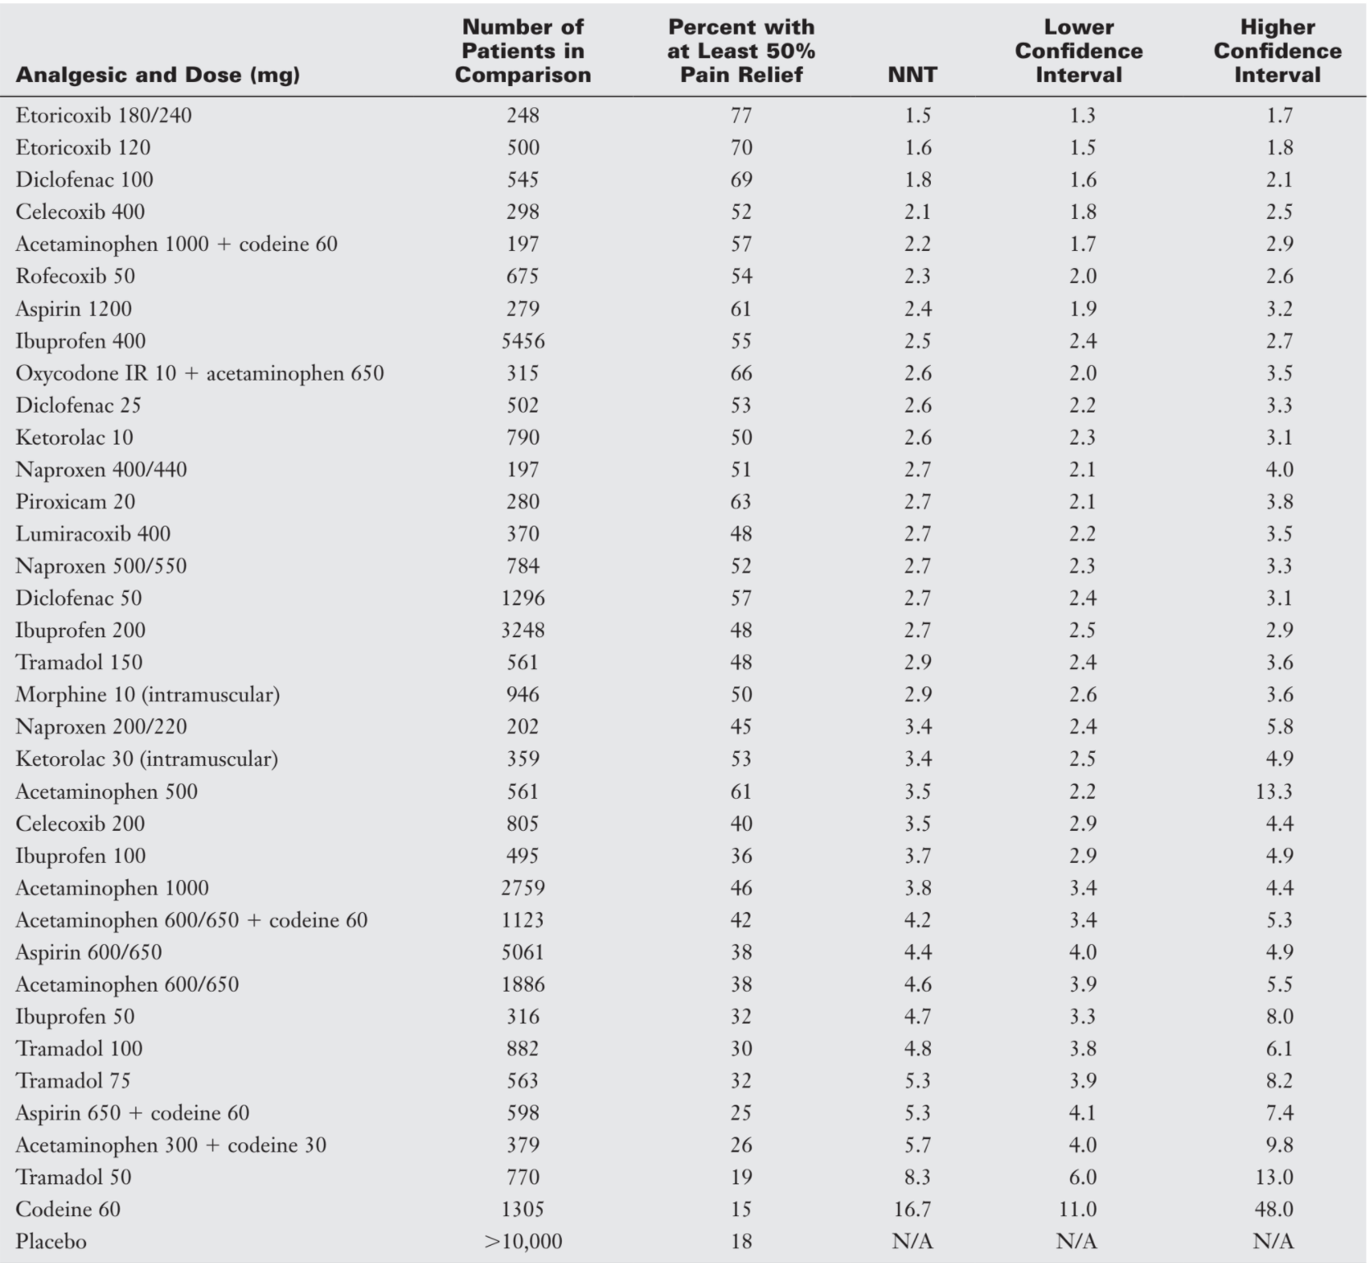
Notes:
Benzon Essentials of Pain Mgmt

Slide 13
Drug Dose (mg) NNT (95% confidence interval)
Aspirin 500 Not better than placebo
Aspirin 600/650 4.2 (3.8 to 4.6)
Aspirin 1000 4.2 (3.8 to 4.6)
Diclofenac potassium 25 2.4 (2.0 to 2.9)
Diclofenac potassium 50 2.1 (1.9 to 2.5)
Dipyrone 500 2.3 (1.9 to 3.1)
Ibuprofen acid 200 2.9 (2.7 to 3.2)
Ibuprofen acid 400 2.5 (2.4 to 2.6)
Ibuprofen fast acting 200 2.1 (1.9 to 2.4) Good ibuprofen dose choice
Ibuprofen fast acting 400 2.1 (1.9 to 2.3)
Ibuprofen + caffeine 200+100 2.1 (1.9 to 3.1)
Ibuprofen + paracetamol 200+500 1.6 (1.5 to 1.8) Best choice
Ibuprofen + paracetamol 400+1000 1.5 (1.4 to 1.7) Higher doses not much better
Naproxen 200/220 3.4 (2.4 to 5.8)
Naproxen 400/440 2.7 (2.2 to 3.5)
Naproxen 500/550 2.7 (2.3 to 3.3)
Paracetamol 500 3.5 (2.7 to 4.8) Good APAP dose choice
Paracetamol 600/650 4.6 (3.9 to 5.5)
Paracetamol 975/1000 3.6 (3.2 to 4.1)
Adapted from- Moore RA, Wiffen PJ, Derry S, Maguire T, Roy YM, Tyrrell L./ Non-prescription (OTC) oral analgesics for acute pain - an overview of Cochrane reviews./Cochrane Database of Systematic Reviews 2015, Issue 11. Art. No.: CD010794./ DOI: 10.1002/14651858.CD010794.pub2.

Slide 14

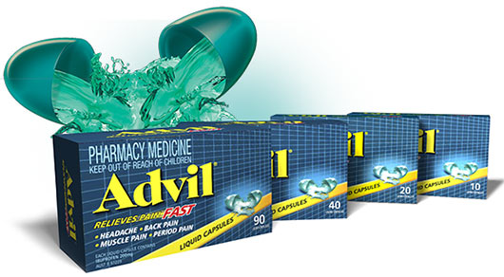
Clinical studies document greater efficacy and more rapid pain relief with ibuprofen liquid caps when compared to tablets
Lower doses of faster onset ibuprofen can be as effective as higher doses of standard formulations
Reduced need for rescue medication
Rapid onset
Advil Liquid Capsules
Postoperative Dental Pain
Formulation Dose NNT
Standard 200 2.9
Fast-acting 200 2.1
Standard 400 2.4
Fast-acting 400 1.8
Adapted from Moore et al., PAIN 155:14, 2014

Slide 15
NSAID Precautions
GI
Hepatotoxicity
Hematologic
ASA-induced asthma
Renal
  Prostaglandins minimally influence RBF or GFR in normal healthy individuals BUT oppose renal vasoconstriction in hypovolemia, CHF, cirrhosis
Cardiovascular
Notes:
APAP and liver: adult dose to produce severe damage is 150-250mg/kg
Rare hepatic injury with NSAIDs (Hyllested 2002 – update?)

Slide 16
NSAIDs-Side Effects
Least to most cardiovascular risk: Naproxen, Diclofenac, COX-2 inhibitors, Ibuprofen
  Naproxen has most COX-1 inhibition (at high doses similar to ASA)
  Risk of hospitalization for heart failure doubled by tx with any NSAID
  COX-2 inhibitors: no platelet effects
Bhala N, et al. Lancet 2013; 382: 769–79
Notes:
Annual absolute effects per 1000 of coxibs and tNSAIDs at different baseline risks of major vascular events and upper gastrointestinal complications.

Slide 17
Anticonvulsants
Very useful for burning pain, dysethesias
  Phenytoin no longer used 2/2 mixed results and AEs
Decision on which to use is based on patient specific variables, co-morbidities and side effect profile of the individual drugs
Therapeutic ranges similar to those used for the treatment of seizures
  One of the most common reasons for treatment failure is subtherapeutic dose and inadequate trial duration
    EXPECTATIONS: slow to achieve maximum effect (up to 8 weeks for gabapentin given titration) → Minimum trial 8-12 weeks

Slide 18
Anticonvulsants
Mechanisms of Action:
  Stabilize the nerve membrane
    Calcium channel blocker (gabapentin, pregabalin)
  Prevent depolarization
    Increase synthesis of gamma aminobutyric acid (GABA) (VPA) or its binding to a receptor in the brain (topiramate)
    Alter voltage-gated sodium channel currents (carbamazepine, oxcarbazepine, zonisamide)
  Block transmission of pain impulses
    Glutamate modulation (pregabalin) or NMDA antagonism (topiramate)

Slide 19
Anticonvulsants
Almost all are well absorbed (80-100%) PO
Most anticonvulsants primarily cleared via hepatic metabolism, low extraction (subject to alterations in CYP)
  many have active metabolites also cleared by liver
  Many older antisz are INDUCERS of CYPs
  Plasma clearance is slow, some t1/2 > 12 hrs
Gabapentinoids and topiramate primarily renal clearance

Slide 20
Gabapentin
Good evidence for neuropathic pain
  2017 Cochrane Review: 37 studies
  Well-tolerated:
    NNH any adverse event: 7.5, for study withdrawal: 30
    Dizziness, somnolence, gait disturbance, peripheral edema
  No difference in serious adverse events
Not much evidence for fibromyalgia
  2017 Cochrane Review: one study, found 49% achieved 30% pain reduction vs 31% placebo but PGIC “better” achieved by 91% vs 47% placebo
Pain Condition | Outcome | Daily Dose | NNT
PHN | 30% pain reduction | ≥1200mg | 4.8 (6.7 for 50%)
DPN | 30% pain reduction | ≥1200mg | 6.6 (same for 50%)
Cochrane Database Syst Rev. 2017 Jun 9;6(6) Cochrane Database Syst Rev. 2017 Jan 3;1(1)

Slide 21
Pregabalin
Good evidence for neuropathic pain
  2019 Cochrane Review, 45 studies (PDN>>PHN>mixed)
  No difference serious adverse events but more somnolence, dizziness
Pain Condition | Outcome | Daily Dose | NNTB
PHN | 30% pain reduction | 300mg/600mg | 3.9/2.7
DPN | 30% pain reduction | 300mg/600mg | 22/9.6
DPN | PGIC much/very much improved | 300mg | 4.9
Mixed NP | 30% pain reduction | 600mg | 8.2 (7.2 for 50%)
Central NP | 30% pain reduction | 600mg | 5.9
HIV neuropathy |  | 600mg | no benefit
back pain, sciatica, NP cancer pain |  |  | ltd evidence of benefit
Cochrane Database Syst Rev. 2019 Jan 23;1(1)
Notes:
1 study of back pain, 1 polyneuropthy, 2 cancer (only 160 participants)

Slide 22
Anticonvulsants:
Dosing and Additional Benefits
Anticonvulsant | Starting Dose (QHS) | Goal Dose/ Max Daily Dose | Additional Benefits
Gabapentin⌃⌃ (Neurontin) | 300mg | 600mg TID/3600mg | Anxiolysis
Pregabalin⌃⌃ (Lyrica) | 50-75mg | 150mg BID/600mg | Anxiolysis
Topiramate⌃ (Topamax) | 25mg | 50mg BID/200mg | Weight loss, nightmares?
Oxcarbazepine⌃ (Trileptal) | 150mg | 300mg BID/1200mg | Fewer side effects than carbamazepine
Carbamazepine (Tegretol) | 100mg | 200mg BID/1200mg | Bipolar *monitor levels
Valproic Acid (Depakote) | 125mg | 250mg BID/1000mg | Anti-panic, bipolar
Zonisamide (Zonegran) | 100mg | 200 mg/400 mg/day | Bipolar ⬆Dose q2 wk
⌃=renal impairment: start at ½ and titrate slowly; ⌃⌃see package insert for renal dosing
Notes:
Serum CBZ levels should be measured initially at three, six, and nine weeks, with a goal level of 4 to 12 mcg/mL
Zonisamide: GFR>50→ no adjustments (go slow); GFR <50 mL/minute: Use is not recommended
Lamotrigine (lamictal) 25-50mg starting then BID and increasing q2 weeks; caution Stevens Johnsons;

Slide 23
Tricyclic Antidepressants
First line for neuropathic pain
  EXPECTATIONS: slow onset (days to weeks) = 8-12 weeks for adequate trial
    Initiate Amitriptyline 10 - 25 mg QHS; titrate slowly Q5 days
  Less expensive than gabapentin
Relieve nerve pain
  block the reuptake of serotonin and norepinephrine, which are released by the pain modulatory systems that descend from the brain stem to the spinal cord
    → accumulation of serotonin and norepinephrine at the synapse inhibits pain impulse transmission
  NNT for neuropathic pain: 2-3
  additional benefit in reducing anxiety and depression
Saarto, 2010) Pain 132 (2007) 237–251. J Neurol Neurosurg Psychiatry 2010;81:1372e1373. doi:10.1136
Notes:
5HT also reported with VPA, carbamazepine, amphetamines, meperidine, ergot derivatives, fentanyl, Li++
ADRs: MC= orthostasis (2/2 alpha-adrenergic blockade), also various arryhthmias, decreased sz threshold

Slide 24
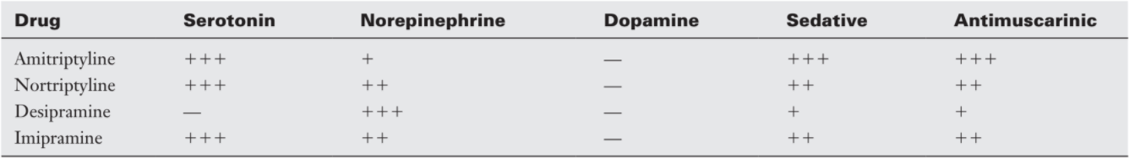
Tricyclic Antidepressants
Limited by side effects
  Sedation, orthstatic hypotension, anticholinergic effects (dry mouth, obstipation, cardiac arrythmias, urinary retention)
Most have similar efficacy → Select less anticholinergic
  Nortriptyline (less hypotension), desipramine a.m. or early p.m. as it may increase insomnia (elderly)
Pringsheim T et al. Can J Neurol Sci, 2012, 39(2 Suppl 2):S1-59.
Notes:
Trazodone (Desyrel) not a TCA but has some of the same activity

Slide 25
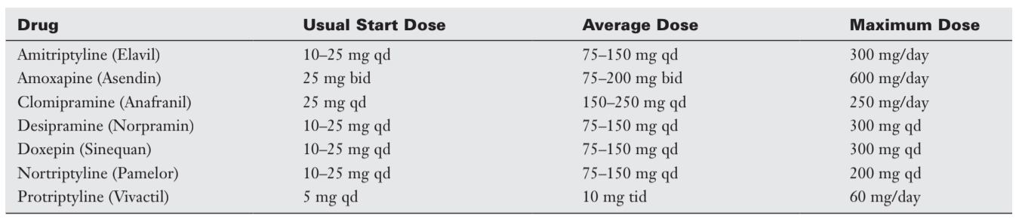
Tricyclic Antidepressants
Caution with other CNS depressants, serotonergic medications
  Tramadol, muscle relaxants (cyclobenzaprine), SSRIs, etc.
  Also caution with CYP450 2D6 inhibitors (cimetidine, diphenhydramine, methylphenidate, fluoxetine, duloxetine, amiodarone)
Metabolized by liver, excreted in urine and feces
Pringsheim T et al. Can J Neurol Sci, 2012, 39(2 Suppl 2):S1-59.

Slide 26
Antidepressants – Selective Serotonin Reuptake Inhibitors
  Fewer side effects than tricyclics.
  Not as effective in relieving nerve pain
    May have some benefit in fibromyalgia if not responsive to other treatments
  Serotonin-Norepinephrine Reuptake Inhibitors (SNRIs)
    duloxetine, milnacipran both well-studied; less data to support the use of venlafaxine, desvenlafaxine
    Like TCAs, require 8-12 weeks at target dose for adequate trial
    NNT 6.4, NNH 11.8
Saarto T, Wiffen PJ. J Neurol Neurosurg Psychiatry. 2010;81(12):1372. Finnerup NB, Attal N, Haroutounian S, et al. Lancet Neurol 2015;14(2):162-173.
Notes:
No good evidence for SSRIs or SNRIs for tension HA nor migraine HA ppx:
Cochrane Database Syst Rev. 2015 May 1;5:CD011681. [Epub ahead of print]
Selective serotonin reuptake inhibitors (SSRIs) and serotonin-norepinephrine reuptake inhibitors (SNRIs) for the prevention of tension-type headache in adults.
Banzi R1, Cusi C, Randazzo C, Sterzi R, Tedesco D, Moja L.
Cochrane Database Syst Rev. 2015 Apr 1;4:CD002919. doi: 10.1002/14651858.CD002919.pub3.
Selective serotonin reuptake inhibitors (SSRIs) and serotonin-norepinephrine reuptake inhibitors (SNRIs) for the prevention of migraine in adults.
Banzi R1, Cusi C, Randazzo C, Sterzi R, Tedesco D, Moja L.

Slide 27
SNRIs
Medication | Adverse Effects, Contraindications | 5HT:NE selectivity
Milnacipran (Savella®) | nausea and vomiting, headache, dizziness, insomnia, and palpitations Avoid if hx serotonin syndrome or NMS, uncontrolled HTN, szs or liver dz | n/a
Duloxetine (Cymbalta®) | Nausea, dry mouth, constipation, loss of appetite, fatigue, drowsiness, sweating | 9
Desvenlafaxine (Pristiq®) | ⬆ By 50mg Q 2-4 wks to 100mg QD | 85
Venlafaxine (Effexor XR ®) | Hypertension, also orthostatic hypotension, increased QTc, mydriasis, anxiety, nervousness, insomnia, and weight loss Caution with narrow-angle glaucoma, liver disease, or renal impairment | 115-120
Amitriptyline Nortriptyline |  | 8 0.24
Curr Pain Headache Rep (2019) 23:66. Pain (2007) 132:237–251

Slide 28
SNRI Dosing
Medication | Starting Dose | Titration & Therapeutic Dose | Maximum dose
Milnacipran (Savella®) | 12.5 mg QD | Gradual to 50mg BID by day 7 | 100mg BID
Duloxetine (Cymbalta®) | 30 mg QD | X 2wk then 60mg QD Avoid w/ hepatic impair. Decrease dose in severe renal dz | 60mg BID*
Desvenlafaxine (Pristiq®) | 50mg | By 50mg Q 2-4 wks to 100mg QD Decrease dose in renal dz | 400mg QD
Venlafaxine (Effexor XR ®) | 37.5 mg QD | X 1 wk then 75mg; ⬆ by 75mg Q1-2 wks to 75mg BID Decrease dose in hepatic or renal dz | 375mg total daily
Pain 132 (2007) 237–251

Slide 29
N-methyl-D-aspartate Receptor Antagonist
Blocks excitatory receptor in the spinal cord thought to be involved in the development of central sensitization and the wind-up phenomenon (due to either persistent nociceptor activation or chronic opioid administration)
Classic antagonist:
  Ketamine:
    Oral: start 25-50 mg TID with meals, titrate to 100 mg tid, max 1000mg daily
    Topical: 10% ointment to affected area tid-qid
Notes:
PO ketamine: CO’s CURE https://cha.com/wp-content/uploads/2019/09/M3_Oral-Ketamine-Tip-Sheet.pdf

Slide 30
N-methyl-D-aspartate Receptor Antagonist
  Methadone
  Memantine (Namenda) 5-10 mg bid (max 40 mg bid)
  Amantadine 400 mg: start 100 mg bid
  Magnesium: Magnesium citrate 300mg/day

Slide 31
ALPHA-ADRENERGICS
Receptors found pre and post-synaptically
  Mechanisms: decrease calcium conductance, increase potassium conductance, reduce sympathetic outflow, increase acetylcholine levels at the dorsal horn
  Clonidine: 0.1 mg -0.3mg/day patch or 0.1% gel
    NNTB for 30% reduction in DPN = 8.33 (95% CI 4.3 to 50)
  Tizanidine: start 2-4 mg qhs, then bid-qid prn up to 36 mg/day

Slide 32
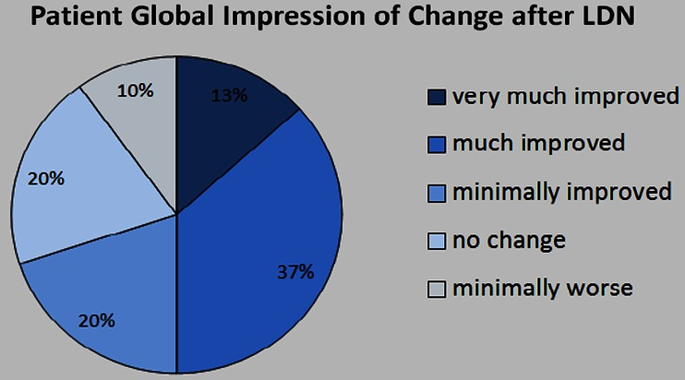
Low-Dose Naltrexone
Glial-cell modulator
  May reverse hyperalgesia due to opioid use, other central sensitization
  Anti-inflammatory: elevated ESR correlates to better treatment response in fibromyalgia
Dose: 4.5mg QHS
    Compounded
Side effects: Nausea, vivid dreams, headache
Younger et al. Clin Rheumatol 2014; 33(4): 451-459
Younger et al. Clin Rheumatol 2014; 33(4): 451-459 Younger J et al. Arthritis Rheum. 2013;65(2):529-38.
Notes:
n=29, assessed daily over 12 weeks with 4 week followup

Slide 33
Some Bad News…
AHRQ comparative review 2020 of nonopioid pharmacologic agents for chronic pain
  Considered pain and function, also QoL, AEs
Included 185 RCTs and 5 systematic reviews
Evaluated short term (1-<6 months), intermediate (6 to <12 months), long term (≥12 months)
McDonagh MS, Selph SS, Buckley DI, et al.]. Agency for Healthcare Research and Quality (US); 2020 Apr. (Comparative Effectiveness Review, No. 228.)
Notes:
Agency for Healthcare Research and Quality

Slide 34
“In the short term, anticonvulsants (pregabalin, gabapentin, and oxcarbazepine for neuropathic pain, pregabalin/gabapentin for fibromyalgia), SNRI antidepressants (duloxetine for neuropathic pain, fibromyalgia, osteoarthritis, and low back pain, milnacipran for fibromyalgia), and NSAIDs (for osteoarthritis and inflammatory arthritis) were associated with mostly small improvements (e.g., 5 to 20 points on a 0 to 100 scale) in pain and function. Function was not found to be improved with duloxetine for low back pain or pregabalin/gabapentin for neuropathic pain.”

Slide 35
“1 RCT showed memantine moderately improved pain, function, and quality of life in patients with fibromyalgia” in the intermediate term.
“Other drugs studied, including acetaminophen (osteoarthritis), capsaicin (neuropathic pain), cannabis (neuropathic pain), amitriptyline (fibromyalgia, neuropathic pain), and cyclobenzaprine (fibromyalgia) had no clear effects.”
“Withdrawal from study due to adverse events was significantly increased with nonopioid drugs, with the greatest increase over placebo seen with cannabis.”

Slide 36
Placebo in Chronic Pain
Overall, placebo response increasing in trials of neuropathic pain in the US in recent years, though drug responses have remained stable → more “negative” trials
  Increased study size, length associated with more placebo
Pain (2015) 156:2616-2626

Slide 37

Placebo: Definition
Many meanings
  Latin: “I will please”
Neutral, inert, inactive treatment provided as if it is biologically active treatment
  Yet placebo is NOT physiologically inert!
  NOT equivalent to no treatment
    Affects physical, not just psychological functions
    Response to placebo does NOT differentiate between organic and mental disease
Eur Neuropsychopharm 24:333-341
Notes:
Most current knowledge based upon placebo analgesia

Slide 38
Placebo is everywhere
Psychological disorders
  Depression, ADHD
Atopic problems
  Asthma
  Dermatitis
  Conjunctivitis
Epilepsy
Autism
HTN
Syncope
More pronounced for patient-reported outcomes but still seen in biomarkers
Verbal instructions can alter visceral function
  Organ specific:
  Gastric activity
  Lung function in asthmatics
  Blood pressure and heart rate
  Coronary blood flow independent of HR and BP!
Response rate varies with condition
  Important to differentiate not the fraction of patients who had any pain relief but rather the degree of relief
  The same individual my have a different response to different placebos = no generic “placebo responder”
Notes:
Approximately 41% of children with abdominal pain-related functional gastrointestinal disorders improve on placebo. Several trial characteristics are correlated significantly with the proportion of patients with no pain on placebo and with the magnitude of the placebo response on Faces Pain Scales (region, randomization, female). J Pediatr. 2017 Mar;182:155-163.
Br J Anaesth . 2019 Aug;123(2):e254-e262
J Neurosci 2012; Pain 155:2229-2235
Schedlowski M et al. Pharmacol Rev 67:697–730, July 2015

Slide 39
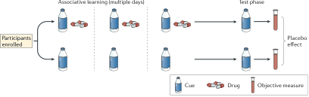
“Objective” Placebo Response
Demonstrated placebo responses have included:
  autonomic effects (skin conductance, pupil diameter, EEG, etc.
  Neuroendocrine effects (cortisol levels, norepi)
  Immune responses
    Paired taste cues with immunosuppressive drugs during conditioning phase. When later given the taste cue alone, immune response (esp T-cells and release of IL-2 and IFN-γ) reduced in both humans and rodents
Nat Rev Neurosci 2015; 16: 403-418

Slide 40
Placebo effects produced by
Verbal instructions
Suggestion of expectation, recall of previous experiences
For pain, greater expectation of analgesia = greater relief
Conditioning
Stronger effects than verbal suggestions alone
Placebo effects mimic those of drug used for conditioning (DA-agonist, BZD and BZD-antagonist, immunosuppressant)
Social observation
Effects comparable to experiencing benefit directly
Interpersonal interactions
Br J Anaesth . 2019 Aug;123(2):e254-e262
Notes:
Expectation = relief: told “powerful pain killer” have more relief that told “may be a pain killer or placebo”. Br J Anaesth . 2019 Aug;123(2):e254-e262

Slide 41

Expectations
Directly mediate placebo
Critical to placebo: when subjects attribute pain relief to source other than placebo, no analgesia obtained
  Can block conditioned placebo response with verbal suggestions of hyperalgesia
Belief in placebo is critical to its efficacy
Notes:
active acupuncture shows no effect over placebo acupuncture when data are analysed according to actual treatment allocation. Yet, when data are analysed according to perceived treatment allocation, the patients who believe they received active acupuncture experienced significantly more pain relief as compared with those who believed they received placebo acupuncture. Br J Anaesth . 2019 Aug;123(2):e254-e262

Slide 42
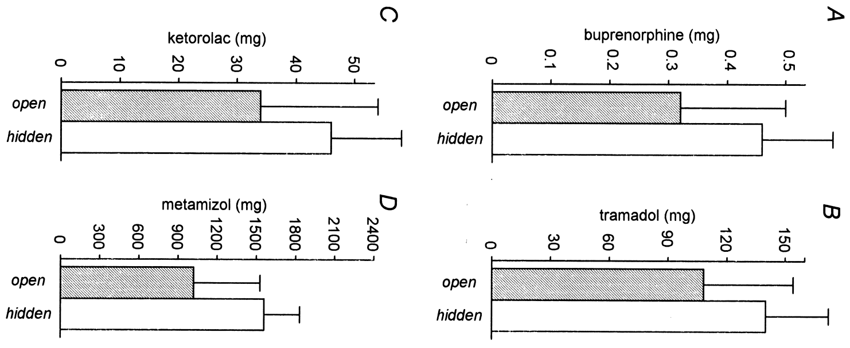
Analgesic Efficacy and Expectations
AD50 (analgesic dose for 50% pain reduction in each patient)
Pain (2001) 90:205-215
Notes:
AD(50) = Analgesic dose for 50% pain reduction in each patient – this is lower when open treatment
Opioid mediated: when naloxone given with open injection of ketorolac, efficacy for relieving experimental ischemic arm pain disappeared
Amanzio (2001) Pain 90:205-215

Slide 43
Open-label Placebo
Some have found that placebos lose their power when patients are aware of the placebo (Klinger, 2017)
Many others have found that placebo is effective even when patients are fully aware of it
Carvalho et al (2016) provided patients with chronic low back pain pills for 3 weeks openly as placebos
Patients were educated about benefits of placebo
Explanation of rationale to patients may be critical to the efficacy of open-label placebo (Locher, 2017)
Placebo-treated patients experienced 30% improvement in pain and disability after 3 weeks
Even those not initially treated with placebo experienced benefit in open-label cross-over
Klinger et al. Pain (2017) 158: 1893-1902. Carvalho et al. Pain (2016) 157: 2766-2772. Locher et al (2017) Pain (PAP).
Notes:
Klinger: other findings: stronger response with conditioning (varied stimulus intensity during conditioning phase) and results were independent of patients’ opioid use

Slide 44
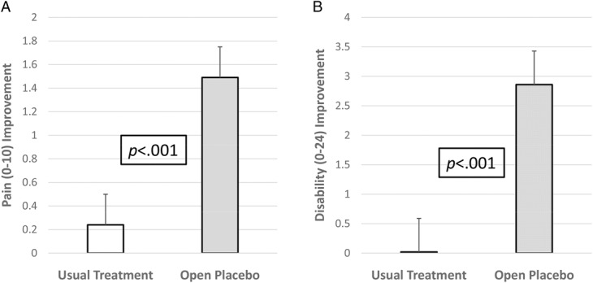
Open-label Placebo
Klinger et al. Pain (2017) 158: 1893-1902. Carvalho et al. Pain (2016) 157: 2766-2772. Locher et al (2017) Pain (PAP).

