Slide 1
Medications for alcohol use disorder
David Mendez MD FASAM
Addiction Medicine

Slide 2
CDC:
  52.8% of adults over 18 regularly consume alcohol
    10% of adults over 18 with AUD in past year
    <10% of adults with AUD report treatment
  Alcohol associated liver deaths: 30,910
  Alcohol induced deaths: 51,191

Slide 3
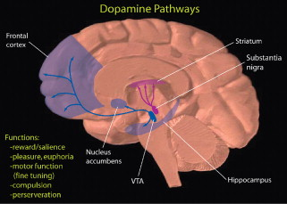
Basics of addiction
Mesolimbic pathway
  VTA -> nucleus accumbens, amygdala, hippocampus
Dopamine
Endocannabinoid system
Endogenous opioid system

Slide 4
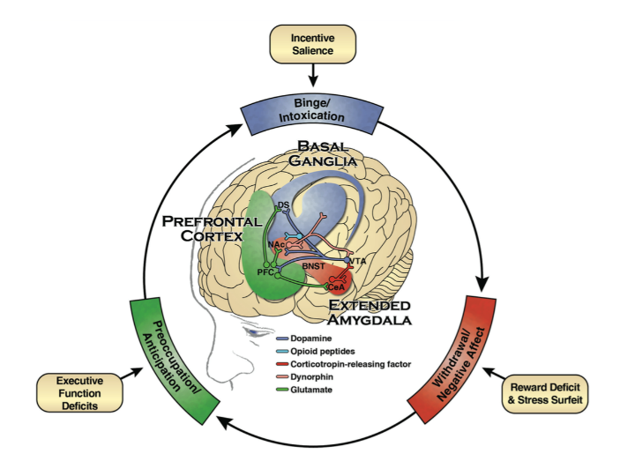
Cycle of addiction

Slide 5
Diagnosis of a substance use disorder
Impaired control
Used in larger amounts or longer than intended
Social impairment
Risky use
Pharmacological properties
Unsuccessful efforts to cut back
Excessive amount of time obtaining or using
Craving
Failure to fulfill work/school/home obligation
Persistent social or interpersonal problems
Reduced or given up social, occupation or recreational activities
Using in physical hazardous situations
Persistent use despite physical or psychological problems
Tolerance
Withdrawal

Slide 6


Naltrexone
  Mu opioid receptor antagonist
  Decrease in cravings and heavy drinking days
  XR: vivitrol
  Do not use in decompensated cirrhosis or severe alc hep
  Sinclair method

Slide 7

Acamprosate
  Modulates glutamate receptors; increases GABA-ergic system and decrease glutamate
  May be helpful with PAWS
  TID dosing
  Dose adjustment with GFR 30-50 (333mg TID); avoid in <30

Slide 8
Gabapentin
Binds to voltage gated calcium channels and modulates release of excitatory neurotransmitters
May be helpful with PAWS and anxiety
TID dosing

Slide 9
Antabuse
  Blocks breakdown of acetaldehyde
  Avoid in liver disease
  May be used intermittently during high risk situations

Slide 10
Semaglutide
  GLP1 agonist
  Some data suggesting decrease in cravings and consumption of alcohol

Slide 11
Harm reduction
Motivational interviewing
Daily vitamin
Glass of water between beverages
Three daily meals

