Slide 1
Benefits of MOUD in outpatient and carceral settings
JK Costello, Director of Behavioral Health Consulting
jkcostello@
steadmangroup.com
Notes:
Intro self

Slide 2
Benefits of MOUDs in outpatient and carceral settings
Learners will:
Describe the nonfinancial benefits of such medications in both settings
Describe the financial costs and benefits of medications for opioid use disorder in both outpatient and carceral settings
Understand recent trends in opioid use and treatment from clinical, legal and regulatory angles
Notes:
Describe my background on MOUD in community and carceral settings
Outline: Treatment and prevalence updates, followed by legal/regulatory, financial, community, then corrections.

Slide 3
MOUD Updates: Use and Treatment
OUD prevalence trending upward
2016, 0.8% (NSDUH)
2021, 2.0%
Localized estimates are far higher in some places (Barocas et al)
MA, 4.6%, 2015
KY, 5.9%, 2019; 17.7% in some counties
Notes:
Lack of data on prevalence– concentrates in jails

Slide 4
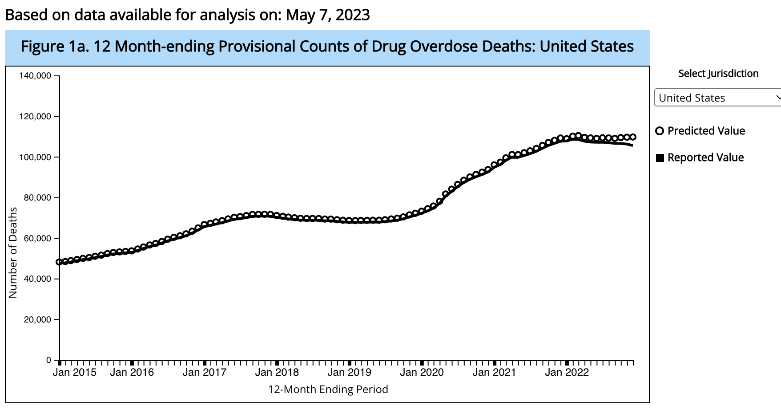
MOUD Updates: Use and Treatment
Notes:
Plateau is not good!!! Keep the pressure on!

Slide 5
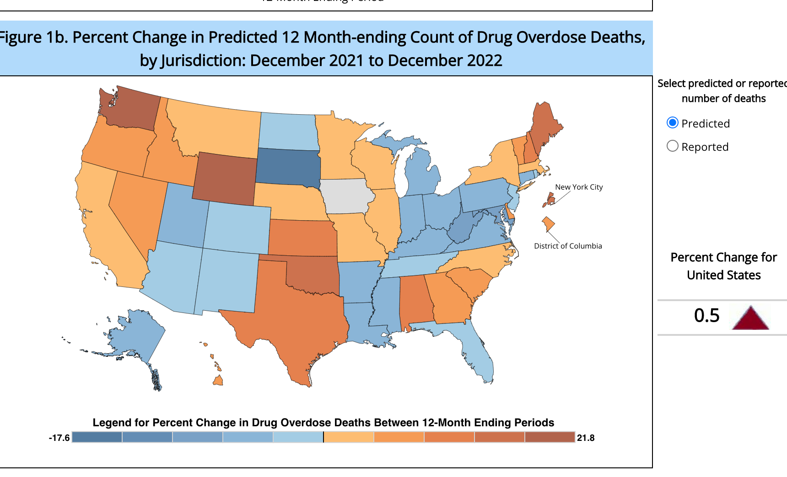
MOUD Updates: Use and Treatment
Notes:
Note regions where it it’s decreased– highest OD areas

Slide 6
MOUD Updates: Use and Treatment
Moderate changes in MOUD options 2020-2023
OTPs more flexible in dosing, staffing
Increases in # OTPs
New injectable options for buprenorphine
Naloxone now OTC, two new options for meds
Notes:
Go into depth on this. Note that there are similar changes on p. 9

Slide 7
MOUD Updates: Use and Treatment
Treatment trending upward? Conflicting findings.
In 2019, 1.7M people used buprenorphine as prescribed
AATOD stated 513,000 in OTP settings alone in 2021
47.3% of people who received treatment for illicit SUD were through telehealth
0.4% of the general population received MOUD in 2021
22.1% of the people with OUD

Slide 8
MOUD Updates: Use and Treatment
Still major gaps in general SUD treatment!
91.6% of people who needed treatment did not get specialty treatment
Vast majority of those people (95.7%) did not see a need for treatment
29% of people with illicit SUD received treatment in 2021
Outpatient
Self-Help
Hispanic people (0.6%) only half as likely to receive specialty SUD treatment

Slide 9
MOUD Updates: Legal/Regulatory
Major changes in prescribing/dispensing landscape
X-waiver gone
OTPs
Greater dosing flexibility
More discretion for takeaways
Telehealth: Can still prescribe first time through telehealth

Slide 10
MOUD Updates: Legal/Regulatory
DOJ guidance explicitly warned against institutional bans on particular medication (buprenorphine in this case)
Long-term residential recovery
Employee health programs
Drug courts
Jails
Colorado recently mandated OUD screening, treatment plan, naloxone, care coordination for people in jail
Notes:
Go into great depth on this.

Slide 11
MOUD Updates: Legal/Regulatory
There have now been several (dozens?) of lawsuits regarding MOUD in jail
Death or injury
Injunctions in MA, ME, NM, NY
County, state, federal
Notes:
This should not be a lead, but definitely mention this!!!!

Slide 12
MOUD Financial Benefits
Program name | Total benefits | Costs | Benefit to cost ratio
Methadone maintenance for OUD | $9,124 | -$3,962 | $2.30
Buprenorphine maintenance treatment for OUD | $8,645 | -$4,859 | $1.78
Injectable naltrexone for opiates | -$1,040 | -$17,406 | -$0.06
Injectable naltrexone for alcohol | -$7,814 | -$17,406 | -$0.45

Slide 13
MOUD Financial Benefits: Community
In primary care, “compared with the status quo, buprenorphine and harm reduction kits reduced drug use–related mortality by 33% and was cost-effective.” (Jawa 2023)
A simulation model suggested that hospital-based buprenorphine and harm reduction would reduce overdoses at $7600 to $14300 per QALY (Barocas (2022)

Slide 14
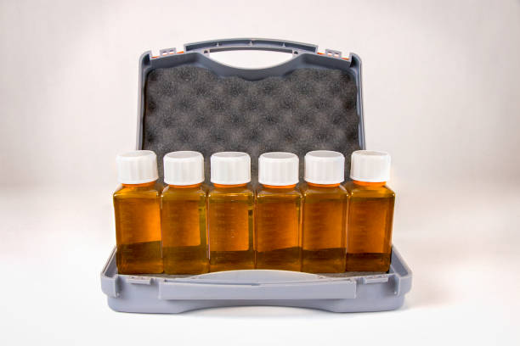
MOUD Financial Benefits: Community
Canadian study suggested that methadone dominates buprenorphine (Enns 2023)
A large national study showed that initial outpatient management was associated with far lower costs (LaRochelle 2020)

Slide 15
MOUD Financial Benefits: Corrections
Recent Massachusetts study (Chatterjee 2023) suggested that comprehensive 3-drug correctional MOUD program vs. naltrexone-only
Increase quality-adjusted years of life
Cost less
Horn (2020) showed that methadone maintenance therapy cost about $23 per day of incarceration avoided
A large Australian study demonstrated that all-in costs are lower for people released with buprenorphine

Slide 16
MOUD Financial Benefits: Community
Canadian study suggested that methadone dominates buprenorphine (Enns 2023)
A large national study showed that initial outpatient management was associated with far lower costs (LaRochelle 2020)

Slide 17
MOUD Nonfinancial Benefits: Community
Wakeman et al (2019) showed that, in community settings, ONLY methadone and buprenorphine reduced
Serious opioid-related acute care
Overdose at three months
Fairley (2021) showed that MOUD reduce overdoses, and work better when combined with OEND and psychotherapy.
Naltrexone was a dominated strategy
Samples (2020) suggests that longer-term treatment associated with massive declines in ED, inpt utilization, OD

Slide 18
MOUD Nonfinancial Benefits: Corrections
In jail/prison, Green et al (2018) showed a 60.5% reduction in fatal overdoses for people leaving incarceration after implementation a statewide program
An far larger Australian study showed a similar (0.3% vs. 0.7%) decrease in fatal overdoses for treatment (buprenorphine on release) vs. control
Also in Massachusetts, individuals who received buprenorphine had 20% lower recidivism and rearraignment rates than a comparable group that didn’t (Evans 2022)

Slide 19
Thank you for being attentive!
JK Costello, Director of Behavioral Health Consulting
jkcostello@steadmangroup.com

