Slide 1
CDC Clinical Practice Guideline
for Prescribing Opioids for Pain
Ally Costello MD, MBA
Allison.Costello@cuanschutz.edu
Department of Family Medicine
David Mendez
Addiction Medicine
Department of Family Medicine

Slide 2
5 Guiding Principles
Appropriate treatment of pain
Flexibility
Multimodal and Multidisciplinary
Avoid misapplication of guideline beyond intended use
Vigilance to health inequities
Notes:
The appropriate treatment of pain
Flexibility to meet the care needs and clinical circumstances of each patient
A multimodal and multidisciplinary approach to pain management
Avoiding misapplication of clinical practice guideline beyond its intended use
Vigilance in attending to health inequities and ensuring access to appropriate, affordable, diversified, coordinated, and effective nonpharmacologic and pharmacologic pain treatment for all persons

Slide 3
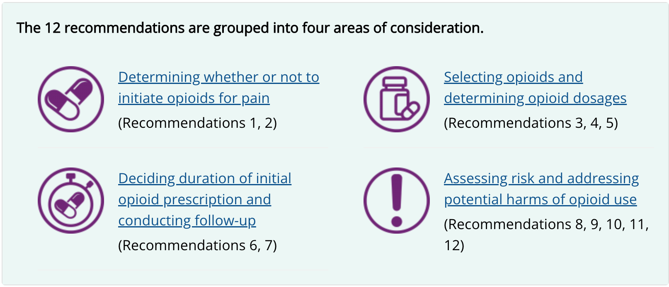

Slide 4
Key additions
Acute Pain (<1 mo)
Non-opioid pharmacologics are at least as effective as opioids
Opioids still recommended for trauma/invasive surgery, or when NSAIDs are contraindicated
Subacute Pain (1-3 mo)
Serves as a key time for reassessment of opioid needs to avoid inadvertent continuation

Slide 5
Key changes
Expanding scope from PCPs to all outpatient clinicians
Separating out initial therapy vs continued therapy
Discussion on opioid tapering.
Recommendations regarding opioid dosages
Expanding recommendations for non-opioid pain relief therapies
Use of urine toxicology testing

Slide 6
Recommendation 1: Non-opioid therapies are at least as effective as opioids for many common types of acute pain

Slide 7
Recommendation 1: Non-opioid therapies are at least as effective as opioids for many common types of acute pain
Maximize use of nonpharmacologic and nonopioid pharmacologic therapies
Minimize opioid use for both opioid naive and tolerant patients

Slide 8
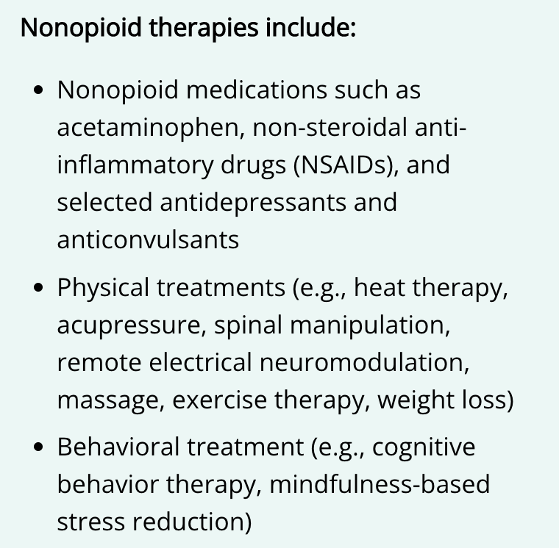
Recommendation 1: Non-opioid therapies are at least as effective as opioids for many common types of acute pain

Slide 9
Recommendation 2: Non-opioid therapies are preferred for subacute and chronic pain

Slide 10
Recommendation 2: Non-opioid therapies are preferred for subacute and chronic pain
Maximize use of nonpharmacologic and nonopioid pharmacologic therapies
Discuss realistic benefits and known risks of opioid therapy
Establish treatment goals for pain and function (PEG tool, AAFP pain assessment toolkit )
Consider how opioids will be discontinued if benefits do not outweigh the risks
Notes:
Patients should not be required to sequentially fail non-pharmaceutical and non-opioid treatments before starting opioids

Slide 11
Recommendation 2: Non-opioid therapies are preferred for subacute and chronic pain
Review all low-cost pain management options
Walking, public recreation facilities, physical therapy
Not all non-invasive modalities are covered by insurance
Consider interventional pain options
Consider multimodal pain control (medications, interventional, CBT)
Notes:
Evidence for non-opioid therapies are also limited, but the risks are not there

Slide 12
Recommendation 3: When starting opioid therapy, clinicians should prescribe immediate-release opioids instead of extended-release and long-acting opioids

Slide 13
Recommendation 3: When starting opioid therapy, clinicians should prescribe immediate-release opioids instead of extended-release and long-acting opioids
Acute pain should not be treated with ER/LA opioids
ER/LA opioids should only be considered after >1wk treatment with IR medications
ER/LA opioids should only be used for chronic treatment

Slide 14
Recommendation 4: When initiating opioids for opioid-naïve patients with acute, subacute, or chronic pain, clinicians should prescribe the lowest effective dosage

Slide 15
Recommendation 4: When initiating opioids for opioid-naïve patients with acute, subacute, or chronic pain, clinicians should prescribe the lowest effective dosage
Dose recommendations are not inflexible standards
There is no single dose threshold where risks are eliminated
Higher doses associated with higher all-cause mortality
Caution when starting opioids in patients >65, or with renal/hepatic impairment

Slide 16
Recommendation 4: When initiating opioids for opioid-naïve patients with acute, subacute, or chronic pain, clinicians should prescribe the lowest effective dosage
Lowest starting dose often equivalent to 5-10 MME per dose, or 30 MME per day
Increases beyond 50 MME/day are more likely to yield diminishing returns

Slide 17
Recommendation 5: For patients already receiving opioid therapy, clinicians should weigh benefits and risks and exercise care when changing opioid dosage

Slide 18
Recommendation 5: For patients already receiving opioid therapy, clinicians should weigh benefits and risks and exercise care when changing opioid dosage
When to taper:
If risks outweigh benefits, clinicians should gradually taper down or off opioids
When patients and clinicians do not agree on taper plan, it is important to make patient-centered treatment changes to avoid patient abandonment
Unless life threatening circumstances, opioids should not be stopped abruptly or tapered too rapidly
Patients who are not taking their meds (diverting) do not require tapers

Slide 19
Recommendation 5: For patients already receiving opioid therapy, clinicians should weigh benefits and risks and exercise care when changing opioid dosage
Taper Recommendations
Agree on how quickly taper will happen and when pauses will occur
Slow taper to avoid symptoms of opioid withdrawal
For patients who have been on opioids for extended periods of time, tapers of 10% per month or slower are best tolerated
Once at smallest dose, can adjust medication frequency
Frequent follow-up (ie every month)
Notes:
https://www.hhs.gov/opioids/sites/default/files/2019-10/Dosage_Reduction_Discontinuation.pdf

Slide 20
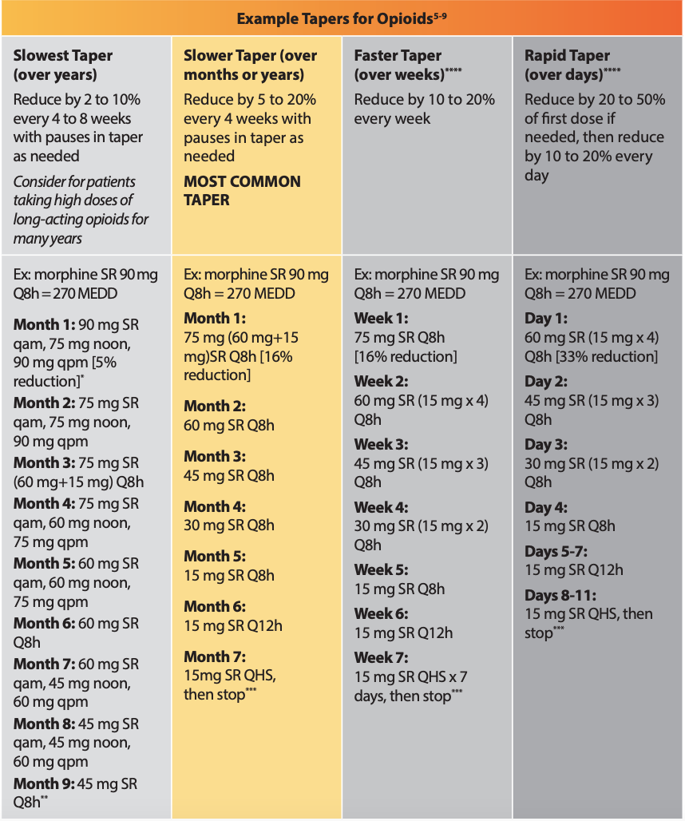
Example Tapers
VA Clinician’s Guide

Slide 21
Recommendation 6: When opioids are needed for acute pain, clinicians should prescribe no greater quantity than needed for the expected duration of pain

Slide 22
Recommendation 6: When opioids are needed for acute pain, clinicians should prescribe no greater quantity than needed for the expected duration of pain
Re-evaluation at least every 2 weeks
If round-the-clock opioids, consider brief taper to avoid withdrawal
Notes:
https://www.hhs.gov/opioids/sites/default/files/2019-10/Dosage_Reduction_Discontinuation.pdf

Slide 23
Recommendation 7: Evaluate benefits and risks with patients within 1–4 weeks of starting or dose increase of opioid therapy for subacute or chronic pain

Slide 24
Recommendation 7: Evaluate benefits and risks with patients within 1–4 weeks of starting or dose increase of opioid therapy for subacute or chronic pain
Consider shorter follow-up intervals especially for ER/LA medications due to increase risk of overdose
Regular re-evaluation of patients on chronic opioids should occur at a suggested interval of every 3 months or more frequently as needed, especially for those at higher risk
Mental health disorder
Previous overdose
History of SUD
Notes:
Higher risk populations: comorbid mental health disorder, previous hx of OD, hx of SUD

Slide 25
Recommendation 8: Before starting and while continuing opioid therapy, clinicians should evaluate risk for opioid-related harms and discuss risk with patients

Slide 26
Recommendation 8: Before starting and while continuing opioid therapy, clinicians should evaluate risk for opioid-related harms and discuss risk with patients
Clinicians should work with patients to incorporate into the management plan strategies to mitigate risk, including offering naloxone
Naloxone should not be required for opioid prescriptions
No free naloxone in Colorado
Free naloxone and fentanyl testing strips in Denver
Standing order at pharmacy
Notes:
Naloxone especially important in high risk patients
If a family member is in a visit, they can just pick it up
Call 911
Safe storage

Slide 27
Recommendation 8: Before starting and while continuing opioid therapy, clinicians should evaluate risk for opioid-related harms and discuss risk with patients
At risk populations
Sleep disordered breathing
Renal/hepatic impairment
Performing hazardous tasks
History of SUD and/or previous overdose
Pregnancy
Notes:
Pregnancy should not be a reason to avoid treating acute pain
Risks to fetus and patient
If patient already on opioids and considering taper, consider risks of withdrawal
If patient with OUD, MOUD is recommended
Stillbirth risk, preterm delivery, poor fetal growth

Slide 28
Recommendation 9: When initially prescribing and periodically during continued opioid therapy, clinicians should review the history of controlled substance prescriptions using PDMP data

Slide 29
Recommendation 9: When initially prescribing and periodically during continued opioid therapy, clinicians should review the history of controlled substance prescriptions using PDMP data
PDMP should be reviewed before every prescription for acute, subacute, and chronic pain
Review all medications on PDMP and calculate total MMEs
PDMP data should not be used in a way that is harmful to patents
Notes:
Bup should not be counted in total daily MME
No dismissal because of PDMP

Slide 30
Recommendation 10: When prescribing opioids for subacute or chronic pain, clinicians should consider the benefits and risks of toxicology testing

Slide 31
Recommendation 10: When prescribing opioids for subacute or chronic pain, clinicians should consider the benefits and risks of toxicology testing
Should not be used in a punitive manner
Should not dismiss patients based on toxicology testing
Discussion with patient before confirmatory testing
Fentanyl testing not widely available
Clinic protocol about unexpected result

Slide 32
Recommendation 10: When prescribing opioids for subacute or chronic pain, clinicians should consider the benefits and risks of toxicology testing
Notes:
https://blog.employersolutions.com/a-closer-look-drug-testing-panels/

Slide 33
Recommendation 11: Clinicians should use particular caution when prescribing opioid pain medication and benzodiazepines concurrently

Slide 34
Recommendation 11: Clinicians should use particular caution when prescribing opioid pain medication and benzodiazepines concurrently
Consider whether benefits outweigh risks of concurrent prescribing of opioids and other central nervous system depressants
Buprenorphine or methadone should not be withheld from someone who is taking benzodiazepines
Risks greater at higher doses
Taper of benzodiazepines

Slide 35
Recommendation 12: Clinicians should offer or arrange treatment with evidence based medications to treat patients with opioid use disorder

Slide 36
Recommendation 12: Clinicians should offer or arrange treatment with evidence based medications to treat patients with opioid use disorder
Detoxification on its own, without MOUD, is not recommended for opioid use disorder because of increased risks for resuming drug use, overdose, and overdose death
Agents used: buprenorphine, methadone, naltrexone (preferably extended release)
Notes:
Bup should not be counted in total daily MME
No dismissal because of PDMP

Slide 37
Recommendation 12: Clinicians should offer or arrange treatment with evidence based medications to treat patients with opioid use disorder
Buprenorphine
SAMHSA Guide for induction
Methadone
Clinics in Colorado
Naloxone (preferably long acting)

Slide 38
Outstanding questions
Use of partial opioid agonists

Slide 39
Questions

Slide 40
References
Dowell D, Ragan KR, Jones CM, Baldwin GT, Chou R. CDC Clinical Practice Guideline for Prescribing Opioids for Pain - United States, 2022. MMWR Recomm Rep. 2022;71(3):1-95. Published 2022 Nov 4.
Krebs EE, Lorenz KA, Bair MJ, et al. Development and initial validation of the PEG, a three-item scale assessing pain intensity and interference. J Gen Intern Med. 2009;24(6):733-738.
PAIN ASSESSMENT | Section 1 AAFP Chronic Pain Toolkit. doi:10.1093/med:psych/9780199772377.001.0001/
Opioid Taper Decision Tool. https://www.pbm.va.gov/AcademicDetailingService/Documents/Pain_Opioid_Taper_Tool_IB_10_939_P96820.pdf
Overdose Prevention. denvergov.org. Accessed December 13, 2022. https://denvergov.org/Government/Agencies-Departments-Offices/Agencies-Departments-Offices-Directory/Public-Health-Environment/Community-Behavioral-Health/Behavioral-Health-Strategies/Overdose-Prevention
Map. Home. Accessed December 13, 2022. https://www.stoptheclockcolorado.org/
Prescription Drug Monitoring Program (PDMP) HOME | Division of Professions and Occupations. dpo.colorado.gov. https://dpo.colorado.gov/PDMP
Gutierrez H. A closer look: Drug testing panels | Quest Diagnostics. Quest Diagnostics Employer Solutions Blog. Published January 21, 2020. Accessed December 13, 2022. https://blog.employersolutions.com/a-closer-look-drug-testing-panels/
Effective Treatments for PTSD: Helping Patients Taper from Benzodiazepines Benzodiazepines Overview Quick Facts. https://www.va.gov/PAINMANAGEMENT/docs/OSI_6_Toolkit_Taper_Benzodiazepines_Clinicians.pdf

Slide 41
Recommendation 1: Non-opioid therapies are at least as effective as opioids for many common types of acute pain.
Low back pain- NSAID, APAP, heat, spinal manipulation
Neck pain- NSAID, APAP, cervical collar, exercise
Headache- NSAID, APAP, triptan, ergotamine
Kidney stone- NSAID
Pregnant patients
Vaginal delivery: APAP and NSAIDs
C-section: APAP, NSAID, and if needed, short course of short acting, low-potency opioid
Invasive surgery/Severe trauma- Opioids
Notes:
American Headache Society recommends against opioids for headaches

