Slide 1
ISP Touchbase
07.13.2022
Notes:
Kathy

Slide 2
Call Instructions
Please ​​
Mute your phone, microphone, and speakers on your computer/device​​
Enter your name/pronouns and organization in the chat box feature
We encourage active participation via Chat or audio​​
Submit questions via the chat box feature​​
Questions will be answered as submitted​​
Unmute yourself to ask question and participate in discussions​​
Time to ask questions via audio will be offered for those on the phone​​
*6 - Toggle mute/un-mute​​
*9 - Toggle raise/lower hand

Slide 3
Agenda
Harm Reduction
David Mendez, MD, FASAM
Addiction and Family Medicine
ISP Questions/Videos
Upcoming Due Dates
Notes:
Kathy

Slide 4
Implementing Harm Reduction
David Mendez, MD, FASAM
Addiction and Family Medicine

Slide 5
Objectives
Learn the foundations of harm reduction
Understand naloxone and how it’s utilized for opioid overdose prevention.
Discuss fentanyl and fentanyl testing strips
Learn various methods on how patients can use safer.

Slide 6
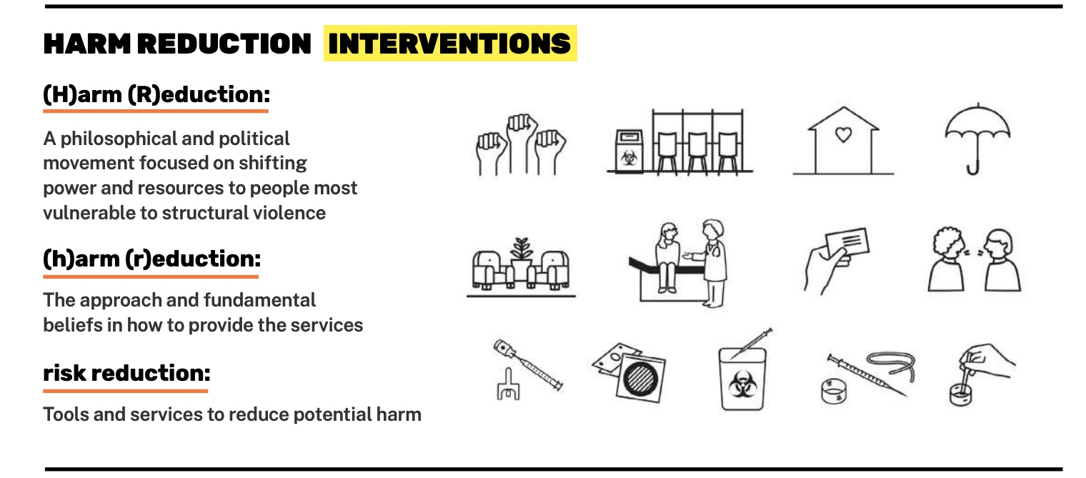
What is harm reduction?
Policies, programs, and practices that aim primarily to reduce the adverse health, social, and economic consequences of the use of legal and illegal psychoactive drugs without necessarily reducing drug consumption.

Slide 7
Target risks and harms from substance use
1
Acknowledge the significance of any positive change
2
Accept people who use drugs as they are with dignity and compassion
3
Maintain transparency in decisions
4

Slide 8
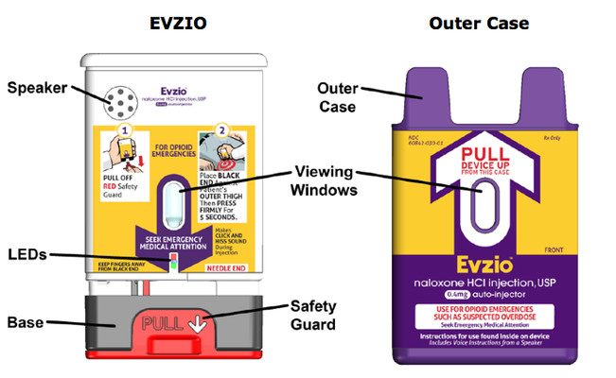
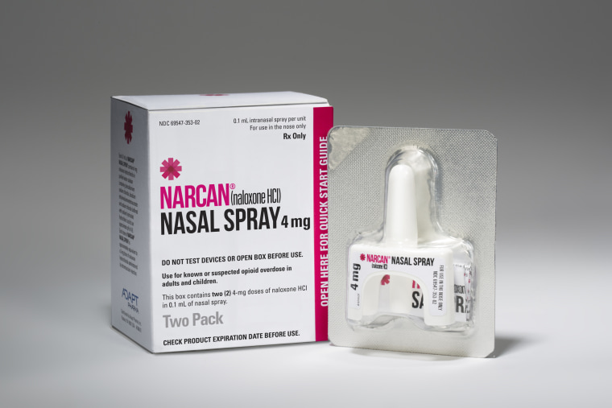
Naloxone – what is it?
Competitive opioid antagonist
No effect on people who are not on opioids
Reverses respiratory depression from opioid overdose and prevents overdose deaths
Data does not show that prescribing naloxone increases opioid use
Incorporated into AHA BLS training

Slide 9
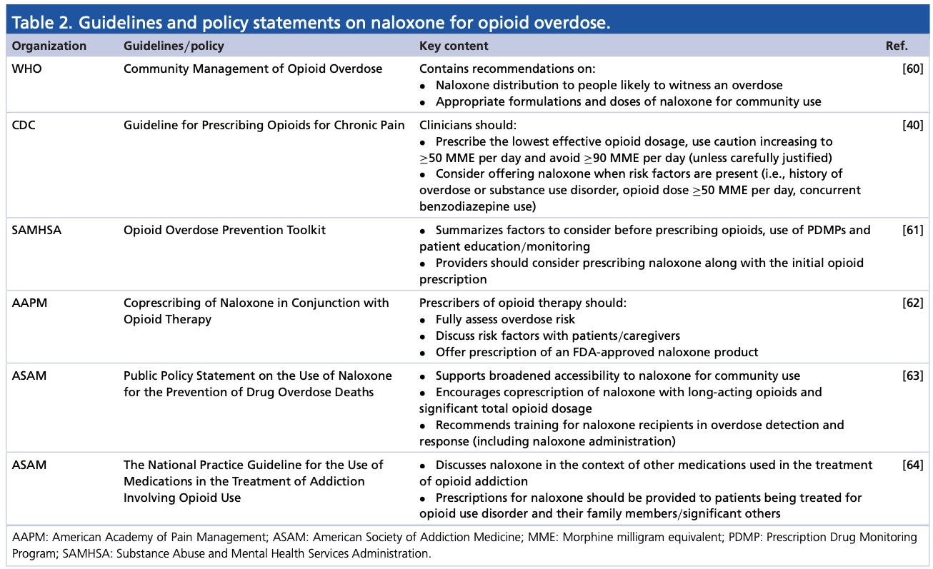
Who should be prescribed?
Consider prescribing to any patients with a h/o OUD, on chronic opioid pain medications, h/o substance use disorder, living with someone with a substance use disorder
Prescribed at lower rates in outpatient settings

Slide 10
Colorado
State’s chief medical officer: standing order for anyone to pick up naloxone
Pharmacies carrying naloxone: https://www.stoptheclockcolorado.org/map/
Carried by law enforcement and first responders
Good Samaritan Law: Provides immunity from criminal prosecution for people who suffer or report and emergency drug or alcohol overdose
Denver: Access to mailed naloxone and fentanyl testing strips
CDPHE: jericho.dorsey@state.co.us

Slide 11
How do you use it?
Different formulations:
Intranasal spray, autoinjector for IM, atomizer
IM: 0.4mg
IN: 4mg
Call 911
Start rescue breathing if needed
Administer Naloxone
Attempt to keep person awake and breathing
Lay person on side to avoid choking

Slide 12
Signs of opioid overdose

Slide 14
Fentanyl
Not naloxone resistant
Various analogues exist
Cannot overdose by touch: needs to be introduced to mucosa or blood stream
How to use safely:
Use slowly and less
Use in groups and stagger doses
Snort or smoke instead of injecting: injecting has higher risk of overdose
Test
Carry naloxone

Slide 15
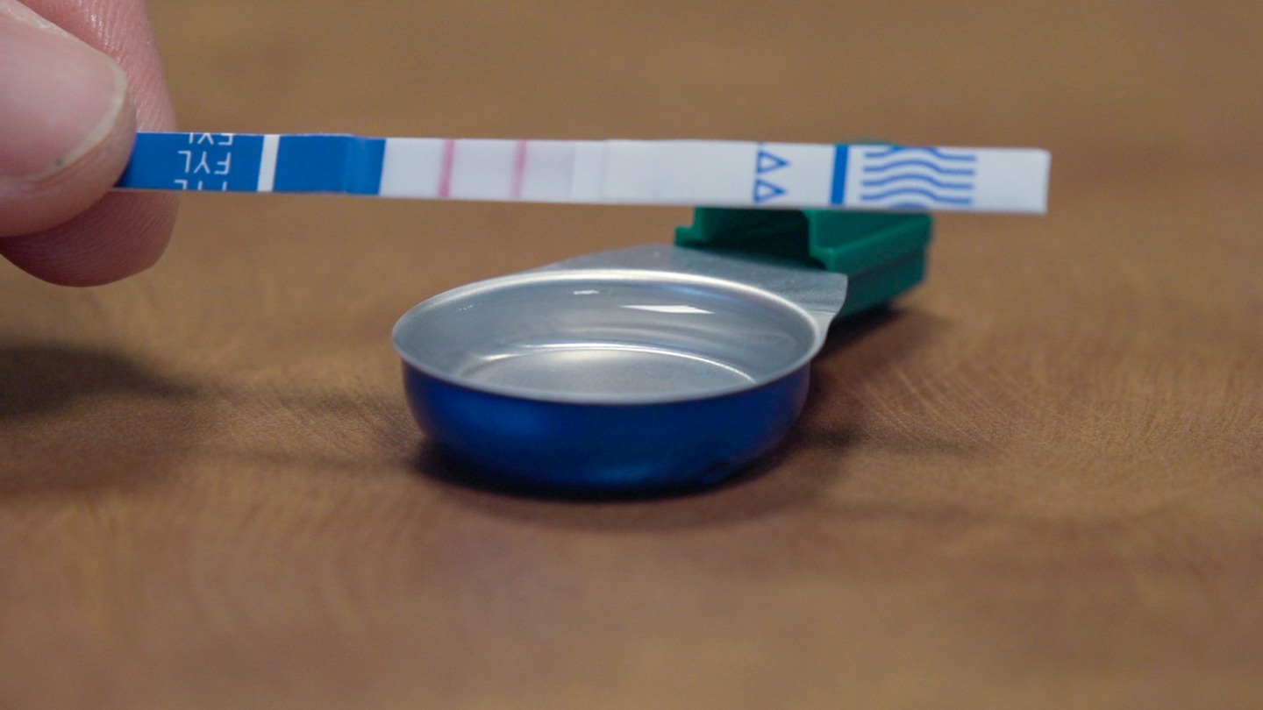
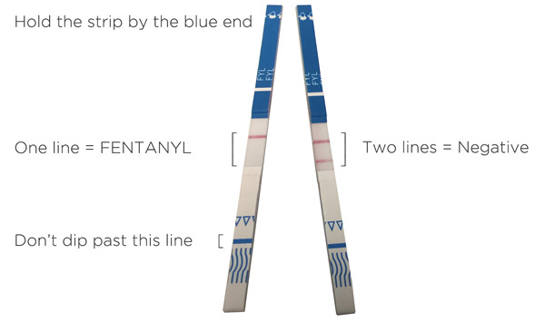
Fentanyl testing strips
Easy to use with minimal instructions
Allow PWUD to be more knowledgeable about their substance use
More likely to implement other harm reduction tools
Does not give percentage of fentanyl in the substance

Slide 17
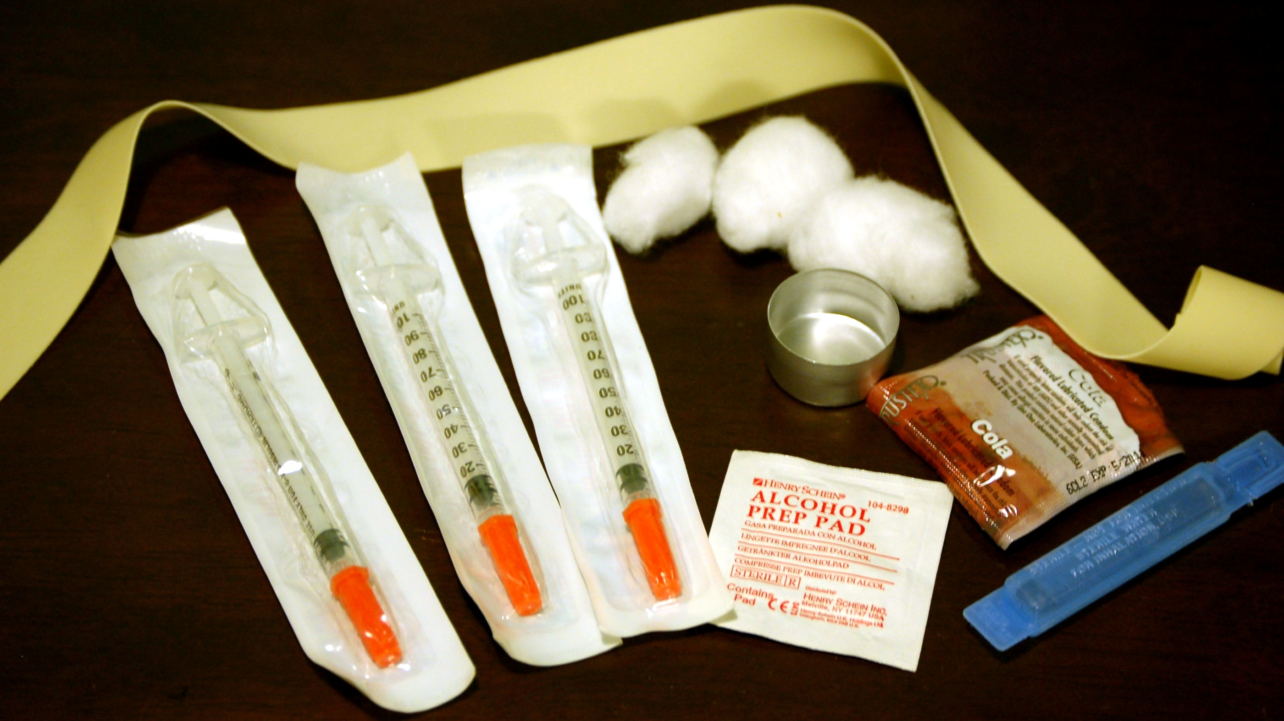
Syringe service programs
Cookers – Metal cup to heat and dissolve drugs
Alcohol pads – clean injection site
Sterile water/saline
Vitamin C – helps dissolve crack cocaine and black tar heroin
Cotton - catch particulates drawn up into a syringe
Needles
Tourniquets
Syringes
Sharps containers
Wound care supplies
Fentanyl testing strips
Naloxone

Slide 18
Harm reduction:
Safer use
Managed use
Abstinence
Meeting people who use substances where they’re at

Slide 19
References
Dunne, Robert. (2018). Prescribing naloxone for opioid over dose intervention. Pain management. 8(3); 197-208
https://harmreduction.org/issues/fentanyl/
https://Idaho.gov
https://www.nbcnews.com/health/health-news/surgeon-general-wants-naloxone-widely-hand-feasible-n866976
Harmreduction.org

Slide 20
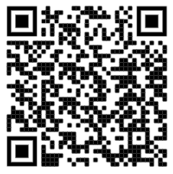
ICPF Summer Collaborative Learning Session - Registration Open!
EHR Skill Building for Practice Facilitators
Thursday July 28th
1:00pm – 1:50pm (MT)
Speaker: James McCormack, PhD, Independent Health IT Consultant and Senior Research Associate at Oregon Health & Science University’s Oregon Rural Practice-based Research Network
Registration Link
https://us02web.zoom.us/meeting/register/tZUtdeutrz0iE9XGjDiknMnV0z0AmkqI1BHm
Please don’t hesitate to reach out to Brittany Badicke at Badicke@ohsu.edu with any questions.

Slide 21
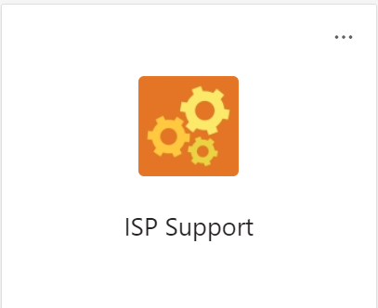
ISP Refresher and Questions
We have videos on the ISP program that are available for you to review
Please let Jennifer Halfacre know if you do not have access to the ISP Support Team
Any new PFs that will be supporting ISP?
https://medschool.cuanschutz.edu/practice-innovation-program/current-initiatives/innovation-support-project
Any Questions/Comments/Concerns?
Notes:
Jen
Put in chat - https://medschool.cuanschutz.edu/practice-innovation-program/current-initiatives/innovation-support-project

Slide 22
Upcoming due dates
MACs
New Practices baseline – due 08/15/2022
All Practices Update – due 01/15/2023
Data
New Practices baseline – due 07/31/2022
All Practices – Q3 2022 due 10/31/31/2022
Field Notes
All Waves – due by the 8th of the month for the prior month (i.e., February field note is due 03/08/2022)
Notes:
Jen

Slide 23
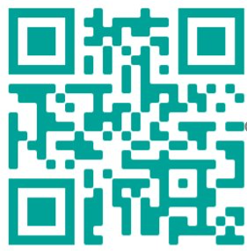
We want your Feedback!
Scan QR Code
OR Enter:
Feedback Survey Link https://bit.ly/3yuJfmQ

