Slide 1
Call Instructions:​​
Please ​​
Mute your phone, microphone, and speakers on your computer/device​​
Enter your name, pronouns and organization in the chat box feature
We encourage active participation via Chat or audio​​
Submit questions via the chat box feature​​
Questions will be answered as submitted​​
Unmute yourself to ask question and participate in discussions​​
Time to ask questions via audio will be offered for those on the phone​​
*6 - Toggle mute/un-mute​​
*9 - Toggle raise/lower hand
Notes:
Kathy

Slide 2
Health Equity in ISP: Addressing “I treat everyone the same” & Health Equity Impact Assessment
Heather Bleacher, MD MPH
June 8, 2022

Slide 3
What we’ll be talking about today
What is “colorblindness” and why is it a problem?
Practical tool:
Health equity impact assessment

Slide 4
Raël Nelson James on why “seeing color” matters
Notes:
https://ready.web.unc.edu/section-1-foundations/module-11-2/

Slide 5
Why “Colorblindness” is Harmful in Healthcare
Implies that everyone has the same opportunities for health.
Attributes inequitable outcomes to individual/cultural shortcomings, NOT discriminatory social systems.
Invalidates the experiences of people experiencing inequities.
Allows people and organizations to avoid acknowledging their role in inequities.
Prevents action on health inequities.

Slide 6
How to Respond to “I treat everyone the same”…
Option 1: Channel your inner Raël Nelson James
Embracing patients’ full identity is a way to honor their humanity.

Slide 7
How to Respond to “I treat everyone the same”…
Option 2: Discuss implicit bias.
Refresher on the definition of implicit bias: “The attitudes or stereotypes that affect our understanding, actions, and decisions in an unconscious manner.” (The Kirwan Institute, 2013)
Involuntary
Can be in direct conflict with morals and values
Everyone has implicit bias
Can lead to unintentionally giving preferential treatment to some groups over others

Slide 8
"Because of the prejudice and racism in our environment when we are children, we cannot be blamed for learning what we were taught (intentionally or unintentionally).
Yet now that we are grown, we have the responsibility to identify, interrupt, and change the cycle.”
- Beverly Daniel Tatum, 1992

Slide 9
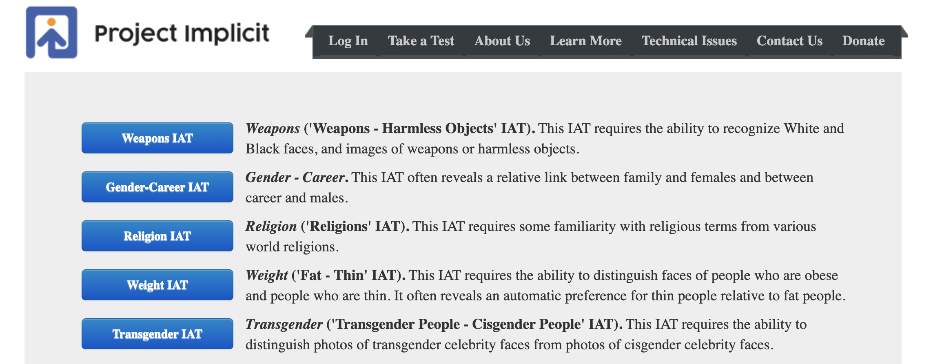
Resources for practices
Option 1: Discuss implicit bias.
Refresher on the definition of implicit bias: “The attitudes or stereotypes that affect our understanding, actions, and decisions in an unconscious manner.” (The Kirwan Institute, 2013)
Involuntary
Can be in direct conflict with morals and values
Everyone has implicit bias
Can lead to unintentionally giving preferential treatment to some groups over others

Slide 10
Resources for Practices

Slide 11
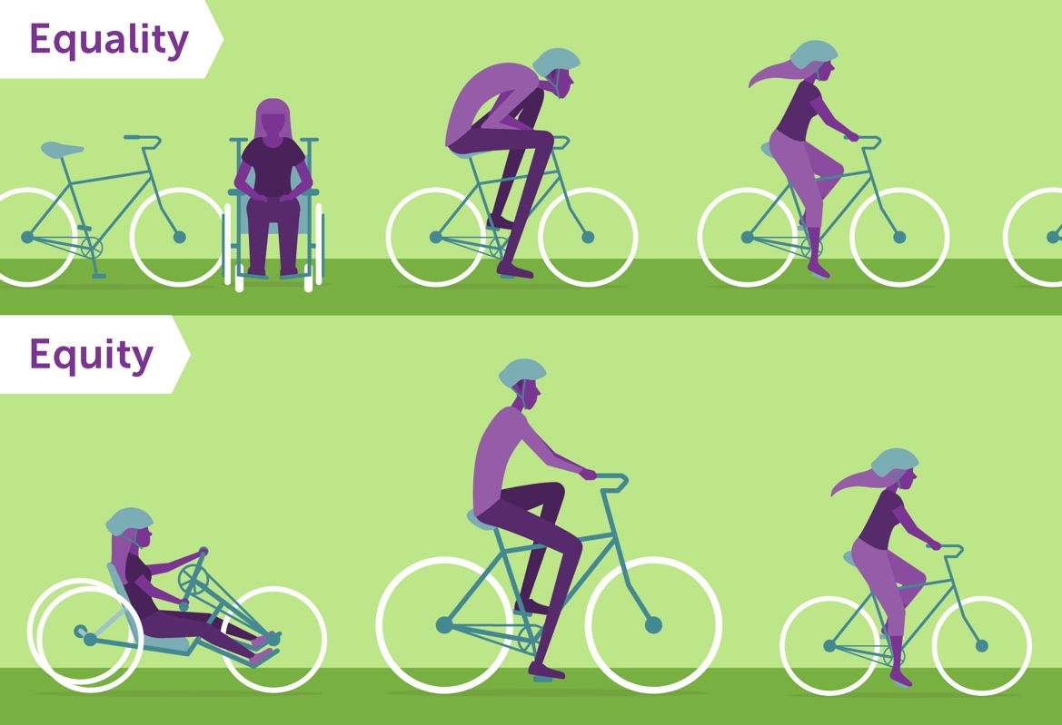
How to Respond to “I treat everyone the same”…
Option 3: Discuss equity vs equality
Notes:
We

Slide 12
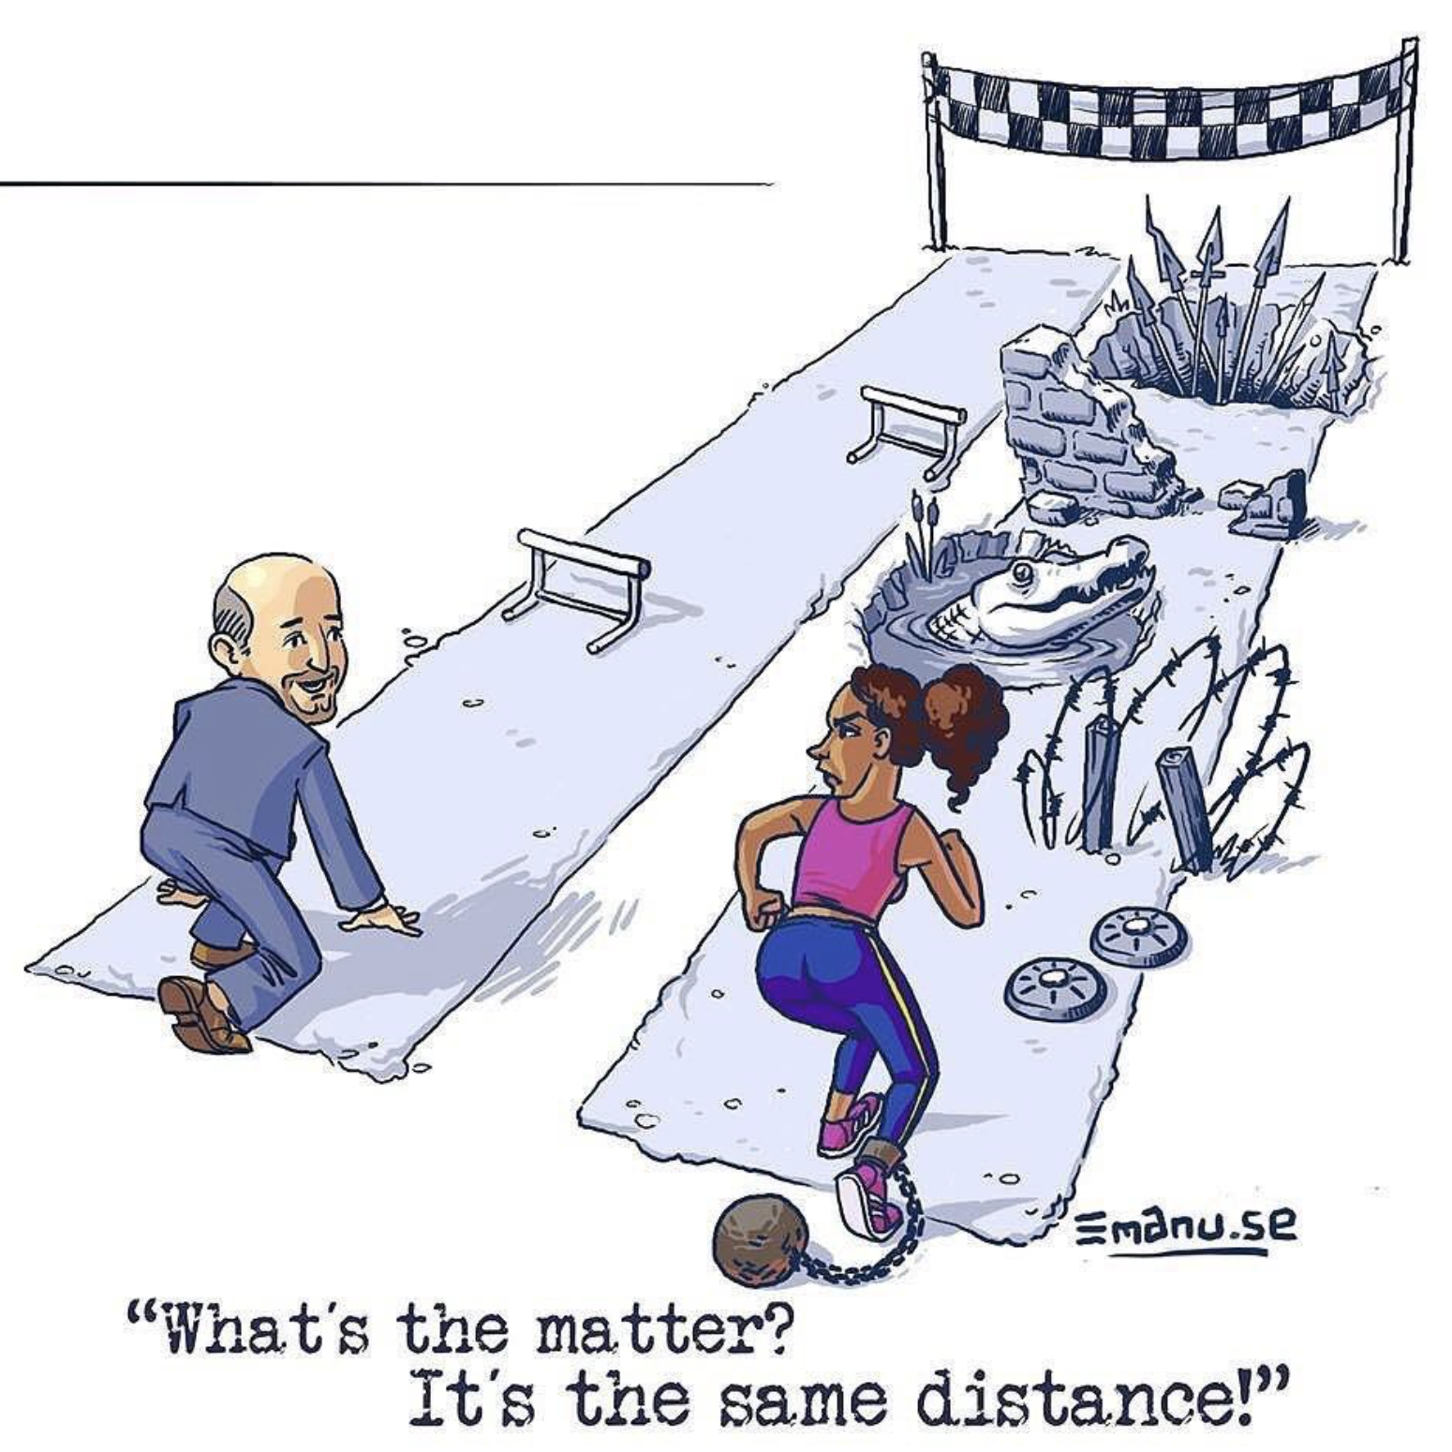
Notes:
Even IF practices treat every patient exactly the same, patients belonging to groups that have been historically disadvantaged will face more challenges to completing their health-related tasks

Slide 13
COLONOSCOPY!
MICROAGGRESSIONS
TRUSTWORTHINESS OF MEDICAL SYSTEM
TRANSPORTATION
TIME OFF FROM WORK
INSURANCE STATUS
Notes:
Even IF practices treat every patient exactly the same, patients belonging to groups that have been historically disadvantaged will face more challenges to completing their health-related tasks

Slide 14
How to Respond to “I treat everyone the same”…
How have YOU addressed this?

Slide 15
Health Equity Impact Assessment

Slide 16
Health Equity Impact Assessment
What is it?
A tool to systematically examine how groups that have been, and continue to be, disenfranchised and discriminated against will likely be affected by a proposed action or decision.
When should it be used?
Ideally, during the decision-making process, prior to enacting new proposals.
www.raceforward.org/sites/default/files/RacialJusticeImpactAssessment_v5.pdf
https://www.seattlechildrens.org/globalassets/documents/clinics/diversity/equity-impact-assessment.pdf

Slide 17
Health Equity Impact Assessment
“The HEIA can be a vital tool for preventing institutional racism/bias and for identifying new options to remedy long-standing inequities.”
www.raceforward.org/sites/default/files/RacialJusticeImpactAssessment_v5.pdf
https://www.seattlechildrens.org/globalassets/documents/clinics/diversity/equity-impact-assessment.pdf

Slide 18
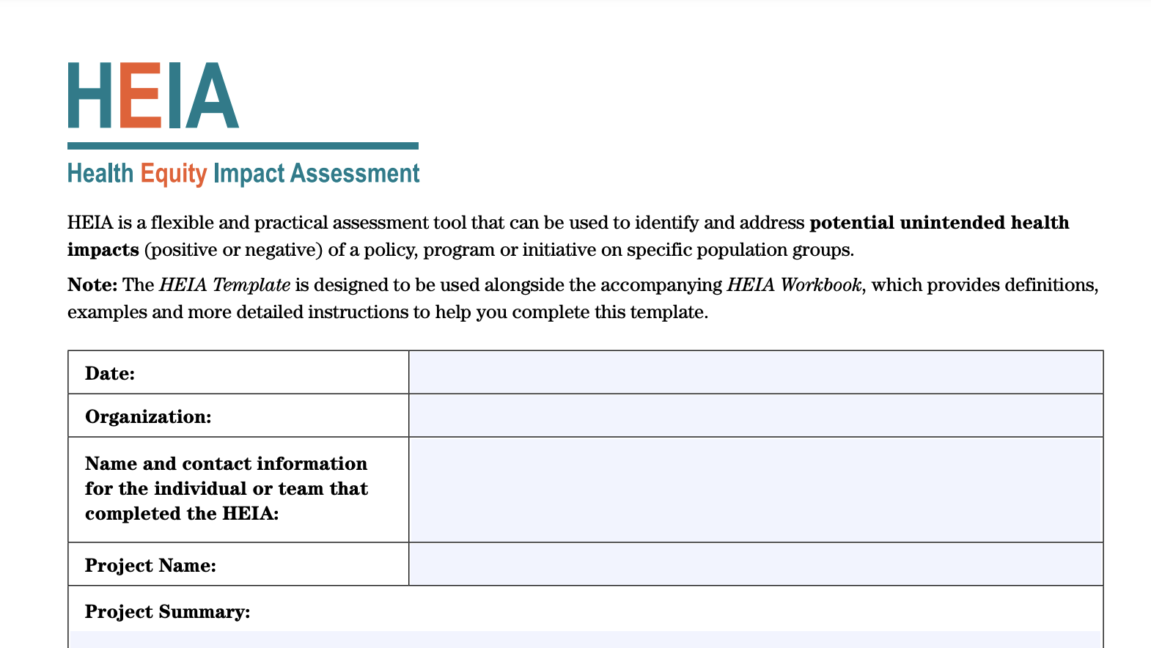

Slide 19
Health Equity Impact Assessment
Six Steps
Define the proposal
Identify groups that may be inequitably impacted
Define the current state
Evaluate inequitable impacts
Examine alternatives or improvements
Monitoring and accountability

Slide 20
Step 1: Define the proposal
What change is being proposed?
What does the change seek to accomplish?
Who is this change explicitly intended to benefit?

Slide 21
Step 2: Identify groups that may be inequitably impacted
Which populations may be burdened or advantaged by this change? Consider:
• Black, Indigenous, and People of Color
• LGBTQ+ groups
• People who speak languages other than English
• People with disabilities
• Low-income people
• People with mental illness or substance abuse
• Immigrants/refugees
• People experiencing homelessness
• Religious/faith communities
• Age-related groups
• Military/veteran status
• Other

Slide 22
Step 3: Define the current state
Who are stakeholders or representatives of groups impacted by the change?
How will they be engaged in the process?
What process will be used for decision-making and communication of results? When possible, prioritize input from those who have or are at risk of experiencing a disproportionate burden due to the change.

Slide 23
Step 3: Define the current state
What is known about the identified groups’ (step 2) current experience of the issue under discussion? Are they experiencing advantages, burdens, or other inequities in the current state? Sources of this information may include:
• Stakeholder input
• Medical records data
• Patient satisfaction surveys
• Staff and clinician input
• Patient/family advisory councils
• Other avenues for patient input
• Local or regional public health data

Slide 24
Step 3: Define the current state
How did these inequities arise?
Does the proposed change impact the root causes?

Slide 25
Step 4: Evaluate inequitable impacts
Considering the groups identified in step 2, what equity-related adverse impacts or unintended consequences could result from this initiative?
What positive impacts on equity and inclusion, if any, could result from this initiative?

Slide 26
Step 5: Examine alternatives or improvements
How could adverse impacts be prevented or minimized?
What provisions could be changed or added to ensure positive impacts on equity and inclusion?
How can the most equitable options be reconciled with functional and fiscal drivers?
What is the final decision about the proposed change?

Slide 27
Step 6: Monitoring & accountability
How will you know this change has been successful?
How will you monitor the impact of the change on equity?
What steps will be taken if inequities are maintained or increased because of this change?
How will you communicate the effects of this change to stakeholders who were engaged in the process?

Slide 28
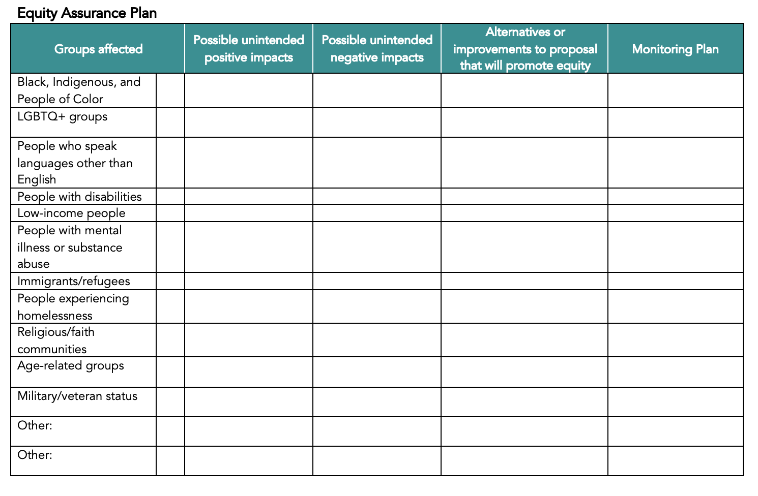
For smaller decisions, or when time is limited

Slide 29
Health Equity Impact Assessment
What is a decision one of your practices has made that would have benefitted from some or all of this process?

Slide 30
References/Resources
Cunningham BA, Scarlato ASM. Ensnared by Colorblindness: Discourse on Health Care Disparities. Ethn Dis. 2018;28(Suppl 1):235-240. Published 2018 Aug 9.
Edgoose JYC, Quiogue M, Sidhar K. How to Identify, Understand, and Unlearn Implicit Bias in Patient Care. Fam Pract Manag. 2019;26(4):29-33.
www.raceforward.org/sites/default/files/RacialJusticeImpactAssessment_v5.pdf
https://www.seattlechildrens.org/globalassets/documents/clinics/diversity/equity-impact-assessment.pdf
https://www.healthierhere.org/wp-content/uploads/2018/07/equity-tool.pdf
https://www.health.gov.on.ca/en/pro/programs/heia/tool.aspx

Slide 31
Breakout Rooms
We are going into breakout rooms
Please stay for these sessions, they are NOT recorded and we want hear from everyone (PFs, RHCs, other staff)
There is no pressure for this breakout – this an informal opportunity to catch up and learn from your peer
Notes:
Kathy – this is my note - Set Expectations for Breakout Rooms – Kathy can speak to this when we’re going into breakout rooms
Please add/delete if you just want to say these things – not exactly sure what you wanted to say, I was just trying to make it a relaxed place to talk – I think sometimes people feel pressure to say something inspirational or have an ah-ha moment.

Slide 32
Breakout Room discussions
How to do you start a conversation with your practice about allyship?
How do you move forward with engagement in these equality/allyship discussions?
How do we know we’re prioritizing this, how are we working toward health equity, what are our goals, intent as we go forward?
Including health equity in everything we’re doing – how can we make this less vague, what goals can we meet?

Slide 33
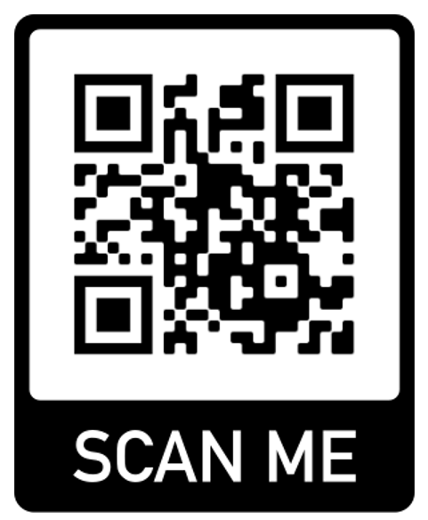
Feedback
https://bit.ly/3zgRxkm
Notes:
Copy and paste into chat –
https://bit.ly/3zgRxkm

Slide 34
Upcoming due dates
MACs
Wave 1, 2 & 3 Final – due 05/31/2022
Wave Final – due 06/15/2022
Data
No additional data due for this grant year.
Shared Care Plan
All Waves – due 06/30/2022
Field Notes
All Waves – due by the 8th of the month for the prior month (i.e., February field note is due 03/08/2022)
All Waves Final note – due by 06/30/2022
Notes:
Jen

