Slide 1

ISP Touchbase
April 13, 2022

Slide 2

Call Instructions:​​
Please ​​
Mute your phone, microphone, and speakers on your computer/device​​
Enter your name, pronouns and organization in the chat box feature
We encourage active participation via Chat or audio​​
  Submit questions via the chat box feature​​
    Questions will be answered as submitted​​
  Unmute yourself to ask question and participate in discussions​​
Time to ask questions via audio will be offered for those on the phone​​
*6 - Toggle mute/un-mute​​
*9 - Toggle raise/lower hand
Notes:
Kathy

Slide 3

Agenda
What makes a good field note?
  Doug Fernald, Department of Family Medicine
Building Block 2 – Data Drive Improvements
  Megan Reilly, Contexture/CORHIO
  Jolene Reini, Contexture/CORHIO
  Leslie Taylor, Contexture/CORHIO
Upcoming Due Dates
Notes:
Kathy

Slide 4

A Good Note

Slide 5

How we look at the data
Different analyses
  Look across all cases with all data
  Look within some cases over time
  Look at parts of some or all cases
  We can only describe what’s in the notes

Slide 6
Q: What goes into a good note?

Slide 7

A: Just enough facts
… and a little interpretation
… so that we can reconstruct what happened month-to-month and overall

Slide 8
1st Priority
The facts as you observed them
> who (people, roles, actors, pronouns)
> what (things, verbs, actions, decisions)
> when (timing, sequence, length)
> where (only if not obvious)
> how and why (only if you know)

Slide 9
1st Priority
If you remember, add:
> things you did or said
> decisions made, actions taken
> anything notably different or unexpected
> absence of something or someone

Slide 10
2nd Priority
Your reactions, impressions, interpretations, and reflections about what’s going on
Your predictions/plans about what will happen next (clearly indicate it hasn’t happened yet)

Slide 11
What else helps?
Additional concrete details in the form of:
Specific names and roles of people and things
Context clues (e.g., reminders about some that happened previously, an ongoing issue, part of part of a system, climate, “vibe,” something about the patient population or community)
Numbers, percentages, values
Complete sentences
Spell out uncommon abbreviations
Brief examples

Slide 12
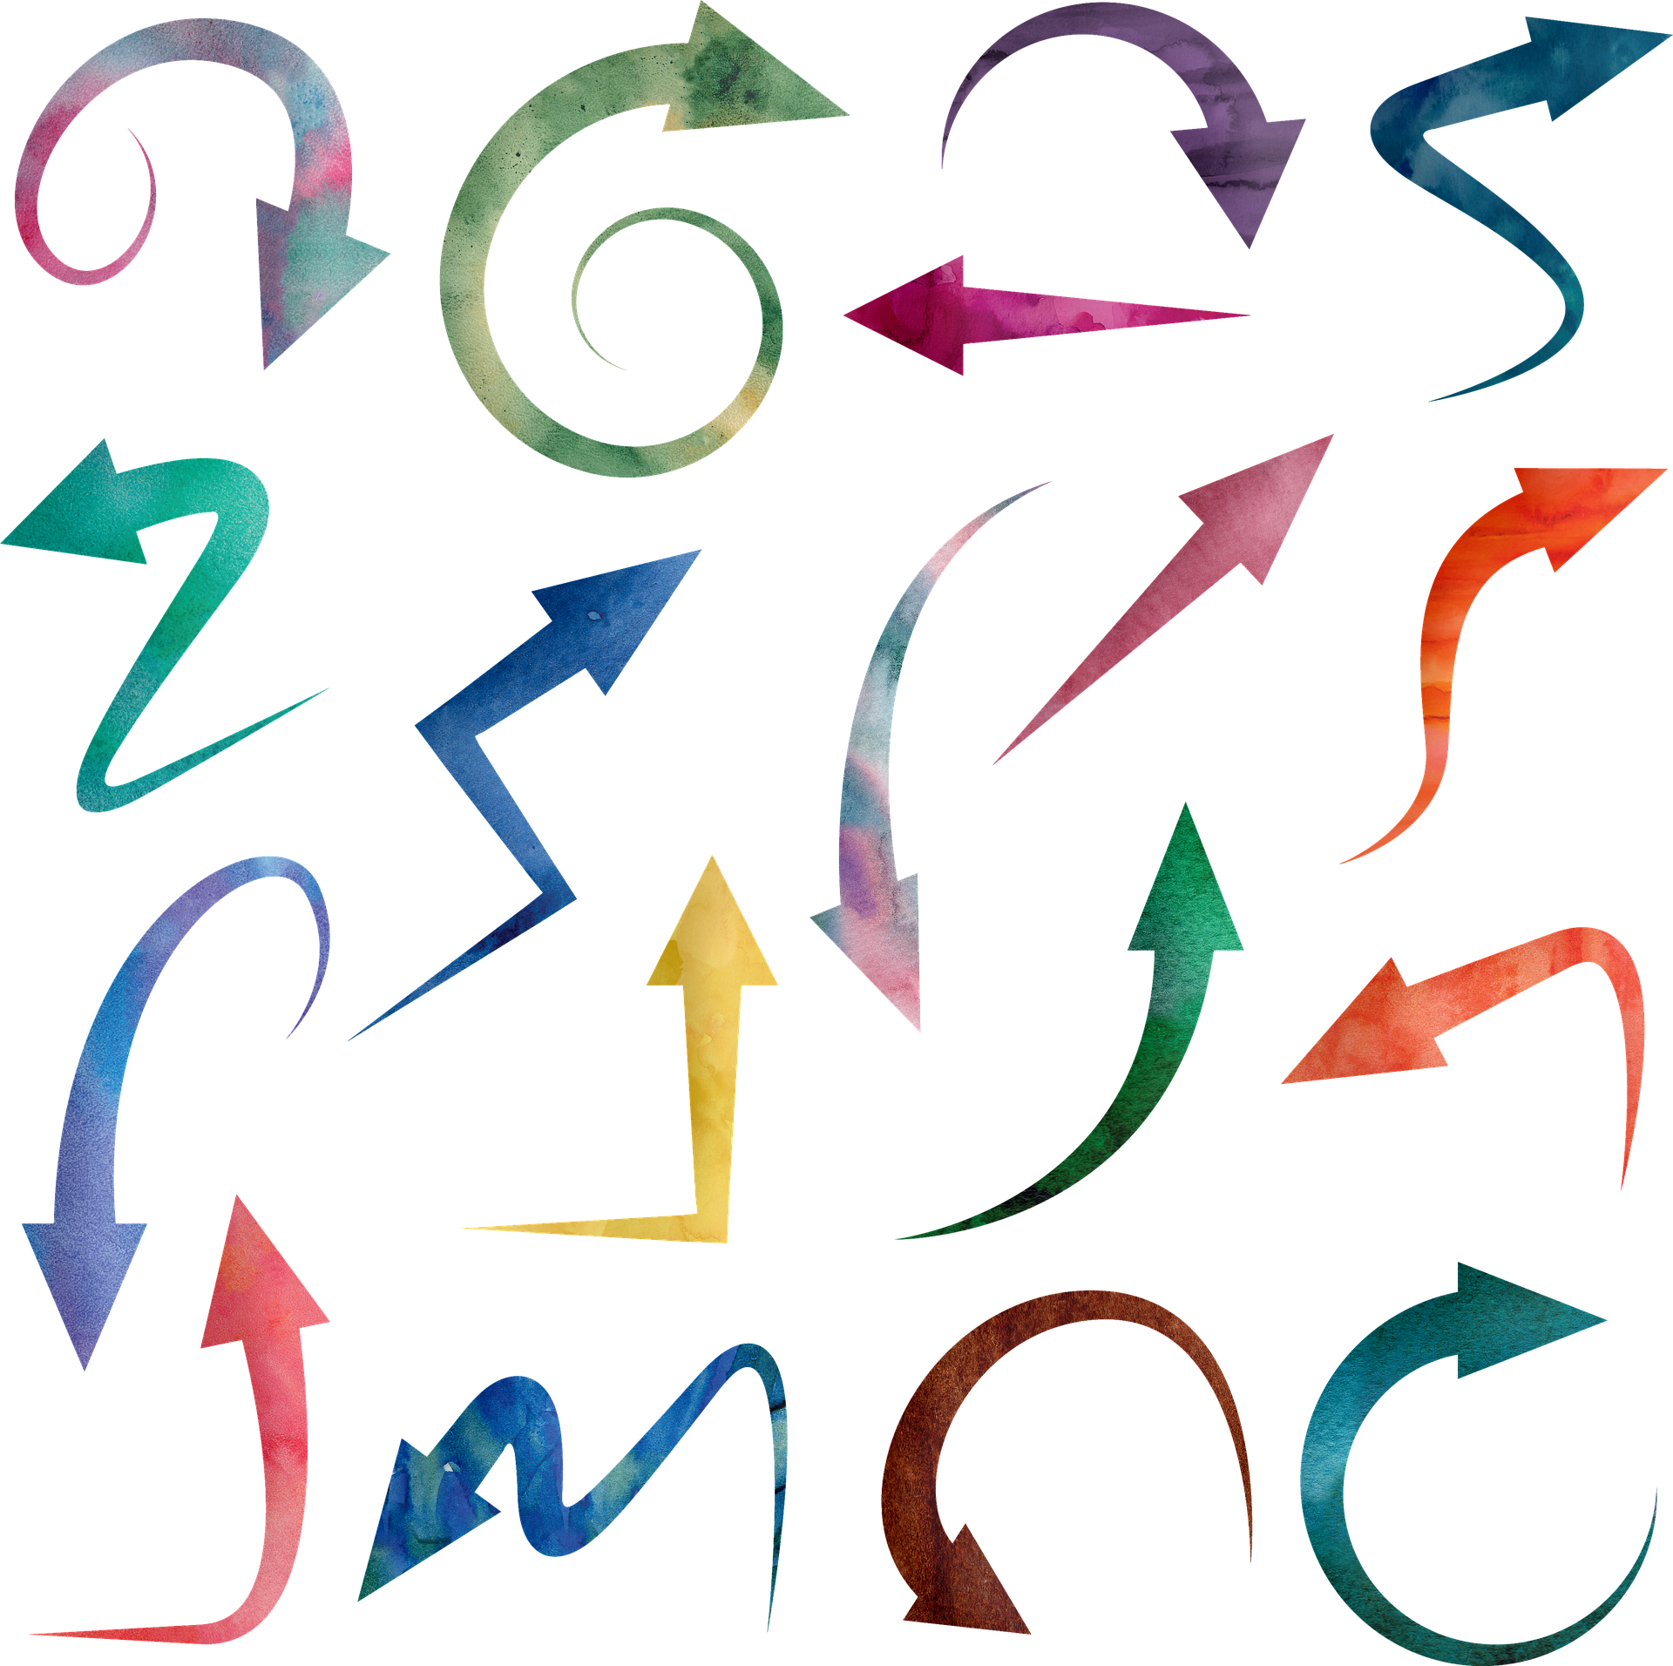
One favor
“see above”
“see below”
Copy and paste instead

Slide 13
  Describe the work completed this month regarding screening:
  Good (17 words): Reviewed data on AUD screening rates. Practice figured out workflows for documenting AUD screening in the EHR.
  Better (24 words): We reviewed data on AUD screening rates. The physicians and MAs worked together to figure out workflows for documenting AUD screening in the EHR.
  Still better (37 words): We reviewed AUD screening. Rates averaged 10% of adult patients last year. Drs. Smith and Garcia and MAs huddled together for 15 minutes to refine existing workflow to document in the EHR the new AUD screening tool.

Slide 14


Building Block 2
Data Driven Improvements
Contexture/ CORHIO
Megan Reilly
Jolene Reini
Leslie Taylor
Notes:
Leslie: We have been asked to present today on BB2, Data Driven Improvements. I am Leslie Taylor from Contexture aka CORHIO. I will be presenting with my colleagues Jolene Reini and our director of the Quality Improvement team at Contexture, Megan Reilly. We will go over the importance of data, eCQM specifics, Measure Alignment, Workflows, and eCQM tracking. We will have time at the end of the presentation to take any questions you may have.

Slide 15
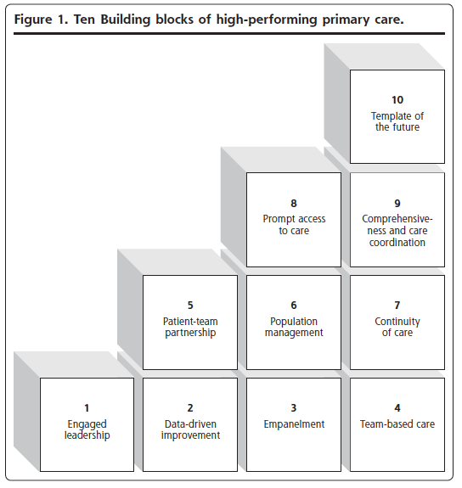
Bodenheimer, et al. Annals of Family Medicine. 2014
Notes:
Leslie: The ISP Project utilizes the Bodenheimer 10 building blocks of a high-performing primary care model. This model was developed by Dr. Thomas Bodenheimer and other researchers over a ten year period and published in 2014. The building blocks include 4 foundational elements: Engaged leadership, Data-driven improvement, Empanelment, and Team based care. Without the foundational elements in place, it is likely none of the others will be successful. The building blocks are both a description of a high performing practice and a model or roadmap for improvement. Again, today we will be focusing on BB 2, Data driven improvement.

Slide 16

Why is data so important?
YOU Can’t improve what you can’t measure
How do you know what you are doing is working?
Often tied to payment
Notes:
Leslie: Why is data in healthcare so important? Data allows practices to better understand who is included in their panel and shows how well populations are being managed. Healthcare data can include diagnoses, demographics, test results etc to name a few.
One of the reasons we review data in practices is that you can't improve what you can't measure. The baseline data also provides a starting point for implementing a data quality improvement plan. When outcomes are measured, it fosters improvement and adoption of best practices thereby, hopefully, improving outcomes over time. Understanding outcomes via data is key in providing value based care. And with more and more programs requiring data submission for payment models, this has become an extremely relevant and important topic.
How do you know what you are doing is working? Once a data quality improvement plan is in place, the baseline data reports should be obtained. Careful analysis of the numerator, denominator, coding, documentation should be done for each measure. Often clinicians are hesitant to accept that the data is not where they think it should be. We hear a lot of, "I do depression screenings all the time, the data is wrong", which maybe they indeed do depression screenings all the time but the numerator/denominator definitions, coding, documentation in a discrete field, etc all must follow the measure guidelines for the clinician to get "credit" for accomplishing that measure or intervention. Next, we would implement workflow modifications, documentation changes, coding changes and make sure all staff is knowledgeable about these changes. We then would run the reports periodically to verify that the interventions implemented are having a positive effect on the data and amend if needed as we monitor the data. Next Jolene will go over more specific information on eCQMs.

Slide 17
Electronic Clinical Quality Measures
These measures are calculated directly from a PCMP’s electronic health record (EHR) and reflect the impact of the health care service or intervention on the health status of a PCMP’s patient panel.
Per national measure specifications, eCQM denominators include all eligible patients —
regardless of payer — that meet the measure criteria, which provides a view into how a PCMP is performing overall for all measures submitted
Examples of eCQM measures include:
  Diabetes hemoglobin A1c poor control
  High blood pressure control
  Depression Screening and Follow Up
Notes:
Jolene - Electronic clinical quality measures or eCQMs are calculated from the EHR and reflect a healthcare service or intervention provided and the impact on a specific health outcome. eCQMs include all eligible patients that meet the measure criteria. Examples of eCQMs include diabetes hbA1c poor control, controlling high blood pressure and depression screening and follow up.

Slide 18
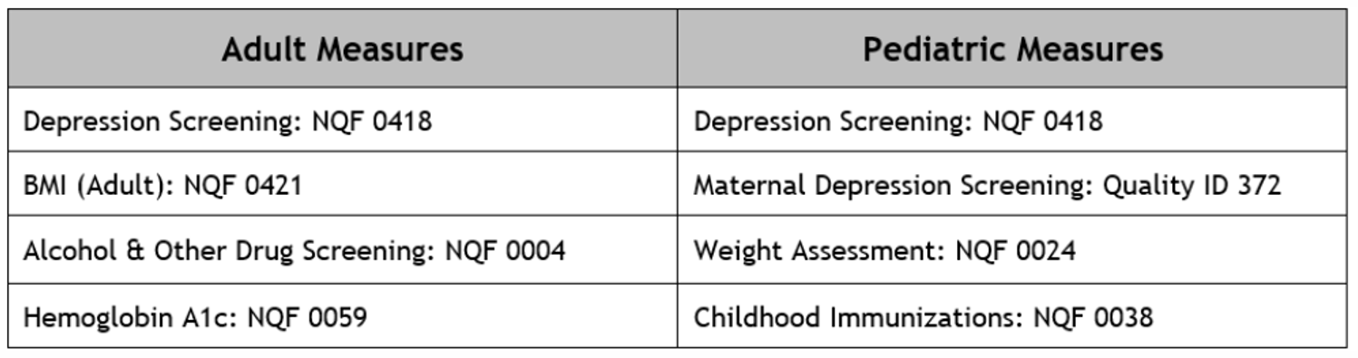
ISP Measure Sets
Notes:
Jolene: When working with practices, it is important to determine what measures align across various projects and programs. The adult measure set for ISP includes depression screening and diabetes poor control and the pediatric measure set includes depression screening and childhood immunizations which all align with mandatory measures that are part of the Medicaid APM Program. Weight assessment and counseling for nutrition and physical activity and adult BMI screening and follow up may also be an optional eCQMs selected as part of Medicaid APM. Some measures may align with HEDIS and QPP as well. It is important for clinicians to select meaningful measures that align across various programs and projects in order to be realistic in their quality improvement goals and decrease burden on the practice.

Slide 19
Measure Selection and Workflows
Establish measures of interest
Determine whether the EHR supports the measure
Develop correct workflows to meet the measure
Notes:
Jolene - After a practice selects measures of interest, they should determine if their EHR vendor supports this measure. In other words, is there a way for the practice to run a report that includes numerator, denominator and performance rate for each measure. Practices should then determine what workflows need to be in place in order to meet the measure criteria. Free texting in a progress note does not allow for practices to run a report on a measure. Typically, there are specific places within the progress note that use certain codes to meet measure specifications.

Slide 20
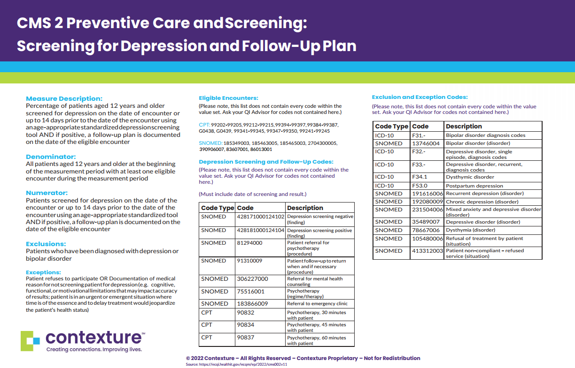
Notes:
Jolene: It is important that practices and practice facilitators understand the measure definitions and the requirements in order to meet the measure. eCQMs follow very specific guidelines and codes. An eCQM value set is a list of specific values, terms, and their codes used to describe clinical concepts in quality measures. CMS 2 – Depression Screening and Follow-Up, for example, looks at the percentage of patients 12 and older screened for depression on the date of the encounter or 14 days prior. This screening should be documented in a discrete data field using proper codes to allow for accurate reporting. If a patient screens positive, a follow-up plan needs to be documented, also in a discrete data field using proper codes contained within the value set. It should be noted that patients with an active diagnosis of depression or bipolar disorder are excluded from this measure denominator. This is an example of an eCQM specification sheet that we at Contexture created to provide to practices to help with understanding of measure specifics and mapping of correct codes to meet the measure.

Slide 21
Workflows and Standing Orders
Integrate workflows
Standing orders
Optimize team
Notes:
Megan:
Success of eCQM reporting relies on a variety of factors. One of those is implementation of eCQMs should be integrated with clinical workflows. Once you complete the clinical workflow, it is important to utilize the electronic health record's eCQM workflows so you can account for the correct data in the discrete data fields, ensuring that you get credit for the work being completed within the clinic. Clinical Workflows can be reviewed and updated to optimize eCQM data capture to ensure the measures are clinically relevant and support efficient clinical workflows, eliminating the need to add an additional workflow to capture the data.
Example: CMS 165 blood pressure, collect it, enter it in the discrete vital field
Example: CMS 2 screening, complete and enter simultaneously if possible, scoring entered in the discrete field
Implementing standing orders can assist a practice in improving their performance on clinical quality measures and has been proven to increase performance in the control of diabetes and immunizations. As we all know standing orders can be specific to patients or conditions/diseases following healthcare needs and include immunization administration, health screening activities, preventative care measures, ordering lab tests or treatments, diabetes measures, and pre/post operative care. For example, if a diabetes patient came in for a routine visit or even a sick visit, there could be a standing order to order a Hemoglobin A1c if the patient had not had one in the past 3 months or if in the past it was high, the standing order could allow the A1c to be ordered. This would assist in capturing the results for CMS 122 eCQM, diabetes hemoglobin A1c poor control. Most EHRs also allow flags to be placed for overdue labs or procedures. Another example: Standing orders can be established where patients over the age of 12 years of age that come in for a visit get the PHQ-9, this would assist to capture the initial population for CMS 2: Screening for depression and follow-up plan.
Team Based Care will also help improve performance by engaging other members of your team in the workflows. It is important to understand who is entering the data required to ensure the clinic is getting credit for the work being completed. Clinics can start by understanding which staff will interact with the patient and at what point and optimize those workflows to capture the necessary data.

Slide 22
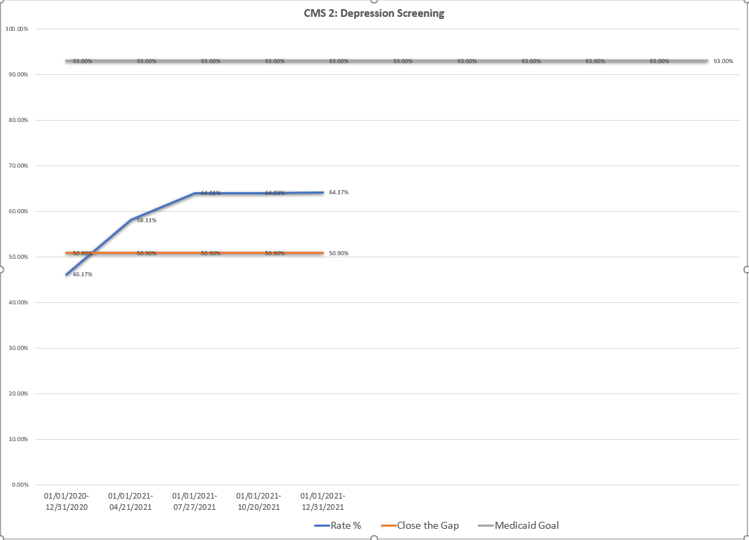
eCQM Reports
Run monthly/quarterly to measure progress
Run baseline data
Notes:
Megan:
It is critical to run clinical quality measure reports frequently to measure progress and to be sure the workflows that you are clicking are giving proper credit for the measure. It is also important to run baseline data so you can set performance improvement goals for the year. Creating run charts gives teams a visual of their current performance and progress towards their goal overtime.
Running reports, creating the run charts and displaying them within the clinics is a good way to motivate clinic teams to be engaged and improve upon performance metrics. Teams within clinics can get competitive and practices can also provide rewards for those teams who do meet clinical quality performance goals.
With an emphasis on ALL patients have equal access to appropriate treatment, it is critical that eCQMs should help promote heath equity and address health disparities. There are gaps in getting this stratified data from EHRs, but as reports can be stratified it is critical to understand the differences in data to equip providers and care teams to make improvements.

Slide 23


Discussion questions
From the coach's perspective – what works well?
Alignment with other projects
Examples of high functioning practices
Examples of practices that are struggling and what did you do to help them?
Notes:
Megan:
To start the discussion, I did want to introduce Contexture’s newest member Brandi Ryan Cabot. Brandi, being the newest member to this work do you have any tips that you can share that would be useful to others?
Terrey – Can you provide an example of a practice that was struggling and what did you do to help them?

Slide 24

Upcoming due dates
MACs
  Wave 1, 2 & 3 Final – due 05/31/2022
  Wave Final – due 06/15/2022
Data
  All Waves – 2022 Q1 – due 04/30/2022
Shared Care Plan
  All Waves – due 06/30/2022
Field Notes
  All Waves – due by the 8th of the month for the prior month (i.e., February field note is due 03/08/2022)
  All Waves Final note – due by 06/30/2022
Notes:
Jen

