Slide 1
ISP Touchbase 03/09/2022 continuing the Equity Conversation

Slide 2
Call Instructions
1. Mute your phone, microphone, and speakers on your computer/device
2. Enter your name, organization and preferred pronouns in the chat box feature
(why announcing pronouns is important)
3. Participation is encouraged!
Submit questions via the chat box
Unmute yourself during our Q&A Sections
*6 – Toggle mute/un-mute
*9 – Toggle raise/lower hand

Slide 3
Hello & Disclosures!
Heather Bleacher, MD MPH
University of Colorado School of Medicine,
Department of Family Medicine
Heather.bleacher@cuanschutz.edu
Notes:
Good morning I’m, etc etc etc
I heard this type of disclosure statement in a webinar that I recently listened to, and I really liked it. Its always important when talking about health equity, that we keep its underlying causes – oppression, privilege, and power – in mind. And I think it is important for me as a “expert” to continuously reflect on the lens I bring to this work and be transparent about that. So, my dislosures are that I am a white, cisgendered, heterosexual, woman with an advanced degree working at an urban academic medical center.

Slide 4
Agenda
How are things going with the health equity milestones?
Health Equity in the most “popular” building blocks
Data Driven QI
Team Based Care
Population Management
Breakout Rooms
Upcoming Due Dates

Slide 5
Health Equity Milestones in the Field

Slide 6
Fieldnote Data

Slide 7
Fieldnote Data

Slide 8
Fieldnote Data
Reasons why practices are NOT working on the I&E block
Currently focusing on social barriers to health
Transitioning into/out of ISP
Unable to find a meeting time
Illnesses/staffing issues
Being addressed at a higher level in the organization

Slide 9
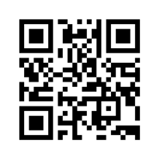
Menti meter survey
https://www.menti.com/8ek5iai455
The voting code 6464 6773

Slide 10
Strategies For Addressing Hesitation
Sell the benefits
Start with Curiosity
Be the “equity question asker”
Notes:
So, if you are meeting hesitation from practices about engaging in this work, there are a few strategies you can use to try to get past that
Start with curiosity
This is an approach that I am trying very hard to adopt as a regular practice. When I am faced with someone who I disagree with, I tend to want to “explain” them into agreeing with me. But, that never works. Instead, learning more about their perspective can help build the relationship and better understand where there might be common ground.
Some specific questions to try:
What worries you about this?
What do you see is the risk?
What do you see as the worst case scenario? What do you see as the best case scenario?
How do you think these issues show up for your patients?
Sell the benefits
There are plenty of ways that everyone involved is better for working towards health equity
Patients – equitable care is quality care
Clinicians – This offers a new way of relating to and caring for patients. Rather than seeing patients as “non-compliant”, gaining expertise in the root causes of health inequities can increase empathy and allow clinicians to adapt their care plans to meet their patients where they are at
Be the “Equity Question Asker”
You can be the person in the room to help shift the conversation towards health equity without even saying those words
When practice teams are discussing other work, you can try?
Which patients is this going to work best for?
Which patients aren’t going to benefit from this much?
Are there any groups of patients that we would want to tailor this to?
How can we make this idea/program/change impactful to more people?

Slide 11
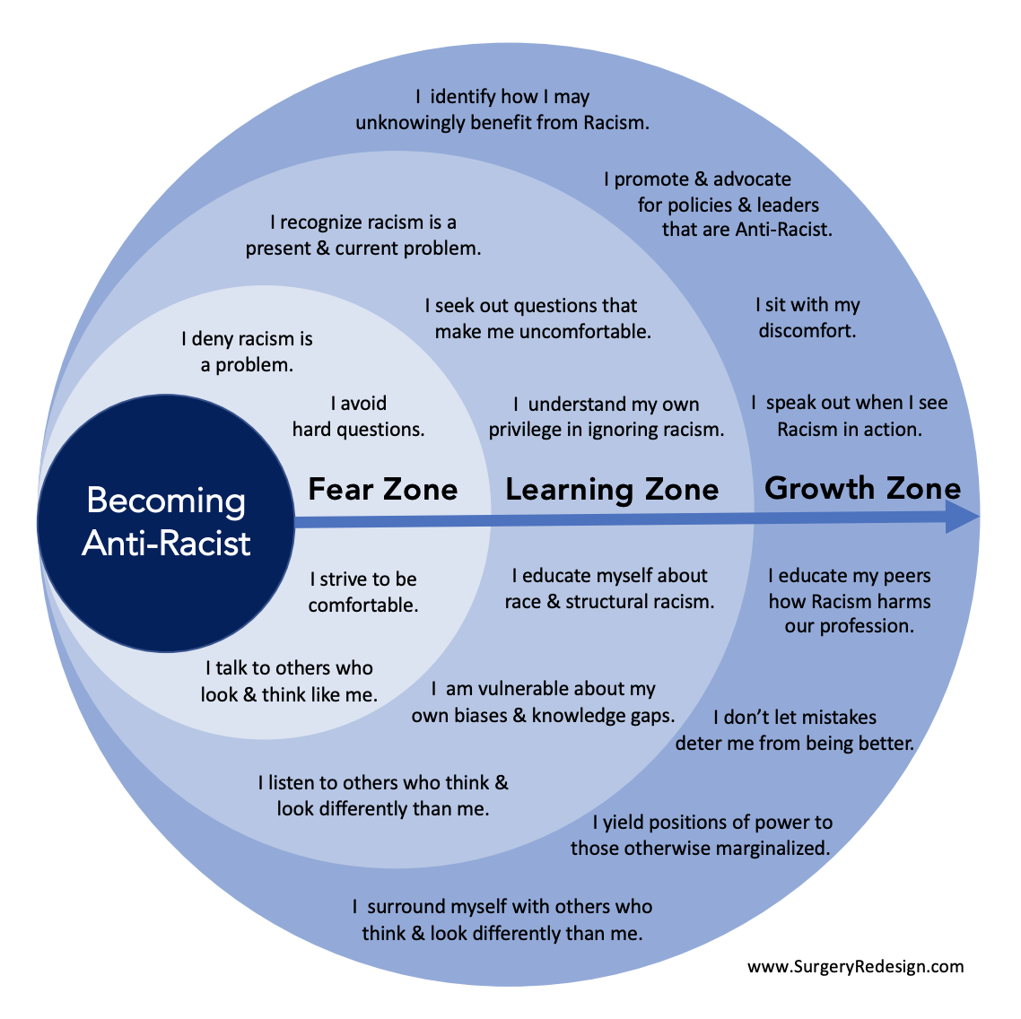
Remember, This Work Takes Time

Slide 12
Building Block 2: Data driven qi
Notes:
Kathy

Slide 13
BUILDING BLOCK 2: DATA DRIVEN QI
Practice uses clinical quality measures data and QI methods to improve care
Develop a QI team, give data to providers, evaluate QI process
Set and meet quality metric goals using QI approaches

Slide 14
BUILDING BLOCK 2: DATA DRIVEN QI
Equity in goal-setting
Target inequities in practice data
(can start small!)
Target inequities in regional, state, or national data

Slide 15
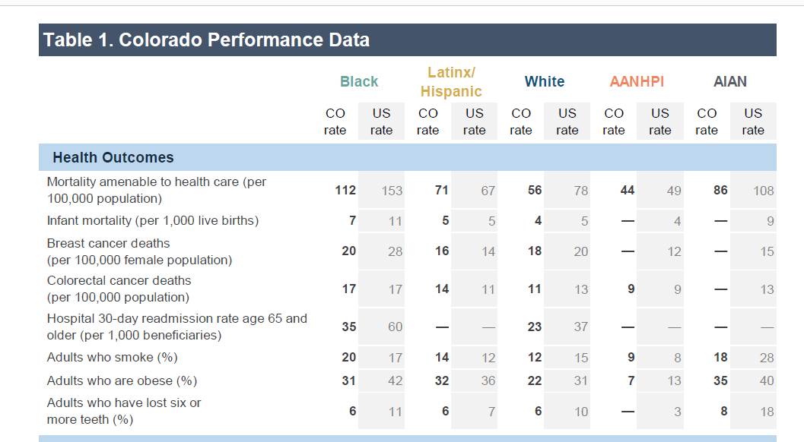
BUILDING BLOCK 2: DATA DRIVEN QI

Slide 16
BUILDING BLOCK 2: DATA DRIVEN QI
Equity in Interventions
Attend to social barriers to health
Culturally tailored interventions
Focus on historically marginalized groups that suffer the worst outcomes

Slide 17
BUILDING BLOCK 2: DATA DRIVEN QI
Equity in Process
Patient participation
Community partnerships
Equity in Process

Slide 18
Building Block 4: Team Based Care
Notes:
Kathy

Slide 19
BUILDING BLOCK 4: TEAM BASED CARE
Practice team uses workflows and protocols to facilitate collaboration and improve care
Creation of job descriptions, accountability for roles, recognition for excellence
Identify and implement team-based care strategies

Slide 20
“Equality is being on the party planning committee”
Twitter

Slide 21
BUILDING BLOCK 4: TEAM BASED CARE
Team Inclusivity
Celebrate cultures and holidays of all team members
Measure inclusiveness of practice in teamwork assessments
Communication strategies support staff participation in decision making

Slide 22
BUILDING BLOCK 4: TEAM BASED CARE
Equity is Everyone’s Job
Job descriptions include commitment to health equity
Recognition or reward for health equity champions
Team receives training that supports health equity

Slide 23
Building Block 6: Population Management
Notes:
Kathy

Slide 24
Building Block 6: Population Management
Practice uses population data to
manage care gaps and
implement care management plans
High risk patients are identified, provided with care management, and have a care plan
Care gaps are identified and addressed proactively at the population level.

Slide 25
BUILDING BLOCK 6: Population Management
Equity in risk stratification
Include assessment of social barriers
to health, disability status, language, etc
Prioritize closing care gaps among groups experiencing inequities
Practice data
Regional, state, or national data
Notes:
I do not include race/ethnicity in risk stratification as I worry that it pathologizes race and increases bias

Slide 26
BUILDING BLOCK 6: Population Management
Equity in Interventions
Care management practices incorporate social barriers to health and cultural health beliefs and practices

Slide 27
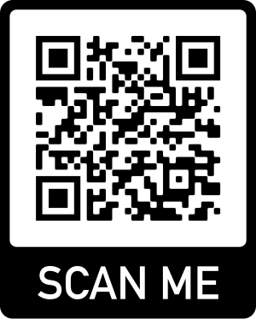
Allyship Training
Develop your comfort and skills discussing health equity and its root causes with the HealthTeamWorks Allyship training.
Dates:
Apr 4, 2022 10:00 AM
Apr 25, 2022 12:00 PM
May 16, 2022 10:00 AM
Register here or scan the QR code:
https://bit.ly/pipcu-allyship-reg

Slide 28
Breakout room discussions
Self select your breakout room by clicking the "Breakout Rooms" button at the bottom of your zoom screen:
Select the breakout room based on the building block discussion you would like to join.
Notes:
Questions:
Have you tried adding an equity focus to this building block?
What was the outcome?
What worked and what didn’t
Any resources or tools that the group should know about?
Where does the conversation get stuck when talking about focusing on health equity?

Slide 29
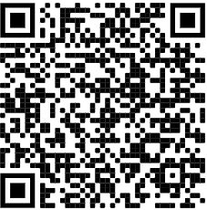
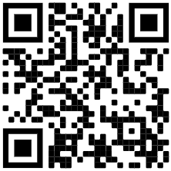
Resources
Commonwealth Fund Racial Equity Scorecard
www.commonwealthfund.org/publications/scorecard/2021/nov/achieving-racial-ethnic-equity-us-health-care-state-performance
American Medical Association Education Hub
(mainly for doctors – need AMA login)
https://edhub.ama-assn.org/ama-center-health-equity
Notes:
Kathy

Slide 30
Questions?

Slide 31
Upcoming due dates
MACs
Wave 4 Update – due 02/28/2022
Wave 1, 2 & 3 Final – due 05/31/2022
Wave 4 Final – due 06/15/2022
Data
All Waves – 2022 Q1 – due 04/30/2022
Shared Care Plan
All Waves – due 06/30/2022
Field Notes
All Waves – due by the 8th of the month for the prior month (i.e., February field note is due 03/08/2022)
All Waves Final note – due by 06/30/2022

Slide 32
Feedback
Please take 1-minute to provide us feedback about today's learning.
Scan the QR code or click on the link in the chat.
https://bit.ly/3sPetDx

