Slide 1
Substance Use in Pregnancy
What Providers and Staff Need to Know
Kaylin Klie, MD
Ryan Jackman, MD

Slide 2
Disclosures
We have no financial disclosures that I know of.

Slide 3
Objectives
Identify the signs and symptoms of substance use disorder, and be able to use them to differentiate substance use disorder from substance use.
Discuss the trends of substance use during pregnancy nationally and in Colorado
Describe how substances affect the physiology of a pregnant patient and the fetus
Understand the recommendations surrounding screening for substance use in pregnancy, and describe screening tools available
Discuss ways in which to minimize stigma and encourage participation in prenatal care among women who use or have used substances in pregnancy
List and compare treatment options for substance use disorders, including medication assisted treatment, in pregnancy

Slide 4
Substance use ≠ Substance Use Disorder
In the past 12 months:
Taking in larger amounts/longer period than intended.
Unsuccessful efforts to cut down or quit
Great deal of time spent in obtaining, using, or recovering
Cravings, strong desire
Failure to fulfill major obligations because of use
Use despite social or interpersonal problems
Recurrent use despite physical hazard
Use despite insight into physical and psych consequences
Tolerance
Withdrawal
Notes:
Why can women stop drinking, stop smoking, stop dying their hair but they continue to take Rx opioids or smoke and inject heroin?
We reinforce Rx use. Increase in prescribing to pregnant women suggesting that it isn’t bad. And why wouldn’t we increase pregnancy is painful and they can’t have non-steroidals? Same anesthesiology study found that in 2007 23% of women on medicaid (18% increase) and 14% of privately insured women filled an Rx for opioids. (*study did not account for increase in MAT, but codeine and vicodin were the most commonly prescribed with oxycodone in the top 4) Note that medicaid population was 1.1 million and privately insured was 500,000. Two separate studies.

Slide 5
What are the national statistics? (2020) [1]
Substance/quantity | Non-Pregnant (15 to 44) | Pregnant (15 to 44)
Alcohol (any amount) | 52.4% | 10.6%
Alcohol (binge drinking) | 26.8% | 5%
Illicit substances (includes MJ) | 17.8% | 8.3%
The rates of substance use and, therefore, infants exposed to substances is still high with more than 400,000 infants exposed to alcohol or illicit drugs in utero each year. The majority coming in mothers < 25 y/o
* Historically alcohol use is lower during the second and third trimesters than during the first trimester
Notes:
More than 60% of women who drink alcohol will discontinue drinking during pregnancy. (ASAM essentials)
More than 50% of women who use illicit substances discontinue use during pregnancy. (National Perinatal Association Statement 2017)
40% discontinue smoking

Slide 6
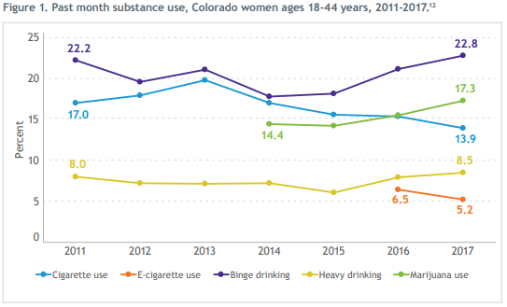
[2]

Slide 7
What are Colorado’s statistics?
Per the perinatal substance use data linkage study (SB19-228 and SB 21-137):
There has been a 98% increase in newborns exposed to opioids between 2012 and 2018
During this same time, drug overdose was the leading cause of pregnancy-associated death
75% of pregnancy-associated deaths in Colorado were deemed preventable.
Among pregnant patients in Colorado enrolled in the Pregnancy Risk Assessment Monitoring System (PRAMS), 2020 report [3]:
15.4 percent reported consuming alcohol in their last trimester. Of those the majority reported drinking 1 drink/week or less.
In the past two years 29.2% reported any smoking in their last trimester
6.8% reported using marijuana or hashish at any time during pregnancy

Slide 8
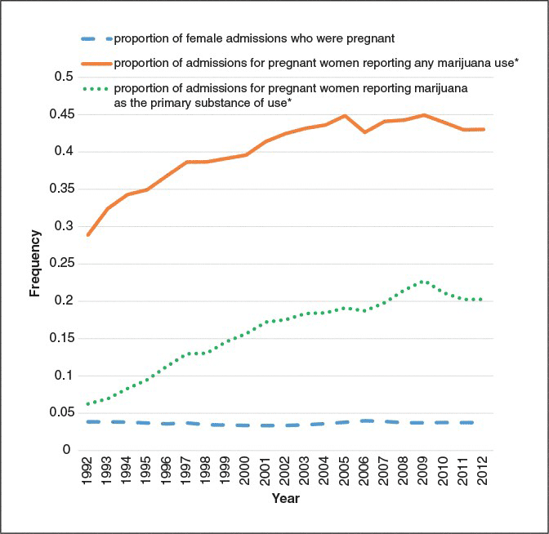
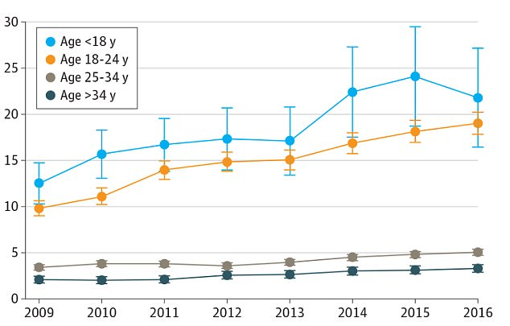
But everyone uses marijuana…
Kaiser Permanente - CA
NIDA. Martin et al 2015

Slide 9
What about Opioids?
Nationally, the number of women with opioid-related diagnoses documented at delivery increased by 131% from 2010 to 2017 [4]

Slide 10
Biopsychosocial impacts of substance use
Effects on Mother & Pregnancy
Substance Exposure
Effects on Fetus
and the need for integrating care

Slide 11
Depressant effects on pregnancy
EtOH
Benzo
Opioid
Also for mother:
Respiratory Depression (all)
Worsened constipation (opioids)
Decreased pain tolerance and increased pain sensitivity (opioids)
IV related infections (opioid/benzo)
Decreased Fetal Growth
Decreased FHR
Decreased Variability
Fetal Alcohol Spectrum Disorder (EtOH specific)
Withdrawal
Neonatal Opioid Withdrawl Syndrome

Slide 12
Withdrawal during pregnancy
Withdrawal when not identified and treated can be fatal to both mother and fetus

Slide 13
Estimated Prevalence of FASD
“In this cross-sectional study of 13,146 first-grade children in 4 regions of the United States surveyed between 2010 and 2016, the most conservative prevalence estimate for fetal alcohol spectrum disorders ranged from 11.3 to 50.0 per 1000 children. Using a weighted approach, the estimated prevalence was 31.1 to 98.5 per 1000 children.”

Slide 14
Stimulants effects on pregnancy
Cocaine
Meth
Nicotine
Also for mother:
Hypertension
Respiratory disease
Psychosis (meth and cocaine)
Worsens other withdrawal syndromes
IV related infections
SGA or IUGR
Increased FHR
Pre-eclampsia
Placental abruption
PROM/PPROM
Preterm labor
Developmental delays (Meth and Cocaine specific)
Increased risk for SIDS (tobacco)
Withdrawal syndrome
Depression

Slide 15
Effects of marijuana on pregnancy
Marijuana has been shown to clinically improve:
Nausea and vomiting
Chronic pain
Muscle spasticity
Marijuana has been shown to have negative impacts on cognitive development and is associated with preterm labor and low birth weights*
There is no safe amount or formulation of MJ in pregnancy.
*difficult to separate from tobacco use
https://www.colorado.gov/pacific/sites/default/files/MJ_RMEP_Pregnancy-Breastfeeding-Clinical-Guidelines.pdf

Slide 16
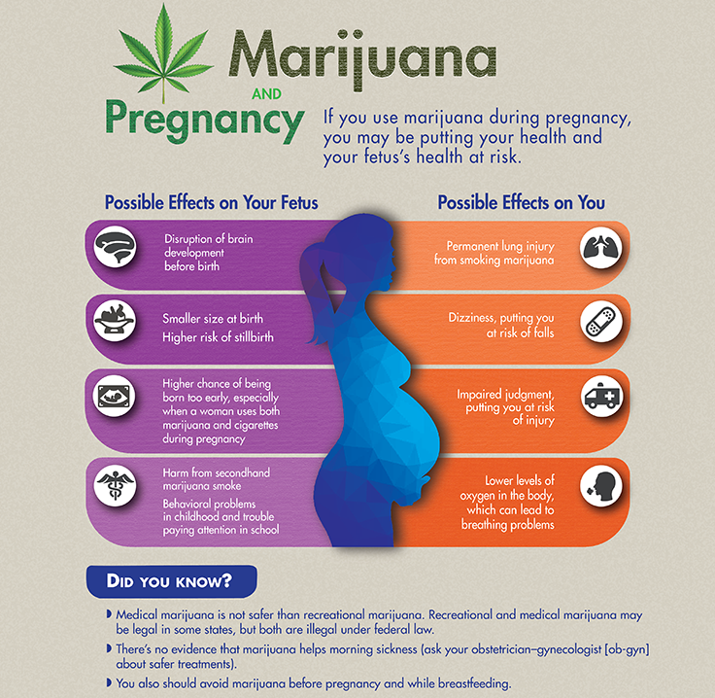
Other effects of marijuana
Concurrent substance use/misuse (tobacco>alcohol>prescriptions>illicit substances)
Decreased prenatal care, out of hospital birth (fear)
Intoxication: accidents, paranoia, psychosis, physical illness/toxicity
Withdrawal
Asthma/pulm dx (96% of marijuana use reported in pregnancy is used via smoking)
Increase risk of dysfunctional labor, precipitous labor, and meconium-stained amniotic fluid

Slide 17
Need for a different approach
Biden-Harris Administration approach to substance use in pregnancy:
1. Having SUD in pregnancy is not, by itself, child abuse or neglect.
2. Criminalizing SUD in pregnancy is ineffective and harmful as it prevents pregnant women with SUD from seeking and receiving the help they need.
3. Everyone has the right to effective treatment, and denying such care on the basis of sex or disability is a violation of civil rights.
4. Pregnant women using substances or having SUD, should be encouraged to access support and care systems, and barriers to access should be addressed, mitigated, and eliminated where possible.
5. Improving coordination of public health, criminal justice systems, treatment and early childhood systems can optimize outcomes and reduce disparities.
Prevalence of Parental Alcohol or Other Drug Use as a Contributing Factor for Reason for Removal in the United States, 2000 to 2015
In 2018, 20% of foster care placements were infants [5]
Notes:
Between 1986 and 1999, the number of women incarcerated in state facilities for drug-related offenses increased by 888%, Marc Mauer, Cathy Potler & Richard Wolf, Gender and Justice: Women, Drugs, and Sentencing Policy, THE SENTENCING PROJECT (Nov. 1999), available at http://www.sentencingproject.org/pdfs/9042.pdf.
Between 1990 and 2009, the number of incarcerated women increased 153% (laze LE. Correctional populations in the United States, 2009. Bureau of Justice Statistics Bulletin. Washington, DC: Department of Justice; 2010. Available at: http://bjs.ojp.usdoj.gov/content/pub/pdf/cpus09.pdf. Retrieved July 29, 2011.).
In 2009 it was estimated that 6-10% of women who were incarcerated were pregnant ( ACOG Number 511, November 2011
Reaffirmed 2016)

Slide 18
Need to screen
“Screening for substance use should be part of comprehensive obstetric care and should be done at the first prenatal visit in partnership with the pregnant woman. Screening based only on factors, such as poor adherence to prenatal care or prior adverse pregnancy outcome, can lead to missed cases, and may add to stereotyping and stigma. Therefore it is essential that screening be universal.”
Notes:
30-50% of pregnancies are unintended. This rate is generally higher is patients who use/misue substances. One estimate suggests that 86% of women with OUD have unintended pregnancies

Slide 19
Need to screen
Only 20% of OB/GYN physicians effectively screen for substance use disorders, and yet pregnancy has been found to be one of the best times to intervene in substance use disorder.
Routine screening should rely on validated tools for screening in pregnancy:
4 P’s , 4 P’s plus, 5 P’s
NIDA Quick Screen
SURP-P
Notes:
30-50% of pregnancies are unintended. This rate is generally higher is patients who use/misue substances. One estimate suggests that 86% of women with OUD have unintended pregnancies

Slide 20
5 P’s
Did any of your Parents have problems with alcohol or drug use?
Do any of your friends (Peers) have problems with alcohol or drug use?
Does your Partner have a problem with alcohol or drug use?
Before you were pregnant did you have problems with alcohol or drug use? (Past)
In the past month, did you drink beer, wine or liquor, or use other drugs? (Pregnancy)
Sensitivity: 87% Specificity 76%.
Validated in the inpatient & outpatient settings

Slide 21
NIDA Quick Screen
Validated in multiple settings
New tool developed from the Quick Screen - TAPS: https://www.drugabuse.gov/taps/#/

Slide 22
Substance Use Risk Profile – Pregnancy (SURP-P)
Have you ever smoked marijuana?
In the month before you knew you were pregnant, how many beers, how much wine, or how much liquor did you drink?
Have you ever felt the need to cut down on you drug or alcohol use?
Low Risk = No to all, Moderate Risk = Yes to 1, High Risk = Yes to 2 or more
Sensitivity: 80-100% (low risk), 48-100% (high risk)
Specificity: 61-64% (low risk), 84-86% (high risk)
Validated in prenatal clinics

Slide 23
I am screening my patients, now what?
Brief Interventions Step by Step:
Acknowledge and thank the patient for the disclosure.
Ask permission to discuss the result
For a negative screen: Reinforce & Educate. Stop here.
For a positive screen: Express concern about substance use
Advise woman to stop use:
“I’m glad you let me know you’ve had some___________ . Would it be okay if we talked about this? Since I know you want a healthy baby, it’s important you don’t use any ________while pregnant because it can have a harmful impact on your baby. ”
Assess/validate woman’s reaction and discuss her feelings & thoughts.
Ask: “Would you like some help to stop using _____________ during your pregnancy?”
Assist or Refer

Slide 24
A Caution on Urine Drug “Screens”
ACOG and others recommend against universal urine drug testing, as it is a toxicology test, and not a screen. Urine drug tests (UDT) can be used to support sobriety, as well as to “build a case” for your patient. Get permission (often written) before collecting.
UDT cannot quantify doses or frequency of opioid use
UDT cannot be used to diagnose OUD
UDT cannot confirm use of a drug
UDT can confirm the presence of a drug above a lab specified threshold

Slide 25
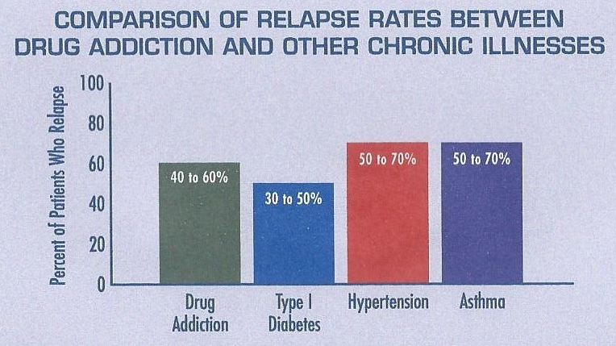
Ways to partner with your patient
Call it what it is
Substance Use Disorder (Addiction) is a primary, chronic disease of brain reward, motivation, memory, and related circuitry.
Prepare yourself and the patient accordingly

Slide 26
Ways to partner with your patient
Know what treatment works [6]
Notes:
Use this to engage your patient in treatment and prepare them for CPS investigation if it is going to happen

Slide 27
Notes:
Use this to engage your patient in treatment and prepare them for CPS investigation if it is going to happen

Slide 28
Notes:
Use this to engage your patient in treatment and prepare them for CPS investigation if it is going to happen

Slide 29
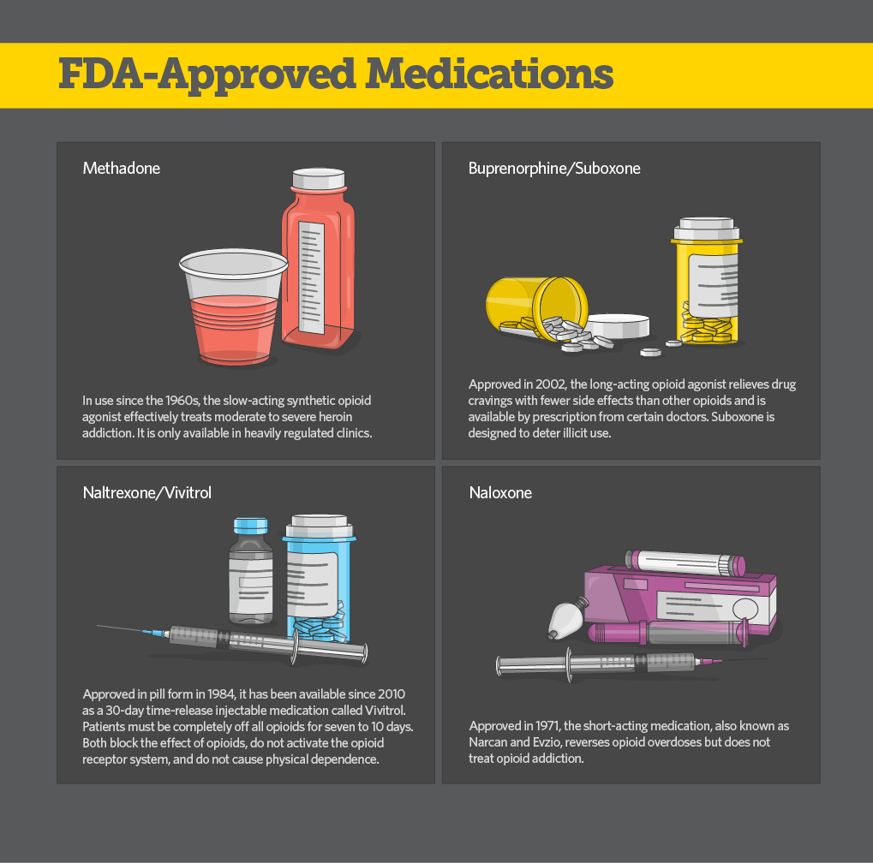
Opioids
Gold Standard Treatment is Medication for Opioid Use Disorder (MOUD)
Methadone
Buprenorphine
Maternal Benefits:
70% reduction in overdose related deaths
Decrease in risk of HIV, HBV, HCV
Increased engagement in prenatal care and recovery treatment
Fetal Benefits
Reduces fluctuations in maternal opioid levels; reducing fetal stress
Decrease in intrauterine fetal demise
Decrease in intrauterine growth restriction
Decrease in preterm delivery

Slide 30
Organization Support for MOUD
Support Pharmacotherapy in Pregnancy:
ASAM
ACOG
AWHONN
JOGNN
AAFP
AAP
SAMHSA
CDC
WHO
Don’t Support Pharmacotherapy in Pregnancy:

Slide 31
Summary of outcomes [6]: | FAVORS Methadone | EQUIVALENT | FAVORS Buprenorphine
Maternal
Treatment efficacy | *better for women that failed treatment in past | X* | *can be considered reasonable first line treatment
Access to treatment |  |  | X
Requires withdrawal for initiation | X
Treatment automatically coordinated | X
Maternal medical complications |  |  | X
Neonatal
Long-term outcome: data | X
Birthweight |  |  | X
Gestational age |  |  | X
% requiring NAS treatment |  | X
Severity of NAS symptoms |  |  | X
Duration of NAS treatment |  |  | X

Slide 32
Plan for Intrapartum Management
Don’t discontinue MAT
Verify dose with MAT Provider
Notify Anesthesiology
Account for pain

Slide 33
A word on NOWS/NAS
Development of a neonatal opioid withdrawal syndrome is NOT a complication. It is an expected therapeutic risk and side effect. (This applies to opioid agonist therapy as well as chronic opioid therapy)
Withdrawal occurrence and severity is not associated with dose of MOUD
If NOWS is to occur, its severity can be predicted by the presence of other substances, which may also cause a neonatal abstinence syndrome such as nicotine and SSRIs
While pharmacologic intervention may be needed for the safety of the infant, evidence strongly supports non-pharmacologic treatment of infants with NOWS, particularly in the early stages. Consider kangaroo care, rooming in, breast feeding
Breast feeding on MOUD is safe and should be encouraged as long as other contraindications are not present.
Notes:
, qui

Slide 34
Medically Supervised Withdrawal is NOT Recommended

Slide 35
References
https://www.samhsa.gov/data/sites/default/files/reports/rpt35323/NSDUHDetailedTabs2020/NSDUHDetailedTabs2020/NSDUHDetTabs6-20pe2020.pdf
https://www.tobaccofreeco.org/wp-content/uploads/2019/02/Substance-Use-Among-Women-of-Reproductive-Age-in-Colorado.pdf
Pregnancy Risk Assessment Monitoring System, Colorado Department of Public Health and Environment, 2011 & 2016
Hirai AH, Ko JY, Owens PL, Stocks C, Patrick SW. Neonatal Abstinence Syndrome and Maternal Opioid-Related Diagnoses in the US, 2010-2017. JAMA. 2021;325(2):146–155. doi:10.1001/jama.2020.24991
https://www.whitehouse.gov/wp-content/uploads/2021/10/ONDCP_Report-Substance-Use-Disorder-and-Pregnancy.pdf
SAMHSA, Clinical Guidance for Treating Pregnant and Parenting Women With Opioid Use Disorder and Their Infants, 2018

