Slide 1

Person First Language
ICWB Shared Learning Call
July 28th, 2025

Slide 2

Words are Powerful
Language shapes public attitudes and policies
Stigmatizing terms can:
Discourage people from seeking treatment
Perpetuate discrimination
Hinder recovery
Using respectful, person-first language promotes dignity and healing
“Words are important. If you want to care for something, you call it a ‘flower;’ if you want to kill something, you call it a ‘weed.’” - Don Coyhis, Founder, White Bison, Inc and the Wellbriety movement

Slide 3
Person-First
  Person-first language maintains the integrity of individuals as whole human beings by removing language that equates people to their condition or has negative connotations.
  For example, “person with a substance use disorder” has a neutral tone and distinguishes the person from his or her diagnosis.
  Stigma against pregnant women and mothers with substance use disorder appears in many forms, such as:
    the use of erroneous language and terminology
    delivery and belief of misinformation about substance use
    punishment of substance use
    belittling of a mother’s relationship with her child

Slide 4
Stigma Harms
People may publicly blame and condemn pregnant women with substance use disorder (SUD) because of a misbelief that having a substance use disorder is a choice versus a medical condition—and that they are, therefore, choosing to harm their unborn baby.
Women themselves often internalize this stigma and feel deep shame as a result.
Shame can sound like:
  “I’m not a good mother”
  ”I’m not worthy of this child”
  “I don’t deserve to get better”
  ”I am a bad person”
Overwhelming shame is intolerable; substance use is an effective (temporarily) and understandable adaptive response to quiet the shame

Slide 5
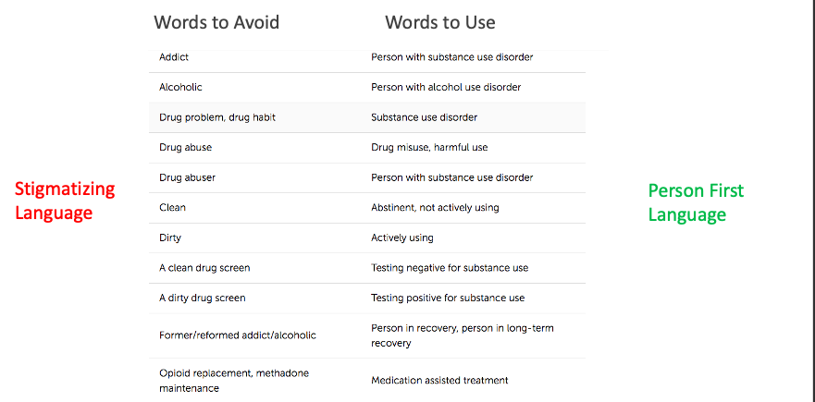
Strike from our lexicon:
“addicted baby”
MOUD: Medications for Opioid Use Disorder or OAT: Opioid Agonist Therapy

Slide 6
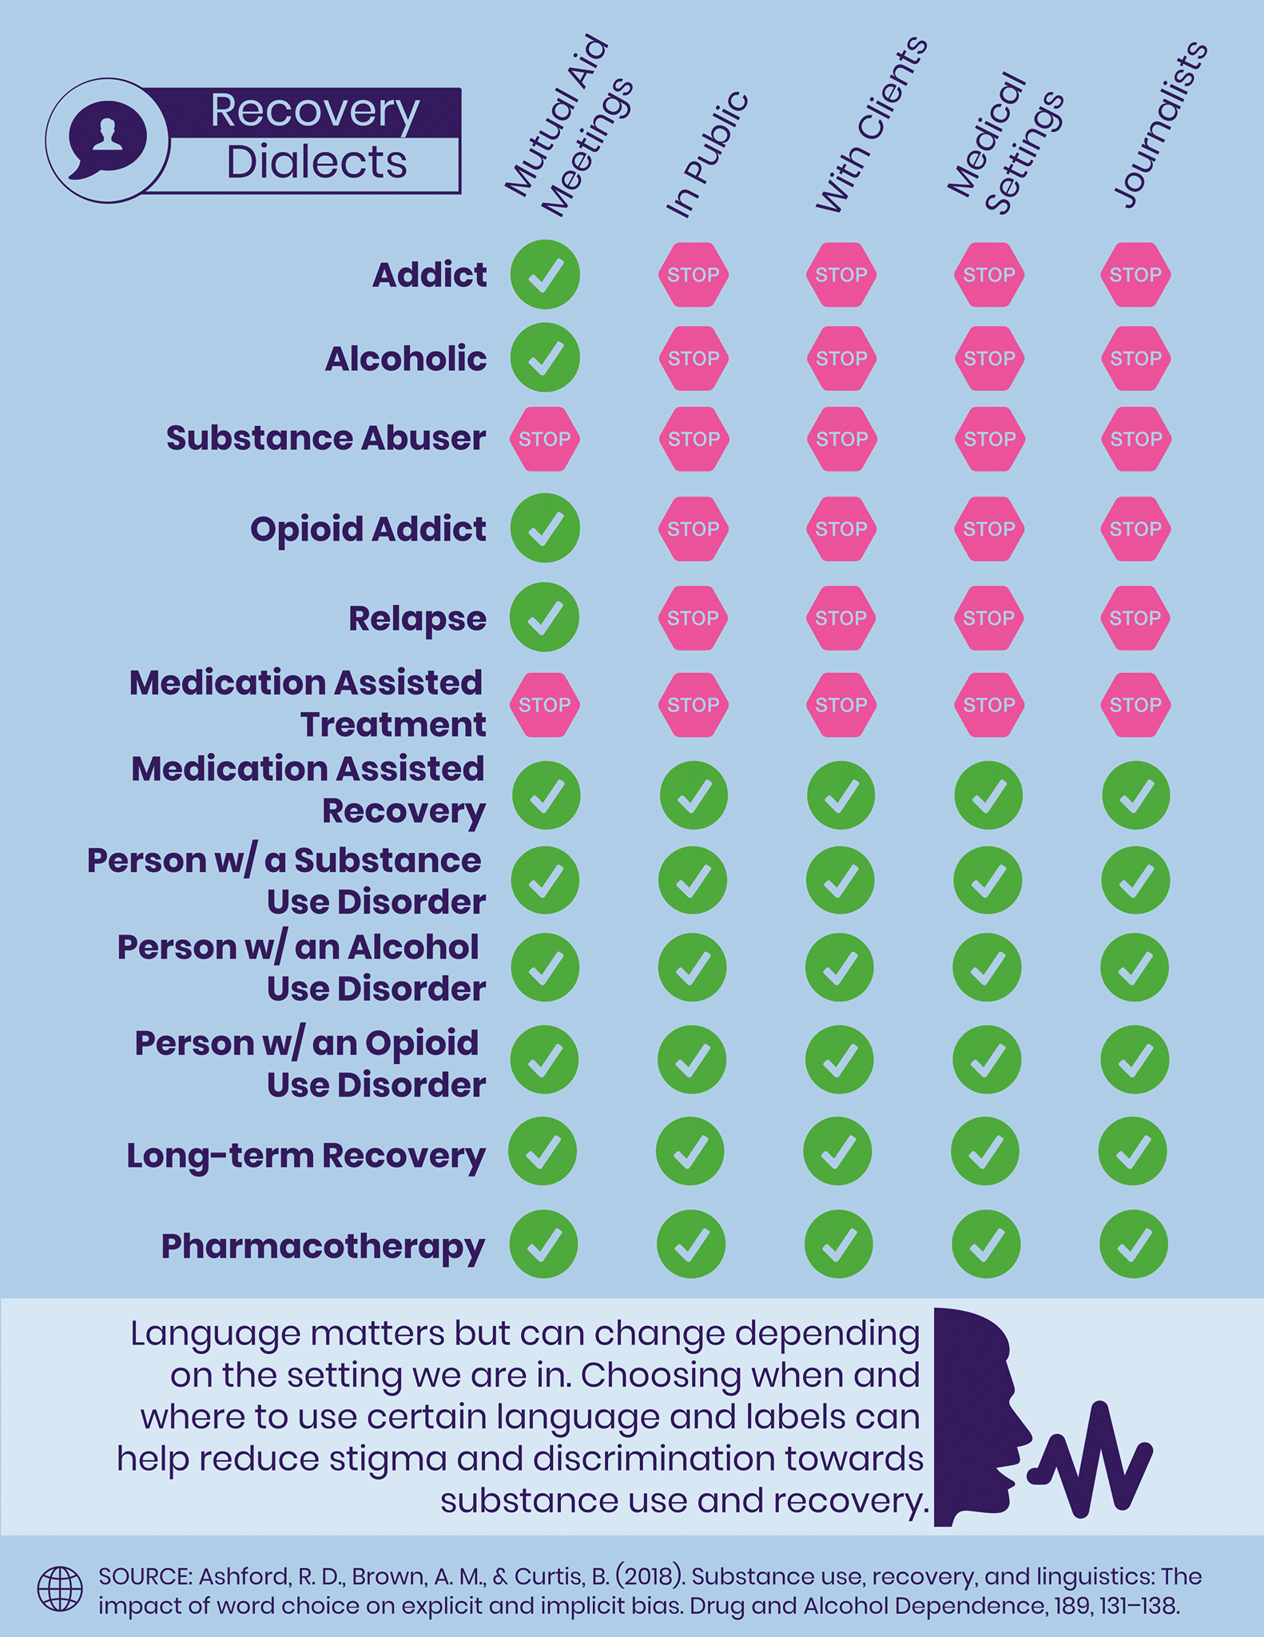

Slide 7
How Person First Language Helps
Places the person with the substance use first, not their disorder
Reinforces use of accurate medical terminology, not colloquial language
Clarifies that we are connecting with a person/pregnant person/mother/infant/family, which is our area of expertise
Consistent use of person-first language by health care providers can start to make amends for the ways in which people with substance use have been mistreated by the health care community
Retrains ourselves and colleagues towards reducing harms

Slide 8
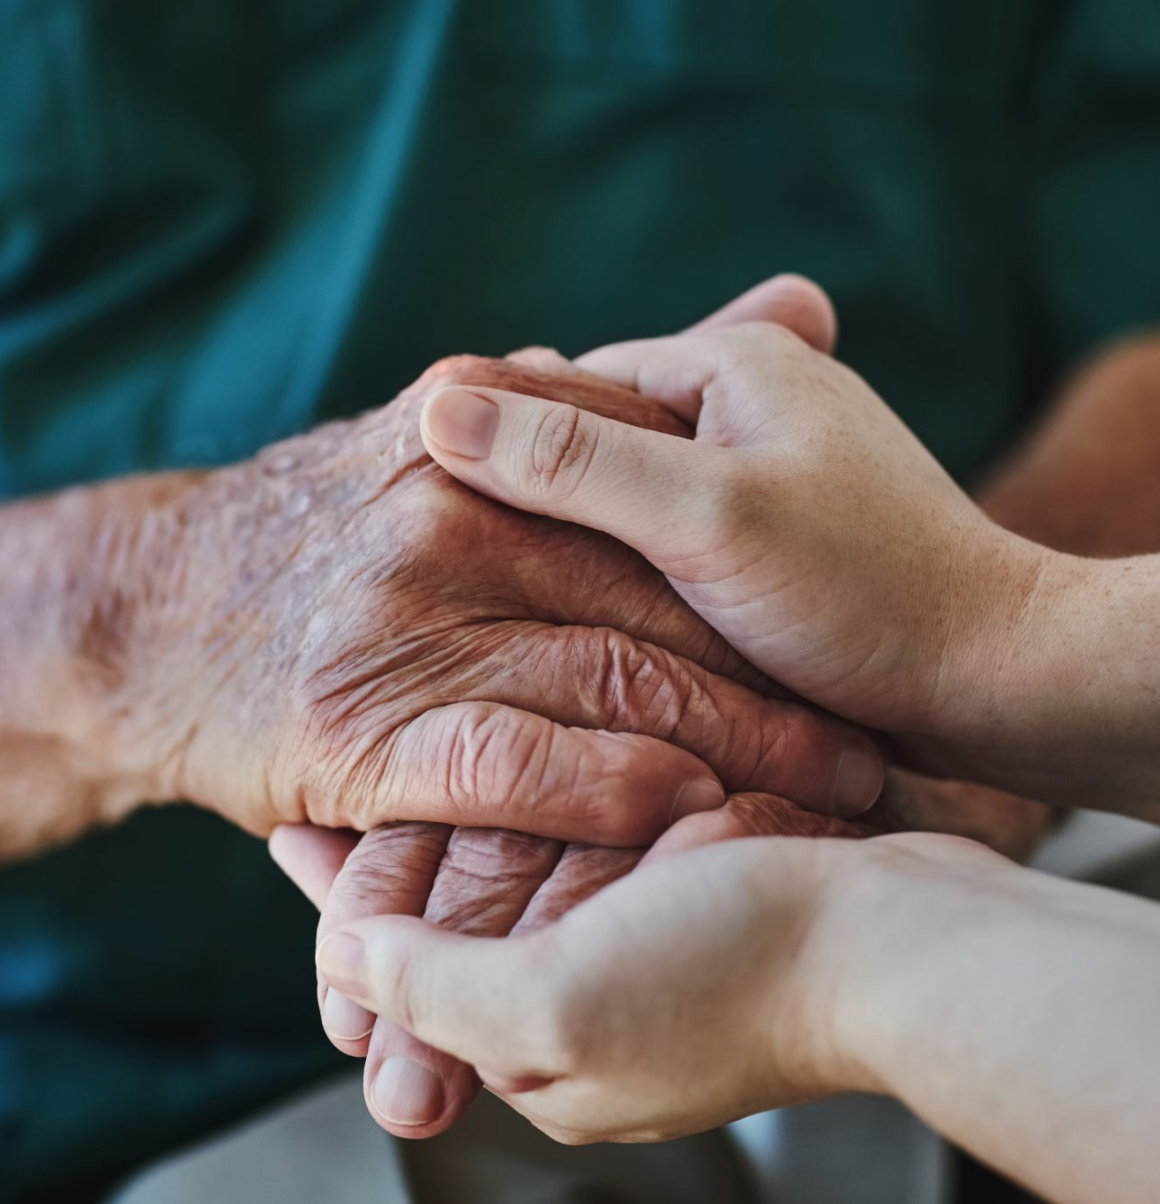
Unconditional Positive Regard
Treating people with unconditional positive regard increases:
  Compassion
  Empathy
  Motivation for helping behaviors
  “The attitude of complete acceptance and love, whether for yourself or for someone else. When you have unconditional positive regard for someone, nothing they can do could give you a reason to stop seeing them as inherently human and inherently lovable. It does not mean that you accept each and every action taken by the person, but that you accept who they are at a level much deeper than surface behavior” (Carl Rogers, 1951)
  The antidote to burnout?

Slide 9

Authenticity Builds Intimacy
Authenticity is “the daily practice of letting go of who we we’re supposed to be and embracing who we are.” –Dr Brene Brown
Rogers said authentic people are comfortable with vulnerability and approach others with openness and curiosity. In short, authenticity builds intimacy.
When people feel safe, honesty follows.
Honesty inspires empathy.
Empathy challenges bias and stigma.

Slide 10
Next Steps.
Try rereading some of your own documentation or that of others and see how much non person first language is used.
Consider how you would want a loved one described who had a substance use disorder.
Think about how comfortable you would feel sharing what you wrote about someone or hearing you describe them to another provider or colleague.
Consider the culture of the program you work within and what language has become normed.
Take opportunities to catch yourself and make adjustments—even in real time with patients.
Take the steps to address the things you learn from the above and make one change

Slide 11

Thank You!
Questions? Discussion?

